Slide 1

STUDENTS FEEDBACK ON FAVORITE LECTURE
REPRODUCIBLE RESEARCH
MARK ASAMOAH
SANDILE NHLALO-SIBANDA
TENDAI MAKUWERERE

Slide 2


What QUSTIONS the research seeks to aNSWER?
How is “course recommendation based on relevance distributed”
Average use of presentation among lecturers.
CORRELATION between solves doubt AND explain concept in an understandable way
How students are well versed with the topic.
On the scale of 1 to 10 how much difficult assignment is.
Rating for teacher that Solves doubt willingly

Slide 3
ORIGINAL DATA SOURCE AND DESCRIPTION
Source: https://www.kaggle.com/code/kashishbhatia2137071/data-analysis-student-survey/data
How well a student is versed in the particular lecture conducted by the instructor.
Explains concepts in an understandable way.
Use of presentations.
Degree of difficulty of assignments.
Solves doubts willingly.
Structuring of the course
Provides support for students going above and beyond
Course recommendation based on relevance

Slide 4



More insights on ORIGINAL data set
THERE WAS A TOTAL OF 1001 RESPONDENTS IN THE ORIGINAL DATA SET
TOTAL RESPONDENTS
ALL DATA WAS COLLECTED ON A SCALE OF 1 TO 10
SCALE
THE DATA WAS COLLECTED AMONG STUDENTS IN MUMBAI
LOCATION

Slide 5
SURVEY DATASET

Slide 6
SURVEY DATA SOURCE AND DESCRIPTION
Source: Google Form Questionnaire
How well a student is versed in the particular lecture conducted by the instructor.
Explains concepts in an understandable way.
Use of presentations.
Degree of difficulty of assignments.
Solves doubts willingly.
Structuring of the course
Provides support for students going above and beyond
Course recommendation based on relevance

Slide 7
More insights on ORIGINAL data set
THERE WAS A TOTAL OF 84 RESPONDENTS IN THE SURVEY DATA SET
TOTAL RESPONDENTS
ALL DATA WAS COLLECTED ON A SCALE OF 1 TO 10
SCALE
AROUND THE WORLD
LOCATION

Slide 8
RESULTS

Slide 9
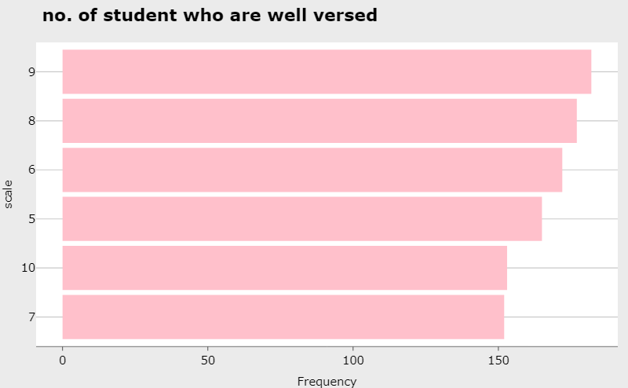
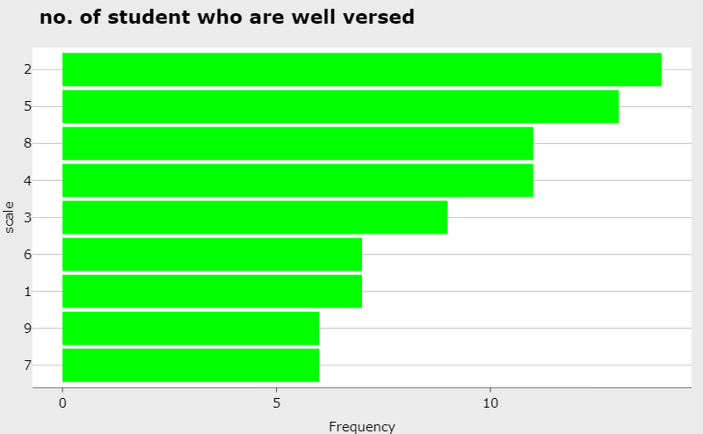
How students are well versed with the topic.
Survey data set
Original data set

Slide 10
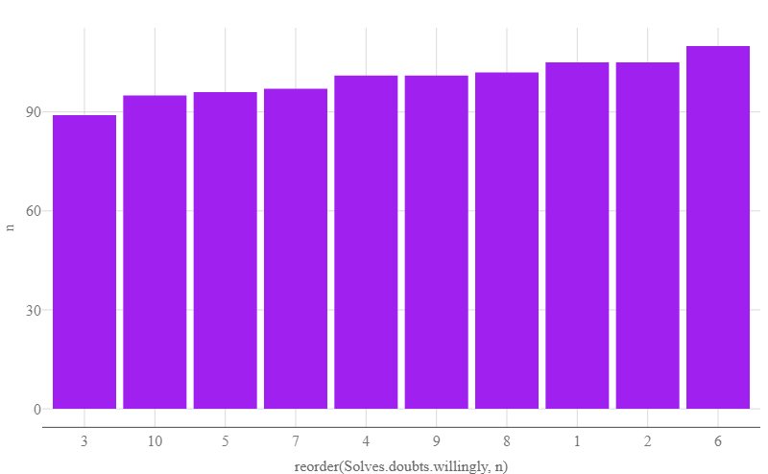
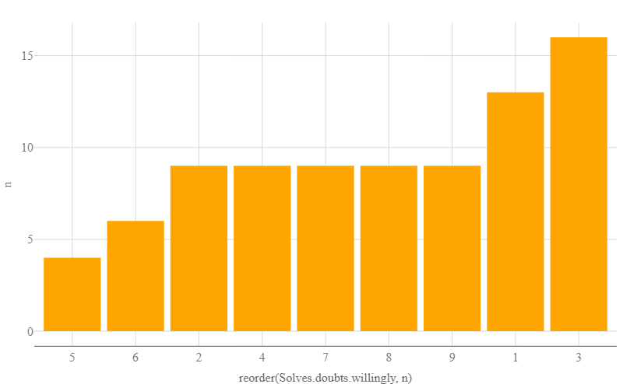
Rating for teacher that Solves doubt willingly
Survey data set
Original data set

Slide 11
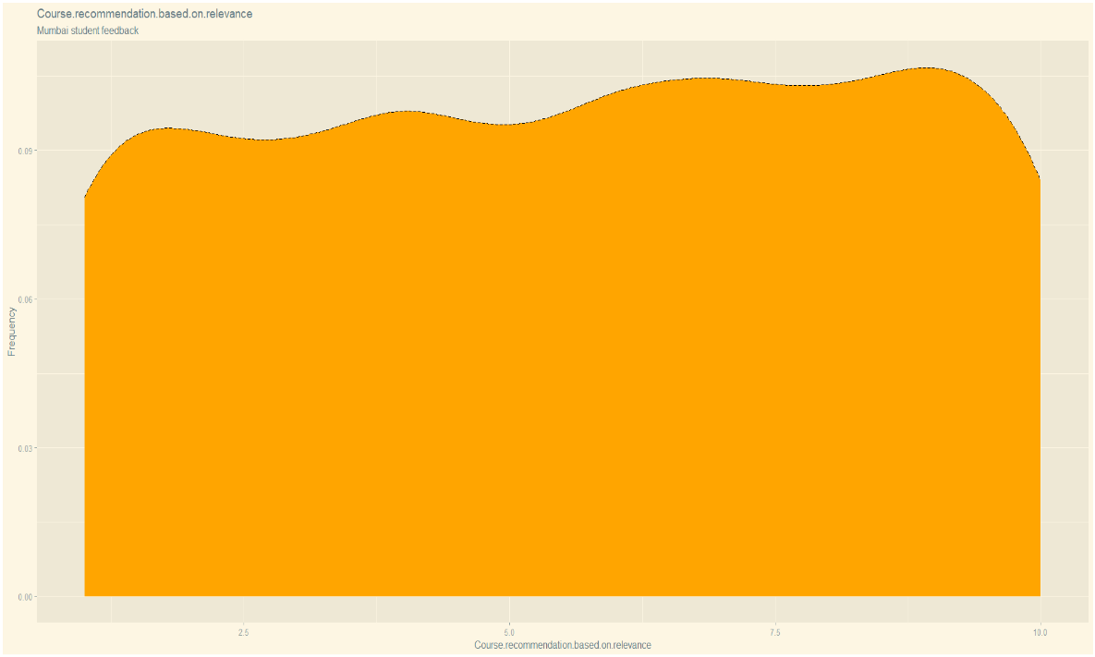
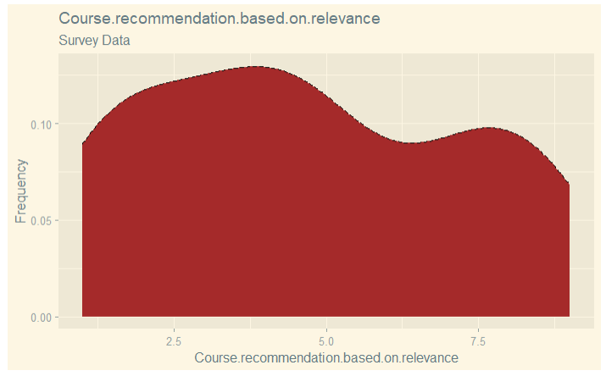
How is “course recommendation based on relevance distributed”
Survey data set
Original data set

Slide 12
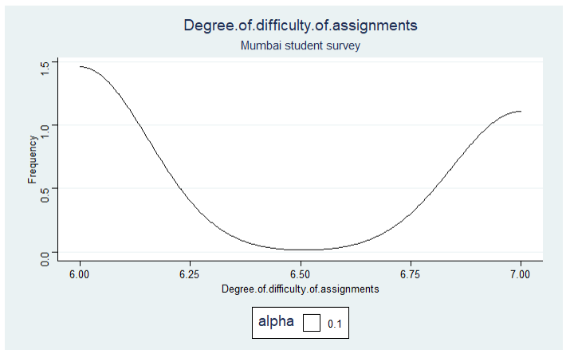
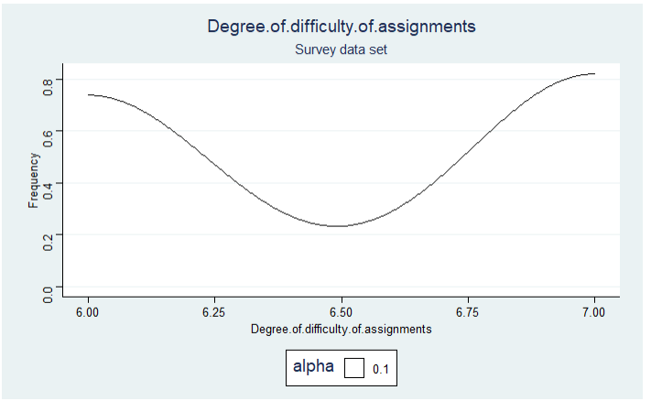
On the scale of 1 to 10 how much difficult assignment is.
Survey data set
Original data set

Slide 13
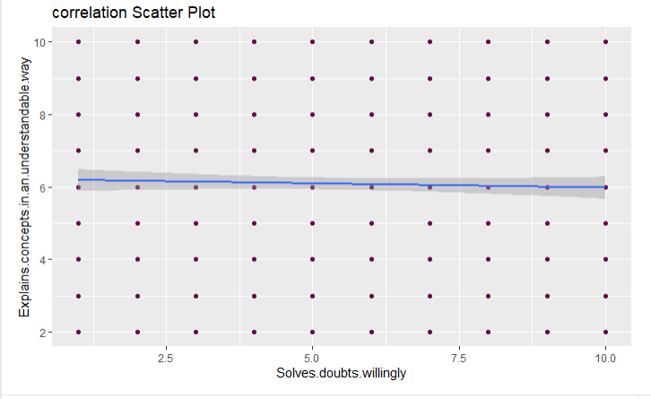
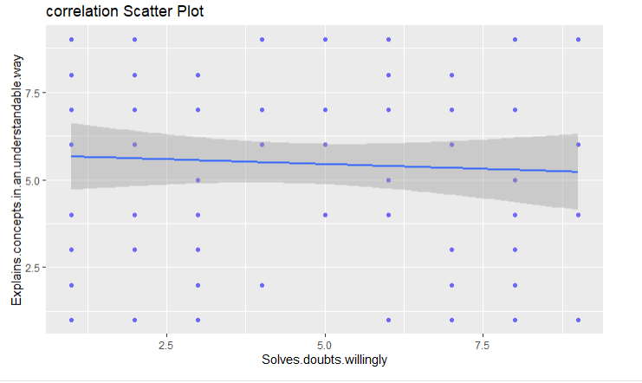
On the scale of 1 to 10 how much difficult assignment is.
Survey data set
Original data set

Slide 14
Conclusions & Limitations
We conclude that students tends to more versed in topics conducted by their favorite instructors in the case of the original data set and but not same can be said about the survey data
On the average students tend to like lecturers that solve their doubts more willing
Most students would recommend the course base on relevance in the original data set but not in the case of the survey data.
Students from both data set almost had the same thoughts regarding the difficulty in assignments judging from the nature of the curve.
As a limitation, the survey data was too small. And also the location from which both data has been collected may be reason for the difference in results.

Slide 15

“THANK YOU”
UNIVERSITY OF WARSAW
FACULTY OF ECONOMIC SCIENCES
REPRODUCIBLE RESEARCH
2022

