Slide 1
Superhero Characteristics
By Morgan Cassimus
Regis University

Slide 2
Agenda
The data
Questions
Exploratory Data Analysis
Tableau
Data Cleaning
R
Exploratory Data Analysis
R
Classification
Navie Bayes
Conclusion

Slide 3

The Data
2 data files
Over 660 superheroes
Demographics
Gender
Race (human, alien, vampire, etc.)
Publisher (DC, Marvel, etc.)
Alignment (good or bad)
Super powers
160+

Slide 4

Questions
What are the most common super powers?
Can I predict which superheroes are good or bad based on their super powers?

Slide 5
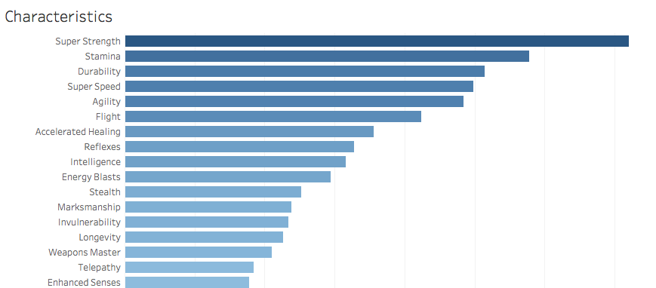
Exploratory Data Analysis – Most Common Characteristics

Slide 6
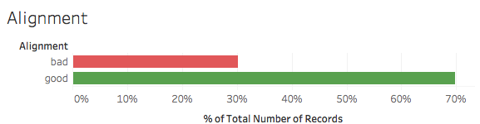
Exploratory Data Analysis – Alignment

Slide 7
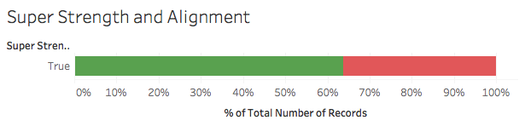
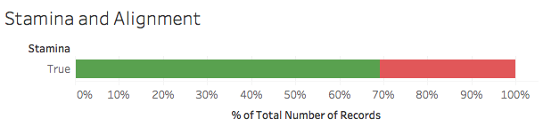
Exploratory Data Analysis – Alignment

Slide 8
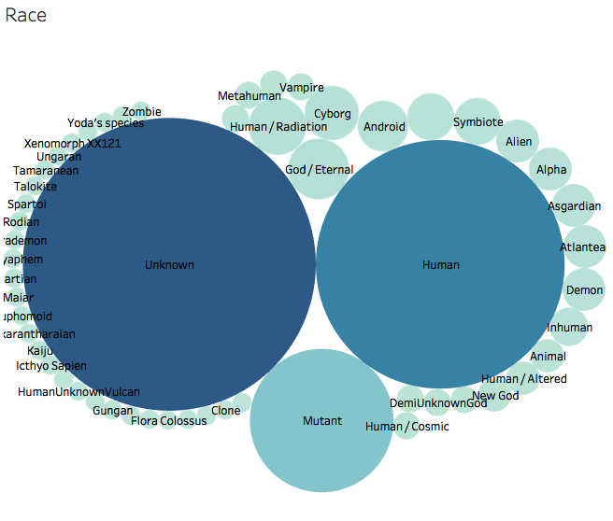
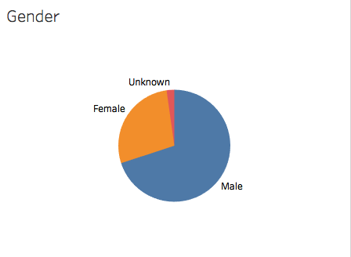
Exploratory Data Analysis – Demographics

Slide 9
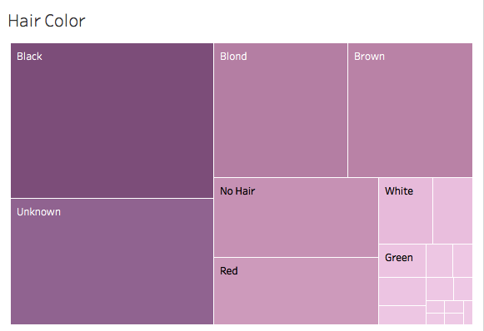
Exploratory Data Analysis – Demographics

Slide 10
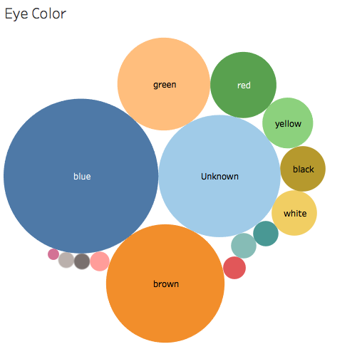
Exploratory Data Analysis – Demographics

Slide 11
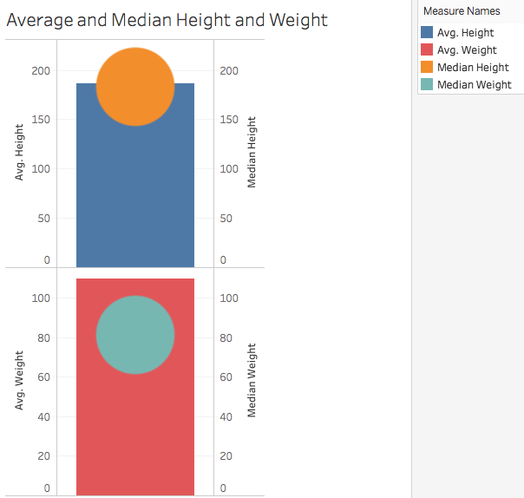
Exploratory Data Analysis – Demographics

Slide 12
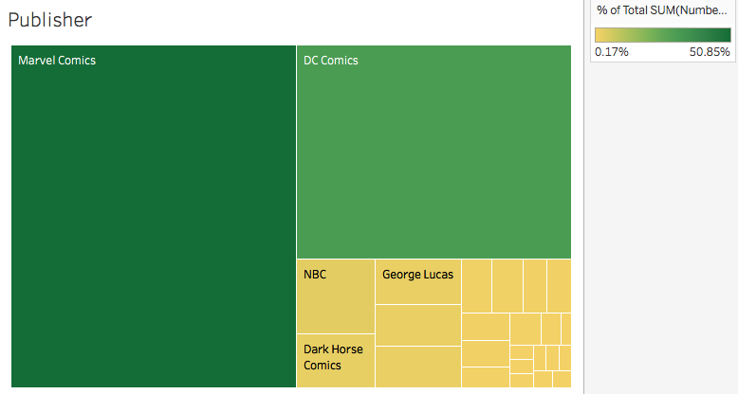
Exploratory Data Analysis – Demographics

Slide 13

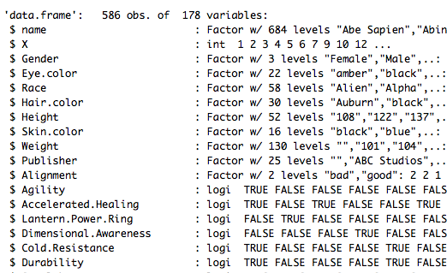
Data Cleaning
Clean some demographics groups for spelling errors
Removing other alignments
Joining the data sets in R

Slide 14
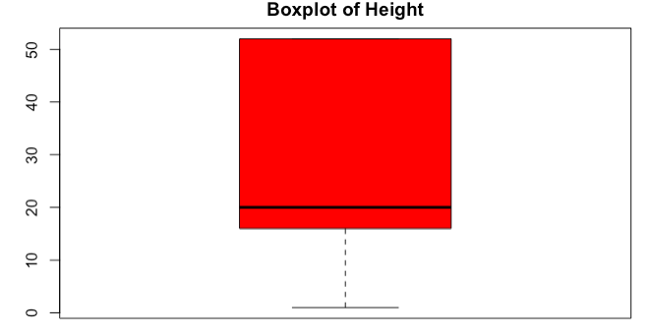
Exploratory Data Analysis – R

Slide 15
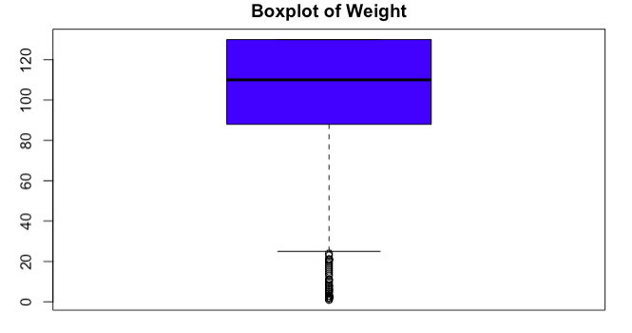
Exploratory Data Analysis – R

Slide 16
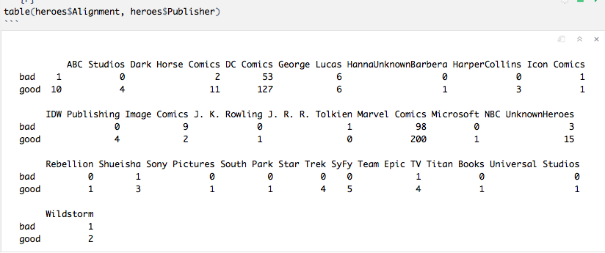
Exploratory Data Analysis – R

Slide 17
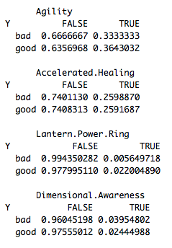
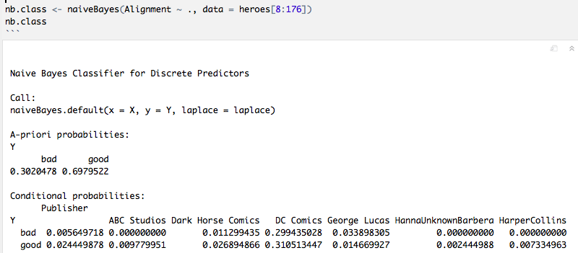
Classification

Slide 18
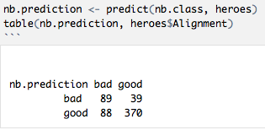
Classification
78% accuracy rate

Slide 19

Conclusion
Super strength and Stamina
Predicting alignment with a 78% accuracy rate

