Slide 1
Backtesting reports
In scope:
  Level play and consistent reporting (e.g. TCF)
  Assign responsibilities: PM will provide a complete backtesting report and Risk Management will review, check for inconsistencies and sign off
  Define what has to be submitted: allow some degree of flexibility given how different the portfolios might be asset/instrument wise
  Log: define what to put into the backtesting archive that will be used to track the evolution of each product
Out of scope:
  How to use those reports with clients

Slide 2
Framework
NARRATIVE: PM will provide some details about
  overview of product strategy, instruments, asset class
  Absolute/relative return. Benchmark analysis
  overview about expected risk and performance
  If this is an amendment the PM will explain (plain English) what was changed and why and will provide a comparison between submitted returns vs. previous version returns. Some test can be added to verify if the change is statistically significant (e.g. Diebold-Mariano)
  Size of the fund
FACTS: question mark about how to present returns. Shall we impose a convention good for all (e.g. daily compounded returns less costs and fees) or is it enough to have the PM saying how the returns are presented?
TRADES: for the Managed Futures fund the list of trades was submitted and we recreated the return series and tested for the quality of the price dataset. Maybe this is a step too far that could be avoided. We might request that in case the return series submitted looks suspicious.
If trades are not submitted it will be on the PM to provide indication about TURNOVER

Slide 3
Framework
RETURN ANALYSIS: standard set of statistics and graphs
RISK: this should highlight
  a comparison between the expected risk and the “actual” portfolio return (e.g. volatility target vs. realized volatility or tracking error vs. relative returns)
  risk attribution/concentration by asset class or other relevant grouping
  portfolio sensitivity by asset class or other relevant grouping
  portfolio exposure (net/gross)
  ideally ex ante risk and attribution (for the relevant groupings) should be offered using VaR and marginal VaR measures (which is how we analyze risk for live portfolios)
IN-SAMPLE/OFF-SAMPLE testing: The PM will split its sample either using cross section or splitting the sample along the time line. Model will run on a sample using the optimal parameters coming from the other sample. A test (e.g. Kolmogorov-Smirnov) will be performed on the two outcomes to determine if those two returns come from the same distribution.
LOG: few question marks

Slide 4
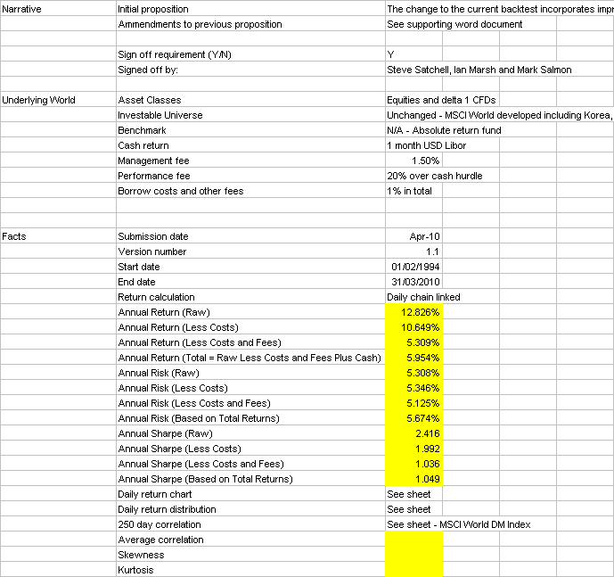
Framework test
GEAR backtest was used to perform an early test of the framework
Pleased with the outcome pending some refining/gaps filling on:
  narrative
  graphs
  returns

