Slide 1
Old Mutual Asset Managers (UK)
Investment risk and performance
April 2010

Slide 2
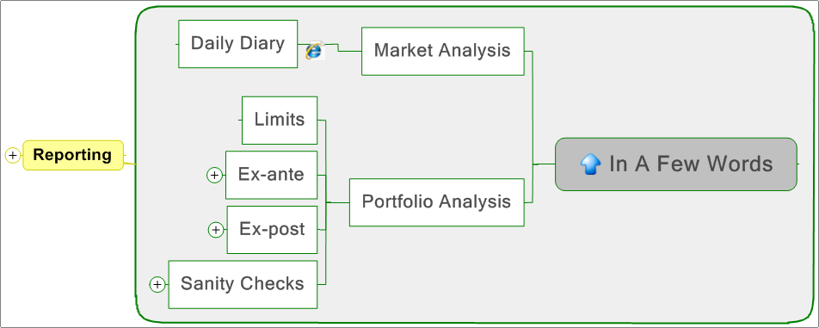
Objectives
Notes:
Our aims:
getting the best possible idea about what the market is doing, what are the relevant themes. By product is the daily diary available on the Wiki
portfolio analysis: getting where the relevant bet is in the most simple of terms. Getting this when the portfolio is over 100 positions is more complicated.
policing: making sure we are not breaching investment guidelines and client mandates
ex-post analysis: what went right/wrong
sanity check: is our portfolio analysis (ex-ante) correct vs. actual results. Example is VaR model sanity check. We predict a certain amount of VaR events over time. Do we have them?

Slide 3
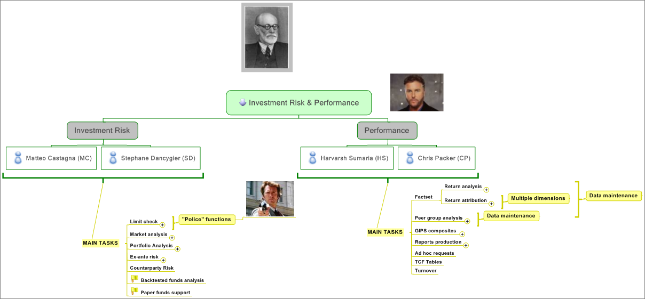
Tasks
Notes:
Different implicit souls for a too often too quantitative analysis. We have “Dirty Harry” policing around, we have Grisom doing the forensic but what we like most is our Freud take on the funds: what are you thinking, what are your fears, your hopes, where do you come from, where are you willing to go?

Slide 4
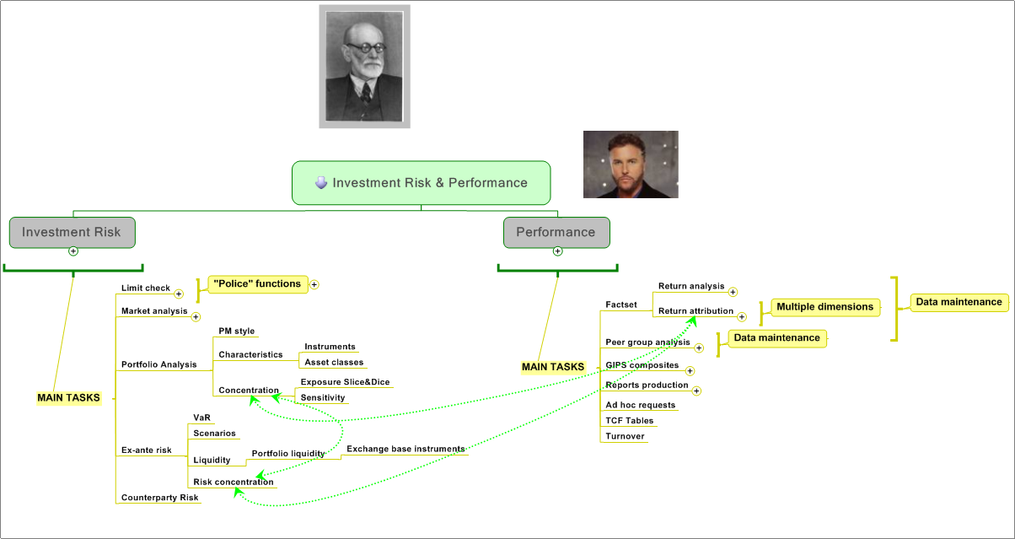
Main target
Notes:
The key point is to be able to merge our knowledge about risk attribution, performance attribution and portfolio weight.
The holy Grail is to reach the maximum performance using the least amount of risk possible.
A position might be using a huge amount of risk and is providing very little
A position might be very big but not adding/subtracting a lot risk wise and might become just a distraction for the PM
A position might be really tiny and still, change the whole portfolio picture because of the interaction with the other portfolio elements.

Slide 5
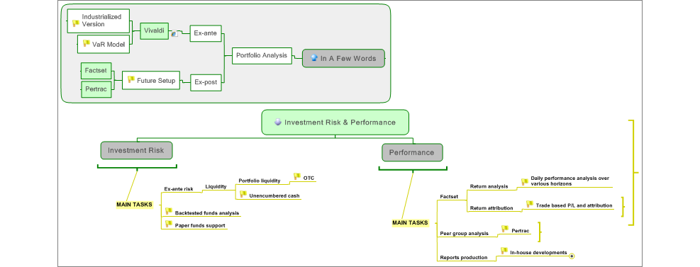
Work in progress
Notes:
Several area are currently work in progress:
risk report adjustments are constant but improvements on the liquidity (cash available, and portfolio liquidity) are important
performance: we are trying to switch from RBC reporting to our own reporting by using Factset
peer performance: embedding Pertrac. Something we pay for and we hardly use since a while ago.
Industrialization of Vivaldi: we are confortable with the present setup but there are a couple of area where we would like to transfer the job to a properly done IT procedure (portfolio upload to BBG, market data capture)
Longer term: in house VaR model/Scenarios

Slide 6
Off to the Wiki
Start page
Market news and notes
Vivaldi reports
Notes:
Market diary
Single pagers: EoD report, splits (gross, net, CCY), HF report, abnormal price changes, [Clean P/L report], Scenarios
Documentation: heavy, light
Fund pages: two pager, scenario

