Slide 1
Volatility & Risk
Definitions, concepts and usage

Slide 2
Outline
Forewords: what I’m going to talk about
Few definitions: sharpen your pencil
The happy world: we all like the normal distribution
The ugly truth: skew, fat tails & changes of speed
OMAM Risk & Performance: risk management down to earth

Slide 3
Outline
Forewords: what I’m going to talk about
Few definitions: sharpen your pencil
The happy world: we all like the normal distribution
The ugly truth: skew, fat tails & changes of speed
OMAM Risk & Performance: risk management down to earth

Slide 4
Forewords
This can be a very complicated matter: if you want to
Books about the subject are quite “unreadable”
Form rather than substance dominates
Notes:
Academics, phD: people that have not dealt with financial markets with their own hands.

Slide 5
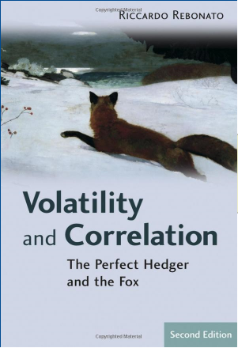
Example
Volatility and correlation are at the very core of all option pricing and hedging. In this book, Riccardo Rebonato presents the subject in his characteristically elegant and simple fashion. […] A rare combination of intellectual insight and practical common sense.
[…] the author deals with CEV processes, with diffusive stochastic volatility and with Markov–chain processes.
“Dr. Riccardo Rebonato is Global Head of Market Risk and Global Head of the Quantitative Research Team at RBS [...]”

Slide 6
What I will do
Given the amazing rate of failures from quants - Nobel prized or not - in running financial ventures, it's better to:
  Keep this on the light side
  Keep the math at minimum
  Make it useful
Notes:
e.g. R. Merton and M. Scholes (Nobel prizes 1997) Platinum Grove down 38% in 2008 and halted investors withdrawals, after LTCM implosion in 1998; Trinsum Group filed for Chapter 11 in 2007; Dimensional: look at performances since inception)

Slide 7
What I will do
I’ll try whenever it’s possible to refer to volatility in the context of fund returns
The presentation might not be fully respectful of the analytics behind the concepts presented
Which means: if there’s a quant/professor/phD out there, please, don’t hit me!

Slide 8
Outline
Forewords: what I’m going to talk about
Few definitions: sharpen your pencil
The happy world: we all like the normal distribution
The ugly truth: skew, fat tails & changes of speed
OMAM Risk & Performance: risk management down to earth

Slide 9
Definitions
Suppose we have some magnitude that assumes certain values. We can describe that magnitude using a probability density function (PDF).
PDFs (might) have distribution moments:
  First = average
  Second = variance where Sqrt(variance) = standard deviation
  Third = skewness
    skewness is a measure of the asymmetry of the probability distribution
  Fourth = kurtosis.
    A high kurtosis distribution has a sharper peak and longer, fatter tails, while a low kurtosis distribution has a more rounded peak and shorter thinner tails. Kurtosis for the normal distribution is 0.
The first two moments completely define a normal distribution
A special case of the Normal distribution is the Standard Normal distribution which is the one where the average is 0 and the standard deviation is 1
Notes:
Distributions with zero excess kurtosis are called mesokurtic, or mesokurtotic. The most prominent example of a mesokurtic distribution is the normal distribution family, regardless of the values of its parameters.
A distribution with positive excess kurtosis is called leptokurtic, or leptokurtotic. In terms of shape, a leptokurtic distribution has a more acute peak around the mean (that is, a higher probability than a normally distributed variable of values near the mean) and fatter tails (that is, a higher probability than a normally distributed variable of extreme values). Examples of leptokurtic distributions include the Laplace distribution and the logistic distribution. Such distributions are sometimes termed super Gaussian.
A distribution with negative excess kurtosis is called platykurtic, or platykurtotic. In terms of shape, a platykurtic distribution has a lower, wider peak around the mean (that is, a lower probability than a normally distributed variable of values near the mean) and thinner tails (if viewed as the height of the probability density—that is, a lower probability than a normally distributed variable of extreme values). Examples of platykurtic distributions include the continuous or discrete uniform distributions, and the raised cosine distribution. The most platykurtic distribution of all is the Bernoulli distribution with p = ½ (for example the number of times one obtains "heads" when flipping a coin once, a coin toss), for which the kurtosis is −2. Such distributions are sometimes termed sub Gaussian.
Skewness: a distribution has:
1. negative skew: The left tail is longer; the mass of the distribution is concentrated on the right of the figure. It has relatively few low values. The distribution is said to be left-skewed. Example (observations): 1,1000,1001,1002,1003
2. positive skew: The right tail is longer; the mass of the distribution is concentrated on the left of the figure. It has relatively few high values. The distribution is said to be right-skewed. Example (observations): 1,2,3,4,100.
In a skewed (unbalanced, lopsided) distribution, the mean is farther out in the long tail than is the median. If there is no skewness or the distribution is symmetric like the bell-shaped normal curve then the mean = median = mode.

Slide 10
Standard deviation
Standard deviation measure the variability (dispersion) of a statistical population, a data set, or a probability distribution.
A large standard deviation indicates that the data points are far from the mean and a small standard deviation indicates that they are clustered closely around the mean.
A useful property of standard deviation is that, unlike variance (standard deviation squared), it is expressed in the same units as the data.
Analytically we have:
  The average is the expected value of that population (data set, probability distribution). A decent way to get that expected value is to compute the average of that object. The average is normally denoted by the greek letter μ.
  The standard deviation (normally denoted by the greek letter σ - sigma) is the squared root of the expected value of (X − μ)². A decent way to get that expected value is to take the square root of the average value of (X − μ)²
Notes:
Note that the term "standard deviation of the sample" is used for the uncorrected estimator (using N) whilst the term "sample standard deviation" is used for the corrected estimator (using N − 1). The denominator N − 1 is the number of degrees of freedom in the vector of residuals

Slide 11
Standard deviation
Be careful: standard deviation is not average deviation. Standard deviation is just a number that you scale things to if phenomena were Gaussian (i.e. normally distributed).
These standard deviations are often nicknamed "sigma." People also talk about "variance" (variance is the square of the sigma, i.e., of the standard deviation).

Slide 12
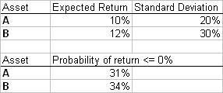
Standard deviation & Finance
In finance, standard deviation is a representation of the risk associated with a given security (stocks, bonds, property, etc.), or the risk of a portfolio of securities. Standard deviation provides a quantified estimate of the uncertainty of future returns.
For example, let's assume an investor had to choose between two stocks.
  Stock A over the last 20 years had an average return of 10%, with a standard deviation of 20%
  Stock B, over the same period, had average returns of 12%, but a higher standard deviation of 30%
On the basis of risk and return (and assumption of normality!), an investor may decide that Stock A is the safer choice, because Stock B's additional 2% points of return is not worth the additional 10 pp standard deviation (greater risk or uncertainty of the expected return).
Notes:
Risk is an important factor in determining how to efficiently manage a portfolio of investments because it determines the variation in returns on the asset and/or portfolio and gives investors a mathematical basis for investment decisions (known as mean-variance optimization). The overall concept of risk is that as it increases, the expected return on the asset will increase as a result of the risk premium earned – in other words, investors should expect a higher return on an investment when said investment carries a higher level of risk, or uncertainty of that return. When evaluating investments, investors should estimate both the expected return and the uncertainty of future returns.
Calculating the average return (or arithmetic mean) of a security over a given number of periods will generate an expected return on the asset. For each period, subtracting the expected return from the actual return results in the variance. Square the variance in each period to find the effect of the result on the overall risk of the asset. The larger the variance in a period, the greater risk the security carries. Taking the average of the squared variances results in the measurement of overall units of risk associated with the asset. Finding the square root of this variance will result in the standard deviation of the investment tool in question.

Slide 13
Volatility and Standard Deviation
Volatility has become the de facto measure of risk for the investment community over the last 40 years.
Volatility is actually become synonym with the standard deviation of the returns.
Standard Deviation indicates the variability around an average and penalizes volatility - movement away and towards the mean - above and below this average (mean) equally.
The standard deviation of a set of variables is normally used to measure volatility which, in turns is used as a measure of risk
Notes:
Volatility does not measure the direction of a trend, only its magnitude. This is because when calculating standard deviation (or variance), all differences are squared, so that negative and positive differences are combined into one quantity. Two instruments with different volatilities may have the same expected return, but the instrument with higher volatility will have a larger swings in values at the end of a given period of time.

Slide 14
Ex-ante/ex-post measures of volatility
Historical volatility (or ex-post volatility) is the volatility of a financial instrument based on historical returns.
Implied volatility (or ex-ante, or forward-looking) is the volatility implied by the market.

Slide 15
Outline
Forewords: what I’m going to talk about
Few definitions: sharpen your pencil
The happy world: we all like the normal distribution
The ugly truth: skew, fat tails & changes of speed
OMAM Risk & Performance: risk management down to earth

Slide 16
Normal Distribution and Risk Management
The Gaussian (Normal) distribution lies at the center of modern finance, especially risk management and financial modeling.
Gauss discovered the fact that most natural phenomenon, like the heights of children, fall into a normal distribution.
The key characteristics of the normal distribution is that all points can be described by two numbers – the average (mean) and variance or standard deviation.
Variance or standard deviation is synonymous with risk. It measures the size and speed of price changes. The larger the changes in price, the higher the risk.

Slide 17
The square root of time rule
This trick is a common statistical trick based on the hypothesis of a magnitude following a Geometric Brownian Motion (GBM).
GBM describes how something, like the stock price, moves randomly over time from its current price in such a way that the daily price changes are distributed normally.
The average price change is proportional to the square root of the elapsed time.
GBM derives from the work of a botanist – Robert Brown.
Risk measurement is mostly founded on the mathematics of children’s heights and pollen grains in water.
Notes:
Brownian motion gets its name from the botanist Robert Brown (1828) who observed in 1827 (“A Brief Account of Microscopical Observations Made in the Months of June, July and August 1827, on the Particles Contained in the Pollen of Plants”) how particles of pollen suspended in water moved erratically on a microscopic scale—first moving in one direction and then zig zagging in another. The motion was caused by water molecules randomly buffeting the particle of pollen. Brown posed the problem of mathematically describing the observed movement, but he did not solve the problem himself. While individual grains moved one way and another, the distribution of the changes in direction was normal.
The first discoverer of the stochastic process that we today call Brownian motion was Louis Bachelier. Anticipating by 70 years developments in options pricing theory, Bachelier mathematically defined Brownian motion and proposed it as a model for asset price movements. He published these ideas in his (1900) doctoral thesis on speculation in the French bond market. That work attracted little attention. Five years later, Albert Einstein (1905) independently discovered the same stochastic process and applied it in thermodynamics. The work of Bachelier and Einstein was not entirely rigorous. Neither man proved that a stochastic process even existed satisfying the four properties that define Brownian motion. Norbert Wiener (1923) ultimately proved the existence of Brownian motion and made significant contributions to related mathematical theories, so Brownian motion is often called a Wiener process.

Slide 18
The square root of time rule
Example: a price has 24% annual volatility. What is its daily volatility, (assuming it follows a Geometric Brownian Motion)?
  We can apply the square root of time rule.
  In converting from a year to a day, should we count actual days (including weekends and holidays) or should we count only trading days? The latter approach seems more plausible because prices cannot change on days that no trading takes place.
  In most markets, price fluctuations from one trading day to the next appear typically not to be much larger if there is an intervening weekend or holiday as when there is not.
  Returning to our example, in the United States, there are about 252 trading days in a year. Accordingly, our price will have daily volatility of 24%/Sqrt(252) = 1.5%
The square root of time rule is exact if volatilities are based upon log returns. It is approximately correct if volatilities are based upon simple returns. We are perfectly safe using simple returns if they are below 200%.
The same trick can be used translating from daily to weekly - by using sqrt(5) - or to monthly - sqrt(20) - volatility.

Slide 19
VaR
Category of risk metrics that describe, probabilistically, the market risk of a trading portfolio.
For a given portfolio, probability and time horizon, VaR is defined as a threshold value such that the probability that the mark-to-market loss on the portfolio over the given time horizon exceeds this value (assuming no trading in the portfolio) is the given probability level.
If a portfolio of stocks has a one-day VaR of $1 million at 95% confidence level, it means there is a 5% probability that the portfolio will fall in value by more than $1 million over a one day period (assuming there is no trading).
Informally, a loss of $1 million or more on this portfolio is expected on 1 day in 20.
If a portfolio contains just one single stock then VaR in its parametric approach would be equal to that stock standard deviation times the number of sigmas implied by the confidence interval (for 95% confidence you have 1.64 Sigmas, for 99% they are 2.33).
If a portfolio contains multiple assets than correlation plays an important role. Beauty of diversification (assuming stable correlation among those assets!).
Notes:
Just about every VaR model assumes that the portfolio under consideration doesn't change over the forecast horizon. This is a fiction, especially for trading portfolios, but trying to incorporate forecasts of position changes into a model forecasting returns is very complicated. VaR models also assume that the historical data used to construct the VaR estimate contains information useful in forecasting the loss distribution. Some VaR models go further and assume that the historical data themselves follow a specific distribution (e.g., a "normal distribution" in RiskMetrics(TM)).
Historical Simulation is a simulation technique, but it skips the step of making assumptions about the distribution of changes in market prices and rates (as per MonteCarlo simulations). Instead, it assumes that whatever the realizations of those changes in prices and rates were in the past is what they can be over the forecast horizon. It takes those actual changes, applies them to the current set of rates, then uses those to revalue the portfolio. When done, you've got a set of portfolio revaluations corresponding to the set of possible realizations of rates. From that distribution you take the Xth percentile loss as the VaR.

Slide 20
Volatility targets, Risk , VaR
When we talk about volatility target we actually define a product. This is crucial when we talk to client and it’s equally crucial when we track a portfolio as risk managers
It is THE number that define how risky (ex-ante) is a specific product.
Under the assumptions of normality we can draw a relationship between this target and the risk (as measured by a VaR estimate) that a portfolio manager should take
Suppose we have a VaR model returning an ex-ante risk measure of 60 basis points in 1 day at 95% confidence level.
We can conclude that 0.6% / NORMSINV(95%) * SQRT(252) = 5.8% is the annual ex-ante volatility of the fund given the present level of risk.
We can clearly work the other way around when asked: what is the “correct” risk level (as expressed by a VaR measure) a PM should take in order to achieve a specific volatility target?

Slide 21
Outline
Forewords: what I’m going to talk about
Few definitions: sharpen your pencil
The happy world: we all like the normal distribution
The ugly truth: skew, fat tails & changes of speed
OMAM Risk & Performance: risk management down to earth

Slide 22
The ugly truth
If the world of finance were Gaussian, an episode such as the 1987 crash (more than twenty standard deviations) would take place every several billion lifetimes of the universe.
Think about Aug and Oct 2008 or Q1 2009: several 10 sigma days in a row.
Truth is:
“when the goin' gets tough ... the normal model doesn’t get goin’”
(RM&P version of Animal House, Matteo 2009)

Slide 23
The ugly truth
Price changes actually do not follow Gaussian distributions. Better distributions used to describe them actually have "fat tails”.
Other metrics (other than the standard deviation) may be used to describe the degree of spread of the variable.
New definition: volatility reflects the degree of risk faced by someone with exposure to that variable and can be expressed with something different than the standard deviation of its distribution.
Unfortunately if you take out the normal distribution, things might become really complicated!

Slide 24
The ugly truth
Problem is actually bigger: “Standard deviations do not exist outside the Gaussian, or if they do exist they do not matter and do not explain much. But it gets worse. The Gaussian family are the only class of distributions that the standard deviation (and the average) is sufficient to describe. You need nothing else. There are other notions that have little or no significance outside of the Gaussian: correlation and, worse, regression.” (N.N.Taleb)
Notes:
Yet they are deeply ingrained in our methods

Slide 25
Non-standard standard deviation
“the illusion of concreteness affects what we call standard deviations. Take any series of historical prices or values. Break it up into sub segments and measure its standard deviation. Surprised? Every sample will yield a different standard deviation. Then why do people talk about standard deviations? Go figure.” (N.N.Taleb)
This is a well know issue called heteroschedasticity (time varying volatility)
ARCH/GARCH models (Engels: an other Nobel prize - 2003) try to solve this.

Slide 26
More on the Taleb’ critique
“The Black Swan idea conclusion is that you cannot use one single measure for randomness called standard deviation (and call it "risk"); you cannot expect a simple answer to characterize uncertainty.”
Risk, uncertainty: are they the same?

Slide 27
Risk and uncertainty
“... Uncertainty must be taken in a sense radically distinct from the familiar notion of Risk, from which it has never been properly separated. The term “risk”, as loosely used in everyday speech and in economic discussion, really covers two things which, functionally at least, in their causal relations to the phenomena of economic organization, are categorically different. ... The essential fact is that "risk" means in some cases a quantity susceptible of measurement, while at other times it is something distinctly not of this character; and there are far-reaching and crucial differences in the bearings of the phenomenon depending on which of the two is really present and operating. ... It will appear that a measurable uncertainty, or "risk" proper, as we shall use the term, is so far different from an unmeasurable one that it is not in effect an uncertainty at all. We ... accordingly restrict the term "uncertainty" to cases of the non-quantitative type.”
Risk, Uncertainty, and Profit, Frank Knight (1921)
Notes:
Knight was Friedman professor at Chicago.
Galbraith once noted that: “Between human beings there is a type of intercourse which proceeds not from knowledge, or even lack of knowledge, but from failure to know what isn’t known.” This is especially true of much of the discourse on risk.

Slide 28
Fat tails
A fat tail is a property of some probability distributions exhibiting extremely large kurtosis particularly relative to the gaussian which itself is an example of an exceptionally thin tail distribution.
By contrast to fat tail distributions, the normal distribution posits events that deviate from the mean by five or more standard deviations ("5-sigma event") are extremely rare, with 10- or more sigma being practically impossible.
When data naturally arise from a fat tail distribution, force the normal distribution model of risk — and an estimate of the corresponding sigma based necessarily on a finite sample size — would severely understate the true risk.
Notes:
. On the other hand, fat tail distributions such as the Cauchy distribution (and all other stable distributions with the exception of the normal distribution) are examples of fat tail distributions that have "infinite sigma" (more technically: "the variance does not exist").
Many — notably Benoît Mandelbrot as well as N.N.Taleb— have noted this shortcoming of the normal distribution model and have proposed that fat tail distributions such as the stable distribution govern asset returns frequently found in finance.
The Black-Scholes model of option pricing is based on a normal distribution. If the distribution is actually a fat-tailed one, then the model will under-price options that are far out of the money, since a 5 or 7 sigma event is more likely than the normal distribution predicts.

Slide 29
Fat tails
In finance, fat tails are considered undesirable because of the additional risk they imply.
Example, an investment strategy may have an expected return, after one year, that is five times its standard deviation. Assuming a normal distribution, the likelihood of its failure (negative return) is less than one in a million; in practice, it may be higher.
Normal distributions that emerge in finance generally do so because the factors influencing an asset's value or price are mathematically "well-behaved", and the central limit theorem provides for such a distribution.
However, traumatic "real-world" events (such as an oil shock, a large corporate bankruptcy, or an abrupt change in a political situation) are usually not mathematically well-behaved.
Fat tails in market return distributions also have some behavioral origins (investor excessive optimism or pessimism leading to large market moves) and are therefore studied in behavioral finance.

Slide 30
Right tail/Left tail
In finance and investment theory any variability is defined as risk per se.
In calculating the risk of an asset return, information about positive and negative returns from the mean return of the asset are equally material.
But in an investor's mind risk always means "losing money". If there is variability of the asset return on the positive side of the return distribution - i.e. he makes money because the asset has moved favorably - he doesn't take this as risk. Every investor or trader makes money in the financial markets because of volatility, but no one thinks that as a part of risk. Therefore,
Though the calculation of volatility (standard deviation) takes into account both the positive and the negative variation around the mean to an investor volatility signifies loss from investment.
Downside volatility: an other work in progress
Notes:
In the world of mathematics and physical sciences, or even some branches of social sciences, this is a very useful measure of variability and is underpinned by the notion of Normal (Gaussian) distribution. If the probability distribution of a variable is Normal, and perfectly Normal, then volatility symmetrically displays the deviation away from the mean of the distribution on both sides.

Slide 31
Outline
Forewords: what I’m going to talk about
Few definitions: sharpen your pencil
The happy world: we all like the normal distribution
The ugly truth: skew, fat tails & changes of speed
OMAM Risk & Performance: risk management down to earth

Slide 32
Risk Management
Risk managers produce numbers which tell people who don’t really want to know what they could lose if what they don’t believe can happen does happen. Nobody thinks they will be at sea in the perfect storm. Nobody believes that they will in the low lands when the one in 10,000 year flood happens.
“Perfect Storms” – Beautiful & True Lies In Risk Management Satyajit Das - 2007

Slide 33
Other VaR definitions
B.Schachter (1997): “A number invented by purveyors of panaceas for pecuniary peril intended to mislead senior management and regulators into false confidence that market risk is adequately understood and controlled.”
D.Einhorn (2008): “[VaR is] an airbag that works all the time, except when you have a car accident.”

Slide 34
So what?
VaR is not useful when you mostly need it
  Fat tails events
  Volatility jumps
  Black swan
We don’t want to be a Gaussian slaves
  But there’s no other option either!
We still have to be compliant with the regulators
We still want to produce something on client behalf
We still want to try to help PMs even if, most of the time, they really don’t care

Slide 35
OMAM Risk Management
VaR measurement using historical simulations
  Agnostic about portfolio returns distribution
  Take actual portfolio back in time (1 year) and get the relevant quintile worst loss
Provide additional measures of risk
Keep a close eye on the market
Make sure PMs are not collecting pennies in front of steamrollers

Slide 36
Additional measures of portfolio risk
Stress testing & scenario analysis
Concentration analysis
Liquidity analysis
PM strategy (style) analysis
Notes:
Stress Testing: Motivation (complement VaR), Stress test types, Potential Pitfalls (Is it the worst case?, Missing data (e.g., Oct ’87), Relation to VaR)

Slide 37
Risk manager role
Risk Identification
  Position, strategy and portfolio risks
  Trader risk tendencies
Risk Measurement
  Exposures, sensitivities
  Value at Risk
  Stress testing and “what-if” analysis
Risk Control
  Limits: concentration, liquidity, NMV, GMV, VaR
  Cajolery, jawboning, and suasion
Notes:
Risk Identification: What are the positions? What are strategies underlying them? What are the risk drivers? How do risks interact at the portfolio level? How are the PMs thinking about the risks? “The worst bet I ever made was the one I didn’t know I had”
Risk Measurement of Equity: Notional (GMV, NMV), Liquidity (Share of Volume), Beta (Market risk), Factor models (Fama/French: Small/Large Cap (Market Cap), Value/Growth (Book to Price)), Value at Risk and Stress Testing
Risk Measurement of Fixed Income: Key Rate sensitivities, Credit DV01, Factor Models ( Principal Components (level, slope, “bow”), Theoretical rate models), Value at Risk and Stress Testing
Risk measurement of Options: Vanillas (delta, gamma, vega, theta, rho), Exotics (the above plus correlation, barrier, and others), Value at Risk and Stress Testing. Non linearity actually adds a lot of issues and the whole model gets more and more complicated
Trading Challenges: Non-directional strategies, Arbitrage/convergence strategies, Merger arbitrage, Liquidity risk for “chunky” positions

Slide 38
Risk manager role
Improving the quality of risk taking
  Taking better risks
  Being a partner not a cop: it’s always true that a good PM is primary a good risk manager!
  Being proactive not reactive: forensic is not a nice activity (but is part of the job)
Improve risk-dependent admin decisions
Notes:
PM risk coach/partner
PM is primary risk manager: idea generation and risk/reward, position entry, position sizing, position management, trade horizon, Position Exit
What worries me: unmeasured risks, illiquidity (black holes, low volume, no bids), hubris (“I have never lost money before”, “There are a million reasons for this to work”), style drift/double guessing (market view takes over, losers become long-term trade ideas, doubling-down), failure to look at hidden risks of a portfolio (FX exposure, implicit directionality of market neutral strategies, cash balances – ALM)

Slide 39
Risk manager role
Portfolio Managers
  Focus: position and portfolio risks
  Action: advise, coach, enforce limits
Senior Management
  Focus: risk aggregation
  Action: inform and recommend
External Stakeholders
  Focus: risk and exposure reporting
  Action: inform

Slide 40
Risk manager role – the next level
Principle: risk and return are not separable
  Return cannot be evaluated without the risk context (e.g. Sharpe ratio)
The impact of the risk manager is greatest when this is exploited
Therefore the next level is the risk manager as performance manager
  Macro-strategic
  Micro-tactical
Notes:
Strategic: monitor fund exposures and recommend corrective action, create risk measures for performance-based compensation, create portfolio allocation/optimization analytics
Tactical: (Interview prospective PMs), work with PMs on trading, Stops and position sizing, Portfolio Hedging, Trade structure, Portfolio management style

Slide 41
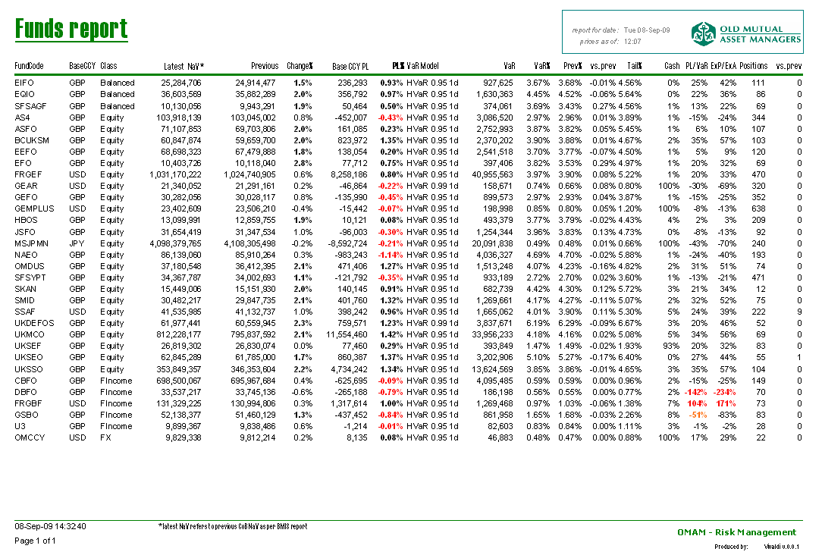
OMAM risk reporting - examples

Slide 42
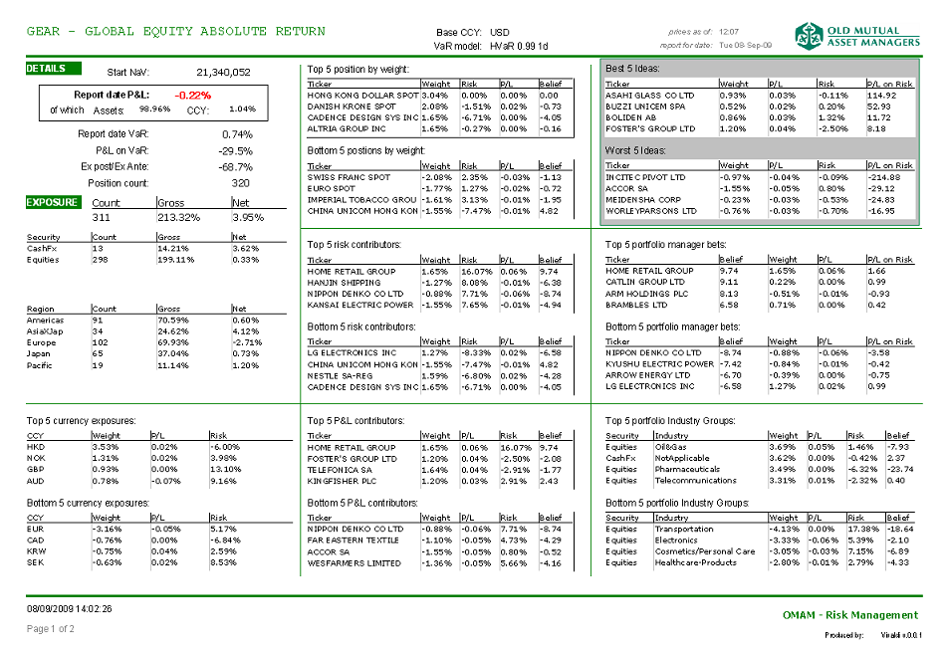
OMAM risk reporting - examples

Slide 43
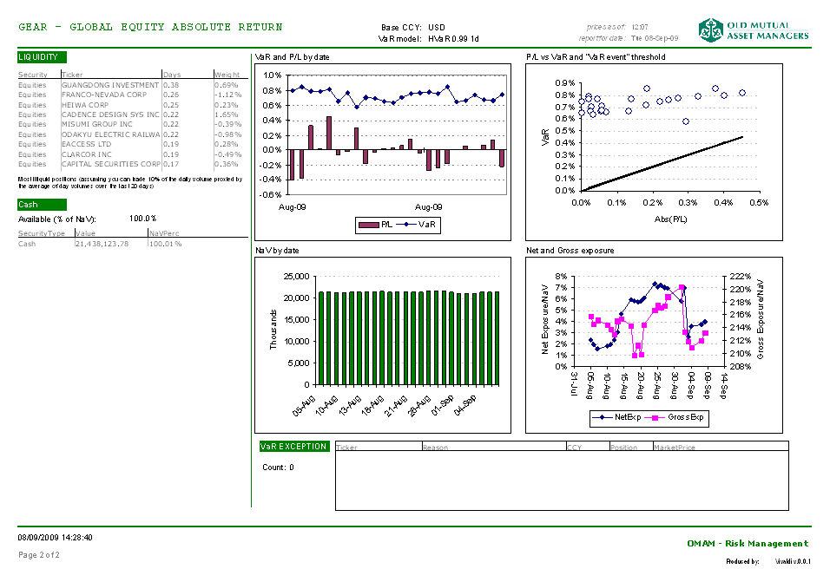
OMAM risk reporting - examples

