Slide 1
Talent Management and attrition
Michael Catalano
MSDS 6306 Case Study 2

Slide 2
Overview
Conduct an analysis of existing employee data, identifying:
Determining factors leading to attrition
Job role specific trends that exist in the data
Experiment and build-out a classification model to predict attrition using a training and test data set
Model Chosen: K-Nearest Neighbors

Slide 3
Determining factors leading to attrition
The first step in the analysis was to retrieve, assess, and if necessary, clean our data (EDA)
Data attributes (Training set):
1,170 observations
37 variables (not counting ID number)
A mix of quantitative and categorical variables
EDA Strategy:
Delete non-meaningful variables (Over18 and Standard Hours variables)
Run correlation matrix on cleansed dataset
Check Attrition column against other numerical variables, assess the strength of the correlation (r)
Choose the right correlated variables while keeping overfitting in mind
Results:
The following variables showed the highest correlation with attrition, and the responding correlation coefficient r
Job Involvement (0.14)
Monthly Income (0.14)
Over Time (0.23)
Total Working Years (0.15)

Slide 4
Chi-squared test to assist correlation
To aid in the statistical significance of our targeted variables, a chi-squared test was used to assess p-values of attrition and the five chosen variables
Job Involvement (r = 0.14) | p-value < .0001
Monthly Income grouped in $5000 increments (r = 0.14)| p-value = .0002
Over Time (r = 0.23) | p-value <.0001
Total Working Years grouped in 5-year increments (r = 0.15)| p-value = <.0001
Since all p-values are <0.05, the differences we see in these variables as they relate to attrition are not just due to randomness

Slide 5
Job/role specific trends
The job roles with the highest attrition are Sales Representative (40%), followed by Laboratory Technician (24%), and Sales Executive (18%)
Sales Representative and Lab Technician have two of the lowest monthly incomes (avg.)
These three roles are at the lower-end of the spectrum in terms of job involvement
These three roles require overtime at least 25% of the time
These roles carry the lowest avg. working years (see right)
Attrition aside, these attributes had the highest correlation in our dataset (again using the highest correlation coefficient r)
Job level and monthly income (0.948)
Job level and total working years (0.77)*
Percent salary hike and performance rating (0.77)
Monthly income and total working years (0.76)
Years at company and years with current manager (0.76)
Notes
*Introduces collinearity in the model since we use both as independent variables in the KNN classifier, however we kept both in the model for higher prediction accuracy.

Slide 6
Prediction

Slide 7
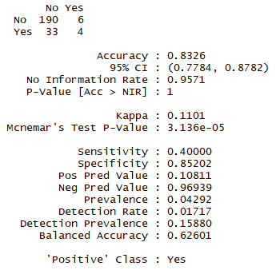
K-NN Classifier
Using the four chosen explanatory variables showing the highest correlation with attrition:
Job Involvement
Monthly Income
Over Time
Total Working Years
Classifier results:
Overall accuracy rating of 83%
Sensitivity rating of .40, means when there is an attrition event, the model predicts this event 40% of the time
Specificity is .85, meaning when there is a non-event (non-attrition), the model predicts it 85% of the time

