Slide 1

oneStock.com
Your one stop investment solution
Presented by - Mohammed Azim, Alvi Rahman, Debjyoti Bhadra, Mustafa Kapadia, Towsif Ali

Slide 2
1.
Business Plan

Slide 3
What is oneStock.com?
oneStock.com is a one-stop platform for Gen-Z investors, which incorporates data from various sources and provides all the necessary information required to make an informed investment.
oneStock.com is a fast, user-friendly and an interactive website that makes investing easier and more accessible

Slide 4
Targeted Customers
What problem is being solved?
Gen-Z Investors
Dealers
Stockbrokers
Researchers
Inadequate information
Steep learning curve for Gen-Z investors to start investing
Scarcity of websites for Investors and Stockbrokers to connect

Slide 5
2.
Product Features
Well Engineered design to get data from credible sources from all over the internet
Platform to connect investors and brokers
Fast and easy-to-use platform for Gen-Z investors to start investing
Sentimental analysis

Slide 6
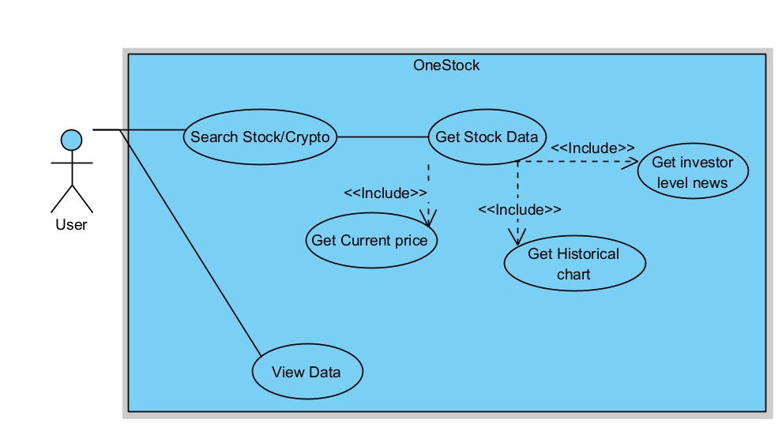
Work-Flow

Slide 7
3.
Research and Development Plan

Slide 8
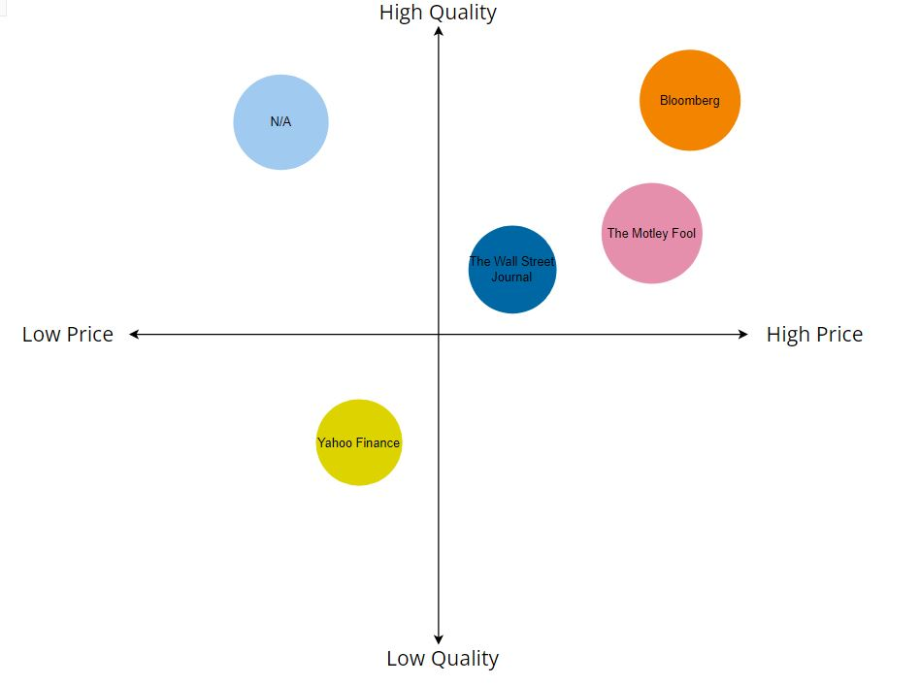
Perceptual Mapping

Slide 9
Competitive Analysis
Features/ Problems to be solved | oneStock.com | Competitors
 |  | Yahoo! Finance | Bloomberg | Coindesk
a) Free Access | ✓ | ✓ |  | ✓
b) Sentimental Analysis | ✓
c) Low Barriers to entry | ✓ | ✓

Slide 10
4.
Sales and Marketing
Financial Planning 2022
Quarter 1 | Quarter 2 | Quarter 3 | Quarter 4
Bank loan for funding | Commissions from brokers | Commissions from Stock sales | IPO of our company

Slide 11
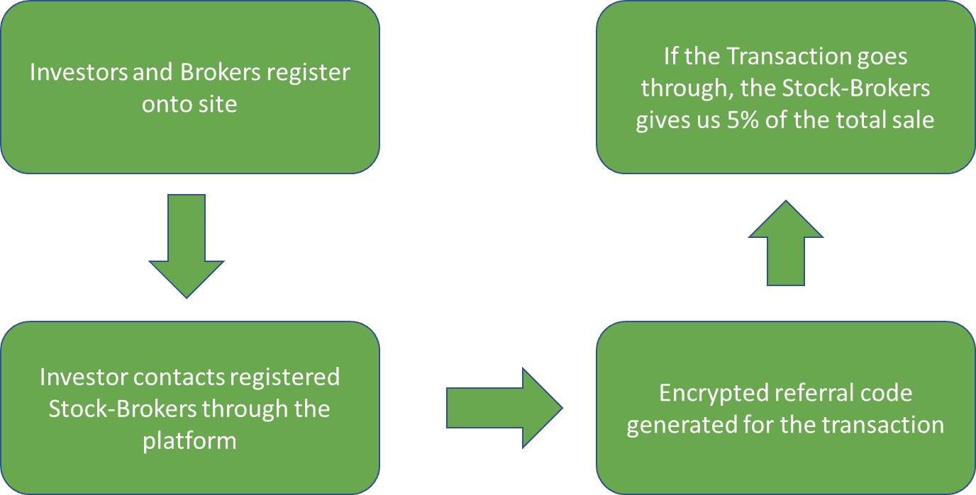
Revenue Model
Notes:
Mention “up to 5%” not fixed 5%

Slide 12
5.
Project Schedule
2022
Technological Development | Quarter 1 | Quarter 2 | Quarter 3 | Quarter 4
 | More Stock and Crypto inclusion | ChatBox implementation | Trading feature | Predictive modeling
Business development | PR and Marketing | App deployment | Diversify into other financial investments | Expansion of company

Slide 13
6.
People Involved

Slide 14

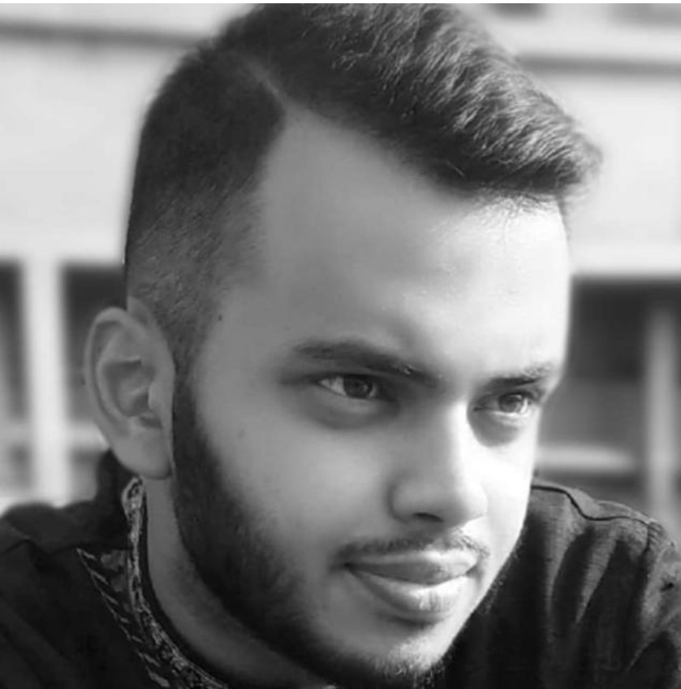
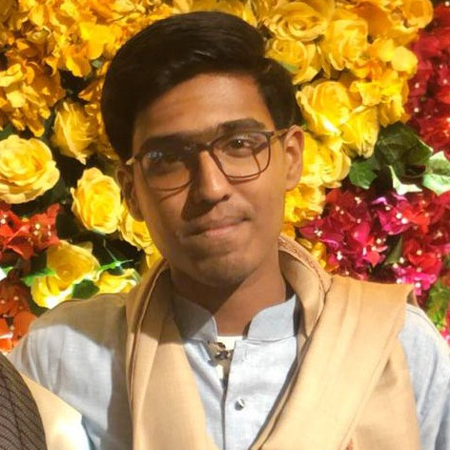


Team Presenting
Debjyoti Bhadra
Head of Sales
Mohammed Azim Project Leader
Alvi Rahman
Senior Developer
Towsif Ali
Front-End Developer
Mustafa Kapadia Head of Finance

