Slide 1
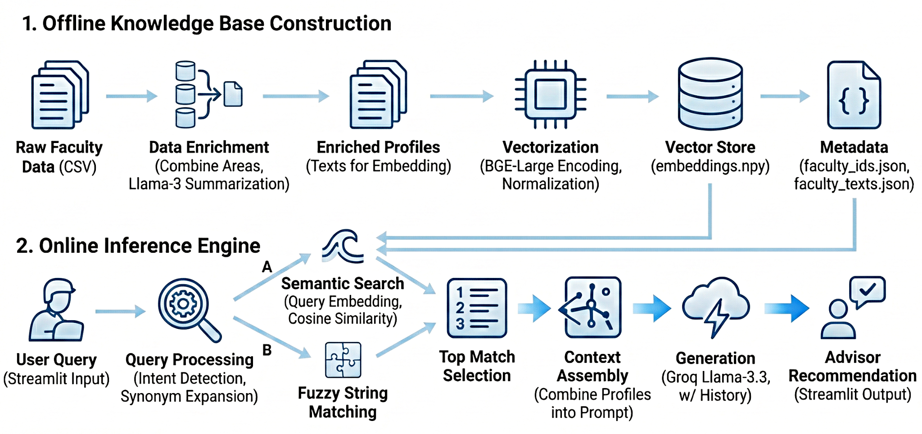
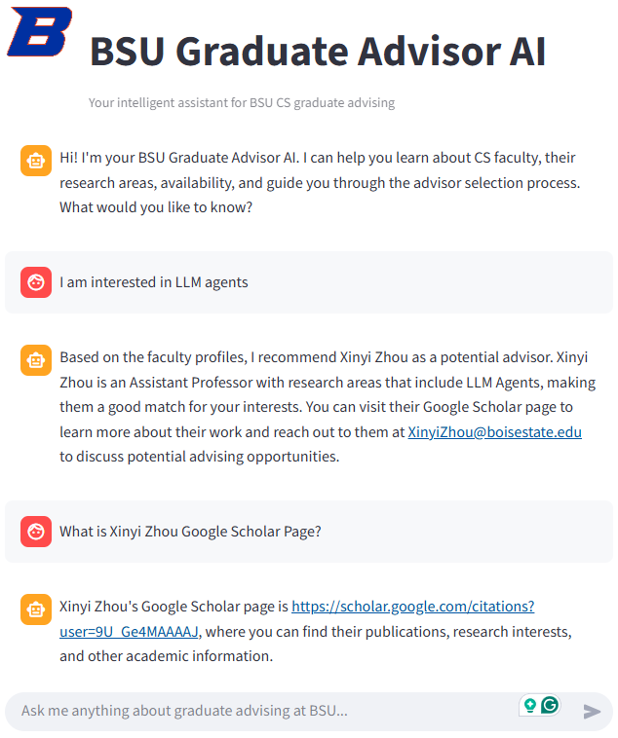
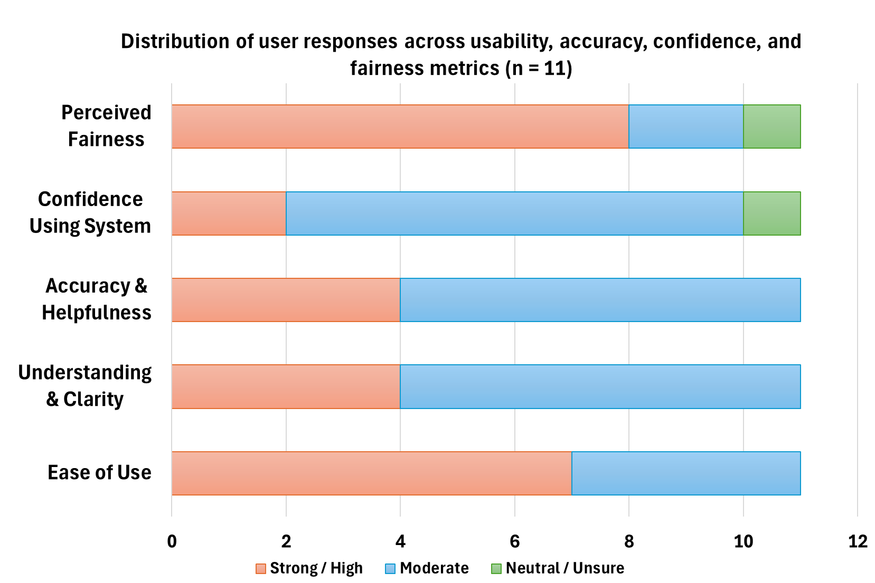
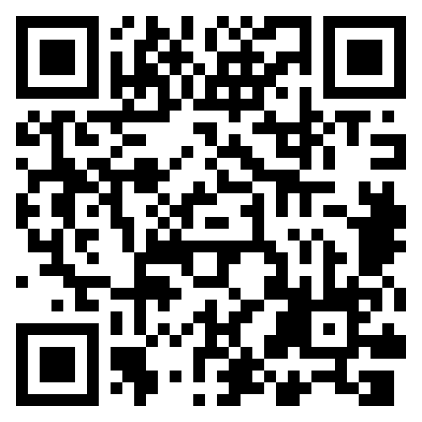
Retrieval-Augmented Conversational Advisor Recommendation for BSU CS Graduate Students
DEPARTMENT OF COMPUTER SCIENCE
Meherunnesa Tania, Afsana Afrin, Miguel Carrasco Belmar
Introduction
Proposed System
Conclusions
CS graduate students at Boise State University must select a permanent research advisor within their first or second semester.
It is a critical, stressful, and time-sensitive requirement, and many students struggle to understand faculty research areas and current advisor availability due to fragmented and unclear information.
We propose an AI-powered advisor recommendation system that provides accurate, context-aware guidance through natural-language interaction.
A Retrieval-Augmented Generation (RAG) architecture is effective for advisor recommendation, combining semantic retrieval with natural-language reasoning rather than static ranked lists.
Quantitative evaluation shows high top-rank retrieval accuracy (P@1 = 0.857), robust name handling (100% fuzzy-match accuracy), and low-latency performance, with ~0.3s retrieval time and ~1.1s end-to-end response time in real use.
User feedback indicates that the system is intuitive and helpful, supporting confident advisor exploration through conversational interaction.
Overall, the results demonstrate that institution-specific, conversational AI tools can meaningfully support high-stakes academic decisions such as research advisor selection.
Novelty & Contribution
Novelty
Advisor-specific, institution-specific: Targets research advisor selection for Boise State University CS, rather than course or program recommendation.
Conversational RAG framework: Uses Retrieval-Augmented Generation to answer natural-language queries, instead of returning static similarity-based rankings.
Interactive deployment: Implemented as a user-facing chatbot prototype, moving beyond offline recommendation models such as AVRD.
Contribution
Design and implementation of a RAG-based conversational advisor recommendation system tailored to BSU CS graduate students.
Creation of a structured faculty knowledge base containing research areas, publications, contact information, and advisor availability
Development and evaluation of a user-friendly chatbot prototype that provides accurate, context-aware advisor guidance through natural-language interaction.
Future Work
Migrate from static CSV files to a cloud-based, live database to enable automatic updates to faculty information.
Deploy the system publicly so students can access it outside the development environment (e.g., through a BSU-hosted platform).
Extend the system to additional departments beyond Computer Science within Boise State University.
Generalize the platform for use at other institutions, enabling cross-university advisor recommendation
Offline construction of a faculty knowledge base using profile enrichment and semantic embeddings (BAAI/bge-large-en-v1.5).
Online retrieval via semantic search (cosine similarity) and fuzzy string matching for robust query handling.
Context assembly and response generation using a RAG pipeline with Groq llama-3.3-70b-versatile.
Natural-language advisor recommendations delivered through a Streamlit-based chatbot interface.
Prototype
Evaluation and Results
Automated Evaluation: High retrieval performance across research domains (Avg P@1 = 0.857, P@3 = 0.619) with 100% accuracy on misspelled faculty name matching. Retrieval averages ~0.3s, with end-to-end responses around ~1.1s, supporting real-time interaction.
User Study: Conducted with 11 CS PhD and Master’s students. All participants reported the system was easy or very easy to use, and most found the responses accurate, helpful, fair, and reported confidence in using the system for advisor selection.
Key Insight: Results confirm that a RAG-based conversational approach is effective for advisor recommendation, while user feedback highlights opportunities for scalability and broader deployment.
Key References
[1] Boise State University, Computer Science Master’s Student Handbook, 2025.
[2] N. Kamal, F. Sarker, A. Rahman, S. Hossain, and K. A. Mamun, “Recommender system in academic choices of higher education: A systematic review,” IEEE Access, vol. 12, pp. 35475–35501, 2024.
[3] X. Wang, J. Zhou, L. Jian, Y. Yin, and L. Li, “Empowering college students to select ideal advisors: A text-based recommendation model,” Frontiers in Education, vol. 10, 1673956, Oct. 2025.
[4] A. Baskota and Y.-K. Ng, “A graduate school recommendation system using the multi-class support vector machine and kNN approaches,” in Proc. IEEE Int. Conf. Information Reuse and Integration (IRI), 2018, pp. 277–284.
Dataset
Detailed dataset of Boise State University Computer Science faculty profiles, including position, research areas, publications, and contact details.
Data collected from trusted public sources, including BSU CS faculty webpages and Google Scholar profiles.
Dataset is institution-specific and structured to support retrieval in a RAG-based advisor recommendation system.
Scan for
Live Demo
Streamlit-based chatbot prototype demonstrating natural-language advisor queries and context-aware recommendations.

