Slide 1
A6 Extension: The most vulenerable groups in St. Louis County
By Matthew Blake

Slide 2
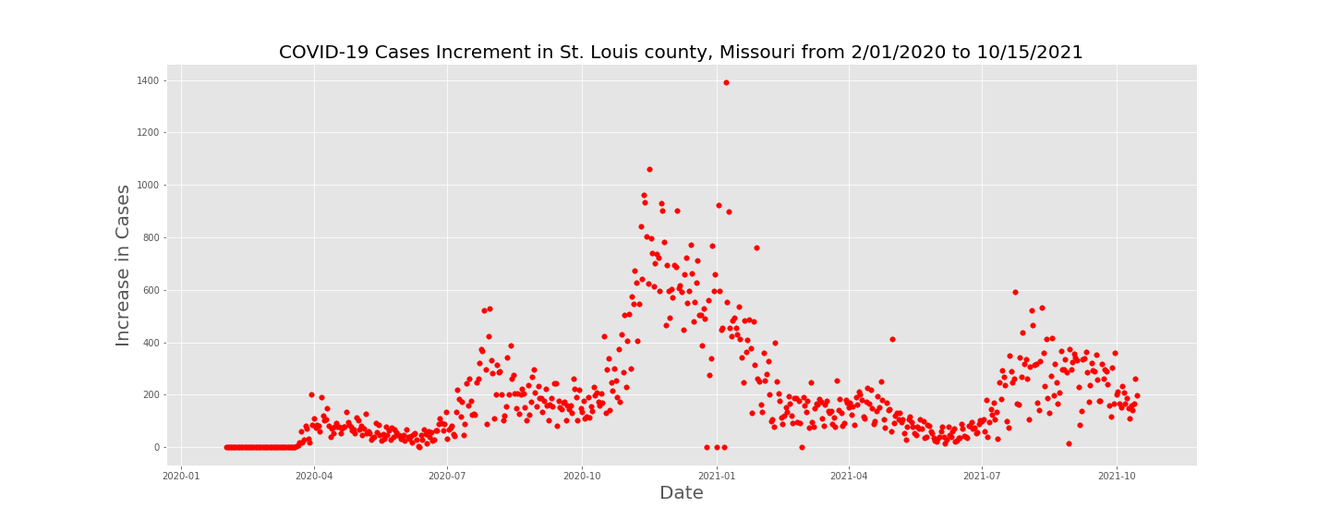
Cases over Time

Slide 3
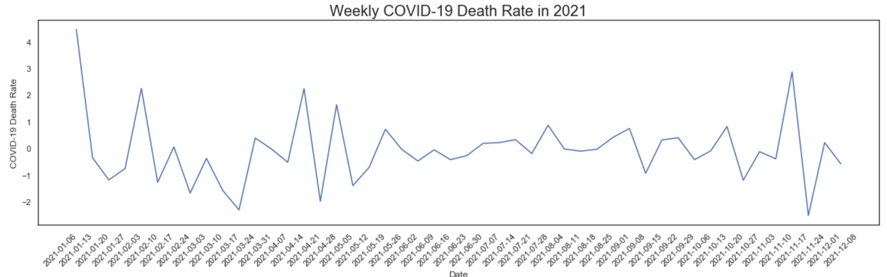
COVID-19 Death Rate over Time
Reflects the change in the death rate from a week prior
Severe drop after the second wave
Rate fluctuated, but has now relatively stabilized

Slide 4
Follow-up Question from A4
Regarding the local economy, how did the COVID-19 pandemic affect employment St. Louis County?
Who were the most vulnerable groups during the pandemic in this county?
Were surrounding, more rural counties affected in a similar manner (Specifically Boone, St. Charles, Jackson county)

Slide 5
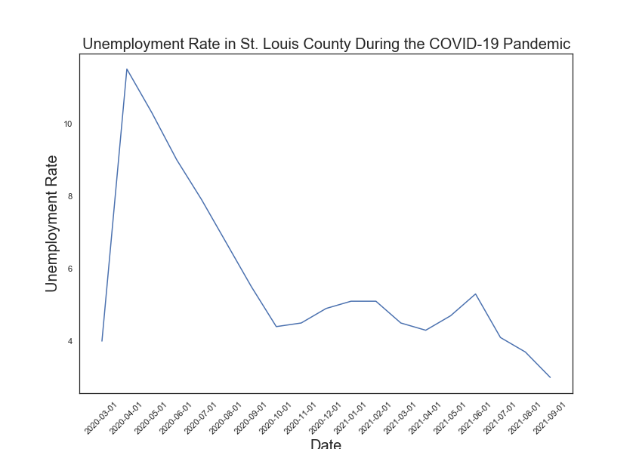
Unemployment in St. Louis County

Slide 6
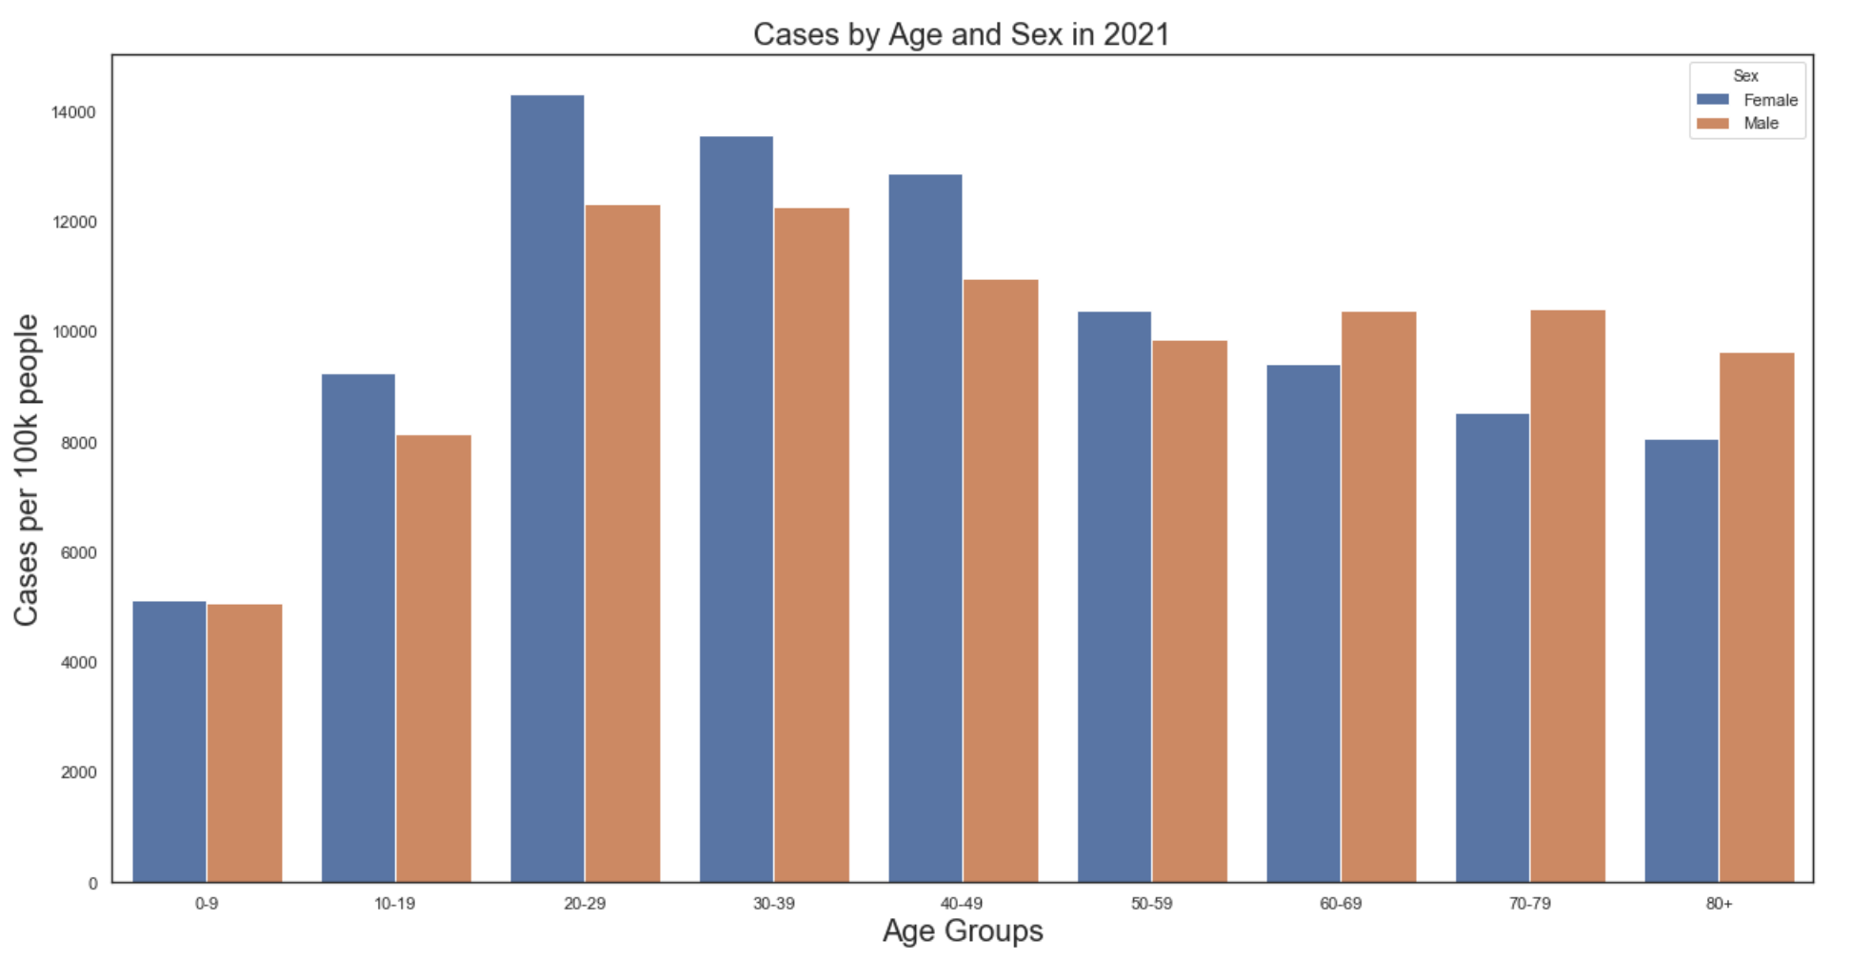
COVID-19 Cases by Age and Sex

Slide 7
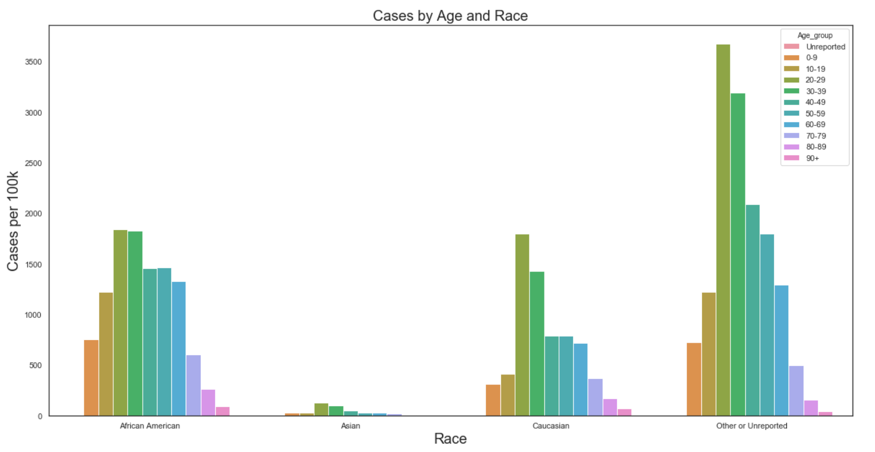
COVID-19 Cases by Age and Race

Slide 8
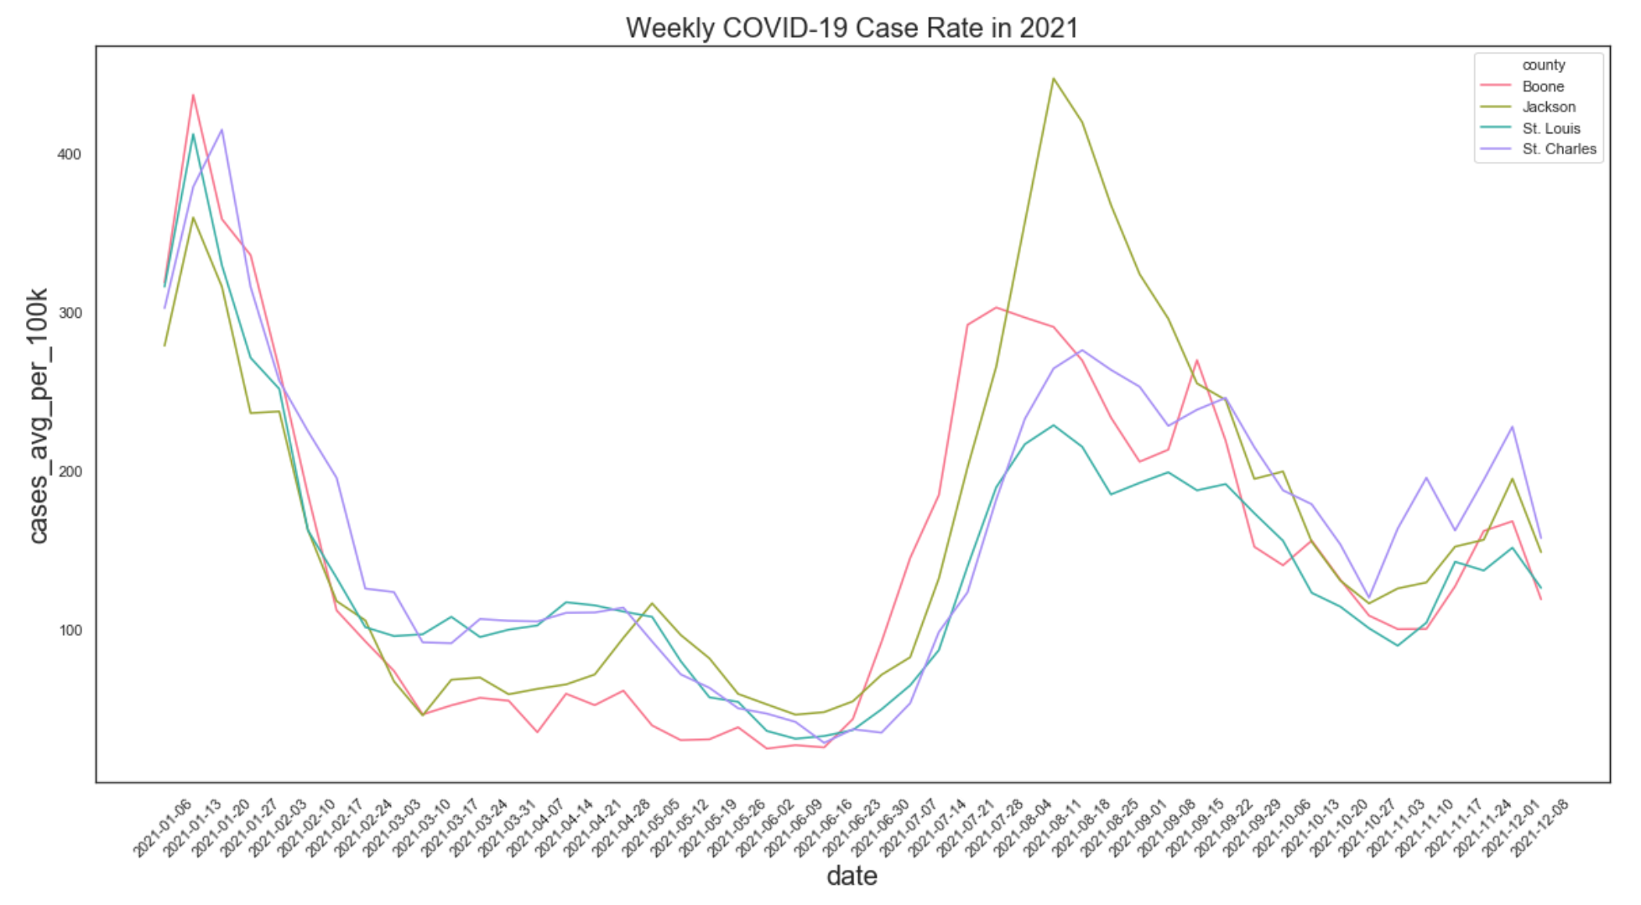
Case Rates Over Time Comparison

Slide 9
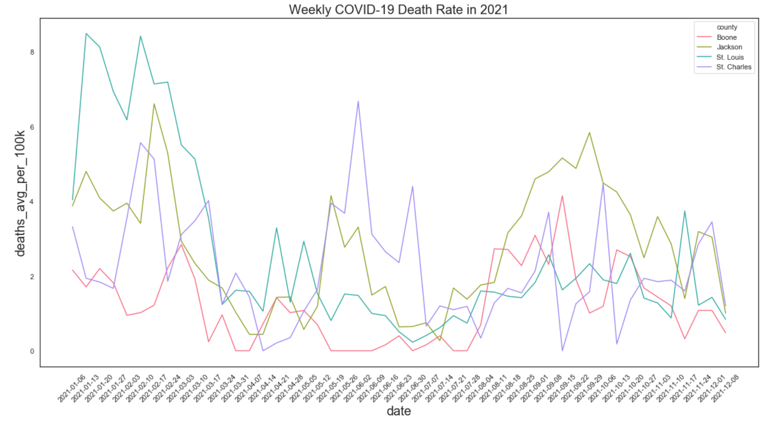
Deaths Over Time Comparison

Slide 10
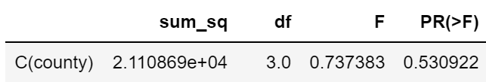
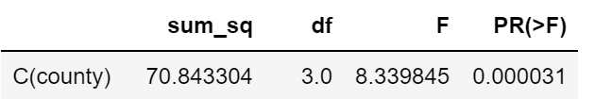
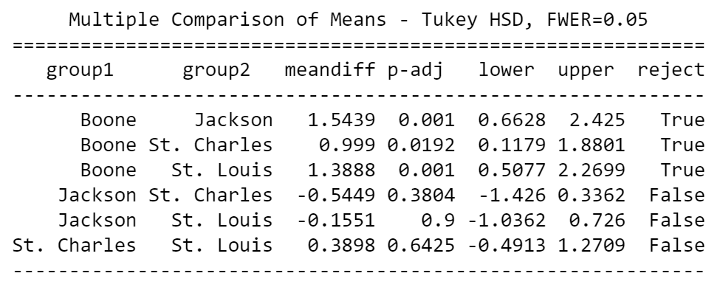
Results of One-Way Anova
Average cases per 100k people:
Average deaths per 100k people:
Post-hoc Analysis of Average Deaths

Slide 11
Follow-up Questions to be Considered
Are there observable differences in these trends for the variants of COVID-19 (i.e. Delta, Omnicron etc.)?
Does local mask mandates (or lack thereof) affect these trends? How does St. Louis county compare to counties with & without mask mandates?
Which groups are more susceptible to long-term effects of COVID-19 (i.e. reduced lung capacity, cardiovascular complications etc.)?

Slide 12
Data Sources
Coronavirus (COVID-19) Data in the United States by The New York Times: https://github.com/nytimes/covid-19-data
COVID-19 Data from St.Louis-MO.gov: https://www.stlouis-mo.gov/covid-19/data/
COVID-19 open data repository by the Google Cloud Platform: https://github.com/GoogleCloudPlatform/covid-19-open-data/tree/main/src/data
Economic Research Federal Reserve Bank of St. Louis: https://fred.stlouisfed.org

