Slide 1
Intro to AWSPowerShell and AWS-ApplyDSCMofs
Matt Bobke – SoCal PowerShell User Group

Slide 2




About Me
Operations Administrator @ Blizzard Entertainment
Started with PowerShell in mid 2017
https://mattbobke.com
Twitter: @mattbobke

Slide 3
Agenda
What is AWSPowerShell?
What is PowerShell Desired State Configuration?
What is AWS Systems Manager?
How do all three of the above work together?
Code walkthrough for sample usage of all of the above!

Slide 4
AWSPowerShell
From AWS:
“The AWS Tools for PowerShell let developers and administrators manage their AWS services and resources in the PowerShell scripting environment.”
As of November 2019, there are 3 package options:
AWSPowerShell – legacy Windows-only monolithic module
AWSPowerShell.NetCore – legacy cross-platform monolithic module (requires .NET Framework 4.7.2 on Windows)
AWS.Tools – “modularized module” where each AWS service has an associated smaller sub-module (requires .NET Framework 4.7.2 on Windows)
https://docs.aws.amazon.com/powershell/latest/userguide/pstools-welcome.html
https://docs.aws.amazon.com/powershell/latest/reference/

Slide 5
PowerShell Desired State Configuration
From Microsoft:
“DSC is a management platform in PowerShell that enables you to manage your IT and development infrastructure with configuration as code.”
Declarative PowerShell scripts (Configurations) define what a server should look like in its final ideal state
Installed Windows features, firewall rules, group memberships, running services…
“This is what I want, now make it so.”
Configurations are made up of instances of Resources that contain the code that performs the desired system changes
Configurations are “compiled” to MOF (Managed Object Format) files
The Local Configuration Manager (LCM) is the engine that drives Resource execution – first-time run, scheduled or manual comparison checks of current state against desired state
The LCM parses a MOF file and applies its declarations
MOF is pushed via code, or pulled via the LCM from a Pull Server
https://docs.microsoft.com/en-us/powershell/scripting/dsc/overview/overview?view=powershell-5.1

Slide 6
AWS Systems Manager
From Amazon:
“AWS Systems Manager is an AWS service that you can use to view and control your infrastructure on AWS.”
Observe and control AWS EC2 Instances as well as on-prem servers, VMs in other cloud environments
Configuration management, maintenance, command execution, inventory…
Full listing of capabilities: https://docs.aws.amazon.com/systems-manager/latest/userguide/features.html
Many of these capabilities are free or very low-cost – viable alternative to pricey on-prem management platforms

Slide 7
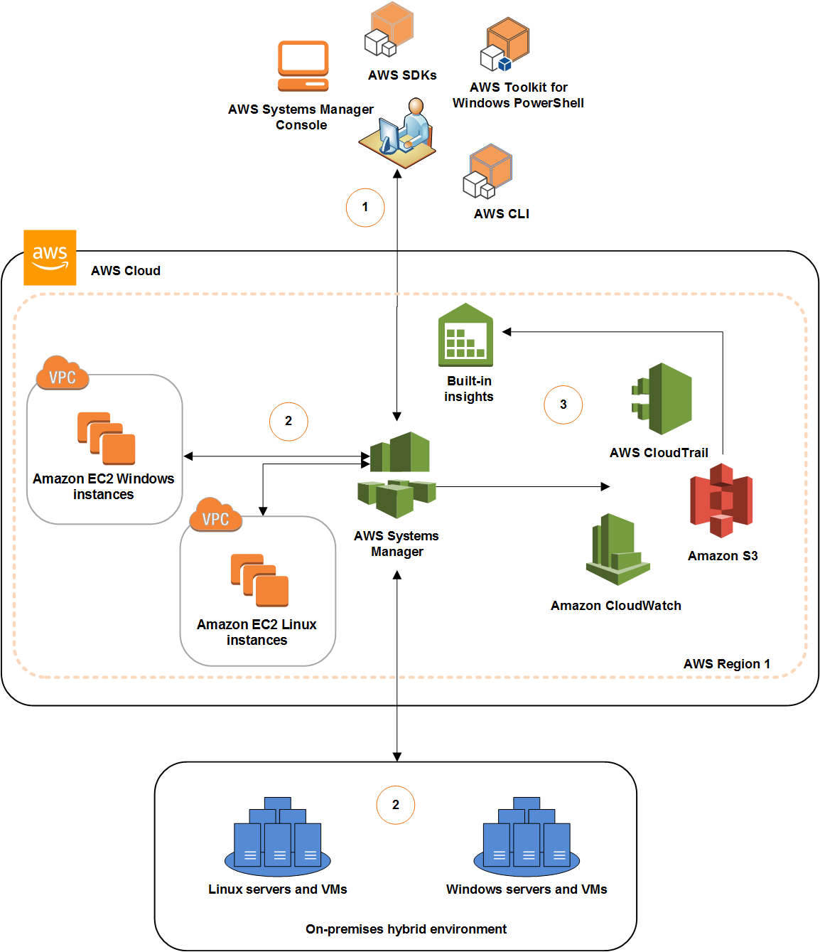

Slide 8
AWS Systems Manager Agent
Amazon software agent that must be installed on any managed machine for Systems Manager to be able to perform its tasks
Installed by default on many Amazon-provided machine images (AMIs)
Must be installed and configured via a separate process for on-prem machines and non-Amazon VMs

Slide 9
AWS Systems Manager Documents
JSON or YAML files that define the actions that Systems Manager should perform on managed instances
Amazon provides many pre-configured documents in Systems Manager and you can also create your own

Slide 10
AWS-ApplyDSCMofs
Systems Manager document that applies one or more MOFs to one or more managed machines
Can be executed once with Run Command, or on a defined schedule with State Manager
MOFs can be stored in S3, retrieved from file shares, or requested via HTTP
DSC resource modules can be downloaded from the PowerShell Gallery, or from S3 if your org does not allow public package feeds
Dynamic Token Substitution can replace specially-formatted “tokens” in Configurations with values from environment variables, Parameter Store, or instance tags
Allows for development of common MOFs that still use instance-specific values
Compliance reports are automatically written to S3 and reported in the Systems Manager console

Slide 11
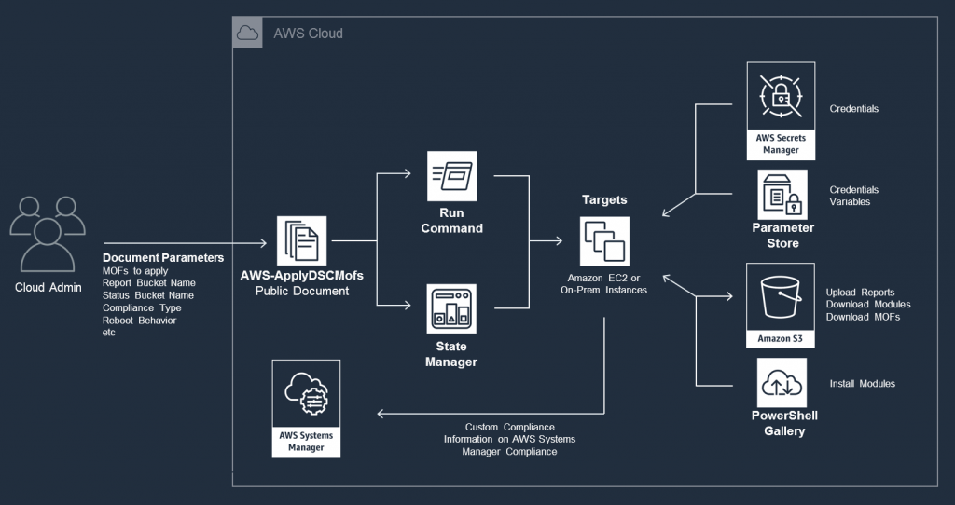
https://aws.amazon.com/blogs/mt/run-compliance-enforcement-and-view-compliant-and-non-compliant-instances-using-aws-systems-manager-and-powershell-dsc/

Slide 12
Pros and “Cons” of AWS-ApplyDSCMofs
Pros
Generalized MOFs – no hostname specification needed
Automated installation of required DSC resource modules on managed machines
Multiple MOFs can be applied at once – better modularity of configurations
Easily accessible JSON configuration results are written to S3 and can be used as input for metrics and alerting
Secrets (passwords, API keys, stuff that you shouldn’t be putting in DSC configurations anyway) can be stored securely in Parameter Store or Secrets Manager and retrieved at runtime by the Systems Manager Agent without needing to use certificates
https://docs.aws.amazon.com/systems-manager/latest/userguide/systems-manager-state-manager-using-mof-file.html#systems-manager-state-manager-using-mof-file-credentials
No need to set up a Pull Server or write any push-mode tooling
Cons
Bringing on-prem or non-Amazon VMs into Systems Manager requires installing the agent via PowerShell/Bash code that Amazon provides

