Slide 1
AIR-DS
A design system agents
cannot hallucinate against.
White-label · AI-ready · built once, re-branded per customer as a single theme file — with the machine layer that makes customer agents productive on day one.
--ds-color-accent-default
--ds-space-gap-md
--ds-radius-md
components-index.json
“Instruction hopes the model complies. Structure checks.”

Slide 2
THE MOMENT
Every customer now generates UI with agents
17/20
18/20
14/20
leading design systems
ship MCP servers
ship agent skills
publish llms.txt
The problem. Agents produce garbage against design systems they cannot read: invented components, fabricated tokens, off-brand drift. The July 2026 “State of AI in Design Systems” field study settled the debate — machine interfaces are table stakes; leaders compete on how well they slice, gate, and validate context.
The opportunity. A white-label system that is AI-ready out of the box lets a customer’s teams — and their agents — ship on-brand, accessible, validated UI from week one. And we re-theme the entire stack, including every AI artifact, per customer in minutes, not months.
The build rule that shaped everything: prefer deterministic structure (types, linters, validators, registries) over prose instructions — and prose over nothing.

Slide 3
WHAT WE BUILT
Four layers, one source of truth — everything compiled
1 · Tokens
2 · Components
3 · Machine surface
4 · Enforcement
DTCG source, three tiers.
Brand tier = the only theming surface. WCAG-AA contrast gate fails the build.
14 components + 25 icons on React Aria. Typed unions; a11y inside; stories are contract artifacts.
llms.txt family, markdown twins, 6 skills, 4 editor channels, MCP server, per-customer auditor agent.
Deterministic gauntlet + eval suite + browser axe + nightly benchmark. No LLM in the merge path.
→
→
→
The closed world: every legal token and component is enumerated in generated registries. Anything not in a registry is provably fabricated — checkable by grep, not judgment.
tokens-index · 232
components-index · 21
icons-metadata · 25
patterns-index · 6
contrast-report · 27 AA
Customer = one brand token file. Zero component code changes for standard engagements (ADR-006).

Slide 4
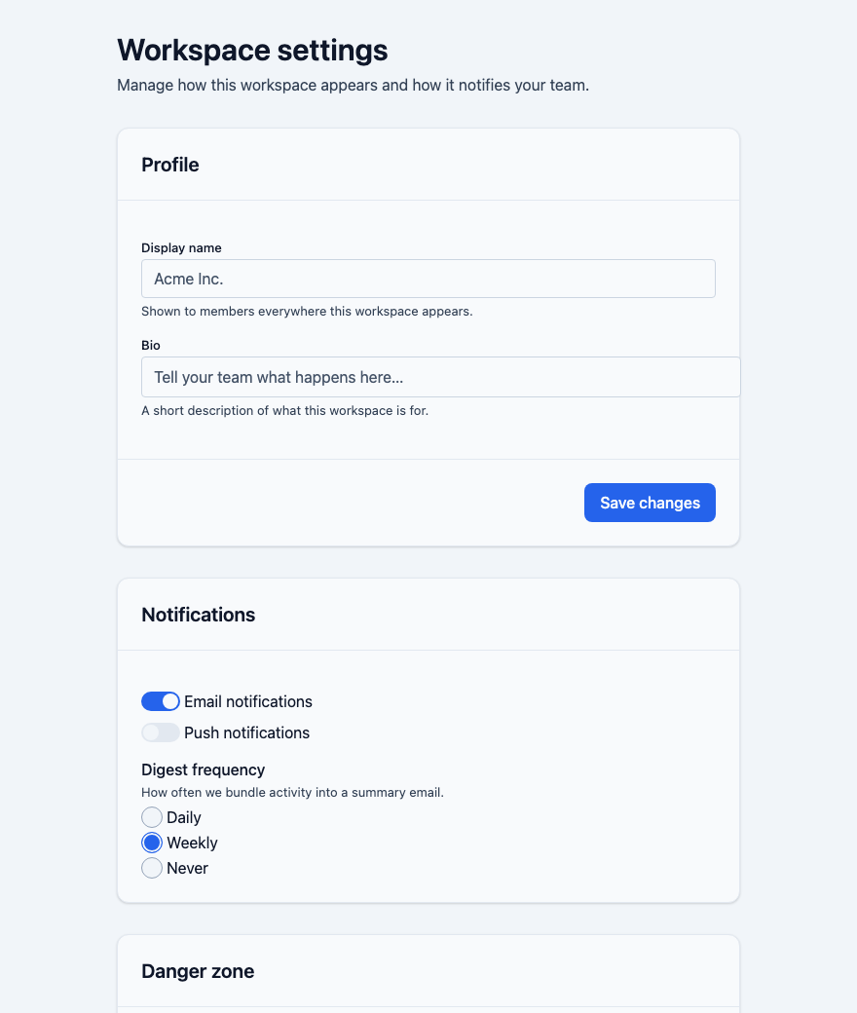
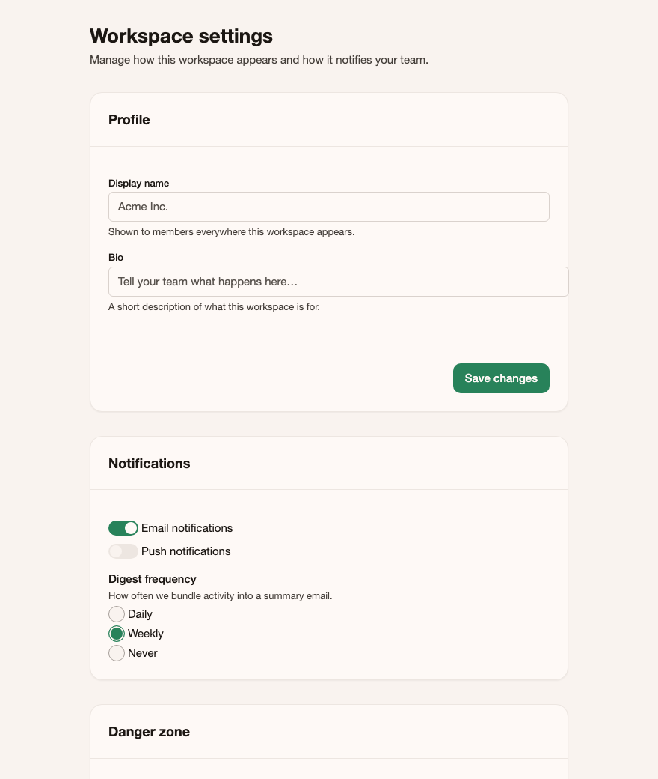
WHITE-LABEL, PROVEN
Same compiled bundle — one theme file apart
260 ms
intake file → complete branded
system, incl. all 50+ AI artifacts
The pipeline: seed colors → deterministic OKLCH ramps → WCAG-AA pre-check with auto-repair (a failing palette is fixed and logged, never shipped) → isolated token build → every agent-facing artifact re-emitted with the customer’s values, to their private npm scope.
Their agents consume THEIR system — llms.txt, skills, editor rules, MCP answers all reflect the active brand.
brands/default.json — neutral core
brands/acme.json — generated from an intake file

Slide 5




ENFORCEMENT
Hallucinated UI is unmergeable — not “flagged”
typecheck
→
lint · 11 rules
→
build
→
test + axe
→
registry check
One command — pnpm validate — in our CI and the customer’s. LLMs draft, review, and repair; only deterministic checks approve.
Closed-world linting
Every var(--ds-*) and import checked against the registries; fabrication is a build failure with a named fix.
A negative-rule catalog that compiles
13 observed hallucination classes (NR-001…013), each a wrong→right pair shipped into skills, editor rules, and MCP messages.
Evals as regression tests
Every rule has a wrong/right pair executed in CI: 21/21 passing, critical gates at a required 1.0.
Browser-verified accessibility
97 Storybook stories swept by axe in real Chromium: zero violations at any impact level. Contrast is gated at token-build time (27 AA pairs).

Slide 6
PROOF, NOT PROMISES
Three acceptance tests, run for real
The blind consumer
The live MCP client
The outside contributor
A fresh agent locked to the compiled artifacts only — no source access — built a full settings screen.
A real stdio JSON-RPC session against the shipped server: closed-world errors, all 13 negative rules firing with fixes, theme-swap invariant across brands.
An agent with only the contribution checklist built a 15th component in a clean clone.
0
PASS
1st try
fabricated tokens or components
(validator-verified, 12 components, 16 tokens used)
every functional expectation met;
survived malformed input without a crash
gauntlet-green — and its friction list
became three new shipped rules

Slide 7


DEMOABLE ANYWHERE
Zero credentials to run. Clients bring their own keys.
$ bash scripts/demo.sh
Client plug-points (theirs, by design)
One command, ~30 s warm, fully offline: build → gauntlet → evals → benchmark (committed fixture replay) → ingest the sample customer → metrics report.
LLM benchmark generator
their agent CLI + API keys, via one config flag
npm publishing
documented, disabled workflow step gated on their NPM_TOKEN
Figma
the design-to-code skill works from any input; the Figma adapter is documented and waits for their credentials
Everything runs locally
Deterministic compilers, fixture-replay benchmark, local-Chromium axe, pnpm-pack release artifacts. No accounts, no network services.
MCP with zero setup
Open the repo in Claude Code and the design-system server is already wired (.mcp.json).
Rule recorded in the repo: nothing in the product requires credentials to build, validate, or demo.

Slide 8
THE BUILD ITSELF
Built by an agent team — with its own medicine
exemplar
→
adversarial audit
→
freeze the pattern
→
parallel fan-out
→
deterministic gate
→
findings → rules
The pre-fan-out audit caught 10 pattern defects in the exemplar — including dead theming hooks and an illegible disabled state — before they could be copied 13×. Every later friction finding became a named negative rule, then a deterministic check. That promotion loop ran five times across the build.
~30
13/13
0
16
agent engagements
across five waves
fan-out agents passed
their gates first try
fabricated tokens across
the entire build
phase-gated commits,
brief phases 0–4 complete
Human gates stayed intact: architecture decisions, frozen scope, and every phase commit were the lead’s calls — agents drafted, audited, and repaired; the gauntlet approved.

Slide 9
MANDATE V2 — SHIPPED
The design system is the proof. This is the product.
ds-assess
ds-retrofit
ds-fleet
Score any repo’s AI-readiness: six evidence-backed pillars. This repo: 99.4/A; a typical 2023 DS: 6.6/F, gaps named.
Their existing system in — CSS vars, Tailwind, React lib — our registries, machine surface, and fabrication gauntlet out. No rewrite.
Hallucination rate, first-pass rate, and policy compliance across N repos in one dashboard; policy-as-code breaches block merges.
@ds/genui
@ds/wc + RN
evidence pack
Safe generative UI at runtime: agents emit a wire format that can only compose registry components. 51-case fuzz: all injections inert.
Same token graph, new render targets — Shadow-DOM CSS, React Native styles, a registry-listed web component.
One command → auditor bundle: WCAG, provenance, dependencies. A broken system cannot produce passing evidence.
Every capability runs locally with zero credentials — and the gauntlet now governs this repo itself: policy-as-code is merge-blocking here, 6/6 green.

Slide 10
BY THE NUMBERS
The system, measured
1,013
232
97 / 0
tests across eleven packages
public tokens · 131 themable hooks, zero dead
stories swept by browser axe / violations
21 / 21
5 / 5
260 ms
evals passing · critical at 1.0
gauntlet steps green, no LLM in the gate
full customer re-theme, AI artifacts included
Hallucination rate across every acceptance test and the build itself: zero.

Slide 11




WHAT REMAINS
Honest edges, and the road from here
Figma library + Code Connect
The brief’s named differentiator — needs design tooling and a seat. The token pipeline is variables-ready and the design-to-code skill already ships the Figma-agnostic spec-extraction half.
Pilot customers
The final field gate: 1–2 friendly customers whose agents pass the gauntlet first-try ≥80%. Acme proves the mechanics; pilots prove the market.
v1.1 backlog, already scoped
Sixteen tracked findings from audits, acceptance tests, and live dogfooding (thin-dimension tokens, play-function execution, first-pass metric semantics…) — each with an owner area.
Client-side wiring
Their npm scope, their benchmark LLM, their Figma credentials, their crawl-ability decision per engagement — all pluggable, none blocking a demo.
See it yourself: bash scripts/demo.sh · docs/architecture.md · examples/brand-demo

