Slide 1
Git
a tale told by an idiot
Matt Burton (@mcburton)

Slide 2
Git is a distributed version control system (DVCS) or source code management (SCM) system

Slide 3
"I'm an egotistical bastard, and I name all my projects after myself. First 'Linux', now 'git'." -Linus Torvalds

Slide 4
push it
pull it
fork it
clone it
check it
branch it
stash rebase it.
commit
merge it
log it
help it
clean it
blame it
move remove it
add it
grep it
diff it
fetch it
tag it
show it
pull request it.
Git's (complex) logic

Slide 5
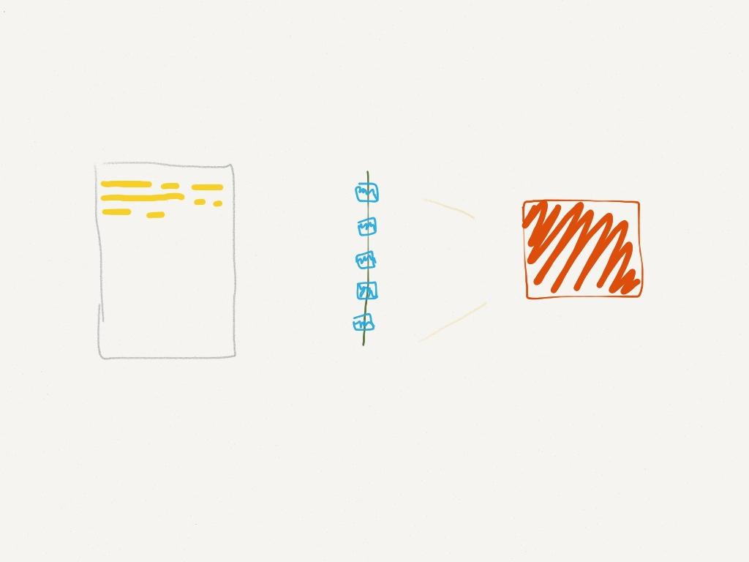
Work you have saved can be bundled into a Commit.

Slide 6
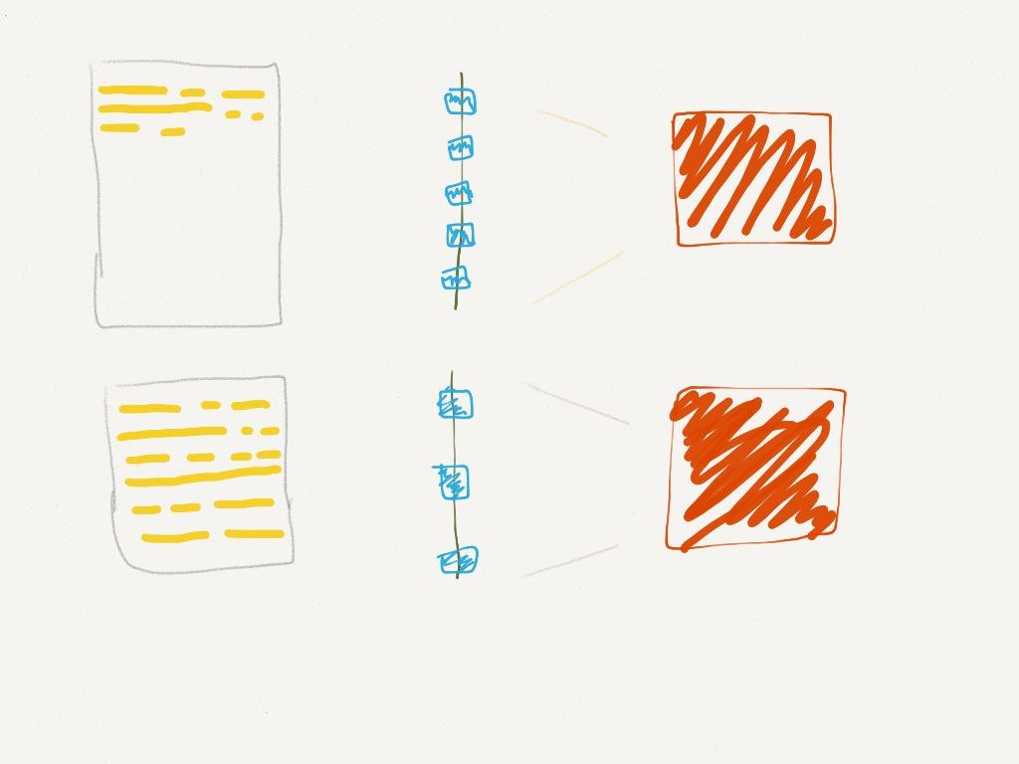
A Commit is a snapshot of all new work since the previous Commit.

Slide 7
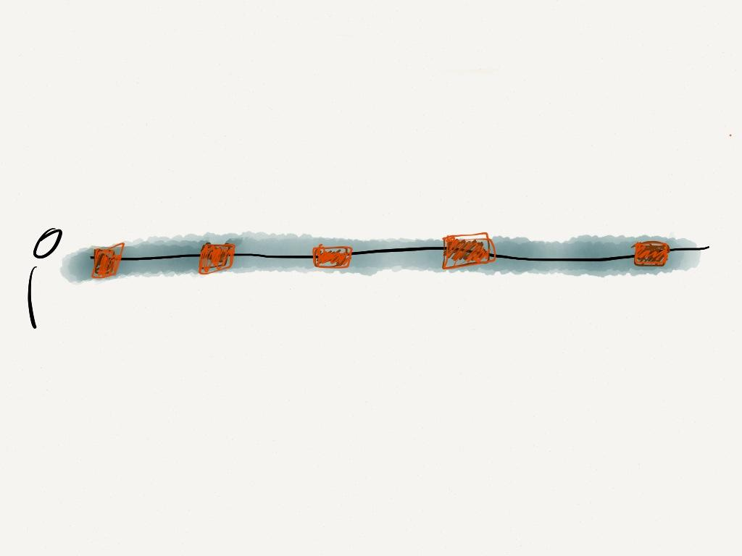
Commits are humane units of work. All glory to the metadata.

Slide 8
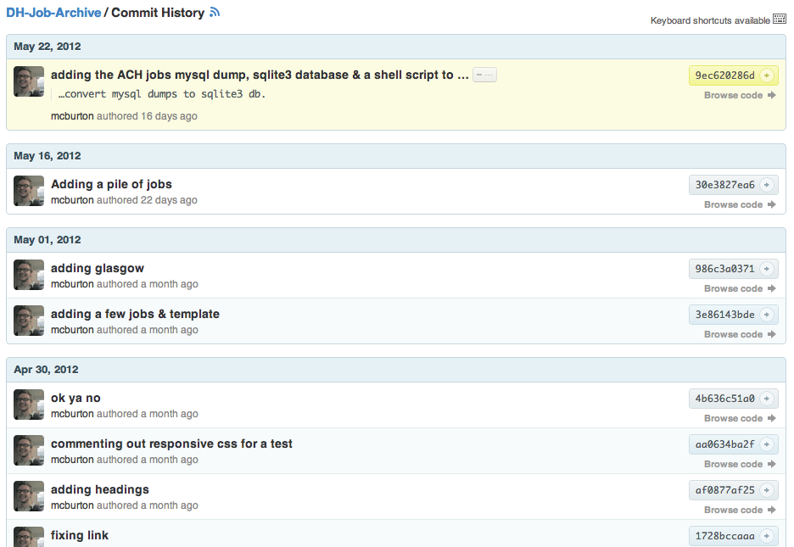
Commit history provides a log of punctuated meaningful work

Slide 9
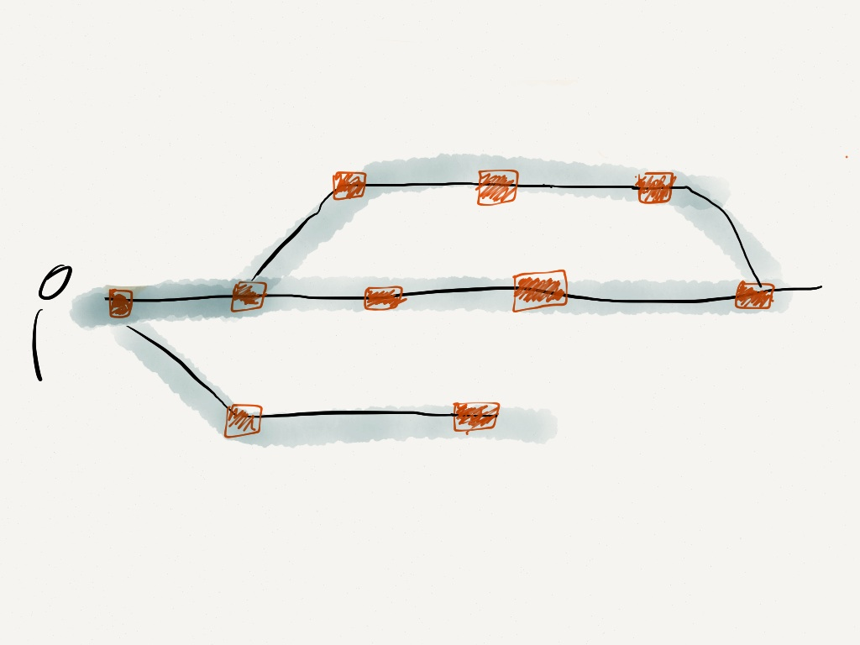
Branching & Merging these units enables parallel workflows.

Slide 10
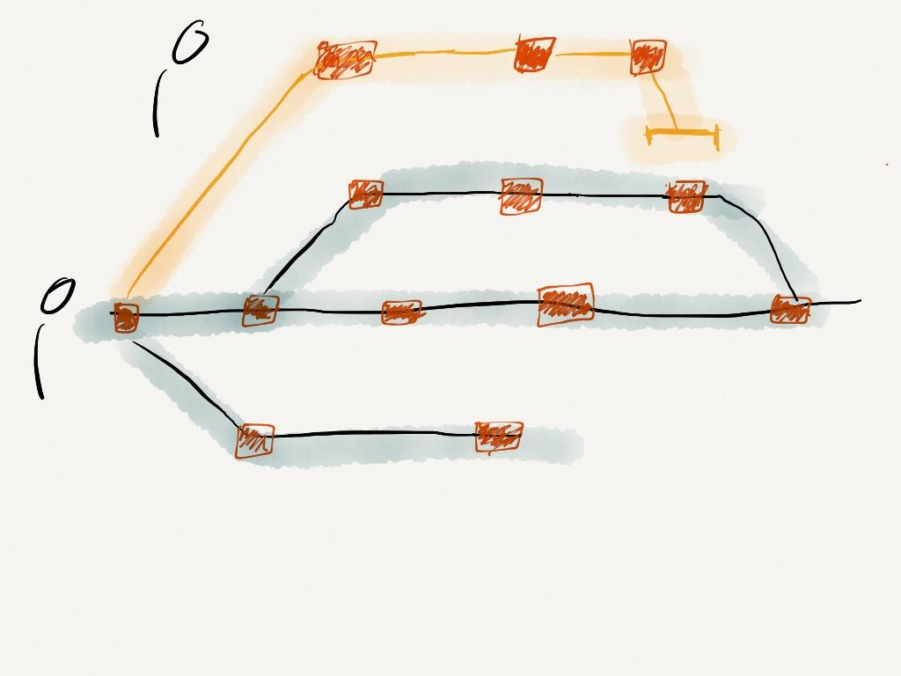
Cloning or Forking these branches enables asynchronous remote collaboration.

Slide 11
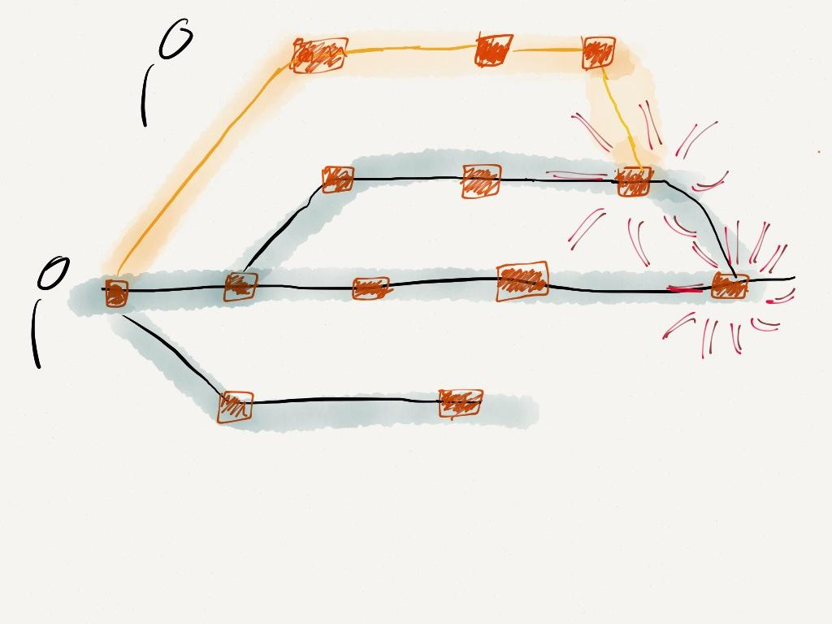
Merging lets you incorporate branches or Pull remote work.

Slide 12
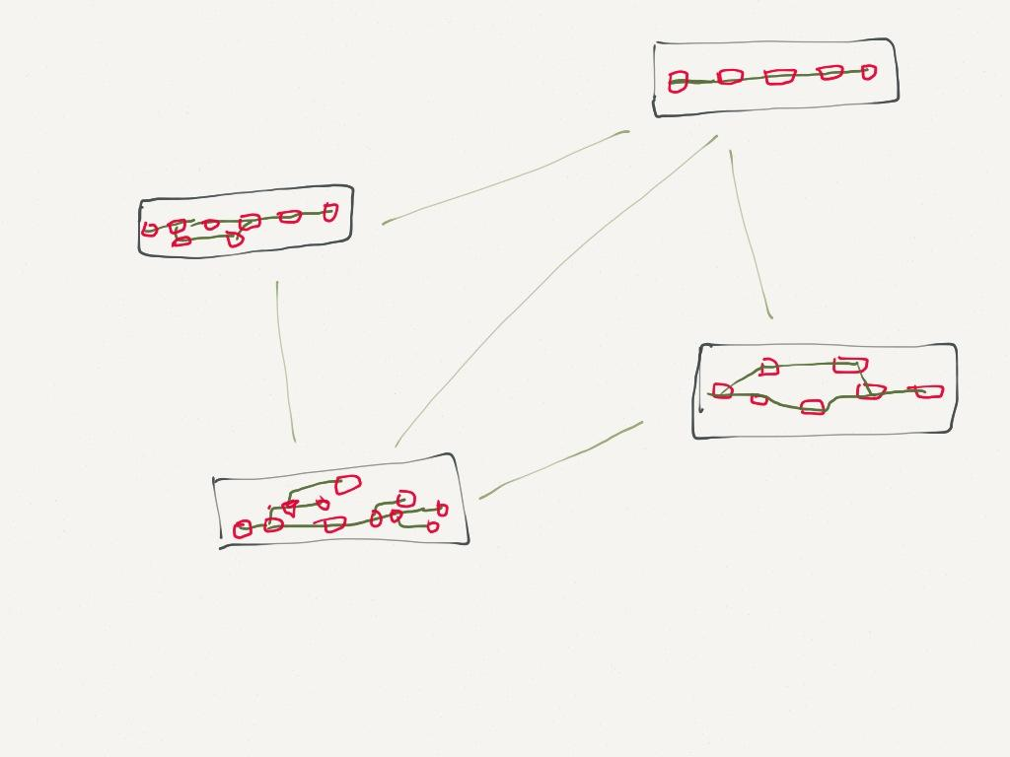
Git is a protocol and a scaffolding for sharing and scaling Repositories.

Slide 13
While Git is technically indifferent to the stuff in the repository.
The design favors structured text (code, html, xml, etc)

Slide 14
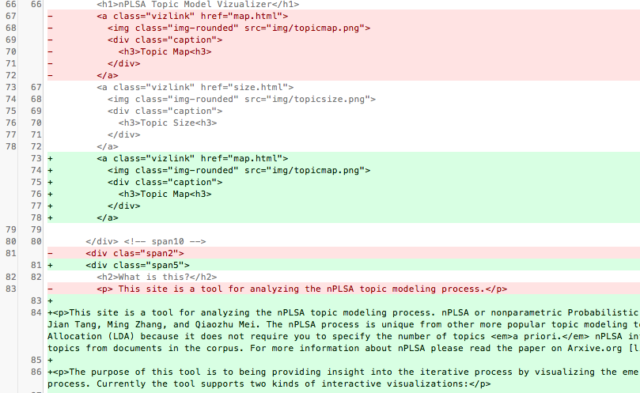
Diff allows you to see the differences between Commits.

Slide 15
Git is great with data, not as great (but still good) with prose.
Need prose-centric vs. code-centric diff and merge (Juxta perhaps?)

Slide 16
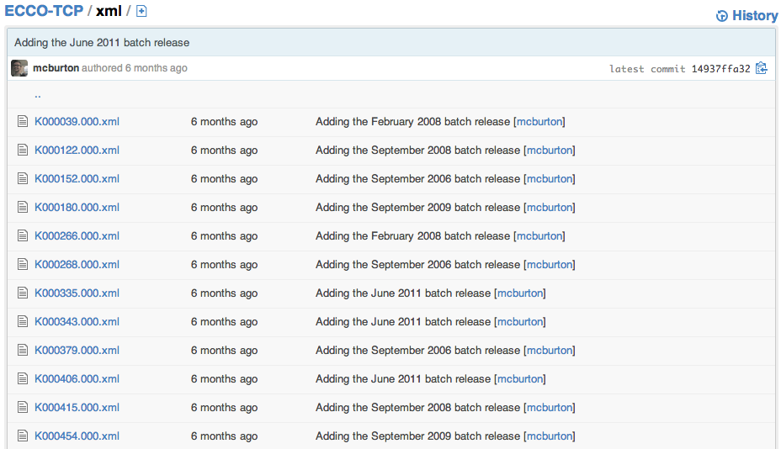
Repository structure is complicated. Directories of XML files is not ideal.

Slide 17
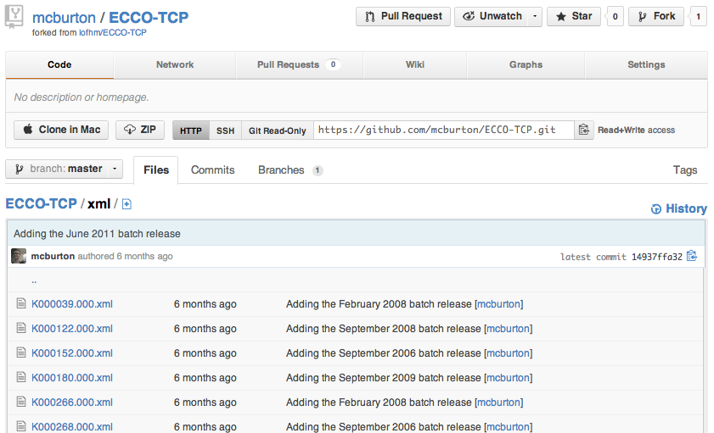
Git and GitHub can be used as a platform for hosting, sharing, and tracking Digital Humanities data repositories.

Slide 18
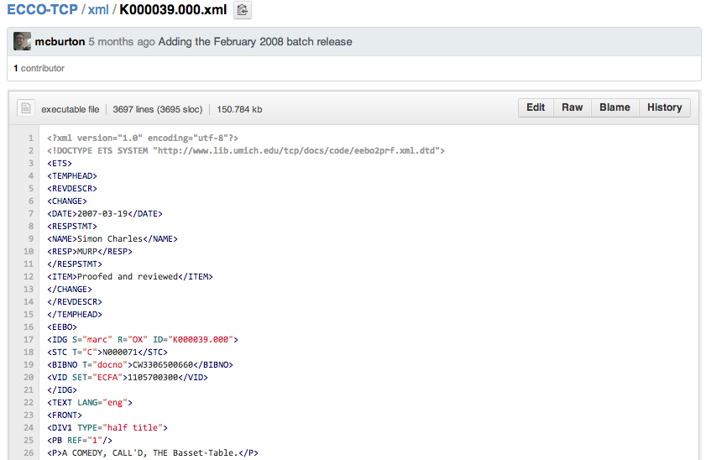
Github as a host for DH data. ECCO-TCP is already there.

Slide 19
Github can be used as a central coordination point for distributed, asynchronous collaboration.

Slide 20
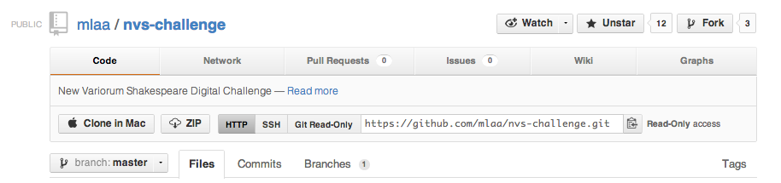
I can Pull a remote repository from Github to my local machine...

Slide 21
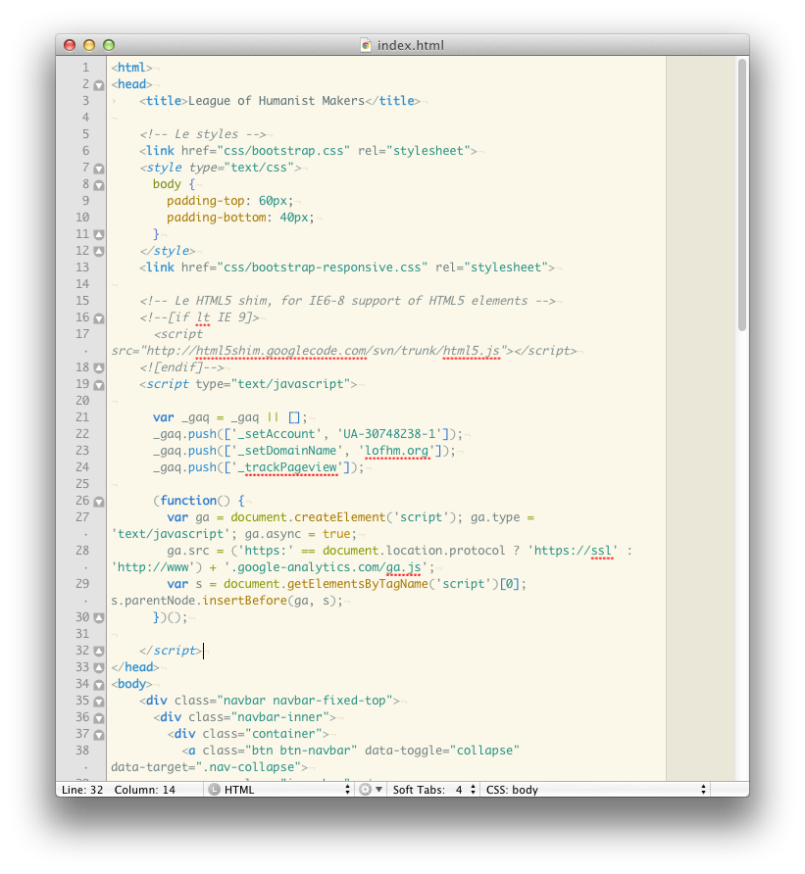
....edit files locally with my favorite editors and tools...

Slide 22
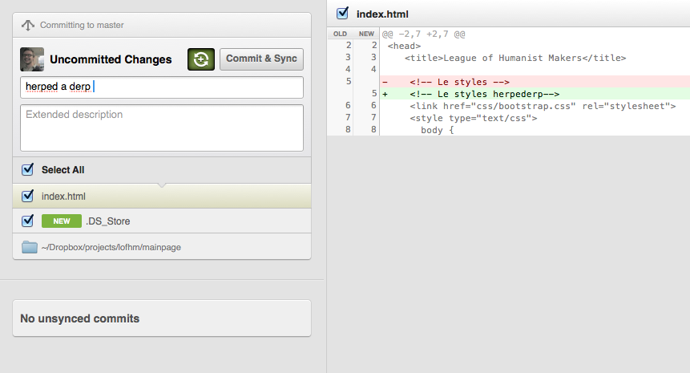
...Commit the changes to my local repository...

Slide 23

...and Push my updated repository to GitHub.

Slide 24

This is a very high level, conceptual overview.
Using Git is complicated and requires lots of patience.

Slide 25
Thanks! If you have questions please contact me on twitter (@mcburton) or email (matt@mcburton.net).

