Slide 1
Scholarly Publishing & the Digital Humanities
A work in progress by Matt Burton
Scholarly publishing & the digital humanities. Field Prelim. Matt Burton

Slide 2
What are Digital Humanities?

Slide 3
“The digital humanities is a new set of practices, using new sets of technologies, to address research problems of the discipline."
-- Borgman 2004

Slide 4
new research methods

Slide 5
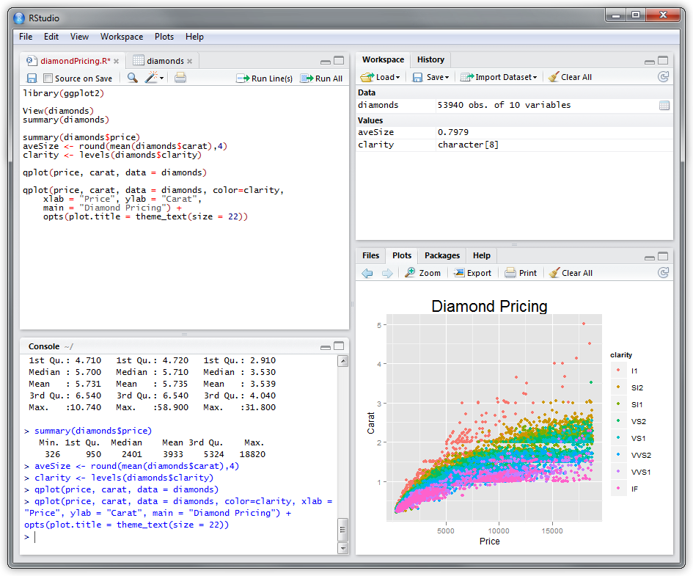
statistical analysis

Slide 6
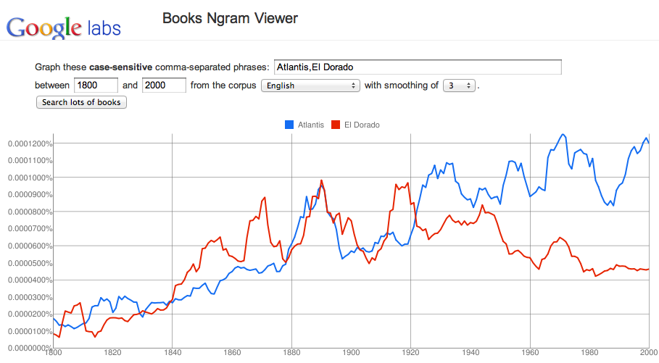
natural language processing

Slide 7
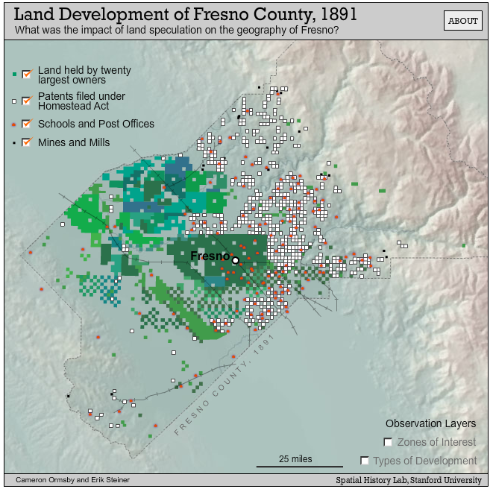
information visualization

Slide 8
new research objects

Slide 9

online communities

Slide 10
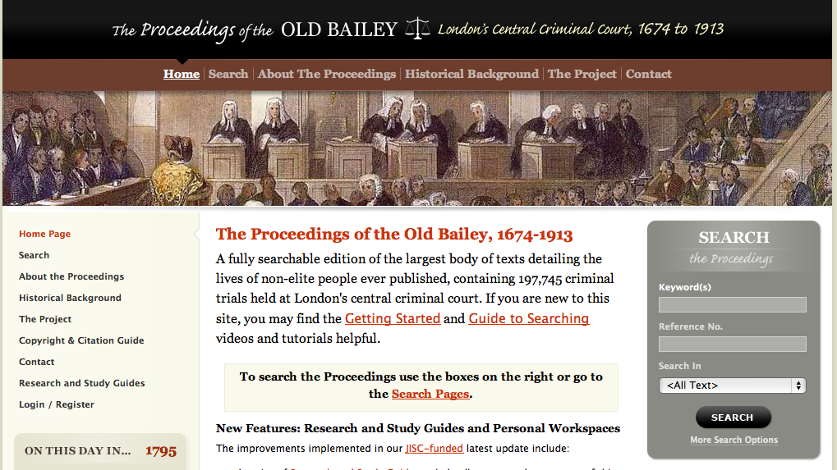
digitized text

Slide 11
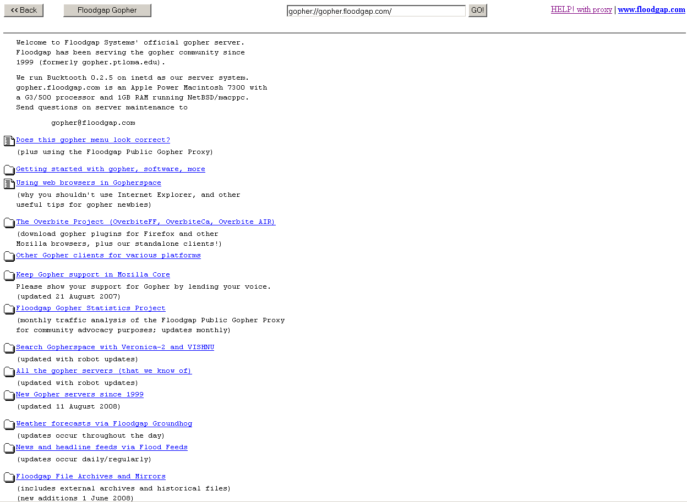
near history

Slide 12
But what about sharing digital humanist knowledge?

Slide 13
There is a crisis in scholarly book publishing.

Slide 14
"The situation is this: over the course of the last few decades, most departments of language and literature have come to demand that junior faculty members produce, as a condition for being seriously considered for promotion to tenure, a full-length scholarly book published by a reputable press. A small number of departments expect the publication of two such books. Whether these expectations are reasonable or necessary is a question that we should collectively ponder and debate. The immediate problem, however, is that university presses, which in the past brought out the vast majority of scholarly books, are cutting back on the publication of works in some areas of language and literature. Indeed, we are told that certain presses have eliminated editorial positions in our disciplines."
-- Former president of the Modern Language Association
Steven Greenblatt

Slide 15
"The situation is this: over the course of the last few decades, most departments of language and literature have come to demand that junior faculty members produce, as a condition for being seriously considered for promotion to tenure, a full-length scholarly book published by a reputable press. A small number of departments expect the publication of two such books. Whether these expectations are reasonable or necessary is a question that we should collectively ponder and debate. The immediate problem, however, is that university presses, which in the past brought out the vast majority of scholarly books, are cutting back on the publication of works in some areas of language and literature. Indeed, we are told that certain presses have eliminated editorial positions in our disciplines."
-- Former president of the Modern Language Association
Steven Greenblatt

Slide 16
"The situation is this: over the course of the last few decades, most departments of language and literature have come to demand that junior faculty members produce, as a condition for being seriously considered for promotion to tenure, a full-length scholarly book published by a reputable press. A small number of departments expect the publication of two such books. Whether these expectations are reasonable or necessary is a question that we should collectively ponder and debate. The immediate problem, however, is that university presses, which in the past brought out the vast majority of scholarly books, are cutting back on the publication of works in some areas of language and literature. Indeed, we are told that certain presses have eliminated editorial positions in our disciplines."
-- Former president of the Modern Language Association
Steven Greenblatt

Slide 17
"The situation is this: over the course of the last few decades, most departments of language and literature have come to demand that junior faculty members produce, as a condition for being seriously considered for promotion to tenure, a full-length scholarly book published by a reputable press. A small number of departments expect the publication of two such books. Whether these expectations are reasonable or necessary is a question that we should collectively ponder and debate. The immediate problem, however, is that university presses, which in the past brought out the vast majority of scholarly books, are cutting back on the publication of works in some areas of language and literature. Indeed, we are told that certain presses have eliminated editorial positions in our disciplines."
-- Former president of the Modern Language Association
Steven Greenblatt

Slide 18
"The situation is this: over the course of the last few decades, most departments of language and literature have come to demand that junior faculty members produce, as a condition for being seriously considered for promotion to tenure, a full-length scholarly book published by a reputable press. A small number of departments expect the publication of two such books. Whether these expectations are reasonable or necessary is a question that we should collectively ponder and debate. The immediate problem, however, is that university presses, which in the past brought out the vast majority of scholarly books, are cutting back on the publication of works in some areas of language and literature. Indeed, we are told that certain presses have eliminated editorial positions in our disciplines."
-- Former president of the Modern Language Association
Steven Greenblatt

Slide 19
"The situation is this: over the course of the last few decades, most departments of language and literature have come to demand that junior faculty members produce, as a condition for being seriously considered for promotion to tenure, a full-length scholarly book published by a reputable press. A small number of departments expect the publication of two such books. Whether these expectations are reasonable or necessary is a question that we should collectively ponder and debate. The immediate problem, however, is that university presses, which in the past brought out the vast majority of scholarly books, are cutting back on the publication of works in some areas of language and literature. Indeed, we are told that certain presses have eliminated editorial positions in our disciplines."
-- Former president of the Modern Language Association
Steven Greenblatt

Slide 20
"The situation is this: over the course of the last few decades, most departments of language and literature have come to demand that junior faculty members produce, as a condition for being seriously considered for promotion to tenure, a full-length scholarly book published by a reputable press. A small number of departments expect the publication of two such books. Whether these expectations are reasonable or necessary is a question that we should collectively ponder and debate. The immediate problem, however, is that university presses, which in the past brought out the vast majority of scholarly books, are cutting back on the publication of works in some areas of language and literature. Indeed, we are told that certain presses have eliminated editorial positions in our disciplines."
-- Former president of the Modern Language Association
Steven Greenblatt

Slide 21
Publishing is dying.

Slide 22
We can rebuild it.

Slide 23
We have the technology.

Slide 24
We have the capability to publish electronically.

Slide 25
Better than it was before.

Slide 26
Better...Stronger...Faster.

Slide 27
But, there are social and technical challenges.

Slide 28
The social <-> technical gap.

Slide 29
“There is a divide between what we know we must support socially and what we can support technically."
-- Ackerman 2000

Slide 30
Tools do not always fit the practice.

Slide 31
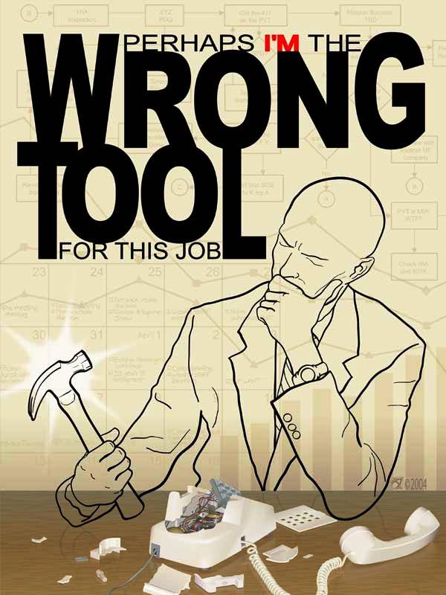

Slide 32
Also, the practice does not fit the tools.

Slide 33


Slide 34
There is a divide between what we know is possible technically and what can we support socially.

Slide 35
I call this "Ackerman's aphorism."

Slide 36
So what do we have?

Slide 37
New scholarly practice made possible in part by digital technology...

Slide 38
Running up against...

Slide 39
A crisis in knowledge dissemination due in part to digital technology...

Slide 40
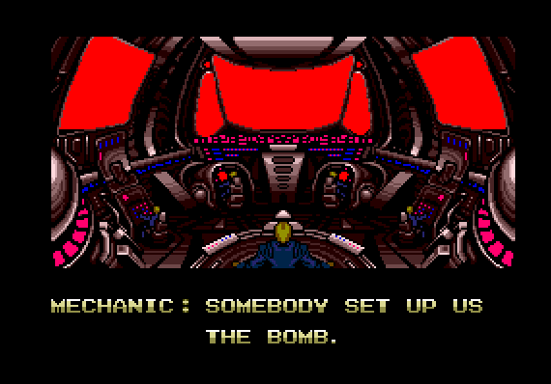

Slide 41
"Studies of collaboration in science, [as] Willard McCarty note[s], are almost entirely unknown to humanists (2005, 212). For that matter, so are studies of interdisciplinary (ID) and transdisciplinary (TD) [collaboration]."
-- Julie Klein (forthcoming)

Slide 42
"Studies of collaboration in science, [as] Willard McCarty note[s], are almost entirely unknown to humanists (2005, 212). For that matter, so are studies of interdisciplinary (ID) and transdisciplinary (TD) [collaboration]."
-- Julie Klein (forthcoming)

Slide 43
"Where are the social studies of the digital humanities?"
-- Borgman 2004

Slide 44
Here.

