Slide 1
FHIR_OMOP
Summay of proof-of-concept test
APR 2024

Slide 2
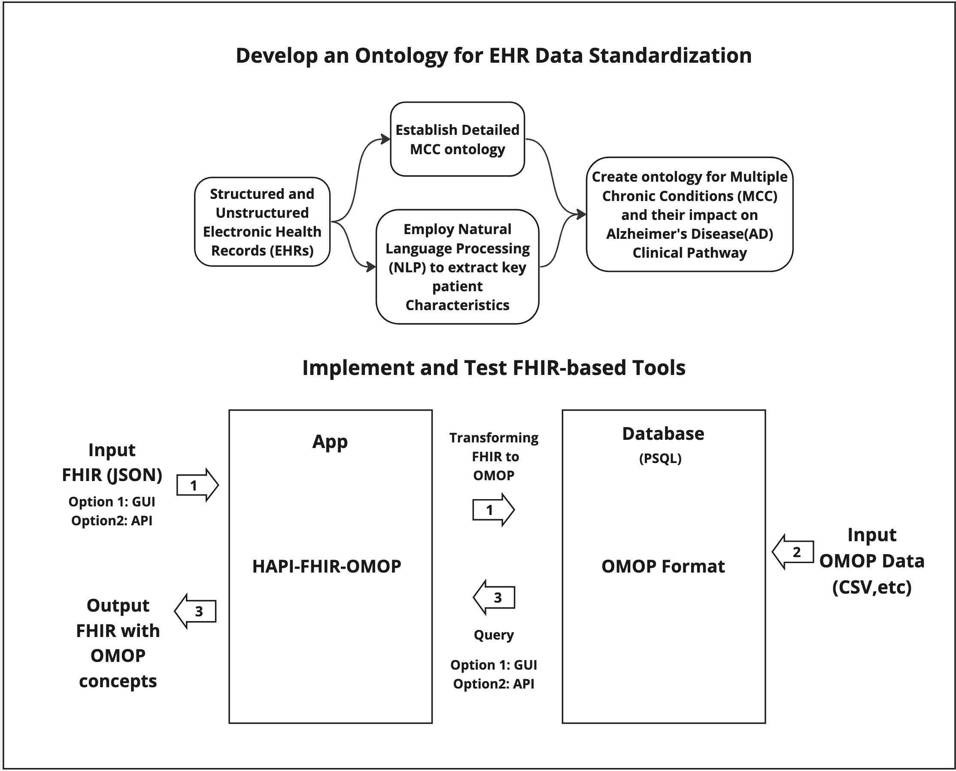

Slide 3
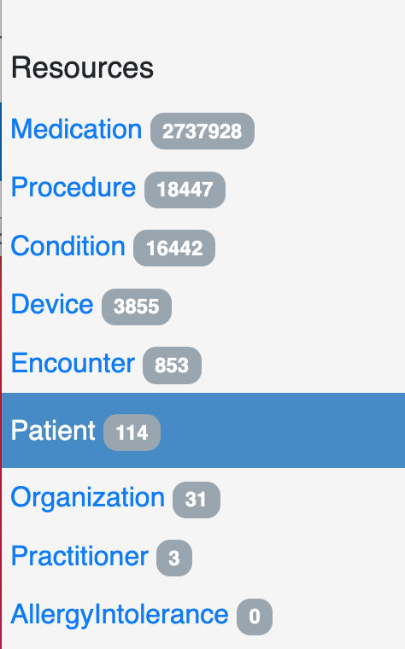
Insert a New Patient Data using GUI
Select "Patient" from the side-bar menu.

Slide 4
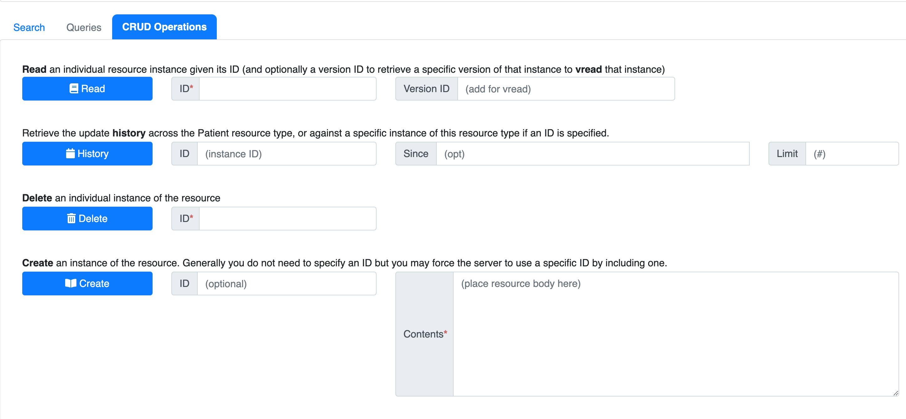
Insert a New Patient Data using GUI
2. Select "CRUD Operations" tab.
3. Paste JSON body request into "Contents" input box near Create button.

Slide 5
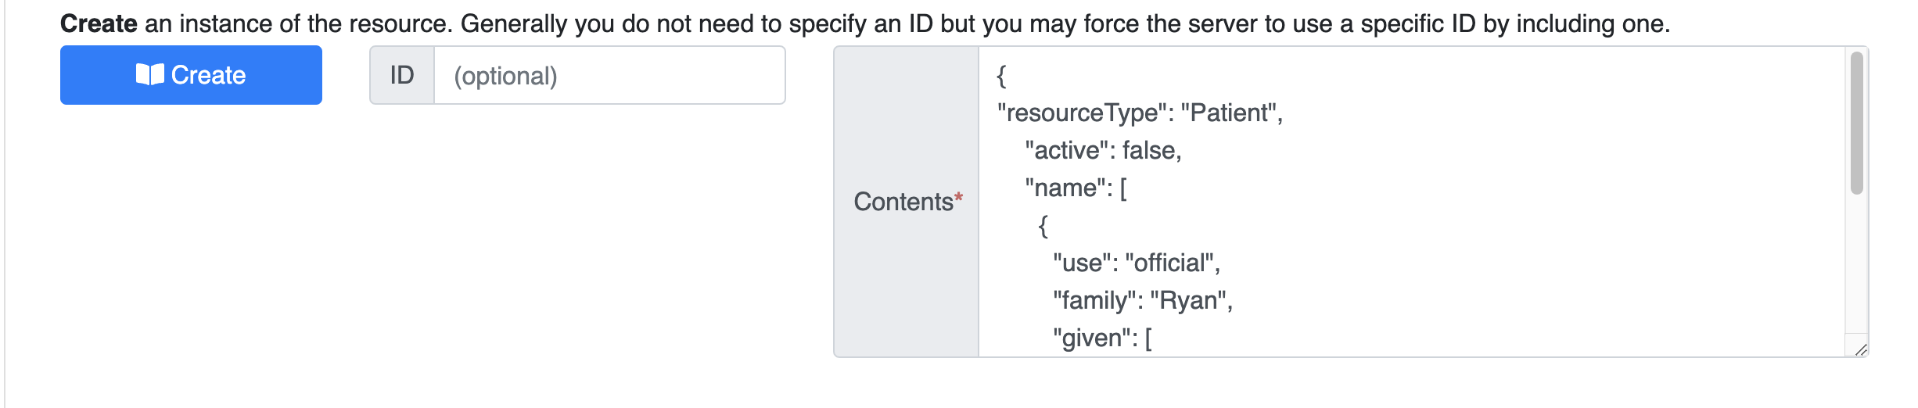
Insert a New Patient Data using GUI
Sample Patient Request:
{
"resourceType": "Patient",
"active": "false",
"name": [
{
"use": "official",
"family": "Ryan",
"given": [
"Jack"
]
}
],
"gender": "male",
"birthDate": "1999-09-09"
}
4. Paste content and click "Create"

Slide 6
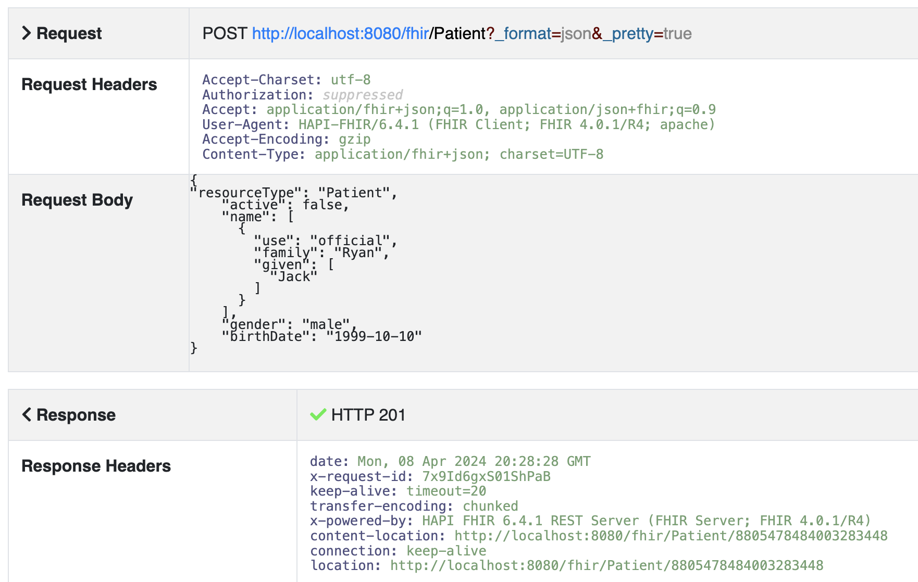

Slide 7
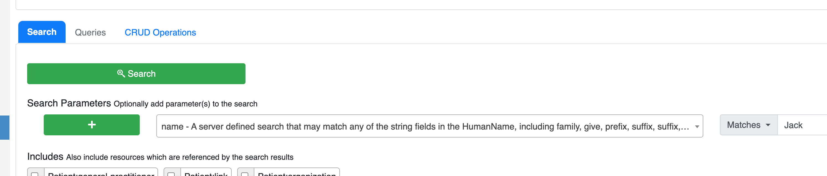
Search the new Patient
2. Select "Patients" from the sidebar.
3. Select "name" to search by name. ( we can search text for non-OMOP files or OMOP Concepts)
4. Input "Jack" and click Search

Slide 8
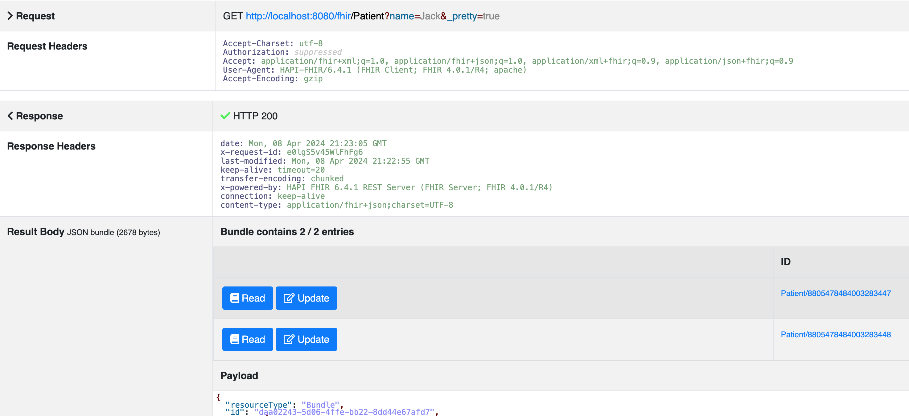
Search the new Patient
All entries with "Jack" are shown. Now you can read each patient to check details.

Slide 9
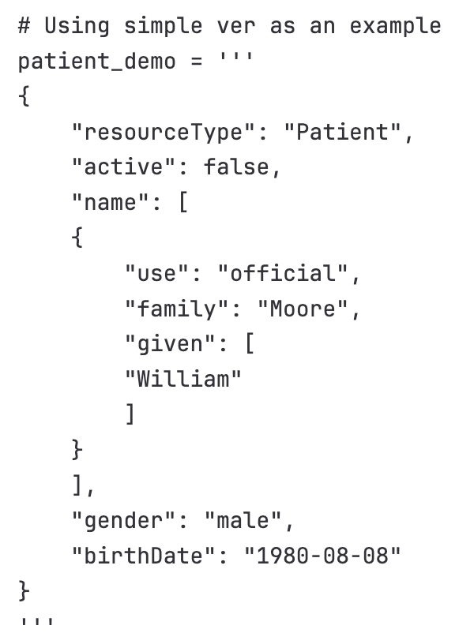
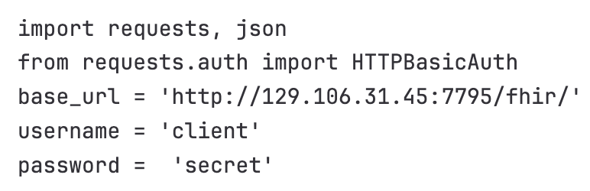
Insert New Patient using API
Start with importing Packages, Credentials, and base URL

Slide 10
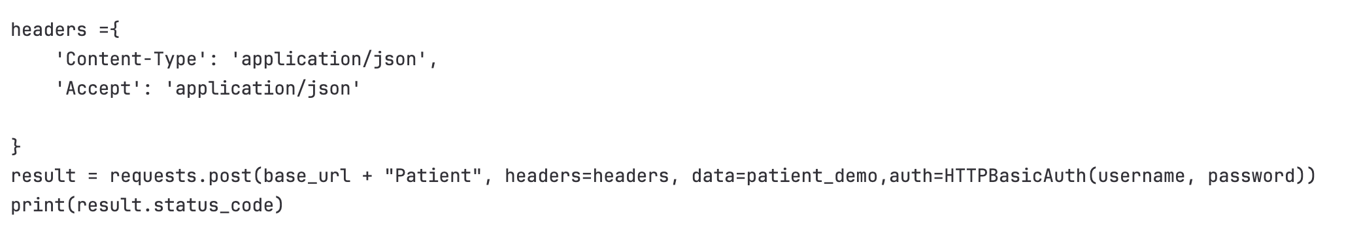
Insert New Patient using API​
Send a POST request to create a new Patient.
Check the response status code -> 201, indicating new Patient resources was successfully created
Could extract the new Patient's information and retrieve the new Patient record to confirm the Patient creation.

Slide 11
Retrieve Patient using API
Patient id: -9066461348710750663
Import Packages, Credentials, and base URL
Standard HAPI server features with password security or OAuth

Slide 12
Retrieve Patient using API
If we load the result, we could see all the information stored for this Patient.
{
'resourceType': 'Patient', 'id': '-9066461348710750663', 'meta': {'profile': ['http://hl7.org/fhir/us/core/StructureDefinition/us-core-patient']}, 'text': {'status': 'generated', 'div': '<div xmlns="http://www.w3.org/1999/xhtml"><div class="hapiHeaderText"></div><table class="hapiPropertyTable"><tbody><tr><td>Identifier</td><td>10037975</td></tr><tr>
<td>Date of birth</td><td><span>15 June 2125</span></td></tr></tbody></table></div>'}, 'identifier': [{'value': '10037975'}], 'active': False, 'gender': 'male', 'birthDate': '2125-06-15'
}

Slide 13
FHIR-OMOP Format Conversion with real data
Tested Patient, Encounter, Condition
All the findings were tested using Epic sandbox sample data

Slide 14
FHIR-OMOP Format Conversion
Patient
Only resourceType, id, meta, text, extension, identifier, active, name, telecom, gender, birthDate, address, generalPractitioner were included. id, meta, text were generated by the system.
The "rank" in "telecom.email" was removed and replaced with "use". Will show all telecom.
Removed last few digits for the postalCode in address. Only the first address will be stored.
Only the first practitioner is stored.
Only the first identifier will be stored and used.

Slide 15
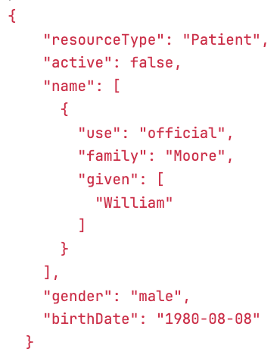
FHIR-OMOP Format Conversion
Patient
{
'resourceType': 'Patient', 'id': '-9066461348710750663', 'meta': {'profile':
['http://hl7.org/fhir/us/core/StructureDefinition/us-
core-patient']}, 'text': {'status': 'generated', 'div': '<div xmlns="http://www.w3.org/1999/xhtml">
<div class="hapiHeaderText"></div><table class="hapiPropertyTable"><tbody><tr>
<td>Identifier</td><td>10037975</td></tr><tr>
<td>Date of birth</td><td><span>15 June
2125</span></td></tr></tbody></table></div>'}, 'identifier': [{'value': '10037975'}], 'active': False, 'gender': 'male', 'birthDate': '2125-06-15'
}

Slide 16
FHIR-OMOP Format Conversion
Encounter
Only resourceType, id, status, subject, paticipant, period were included. id was generated by the system.
"status" will be "finished", no matter what is inputted.
"class" and "type" in the input will be ignored.

Slide 17
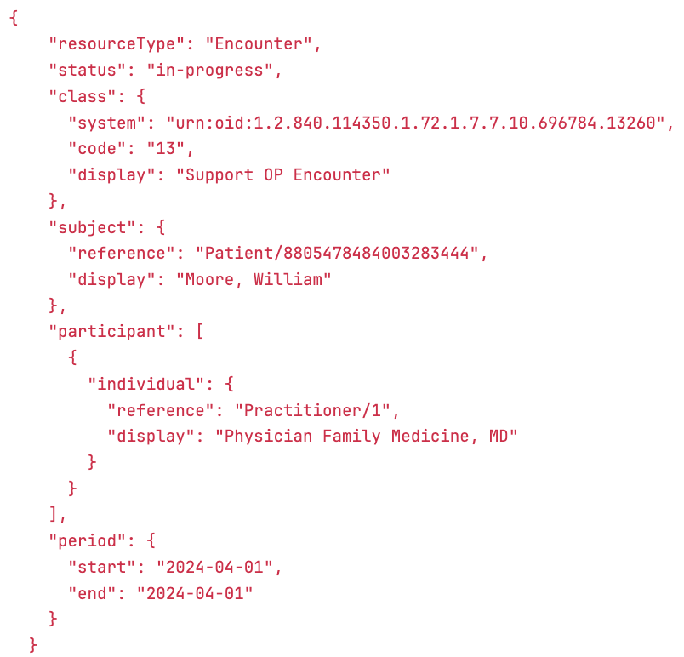
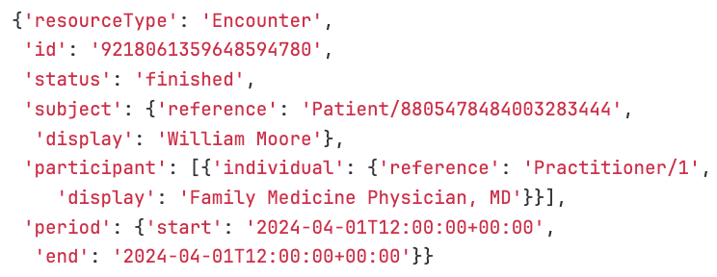
FHIR-OMOP Format Conversion
Encounter

Slide 18
FHIR-OMOP Format Conversion
Condition
Only resourceType, id, category, code, subject, encounter, onsetDateTime, abatementDateTime were included. id was generated by the system.
Requires onsetDateTime, abatementDateTime, recordedDate (not included in Epic, so need to be added manually or with a default value)
recordedDate was not recorded

Slide 19
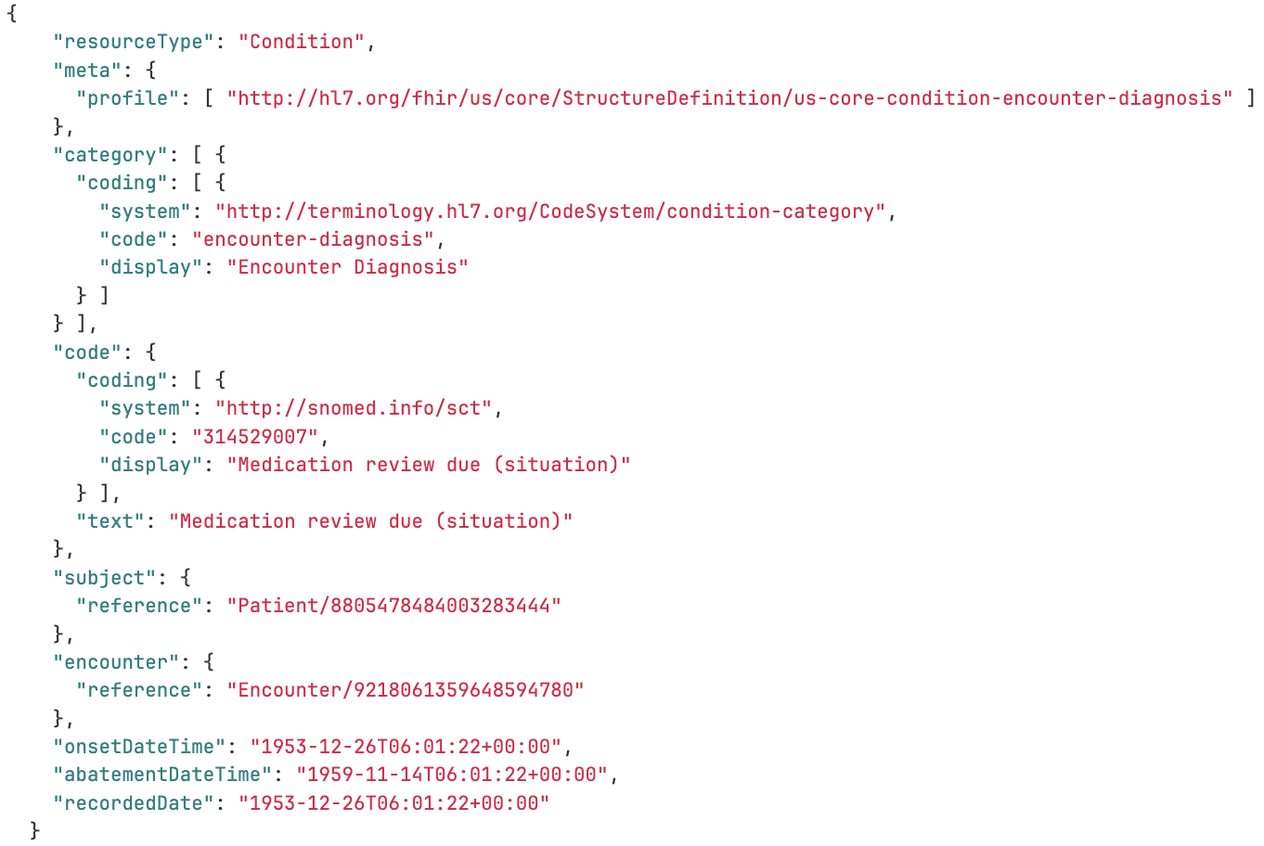
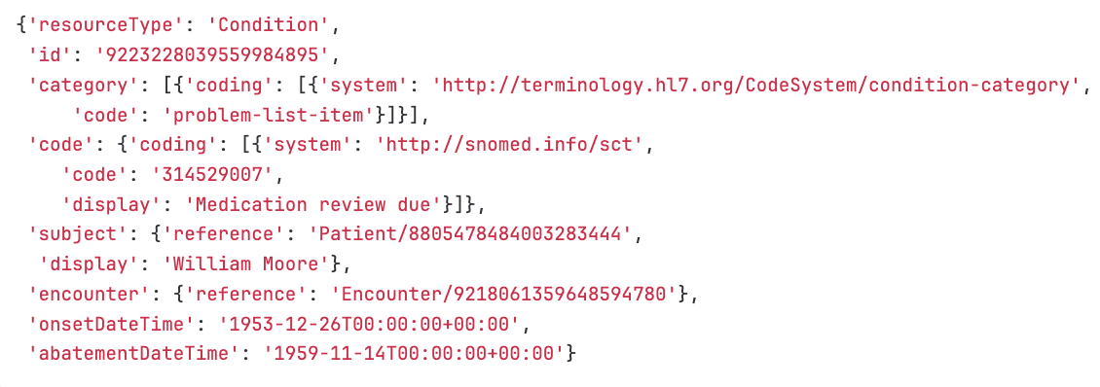
FHIR-OMOP Format Conversion
Condition

