Slide 1
F-gas emissions & climate change policy
Jan Minx, William Lamb, Matt Rigby
17.12.2021

Slide 2
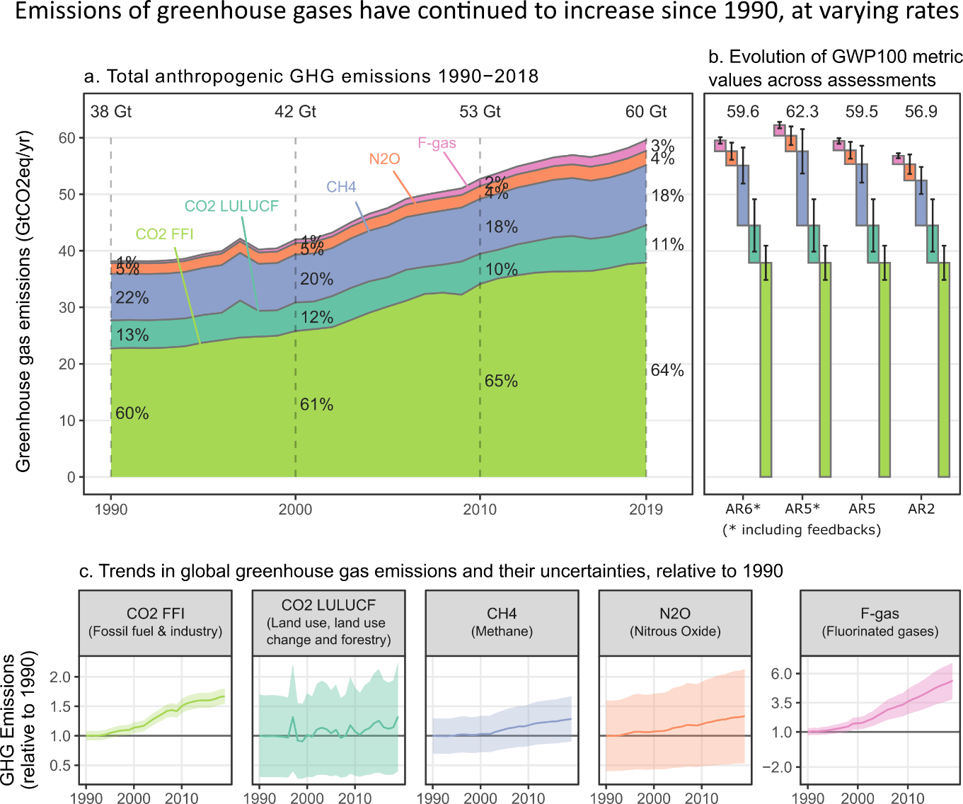
Total global net anthropogenic GHG emissions have continued to rise
Average GHG emissions during 2010–2019 were higher than in any previous decade, but the rate of growth between 2010 and 2019 was lower than that between 2000 and 2009. Emissions growth has varied, but persisted across all groups of greenhouse gases.
The average annual emission levels of the last decade (2010-2019) were higher than in any previous decade for each group of greenhouse gases.
Compared to 1990, the magnitude and speed of these increases differed across gases: CO₂ from fossil fuel and industry (FFI) grew by 15 GtCO₂eqyr⁻¹ (67%), CH₄ by GtCO₂eqyr⁻¹ (29%), F-gases by 0.97 GtCO₂eqyr⁻¹ (250%), N2O by 0.65 GtCO₂eqyr⁻¹ (33%).
Based on: Minx, J. C. et al. A comprehensive dataset for global, regional and national greenhouse gas emissions by sector 1970-2019. Earth System Science Data (2021) doi:10.5194/essd-2021-228.

Slide 3
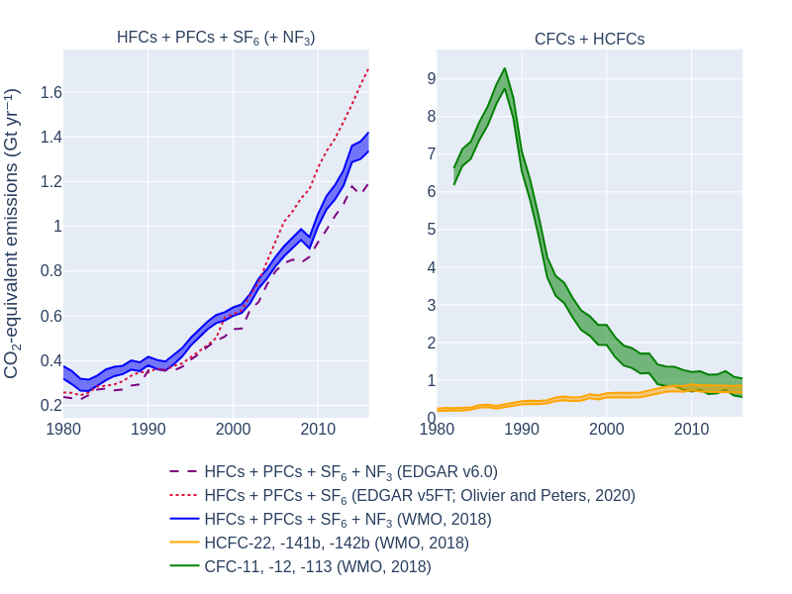
F-gases have been growing fastest and are
F-gases have grown fastest, but from a low base. But today they are no longer negligible at 1.4±0.41 GtCO2eq in 2019.
F-gases excluded from GHG emissions inventories such as chlorofluorocarbons (CFCs) and hydrochlorofluorocarbons (HCFCs) are at least the same size as those included.
Real policy devide on F-gases. We cannot be sure that Montreal regulation will deliver on net-zero.
Huge data quality issues in inventories (not from top-down).
Based on: Minx, J. C. et al. A comprehensive dataset for global, regional and national greenhouse gas emissions by sector 1970-2019. Earth System Science Data (2021) doi:10.5194/essd-2021-228.

Slide 4
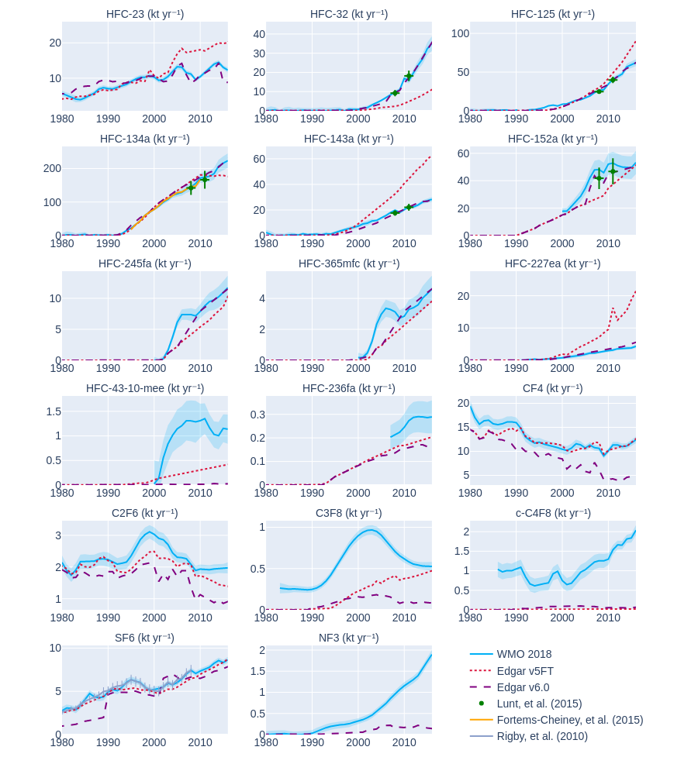
Huge data quality issues on F-gases
EDGAR estimate diverge by 10-30% fom top-down estimates depending on version.
At the species level differences can reach orders of magnitude in some case – particularly for EDGARv5FT.
Huge inventory data problem for non-Annex I countries.
Based on: Minx, J. C. et al. A comprehensive dataset for global, regional and national greenhouse gas emissions by sector 1970-2019. Earth System Science Data (2021) doi:10.5194/essd-2021-228.

Slide 5
Discussion points
Tracking progress by countries in reducing GHG emisisons reliably is still challenging
Absence of good-quality F-gas emissions inventory data
F-gases are no longer negligible and are fast-growing, but do not receive the required political attention
Policy divide between Montreal Protocol and Paris Agreement – how can we ensure net-zero?

