Slide 1
Implementing the Apriori Algorithm
By: Alena Brand

Slide 2
My Apriori Algorithm
The language used was Python.
All implemented methods correspond to the various steps of the Apriori algorithm.
create_transaction_database(fileName): Creates a database from a file
find_one_itemsets(database): Finds and counts one itemsets.
find_two_itemsets(l1) and find_k_itemsets(lk, k_inc): Finds candidate k itemsets by performing the joining step.
count_itemsets(database, ck, k): Counts the occurrences of itemsets in the database.
find_frequent_itemsets(ck, min_support, num_transactions):Finds frequent k itemsets to be put in Lk. This can be used for any pass on the database.
prune_list(prev_list, lk, prev_k):Performs the pruning step on Lk.

Slide 3
Why Python?
Dynamic type checking
Easy to perform typecasting
Dictionary data type is equivalent to a hash table
Ease of using sets and finding subsets

Slide 4
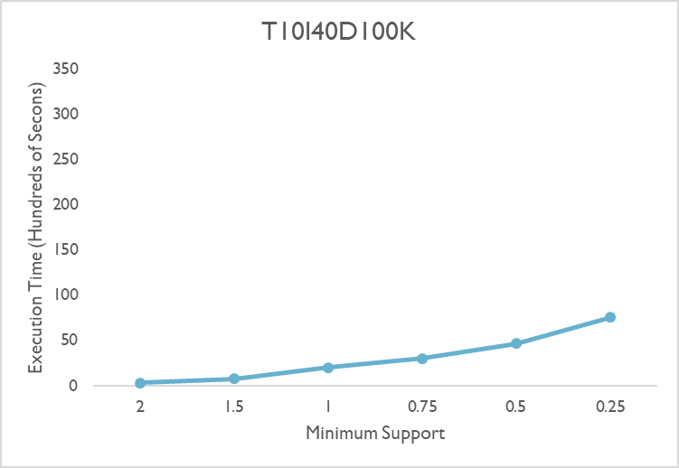
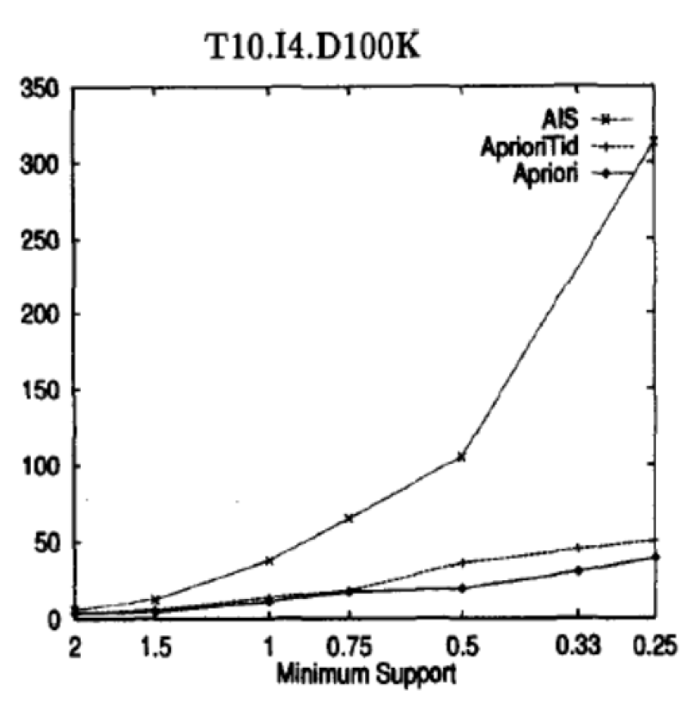
Comparison: “Fast Algorithms for Mining Association Rules”

Slide 5
Reasons for Discrepancies
It is unknown what language the algorithm was written in
Most likely a much faster language like C
Overall optimization issues in my code
Typecasting
Nested loops
Copying data
Possibly saving unnecessary data

Slide 6
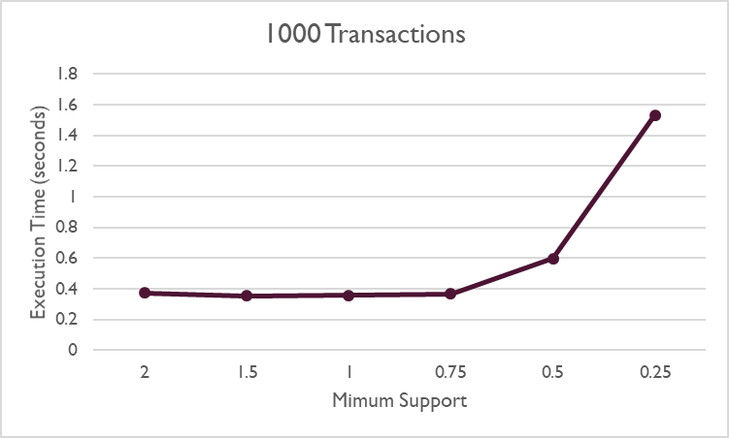
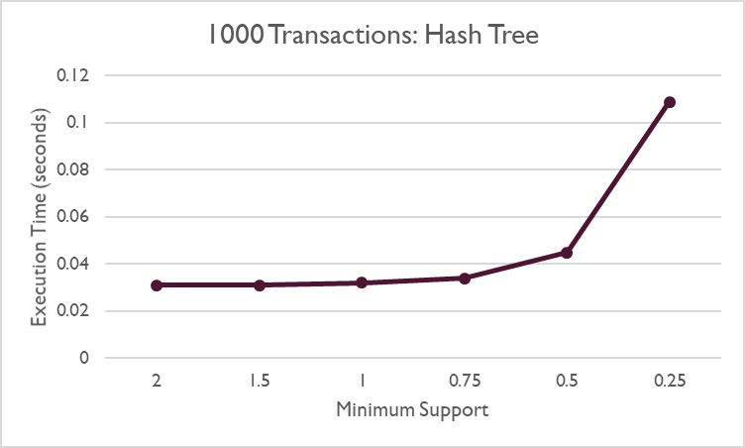
Comparison: Python Hash Tree
https://raw.githubusercontent.com/omjego/AR-Mining-Hash-Tree/master/apriori_with_htree.py

Slide 7
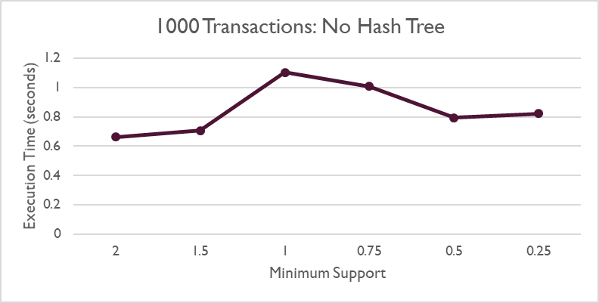
Comparison Python No Hash Tree
https://raw.githubusercontent.com/omjego/AR-Mining-Hash-Tree/master/apriori_with_htree.py

Slide 8
Reasons for Discrepancies
Use of Python dictionary instead of a hash tree
Overall optimization issues in my code
Typecasting
Nested loops
Copying data
Possibly saving unnecessary data
Other Concerns
I don’t understand how the comparison implementation without a hash tree reduced it’s runtime after a minimum support of 1

Slide 9
Future Work
My algorithm should be tested using larger datasets
The Python code that I am using for my comparisons should be more thoroughly investigated
Overall optimization issues can be improved

Slide 10
Questions?

