Slide 1
Incorporating Timing into the Formal Glossa Language
Language for Mapping NL Sentences to an SPN State Machine for Agent Action Patient Association
Alena McCain

Slide 2
Natural Language Understanding: General Process
Based on “Glossa - A Formal Language as a Mapping Mechanism of NL Sentences into SPN State Machine for Actions/Events Association.” by Psarologou, Adamantia
General Process:
Kernel Extraction
Kernel to Glossa conversion
Glossa is used as input for a state machine to produce SPNs

Slide 3
Deviations in Glossa Creation Method
It is assumed that Glossa with multiple kernel conjunctions only have one interpretation for simplicity.
The interpretation is derived recursively, so the central conjunction is the “largest”
The conjunction spans for agents, actions, patients, and kernels are each found separately.
Examples of conjunction separations:
[(Lilly and Jake), or (Mark and Travis)] played chess.
Mark teased [(Lilly, Jake, and John), or Sarah]
[([Jake or Lilly], and [Mark, Sarah or Travis]) played chess] and [(John and Tom) played checkers].

Slide 4
Deviations in Glossa Creation Method
Introduction of the timing separator operator (!#)
This is used to determine whether a comma is part of a conjunction or separates two phrases when one contains a timing word
John played basketball, and Jim played baseball vs. Before John played basketball, Jim played baseball
The latter sentence has undefined behavior in the previous work based on the information provided
Sentences that have a simultaneous timing word are treated like an and conjunction
Sarah played chess, while Tom played checkers

Slide 5
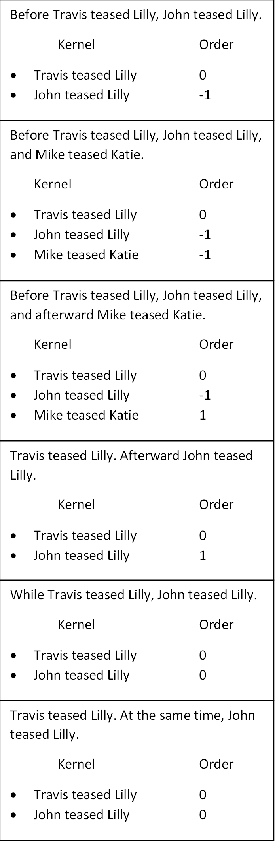
Deviations in Glossa Creation Method
The introduction of the timing separator allows SPNs of kernels to have non-random order relative to each other
See examples in pictures (It is always assumed the first kernel will have a zero order)
The random time assigned to the kernels will preserve their order when the state machine is executed.

Slide 6
Deviations in State Machine Execution
When a sentence has more than one possible outcome, user input can be provided to determine which outcome will occur.
John ate hotdogs or hamburgers

Slide 7
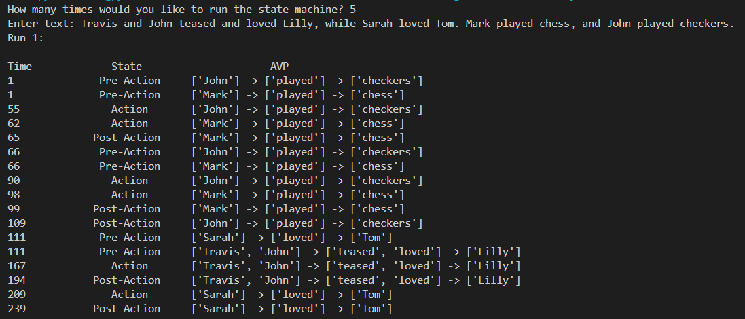
Program Execution: Proper Order

Slide 8
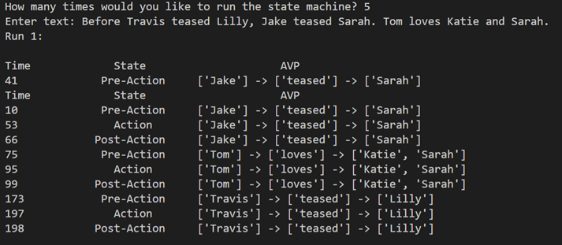
Program Execution: Proper Order

Slide 9
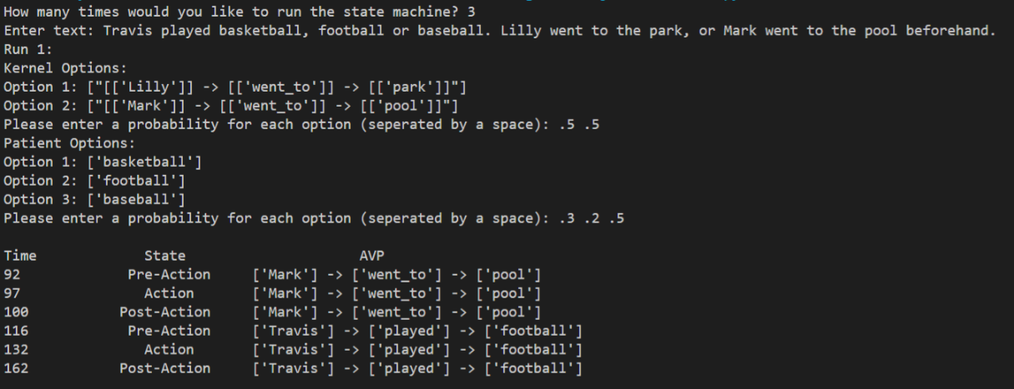
Program Execution: Option Selection

Slide 10
Conclusions
The text-based output of this work provides a better means of showing the timing relation between SPNs compared to the previous work.
The only drawback is that by making the SPN timing so concrete, one loses the ability to generalize the order of the sentences that don’t have an apparent order.
In addition to sentences that contain standard agents, actions, and patients, sentences that are merely descriptive or have a specific start and end time based on context are also affected by the algorithm’s lack of generalization.
The sentence The telescope looks expensive shouldn’t have an inherent start or end time, but with this program it would.

