Slide 1

Citi Bike NY Analysis
February 2019

Slide 2
Drivers
Trip Duration
Membership
Stations

Slide 3
Trip Duration & Stations
2016
2018
103,069 hours
484,933 trips
Pershing Square North is the top 10 Start and End Station suggesting round trips.
165,131 hours
718,944 trips
Pershing Square North is the top 10 Start Station
Number of start and end stations increased since 2016

Slide 4
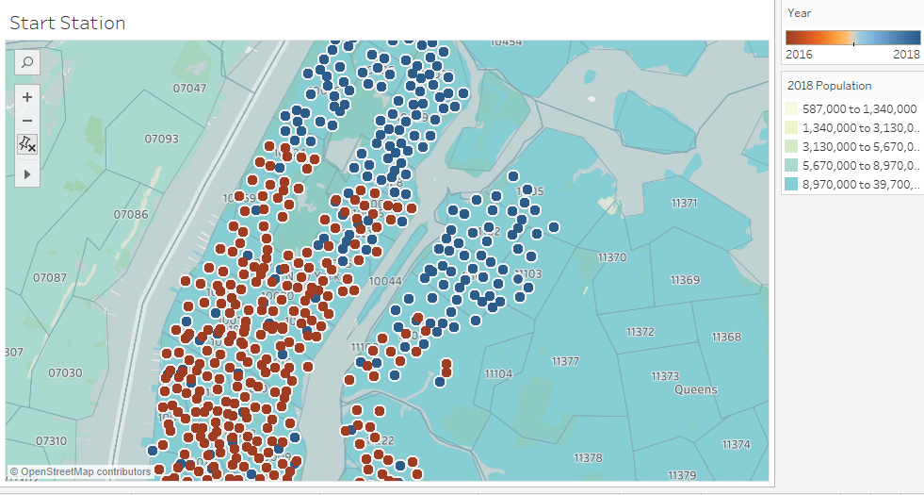
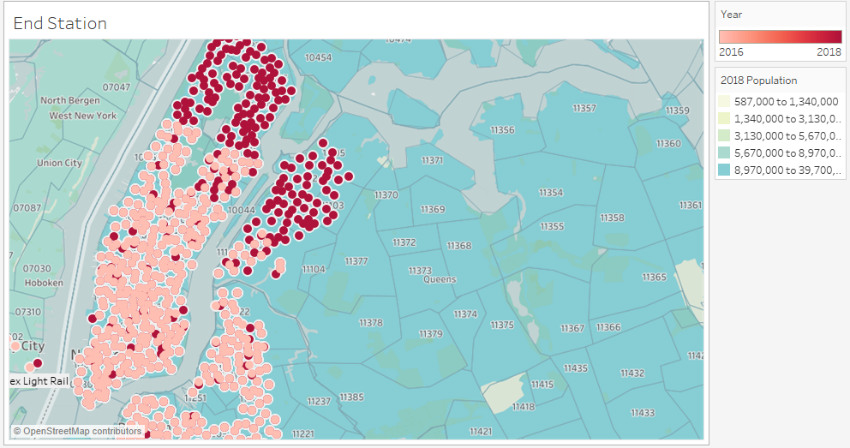
STATIONS
START
END
Start stations overlap with End stations indicating round trips.

Slide 5
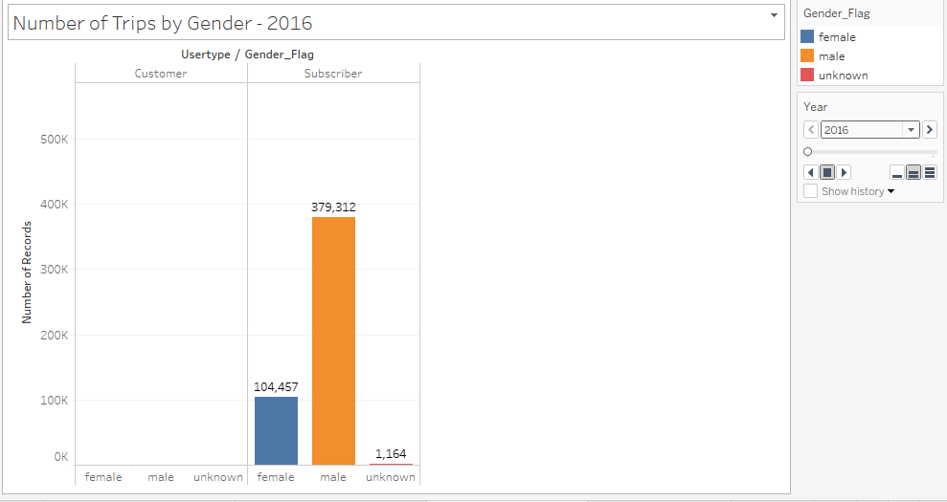
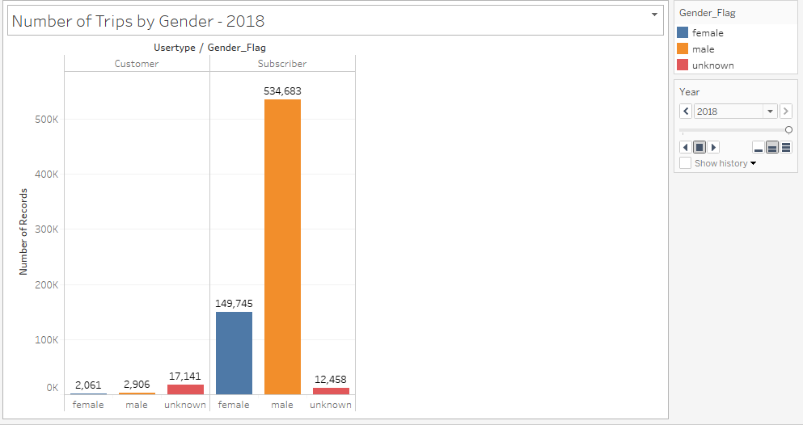
Membership
2016
2018
Annual memberships purchased mostly by Males. This trend continued from 2016 to 2018.

Slide 6
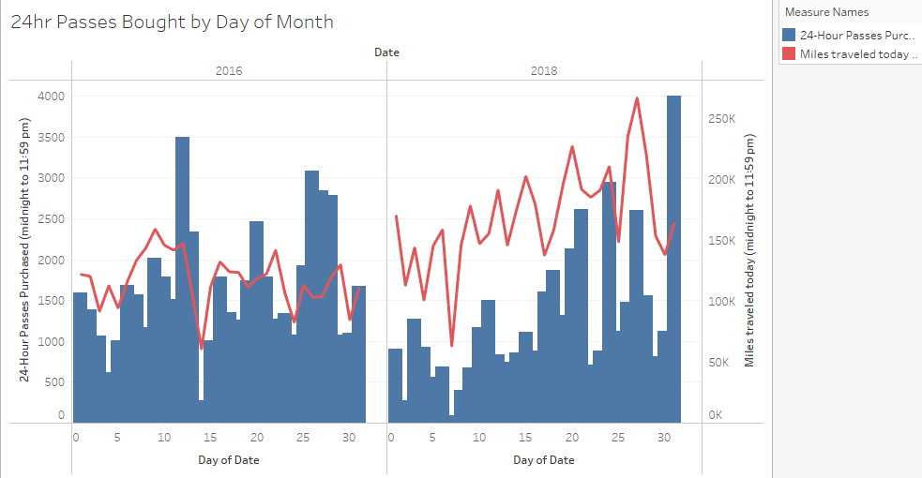
Competitive Landscape
From 2016 to 2018 the growth in members was 8M. This represents a 56% increase in 2yrs.
Miles traveled is and membership have a direct relationship.
Increased bicycle routes in 2016 and 2017 may be the cause of the marked increase.
Population growth combined with vehicular traffic suggests that more people may opt to bike.
24hr passes are more convenient and don’t require an annual subscription.
Continued analysis can be done to identify additional trends. Graphs built in Tableau can be modified to accommodate additional years. Citi Bike is working well and can expect to see continued growth going forward.

Slide 7

Thank You
DATA: https://www.citibikenyc.com/system-data
Analysis: Tableau
https://public.tableau.com/views/2016_2018_CityBike_Data/CityBikeTripsStory?:embed=y&:display_count=yes&publish=yes

