Slide 1
Applied Data Science Capstone
Determining whether a location has an NFL Stadium or International Airport using Foursquare Data

Slide 2
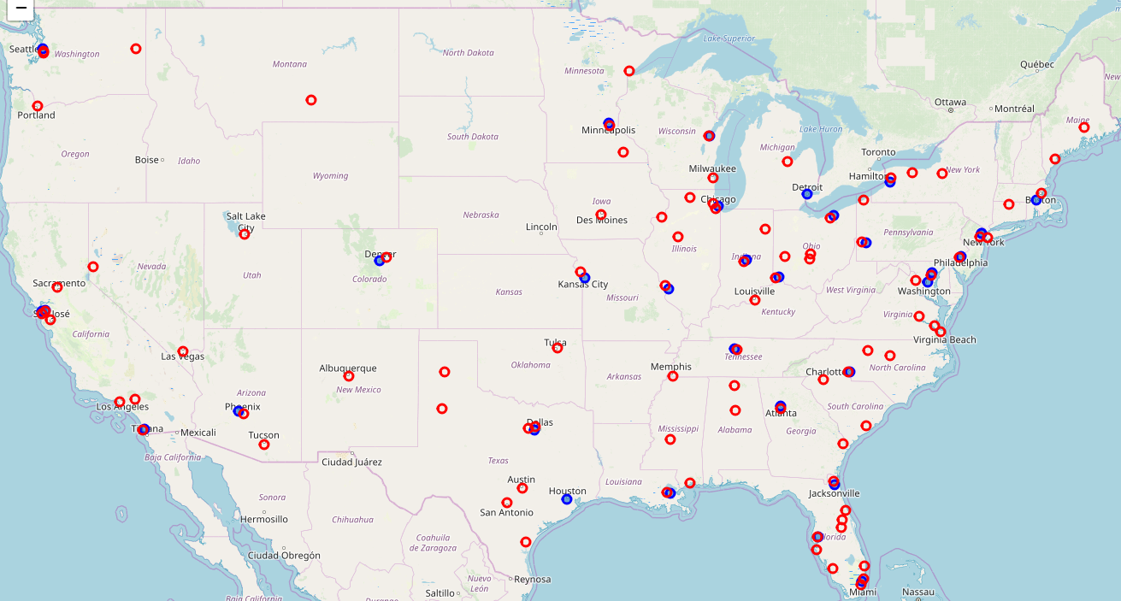
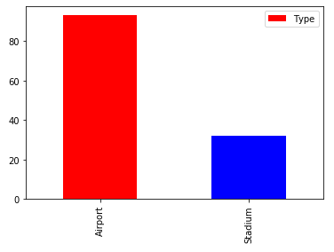
Stadium versus Airport
This analysis compares the areas surrounding NFL Stadiums and International airports to understand if the venues surrounding them can be used to identify them.
NFL Stadiums – 32
International Airports - 62

Slide 3
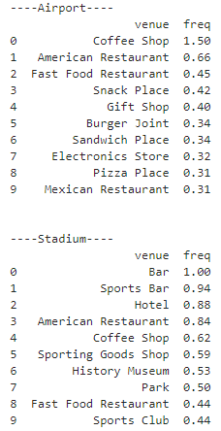
Foursquare Categories
The following tables provide the average number of venue types by airport and stadium
Coffee Shops lead the venues at Airports with 1.5 per location
Bars/Sports Bars lead the categories for Stadiums.
There are overlapping categories however like Coffee Shops, American Restaurants, and Fast Food Restaurants.

Slide 4

Machine Learning
Multiple algorithms were applied to a test data set.
The most successful in identifying a Stadium versus an Airport were KNN and Decision Tree

Slide 5
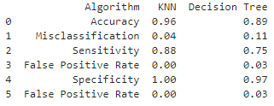
Results
 |  | KNN Actual |  |  |  |  | Decision Tree Actual
 |  | Stadium | Airport |  |  |  | Stadium | Airport
KNN Predicted | Stadium | 28 | 0 |  | Decision Tree Predicted | Stadium | 24 | 2
 | Airport | 4 | 62 |  |  | Airport | 8 | 60
KNN performed slightly better. It was able to identify all stadiums correctly and identified 28 of the 32 stadiums correctly. 4 stadiums were misidentified as airports.

Slide 6
Conclusion
The algorithm worked well however it could be improved by better categorizing the surrounding venues. The categories provided by foursquare are specific (i.e. type or restaurant, bar). It might help to generalize the categories. The radius could also be revised to include/exclude venues.
This exercise was limited to specific locations. It would be interesting to expand the analysis to use general locations to see if it can be determined whether a stadium or airport exists there.
It seems that, for these examples, foursquare data can be used to identify if a type of venue is in the vicinity.

