Slide 1

Doing Reproducible Science An opinionated introduction
Open Science Student Support Group
January 29, 2021
Michael McCarthy
Image by Adam Douglas
©️ 2021 This work is licensed under a CC BY 4.0 license

Slide 2
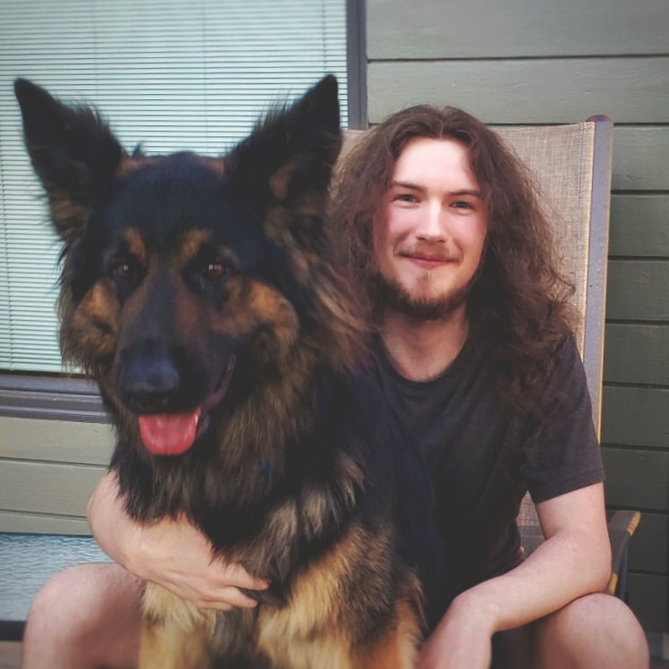

Michael McCarthy
Brain and Cognitive Science student working in Andrea Protzner’s Brain Dynamics Lab
In the spirit of Thomas Kuhn, I am a scientific revolutionary who wants to make open science normal science
Developing workflows, practices, and tools to do reproducible science is one way I hope to make normal science more open
That’s my dog Thor, he’s passionate about open science too
Twitter: @mccarthymg
GitHub: mccarthy-m-g
Personal Website

Slide 3
Reproducible Science
A scientific pipeline whose steps, processes, procedures, and results can be reproduced by other scientists (or future you)
A separate concept from replicable science
The robustness of a given scientific finding as determined by the degree to which it can be repeatedly obtained
Reproducible science makes it easier for other scientists and yourself to:
Verify the veracity of your findings
Replicate your research
Your findings are more likely to replicate when they are informed by Open Theory
Notes:
Reproducibility vs. Replication, how they’re done:
- Verify the veracity of your findings using the same data and same analysis
- Replicate your research using different data but the same analysis

Slide 4
Importance
Scientists are untrustworthy. Some are:
Careerists interested in fame, money, or cultural capital over good science (e.g., Sigmund Freud)
Frauds running citation rings, forging data, p-hacking, or self-plagiarizing (e.g., Daryl Bem, Hans Eysenck, Mark Griffiths, etc.)
Many are:
Humans making basic errors or using heuristics to guide their decision-making (e.g., You and Me)
More than 50% of papers report impossible statistics

Slide 5
Importance Cont’
Thus, scientific findings should be treated as possible but untrustworthy anecdotes unless they can be verified by other scientists
By making science reproducible we allow our results to be verified, increasing their trustworthiness
Trustworthy != True
False positives, undetectable data forgery, etc., are still possible with open data and materials
Reproducibility also makes science more efficient by reducing redundant labour

Slide 6
How does it work?
Science can be made reproducible by:
Sharing materials, data, etc.
Documenting your scientific pipeline
Use free open-source software wherever possible in your scientific pipeline. This ensures your work is accessible to:
Lower-income scientists
Yourself once you lose access to all the licenses the university is paying for you
Cite all software and packages you use ☺
Notes:
- Share through GitHub, OSF, etc.
- Choose a platform that is unlikely to disappear in the future

Slide 7
How does it work? Cont’
Catalog the scientific pipeline used to obtain your results. Methods of reproducibility include:
Written descriptions
Photographic and Video guides
Software along with instructions on how results were obtained (using text, pictures, videos)
Reproducible code
Packaging code and data
Continuous Integration, Continuous Deployment, Unit Testing
Machine-readable Hypothesis Testing

Slide 8
Tips
Guiding principle: Keep it simple for yourself and other scientists
Use OS independent software that works on Mac, Windows, and Linux
Name project folders and files in their order of operation (e.g., 01_data, 02_cleaning, etc.)
All code/syntax should run linearly
Make your code/syntax human readable, follow a style guide:
Google Style Guides (for Python, R, and many other languages)
Tidyverse Style Guide (for R/tidyverse)
Comment your code/syntax liberally, explain what it’s doing and why
Notes:
Linearly means earlier code should not depend on later code

Slide 9
Tips Cont’
Make your data, code, and instructions machine readable (i.e., processable by computers):
Never take screenshots of data or code in place of sharing in a machine-readable format, seriously
.csv is the gold-standard for data, .json has uses too
.txt or .md are ideal for plain-text
Native file formats for any programming language are best for code or reproducible manuscripts
Do not write scripts that install packages or change settings on someone else’s computer, it’s rude and disruptive
Notes:
PDFs or Word docs are okay but not ideal for documentation. Try to save these for your final manuscript if you aren’t outputting to HTML.

Slide 10
Other Tips
Do not hard code information that may change in the future or whose computation should be checked for reproducibility. This includes:
Citation styles
Statistics and other numbers
Tables and Figures
Write your work as a reproducible manuscript to avoid hard coding information
Make templates for yourself to make project management easier in the future
Use GitHub Releases and/or OSF Registrations to take snapshots of your project at different stages
Notes:
Hard coded means data or parameters in a program that are fixed in such a way that they cannot be altered without manually modifying the program. In a manuscript, this would mean writing the results of a statistic as plain text (e.g., literally: “M = 50, SD = 20”) instead of putting in a placeholder that points to the correct value and prints it in the place you specify. This is called soft coding, and is something you can do in R Markdown documents or Jupyter notebooks. I do not believe it is available in Word documents unless you use certain R packages (in which case using R Markdown probably makes more sense anyways).

Slide 11
Other Tips Cont’
Set a seed before running any code/syntax that relies on a randomization function
Use Internet Archive URLs or save webpage data if you are web mining

Slide 12
benefits
Your work will be more trustworthy
There’s proof you actually did what you said you did
The chances of errors in your work being identified will increase
(especially if you have a nemesis who wants to disprove your ideas)
Other researchers (and future you) can repurpose your scientific pipeline for their own projects
Collaboration will be easier
You will learn and apply skills that will help land you a well-paying job

Slide 13
Benefits cont’
You can automate the least creative tasks of the scientific process, leaving you more time for theorizing
Citations can be automagically generated to different formats (APA, MLA, etc.) using CSL files
Statistics, tables, and plots can be automagically generated to reflect changes in your data
You can create living scientific documents that are automagically published to the web

Slide 14
barriers
Reproducibility requires data sharing, and not all data can be shared
Solution: Share synthetic data that has similar statistical properties to your closed data
Making your science reproducible may require learning new software or APIs
This can be difficult working around a busy schedule, but the payoff is worth it
Collaborators might not be willing to switch to or learn these either
Solution: Thoroughly documenting your scientific pipeline in a software agnostic way is a good practice regardless, so do this in the meantime
Notes:
Many of the skills you will learn making your work reproducible will make you valuable outside of academia too

Slide 15
Barriers Cont’
Less robust reproducibility methods may lead to irreproducible results in the future
Certain methods in software can break or disappear after updates
Solution: Use virtual environments, package version control, etc., in your projects
More robust reproducibility methods may be less accessible to scientists with less technical ability than you
Solution: Make it so things “just work” without requiring the user to troubleshoot APIs they are unfamiliar with

Slide 16
Demonstration
If you are viewing these slides after the fact, please see the recorded presentation for the demonstration
Ephemeral demo link: https://osssg-demo.netlify.app

Slide 17
Reproducibility Checklist
Are your results based on a quantitative analysis?
If yes, please work through this checklist
Does your analysis use code?
If no, does the software you’re using output code? (Most GUI statistics software does)
Do you provide code and other documentation sufficient to reproduce all your results?
Do you reference the version of all hardware, software, and code used for analysis in your manuscript?
Is your code and other documentation version controlled? (Git)
Is your code and other documentation deposited in a standard code hosting repository? (GitHub, OSF)
Is your code and other documentation in a human and machine-readable format? (written as plain text)
Do you use package version control for each of the programming languages in your project?
Do you provide a self-contained code execution environment? (Binder, Docker, etc.)
This checklist is adapted from the TOP guidelines for reproducibility and eLife’s reviewer checklist

Slide 18
Reproducibility Checklist
Do your results rely on a series of pre-processing steps?
Do you provide code for preprocessing?
If no, do you clearly describe all steps, provide a flow-chart of the steps, or refer to a pre-existing publicly available workflow?
Do your results rely on a series of analysis steps?
Do you provide code for each of these steps?
If no, do you clearly describe all steps, provide a flow-chart of the steps, or refer to a pre-existing publicly available workflow?
Do you provide code for automated execution of each step in your scientific pipeline?
If no, do you provide detailed descriptions for manual execution of your scientific pipeline?
Has your code been peer-reviewed for reproducibility and accuracy?
If no, are you using Continuous Integration and/or Unit Testing to check for reproducibility?
Notes:
Most journals do not peer-review code at all at the time of writing this. So, you will likely have to ask a colleague who is not involved in the project to help you with this (in exchange for acknowledgement) or hire someone to do so through something like Red Team Markets.

Slide 19
Reproducibility Checklist
Do your results include analysis of data collected by yourself or your collaborators?
Is your data available at a digital repository?
Do the authors include all meta-data to reproduce the analysis?
Do you provide a full account of the procedures used to collect, preprocess, clean, or generate the data?
Do you provide research materials and description of procedures necessary to conduct an independent replication of the research?
Are there any results based on data or materials that cannot be shared for legal or ethical reasons?
Do you provide synthetic data with similar statistical properties instead?
Do you explain the restrictions on the dataset or materials and how they preclude public access?
Do you provide a public description of the steps others should follow to request access to the data or materials?
Do you provide access to all data and materials for which the constraints do not apply?
Notes:
Meta-data is any description of data associated with the results that's important for reproducing the analysis and interpretation of the results described in the manuscript, including but not limited to:
Codebooks
Any experimental observations that affect the analysis
Field-specific considerations (e.g., preprocessing neuroimaging data, storage conditions of cells or tissues, etc.)

Slide 20
Reproducibility Checklist
Is your manuscript written in a reproducible format? (R Markdown, Jupyter Notebook)
Do you report statistics and other numbers using inline code?
Do you generate, report, and embed tables and figures using code?
Is all your project code called within your manuscript?
If yes, consider splitting project code into separate script files, then calling those within the manuscript for readability
Is your manuscript output suitable for the forum you plan to share it in? (Preprint, Journal, Talk, Website)
If no, do you document the additional steps needed to finish formatting your manuscript?
Have you gotten anyone to try to reproduce your results?
Were they successful?

Slide 21
Challenges
Learn more about it!
Work through the The Turing Way, an open source community-driven guide to reproducible, ethical, inclusive and collaborative data science
Listen to one of the reproducible science podcasts linked to at the end of this presentation
Talk about it!
Talk to your collaborators about how you can introduce reproducible workflows into your own projects
Try it out!
Attend our Writing Reproducible Manuscripts workshop in two weeks
Try to reproduce the results of the first analysis you ever did
See how well your current project fairs against our Reproducibility Checklist
Implement it!
Write your thesis project as a reproducible manuscript
Set aside time to check out the coding and reproducibility resources linked to at the end of this presentation
Pick one item on the reproducibility checklist and implement it in your next project

Slide 22
Thank you! Comments, Questions?
Notes:
Session 2 will be a hands-on workshop
Our current idea is “Writing reproducible manuscripts”
We would like feedback on:
What you are interested in learning from the workshop
Your experience with coding
Your experience with Git and GitHub
Are you comfortable installing R on your computer, creating a GitHub account, etc. if you have not used these before?
Please discuss this with us on Slack

Slide 23
Open-source alternatives
Mendeley/Endnote alternative:
Zotero plus Zotero Connector
Import from Mendeley or Endnote
Useful Zotero plugins:
scite
pubpeer
Better BibTeX
zotfile
Sci-hub Downloader
SPSS alternatives with GUI interface:
Jamovi
JASP
Code-based SPSS alternatives:
R and RStudio
Python and RStudio v1.4+
Julia
E-Prime/Presentation/Qualtrics/etc. alternatives:
PsychoPy
jsPsych
Formr

Slide 24
Reproducibility in general
Version control:
Git
Data and code distribution, collaboration:
GitHub and GitHub Desktop
OSF and osfr
Data repositories:
UCalgary Library Guide
Nature Recommended Data Repositories
Virtual environments:
Docker
Code Ocean
Continuous Integration:
GitHub Actions
Web hosting:
Netlify

Slide 25
Reproducibility in R
Use RStudio Projects
Use inline R code to report statistics
Package version control:
{renv} (works at project level; use from the start)
{groundhog} (works at script level; use to recover a reproducible environment in scripts without one)
{holepunch} (easy Docker sessions)
Codebooks:
{codebook}
Reproducible workflows:
{worcs}
{targets}
{breakerofchains}
Rocker
Reproducibility w/ interactive data:
{shinymeta}
Learn R Markdown:
R Markdown Cookbook
R Markdown: The Definitive Guide
Manuscript writing:
{rmarkdown}
{bookdown}
{distill}
{rticles}
{papaja}
{officeverse}
Machine-readable hypothesis testing:
{scienceverse}
Unit testing:
{testthat}
GitHub Actions templates:
r-lib/actions
Zotero connector:
rbbt
citr

Slide 26
Reproducibility in Python
Use Python Projects
Use inline python code to report statistics
The Turing Way has more python reproducibility information
Package version control:
{virtualenv}, {venv} (python virtual environments)
{recipy}
{sumatra}
Manuscript writing:
Jupyter Notebooks
Alternatively, you can use any of the R packages for manuscript writing from the previous slide and run Python code within them using the {reticulate} R package
GitHub Actions guide:
Documentation

Slide 27
resources
Learn Git and GitHub:
Happy Git and GitHub for the useR
GitHub Learning Lab
Resources
GitHub Desktop Documentation
Learn Jamovi:
Documentation
Textbook
Learn JASP:
Textbook
Learn R:
Online Books
Learn R, in R (Swirl package)
Learn Python:
Python for Data Analysis
Automate the Boring Stuff With Python
Learn Docker:
Documentation
Hands-on Tutorials

Slide 28
Open science podcasts
RIOT Science Club:
Is there a reproducibility crisis in science?
Improve your workflow for reproducible science
Five selfish reasons for working reproducibly
Synthetic data: A primer
Reproducibility in neuroimaging: Problems and solutions
JASP and Jamovi
Reproducibility in psychiatric genetics
Reproducibilitea:
Reproducibility now
Everything Hertz:
Predicting the replicability of research
Large-scale collaborative science
Academic hipsters
A manifesto for reproducible science
Data Sharing
Software and coding

