Slide 1

Positive Test Strategies and Confirmation Bias in Social Assessment
Janzen, J., Oswald, F., Acreman, R., McCarthy, M., & van de Wetering, S.

Slide 2
“Confirmation bias… connotes the seeking or interpreting of evidence in ways that are partial to existing beliefs, expectations, or a hypothesis at hand.”
Raymond S. Nickerson
Nickerson, R. S. (1998). Confirmation bias: A ubiquitous phenomenon in many guises. The Review of General Psychology, 2(2), 175-220.

Slide 3
Hypothesis testing strategies
Positive Test Strategy
Negative Test Strategy
Uses tests to confirm a hypothesis
Looks for positive evidence
Useful for building a case
Uses tests to disconfirm a hypothesis
Looks for contradictory evidence
Useful for challenging a proposition

Slide 4


Hypothesis Testing Research
Falsification and scientific reasoning
Two major paradigms:
Wason 2-4-6 test (1960)
Snyder and Swann (1978)

Slide 5
The Wason 2-4-6 Task
Numbers | Reasons for choice | Conforms | Does not conform
2 – 4 – 6
4 – 6 – 8 | Testing if rule works
12 – 14 – 16 | Testing if rule works
56 – 58 – 60 | Testing if rule works
100 – 102 – 104 | Testing if rule works
Rule is even numbers ascending by 2: WRONG
Wason, P. C. (1960). On the failure to eliminate hypotheses in a conceptual task. Quarterly Journal of Experimental Psychology, 7(3), 129-140.

Slide 6
The Wason 2-4-6 Task
Numbers | Reasons for choice | Conforms | Does not conform
2 – 4 – 6
4 – 6 – 8 | Testing if rule works
1 – 3 – 5 | Testing if rule works
1 – 2 – 3 | Testing if rule works
4 – 7 – 12 | Testing if rule works
Rule is any ascending numbers: CORRECT
Wason, P. C. (1960). On the failure to eliminate hypotheses in a conceptual task. Quarterly Journal of Experimental Psychology, 7(3), 129-140.

Slide 7
Responses to 2-4-6 Task
Klayman and Ha
Both positive and negative strategies pragmatic given context
Positive tests can demonstrate sufficiency
Negative tests can demonstrate necessity
Sufficiency weighted more than necessity
Klayman, J, & Ha, Y.-W. (1987). Confirmation, disconfirmation, and information in hypothesis testing. Psychological Review, 94(2), 211-228.

Slide 8
Responses to 2-4-6 Task
Klayman and Ha (Continued)
“[W]hen concrete, task-specific information is lacking, or cognitive demands are high, people rely on the positive test strategy as a general default heuristic.”
Conclusive rule tests rarely possible in real world
Positive tests more pragmatic default
Klayman, J, & Ha, Y.-W. (1987). Confirmation, disconfirmation, and information in hypothesis testing. Psychological Review, 94(2), 211-228.

Slide 9
Responses to 2-4-6 Task
Improved performance on 2-4-6 task when:
Primed or instructed to generate alternatives¹
Primed to use counterfactuals²
Selecting from pre-generated list³
Evaluating hypotheses from other people⁴
1 Gale, M., & Ball, J. B. (2009). Exploring the determinants of dual goal facilitation in a rule discovery task. Thinking & Reasoning, 15(3), 294-315.
2 Farris, H. H., & Revlin, R. (1989). The discovery process: A counterfactual strategy. Social Studies of Science, 19(3), 497-513.
3 Cowley, M. (2015). Hypothesis falsification in the 2-4-6 numbers test: Introducing imaginary counterparts. Philosophy of Mind eJournal, 8(41).
4 Adsit, D. J., & London M. (1997). Effects of hypothesis generation on hypothesis testing in rule-discovery tasks. The Journal of General Psychology, 124(1), 19-34.

Slide 10
Hypothesis-Testing Processes in Social Interaction
Snyder and Swann (1978)
Participants given list of questions to test hypothesis
Asked to determine whether target is an extravert/introvert
Asked to select questions from list to test hypothesis
Participants selected more confirmatory than disconfirmatory
Conclusion: Individuals use positive strategies which may lead to confirmation bias
Snyder, M., & Swann, W. B. J. (1978). Hypothesis-testing processes in social interaction. Journal of Personality and Social Psychology, 36(11), 1202-1212.

Slide 11
Hypothesis-Testing Processes in Social Interaction
Snyder and Swann (1978)
1186+ citations on Google Scholar
Multiple text books references
Some initial criticism¹, but still widely reported
1 For example, Semin, G. R., & Strack, F. (1980). The plausibility of the implausible: A critique of Snyder and Swann (1978). European Journal of Social Psychology, 10, 379-388.

Slide 12

Present study methodology
Partial replication of Snyder and Swann (1978)

Slide 13
Present study methodology
68 undergraduate psychology students from UFV
Mean age = 20.84
59% female
Conditions: Extraversion Seeking (n=32) Introversion Seeking (n=36)
Initial interrater reliability 84.54% After recalibration ~99%
Participants randomly assigned to two conditions
Given blurb on extraversion or introversion
Asked to generate 12 questions to test hypothesis
Participants’ answers coded into 5 categories
Extraversion testing
Introversion testing
Unclassified
Open-Ended
Double-Barreled

Slide 14
Extroverts are typically outgoing, sociable, energetic, confident, talkative, and enthusiastic. Generally confident and relaxed in social situations, this type of person rarely has trouble making conversation with others. This type of person makes friends quickly and easily and is usually able to make a favorable impression on others. This type of person is usually seen by others as characteristically warm and friendly.
Adapted from Snyder and Swann (1978)

Slide 15
Differences from original study
Present
Participants generated own questions
Two conditions: extraversion and introversion testing
Also classified open ended and double-barreled questions
Snyder and Swann (1978)
Participants selected questions from list
Also included high-certainty and low-certainty conditions
Only classified positive, negative, and neutral questions

Slide 16
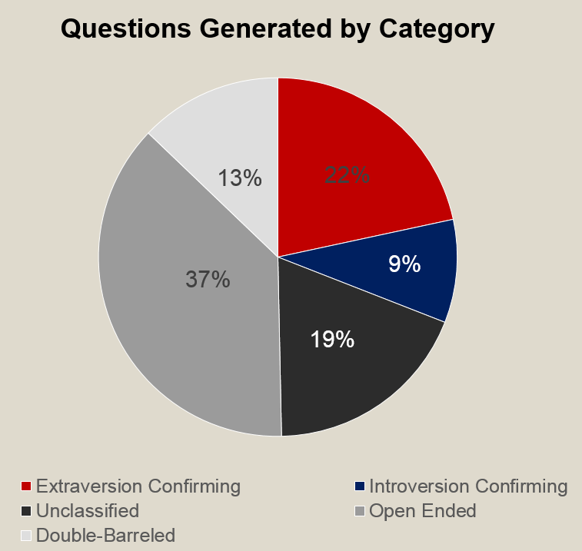
Results
 | Extraversion | Introversion
Extraversion Confirming | 2.72 | 2.17
Introversion Confirming | .63** | 1.42**
Unclassified | 2.00 | 2.19
Open Ended | 4.44 | 4.00
Double-Barreled | 1.50 | 1.39

Slide 17
Results (continued)

Slide 18
Limitations
Exploratory pilot study
Difficult to determine intention
Difference between artificially planning and real-world
20% of questions were neutral or indeterminable

Slide 19

Positive Test Strategy?
50% of questions were open ended or double-barreled
Allowing either direction to be tested
Extraversion questions were more frequent than introversion in both conditions
Even so, averages of 2.72 and 2.17 questions small
Introversion only condition to show significant differences (p<.05)
Effect size small-to-medium (r=.27)
Positive questions still leave room for negation
Mix of positive and negative still ideal

Slide 20
Selection vs Generation
Difference between original and our study
Selecting hypotheses different than generating
Improvements on 2-4-6 task when participants given list to test
A pre-generated list also may imply researchers’ intent
Adsit, D. J., & London, M. (1997). Effects of hypothesis generation on hypothesis testing rule discovery tasks. J Gen Psychol, 124(1), 19-34.

Slide 21


Use of Archetypes
Many participants designed questions testing other constructs
Such as neuroticism and agreeableness
Poor understanding of personality theory?
Use of stereotypical archetypes
Darley and Gross – Stereotypes not as certainties but as hypotheses
Darley, J. M., Gross, P. H. (1983). A hypothesis-confirming bias in labeling effects. Journal of Personality and Social Psychology, 44(1), 20-33.

Slide 22

Future Considerations
More questions than answers
What to do with original study?
Future directions

Slide 23
Conclusion
We did not find similar results to Snyder and Swann (1978)
Hypothesis testing more dynamic than originally claimed
Confirmation bias remains an elusive bias to test for

Slide 24
References:
Adsit, D. J., & London M. (1997). Effects of hypothesis generation on hypothesis testing in rule-discovery tasks. The Journal of General Psychology, 124(1), 19-34.
Bassok, M., & Trope, Y. (1983). People’s strategies for testing hypotheses about another’s personality: Confirmatory or diagnostic? Social Cognition, 2(3), 199-216.
Cowley, M. (2015). Hypothesis falsification in the 2-4-6 numbers test: Introducing imaginary counterparts. Philosophy of Mind eJournal, 8(41).
Dardenne, B., & Leyens, J.-P. (1995). Confirmation bias as a social skill. Personality and Social Psychology Bulletin, 21(11), 1229-1239.
Darley, J. M., Gross, P. H. (1983). A hypothesis-confirming bias in labeling effects. Journal of Personality and Social Psychology, 44(1), 20-33.
Devine, P. G., Hirt, E. R., & Gehrke, E. M. (1990). Diagnostic and confirmation strategies in trait hypothesis testing. Journal of Personality and Social Psychology, 58(6), 952-963.
Farris, H. H., & Revlin, R. (1989). The discovery process: A counterfactual strategy. Social Studies of Science, 19(3), 497-513.
Gale, M., & Ball, J. B. (2009). Exploring the determinants of dual goal facilitation in a rule discovery task. Thinking & Reasoning, 15(3), 294-315.
Klayman, J, & Ha, Y.-W. (1987). Confirmation, disconfirmation, and information in hypothesis testing. Psychological Review, 94(2), 211-228.
Nickerson, R. S. (1998). Confirmation bias: A ubiquitous phenomenon in many guises. The Review of General Psychology, 2(2), 175-220.
Semin, G. R., & Strack, F. (1980). The plausibility of the implausible: A critique of Snyder and Swann (1978). European Journal of Social Psychology, 10, 379-388.
Snyder, M., & Swann, W. B. J. (1978). Hypothesis-testing processes in social interaction. Journal of Personality and Social Psychology, 36(11), 1202- 1212.
Wason, P. C. (1960). On the failure to eliminate hypotheses in a conceptual task. Quarterly Journal of Experimental Psychology, 7(3), 129-140.

