Slide 1

Are IAT Effects an artifact of test design?
Testing the impact of a rest period before reversing response assignments on the Implicit Association Test
Michael McCarthy (Michael.McCarthy@student.ufv.ca), David Hughes, & Dr. Sven Van de Wetering
Notes:
Hello, I'm Michael McCarthy, the primary investigator for this research; this is David Hughes, who assisted me with data collection and interpretation; and our adviser on this project was Dr. Sven Van de Wetering from the University of the Fraser Valley. Our experiment examined the effects introducing a rest period before category-switching would have on performance on the Implicit Association Test, in order to identify how the IAT’s design influences a test taker’s performance.

Slide 2
Outline
An overview of some concerning facts about implicit cognition research, and a possible remedy
An application of the remedy—the present experiment
Question and answer period
Notes:
Our agenda for this talk is to first tell you how the field of implicit cognition effects your life, why you should care, and how you can get involved. This will be brief, but we would love to discuss it in depth later on with anyone who's interested.
Then we'll discuss the experiment we conducted. We obtained some unexpected results which we have yet to develop a good explanation for, so hopefully some of you can contribute to the discussion during the question period.

Slide 3
Some Facts…
The belief that implicit biases/attitudes/prejudices/etc. exist somewhere in the brain unconsciously—causing all manner of ills towards certain groups—has become canonized in our culture (see Mitchell & Tetlock, 2017)
In government (e.g., Comey, 2015), business and technology (e.g., Google, 2013), and academia (e.g., Greenwald, Banaji, & Nosek, 2015)
This belief is based solely upon “evidence” from so-called implicit (read: indirect) measures such as the Implicit Association Test (IAT; Greenwald, McGhee, & Schwarz, 1998)
“In studying implicit cognition, indirect measures are theoretically essential” (Greenwald & Banaji, 1995, p. 5)
The IAT is claimed to be a diagnostic measure: “Measuring Individual Differences in Implicit Cognition: The Implicit Association Test” (Greenwald, et al., 1998)
Notes:
The belief that implicit bias exist somewhere in the brain unconsciously—causing all manner of ills towards certain groups—has become canonized in our culture. This belief has infected the minds of some of the most powerful groups on the planet, from the FBI to Google, despite having no empirically justifiable support based on the scientific method. Indeed, the popularity of these beliefs seems to stem from clever marketing schemes, ideological or
personal motivations, and poor scholarship.

Slide 4
Correction:
Some Concerning Facts
The dual-process typology underlying the theory of implicit cognition is a probably untestable meme with 30 years of available counter-evidence (see Melnikoff & Bargh, 2018)
The belief that the IAT is a diagnostic measure of anything, let alone attitudes or prejudice, is another probably untestable meme with 20 years of available counter-evidence
(see Blanton & Jaccard, 2008; Fiedler, Messner, & Bluemke, 2006; Mitchell & Tetlock, 2017; Oswald, Mitchell, Blanton, Jaccard, & Tetlock, 2013, 2015; or email McCarthy for a manuscript synthesizing this information)
These belief systems are so widespread that they have become a self-perpetuating meme machine (see Mitchell & Tetlock, 2017)
Notes:
These beliefs are so embedded in the literature that one could easily assume they were well-established findings. However, they actually consist of empirically unjustifiable claims and assumptions which are largely untestable. Without the time for an in-depth review of the literature, the best parallel I could draw your attention to would be the polygraph test (aka. the lie-detector test), as the IAT shares a lot the same fundamental design and interpretation issues with the polygraph.
There is actually a laundry-list of documented issues about the IAT, but two of the more damning ones are that: (1) The IAT lacks construct validity, and measures capable of directly testing the construct validity of the IAT do not exist (you would literally need mind-reading technology). (2) Interpretations of the IAT are based on implicit assumptions about the test-taker’s state of mind and lack an underlying testable model; it is merely assumed that performance on the IAT reflects a bias/attitude/association/prejudice/stereotype, rather than some alternative cognitive or behavioural process.
So what we’re dealing with in the field of implicit cognition is actually a system of beliefs which have become popularized to a degree where they appear to be “True” because of the rampant incestuous referencing of these “Truths” in the literature, but which realistically have no legitimate basis as they have no grounding in the scientific method. This should be concerning to everyone here, as these ideas are being pushed into courts of law (e.g., Kang et al., 2012) and the workplace (e.g., Bezrukova, Spell, Perry, & Jehn, 2016); and, quite frankly, the research currently coming out of this area is proving itself to be a waste of time and money (see Oswald et al., 2013, 2015).

Slide 5
A Possible Remedy
The field of implicit cognition desperately needs a paradigm shift
Fortunately, there is a huge empirical gap in this field to give room for a paradigm shift:
Research which treats the IAT (and other similar implicit measures) as a phenomenon unto itself (i.e., as a dependent measure to be studied experimentally), or
Research which manipulates the design of the IAT to study the design-performance relationship
This shift will open the door to research that can help identify (rather than assume) the cognitive mechanisms that underlie performance on the IAT
Thus, this line of research would ultimately help evaluate what the IAT’s empirical value actually is (rather than assuming its value without adequate evidence)
Notes:
Despite how fundamentally flawed this field currently is, it is not going away any time soon; particularly because the psychological phenomena measured by the IAT are both empirically and theoretically interesting, and potentially socially important. However, there is a need for a paradigm shift; the current direction of the field is simply untenable academically and scientifically.
Fortunately, there is a huge empirical gap in this field to give room for a paradigm shift: (1) Research which treats the IAT (and other similar implicit measures) as a phenomenon unto itself (i.e., as a dependent measure to be studied experimentally). (2) Research which manipulates the design of the IAT to study the design-performance relationship. This shift will open the door to research that can help identify (rather than assume) the cognitive mechanisms that underlie performance on the IAT. Thus, this line of research would ultimately help evaluate what the IAT’s empirical value actually is.

Slide 6
The Present Experiment
Design
2-groups (control, experimental)
Tested the effect adding a 15 minute rest period before category-switching would have on performance on the IAT
During the rest period participants completed a moderate or hard difficulty paper and pencil sudoku puzzle (participants chose which puzzle they wanted to do)
Notes:
The design of the present experiment was very simple—in the control condition participants completed an IAT as normal, and in the experimental condition participants completed a modified IAT which included a 15 minute rest period after the fourth block on the IAT. During the rest period participants completed a pencil and paper sudoku puzzle until the 15 minutes elapsed, then they continued onto the fifth block of the IAT.

Slide 7
The Present Experiment
Design Rationale
Adding the rest period should decrease or eliminate interference of the earlier blocks on the later blocks, so responding to the IAT should be easier
One of the typical IAT findings is an order effect (e.g., Greenwald et al., 1998), where completing compatible (vs. incompatible) blocks first produces larger IAT Effects
From personal experience, the test becomes quite confusing in the final blocks, as the response instructions get “jumbled together” as you progress through the blocks
If there are differences between the conditions we can demonstrate that the magnitude of IAT scores are affected by procedural variables, rather than by things such as attitudes/prejudices/etc.
Playing sudoku for 15 minutes should not make someone more positively or negatively prejudiced towards a group
If small changes to the IAT’s design create large differences in outcome, it demonstrates how sensitive performance on the test is to extraneous influences
Notes:
The rationale behind this experimental design came mostly from personal experience—when taking IATs I noticed that as I progressed through the blocks on the test the instructions from the previous blocks would interfere with the instructions on the current block, which greatly impeded my ability to sort the stimuli on the test quickly or accurately—thus, the present experiment tested how performance on the IAT would change if that interference was decreased or eliminated.
Since the IAT claims to be a diagnostic measure of attitudes/etc., we should expect that performance on the test will not be significantly influenced by minor changes to the test’s design if an underlying attitude accounts for most of the variance in performance on the IAT. However, if minor changes do significantly influence performance, it would indicate that procedural variables account for notable amounts of the variance in performance on the IAT—thus, diminishing the diagnosticity of the IAT, and indicating that IAT scores are (in some part) an artifact of design rather than a representation of an individual’s attitudes/etc

Slide 8
The Present Experiment
Participants
88 students (52 female, 36 male; Age, Mean = 19.9) from the University of the Fraser Valley participated in exchange for 1% course credit and to enter a raffle for $100
Note: ~39 participants per condition needed for power on the IAT (see Greenwald et al., 2003)
Participants were tested in groups of up to 24 at a time, and were randomly assigned to a condition using a double-blind procedure
Data for all participants was included for the main analysis or interpretation
Participants’ data was completely anonymous, and all aspects of the experiment were delivered via the computer
Notes:
For this experiment, we collected data from 88 students at our university. Participants were tested in groups of up to 24 at a time and were randomly assigned to a condition using a double-blind procedure. No data exclusions were made for the main analysis and interpretation of the experiment. One important point to note, participants’ data was completely anonymous, so any social desirability effects should have been minimized; additionally, there was minimal interaction between the experimenter and participants, as the experiment was completely computer-delivered.

Slide 9
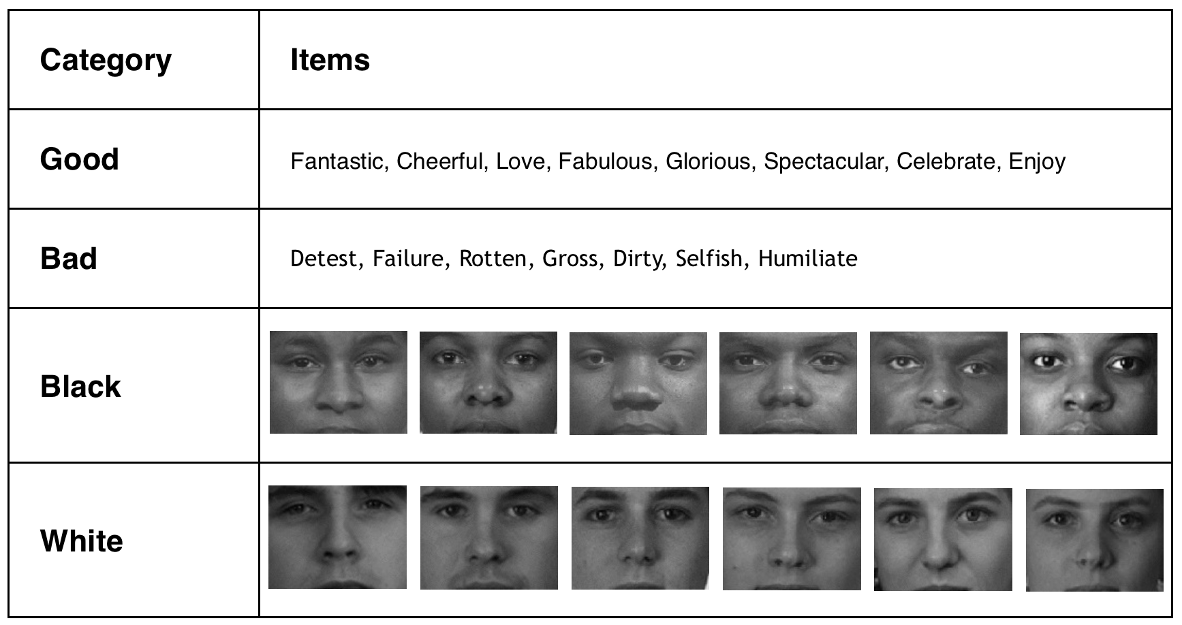
IAT Stimuli
Note: Stimuli taken from the Project Implicit website (Nosek et al., 2007)
Notes:
Here are the stimuli we used on the IAT; these were taken from the Project Implicit website, and are probably the most popular version of the IAT, hence our decision to use them in the present experiment.

Slide 10
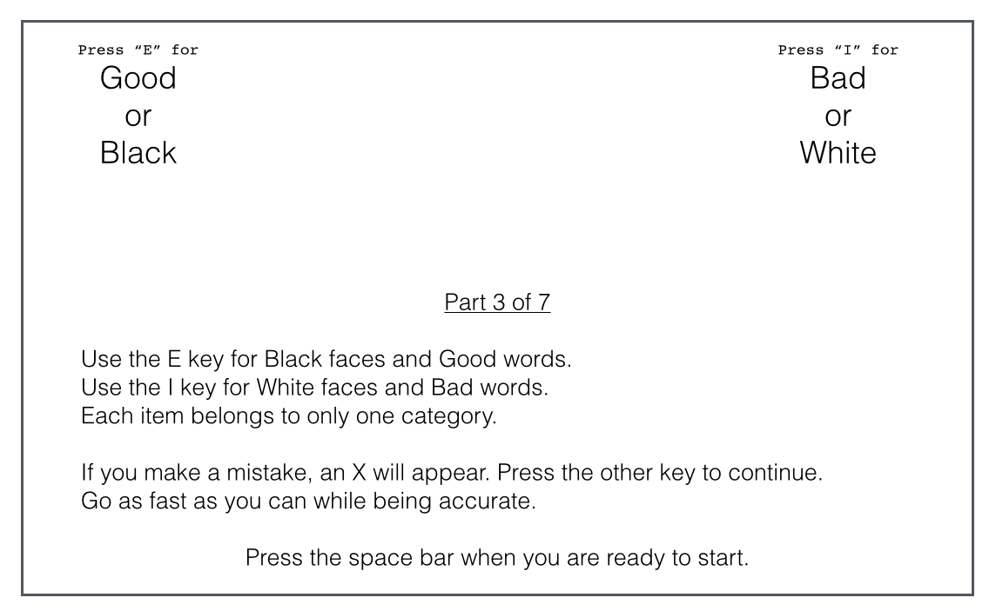
The IAT
Example for those unfamiliar with the IAT
Note: Inter-trial period = 250 ms
Notes:
If you are unfamiliar with the IAT, here is an example instruction page: After pressing the space bar the instructions disappear and a randomly selected stimulus will be presented in the middle of the screen. Participants the have to sort that stimulus to the left or right side of the screen by pressing the correct key on the keyboard.

Slide 11
Procedure | Left Category | Right Category | Congruency
Block 1 | White Faces | Black Faces
Block 2 | Good Words | Bad Words
Block 3 | White + Good | Black + Bad | Congruent
Block 4 | White + Good | Black + Bad | Congruent
Rest Block
Block 5 | Black Faces | White Faces
Block 6 | Good Words | Bad Words
Block 7 | Black + Good | White + Bad | Incongruent
Block 8 | Black + Good | White + Bad | Incongruent
Rest Block | Half the participants went directly to Block 5; the other half completed sudoku puzzles for 15 minutes
Explicit Measures | (1) Suspicion Probes; (2) Race Preference Likert Scale & Race Feeling Thermometers; (3) Basic Demographic Qs
Note 1: Blocks highlighted in red are not part of the typical IAT procedure and are unique to the present experiment. Congruency order was counterbalanced. Note 2: The entire experiment was programmed and delivered to participants via E-Prime (Psychology Software Tools, Inc., 2016)
Notes:
Here is an overview of the experimental procedure, and an overview of the stimuli participants responded to on the different blocks of the IAT. Please note that for half the participants in each condition blocks 1-4 were switched with blocks 5-8. Please also note that we added an extra word block to the IAT in block 6—this was done as we assumed that the rest condition may have forgotten the location of the words after 15 minutes had elapsed, and it was reasoned that this might confound the results by putting them at a disadvantage in the blocks after the rest period. This limits the generalizability of the present experiment’s results to the typical seven block IAT, but this can be addressed in future research if need be. Indeed, I have programmed the entire experiment in E-Prime, so it is very easy to run direct or conceptual replications.

Slide 12
Results
Data analysis was conducted in RStudio (RStudio Team, 2015) to ensure all analyses were reproducible
IAT performance was scored using the IAT scoring algorithm recommended by Greenwald and colleagues (2003)
Note 1: IAT scores are calculated as the difference in response time and accuracy between the congruent and incongruent blocks (it’s actually slightly more complicated, but this is the basic calculation)
Note 2: Positive IAT scores indicated faster and more accurate responses when the categories White + Good and Black + Bad were paired together relative to when the categories White + Bad and Black + Good were paired together
Notes:
Data analysis for the present experiment was conducted in R, so the analyses are reproducible, and so that analyses for any replications of the experiment are automated and require very little time investment.
To score IAT performance we used the scoring algorithm recommended by Greenwald and colleagues (2003). For this there are two points to keep in mind: (1) The IAT effect scores we will reference in this section are comprised of the difference in response time and accuracy between the congruent and incongruent blocks on the IAT; (2) Positive IAT effect scores indicate faster and more accurate responses to congruent pairings, whereas negative IAT effect scores indicate faster and more accurate responses to incongruent pairings.

Slide 13
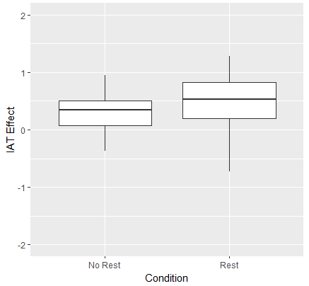
Was There an Effect?
Comparison of IAT effect scores
between conditions
An independent-samples t-test was conducted to compare IAT effect scores in the no rest and rest conditions
There was a significant difference in the scores for the no rest (M= 0.33, SD= 0.35) and rest (M= 0.50, SD= 0.43) conditions; t(86)= -2.04, p = .04, d = 0.44
The rest period (or possibly the sudoku itself) caused a performance difference on the IAT
Notes:
An independent-samples t-test comparing IAT effect scores revealed significant differences between the two conditions, with the rest condition having higher IAT effect scores relative to control. This indicates that the rest period (or possibly the sudoku itself) may have caused a change in performance on the IAT, but we will dig deeper into the data before making any conclusions.

Slide 14
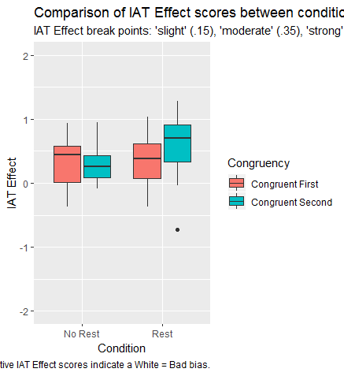
Comparing Congruency Orders
Comparison of IAT effect
scores between conditions
and congruency orders
Note: If the outlier from the rest congruent second condition is removed, the results from the previous t-test become:
no rest (M= 0.33, SD= 0.35), rest (M= 0.53, SD= 0.39); t(85)= -2.51, p = .01, d = 0.54
Notes:
If we divide the conditions up by their congruency order on the IAT, we can plainly see that the participants who had the congruent blocks after the rest period had the highest IAT effect scores; perhaps indicating an interaction.
Interestingly, this group also had the lowest overall IAT effect score, marked by the outlier in the graph. If we were to remove the outlier and re-run the t-test from the previous slide we can see that it makes a minor difference to the mean and standard deviation, but it does alter the p-value and effect size a fair bit.

Slide 15
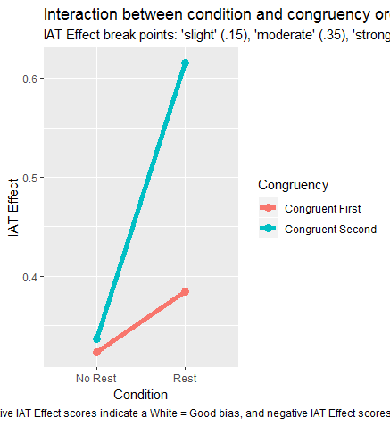
Was There an Interaction?
Comparison of IAT effect
score means between
conditions and congruencies
A 2 (condition) X 2 (congruency order) ANOVA was conducted to examine a possible interaction effect
This analysis revealed no significant interaction between condition and congruency order, F(1, 84) = 1.73, p = .19, ηp² = 0.020
With the aforementioned outlier removed, F(1, 83) = 3.32, p = .07, ηp² = 0.039
Notes:
Because the previous plot indicated a possible interaction effect, we conducted a 2 X 2 ANOVA to examine whether there was in fact an interaction. Results from the ANOVA with or without the outlier in the congruent second rest condition revealed no significant interaction; however, I think the magnitude of difference is still notable. Furthermore, it’s worth noting that this result actually runs counter to the typical IAT order effect mentioned earlier—we will come back to this in the discussion.

Slide 16
Were the Groups Unequal?
Latencies | Congruent First | Congruent Second
(ms) | No Rest | Rest | No Rest | Rest
Block 3 | 859 | 859 | 1074 | 1078
Block 4 | 709 | 710 | 897 | 853
Block 7 | 1010 | 1087 | 846 | 727
Block 8 | 861 | 938 | 797 | 659
The significant differences between conditions were caused mainly by different response speed and accuracy on Block 7 & 8
The differences were 100 (+/- 40) milliseconds, and there was a performance dissociation in the rest condition (relative to no rest) where congruent first performed slower, and congruent second performed faster
Notes:
One possible reason we could have obtained a significant difference between groups would be if they were unequal in some IAT relevant way. However, if we look at the response latencies before and after the rest block, we can see that both conditions had near-identical response latencies before the rest block. This indicates that any effects were likely caused purely by the rest period (or the sudoku). Furthermore, it is important to note that there was a dissociation in performance on the IAT between the two congruency orders in the rest conditions relative to control. As shown in the table, congruent first participants performed slower relative to control whereas congruent second participants performed faster.

Slide 17
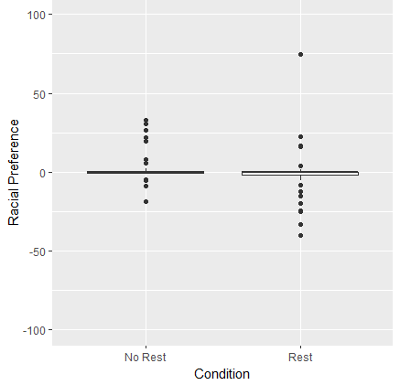
Explicit Race Preference
Comparison of explicit racial
preference between conditions
Data from the race preference likert and race feeling thermometers were combined by averaging participants’ responses to both measures
Clearly, participants generally did not have any overall race preference (counter to what the IAT scores would indicate, if we are to believe them)
We can rule this out as a possible cause for between-group differences
Notes:
Finally, since proponents of the IAT claim it measures attitudes, we examined racial preference between the two conditions. This graph is supposed to be a box and whisker plot, but as we can see, about 75% of participants had no racial preference at all, and the distribution between the two conditions is fairly similar. So we can rule out participants’ racial preferences as a cause for the effect we obtained.

Slide 18
Discussion
Key points
Procedural changes to the IAT that are unrelated to attitudes/prejudices/etc. can cause significant changes in performance on the IAT
Two relevant interpretations of this effect:
(1) Implicit attitudes as measured by the IAT are so unstable that they can be significantly changed by the most innocuous of things (i.e., playing sudoku can make people unconsciously associate white people with goodness…)
(2) The design of the IAT directly influences performance on the IAT, thus, the magnitude of IAT effect scores are an artifact of the test’s design
Notes:
Based on our analysis, I think it is fair to conclude that either the rest period itself, or the sudoku (or possibly both) caused the significant performance difference between the two conditions. Unfortunately we do not know what exactly caused the effect, but I think there are two relevant interpretations to put forth:
First, if we accept the claims that the IAT measures attitudes/etc., then we would have to conclude that attitudes as measured by the IAT are so unstable that they can be significantly changed by the most innocuous things of things. Such a phenomenon isn't unheard of—for example, the famous double-split experiment in quantum physics has demonstrated that even passive observation of quantum phenomena can change the measured result—however, if attitudes as measured by the IAT behave like quantum particles this would be at odds with claims of the IAT’s diagnosticity, as well as the claims that implicit bias causes all manner of ills towards certain groups.
Alternatively, if we treat the IAT as a phenomenon unto itself, we can quite plainly infer that non-attitudinal psychological processes/phenomenon likely accounted for the response speed and accuracy differences between the conditions (either fully or in part), as the act of completing a sudoku for 15 minutes should not have shifted participants’ attitudes in any way. I think this is the most parsimonious explanation.
It is possible participants reflected on their racial attitudes or cultural schemas during the rest block, however, even if this caused the performance change it would only indicate that the IAT is susceptible to the types of self-presentation artifacts present in explicit measures which it was designed to circumvent.

Slide 19
Possible Causes?
The performance dissociation between congruency orders in the rest condition suggests that the results were not caused by fatigue/exhaustion/boredom/etc.
Otherwise we would have expected the same pattern in both conditions (e.g., extremely rapid and inaccurate responses so as to finish faster)
Participants would not be aware of the pairing reversal unless they had completed an IAT before; the performance dissociation could have been spuriously caused by familiarity with the IAT (this is 100% speculative)
Notes:
Thinking about the psychological phenomenon that could have caused the effect, I think we can rule out things like fatigue or boredom—if this was the case I do not believe there would be a performance dissociation between the two rest condition congruency orders. For example, if participants became bored and wished to finish faster they could have rapidly alternated key presses allowing them to blast through the experiment; this would have caused inadmissible scores in both congruency orders. Similar things would likely happen with exhaustion, with overall slower scores and more errors across the board.
It is possible the result could have been caused spuriously by participants’ familiarity with the IAT or their cognitive fluency—however, it is impossible to check this in the data we collected, so this is completely speculative and could be (dis)confirmed by future replications.

Slide 20
Possible Causes? Cont’
The rest period could have allowed participants to complete the remaining blocks “fresh” (similar to why there is typically an IAT order-effect) and with practice, causing performance gains
This would explain the White + Good second condition’s performance, but would not explain why the Black + Good second condition’s performance was worse relative to control
Perhaps this suggests a dissociation in the psychological processes (and/or neural pathways) used to respond to the different pairings on the IAT?
Notes:
The best explanation I have been able to come up with is that the rest period allowed participants to complete the remaining blocks fresh and with practice, thus they were able to perform better. This would be in-line with my hypothesis that the rest period would decrease interference of the earlier blocks on the later blocks. However, the performance dissociation throws a wrench in this explanation, as only the congruent second group saw performance gains relative to control. Indeed, the only explanation I can think of that actually accounts for the dissociation is that it was caused by a dissociation in the psychological processes used to respond to the different pairings on the IAT. I do not know what those processes might be, however, I think this is an idea worth investigating as it could identify why group-averaged IATs tend to be biased in specific directions fairly reliably.

Slide 21
Limitations
The manipulation clearly had an effect, however, interpreting this effect is difficult (particularly because no one knows what the IAT actually measures)
Direct and conceptual replications needed to refine explanations
The experimental paradigm of introducing the IV before the pairing reversal on the IAT seems promising though
It enables the comparison of a priori and a posteriori group differences in performance
To our awareness, no other experiments have used this paradigm, so this experiment is best considered exploratory
Notes:
Obviously this experiment is heavily constrained in the types of data-based interpretations available to it, so direct and conceptual replications are needed in order to refine explanations (I have a few ideas if anyone is interested). However, I think the general experimental paradigm of introducing the independent variable before the pairing on the IAT could be a promising experimental paradigm (to our knowledge no one has done this before). As we saw, this paradigm allows us to compare group differences before and after the manipulation using a single IAT; compared to a pre-test post-test design this is unique as it allows us to see how specific congruency orders on the IAT are effected, rather than only seeing how the entire test is effected. Using three-group designs, this paradigm could also be used to test for double-dissociation effects as well, which might garner interesting findings. It’s worth noting that there is very little cognitive-oriented experimental research in this area, so it would be a great opportunity to conduct unique research.

Slide 22
Conclusions
Despite its popularity, the empirical value of the IAT and theories of implicit cognition are currently based up empirically unjustifiable claims and assumptions
Scholarship treating the IAT (and thus implicit cognition) as a phenomenon unto itself is needed to shift the field’s paradigms towards experimental research based on the scientific method
This paradigm shift will improve scholarship in the field and aid our understanding of all the psychological processes/phenomenon underlying performance on the IAT (everyone wins!)
Notes:
To conclude, it is important that we recognize the immense shortcomings of the IAT and of theories of implicit cognition as they stand today. Currently, these consist mainly of empirically unjustifiable memes that are causing sociocultural problems and wasting valuable researcher resources. However, the field has demonstrated some theoretically and empirically interesting findings that are worth investigating with proper experimentation based on the scientific method. The present experiment exemplifies such paradigm shifting research—I hope it can inspire some of you to conduct your own experiments in this area, as improving the scholarship of implicit cognition research will help the area move from a belief-based system to an evidence-based system which should benefit us all. Thank you.

Slide 23
Questions, Comments, Suggestions?
P. S. If you are interested in this topic, check out McCarthy's other project during Poster Session II (12:45-2:15)!

Slide 24
References
Bezrukova, K., Spell, C. S., Perry, J. L., & Jehn, K. A. (2016). A meta-analytical integration of over 40 years of research on diversity training evaluation. Psychological Bulletin, 11, 1227-1274.
Blanton, H., & Jaccard, J. (2008). Unconscious racism: A concept in pursuit of a measure. Annual Review of Sociology, 34, 277-297.
Comey, J. B. (2015). Hard Truths: Law Enforcement and Race. Retrieved from https://www.fbi.gov/news/speeches/hard-truths-law-enforcement-and-race
Fiedler, K., Messner, C., & Bluemke, M. (2006). Unresolved problems with the "I", the "A", and the "T": A logical and psychometric critique of the Implicit Association Test (IAT). European Review of Social Psychology, 17, 74-147.
Greenwald, A. G., & Banaji, M. R. (1995). Implicit social cognition: Attitudes, self-esteem, and stereotypes. Psychological Review, 102, 4–27.
Greenwald, A. G., Banaji, M. R., & Nosek, B. A. (2015). Statistically small effects of the Implicit Association Test can have societally large effects. Journal of Personality and Social Psychology, 108(4), 553–561.
Greenwald, A. G., McGhee, D. E., & Schwartz, J. L. K. (1998). Measuring individual differences in implicit cognition: The Implicit Association Test. Journal of Personality and Social Psychology, 74, 1464–1480.
Greenwald, A. G., Nosek, B. A., & Banaji, M. R. (2003) Understanding and using the Implicit Association Test: I. An improved scoring algorithm. Journal Of Personality And Social Psychology, 85(2), 197-216.
Google (2013). Unconscious Bias @ Work (video series). Retrieved from https://rework.withgoogle.com/guides/unbiasing-raise-awareness/steps/introduction/
Kang, J., Bennett, M., Carbado, D., Casey, P., Dasgupta, N., Faigman, D.,…Mnookin, J. (2012). Implicit bias in the courtroom. UCLA Law Review, 59, 1124-1186.
Melnikoff, D. E., & Bargh, J. A. (2018). The Mythical Number Two. Trends in Cognitive Sciences, 22(4), 280–293.
Mitchell, G., & Tetlock, P. E. (2017). Popularity as a poor proxy for utility: The case of implicit prejudice. In S. O. Lillienfeld & I. D. Waldman (Ed.), Psychological Science Under Scrutiny: Recent Challenges and Proposed Solutions.

Slide 25
References
Nosek, B. A., Smyth, F. L., Hansen, J. J., Devos, T., Lindner, N. M., Ratliff (Ranganath), K. A., Smith, C. T., Olson, K. R., Chugh, D., Greenwald, A. G., & Banaji, M. R. (2007). Pervasiveness and correlates of implicit attitudes and stereotypes. European Review of Social Psychology,18, 36-88. https://www.projectimplicit.net/stimuli.html
Oswald, F. L., Mitchell, G., Blanton, H., Jaccard, J., & Tetlock, P. E. (2013). Predicting ethnic and racial discrimination: A meta-analysis of IAT criterion studies. Journal of Personality and Social Psychology, 105, 171–192. doi:10.1037/a0032734
Oswald, F. L., Mitchell, G., Blanton, H., Jaccard, J., & Tetlock, P. E. (2015). Using the IAT to predict ethnic and racial discrimination: Small effect sizes of unknown societal significance. Journal of Personality and Social Psychology, 108, 562–571. doi:10.1037/pspa0000023
Psychology Software Tools, Inc. (2016). E-Prime 3.0. Retrieved from http://www.pstnet.com.
RStudio Team (2015). RStudio: Integrated Development for R. RStudio, Inc., Boston, MA. Retrieved from: http://www.rstudio.com/.

