Slide 1
Character Segmentation Of Cursive handwritten words
By Jordan McCaskill

Slide 2
Motivation

Slide 3
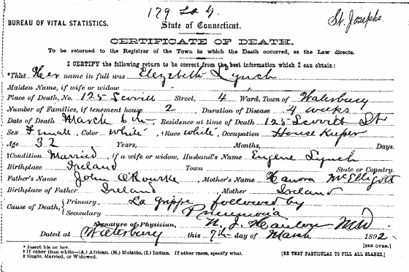
Documents
Identification of handwritten records
Family history work
Other document analysis
Extremely complex problem

Slide 4
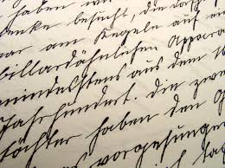
Sentences
Still very complicated
Page layout
Separate words also

Slide 5

Words
No need to separate words
Focus on individual letters
Many implementations to select

Slide 6
Background Information

Slide 7
Over – Segmentation
Attempt to generate many more segmentation points than necessary
Reduce any redundant points
Move through the points systematically to find the most likely

Slide 8

Over - Segmentation

Slide 9
Over - Segmentation

Slide 10
Over - Segmentation

Slide 11
Projection Analysis
Create a histogram of pixel density within all the rows or columns
Use thresholds to determine possible segmentation points
More points is better

Slide 12
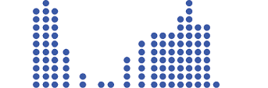
Projection Analysis

Slide 13
Ball Trace
Imagine the letters as tracks
A ball rolls along the tracks with momentum
Momentum carries the ball through to the end
Use this information to determine individual letters

Slide 14
Ball Trace

Slide 15
Ball Trace

Slide 16
Ball Trace

Slide 17
Ball Trace

Slide 18
Ball Trace

Slide 19
Ball Trace

Slide 20
Ball Trace

Slide 21
Ball Trace

Slide 22
Ball Trace

Slide 23
Ball Trace

Slide 24
Ball Trace

Slide 25
Ball Trace

Slide 26
Landmarks
Look at the letters in parts or as a whole
Look for similar structures in each letter
Use these landmarks to determine where letters may occur

Slide 27
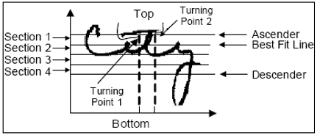
Landmarks

Slide 28
Top – Line Trace
Gather information from only the top line of the letters
Use the top information to determine the likelihood of segmentation points
Bulk of work for project went into this method
Explained better later

Slide 29
Implementations

Slide 30


Test Words

Slide 31
Projection Analysis
Horizontal
Vertical
Generate a histogram for each row
Gather information about height and baselines
Generate a histogram for each column
Determine possible segmentation points

Slide 32


Horizontal Projection Analysis

Slide 33


Horizontal Projection Analysis

Slide 34


Horizontal Projection Analysis

Slide 35
Vertical Projection Analysis

Slide 36


Vertical Projection Analysis

Slide 37
Threshold Value
Draw a line across the vertical histogram
Check for change from black to white or white to black
Changes indicate potential segmentation points

Slide 38
Vertical Projection Analysis – Hello

Slide 39
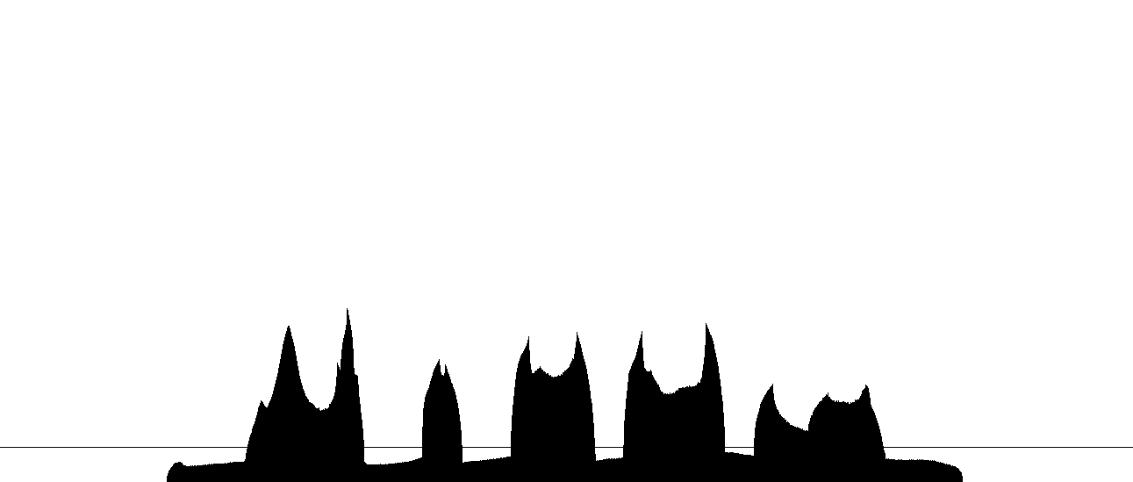
Vertical Projection Analysis – Hello

Slide 40

Vertical Projection Analysis – Hello

Slide 41
Vertical Projection Analysis – Immediate

Slide 42
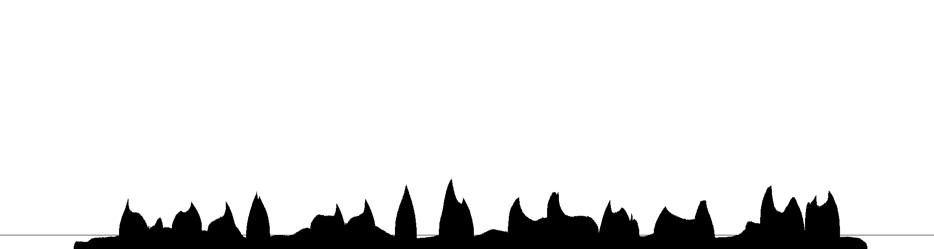
Vertical Projection Analysis – Immediate

Slide 43

Vertical Projection Analysis – Immediate

Slide 44

Vertical Projection Analysis – Immediate

Slide 45

Vertical Projection Analysis – Immediate

Slide 46
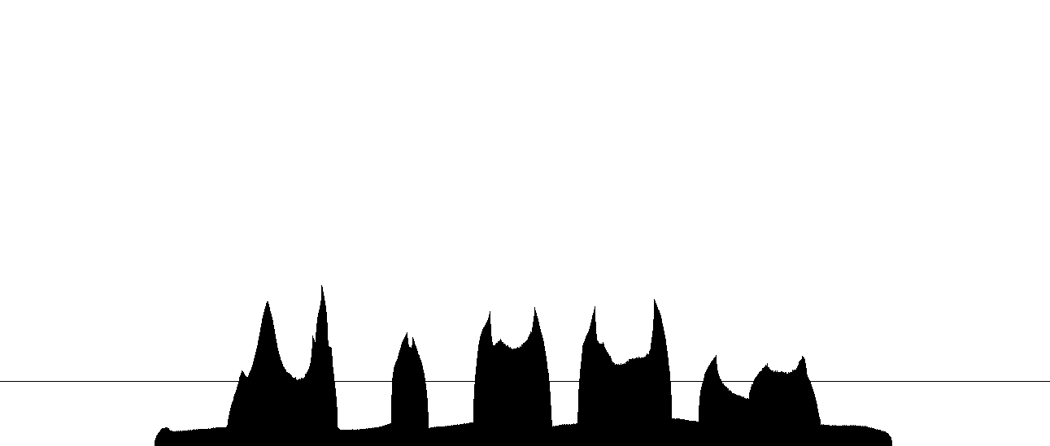

Vertical Projection Analysis – Hello

Slide 47


Top – Line Trace

Slide 48


Top – Line Trace

Slide 49
First Idea

Slide 50
Better Idea

Slide 51

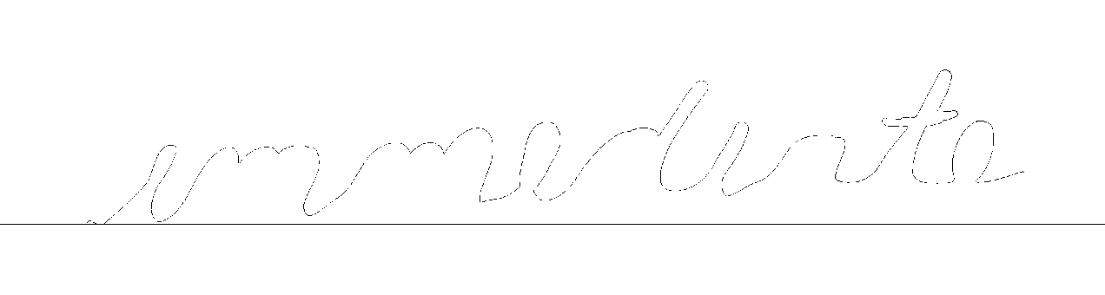
Better Idea

Slide 52
Top – Line Trace
Define three different parameters
High value
Low value
Threshold
High
0.5
1.0
Low
1.5

Slide 53


High=0.5 Low=2.0 Thresh=80%
Notes:
Cut off letters

Slide 54


High=0.5 Low=2.5 Thresh=80%
Notes:
Got worse as they moved right

Slide 55


High=0.6 Low=2.8 Thresh=83%
Notes:
Cuts quite well

Slide 56


High=0.6 Low=5.0 Thresh=80%
Notes:
Final implementation

Slide 57
Thinning

Slide 58


Thinning

Slide 59
Conclusion

Slide 60

Projection Analysis

Slide 61
Top – Line Trace

Slide 62
Projection Analysis vs. Top – line Trace

Slide 63
Questions?

