Slide 1

Attacks on Websites
Mackenzie McClellan
Notes:
Hi my name is Mackenzie mcclellan, and I will be teaching you about different attacks that are possbile on websites

Slide 2
Basic Website Account Attacks
Notes:
more specifically, account attacks. where an attacker can inflatrate an unknown users account and reveal sensitive information

Slide 3
Information security attacks
SQL injection
XSS/Man in the middle
iFrame injection
Buffer overflow
Brute Force
Notes:
imofrmation security attacks can be any of the following, in which i will elaborate about further in this presentation. these include SQL injection, man in the middle attacks, iframe injection, buffer overflow, and brute force attack

Slide 4
These attacks are the result of human error, or not having faulty security
Notes:
these attacks are caused by human error or overall lack of security and i will attempt introduce ways to prevent them.

Slide 5
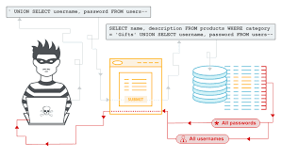
SQL Injection
A SQL injection attack allows the hacker to retrieve data about a user, or the application itself. Once achieved, the hacker can modify data of the application or user.
Notes:
A SQL injection attack allows the hacker to retrieve data about a user, or the application itself. Once achieved, the hacker can modify data of the application or user.

Slide 6
27.8% of all applications have a SQL injection vulnerability
Notes:
27.8% of all applications have a SQL injection vulnerability , which is very scary to think about big scale, and how many businesses are truly at risk

Slide 7
How is this done with users?
In most languages, a coding prompt will ask when a specific username is entered, the password entered matches. This makes the argument true.
Well, this is very vulnerable. Hackers can overwrite this prompt by coding fundamentals, by making the argument true. One of the simplest ways to do this is creating an argument that the computer knows and accepts as true, 1=1.
Notes:
So how is this done? In most languages, a coding prompt will ask when a specific username is entered, that the password entered matches the password that they have on file. This makes the argument true. Well, this is very vulnerable. Hackers can overwrite this prompt by coding fundamentals, making the argument true, or at least making the password and username seem true to the computer.. One of the simplest ways to do this is creating an argument that the computer knows and accepts as true, like 1=1.

Slide 8
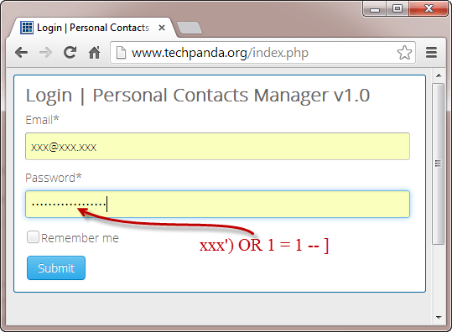
Using programming format, an attacker can login into xxx@xxx.xxx’s account by making the argument true. The argument relays the idea that ’xxx’ is the password attempt, OR 1=1 is true, since we know 1=1 is true, it makes the whole statement true, giving access to the account.
Notes:
Using programming format, an attacker can login into a correct user’s account by making the password argument true. The argument relays the idea that ’xxx’ is the password attempt, OR 1=1 is true, since we know 1=1 is true, it makes the whole statement true, giving access to the account. In computer language, the or is a logical disjunction, meaning that only one side has of the argument has to be labeled true for the whole thing to be true, like false or true equals true. So if an attacker relays a random password that they know is false, all one would have to do Is attach something that the computer and they know is true, like 1=1.

Slide 9

With granted access to a user or admin’s account, the attacker is free to change anything they want.
Notes:
With granted access to a user or admin’s account, the attacker is free to change anything they want.

Slide 10
How to avoid SQL Injection attacks
By limiting the character usage
Validate the user inputs
Actively patch bugs and updates
2-step verification (if necessary)
Notes:
There are many ways to try and prevent this attack, like limiting the character usage. For exalpme, taking away to the single quote would eliminate that attack presented in earlier slides. As well as keeping your system up to date by trying ways to prevent these attacks. Also, 2 step-verification is the soundest way to prevent this, but unfortunately is very pester some. Also some hosting companies have built in security for this.

Slide 11
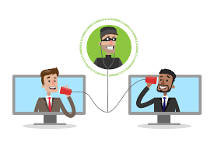
Man in the Middle Attacks
Businesses and clients require a secure pipeline between each other to relay information, but Man in the Middle attacks allow the hacker to eavesdrop on sensitive information being passed through this pipeline.
Notes:
Now, man in the middle attacks are an extreme breach of data. Businesses and clients require a secure pipeline between each other to relay information, but Man in the Middle attacks allow the hacker to eavesdrop on sensitive information being passed through this pipeline

Slide 12
In 2016, 95% of servers were vulnerable to Man in the Middle Attacks
Notes:
In 2016, 95% of servers were vulnerable to Man in the Middle Attacks

Slide 13
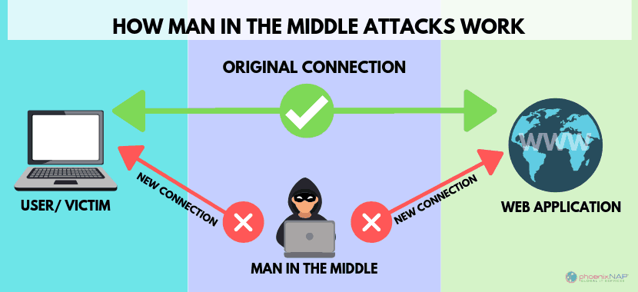
How are these attacks done?
An attacker can “sniff” for unprotected data transfers or “pipelines”, then when the real user logs into the website, the man in the middle will redirect them to their fake website that mimics the original and collect all of the information that the user enters. Once they gathered all the information, the hacker can now input that into the original website for their own malicious use.
Notes:
An attacker can “sniff” for unprotected data transfers or “pipelines”, then when the real user logs into the website, the man in the middle will redirect them to their fake website that mimics the original and collect all of the information that the user enters. Once they gathered all the information, the hacker can now input that into the original website for their own malicious use.

Slide 14
How to Prevent MITM Attacks
Implement SSL/TLS or VPN which helps encrypt the pipeline information
Strong WEP/WAP Encryption on Access Points, otherwise brute-force attacks are possible to allow a malicious user into your network
Force HTTPS + SSL, a secure way to communicate through the passing of public and private keys to decrypt messages
Notes:
Implementing encryption of your data will help prevent secure information to be viewed openly, adding ssl or a vpn helps encrypt that data. Also, a great way is implementing a web application firewall on access points would help prevent attackers from getting in to view this data, while preventing another attack we are going to talk later about, the brute force attack. Also, using both https and ssl will help encrypt and secure the transaction of data by using keys to decrypt data.

Slide 15
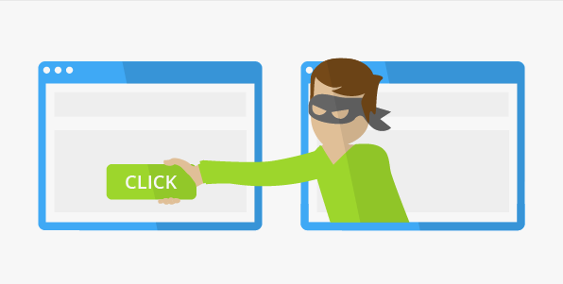
iFrame Injection Attacks
This attack is the most common attack of the cross-site category attacks. What is achieved by this attack is injecting malware onto one’s website by having a hidden frame run in the background.
Notes:
Now, in my opinion, the coolest and scariest attack, the Iframe injection attack. This attack is the most common attack of the cross-site category attacks. What is achieved by this attack is injecting malware onto one’s website by having a hidden frame run in the background. A frame that is the entrance for the attacker,

Slide 16
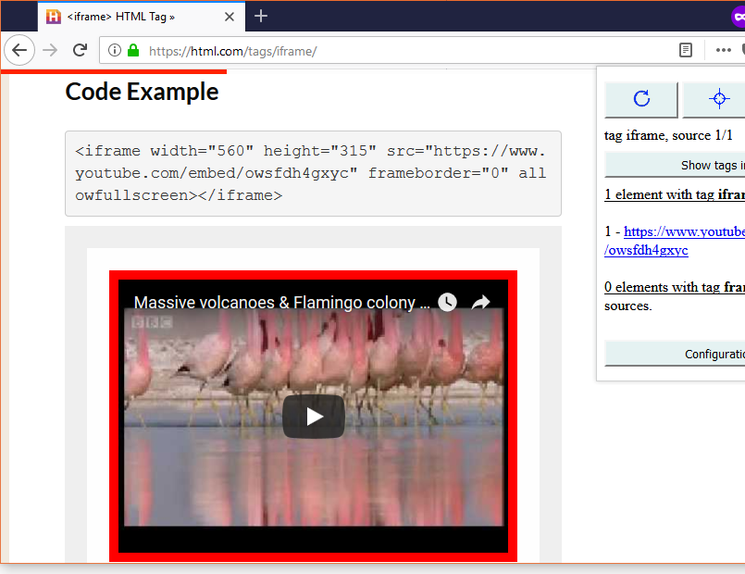
What are iFrames?
iFrames are attributes of the HTML coding for a website. Iframes can be used to add inline frames to a document. This means that a website can be accessed through another website, like how a YouTube video can be played from another website.
Notes:
iFrames are attributes of the HTML coding for a website. Iframes can be used to add inline frames to a document. This means that a website can be accessed through another website, like how a YouTube video can be played from another website.

Slide 17
How does this become malicious?
When styling an iFrame, an attacker can make an iFrame virtually invisible for the user to see. This allows them to implement a malicious website, where malware can be automaticity downloaded in the background without the user noticing.
Notes:
But how does an iframe become malicious and do these attacks? When styling an iFrame, an attacker can make an iFrame virtually invisible for the user to see. This allows them to implement a malicious website, where malware can be automaticity downloaded in the background without the user noticing.

Slide 18
How to prevent XSS/iFrame attacks
Using Content Security Policy(CSP) would be most beneficial against cross-site attacks, including iFrame attacks.
Notes:
Using the Content Security Policy(CSP) in http would be most beneficial against cross-site attacks, including iFrame attacks and is a standard across http.

Slide 19
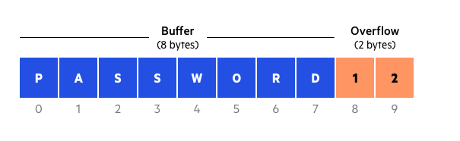
Buffer Overflow Attacks
Buffer Overflow Attacks are when an attacker overflows the database with data that overwrites memory of an application. This damages files, the execution path, and potentially exposes sensitive information
Notes:
Buffer overflow attacks are very hard to understand without the knowledge of how computer infrastructure works, but to sum up what is achieved, it is when when an attacker overflows the database with data that overwrites memory of an application. This damages files, the execution path, and potentially exposes sensitive information.

Slide 20
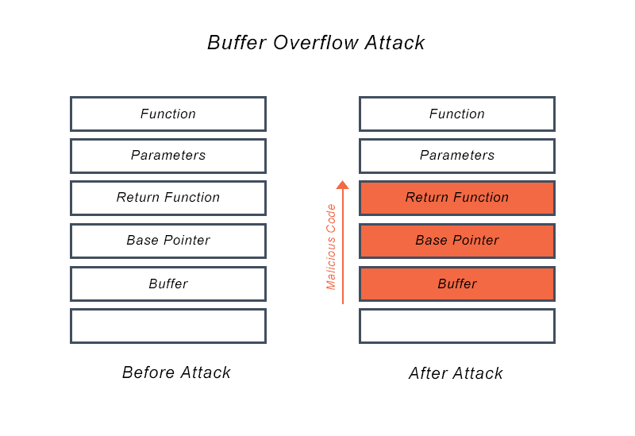
How can one Overflow Memory?
In computer programming, if one rewrites the base pointer of the function, it overwrites the memory of the function, and the attacker can either rewrite or manipulate the output.
Notes:
In computer programming, if one rewrites the base pointer of the function, it overwrites the memory of that function, and the attacker can either rewrite or manipulate the output.

Slide 21
WHY IS THE BASE POINTER SO VULNERABLE?
The key to this attack is finding the buffer distance between the sensitive information and the base pointer to be able to know the exact amount of information at which to overflow the function with, otherwise the attack will not execute. Human error is a big contributor to this problem, and a reason why it is important to try and hide this address locations.
Notes:
The key to this attack is finding the buffer distance between the sensitive information and the base pointer to be able to know the exact amount of information at which to overflow the function with, otherwise the attack will not execute. Human error is a big contributor to this problem, and a reason why it is important to try and hide this address locations.

Slide 22
Why is this so dangerous?
Buffer overflows can happen on all types of software
Notes:
Buffer overflows can happen on all types of software. Because all software memory is built using the same idea.

Slide 23
HOW TO PREVENT BUFFER OVERFLOWS
Address space randomization (ASLR)- this allows space address to be randomly moved around, making it extremely difficult to locate the base pointer
Notes:
Address space randomization (ASLR)- allows space addresses to be randomly moved around, making it extremely difficult to locate the base pointer, which in return, prevents these attacks.

Slide 24
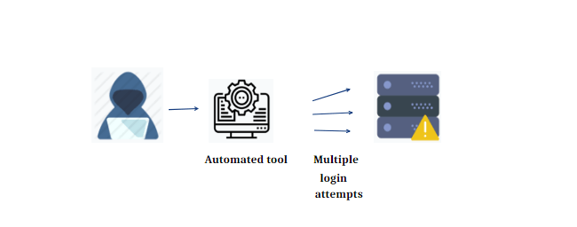
Brute Force Attack
Password hacking not only can be apart of the SQL Injection, but the Brute Force attack as well. This is where a user can use sensitive information or a list of the most common passwords and attempt to file through all the options until a password is found.
Notes:
Now the last and final attack, the brute force attack.
Password hacking not only can be apart of the SQL Injection, but the Brute Force attack as well. This is where a user can use sensitive information or a list of the most common passwords and attempt to file through all the options until a password is found.

Slide 25
How can this be done?
By creating a file of variations of a user’s sensitive information, like name, address or birthday, and other common passwords, a hacker can cycle through each password until one matches. This is a seemingly weak and expensive attack but relays the importance of password requirements.
Notes:
By creating a file of variations of a user’s sensitive information, like name, address or birthday, and other common passwords, a hacker can cycle through each password until one matches. This is a seemingly weak and expensive attack but relays the importance of password requirements. But only shows the importance of having a secure and hard password to guess.

Slide 26
How to prevent Brute Force Attacks
By having the necessary password requirements, this can substantially diminish this attack. This includes character length, special character requirement(!@$), and exclusion of username information in password.
Notes:
By having the necessary password requirements, this can substantially diminish this attack. This includes character length, special character requirement(!@$), and exclusion of username information in password.

Slide 27
Overall Security Necessary for a Website
Password verification/requirements
Use HTTPS + SSL
Backup data and patch updates
Encrypt data as much as possible (ASLR, WEP/WAP and VPN)
Align with the Content Security Policy
Notes:
Now, with all of these attack preventions in mind, these are some way to help keep a secure website. By having password requirements and double verifcaiton, using https and ssl to create an encrypted transaction of information, baking up data and patching bugs with updates, ecrypting your data as much as possible and making those holes more secure by using VPN and web application firewalls, also aligning with the content security policy with http.
Hope this help introduce ideas of how these attacks are possible and ways to prevent these attacks. thanks for listening.

