Slide 1
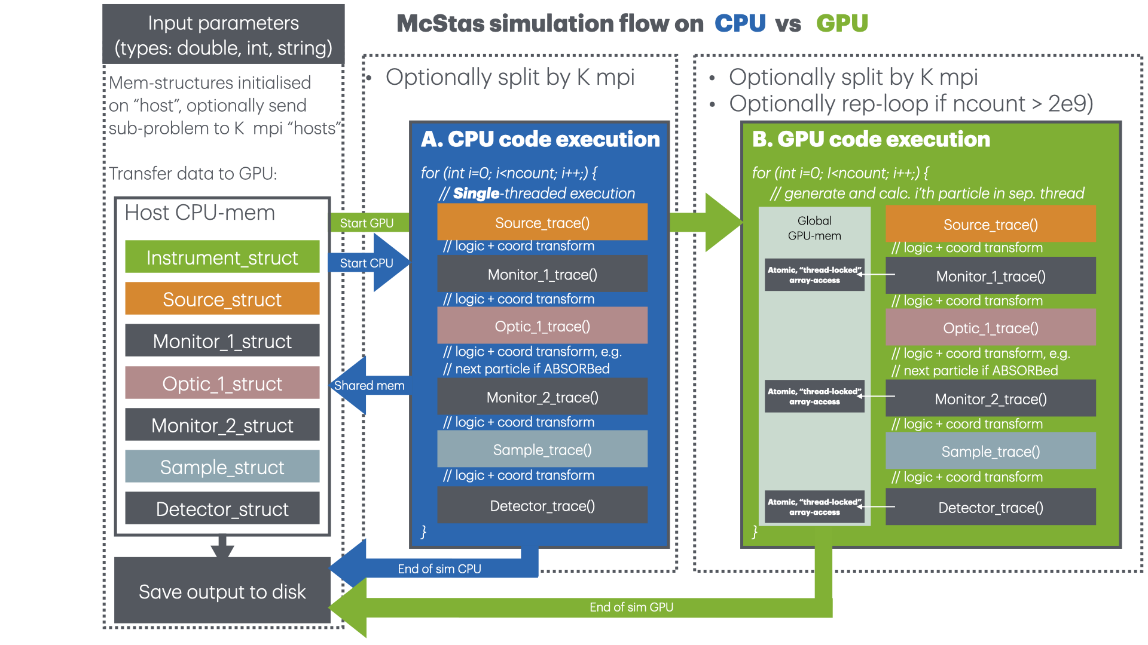

Slide 2
‘Standard layout’ - 1 monolithic kernel
With int raytrace(_class_particle* _particle) { /* single event propagation, called by mccode_main for mini:TRACE */
…
_class_particle _particle_save=*_particle;
/* the main iteration loop for one incoming event */
while (!ABSORBED) { /* iterate event until absorbed */
/* send particle event to component instance, one after the other */
/* begin component arm=Arm() [1] */
/* coordinate change pr. comp, trace fct. pr. comp until the end of comp list / ABS*/
…
/* begin component source=Source_simple() [2] */
mccoordschange(_source_var._position_relative, _source_var._rotation_relative, _particle);
if (!ABSORBED && _particle->_index == 2) {
… class_Source_simple_trace(&_source_var, _particle);
/* restore-logic etc, then next comp */
….
} /* while !ABSORBED */
DEBUG_LEAVE()
particle_restore(_particle, &_particle_save);
DEBUG_STATE()
return(_particle->_index);
} /* raytrace */
/* loop to generate events and call raytrace() propagate them */
void raytrace_all(unsigned long long ncount, unsigned long seed) {
/* CPU-loop */
unsigned long long loops;
loops = ceil((double)ncount/gpu_innerloop);
/* if on GPU, printf has been globally nullified, re-enable here */
#ifdef OPENACC
#undef strlen
#undef strcmp
#undef exit
#undef printf
#undef sprintf
#undef fprintf
#endif
#ifdef OPENACC
if (ncount>gpu_innerloop) {
printf("Defining %llu CPU loops around GPU kernel and adjusting ncount\n",loops);
mcset_ncount(loops*gpu_innerloop);
} else {
#endif
loops=1;
gpu_innerloop = ncount;
#ifdef OPENACC
}
#endif
for (unsigned long long cloop=0; cloop<loops; cloop++) {
#ifdef OPENACC
if (loops>1) fprintf(stdout, "%d..", (int)cloop); fflush(stdout);
#endif
/* if on GPU, re-nullify printf */
#ifdef OPENACC
#undef strlen
#undef strcmp
#undef exit
#undef printf
#undef sprintf
#undef fprintf
#endif
#pragma acc parallel loop num_gangs(numgangs) vector_length(vecsize)
for (unsigned long pidx=0 ; pidx < gpu_innerloop ; pidx++) {
_class_particle particleN = mcgenstate(); // initial particle
_class_particle* _particle = &particleN;
particleN._uid = pidx;
#ifdef USE_MPI
particleN._uid += mpi_node_rank * ncount;
#endif
srandom(_hash((pidx+1)*(seed+1)));
particle_uservar_init(_particle);
raytrace(_particle);
} /* inner for */
seed = seed+gpu_innerloop;
} /* CPU for */
/* if on GPU, printf has been globally nullified, re-enable here */
#ifdef OPENACC
#undef strlen
#undef strcmp
#undef exit
#undef printf
#undef sprintf
#undef fprintf
#endif
MPI_MASTER(
printf("*** TRACE end *** \n");
);
1 big parallel loop - potentially with loops inside
#pragma acc parallel loop num_gangs(numgangs) vector_length(vecsize)
for (unsigned long pidx=0 ; pidx < gpu_innerloop ; pidx++) { … raytrace(_particle); }

Slide 3
‘FUNNEL layout’ - potentially multiple kernels
Followed by ‘grouped’ components, e.g. between SPLIT’s #pragma acc parallel loop present(particles[0:livebatchsize])
for (unsigned long pidx=0 ; pidx < livebatchsize ; pidx++) {
_class_particle* _particle = &particles[pidx];
_class_particle _particle_save;
// arm
if (!ABSORBED && _particle->_index == 1) {
_particle->_index++;
} // Comps up to monochromator in e.g. PSI_DMC …
}
// SPLIT with available livebatchsize
long mult_foc_mono;
livebatchsize = sort_absorb_last(particles, pbuffer, livebatchsize, gpu_innerloop, 1, &mult_foc_mono);
//printf("livebatchsize: %ld, split: %ld\n", livebatchsize, mult); #pragma acc parallel loop present(particles[0:livebatchsize])
for (unsigned long pidx=0 ; pidx < livebatchsize ; pidx++) {
_class_particle* _particle = &particles[pidx];
_class_particle _particle_save;
// foc_mono
if (!ABSORBED && _particle->_index == 21) {
…
mccoordschange(_foc_mono_var._position_relative, _foc_mono_var._rotation_relative, _particle);
_particle_save = *_particle;
class_Monochromator_2foc_trace(&_foc_mono_var, _particle);
if (_particle->_restore)
particle_restore(_particle, &_particle_save);
_particle->_index++;
}
… }
void raytrace_all_funnel(unsigned long long ncount, unsigned long seed) {
// set up outer (CPU) loop / particle batches
unsigned long long loops;
loops = ceil((double)ncount/gpu_innerloop);
…
// create particles struct and pointer arrays (same memory used by all batches)
_class_particle* particles = malloc(gpu_innerloop*sizeof(_class_particle));
_class_particle* pbuffer = malloc(gpu_innerloop*sizeof(_class_particle));
long livebatchsize = gpu_innerloop;
// outer loop / particle batches
for (unsigned long long cloop=0; cloop<loops; cloop++) {
if (loops>1) fprintf(stdout, "%d..", (int)cloop); fflush(stdout);
// init particles
#pragma acc parallel loop present(particles[0:livebatchsize])
for (unsigned long pidx=0 ; pidx < livebatchsize ; pidx++) {
// generate particle state, set loop index and seed
particles[pidx] = mcgenstate();
_class_particle* _particle = particles + pidx;
_particle->_uid = pidx;
#ifdef USE_MPI
_particle->_uid += mpi_node_rank * ncount;
#endif
srandom(_hash((pidx+1)*(seed+1))); // _particle->state usage built into srandom macro
particle_uservar_init(_particle);
}
Particles traced in bunches of size ‘livebatchsize’:
With a split, minimum: 1. Initial kernel
2. Sorting kernel
3. Second kernel

Slide 4
‘MULTIKERNEL layout’ - potentially multiple kernels
Like FUNNEL but there will always be a kernel pr. comp
Define to globally use / not use ‘absorption sort’ kernels in between comp kernels
Rationale:
Allow more fine-grained profiling?
Alternative: Can we add pragmas for profiling / adding nvtx like points in acc regions?

