Slide 1
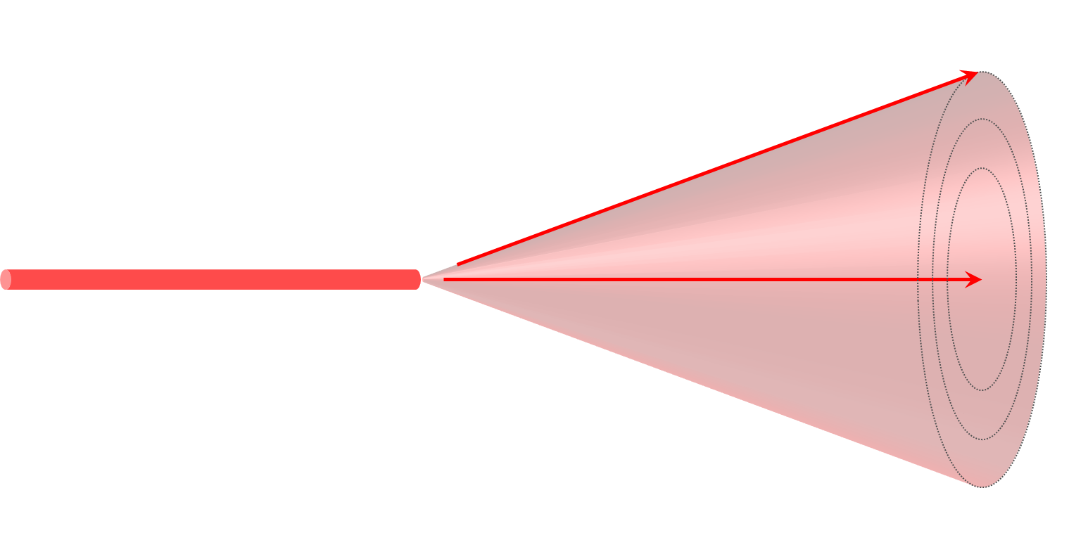
Use Case: Beamline alignment
Upstream from the sample
monochromator
2nd mirror
diffracted beam
1st crystal
1st mirror
detector
incident beam
2nd crystal
sample
Downstream from the sample
Choose Beam Shape (+ maximize intensity)
Often Iterative Process with a lot a degrees of freedom → takes a lot of time!!

Slide 2
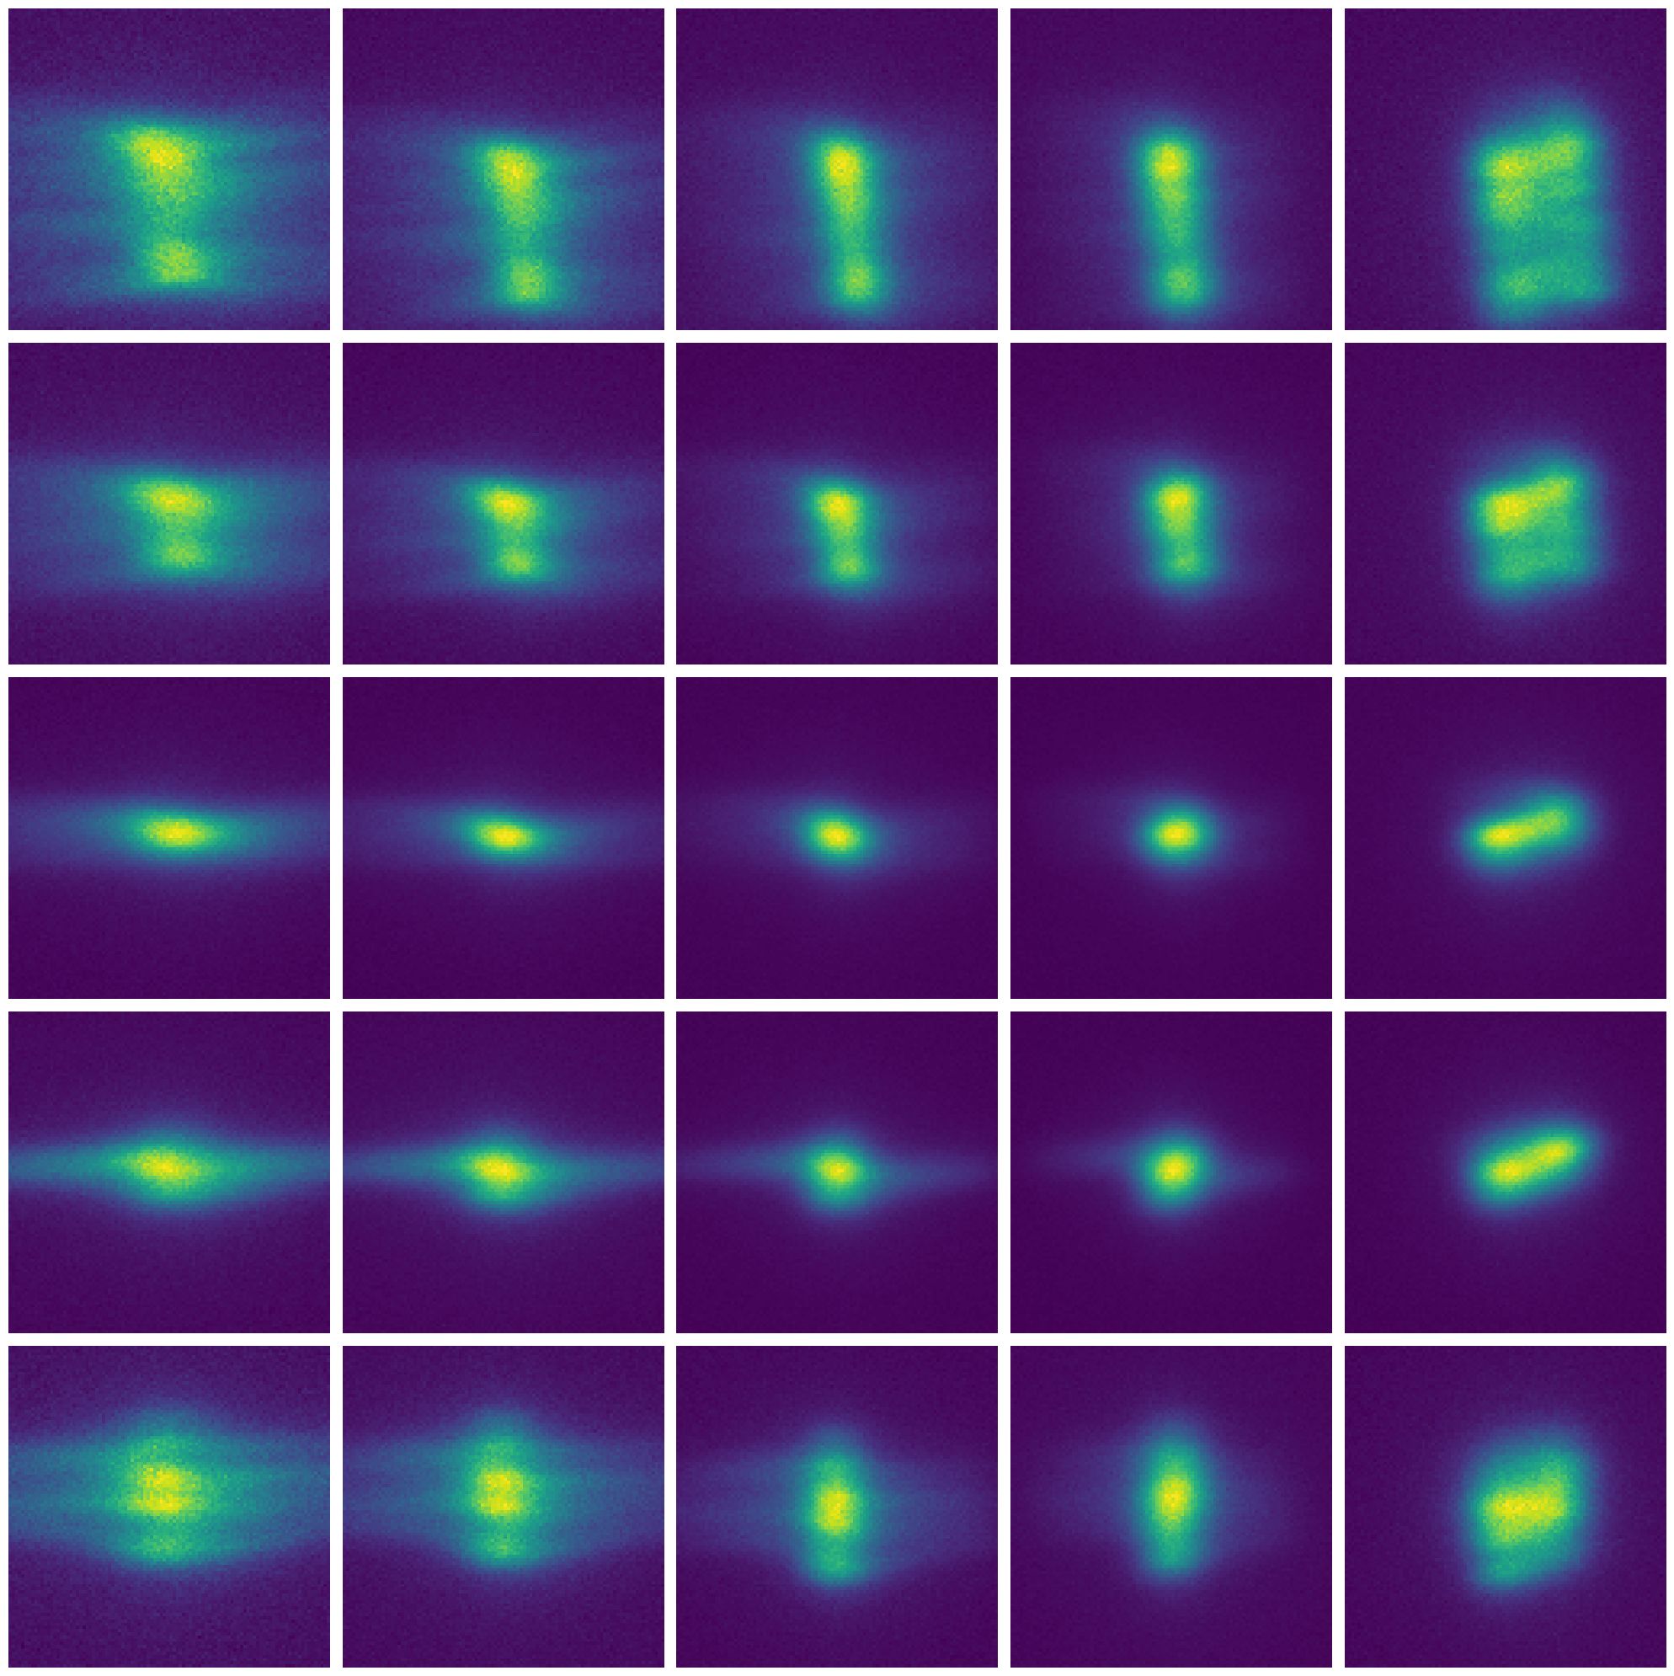
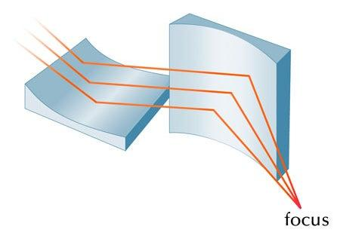
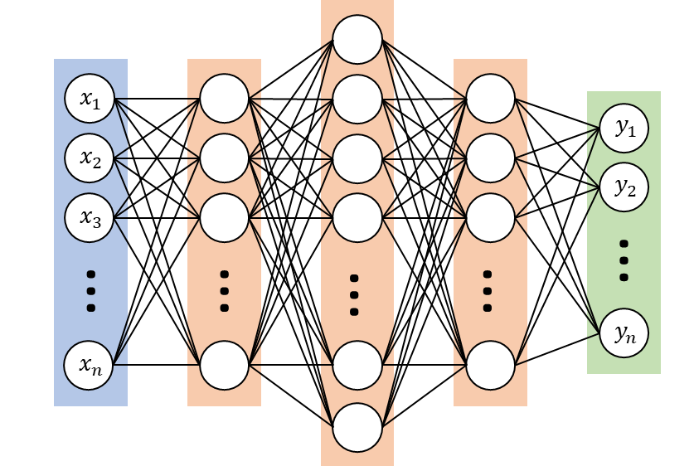
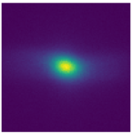






Simplified Use Case: KB mirrors
Wide Range of different Beams
A set of Kirkpatrick-Baez mirrors
Parameters: $\left\{\begin{aligned}\begin{matrix}R_{1} \\ R_{2}\end{matrix} \\ \begin{matrix}θ_{1} \\ θ_{2}\end{matrix}\end{aligned}\right.$
Output of DCM
$$θ_{2}$$
$$R_{2}$$
$$R_{1}$$
$$θ_{1}$$
Sample
The User define an experiment that needs a certain beam:
$\left\{\begin{aligned}\begin{matrix}R_{1} \\ R_{2}\end{matrix} \\ \begin{matrix}θ_{1} \\ θ_{2}\end{matrix}\end{aligned}\right.$
dX, dY
KB Parameters
Input
Regression

Slide 3
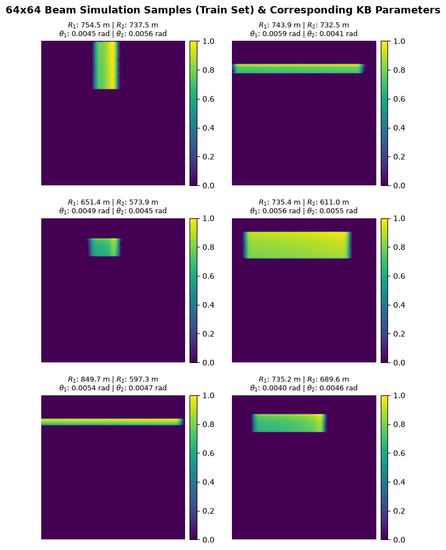
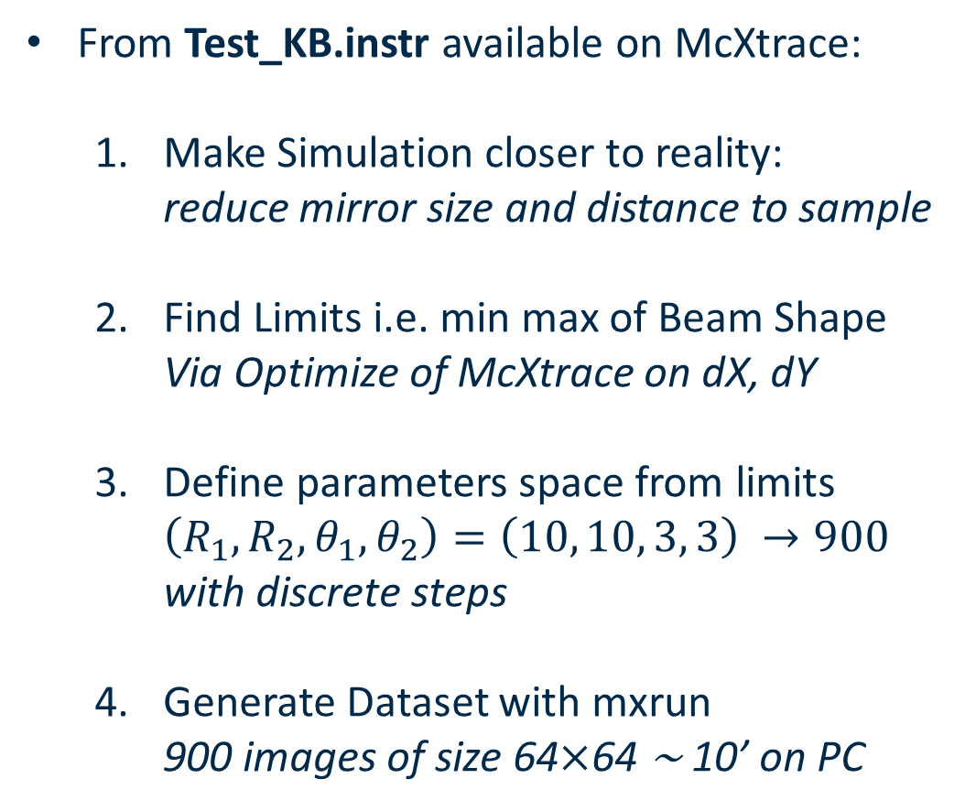
Dataset Generation
From Test_KB.instr available on McXtrace:
  Make Simulation closer to reality:
  reduce mirror size and distance to sample
  Find Limits i.e. min max of Beam Shape
  Via Optimize of McXtrace on dX, dY
  Define parameters space from limits
  $\left(R_{1},R_{2},θ_{1}, θ_{2}\right)=\left(10, 10, 3, 3\right) →900$
  $\text{with} \text{discrete} \text{steps}$
  Generate Dataset with mxrun
  900 images of size 64$×$64 ∼ 10’ on PC

Slide 4
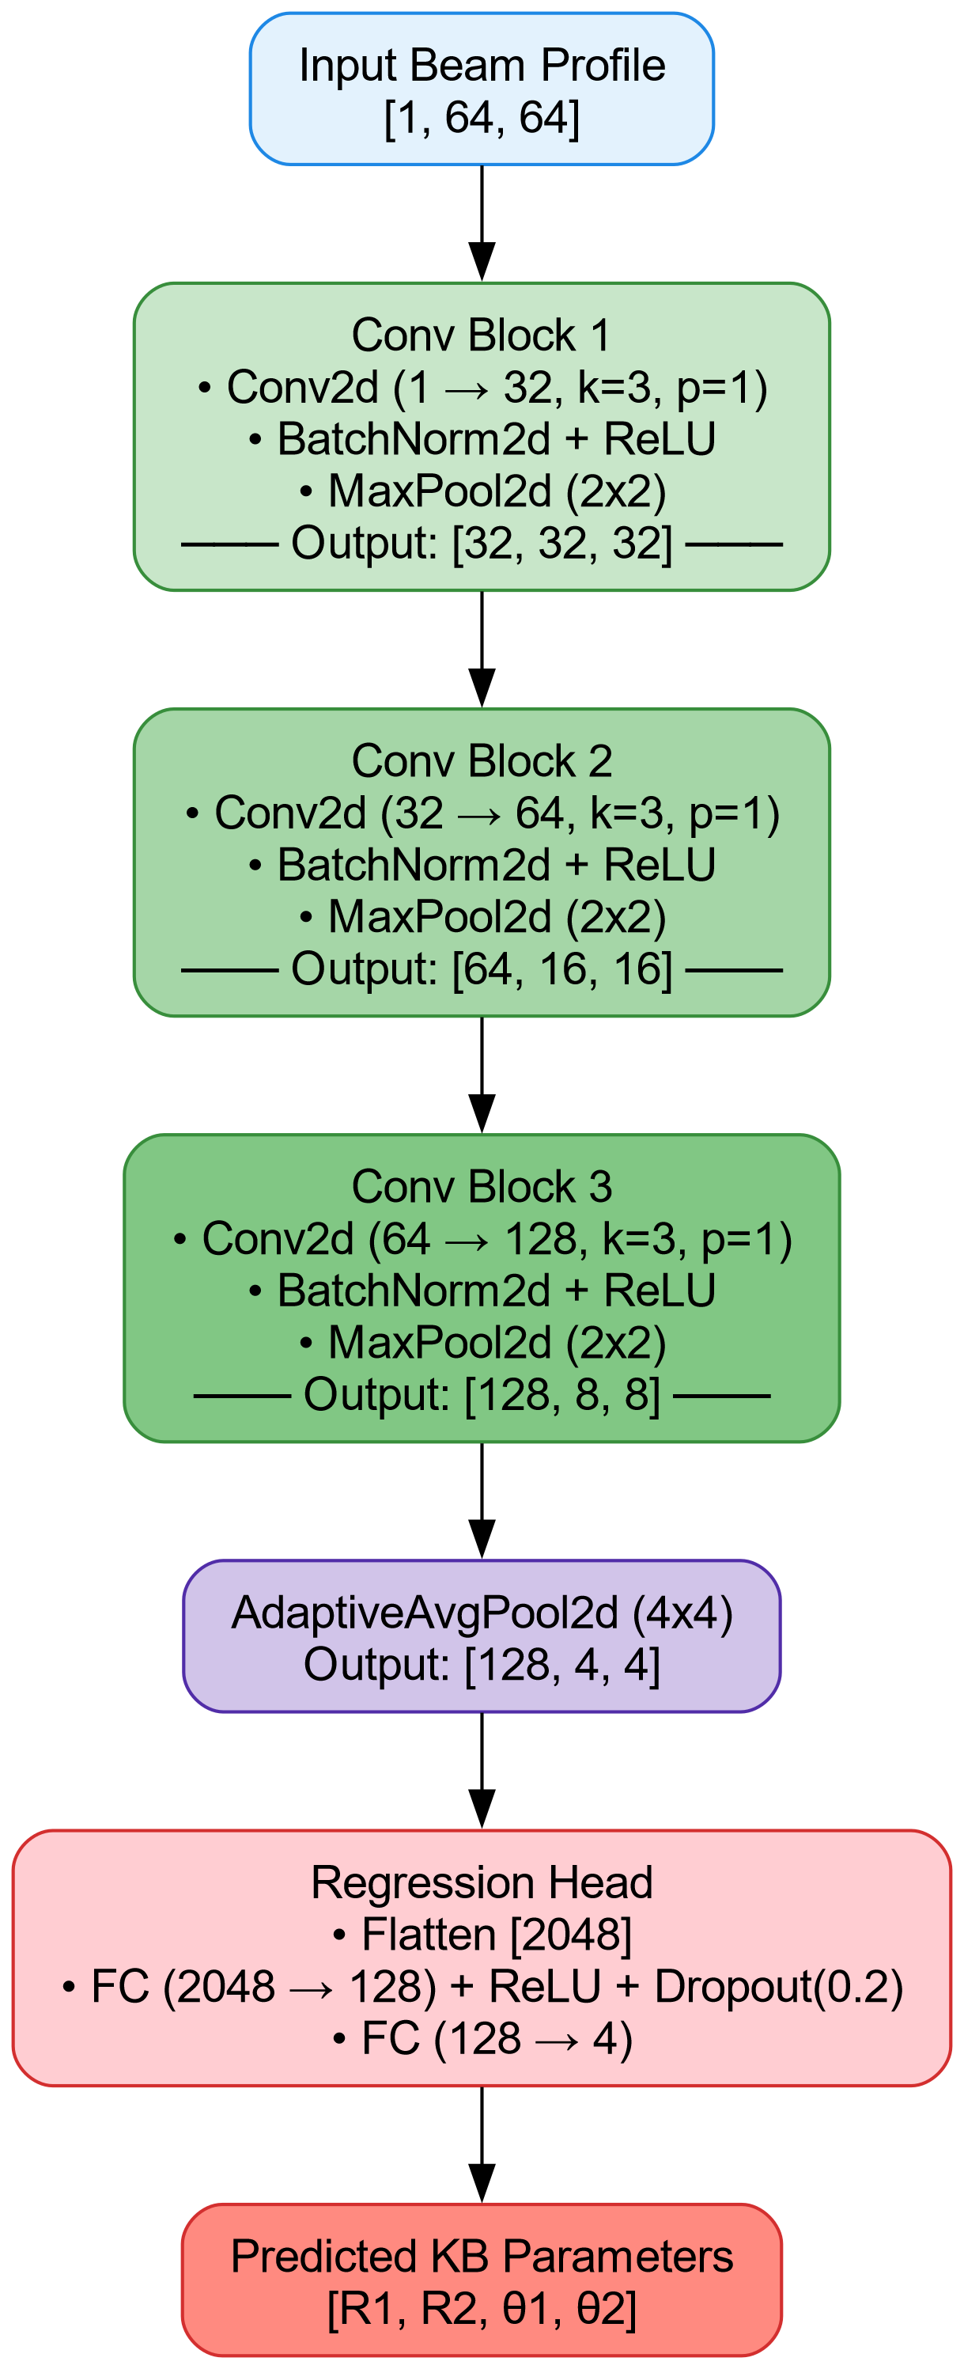
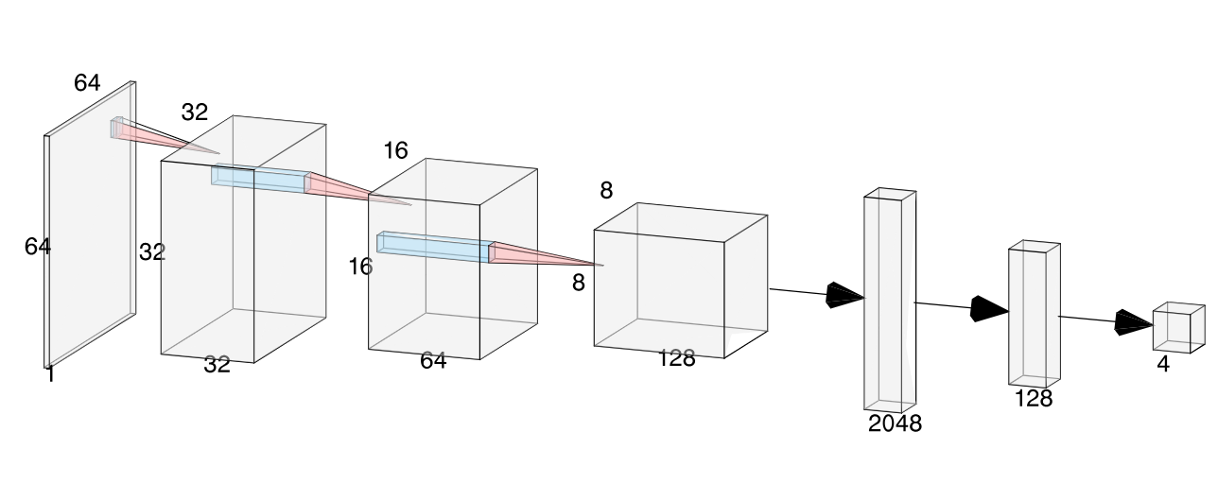
Our NN Architecture
Convolution Neural Network:

Slide 5
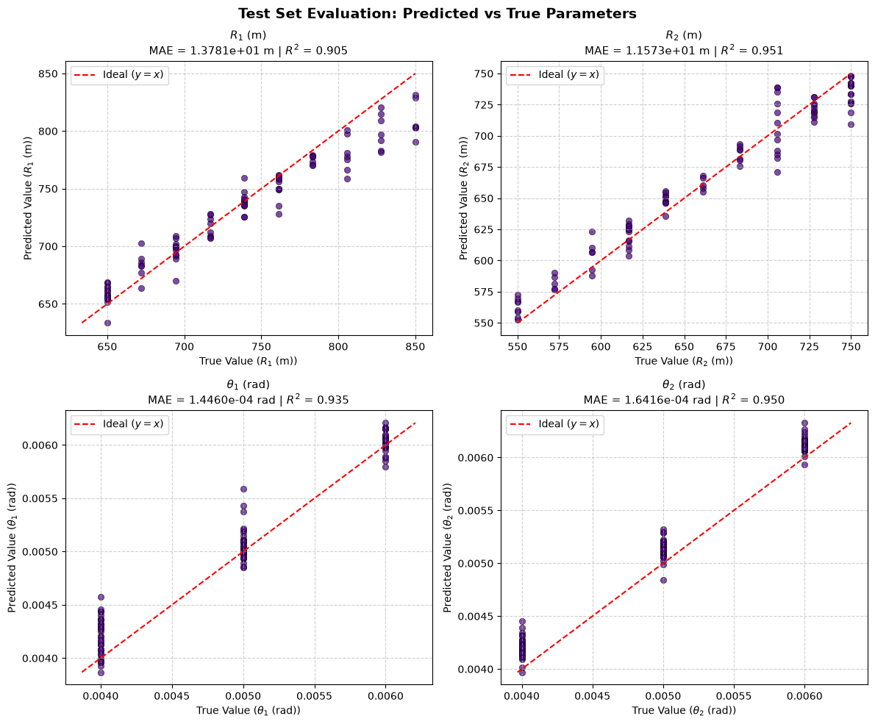
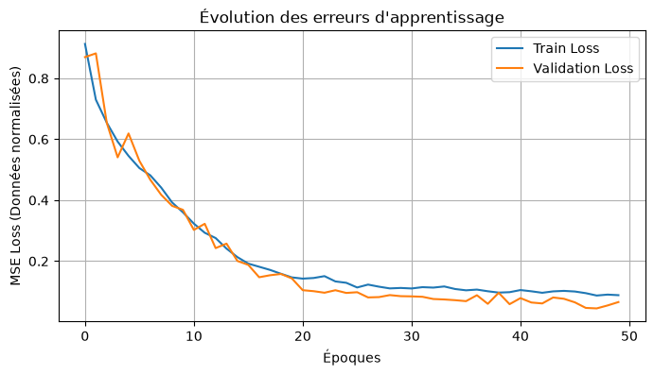
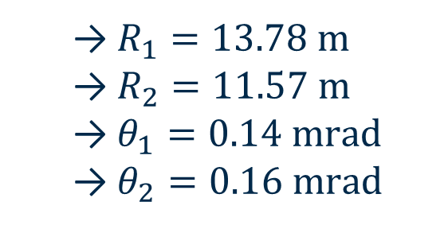
TRAINING 1
Trained with 720 images on 50 epochs (batch_size=32)
Finals MAEs
(8.8%)
  $R_{1}=13.78 \text{m}$
  $R_{2}=11.57 \text{m}$
  $θ_{1}=0.14 \text{mrad}$
  $θ_{2}=0.16 \text{mrad}$

Slide 6
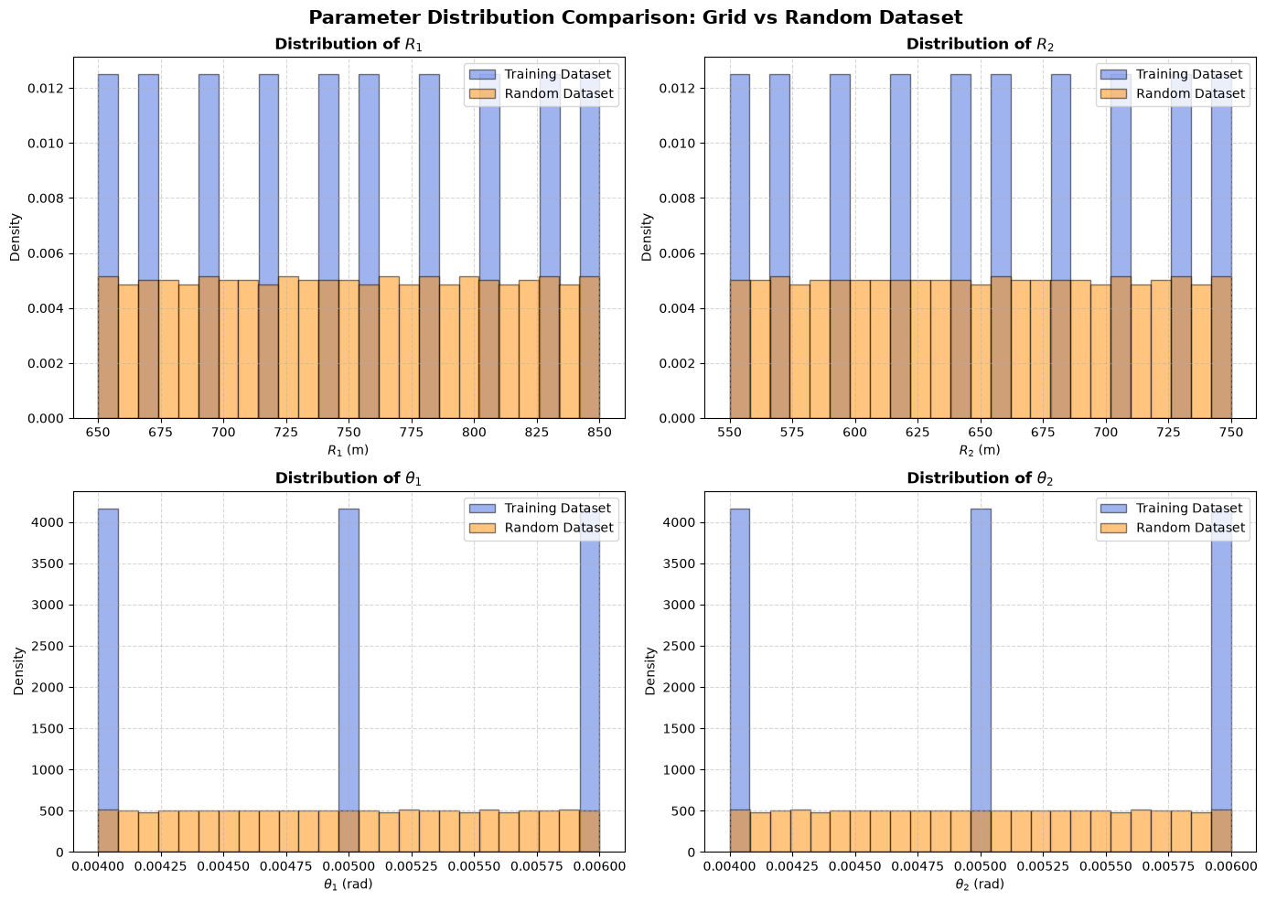

Slide 7
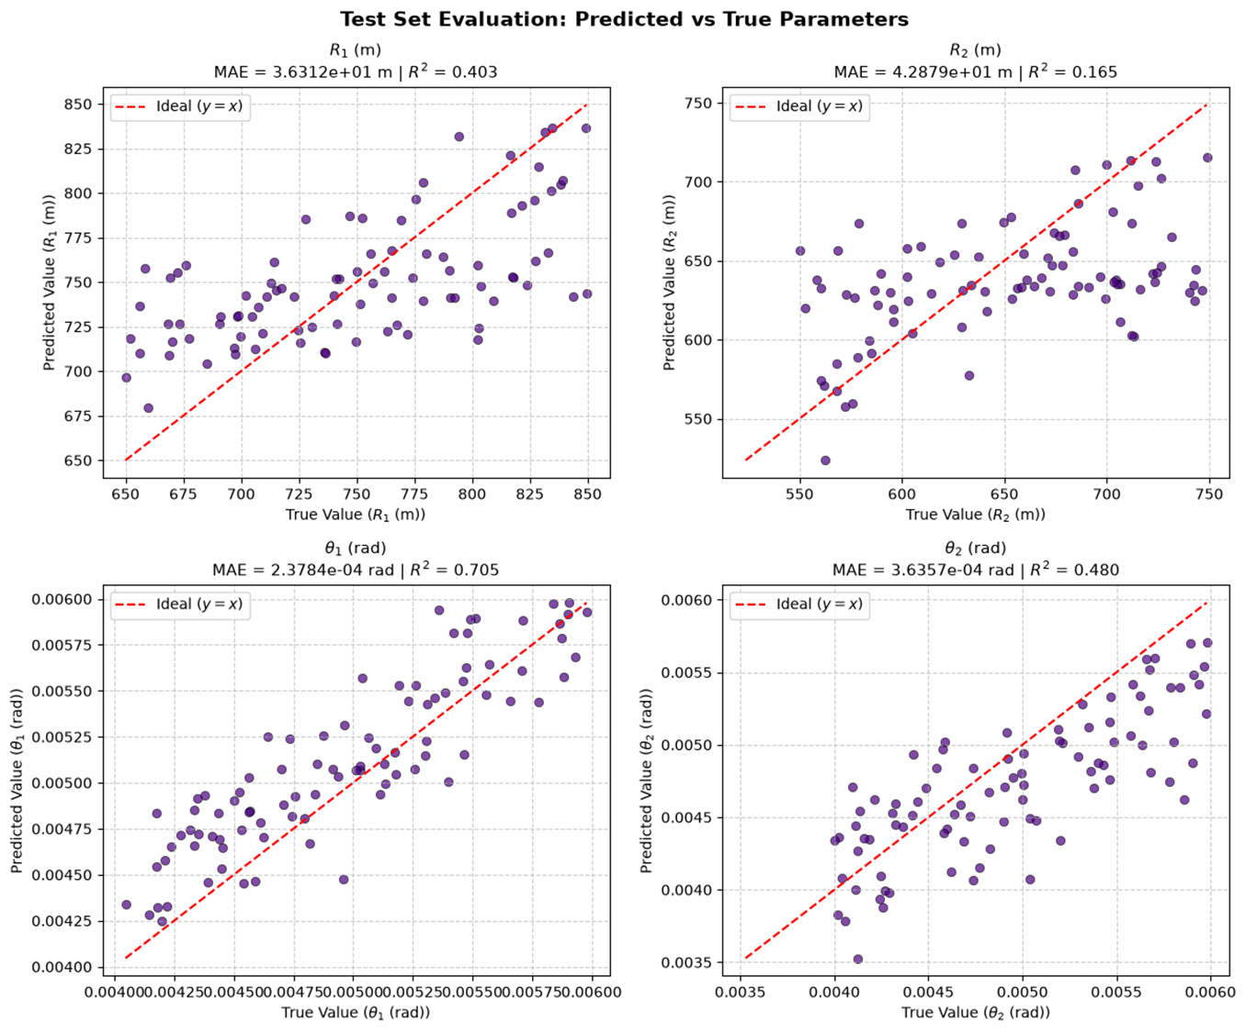
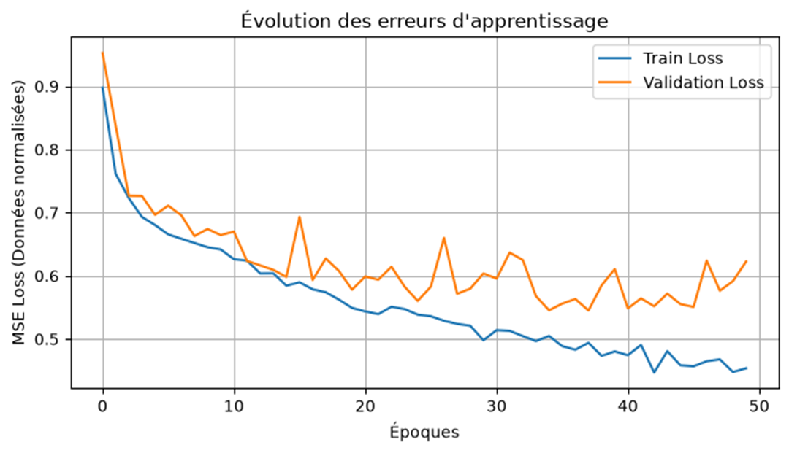
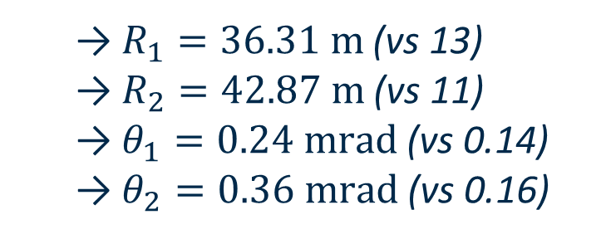
TRAINING 2
Finals MAEs
(45% vs 8.8)
  $R_{1}=36.31 \text{m}$ (vs 13)
  $R_{2}=42.87 \text{m}$ (vs 11)
  $θ_{1}=0.24 \text{mrad}$ (vs 0.14)
  $θ_{2}=0.36 \text{mrad}$ (vs 0.16)

Slide 8
Perspectives
On the Use Case:
  Increase Size of the Training Dataset?
  Explore a more complete range of the parameters
For the Future:
  Input more Beamline Optics (DCM, Mirrors, slits) and parameters
  Try to Maximize Intensity for a given Beam Shape
  Extend this method to different Energies

