Slide 1

GROUP 1 Project:
Isolating the Incoherent and Coherent scattering contributions

Slide 2
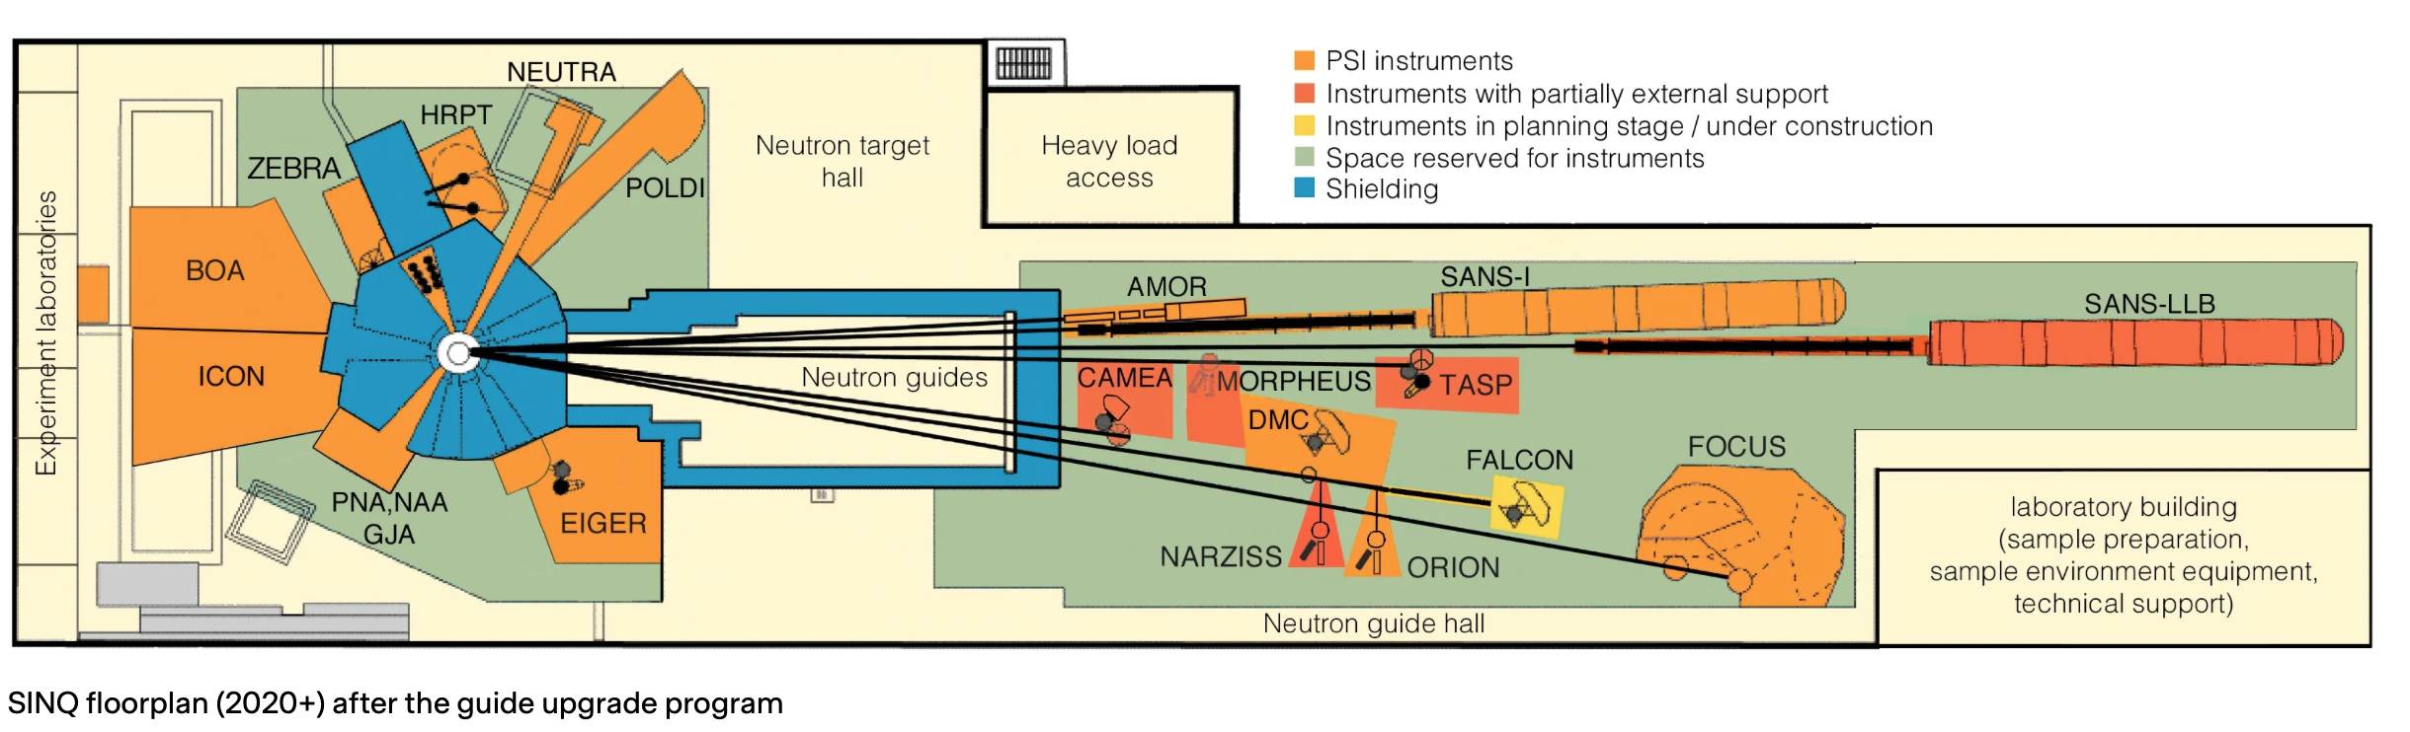
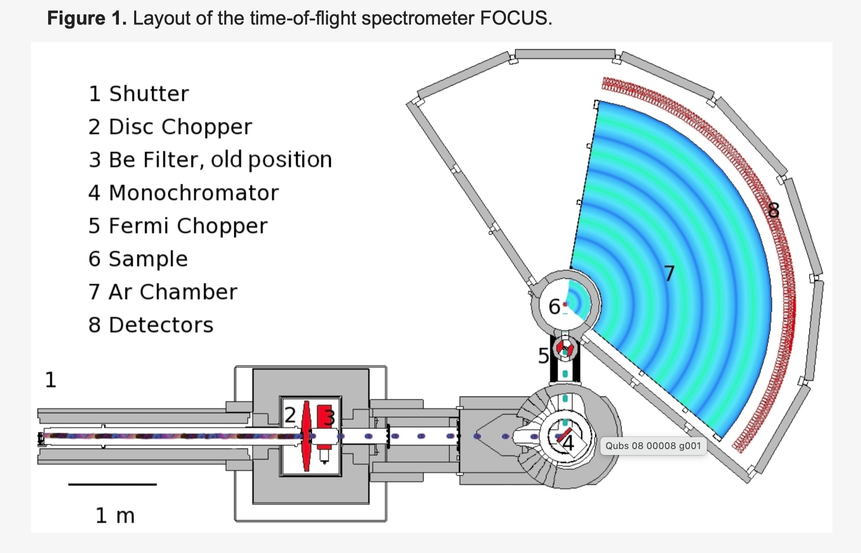
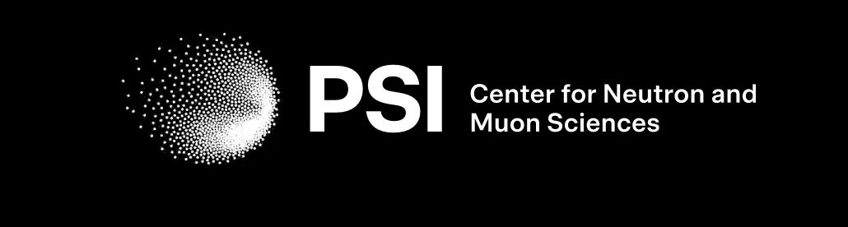
Instrument: FOCUS

Slide 3
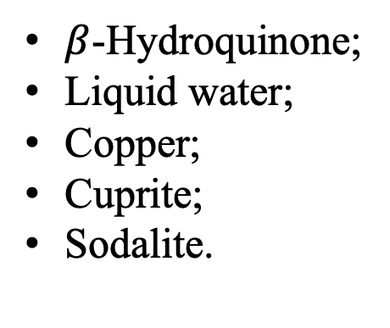
SAMPLES and Parameters
5 Samples
$β$-Hydroquinone;
Liquid water;
Copper;
Cuprite;
Sodalite.

Slide 4

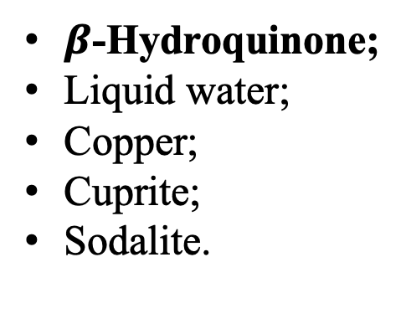
SAMPLES and Parameters
5 Samples
Parameters
x
$β$-Hydroquinone;
Liquid water;
Copper;
Cuprite;
Sodalite.
Temperature
range = 100 to 300 K
step size of = 10 K
on Juliet (CPUs)

Slide 5
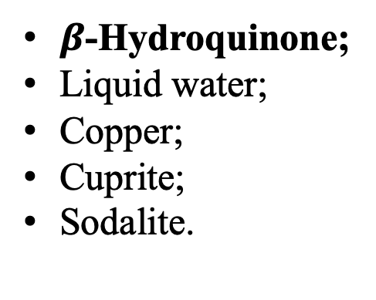

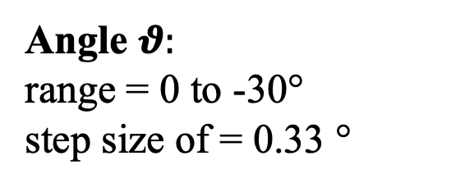
SAMPLES and Parameters
5 Samples
Parameters
x
$β$-Hydroquinone;
Liquid water;
Copper;
Cuprite;
Sodalite.
Angle $θ:$
range = 0 to -30°
step size of = 0.33 °
$$θ$$
z
on Juliet (CPUs)

Slide 6
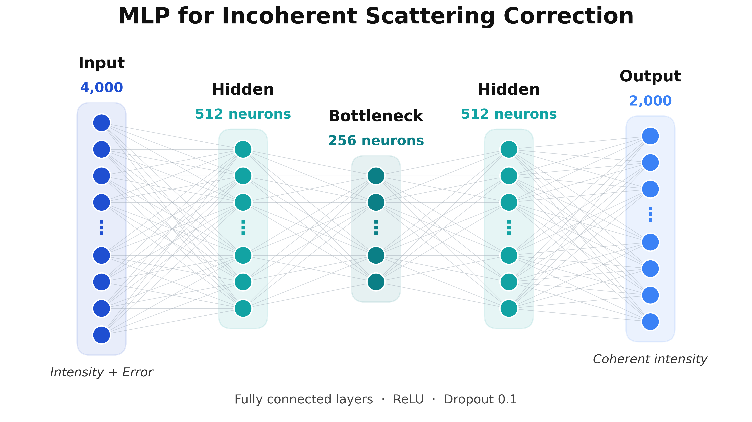
Under the Hood: The Multilayer Perceptron

Slide 7
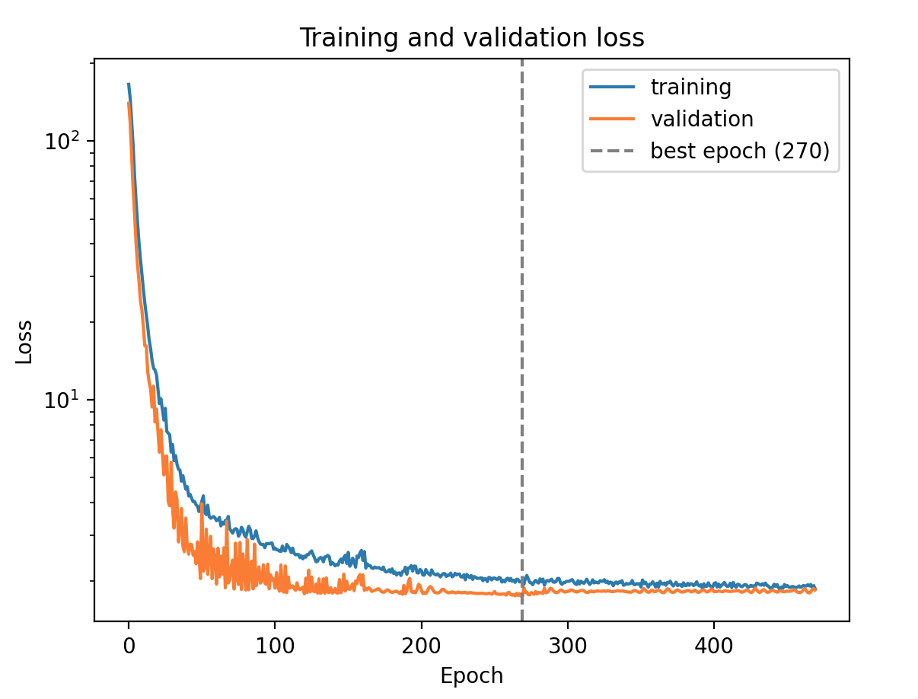
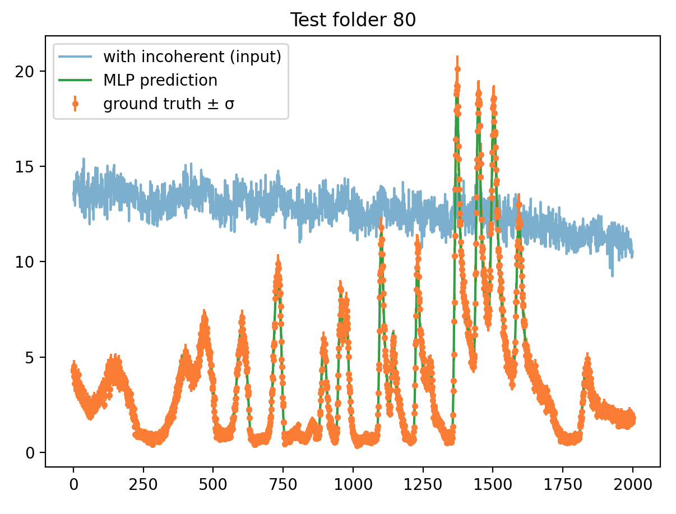
Results: Temperature scan for FIRST SamPLE
Hydroquinone

Slide 8
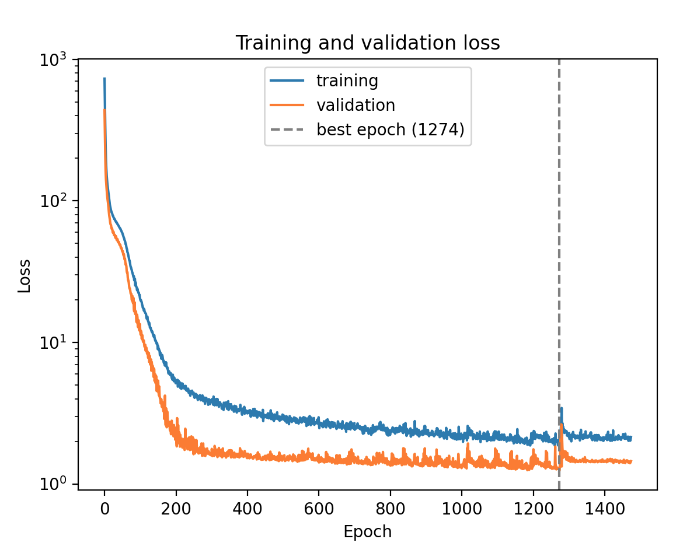
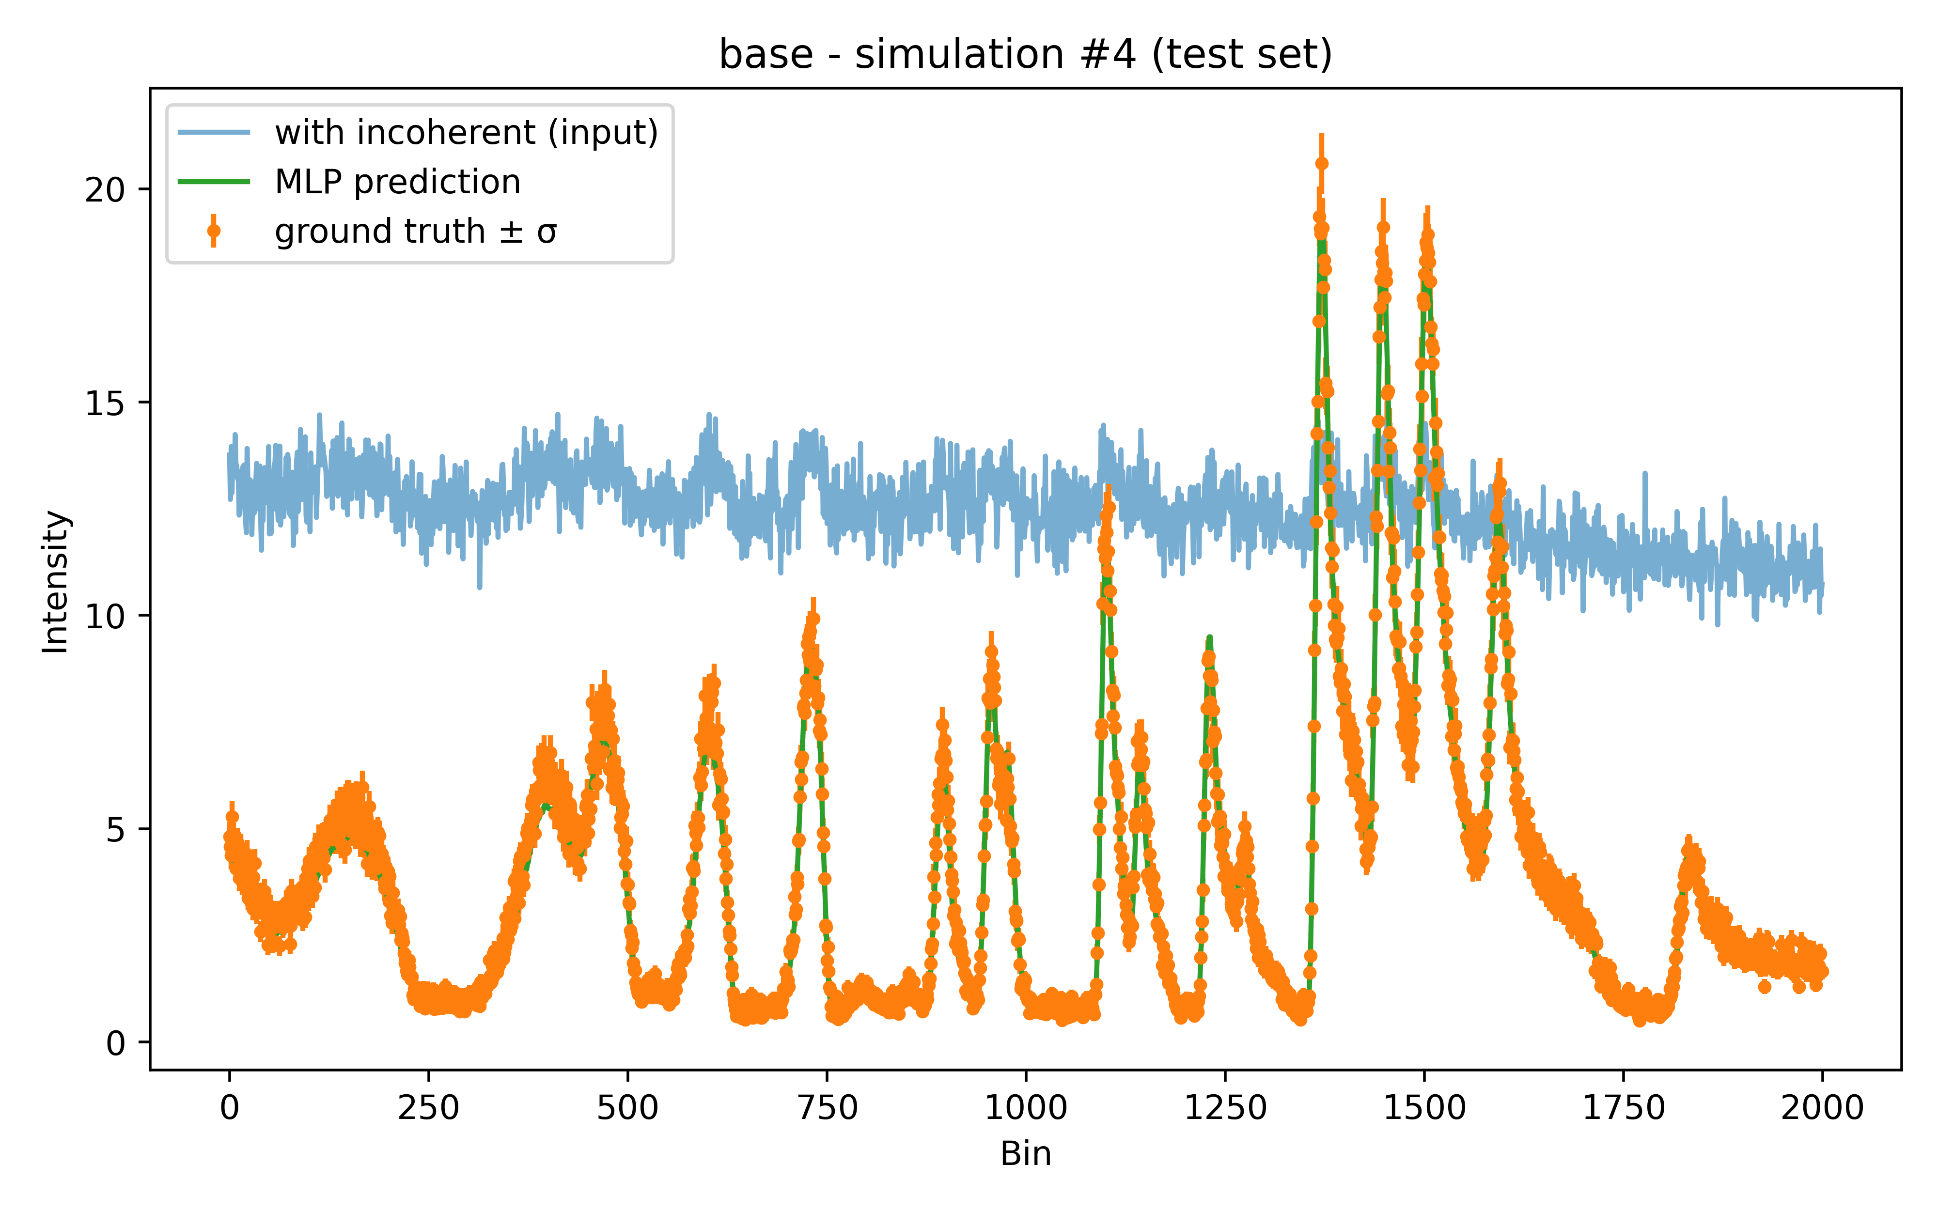

Results: ANGLE $θ$ SCAN for all 5 SAMPLES
Hydroquinone

Slide 9
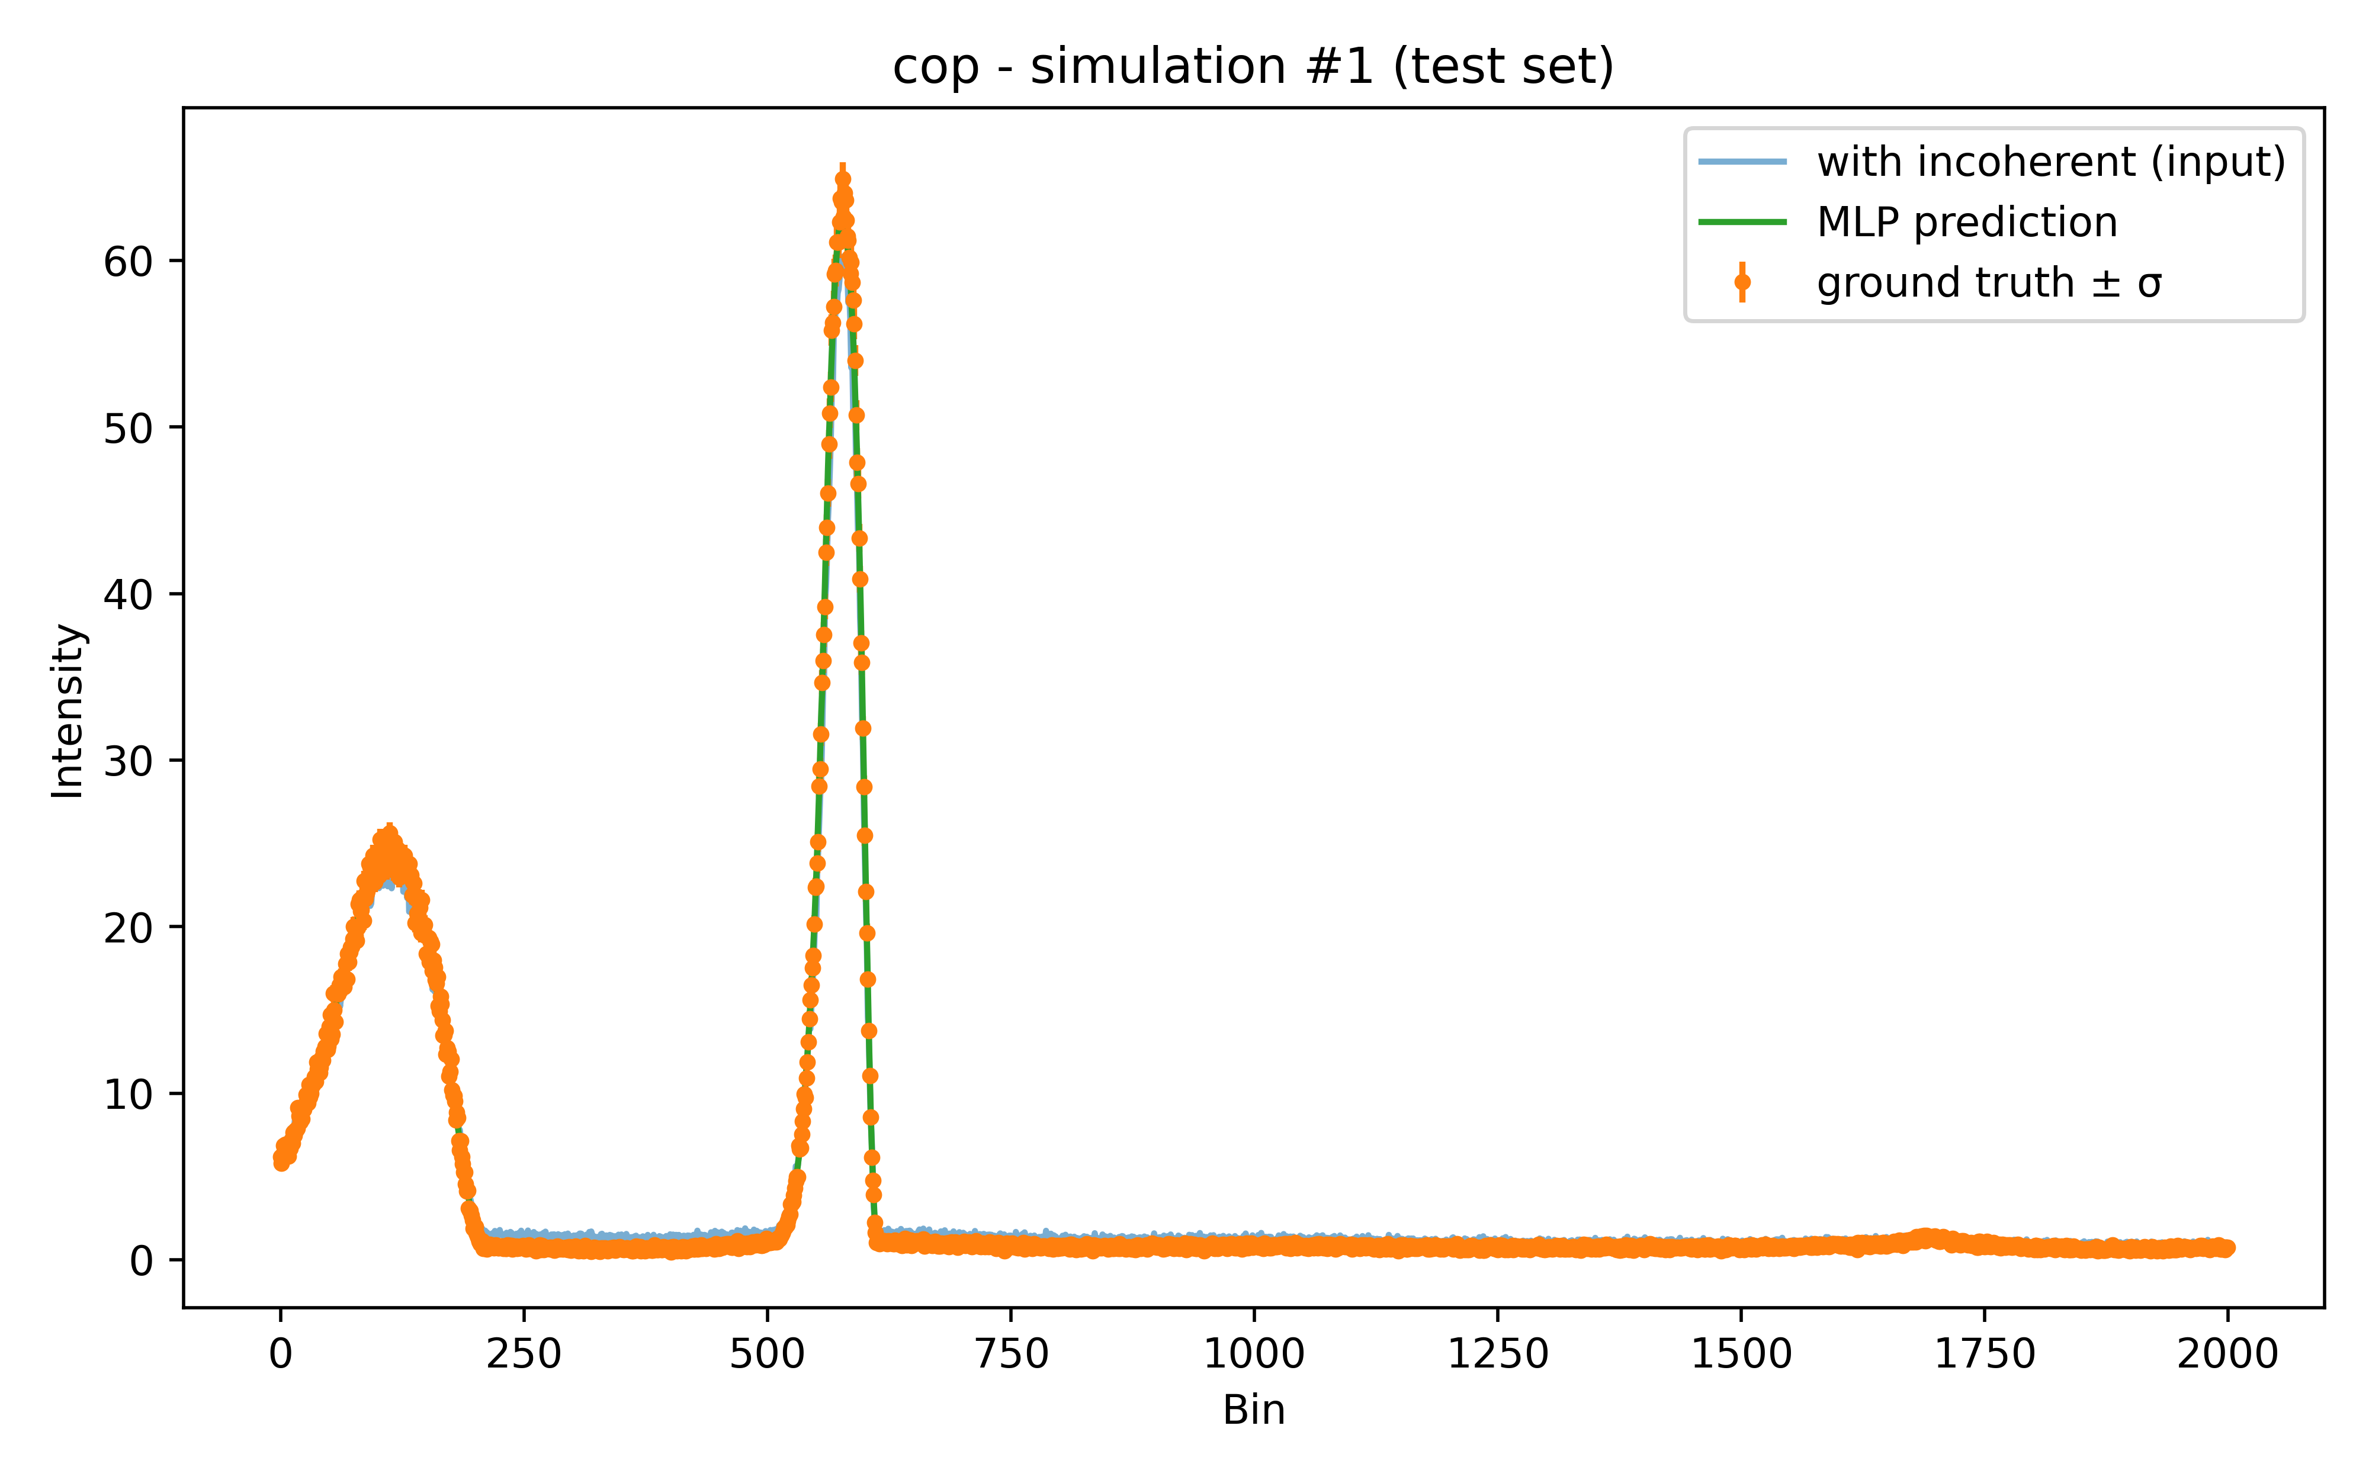
Results: ANGLE $θ$ SCAN for all 5 SAMPLES
Copper

Slide 10
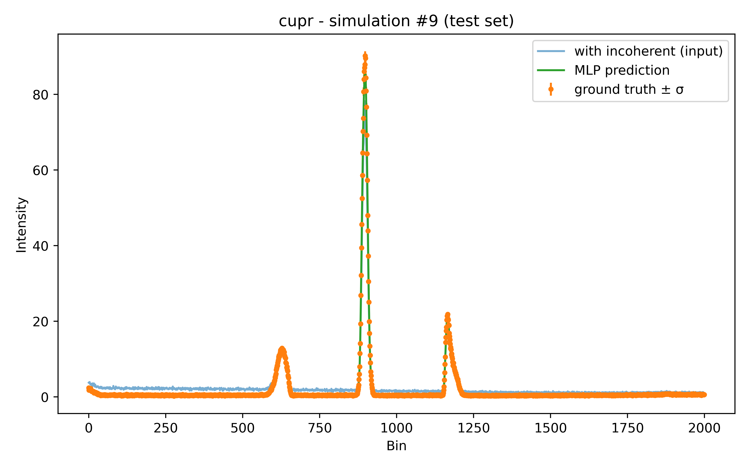
Results: ANGLE $θ$ SCAN for all 5 SAMPLES
Cuprite

Slide 11
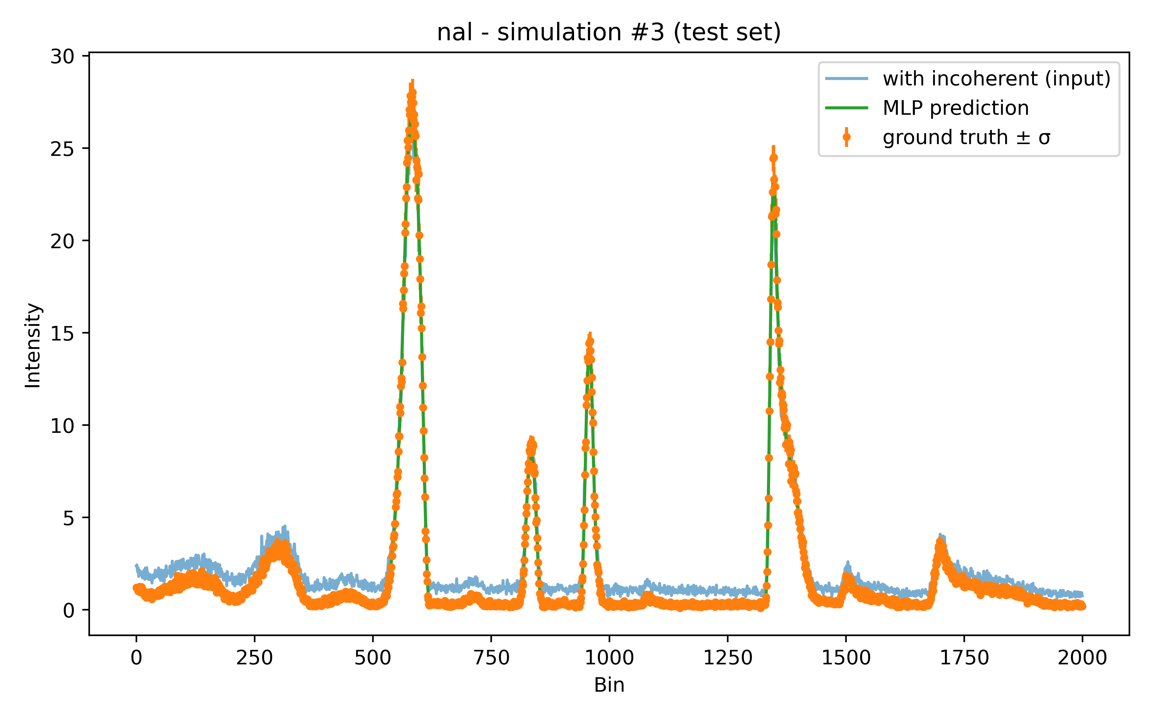
Results: ANGLE $θ$ SCAN for all 5 SAMPLES
Sodalite

Slide 12
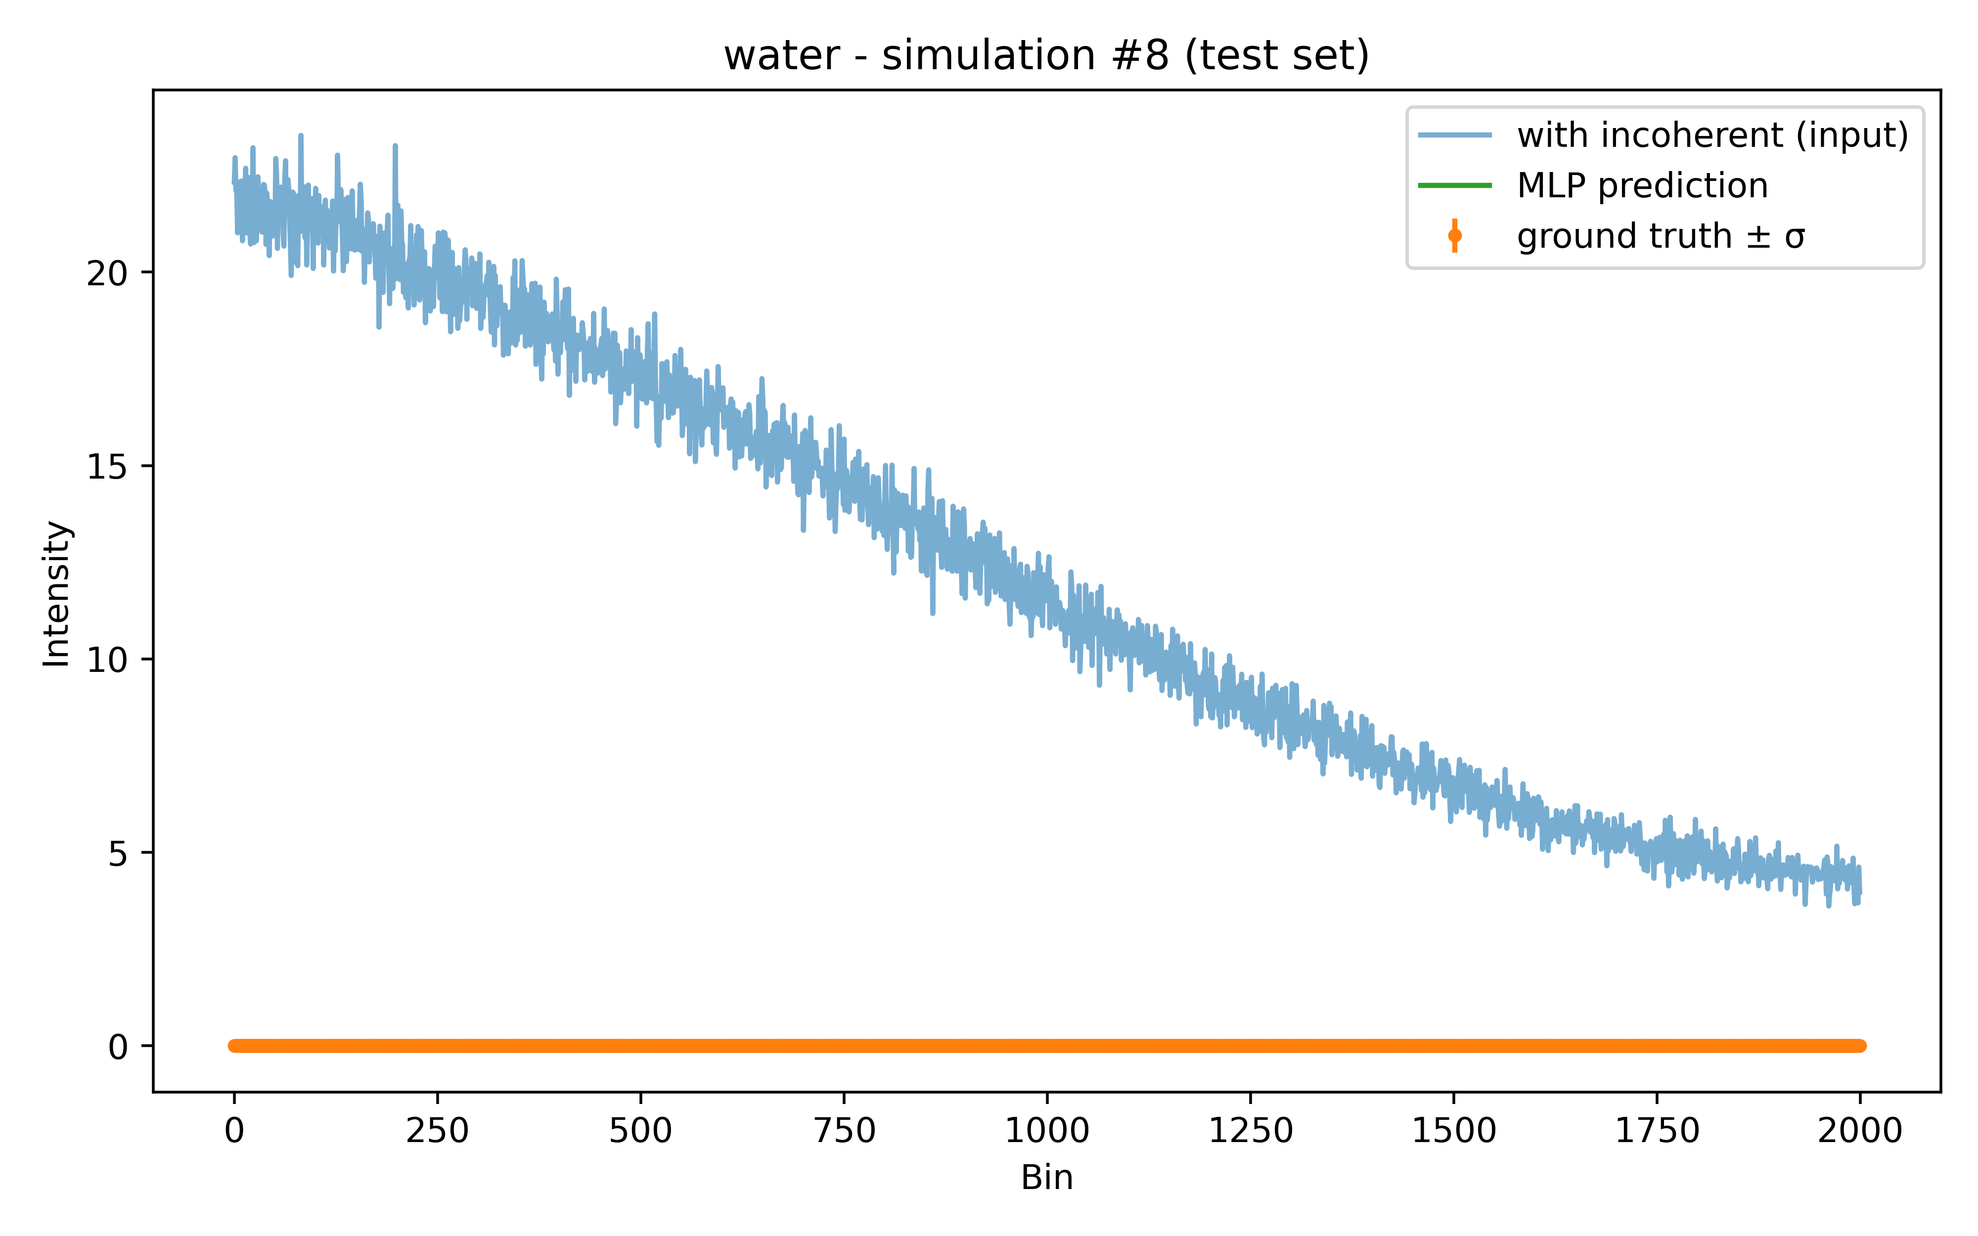
Results: ANGLE $θ$ SCAN for all 5 SAMPLES
Water

Slide 13
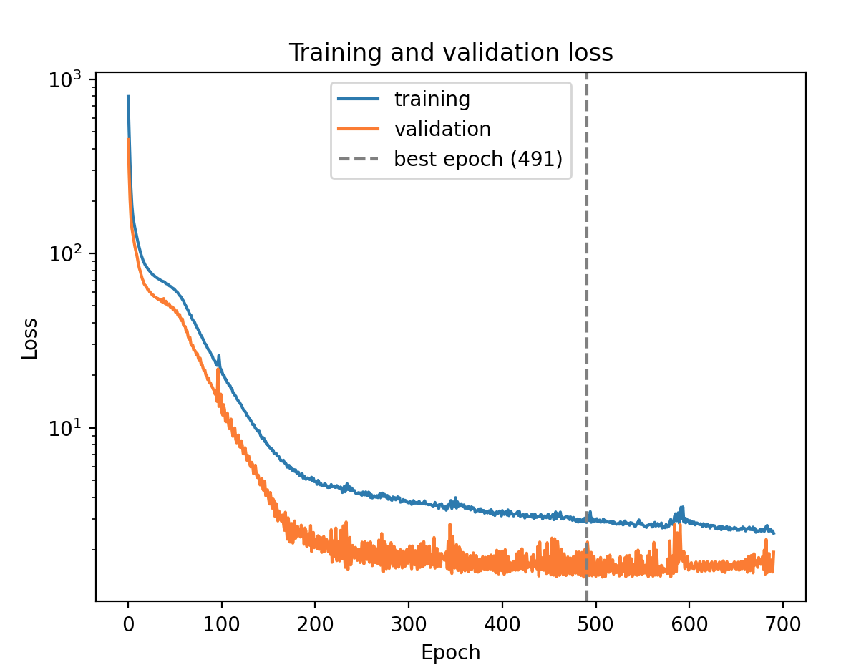
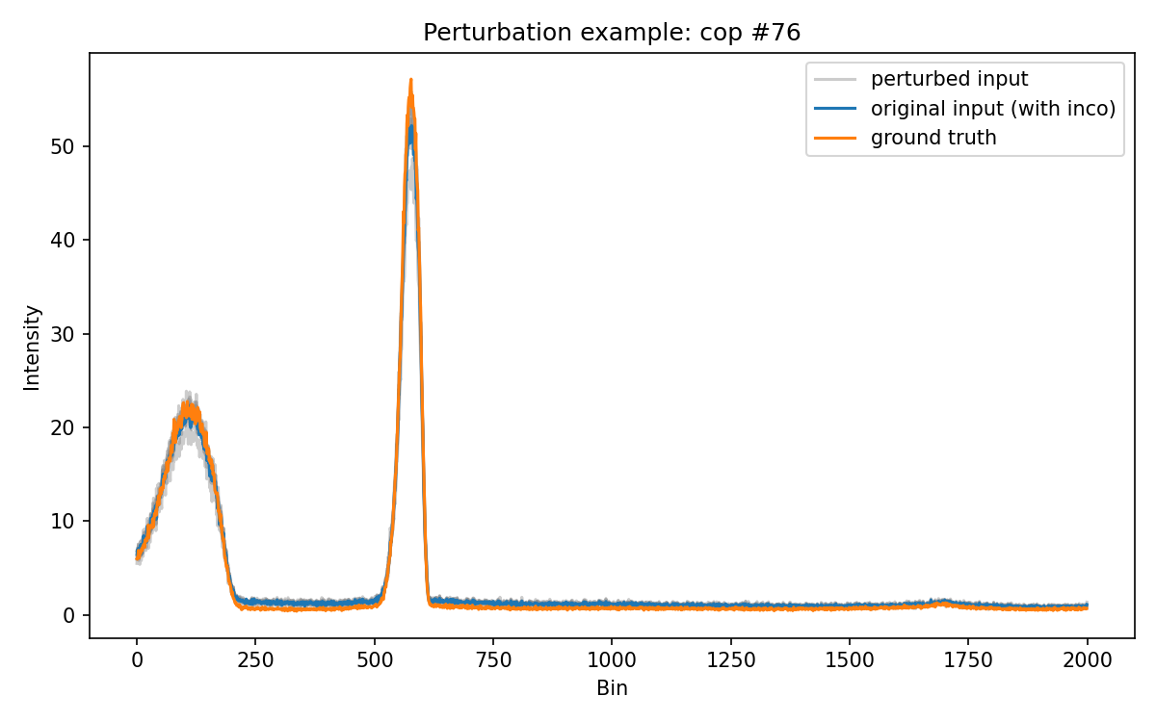
Shake It Up: Adding Perturbations

Slide 14
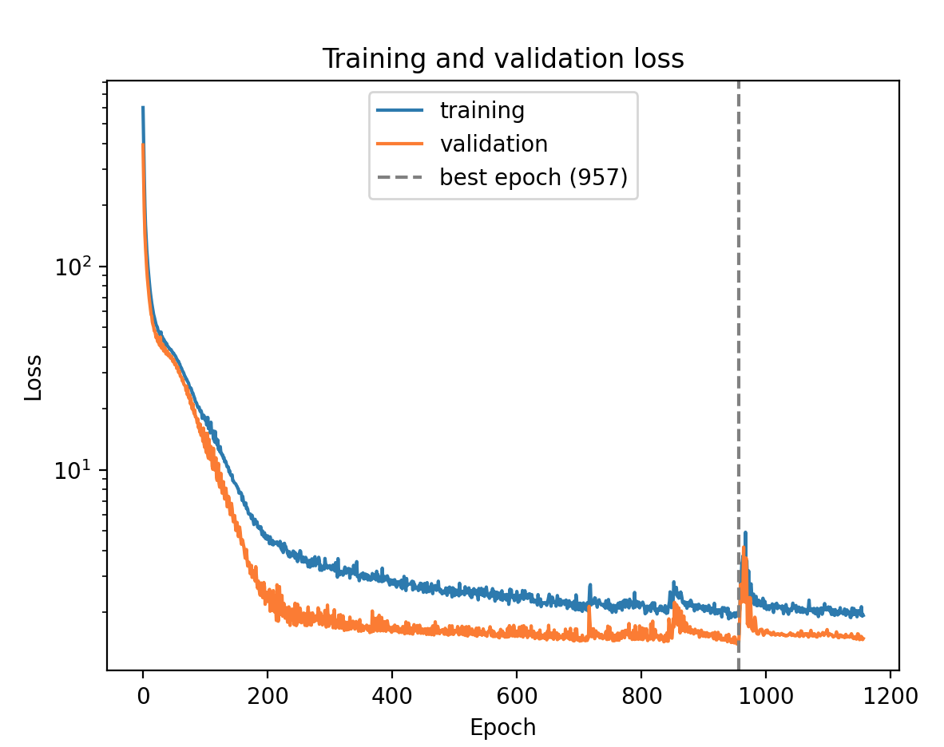
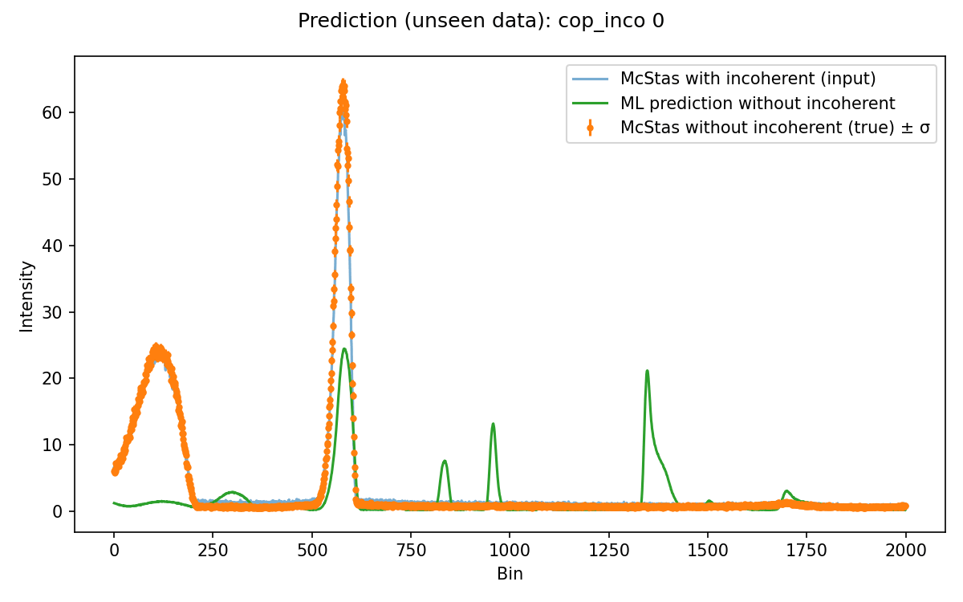

Blind Test: Can the Model Handle Copper?
Mcstas simulations at different $θ$ angles

Slide 15


Blind Test: Can the Model Handle Copper?
Mcstas simulations at different $β$ angles for Copper
Us: << Claude why the model fails? >>
Claude: << The model hasn't learned to remove the incoherent background. It has learned to recognize which of the four training materials a spectrum looks like and redraw that material's pattern. The extra peaks are most likely features copied from the other samples. >>

Slide 16
CLAUDE’S Suggestions
Claude: <<Changes that should help, most important first:
Predict only the background. Change the model so its output is the input minus a predicted incoherent background, with the background kept positive. A model that does nothing then already gives the input back, which for cop is almost perfect. It can no longer lose real peaks or invent new ones.
Use a 1D convolutional network instead of the fully connected one. It looks at local shapes rather than memorising whole spectra, so it copes better with peaks in places it hasn't seen before.
Normalise each spectrum on its own, instead of dividing all of them by one shared maximum.
Add more materials to training if you can simulate them. Four is very few for a model that has to generalise to a new one. >>

Slide 17
CLAUDE’S Suggestions
Claude: <<Changes that should help, most important first:
Predict only the background. Change the model so its output is the input minus a predicted incoherent background, with the background kept positive. A model that does nothing then already gives the input back, which for cop is almost perfect. It can no longer lose real peaks or invent new ones.
Use a 1D convolutional network instead of the fully connected one. It looks at local shapes rather than memorising whole spectra, so it copes better with peaks in places it hasn't seen before.
Normalise each spectrum on its own, instead of dividing all of them by one shared maximum.
Add more materials to training if you can simulate them. Four is very few for a model that has to generalise to a new one. >>

Slide 18
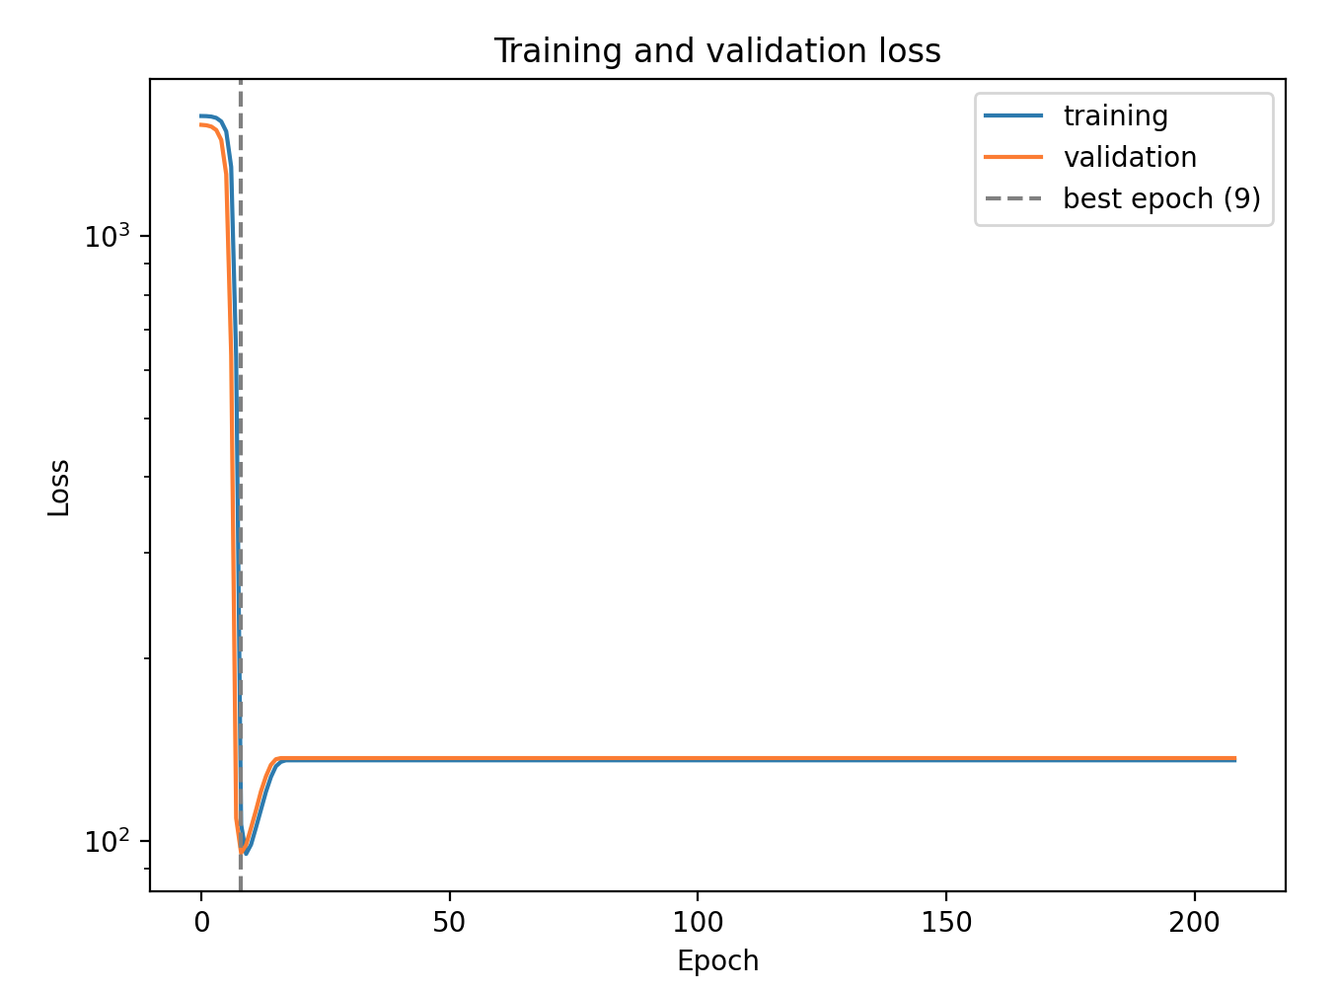
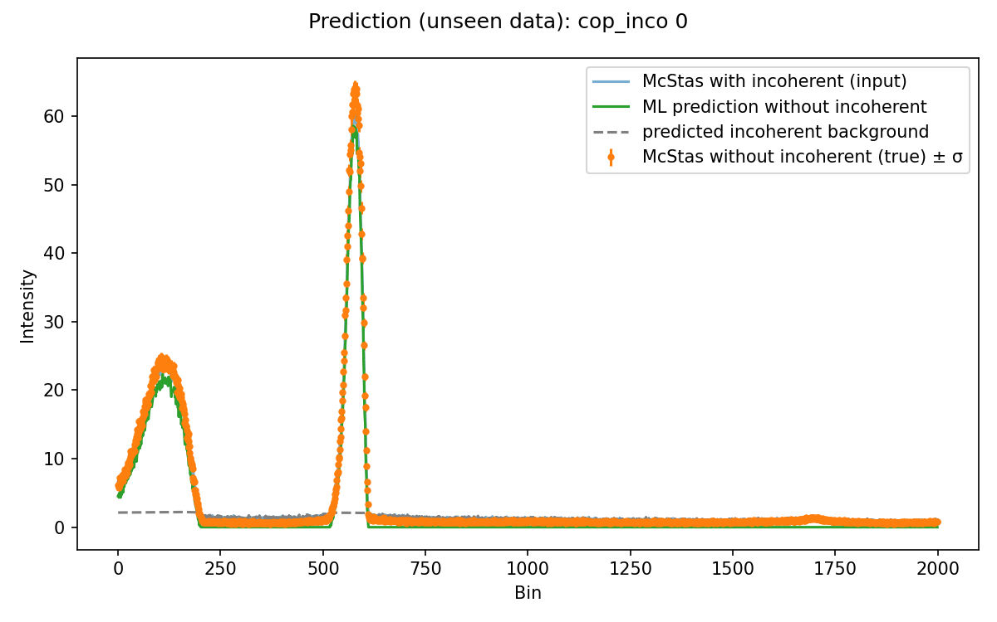
SOLUTION 1: predict only the background
Mcstas simulations at different $β$ angles for Copper

