Slide 1
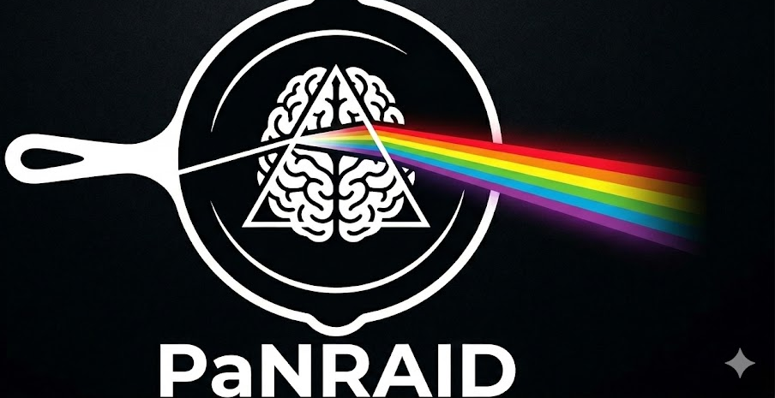

SAMPLE COMPONENTS
The physics at the heart
of the beamline
Diffraction, small-angle scattering, spectroscopy & imaging in McStas & McXtrace
McStas — neutrons
McXtrace — X-rays
Peter Willendrup · DTU Physics
PaNRAID School · supported by PEPR DIADEM

Slide 2
AGENDA
What we'll cover
Four techniques in focus, plus a map of everything else on offer.
1
What a sample does
2
Diffraction
A quick recap, and the sample menu at a glance
Powders and single crystals — neutrons and X-rays
3
Small-angle scattering
4
Absorption & fluorescence
SANS and SAXS, side by side
X-ray-only spectroscopy, with two worked examples
5
Imaging
6
Reflectometry & inelastic scattering
Neutron-only absorption-contrast radiography
Briefly — what's available today
7
Generic & advanced assemblies
8
The full picture
Resolution samples, Union, and the sasmodels library
One table, every technique, both codes
McStas & McXtrace · Sample Components
2

Slide 3
SHARED CONCEPT
What a sample component does
A sample intercepts the ray, decides — statistically — whether it scatters, transmits, or is absorbed, and updates the ray's state accordingly.
p_interact lets you force a chosen fraction of rays to scatter, improving statistics without biasing the physical intensity.
Most samples support several shapes out of the box: box, cylinder, sphere — or a hollow version of each via thickness.
Many also accept an arbitrary OFF/PLY mesh (geometry=file) for a truly custom shape — the same complex-geometry engine underneath the diffraction, spectroscopy and imaging samples we'll see today.
one ray, three possible fates
scattered
transmitted
sample
absorbed (removed)
Whichever happens, the ray's weight p is adjusted so the statistics stay correct on average.
McStas & McXtrace · Sample Components
3

Slide 4
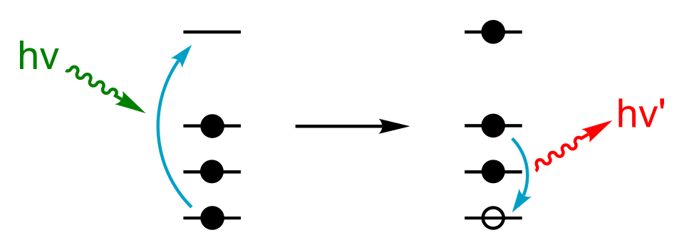
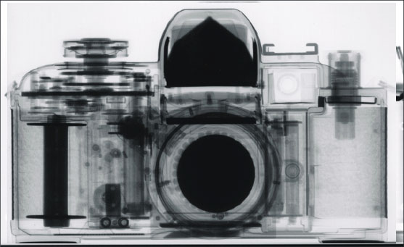
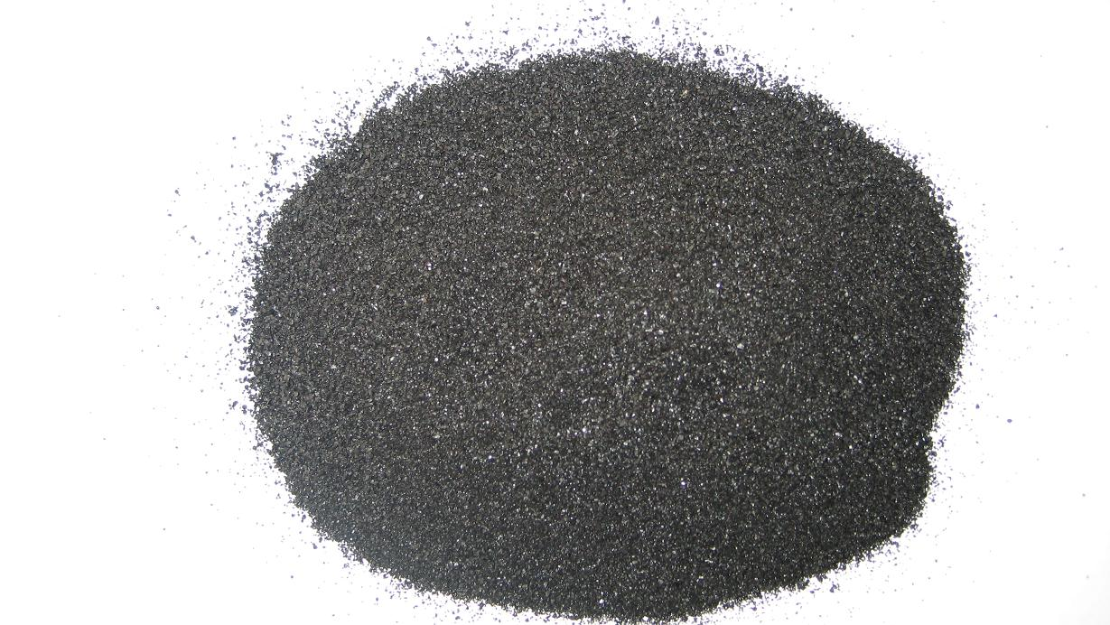
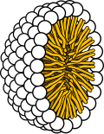
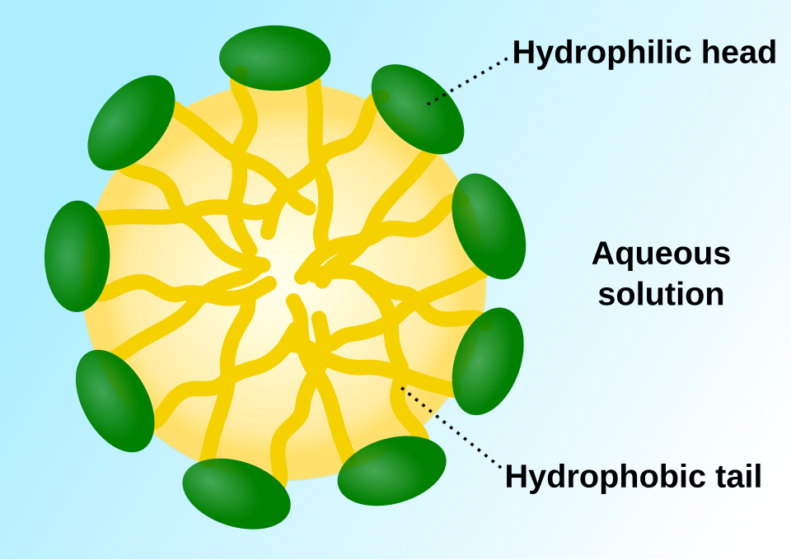
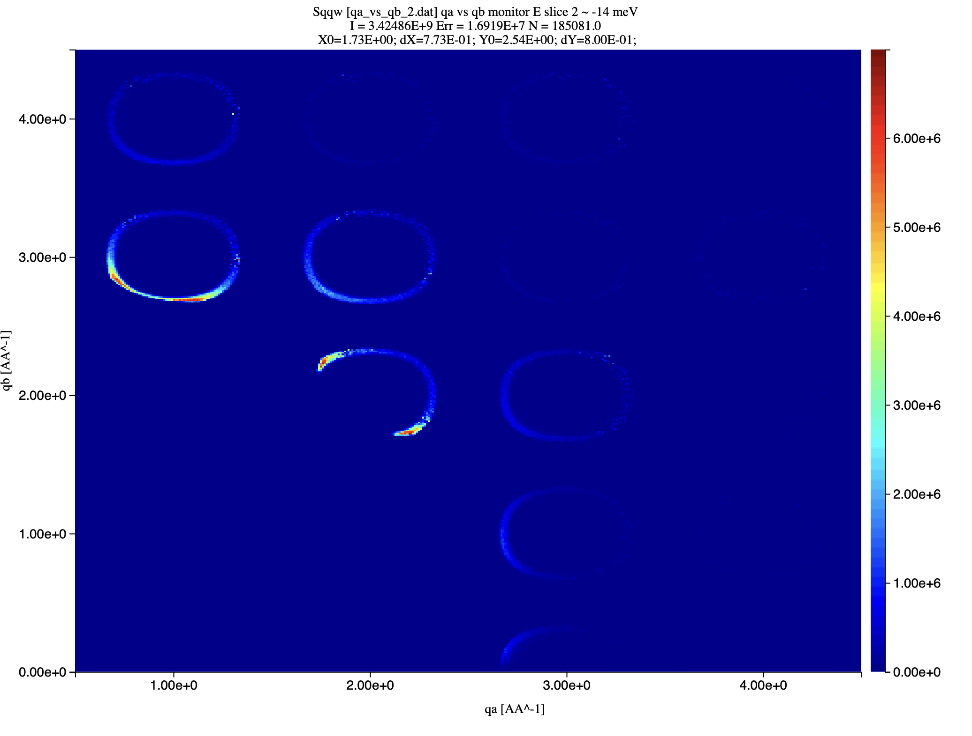
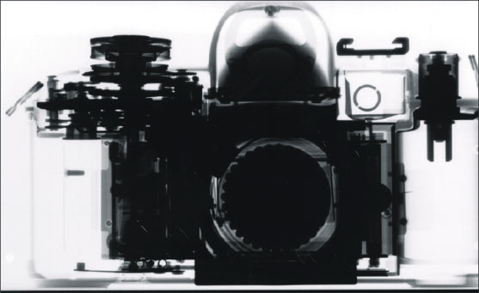
FRAMING
The sample menu, at a glance
Four techniques get the spotlight today — with a map of what else exists at the end.
Diffraction
SANS / SAXS
X-ray Spectroscopy
Imaging
…and more
Powders & single crystals. Both probes, both codes.
Molecular-scale structure from small-angle scattering.
Absorption edges and fluorescence lines.
Absorption-contrast radiography & tomography.
Reflectometry, inelastic scattering, generic & advanced tools.
X-RAY ONLY
All the rest!
Inelastic neutron Scattering
NEUTRONS
X-ray imaging can of course also be done – but is left out of PaNRAID to reduce school scppe…
NEUTRON + X-RAY
NEUTRON + X-RAY
Phonons, Magnons, Spinwaves…
SEE SUMMARY
Left out of PaNRAID to
reduce school scope…
McStas & McXtrace · Sample Components
4
NEUTRON ONLY
X-RAYS
Left out of PaNRAID to
reduce school scope…

Slide 5
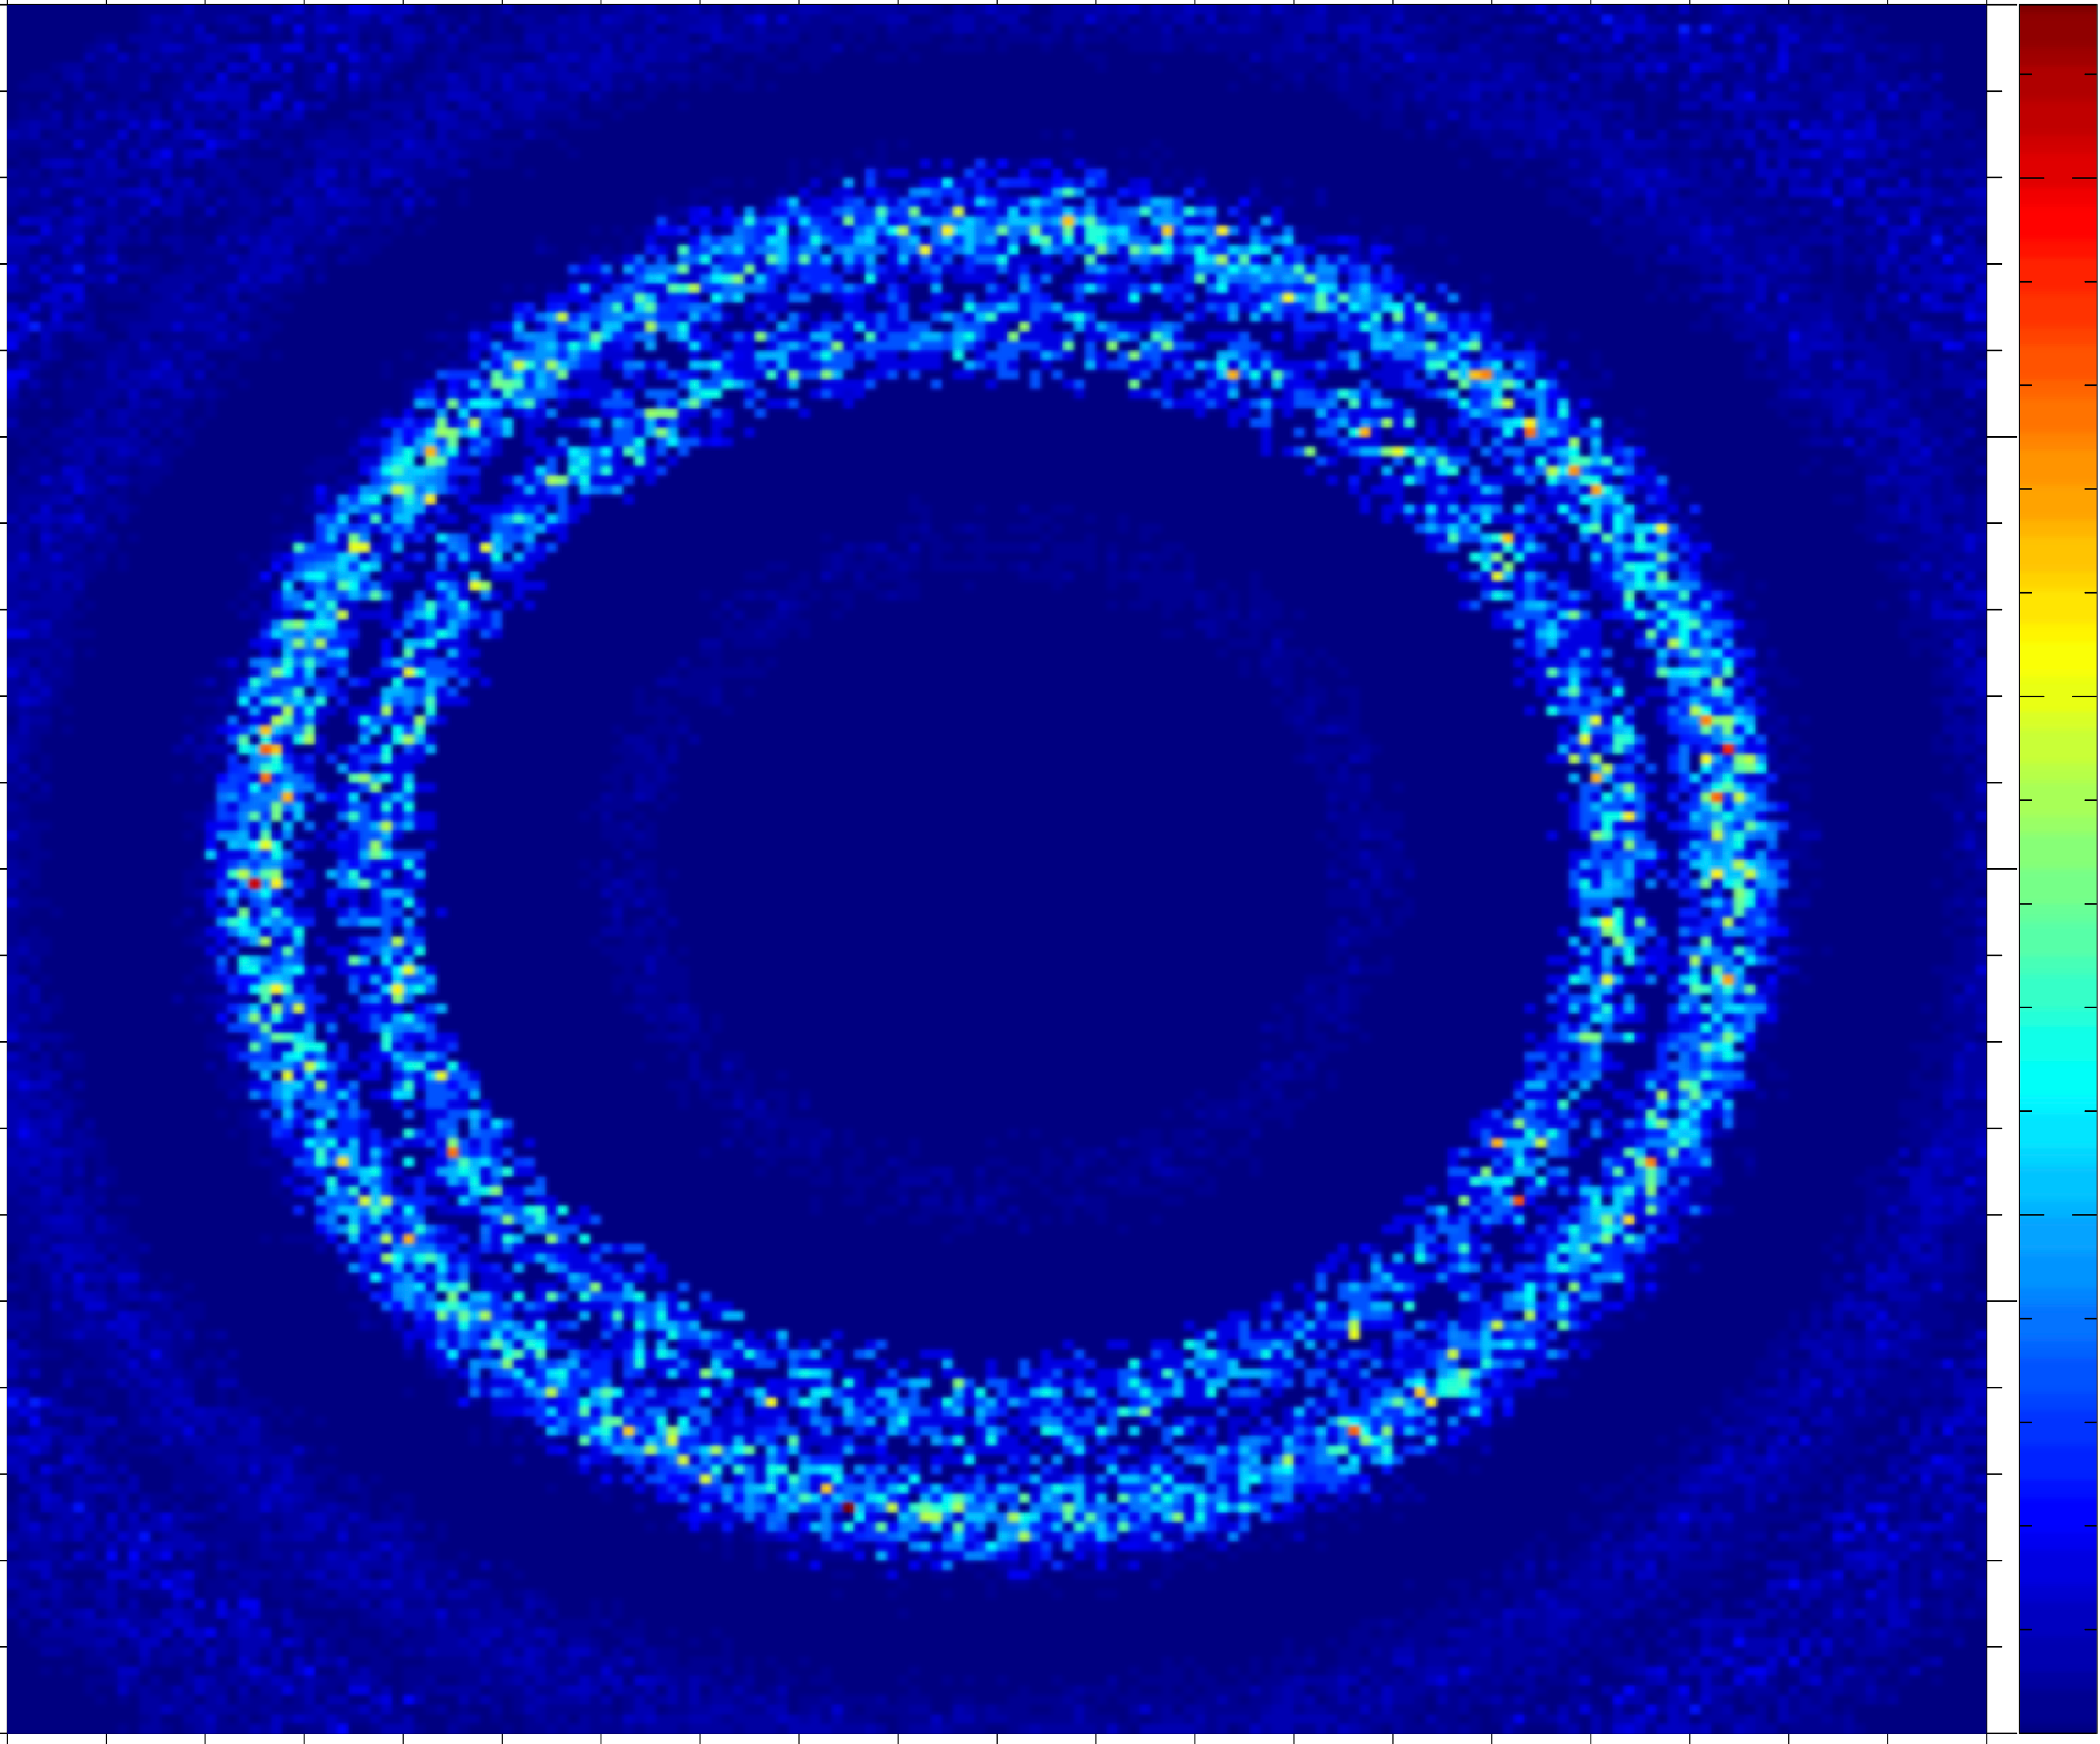
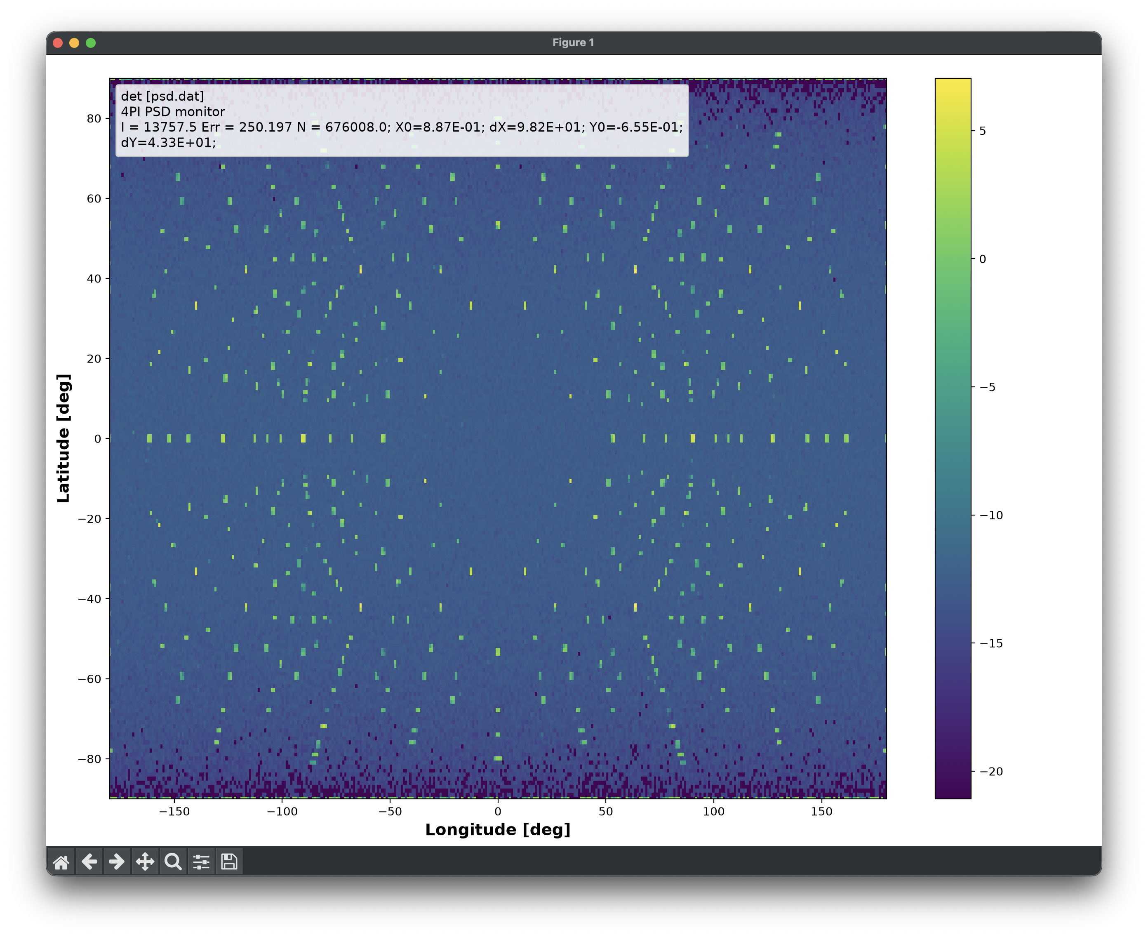
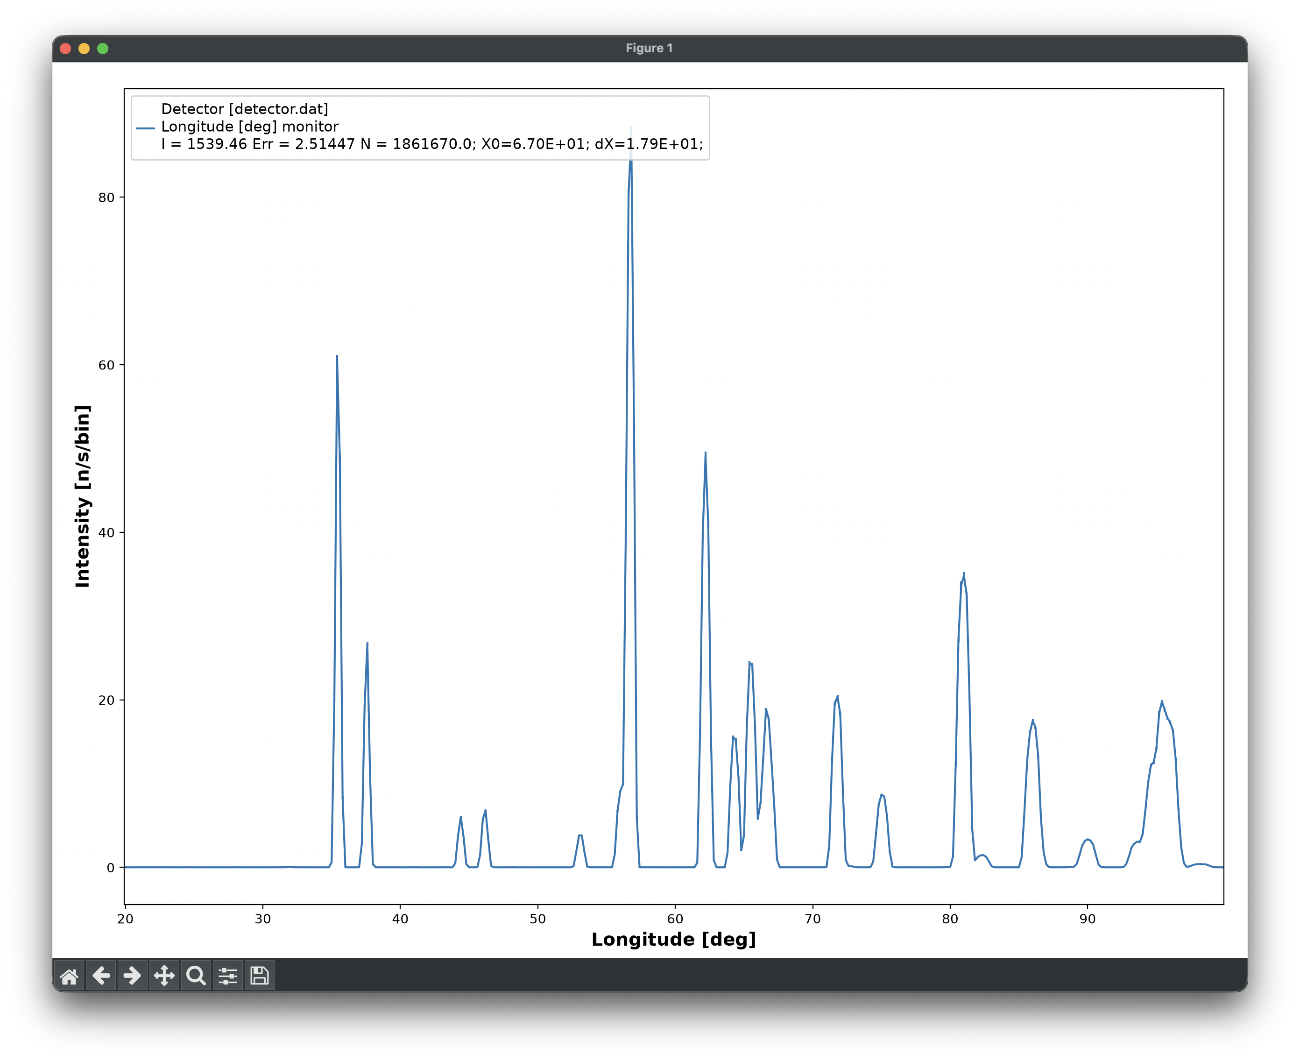
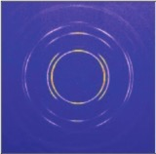
DIFFRACTION · SHARED PHYSICS
From single crystal to powder
A spectrum of disorder — the same underlying lattice, sampled differently.
Single crystal
Textured polycrystal
Powder
One orientation, up to a small mosaic spread
Many crystallites, with a preferred orientation
Complete orientational disorder
McStas's Single_crystal component sits at the ordered end and can itself model a mosaic spread; PowderN sits at the fully disordered end — both exist, under the same names, in McXtrace.
McStas & McXtrace · Sample Components
5

Slide 6
SHARED COMPONENT
Powder diffraction: PowderN
The same component, same reflection-file format, in both McStas and McXtrace.
Reads a list of (hkl, d-spacing, structure factor) reflections from a data file — the physics is entirely data-driven.
concentric=1 lets a PowderN act as an outer container (e.g. a sample can) around an inner sample, sharing one coordinate position.
d_phi and related focusing parameters restrict scattering to a chosen slice of 4π — useful when only a detector bank at certain angles exists.
a concentric container
can (Al)
sample
(Al2O3)
COMPONENT can = PowderN(reflections="Al.laz",
radius=0.02, yheight=0.05, thickness=0.005, concentric=1)
COMPONENT sample = PowderN(reflections="Al2O3.laz", ...)
COMPONENT can2 = COPY(can)(concentric=0)
Each layer computes its own scattering — the can's diffraction lines and the sample's appear together, correctly weighted.
McStas & McXtrace · Sample Components
6

Slide 7
SHARED COMPONENT
Single-crystal diffraction
Single_crystal models an ideally imperfect crystal — peak broadening dominated by mosaic, not appropriate for near-perfect crystals.
Orientation: unit-cell vectors (ax,ay,az, bx,by,bz, cx,cy,cz) encode the crystal's orientation relative to the component's own frame — no assumption about cell shape or symmetry is made.
Isotropic mosaic
Anisotropic mosaic
Rocking-curve mosaic
Gaussian spread of rotation angle around a random axis — one mosaic parameter for the whole crystal.
A separate Gaussian spread around each unit-cell axis (mosaic_a, mosaic_b, mosaic_c).
Mosaic derived from the measured widths of two Bragg peaks — give σ and hkl for each.
McStas & McXtrace · Sample Components
7

Slide 8
SHARED WORKFLOW
Getting reflection data
Find a structure
cif2hkl
.laz / .lau
CIF file from ICSD
or Crystallography Open DB
--powder or --xtal
ships with McStas/McXtrace
Header + reflection list,
ready to use
Used by: PowderN, Single_crystal, Isotropic_Sqw
Data formats in McStas & McXtrace
Format | Used by
.lau | Single_crystal, PowderN, Isotropic_Sqw
.laz | PowderN, Isotropic_Sqw
.sqw / qSq | Isotropic_Sqw (qSq mostly for liquids)
PDB | SANSPDB / SAXSPDB
ncmat | NCrystal-backed samples (McStas)
McStas & McXtrace · Sample Components
8

Slide 9
SANS / SAXS · SHARED PHYSICS
Small-angle scattering, the shared idea
Elastic scattering at small angles — small scattering vector q means sensitivity to big real-space distances r.
Probes molecular-scale structure, typically 10–100 Å: proteins, polymers, nanoparticles, pores.
Often a dilute molecule-in-solvent system: a small contrast in scattering density against a buffer/background.
Usually isotropic scattering — the signal only depends on |q|, not its direction.
Needs good collimation and a long flight path after the sample, to resolve the small angles involved.
small q, big r
small angles
near the beam
sample
detector,
far downstream
McStas & McXtrace · Sample Components
9

Slide 10
SHARED TOOLKIT
SANS & SAXS models, side by side
Three tiers of model, available under matching names in both codes.
Tier | McStas (SANS) | McXtrace (SAXS) | Notes
Analytic shapes | Sans_spheres | Saxs_spheres | Exact naming parallel; dilute, monodisperse hard spheres, given contrast & radius
Benchmarked set | SANS_benchmark2 | — | Experimentally-benchmarked model set (McStas, contrib library)
Full sasmodels library | SasView_* (92 components) | SasView_* (92 components) | File-for-file identical set in both codes — sphere, cylinder, core-shell, fractal, …
Macromolecules | SANSPDB | SAXSPDB | Scattering directly from a PDB structure file (contrib library, both codes)
Under the hood: the sasmodels components are generated from the same SasView/sasmodels project (sasview.org) for both codes — 92 identically-named .comp files in mcstas-comps/sasmodels and mcxtrace-comps/sasmodels, sphere through triaxial ellipsoid.
McStas & McXtrace · Sample Components
10

Slide 11
X-RAY ONLY · PHYSICS
Absorption & fluorescence: the physics
A photon excites a core electron (e.g. the K shell). If the photon energy exceeds the binding energy, the electron is ejected — a photoelectron.
The resulting core hole is filled by an electron from a higher shell — that transition emits a characteristic fluorescence line.
At the absorption edge, the transmitted intensity drops sharply, and a fluorescence line appears at a lower, element-specific energy.
Elastic (Rayleigh) and inelastic (Compton) scattering can accompany absorption — all part of the same interaction budget.
transmission vs. photon energy
transmission
edge
energy
Note the honest limit: today's absorption samples model the edge itself — not the fine pre-edge or EXAFS oscillations.
McStas & McXtrace · Sample Components
11

Slide 12
MCXTRACE — X-RAYS ONLY
The Fluorescence component & friends
Fluorescence
Filter, Abs_objects, Absorption_sample
Models all four processes at once: absorption, fluorescence, Compton and Rayleigh scattering
Any shape (box, cylinder, sphere, or OFF/PLY mesh) and any compound material, e.g. “CaCO3” or “ZnCu”
Computed via XRayLib — about 10× slower than the simpler components, in exchange for real chemistry
FluoCrystal and FluoPowder specialise the same physics for crystalline and powder samples
Absorption only — no fluorescence, Compton or Rayleigh
Require pre-made absorption data files, and only handle pure, mono-atomic materials
Abs_objects and Absorption_sample can combine several OFF/PLY shapes/materials in one component
Much faster — the right choice when fluorescence itself isn't of interest
All of these support concentric geometry (a sample inside a can or cryostat) the same way PowderN does.
McStas & McXtrace · Sample Components
12

Slide 13
MCXTRACE — WORKED EXAMPLES
Two beamlines, built from these samples
ROCK · absorption edge
LUCIA · hyperspectral fluorescence
Bending magnet source, 4–40 keV white beam
A channel-cut DCM (two Bragg_crystal, Si 111) selects the energy
A Fluorescence sample (“ZnCu”, 2×10×1 mm) sits after the monochromator
An energy monitor after the sample shows the absorption shadow and the fluorescence lines together
Scanning energy 8–10 keV sweeps straight across the Zn/Cu edges
HU52 undulator source, feeding a 0.5×0.5 mm slit and a Si(111) DCM
A Fluorescence sample stage — a wire-shaped inclusion (geometry="wire.ply") inside a different bulk material
The two materials are combined so only one “fires” per ray — an advanced-grammar detail we won't dwell on here
A position-resolved energy monitor turns the result into a hyperspectral map — composition read out from fluorescence lines, point by point
McStas & McXtrace · Sample Components
13

Slide 14
MCSTAS — NEUTRONS ONLY
Neutron imaging
Absorption-contrast radiography and tomography — built from the same shapes as everything else.
A single-phase absorbing “block” — box, cylinder, sphere, or an arbitrary OFF/PLY mesh — stands in for the imaged object.
The same complex-geometry engine used for diffraction and spectroscopy samples renders detailed shapes: a chess piece, a bracket with drilled holes, and so on.
Contrast comes purely from attenuation — how much of the beam a given path length and material absorbs.
Rotate the object (or the source/detector) between exposures to build up a tomographic reconstruction.
On the roadmap: multi-phase materials, refractive effects, and phase-contrast imaging are being developed but aren't ready yet — today's imaging samples are single-phase, absorption-contrast only.
Why neutron-only in this session? X-ray imaging exists in principle (attenuation is attenuation) — but McXtrace's sample library so far has focused on spectroscopy and scattering rather than dedicated imaging phantoms.
McStas & McXtrace · Sample Components
14

Slide 15
WHAT ELSE EXISTS — BRIEFLY
Reflectometry & inelastic scattering
Reflectometry
Inelastic scattering S(q,ω)
Probes surfaces & interfaces, solid or liquid, via specular and off-specular reflection
McStas: Multilayer_Sample — phase-matrix formalism plus an incoherent background
Or the simpler route: attach a measured reflectivity curve directly to a Mirror-type component
Today's choice is deliberately small — not a rich library like SANS
McStas: Phonon_simple, Magnon_bcc, Isotropic_Sqw (inelastic mode), Single_crystal_inelastic, Tunneling_sample
McXtrace: Isotropic_Sqw in an experimental Thomson (IXS) mode — no RIXS or single-crystal inelastic yet
Computationally demanding: only a small fraction of rays land in a given (q,ω) window, so large ray counts are needed
McStas & McXtrace · Sample Components
15

Slide 16
WHAT ELSE EXISTS — BRIEFLY
Generic tools & advanced assemblies
Resolution samples
Union framework
sasmodels & PDB
Res_sample, TOFRes_sample, Spot_sample — synthetic, delta-function-like scatterers used to study an instrument's resolution function, independent of any real material.
Small physics-process components — Incoherent_process, Powder_process, Single_crystal_process, NCrystal_process (McStas); Incoherent_process, Powder_process, plus X-ray-specific Compton_xrl_process & Rayleigh_xrl_process (McXtrace) — combined via Union_master into complex multi-material assemblies. Present in both codes; its assembly grammar is a topic for a dedicated advanced session.
92 identically-named SasView_* components in both codes' sasmodels library, plus the SANSPDB / SAXSPDB macromolecule components — already introduced under SANS/SAXS, noted here for completeness.
A note on advanced grammar: concentric, GROUP, WHEN and EXTEND all let you combine sample components into richer assemblies. We've kept today's overview to the physics — ask if you'd like a pointer into the syntax.
McStas & McXtrace · Sample Components
16

Slide 17
SUMMARY
The full picture
Technique | McStas | McXtrace | Notes
Powder diffraction | PowderN | PowderN | Shared name & file format
Single-crystal diffraction | Single_crystal | Single_crystal | Shared name; mosaic model
Isotropic structure/dynamics | Isotropic_Sqw | Isotropic_Sqw (exp.) | Elastic or inelastic, S(q) / S(q,ω)
Library-backed diffraction | NCrystal_sample | — | Via the NCrystal library
SANS / SAXS (analytic) | Sans_spheres | Saxs_spheres | Exact naming parallel
SANS / SAXS (full library) | SasView_* (92 comps) | SasView_* (92 comps) | File-for-file identical set
SANS / SAXS (macromolecule) | SANSPDB | SAXSPDB | Direct from a PDB file (contrib)
Absorption spectroscopy | — | Filter, Abs_objects, Absorption_sample | X-ray only; mono-atomic, fast
Fluorescence | — | Fluorescence, FluoCrystal, FluoPowder | X-ray only; any shape/compound
Imaging | absorbing blocks / OFF meshes | — | Neutron only, in practice
Reflectometry | Multilayer_Sample | — | Small library (contrib)
Inelastic scattering | Phonon_simple, Magnon_bcc, … | Isotropic_Sqw (IXS, exp.) | Richer on the neutron side
Resolution / generic | Res_sample, TOFRes_sample, Spot_sample | — | Synthetic, for resolution studies
Advanced assemblies | Union components | Union components | Shared framework, both codes
McStas & McXtrace · Sample Components
17

Slide 18
Where to go deeper
McStas
McXtrace
mcdoc sample / mcdoc -c
mxdoc sample / mxdoc -c
Data: $MCSTAS/data (Lau/Laz/Sqw/PDB/ncmat)
Practicals: absorption (ROCK), fluorescence (LUCIA)
cif2hkl --powder / --xtal file.cif
McCode wiki: generating Single_crystal/PowderN files
Peter Willendrup · pkwi@fysik.dtu.dk · DTU Physics
McStas & McXtrace · Sample Components
18

