Slide 1

Sources, e.g. rotating anode
To first order emit uniformly into steradian

Slide 2





Sources, e.g. rotating anode
To first order emit uniformly into steradian
Generally we are intersted in sending the input to an aperture, characterised by a certain solid angle , often corresponding to a rectangle x at a distance from the source

Slide 3

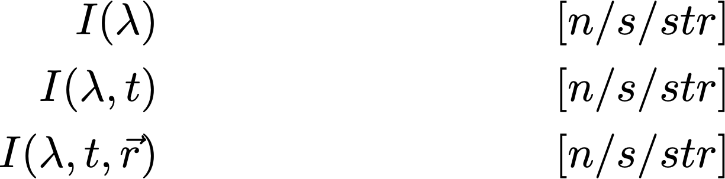
Sources, e.g. rotating anode
The emmission intensity into our chosen solid angle can be a function of wavelength, time (pulsed sources) and possibly point of origin on the source surface (e.g. for partially coherent descriptions).
The emission of particles into the solid angle is in fact an integration and leads to a simulated “intensity” of .
In McXtrace, that integrated intensity is partitioned over a given set of particle rays referred to as ncount, -n or --ncount
The default ncount is 1e6 rays

Slide 4


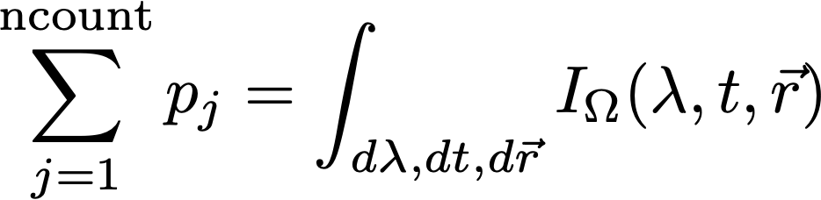
Sources, e.g. rotating anode
Our rays are emitted randomly, sampling and all variables of the source “spectrum”, i.e. wavelength, time and area
assigning ray weights such that

Slide 5



X-ray (rays) in McXtrace - what are they?
X-ray package:
Weight (p), # photons (left) in the package
Coordinates (x,y,z)
Wavevector (kx,ky,kz)
Polarization (Ex,Ey,Ez)
Phase ()
Time(t)
Defining the ray starting conditions imply setting:
The starting point on the surface, i.e. (in the code variables x,y,z)
The direction into and our / k (in the code variables kx,ky,kz)
The starting time (in the code the variable t)
The initial intensity / weight of the X-ray ray (in the code the variable p)
If needed the initial
Electric field polarisation (in the code the variables Ex,Ey,Ez)
X-ray phase (in the code the variable phi)

Slide 6
Monitors: in general
REALITY:
Monitors:
Intensity probe of the beam
Semi-transparent to X-rays → Low Efficiency
Detectors:
Should detect all photons → Efficiency as high as possible
SIMULATIONS (McXtrace):
In McXtrace:
We can program monitors and detectors to behave any way we like. We refer to both of those indistinguishably as ‘monitors’.
E.g. monitor with Efficiency =100% and Transparency=100%

Slide 7
Monitors: Example PSD_monitor

Slide 8
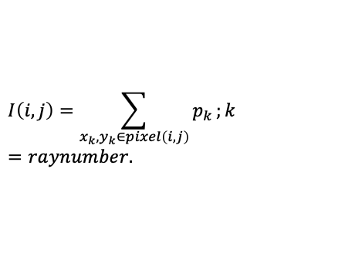
Monitors: Example PSD_monitor
When the simulation has been completed, the detected intensity in pixel (i,j) is:
$$I\left(i,j\right)=\sum_{x_{k},y_{k}∈pixel\left(i,j\right)}{p_{k}};k=raynumber.$$
… during simulation, the pixels are maintained as running sums.

Slide 9
...
TRACE
COMPONENT origin = Progress_bar() AT(0,0,0) ABSOLUTE
COMPONENT src = Source_flat(
radius=0.05, lambda0=2.5, dlambda=1.5,
focus_xw=0.1, focus_yh=0.1, dist=5)
AT(0,0,0) RELATIVE origin
COMPONENT psd = PSD_monitor(xwidth=0.2,
yheight=0.2, filename=”psd.dat”)
AT (0,0,5) RELATIVE src
COMPONENT lm = L_monitor(xwidth=0.2, yheight=0.2,
filename=”lm.dat”,
Lmin=0, Lmax=8)
AT (0,0,5+0.01) RELATIVE src
Monitors: Example PSD_monitor and L_monitor

Slide 10
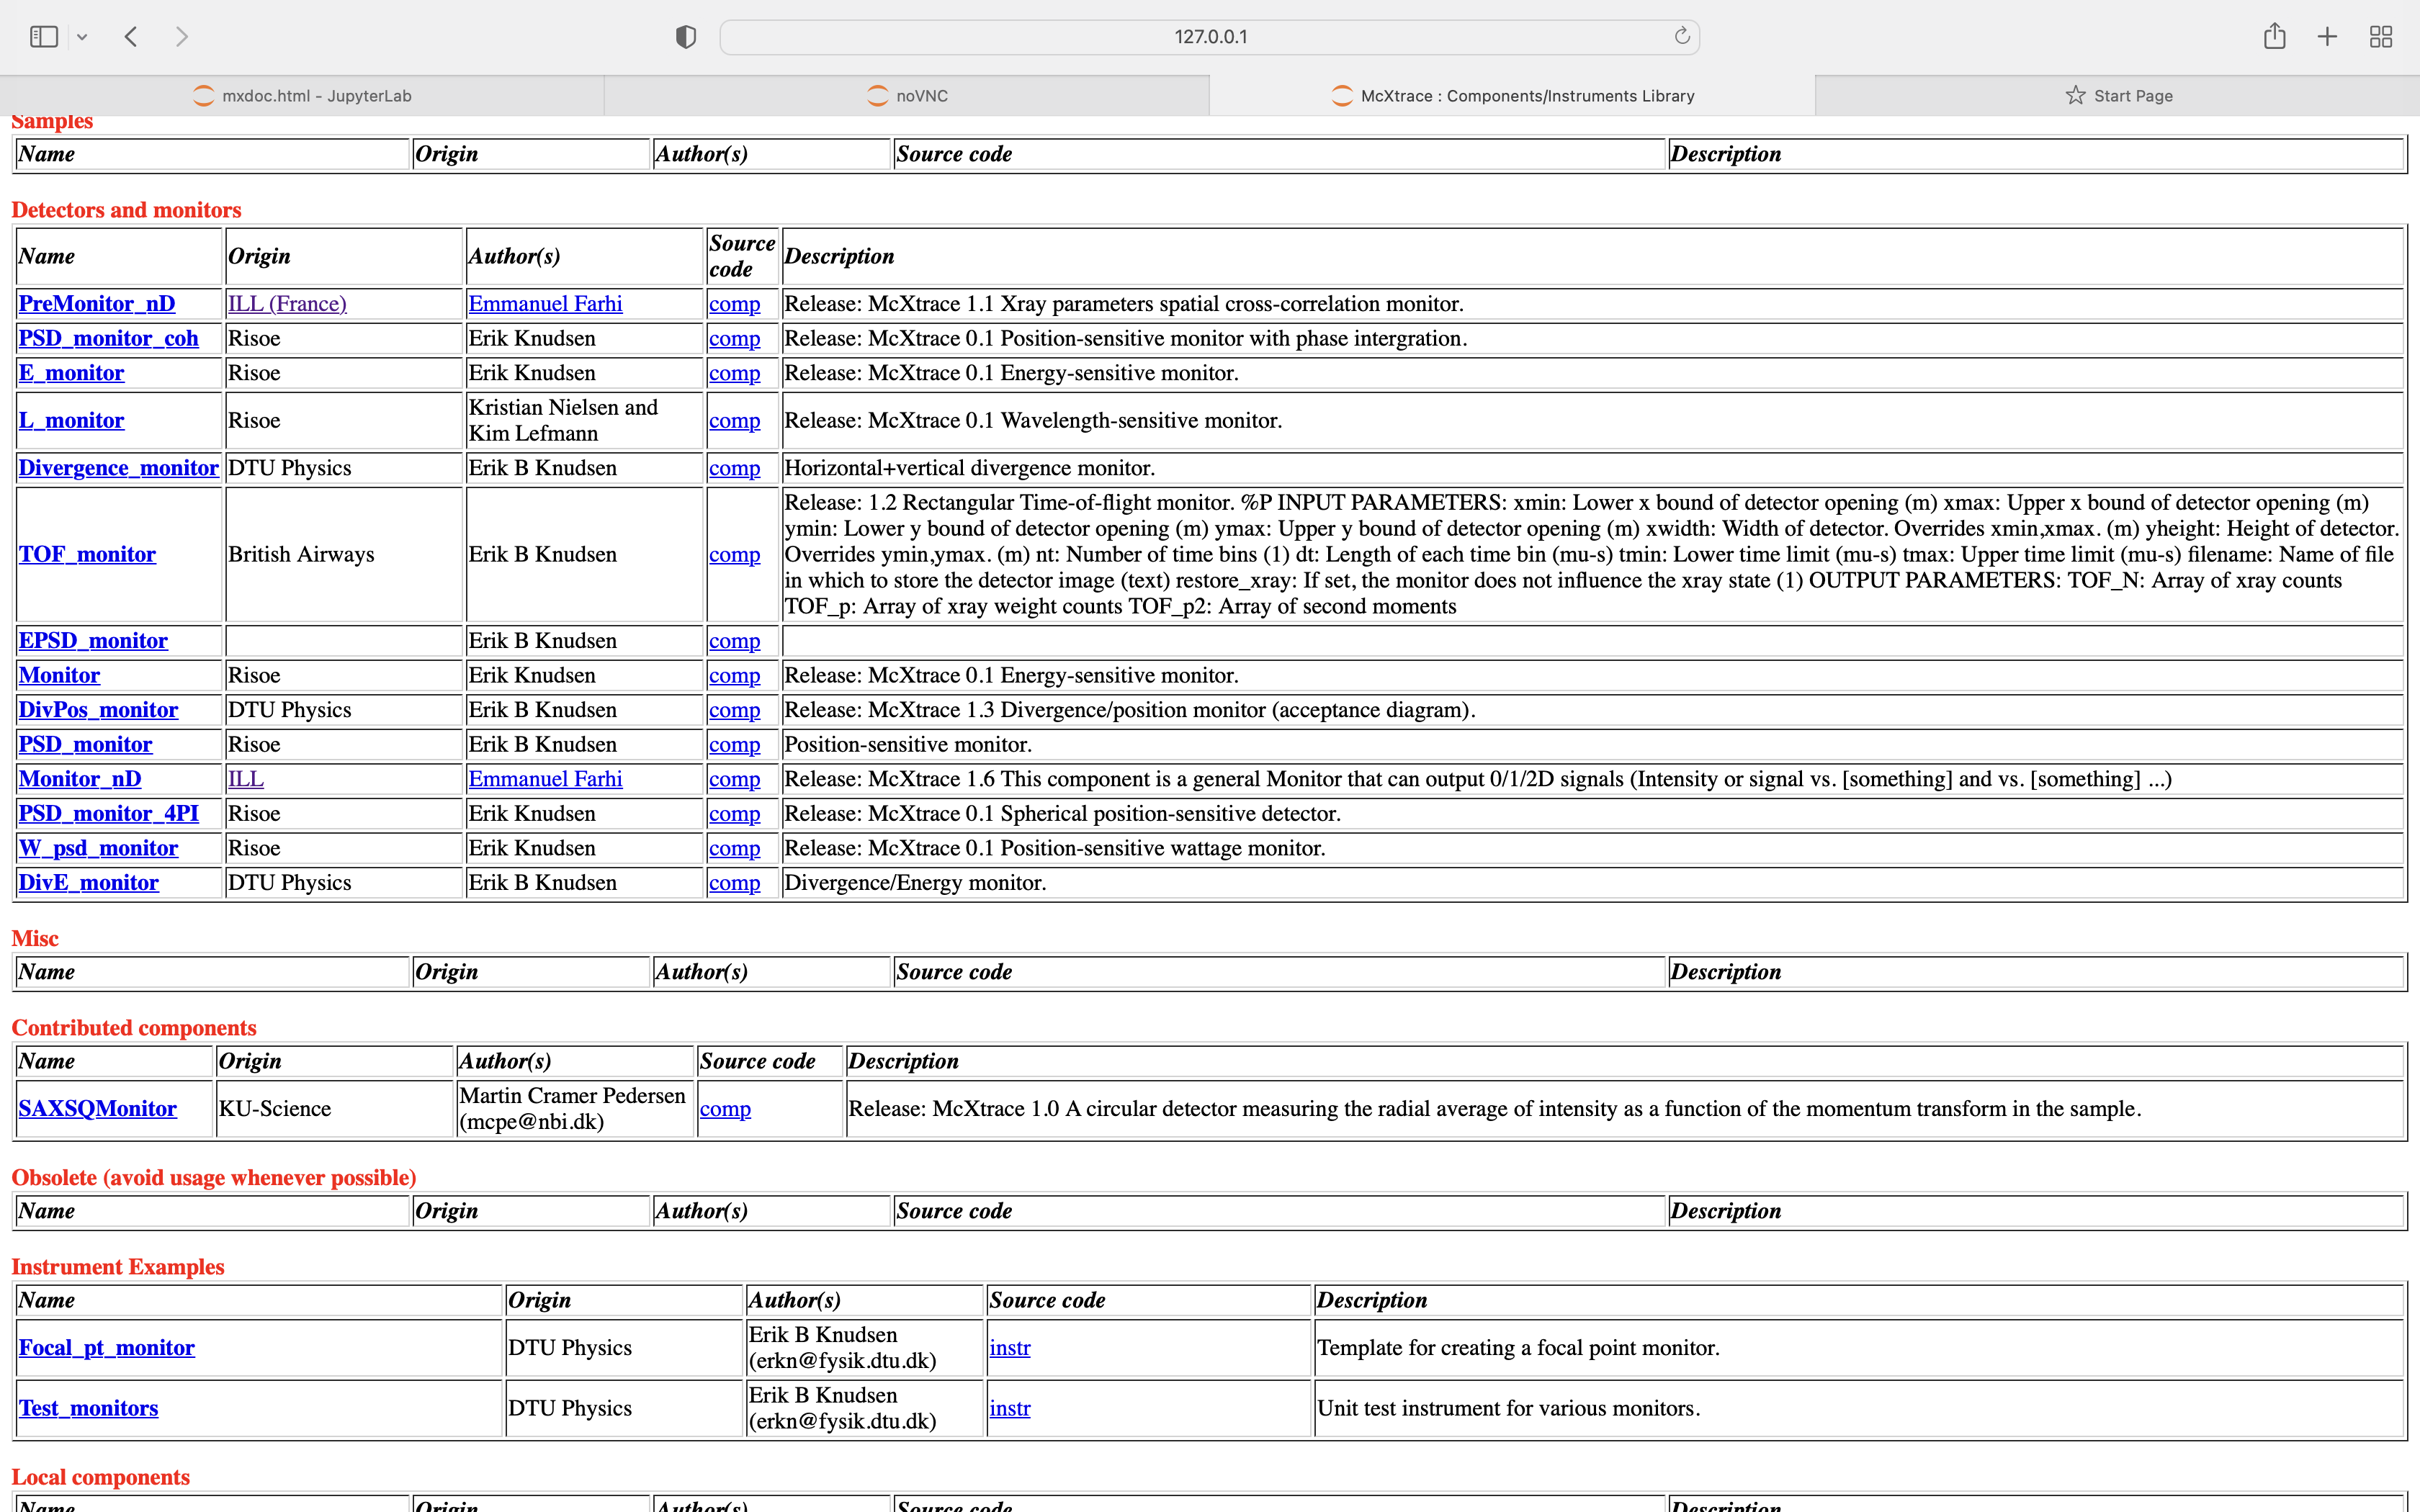
Monitors: what is available
mxdoc monitor from commandline

Slide 11

In a histogram sense
Imagine a histogram, e.g. I(λ)
The RMS variance over that set becomes our statistical error bar E
…
…
In bin i, N events each carrying a fractional intensity pj so that
1
2
3
i
k

Slide 12
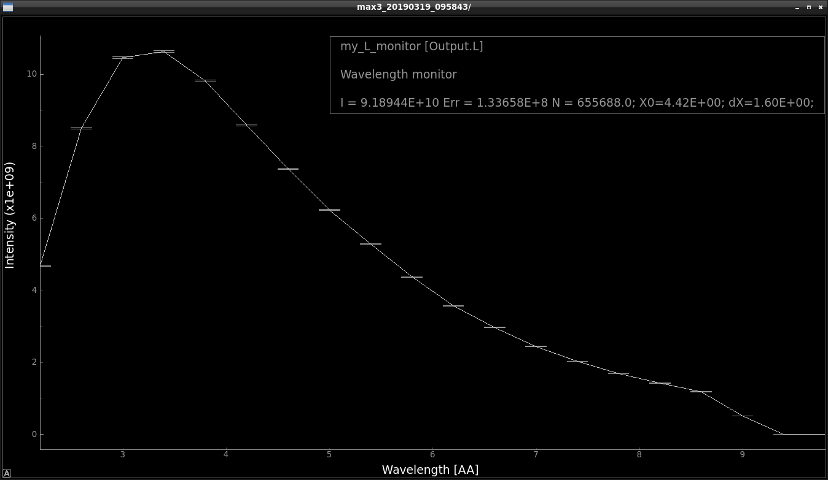
Statistics computed on the fly
In a histogram sense
Monitors: Quick examples
Imagine a histogram, e.g. I(λ)
The RMS variance over that set becomes our statistical error bar E
I
E
N
…
…
In bin i, N events each carrying a fractional intensity pj so that
1
2
3
i
k
# Events
Intensity / n/s
1st and 2nd moments of data
Estimated RMS MC error

Slide 13
Statistics computed on the fly
In a histogram sense
Monitors: Quick examples
Imagine a histogram, e.g. I(λ)
The RMS variance over that set becomes our statistical error bar E
I
E
N
…
…
In bin i, N events each carrying a fractional intensity pj so that
1
2
3
i
k
# Events
Intensity / n/s
1st and 2nd moments of data
Estimated RMS MC error
Statistics also available per bin (inside data file)

Slide 14
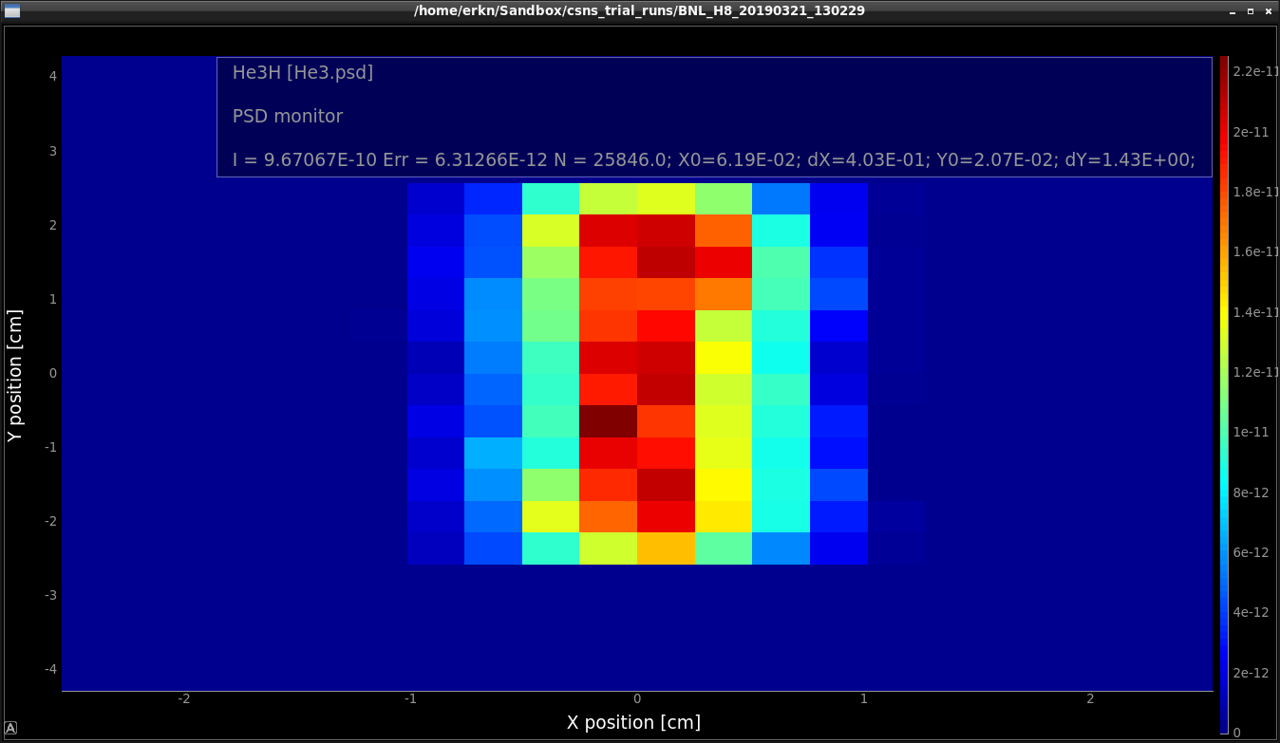
Monitors: Quick examples
In 2D
1st and 2nd moments

Slide 15
A general monitor for 0D/1D/2D records
Monitor_nD
The all-in-one , swiss-army-knife of monitors
Monitor_nD can have almost any shape, and record
any requested standard quantities

Slide 16
A general monitor for 0D/1D/2D records
Monitor_nD
Examples
COMPONENT MyMon = Monitor_nD( xwidth = 0.1, yheight = 0.1, zdepth = 0,
options = "intensity per cm2 angle,limits=[-5 5],
bins=10,with borders, file = mon1")
options = "multiple kx ky kz, auto abs log t, and list all neutrons"
options = "banana, theta limits=[10,130], bins=120, y"

Slide 17
Monitor_nD
… or monitor just about anything:
COMPONENT MyMon = Monitor_nD(xwidth = 0.1, yheight = 0.1,
user1=age, username1="Age of the Captain [years]",
options="user1, auto")

