Slide 1
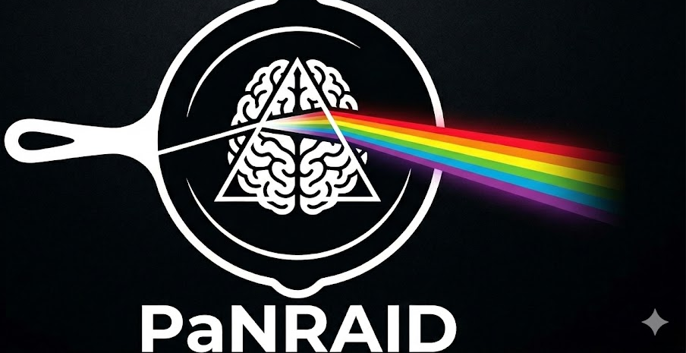

NEUTRON & X-RAY OPTICS
Shaping, focusing,
and timing the beam
Mirrors, lenses, crystals, multilayers and choppers in McStas & McXtrace
McStas — neutrons
McXtrace — X-rays
Peter Willendrup · DTU Physics
PaNRAID School · supported by PEPR DIADEM

Slide 2

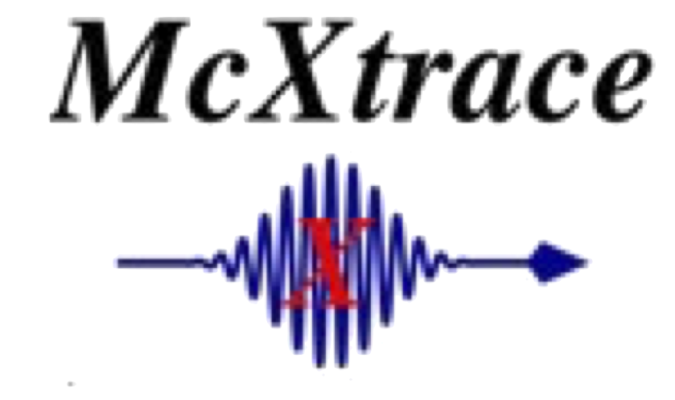


AGENDA
What we'll cover
Everything between source and sample that reshapes the beam in space, direction, energy or time.
1
Five ways to shape a beam
2
Spatial & directional shaping
A quick map of the optics families we'll cover
Slits, apertures and collimators
3
Grazing-incidence reflection
4
Guides & mirrors
The shared physics behind guides and mirrors
Channelling neutrons vs. focusing X-rays
5
Refractive lenses (CRLs)
6
Crystal monochromators
Why X-ray and neutron lenses must be stacked
Bragg's law, mosaicity, and geometry
7
Multilayers
8
Temporal shaping
One interference effect, two very different jobs
Choppers, velocity selectors, and why neutrons are special
McStas & McXtrace · Neutron & X-ray Optics
2

Slide 3
FRAMING
Five ways to shape a beam
Every optical component in either code falls into one of these families.
Spatial
Reflective
Refractive
Diffractive
Temporal
1
2
3
4
5
Pinholes, slits, apertures, collimators — define where the beam is allowed to be.
Mirrors & guides — steer or focus at grazing incidence.
Compound lenses (CRLs) — bend the beam like an ordinary lens, just barely.
Crystals & multilayers — select wavelength/energy via interference.
Choppers & selectors — shape the beam in time, not space.
We'll move roughly in this order — spatial first, temporal last — flagging where neutrons and X-rays share a component and where they don't.
McStas & McXtrace · Neutron & X-ray Optics
3

Slide 4
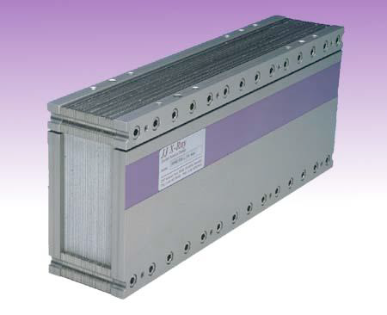
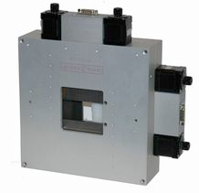
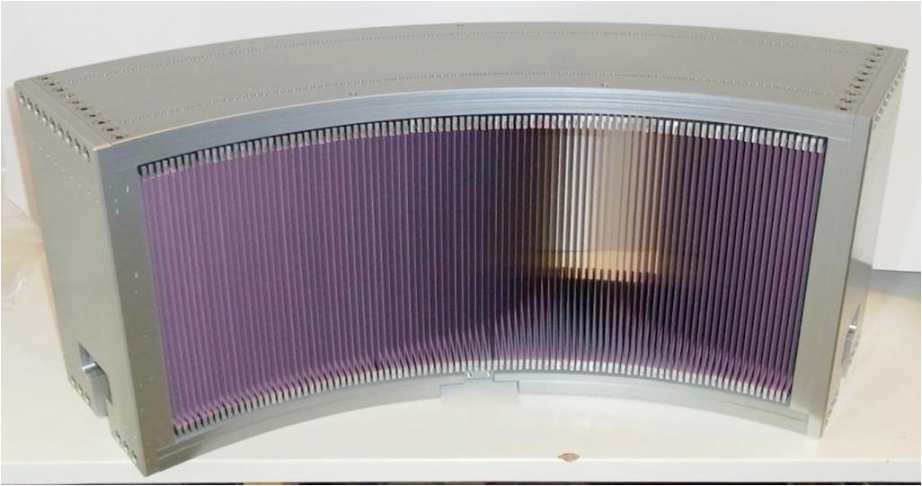
SHARED CONCEPT
Spatial & directional shaping
Spatial: pinholes, slits, apertures
Directional: collimators
A static or adjustable “hole” in absorbing material
Defines the beam's spatial footprint downstream
Same component idea in both codes: Slit
Two or more slits (or a channel array) define an accepted divergence
Absorbing walls create parallel “channels” through the collimator
Usually static, but rotating radial collimators exist — e.g. to reject sample-environment scattering
Fully shared: these are geometric, energy-independent devices — the same component names and logic apply whether the beam is neutrons or photons.
McStas & McXtrace · Neutron & X-ray Optics
4

Slide 5
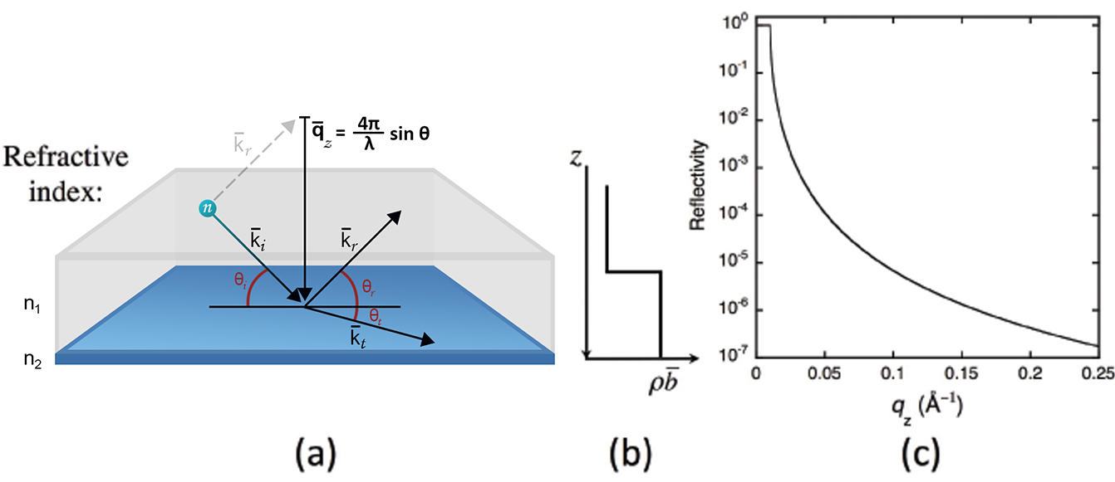
SHARED PHYSICS
Grazing-incidence reflection
For both neutrons and X-rays, matter's refractive index is just below 1: n = 1 − δ (+ iβ for absorption).
Going from vacuum (n=1) into a medium with n<1 mirrors the classic total-internal-reflection picture — here it's called total external reflection.
Below a small critical angle θc, a ray hitting a smooth, flat surface reflects almost perfectly — no coating chemistry required, just the right angle.
This single effect underlies both neutron guides and X-ray mirrors — what differs is how it's exploited.
Neutrons and X-rays – vaccum/matter interface:
Total external reflection
Below θc: total reflection
Visible light – water/air interface:
Total internal reflection
θc is tiny — typically a fraction of a degree — for both probes, which is why guides and mirrors are long, shallow, and need to be extremely flat/smooth.
McStas & McXtrace · Neutron & X-ray Optics
5

Slide 6
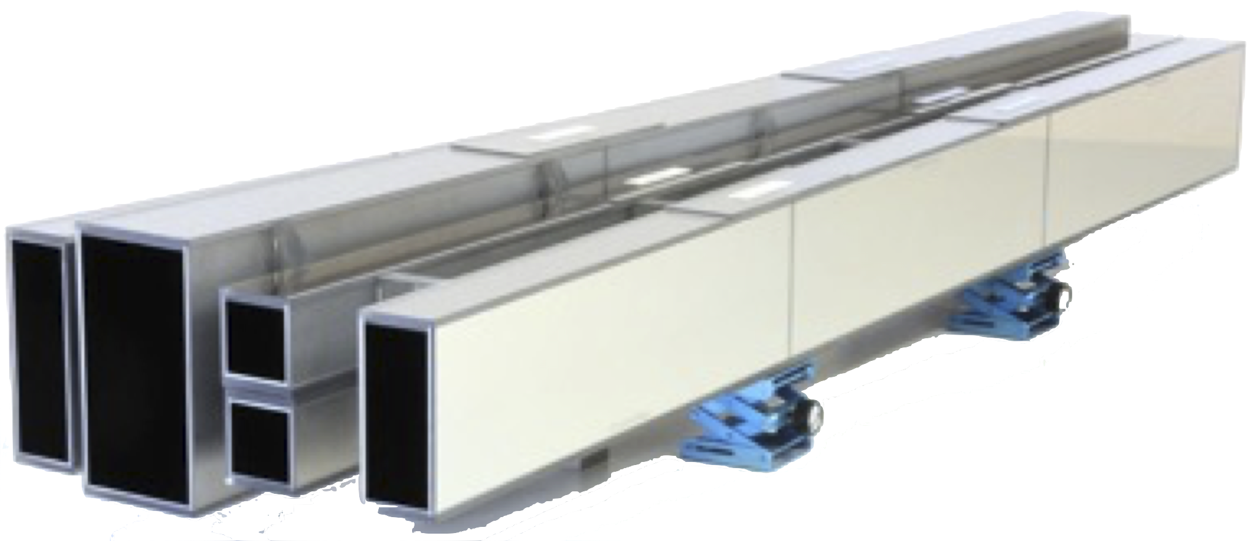
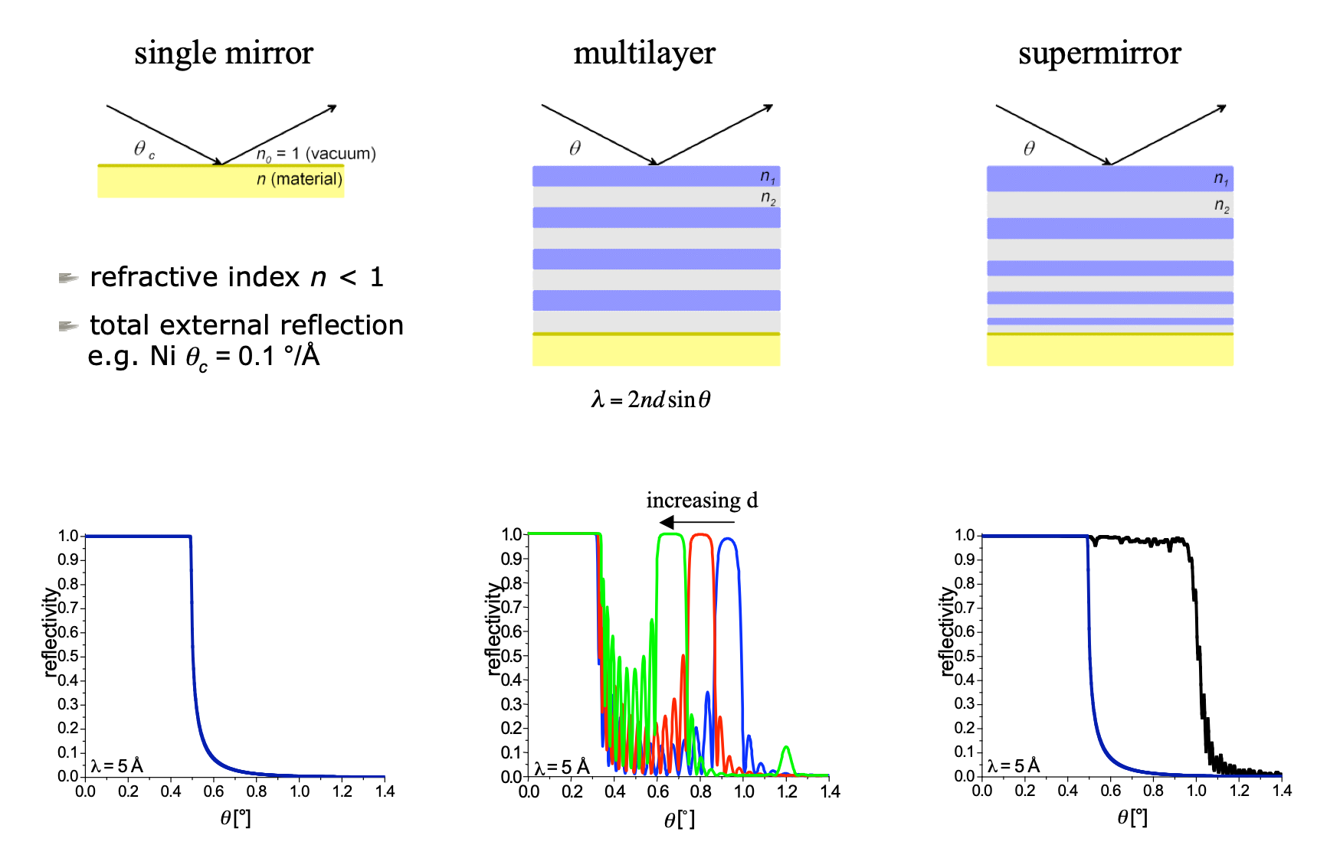
SAME PHYSICS, DIFFERENT USE
Guides & mirrors
Same critical-angle physics, but neutron beamlines and X-ray beamlines put it to work differently.
McStas · neutron guides
McXtrace · X-ray mirrors
Guide, Guide_channeled, Guide_gravity: long supermirror-coated channels
Many shallow bounces over metres — preserves intensity over long transport distances
Coating quality set by an “m-value” — multiples of the natural-Ni critical angle
Mirror_curved, TwinKB_ML: one or two large, single-bounce focusing mirrors
Typically one bounce per axis (e.g. a Kirkpatrick-Baez pair) rather than a many-bounce channel
Reflectivity data files (measured or computed) describe the coating's angle/energy response
Why the difference? Neutron sources are weak per-neutron, so long guides trade length for preserved flux; X-ray sources are so bright that a couple of well-figured mirrors are enough to focus or steer the beam.
McStas & McXtrace · Neutron & X-ray Optics
6

Slide 7
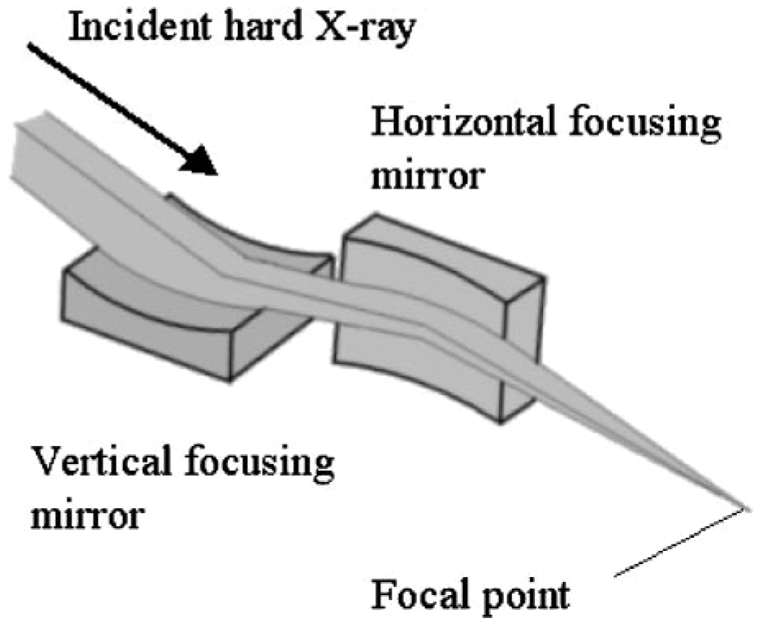
MCXTRACE — X-RAYS
KB mirrors, in practice
A Kirkpatrick-Baez (KB) pair: two perpendicular curved mirrors, one per focusing axis.
First (meridional) mirror focuses one axis; a glancing angle θ redirects the beam by 2θ.
An Arm component re-establishes the optical axis after each reflection — it does nothing physically, it just carries a rotated coordinate frame forward.
The second mirror sits on an Arm rotated 90° around the beam axis, so it focuses the perpendicular direction.
Focal lengths follow directly from the glancing angle and radius of curvature R:
source → mirror 1 → mirror 2 → focus
f_m = R · sin(θ/2) (meridional / 1st mirror)
f_s = R/2 · sin(θ) (sagittal / 2nd mirror)
θ is typically only a few mrad — chosen from the material's critical angle at the working energy.
McStas & McXtrace · Neutron & X-ray Optics
7

Slide 8
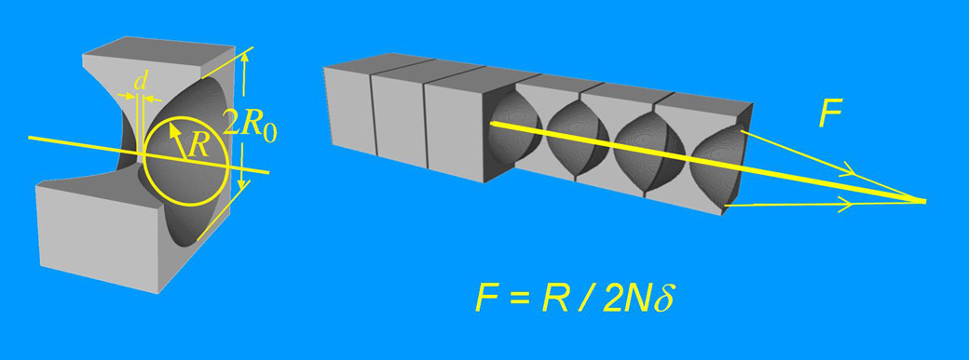
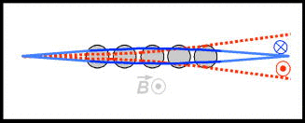
SHARED PHYSICS
Refractive lenses (CRLs)
Both codes offer compound refractive lenses — and both need them for the same reason.
X-ray
Neutron
δ_Xray = f(Z, λ)
n = 1 − δ_neutron = f(b, B)
Grows with electron density — higher atomic number Z means more refraction, but also more absorption
Low-Z, low-absorption materials preferred: Be, Al, polymers
Governed by coherent scattering length b, plus a magnetic term B
The magnetic (spin-dependent) lensing effect is small in practice — hence ordinary CRLs are still the practical choice
Why “compound”: in both regimes the index is barely below 1, so a single lens bends the beam almost imperceptibly. Stacking many (parabolic) lenses in series — a compound refractive lens — adds up to a usable focal length.
McStas & McXtrace · Neutron & X-ray Optics
8

Slide 9
MCXTRACE — WORKED EXAMPLE
A CRL beamline, worked example
Stack | Material | R (tip) | Lenses | Diameter | Thickness (tip)
Stack 1 | Be | 200 µm | 16 | 1 mm | 50 µm
Stack 2 | Al | 200 µm | 10 | 1 mm | 20 µm
Setup: Source_gaussian at E0=23.32 keV (dE=1 keV), CRL stack 31.5 m downstream, focused to a spot 10 m further on. A 2D + energy monitor at the stack checks the incoming footprint and spectrum; another monitor is scanned in z to find the true focus.
Directional sampling (focus_xw, focus_yh, dist on the source) concentrates statistics on the aperture that matters, without biasing intensity.
Used together with a slit, the CRL's achromatic focusing can double as a crude, high-throughput monochromator.
mxdisplay (“Trace” mode) lets you visually follow rays through the lens stack — useful for sanity-checking alignment.
Swapping Be ↔ Al lets you compare absorption vs. refraction trade-offs directly.
McStas & McXtrace · Neutron & X-ray Optics
9

Slide 10
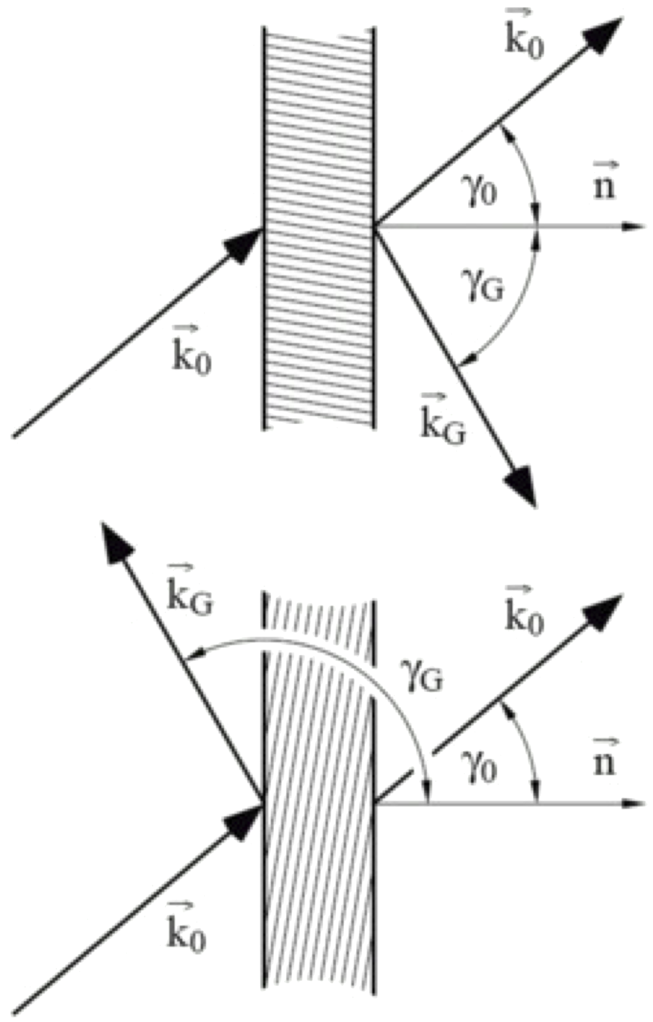
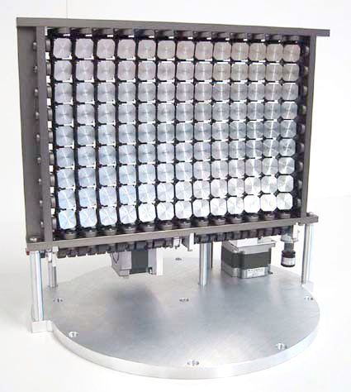
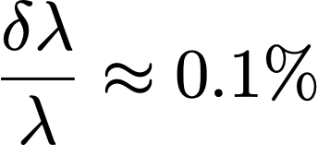
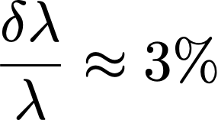
SHARED PHYSICS
Crystal monochromators: Bragg's law
n λ = 2 d sin(θ) — exactly the same equation, in both codes
 | X-ray | Neutron
Typical crystal | Perfect single crystal: Si, Ge, C | Mosaic crystal: pyrolytic graphite, deformed Cu, Ge
Mosaicity | Very low | Often high (multi-crystal, focusing arrays)
Geometry | Laue (transmission) or Bragg (reflection) | Almost always Bragg (reflection)
Resulting beam | Narrow, low divergence and | Medium divergence and
In both codes: Bragg_crystal (McXtrace) and Monochromator_flat / Monochromator_curved / Single_crystal (McStas) all rotate to satisfy Bragg's law — the rotation angle is a natural scan parameter for a rocking curve.
McStas & McXtrace · Neutron & X-ray Optics
10

Slide 11
MCXTRACE — DEEP DIVE
Bent crystals & double-crystal monochromators
Bending a crystal
Double-crystal monochromators (DCM)
A radius of curvature on the crystal (Bragg_crystal_bent) is a simple way to model a heat-bump — thermal distortion from absorbed beam power.
Compare a Divergence_monitor before/after bending to see the extra divergence introduced.
A rocking curve (scanning θ) shows the peak shape change directly.
A second crystal, rotated by the negative of the first angle, brings the beam back parallel to the incoming direction
Arms track the beam axis between crystals; the pair can share a single rotation stage, as in a real DCM
Laue_crystal_BC swaps reflection for transmission geometry — useful for higher-energy or higher-heat-load beamlines
// crystal 2, mirrored relative to crystal 1's Arm
COMPONENT xtal2 = Bragg_crystal(...)
AT (0,0,0) RELATIVE arm_after_xtal1
ROTATED (-MONO_ANGLE, 0, 0) RELATIVE arm_after_xtal1
McStas & McXtrace · Neutron & X-ray Optics
11

Slide 12
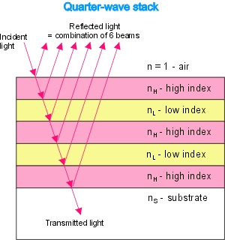
SAME PHYSICS, DIFFERENT NAMES
Multilayers: one concept, two jobs
A stack of thin alternating layers reflects by interference — like Bragg's law, but for a synthetic superperiod.
X-ray: a broadband monochromator
Neutron: a “supermirror” coating
Used as a monochromator with a much broader bandpass — and higher flux — than a perfect crystal
Pick one of the first “side peaks” on the reflectivity curve
Curved multilayers combine monochromation with focusing
Stacked Bragg-like reflections extend the total-external-reflection range well beyond a single critical angle
Ideally a wide, flat reflectivity vs. Q
Used to coat neutron guides — effectively an “optical fibre” for neutrons
Same underlying phase-interference physics in both codes — only the intended job (monochromate vs. transport) differs.
McStas & McXtrace · Neutron & X-ray Optics
12

Slide 13
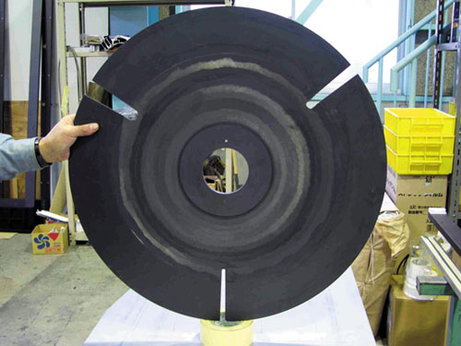
SHARED CONCEPT
Temporal shaping: choppers
A rotating absorbing disk with one or more slits cuts a continuous beam into pulses in time.
Both X-ray and neutron beamlines use a disk-chopper-like component to define or measure time structure — e.g. for time-of-flight (TOF) measurements.
The physical picture is identical: a slit sweeps across the beam at a set frequency, and only rays arriving within the open window get through.
Where it stops being shared: only neutrons are slow enough that a mechanical rotor can also act as an energy filter. An X-ray chopper shapes time only — it can't pick out an energy band the way a neutron velocity selector or Fermi chopper can.
Up next: two neutron-only rotating devices that filter on speed, not just on time.
McStas & McXtrace · Neutron & X-ray Optics
13

Slide 14
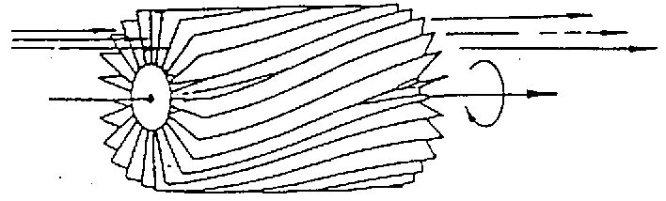
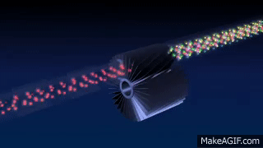
MCSTAS — NEUTRONS ONLY
Velocity selectors
A rotating drum of twisted, absorbing blades — only a narrow velocity (wavelength) band makes it straight through.
Parameter | Meaning
xwidth, yheight [m] | entry aperture
zdepth [m] | housing length
length, d [m] | blade length / thickness
alpha [deg] | blade twisting angle
radius [m] | rotation axis → aperture-centre distance
nu [Hz] | rotation speed (counterclockwise)
nslit | number of blades
twisted absorbing blades
broad monochromatization
δλ/λ ≈ 10%
McStas & McXtrace · Neutron & X-ray Optics
14

Slide 15
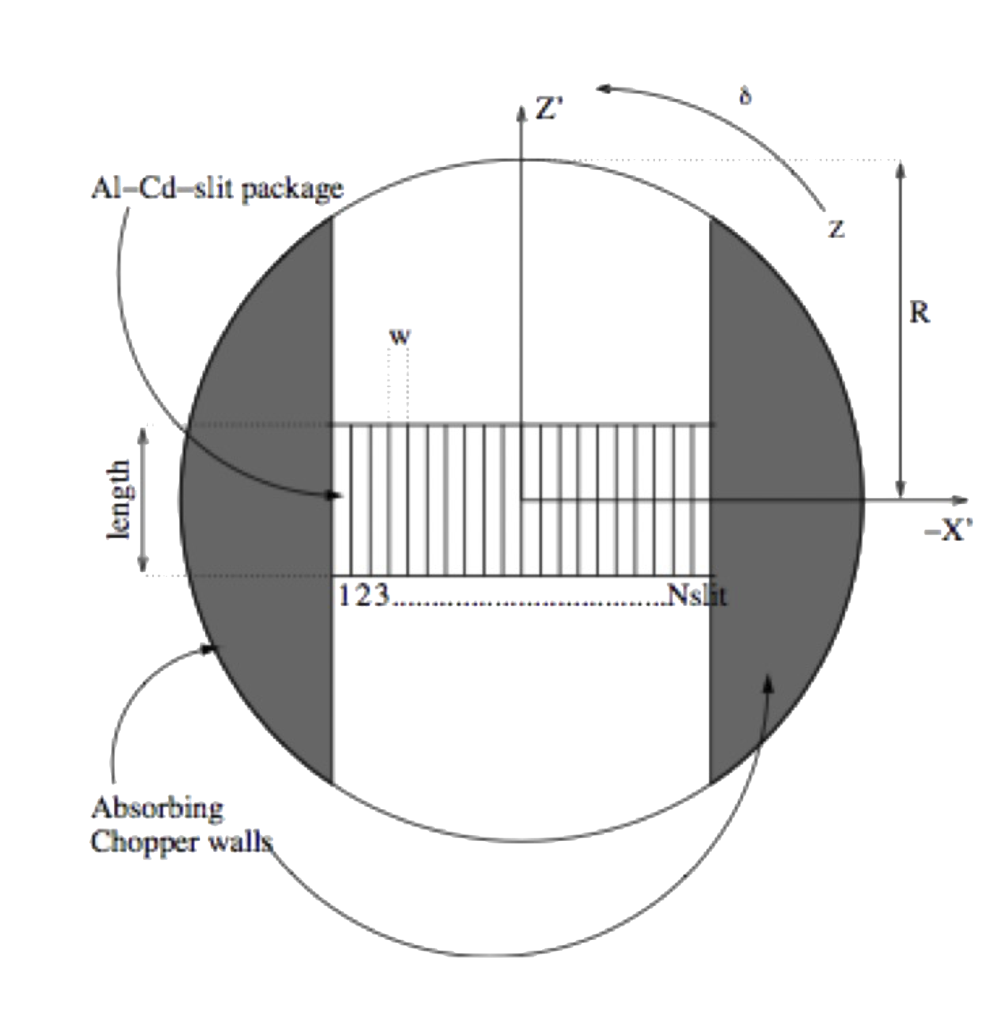
MCSTAS — NEUTRONS ONLY
Disk & Fermi choppers
DiskChopper
Fermi chopper
Parameter | Meaning
nu, theta_0 | frequency; angular slit width
radius, yheight, xwidth | disk geometry / slit opening
jitter, delay, phase | timing: random jitter, fixed delay, or angular phase
isfirst, npulse | marks the first chopper; pulses to generate if so
A small drum of curved slit packages, spinning fast, sitting directly in the beam — a “rotating collimator”.
Only neutrons with the right speed can cross the curved channel before it rotates shut — so it acts as a combined fast time-gate and coarse energy filter.
Used right next to the sample, where a disk chopper's timing alone is no longer selective enough.
Both are McStas-only: there's no X-ray analogue — the mechanical rotation speeds needed would be absurd at the speed of light. X-ray timing instead comes from the accelerator's bunch structure itself.
McStas & McXtrace · Neutron & X-ray Optics
15

Slide 16
RECAP
One optics toolkit, two beams
What's shared
What differs
Spatial shaping: slits & collimators, same logic either way
Grazing-incidence total external reflection (n<1, critical angle)
Bragg's law, and the idea of rotating a crystal to tune it
Refractive-index-just-below-1 logic behind compound lenses
Multilayer interference physics
The chopper concept for defining time structure
Many-bounce guides (neutron) vs. one/two-bounce focusing mirrors (X-ray)
Crystal choice: near-perfect low-mosaicity vs. mosaic/multi-crystal
Multilayer role: X-ray monochromator vs. neutron guide coating
Velocity selectors & Fermi choppers exist only for neutrons
X-ray timing comes from the accelerator, not a mechanical rotor
McStas & McXtrace · Neutron & X-ray Optics
16

Slide 17
Where to go deeper
McStas
McXtrace
mcdoc optics / mcdoc -c
mxdoc optics / mxdoc -c
Guide, Guide_channeled, Monochromator_flat/curved, DiskChopper, FermiChopper, V_selector
Practical exercises: CRLs, KB mirrors, monochromators — pick two of the three
mcstas.org
mcxtrace.org
Peter Willendrup · pkwi@fysik.dtu.dk · DTU Physics
McStas & McXtrace · Neutron & X-ray Optics
17

