Slide 1
2025 ISIS McStas School, November 4th-6th 2025
McStas Introduction and general concepts

Slide 2
Agenda
A (very) brief introduction to McStas
Components of neutron instruments
How McStas works under the hood
Components and instruments
A demo

Slide 3
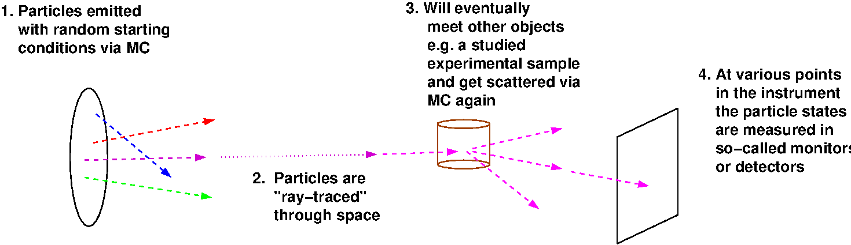
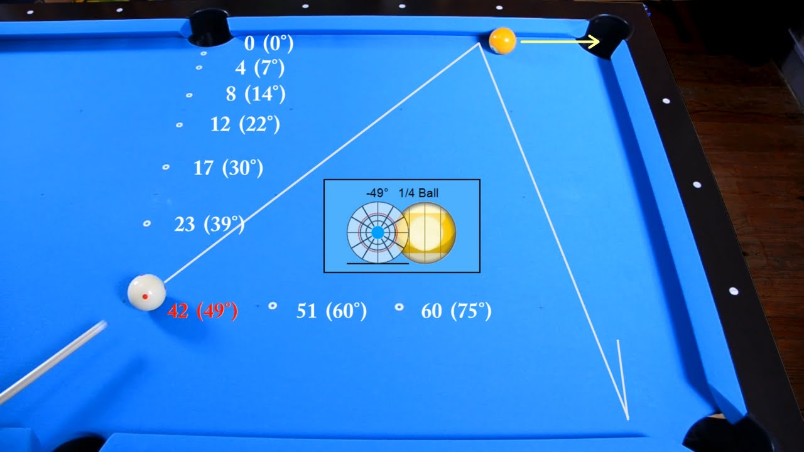
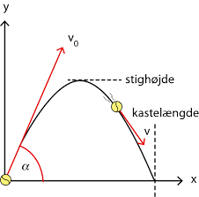
In the big picture, McStas is this…
Classical Newtonian mechanics, i.e. and
(independent, particles though…)

Slide 4
In the big picture, McStas is this…
Instrument
The instrument defines our “lab coordinate system”

Slide 5
In the big picture, McStas is this…
Instrument
Component
Component
Component
The instrument defines our “lab coordinate system”
The components define devices or features available in our instrument

Slide 6
In the big picture, McStas is this…
Instrument
Sample
Source
Monitor
The instrument defines our “lab coordinate system”
The components define devices or features available in our instrument - they have different function

Slide 7
In the big picture, McStas is this…
Instrument
Sample
Source
Monitor
Neutrons
The instrument defines our “lab coordinate system”
The components define devices or features available in our instrument - they have different function
Neutron particles are passed on from one component to the next, changing state under way

Slide 8
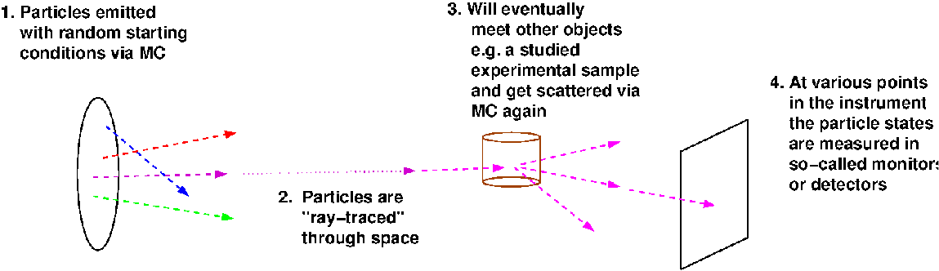
McStas is a Monte Carlo ray-tracer
Instrument
Sample
Source
Monitor
Neutrons

Slide 9
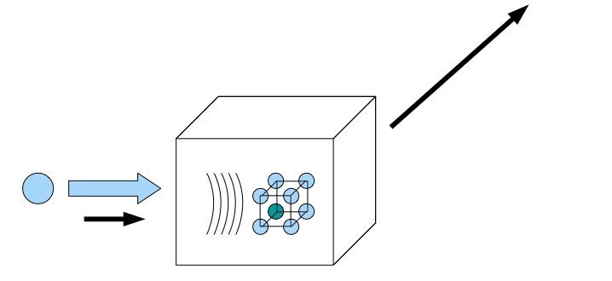
Elements of Monte-Carlo raytracing
Instrument Monte Carlo methods implement coherent scattering effects
Uses deterministic propagation where this can be done
Uses Monte Carlo sampling of “complicated” distributions and stochastic processes and multiple outcomes with known probabilities are involved
- I.e. inside scattering matter
Uses the particle-wave duality of the neutron to switch back and forward between deterministic ray tracing and Monte Carlo approach
Result: A realistic and efficient transport of neutrons in the thermal and cold range

Slide 10
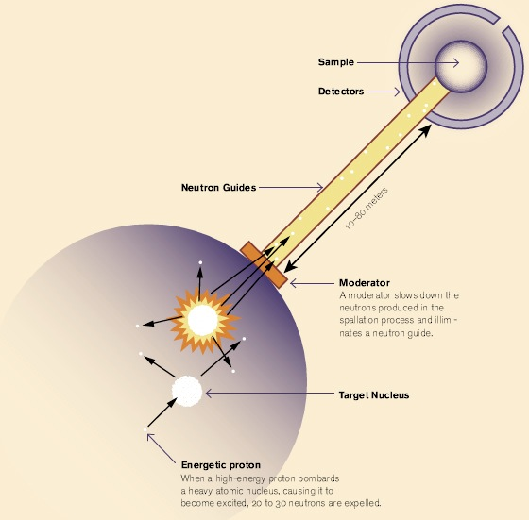
Components of neutron instruments

Slide 11
Components of neutron instruments
In McStas the moderator is the “source”

Slide 12
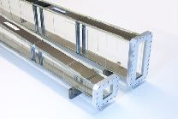
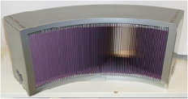
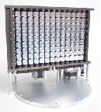
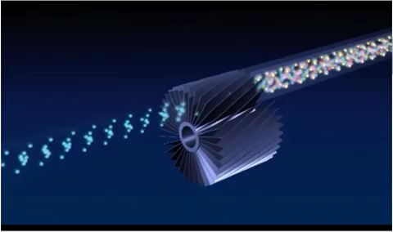
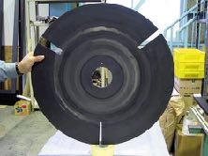
Components of neutron instruments
Neutron optics include things like:
Mirrors and guides
Collimators and slits
Diskchoppers, Fermi choppers and velocity selectors
Monochromators/Analysers
In McStas the moderator is the “source”

Slide 13
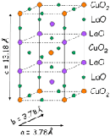

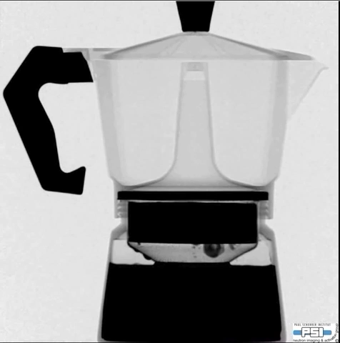

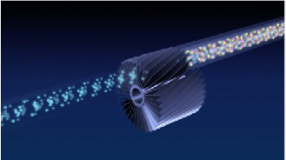
Components of neutron instruments
The sample:
Crystalline, powders, liquids, micelles, structures to image, inelastic features like phonons…
Neutron optics include things like:
Mirrors and guides
Collimators and slits
Diskchoppers, Fermi choppers and velocity selectors
Monochromators/Analysers
In McStas the moderator is the “source”

Slide 14
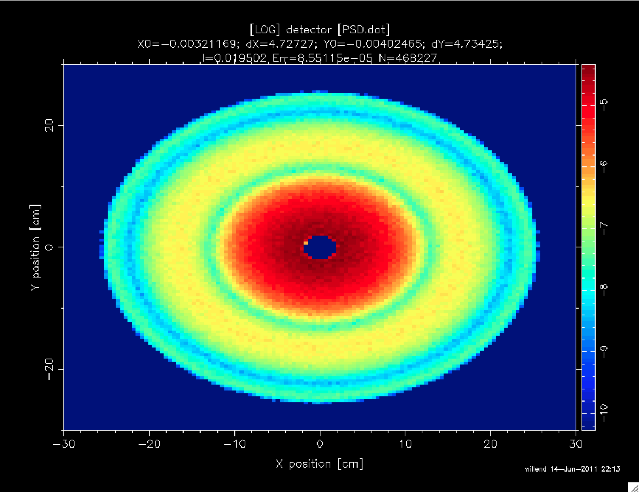
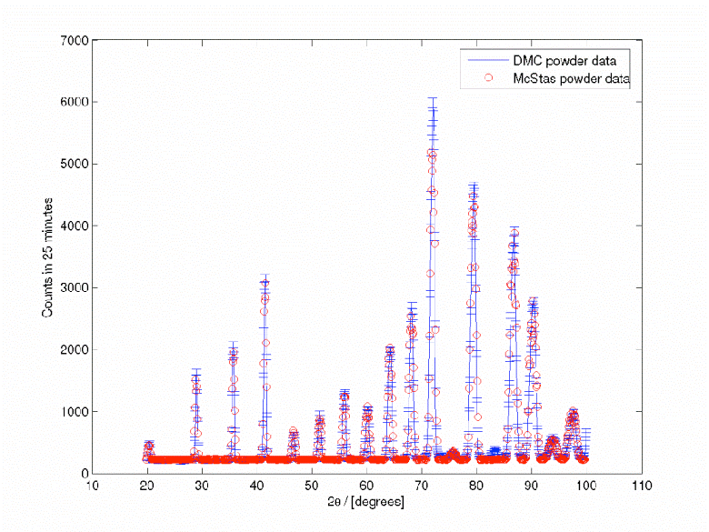
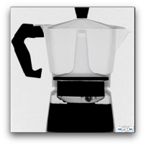
Components of neutron instruments
Detectors are “monitors” in McStas. Mostly they act as “perfect probes” and can be positioned thought your instrument gathering 1D/2D/ event lists…
The sample:
Crystalline, powders, liquids, micelles, structures to image, inelastic features like phonons…
Neutron optics include things like:
Mirrors and guides
Collimators and slits
Diskchoppers, Fermi choppers and velocity selectors
Monochromators/Analysers
In McStas the moderator is the “source”

Slide 15

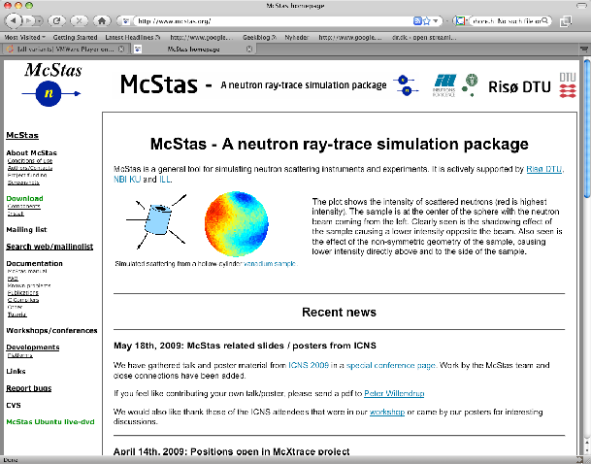
McStas Introduction
Flexible, general simulation utility for neutron scattering experiments.
Original design for Monte carlo Simulation of triple axis spectrometers
Developed at DTU Physics, ILL, PSI, Uni CPH, ESS DMSC
V. 1.0 by K Nielsen & K Lefmann (1998) RISØ
Currently 2.5+1 people full time plus students
GNU GPL license
Open Source
Project website at
http://www.mcstas.org
mcstas-users@mcstas.org mailinglist

Slide 16
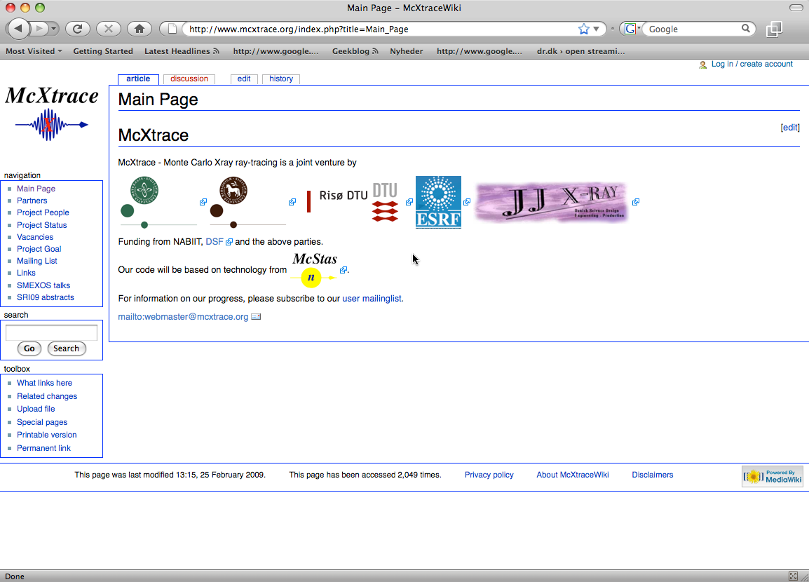
McStas Introduction
McXtrace - since jan 2009 similar for X-rays
Flexible, general simulation utility for neutron scattering experiments.
Original design for Monte carlo Simulation of triple axis spectrometers
Developed at RISØ DTU, KU and ILL, Grenoble.
V. 1.0 by K Nielsen & K Lefmann (1998)
Currently 2.5+1 people full time plus students
GNU GPL license
Open Source
Project website at
http://www.mcstas.org
neutron-mc@risoe.dk mailinglist
Synergy, knowledge transfer, shared infrastructure
4

Slide 17
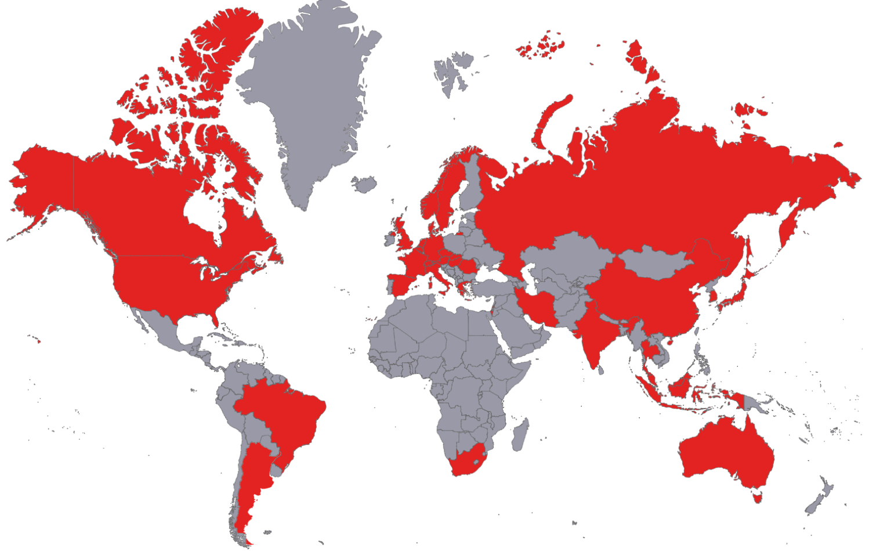


















Used in many places

Slide 18
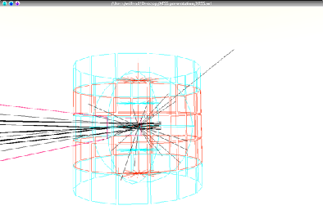
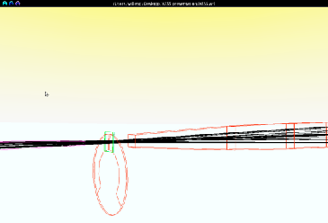
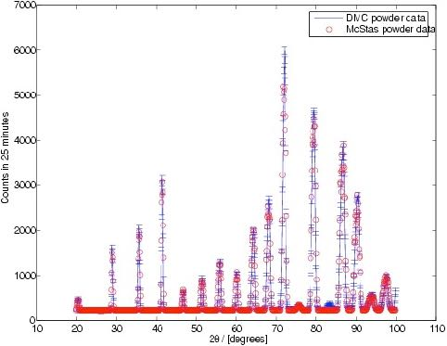
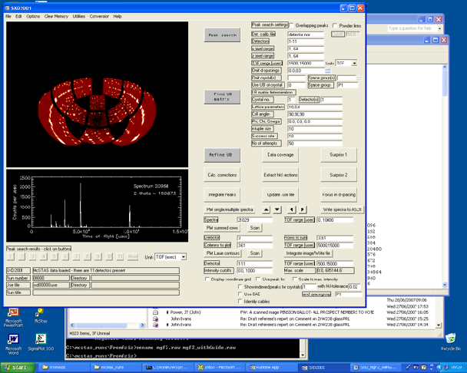
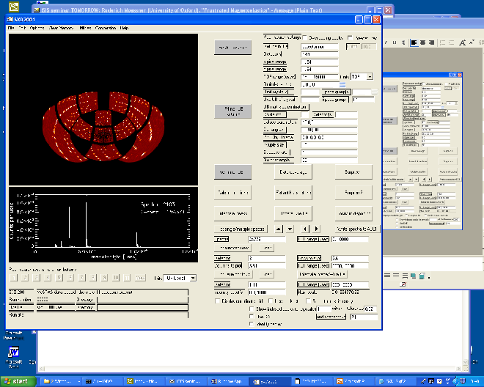
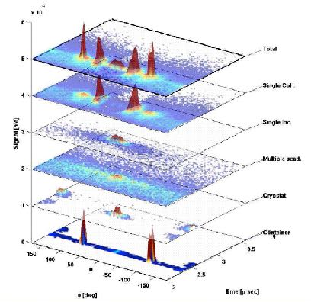
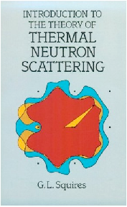
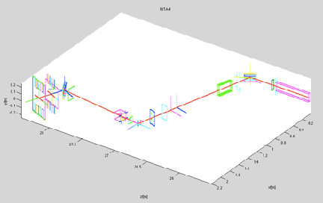
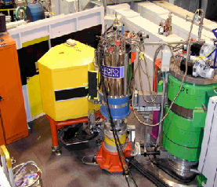
What is McStas used for?
Instrumentation
Planning
Construction
Virtual experiments
Data analysis
Teaching
(KU, DTU)

Slide 19


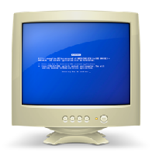
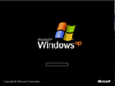
McStas overview
Portable code (Unix/Linux/Mac/Windoze)
Ran on everything from iPhone to 1000+ node cluster!
'Component' files (~100) inserted from library
Sources
Optics
Samples
Monitors
If needed, write your own comps
DSL + ISO-C code gen.

Slide 20
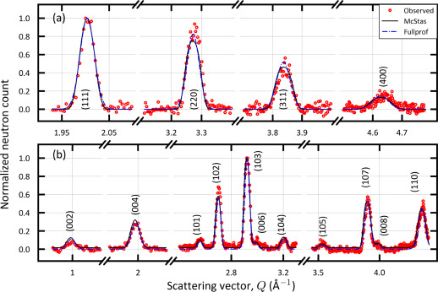
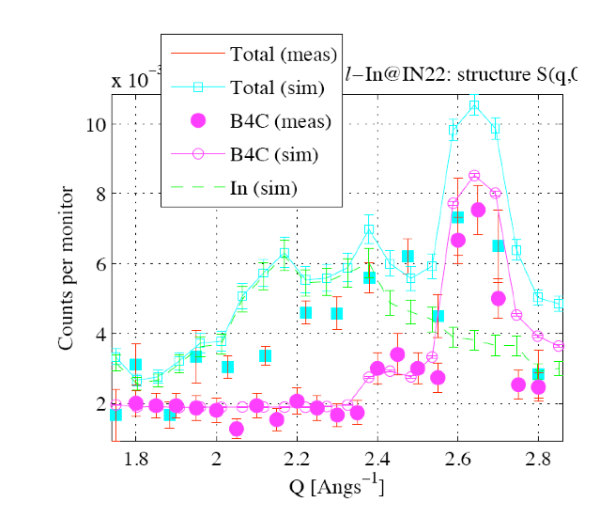
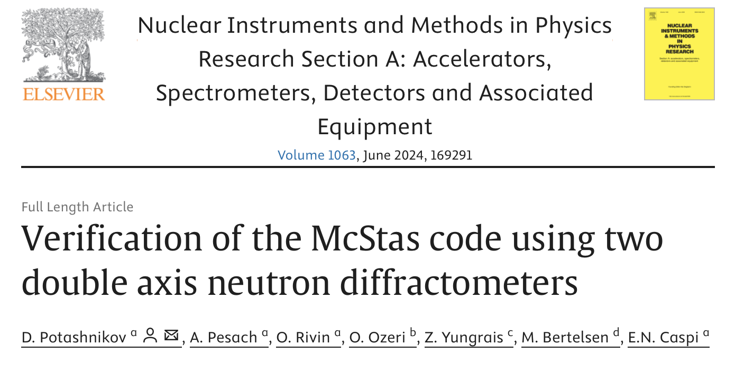
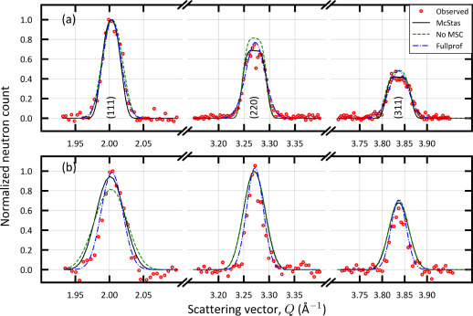
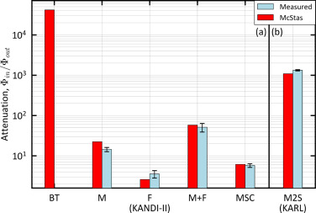
Reliability - cross comparisons
KANDI-II 2.47 Å wavelength
Much effort has gone into this
Here: simulations vs. exp. at powder diffract. DMC, PSI
The bottom line is
McStas agree very well with other packages (NISP, Vitess, SIMRES, MCViNE)
Experimental line shapes are within 5%
Absolute intensities are within 10%
Common understanding: McStas and similar codes are reliable
Si
Gr₂GaC
KARL Si sample
PG 2.421 Å
E. Farhi, P. Willendrup, from IN22 benchmark exp.
https://doi.org/10.1016/j.nima.2024.169291
Gold foil intensity measurements
Cu 0.98 Å
P. Willendrup et al., Physica B, 386, (2006), 1032.

Slide 21
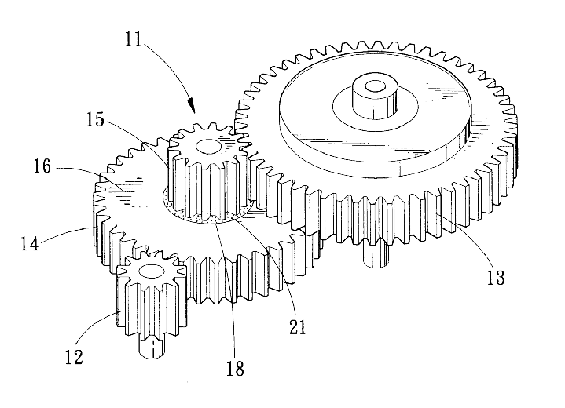
Under-the-hood / inner workings
Domain-specific-language (DSL) based on compiler technology (LeX+Yacc)
Simple Instrument language ISO C
Component codes realizing beamline parts (including user contribs)
Library of common functions for e.g.
I/O
Random numbers
Physical constants
Propagation
Precession in fields
...
Code generation

Slide 22
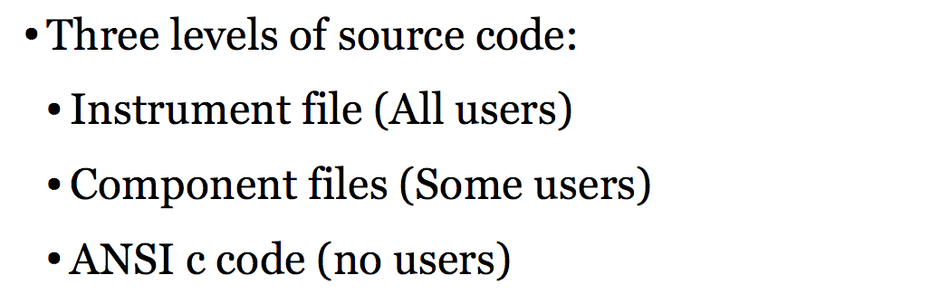
Implementation

Slide 23
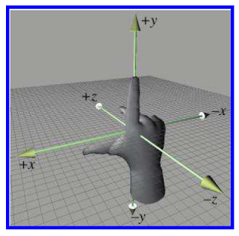
Placing components - source
One of the first components in your instrument is typically a source, which has a coordinate system like this….
z is along neutron beam direction
y is vertical
x at an angle of 90° wrt. z,y
y
x
z
Right-handed
coordinate system

Slide 24
Placing components - source
Often the source coordinate system coincides with the “lab” coordinate system, denoted ABSOLUTE in McStas language, i.e.
COMPONENT Source = Source_simple(…) AT (0,0,0) ABSOLUTE
y
x
z

Slide 25
Placing further components - RELATIVE
Placing further components is done by order of 1. Location, i.e
COMPONENT Source = Source_simple(…) AT (0,0,0) ABSOLUTE
y
y´
x
x´
z
z’
COMPONENT Guide = Guide(…) AT (0,0,1) RELATIVE Source

Slide 26
Placing further components - RELATIVE
Placing further components is done by order of 2. Rotation, i.e
COMPONENT Source = Source_simple(…) AT (0,0,0) ABSOLUTE
y
y´
x
x”
x´
z”
z
z’
COMPONENT Guide = Guide(…) AT (0,0,1) RELATIVE Source
ROTATED (0,30,0) RELATIVE Source
(Reference labels can also be PREVIOUS or PREVIOUS+1 etc.)

Slide 27
Components often have their origin at the centre of mass, i.e. for samples … but not for neutron guides
y´
y
x
x´
z
z’
Generally speaking, the component author can choose
the meaningful coordinate system for the given problem!
- The McStas system takes care of the transformation between them….

Slide 28
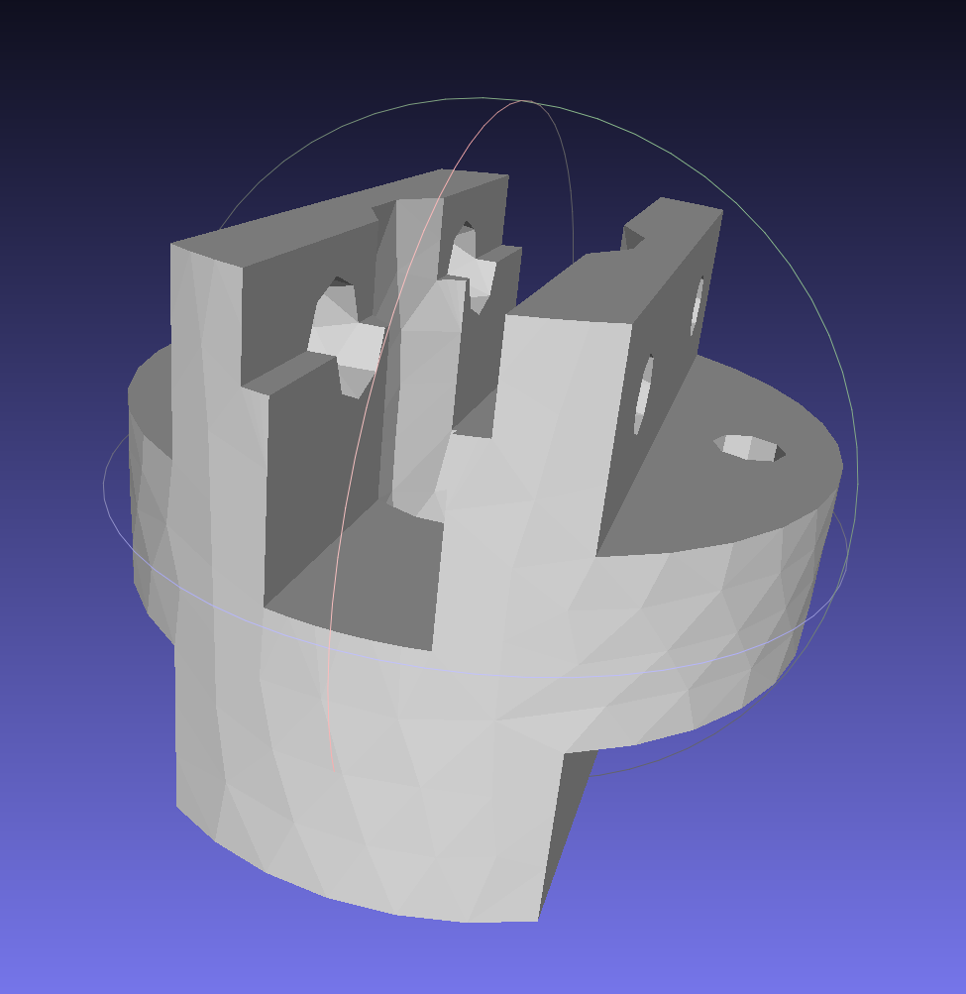
Component geometries are typically simple objects… But some have polygon-description of the surface
2D
3D

Slide 29
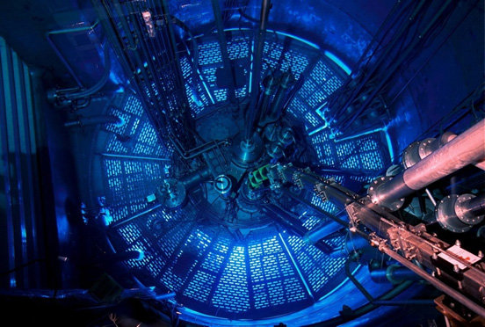
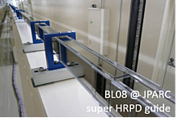
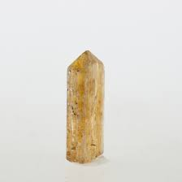
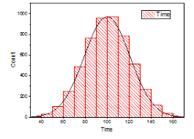


Component classes
Sources - these define MC starting conditions / “inject” neutrons to our simulation
Optics - used to tailor properties of the neutron beam
Examples are mirrors, guides, choppers, collimators, slits, …
Samples - “matter” of some form
Powders, single crystals, liquids, micelles in solution, reflecting surfaces…
Monitors - may probe the state of the neutron beam and store histograms / event lists
Misc, obsolete
“Other stuff” and “Old stuff”

Slide 30
Component classes
Sources - these define MC starting conditions / “inject” neutrons to our simulation
Optics - used to tailor properties of the neutron beam
Examples are mirrors, guides, choppers, collimators, slits, …
Samples - “matter” of some form
Powders, single crystals, liquids, micelles in solution, reflecting surfaces…
Monitors - may probe the state of the neutron beam and store histograms / event lists
Misc, obsolete
“Other stuff” and “Old stuff”
Common to all components:
They set, manipulate/interact with
or measure the state of the neutron (ray)

Slide 31

Neutron sources, i.e. moderators
To first order emit uniformly into steradian

Slide 32





Neutron sources, i.e. moderators
E.g. the beamport?
Generally we are intersted in the input to a single instrument, characterised by a certain solid angle , often corresponding to a rectangle x at a distance from the source

Slide 33
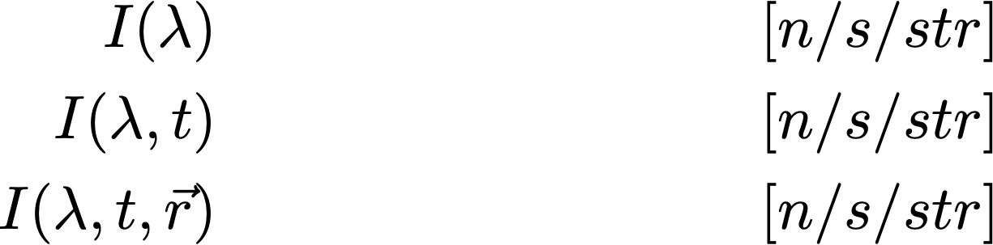

Neutron sources, i.e. moderators
The emmission intensity into our chosen solid angle can be a function of wavelength, time (pulsed sources) and possibly point of origin on the source surface
The emission of particles into the solid angle is in fact an integration and leads to a simulated “intensity” of .
In McStas, that integrated intensity is partitioned over a given set of particle rays referred to as ncount, -n or --ncount
The default ncount is 1e6 rays

Slide 34


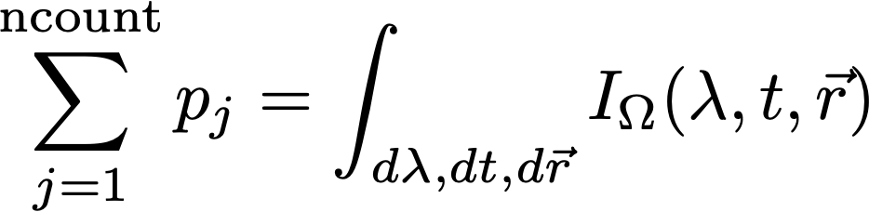
Neutron sources, i.e. moderators
Our neutron rays are emitted randomly, sampling and all variables of the source “spectrum”, i.e. wavelength, time and area
assigning neutron weights such that

Slide 35



Neutron rays in McStas - what are they?
Neutron ray in McStas:
Location x,y,z
Velocity vx,vy,vz
Time t
Polarisation. sx,sy,sz
Intensity p
Defining the neutron starting conditions imply setting:
The starting point on the surface, i.e. (in the code variables x,y,z)
The direction into and our / (in the code variables vx,vy,vz)
The starting time (in the code the variable t)
The initial intensity / weight of the neutron ray (in the code the variable p)
If needed the initial polarisation (in the code the variables sx,sy,sz)

Slide 36
Neutron (ray)-matter interaction 1: reflecting surface
1 starting situation
Mirror surface
Neutron ray
(x,y,z,vx,vy,vz,t,sx,sy,sz,p)
0

Slide 37
Neutron (ray)-matter interaction 1: reflecting surface
2. Propagate to the mirror surface
(x,y,z,vx,vy,vz,t,sx,sy,sz,p)
1
(x,y,z,vx,vy,vz,t,sx,sy,sz,p)
0

Slide 38
Neutron (ray)-matter interaction 1: reflecting surface
3. Checks (are we on surface, what is probability of reflection etc.)
(x,y,z,vx,vy,vz,t,sx,sy,sz,p)
1
(x,y,z,vx,vy,vz,t,sx,sy,sz,p)
0

Slide 39
Neutron (ray)-matter interaction 1: reflecting surface
4. Reflect
(x,y,z,vx,vy,vz,t,sx,sy,sz,p)
1
(x,y,z,vx,vy,vz,t,sx,sy,sz,p)
0
(x,y,z,vx,vy,vz,t,sx,sy,sz,p)
2
Weight of final ray is adjusted according to reflectivity, see next slide

Slide 40
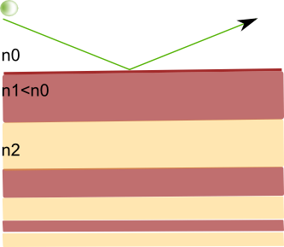
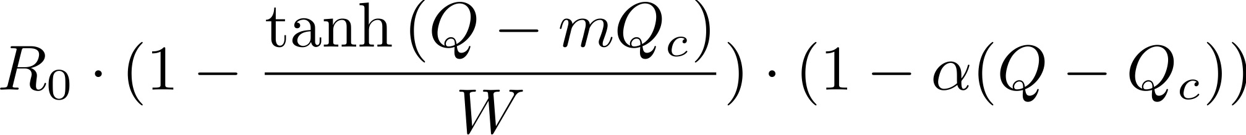
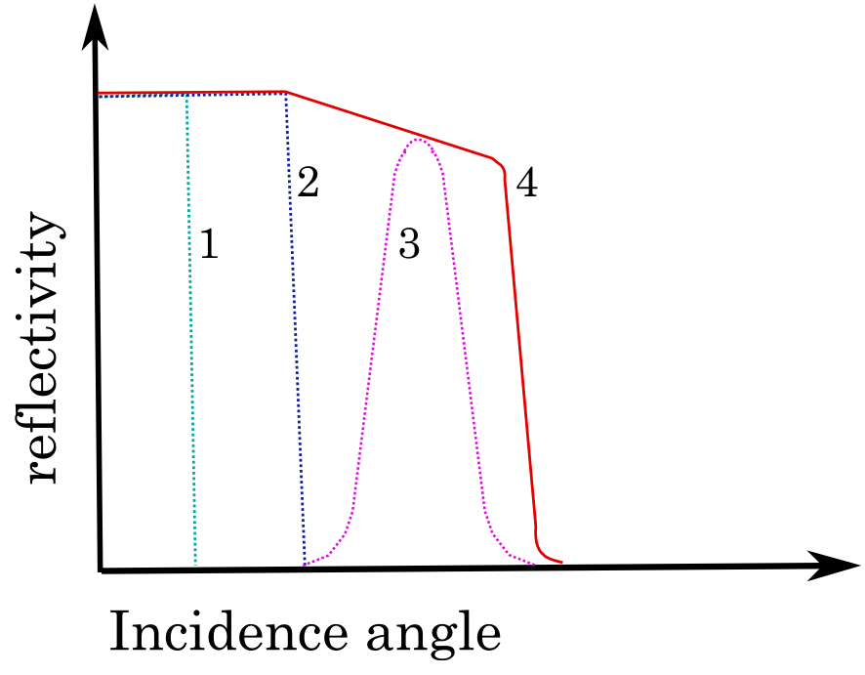



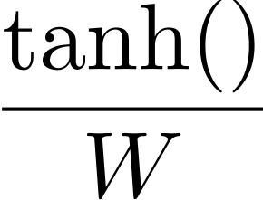





Parametrisation of reflectivity on mirrors etc.
d
R
(i.e. Q is calculated for given neutron, reflectivity encoded in changed p value)

Slide 41
Neutron (ray)-matter interaction in General
A neutron hitting a sample can be:
absorbed, transmitted, or scattered

Slide 42



Samples
For a non-thin sample the probabilities for absorption, transmission or scattering are given by
t = sample thickness
macroscopic cross section [cm⁻¹]
microscopic cross section [barn/atom]
1 barn = 10⁻²⁴cm²
number density [atoms/cm³]

Slide 43

Samples/Matter interaction in General in McStas
A neutron ray hitting a sample can be:
transmitted+absorption, or scattered+absorption

Slide 44









Transport of weight through the instrument…
In a given component, the neutron intensity is adjusted by a multiplicative factor (probability)
Instrument
Sample
Source
Monitor
The weight multiplier of the j’th component, , is calculated by the probability rule where Pb is the physical probability for the event ”b“, and is the probability that the Monte Carlo simulation selects this event.
In case of “branching”, i.e. multiple outcomes, it is clear that

Slide 45
To first order, McStas is linear and follows sequence of components in your file…
1
3
2
1
2
3
Starting at the source

Slide 46
To first order, McStas is linear and follows sequence of components in your file…
1
3
2
1
2
3
Moving to first comp in the list

Slide 47
To first order, McStas is linear and follows sequence of components in your file…
1
3
2
1
2
3
Moving to 3rd comp in list requires “moving back in time”.
Default behavior is to ABSORB this type of neutron.
For monitors use restore_neutron=1 in this case.
For homegrown comps use ALLOW_BACKPROP macro.

Slide 48
To first order, McStas is linear and follows sequence of components in your file…
The order of components is important,
and in general overlaps should be avoided!
1
3
2
1
2
3
Moving to 3rd comp in list requires “moving back in time”.
Default behavior is to ABSORB this type of neutron.
For monitors use restore_neutron=1 in this case.
For homegrown comps use ALLOW_BACKPROP macro.

Slide 49


Instrument file

Slide 50



Component file

Slide 51



Generated c-code

Slide 52


Writing new comps or understanding existing is not that complex...
Check our long list of components and look inside... Most of them are quite simple and short... Statistics:
Number of lines of code per component - 199 comps in total
(update: 175)
# Lines of code (log axis)

Slide 53
Writing new comps or understanding existing is not that complex...
Check our long list of components and look inside... Most of them are quite simple and short... Statistics:
Number of lines of code per component - 199 comps in total
(update: 175)
Well-developed community support
30-40% of existing and new additions are from users
No direct refereeing of the code, but these requirements:
At least one test-instrument
Meaningful documentation headers (in-code docs)
Contributions go in dedicated contrib/ section of library

Slide 54










Example suite: ~140 instruments

Slide 55


Slide 56


Units used - and differences to Vitess
Generally SI-Units, e.g. meters and seconds etc.
Added neutron-scattering meaningful quantities of E[meV], 𝝺[Å] and cross sections in 𝞂 [barns]
Main differences / difficulties translating between McStas Vitess
Different length-units for placement / sizes [m] [cm]
Different propagation-coordinate system
McStas explicitly and automatically contains “free space”, Vitess has this “inside” the modules or by adding “spacewindow”
Sources in McStas always propagates “by virtual window”, i.e. does not itself propagate
z || beam
y vertical
x ⊥ beam
x || beam
z vertical
y ⊥ beam

Slide 57
McStas Vitess compatibility features
MCPL particle list is supported from McStas 2.3- (2016) and Vitess 3.4 (2018)
McStas includes Vitess_output and Vitess_input, but better use MCPL
mcstas2vitess can be used to port McStas components to Vitess
Vitess_ChopperFermi is the Vitess Fermi chopper ported to McStas
Friendly competition and collaboration for 1.5 decades! - e.g. Klaus Lieutenant was part of McStas team for 2 years

Slide 58






McStas: Neutrons, Monte Carlo & ray-tracing
Subatomic particle discovered by
Sir James Chadwick in 1932
,

Slide 59





Neutron facilities

Slide 60



Monte Carlo techniques
Los Alamos has since then developed and perfected many different monte carlo codes leading to what is today known as the codes MCNP5 and MCNPX
State of the art is MCNP6 that features numerous (even exotic) particles
MCNP was originally Monte Carlo Neutron Photon, later N-Particle
Mainly used for high-energy particle descriptions in weapons, power reactors and routinely used for estimating dose rates and needed shielding
Does not to date handle crystalline / ordered material and coherent scattering of neutrons due to the focus on high energies

Slide 61
Examples of Monte Carlo programs
Each time physics takes place (scattering, absorption, …)
random choices are made.
Light ray-tracing: PoV-RAY and others ...
Nuclear reactor simulations (neutron transport):
MCNP, Tripoli, GEANT4, FLUKA
Neutron Ray-Tracing propagation:
McStas <www.mcstas.org>, Vitess, Restrax, NISP, IDEAS, McVine
Neutrons are described as (r, v, s, t), and are transported along
instrument models.
Propagation simply uses Newton rules, incl. gravitation.
X-ray tracing
Shadow, McXtrace, RAY, …

