Slide 1


Powered by McStas technology
"McXtrace: a Monte Carlo software package for simulating X-ray optics, beamlines and experiments", Journal of Applied Crystallography, vol. 46, part 3, June 2013
Peter Willendrup <pkwi@fysik.dtu.dk> (slides from Erik Bergbäck Knudsen)

Slide 2
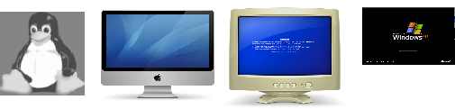
What is it?
Built on proven base of McStas for neutron ray tracing
K. Lefmann and K. Nielsen, Neutron News 10, 20, (1999).
Releases 1.7.1 and 3.1 (GPU support). New releases after SOLEIL school.
Portable code (Unix/Linux/Mac/Windows, 32 and 64 bit support)
Has run on all from iPhone to FERMI (world no. 7)
GPL-license
DSL / Compiler Technology.
Using Lex & Yacc
Modular Open Structure.
Components/devices written in structured ISO-c automatically fits in the system
Dependencies: c-compiler (python3/qt5 or perl/tk for gui).
Permanent staff at DTU Physics maintaining the code
Project website at
http://www.mcxtrace.org
Project mailing list at
mcxtrace-users@mcxtrace.org

Slide 3
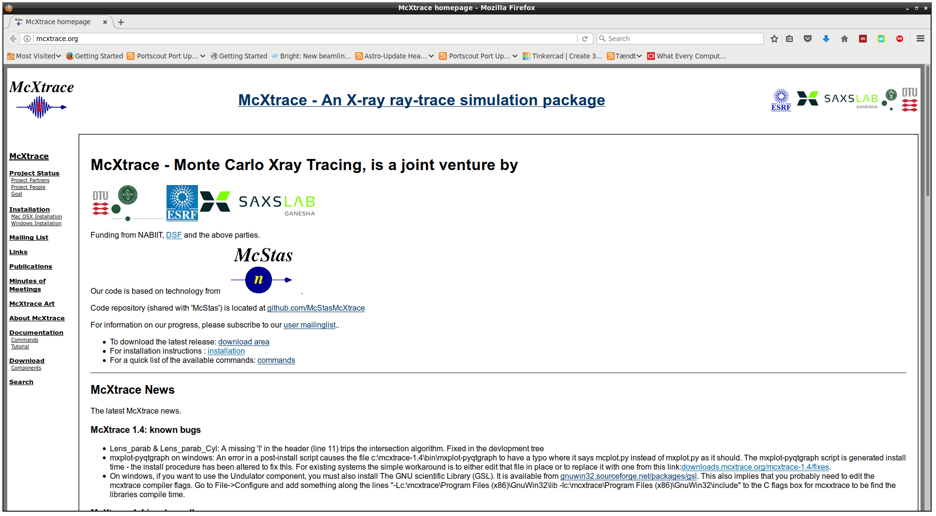
Website at https://www.mcxtrace.org

Slide 4
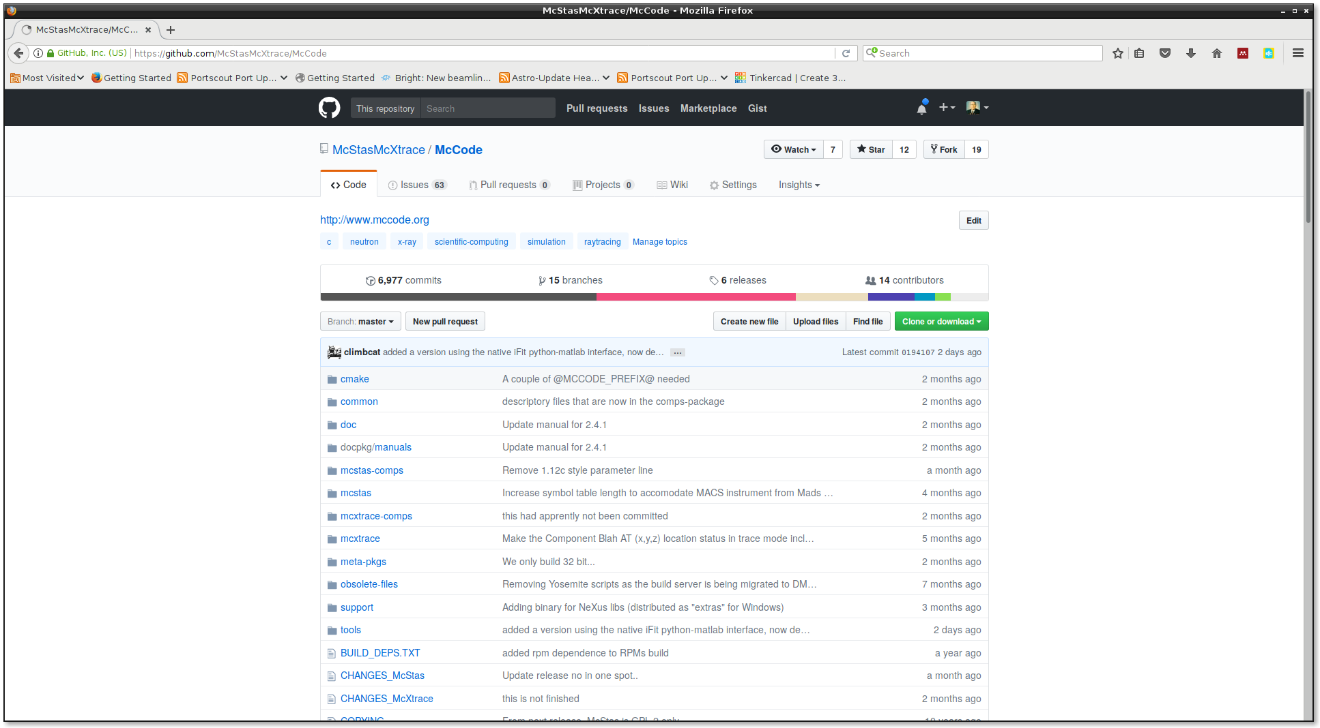
Github

Slide 5

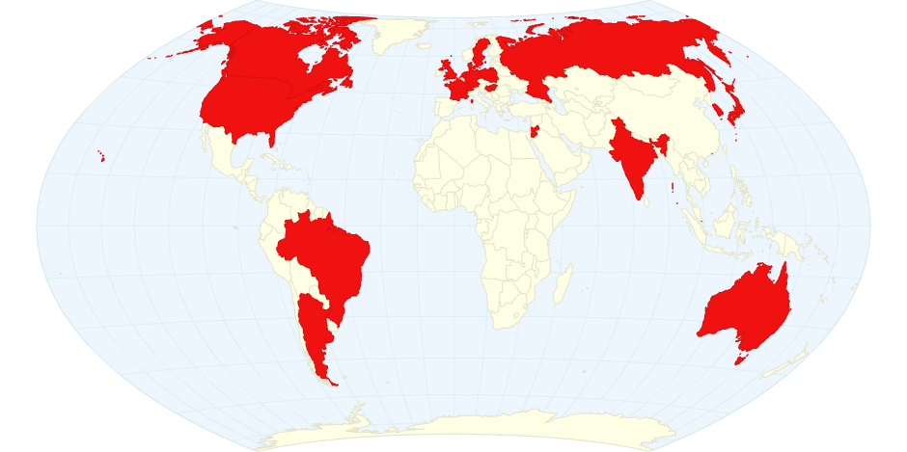











Where?

Slide 6
Feature History - and plans for NG (not fully up-to-date)

Slide 7
The McXtrace way
Describe your beamline in the McXtrace language (In a text file).
Automatically convert beamline into ANSI c
Compile
Run
1.Optimized for your platform
2.Only includes what you use

Slide 8
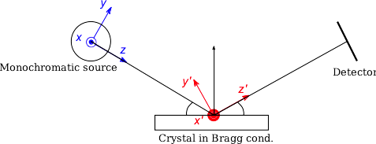
How?
Photon ray/package:
(r,k,φ,t,p,E)
r - spatial coordinates
k - wave vector
φ - phase
t - time
p – photon weight
E - Electrical field polarisation

Slide 9
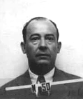
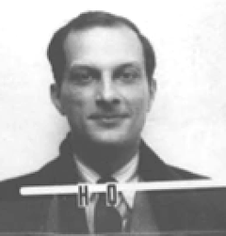
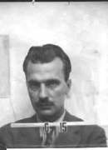
Monte Carlo techniques
During WW2, “numerical experiments” were applied at Los Alamos for solving mathematical complications of computing fission, criticality, neutronics, hydrodynamics, thermonuclear detonation etc.
Notable fathers: John v. Neumann Stanislav Ulam Nicholas Metropolis
Named “Monte Carlo” after Ulam’s fathers frequent visits to the Monte Carlo casino in Las Vegas
Initially “implemented” by letting large numbers of women use tabularized random numbers and hand calculators for individual particle calculations
Later, analogue and digital computing devices were used

Slide 10
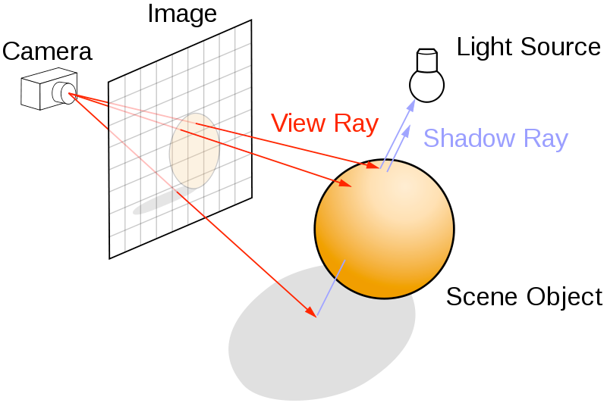
Ray-tracing methods
When particles move in “free space”, we use ray-tracing - but in most cases in direction source -> detector

Slide 11
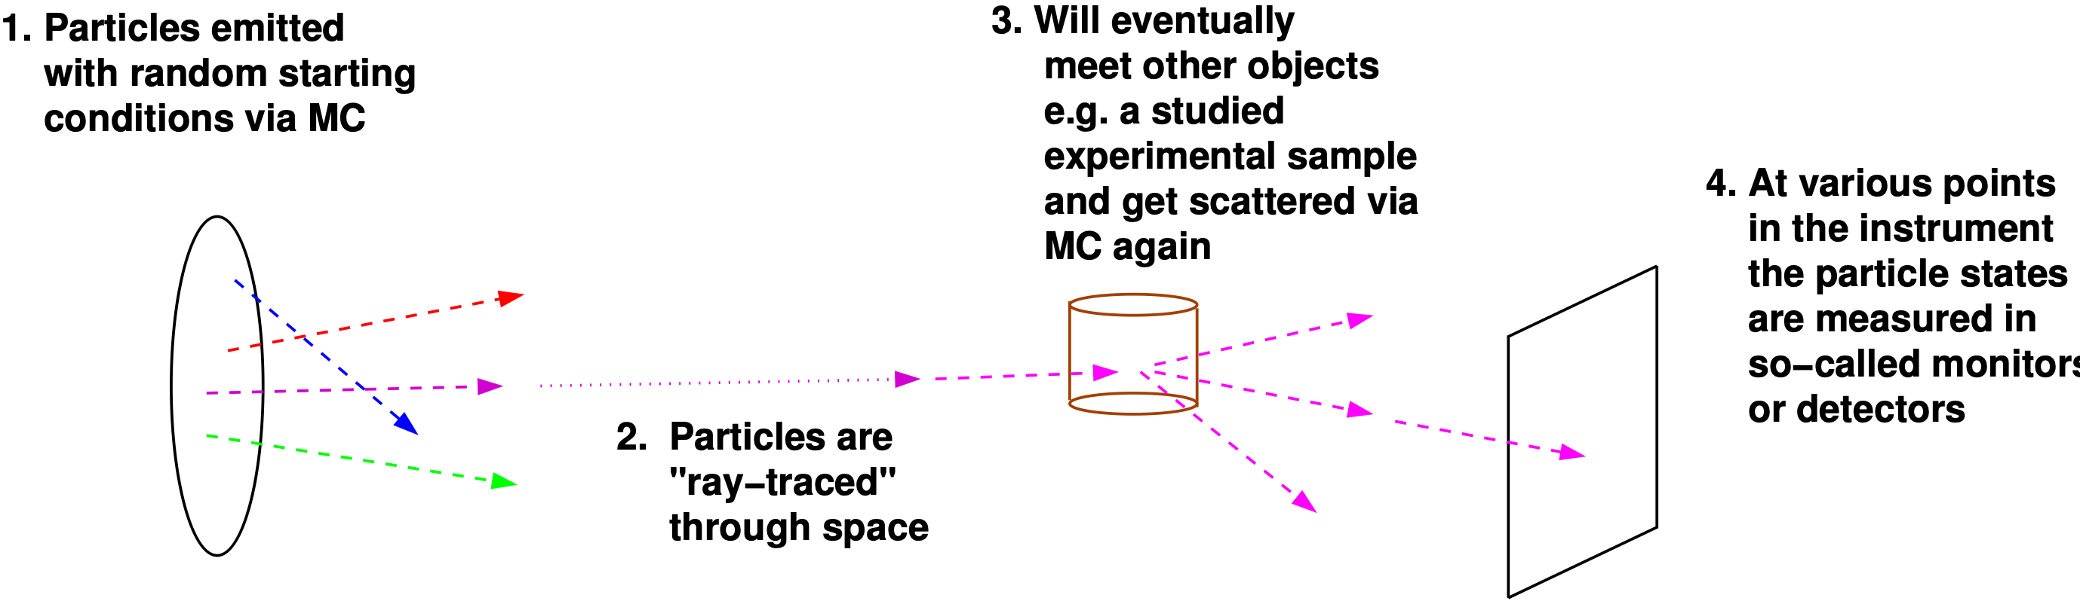
Overall picture: Monte Carlo Ray-Tracing
Important efficiency mechanisms:
“Focusing” - e.g. lab source to first slit (4π vs. limited solid angle only)
Rather vs. single particle description, absorption handled though statistics and downscaling the ray weight

Slide 12









Code Levels
Instrument file – all users
existing examples
user written – GUI assisted
Component files – some users
Short pieces of code
Easy to modify from existing
Kernel code – McXtrace developers
Propagation routines
Intersections
Generated ISO-C code – “no” users
Assembled by code generation
Very low overhead of unneeded code
Includes runtime libs that comps rely on (propagation etc.)
Instrument file (average user, point/click, DSL)
Component (advanced user, modify from existing, c-code)
Kernel (McXtrace team)

Slide 13
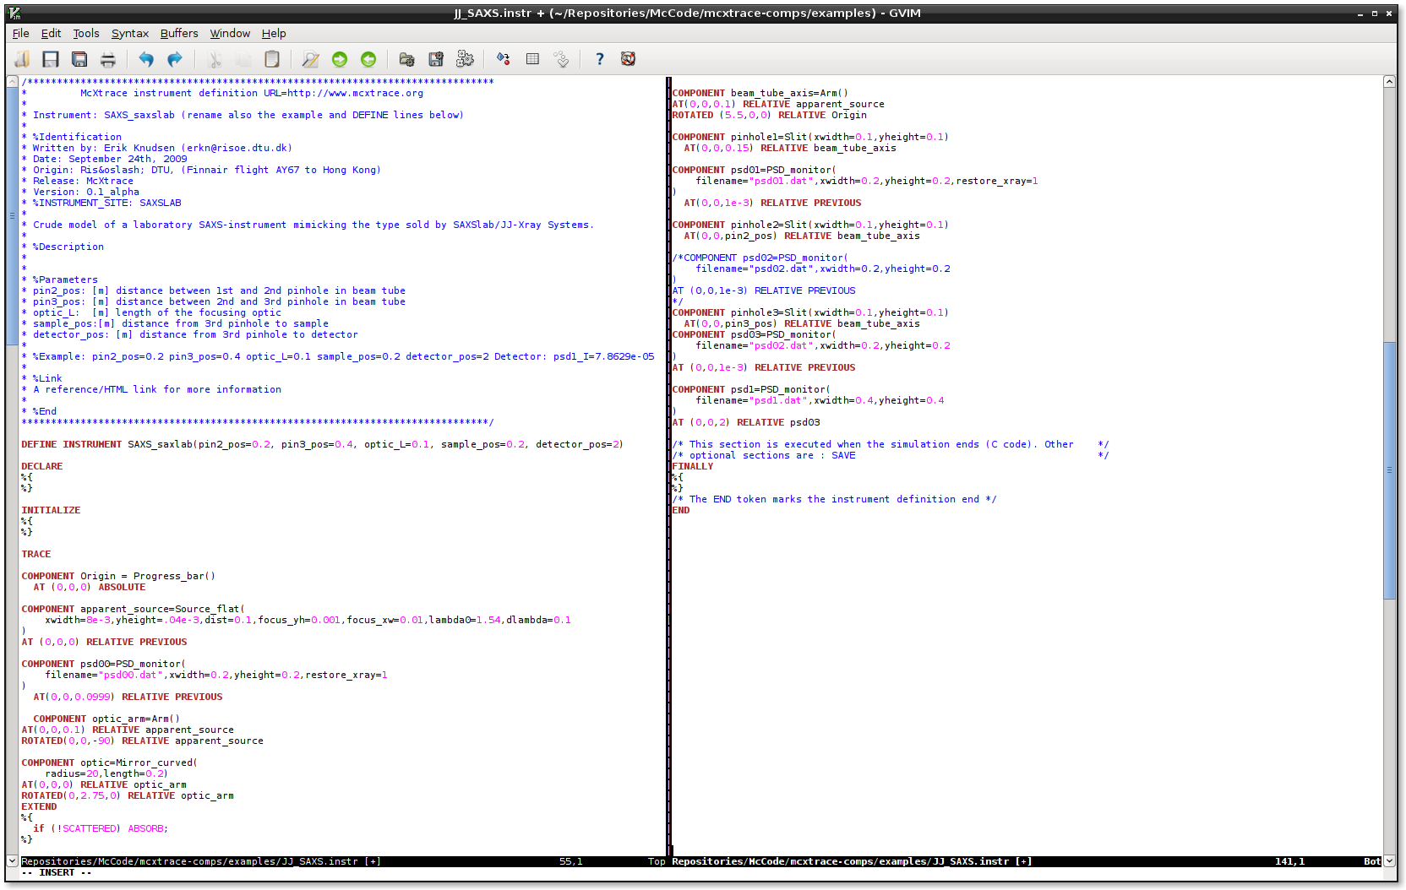
Instrument file

Slide 14
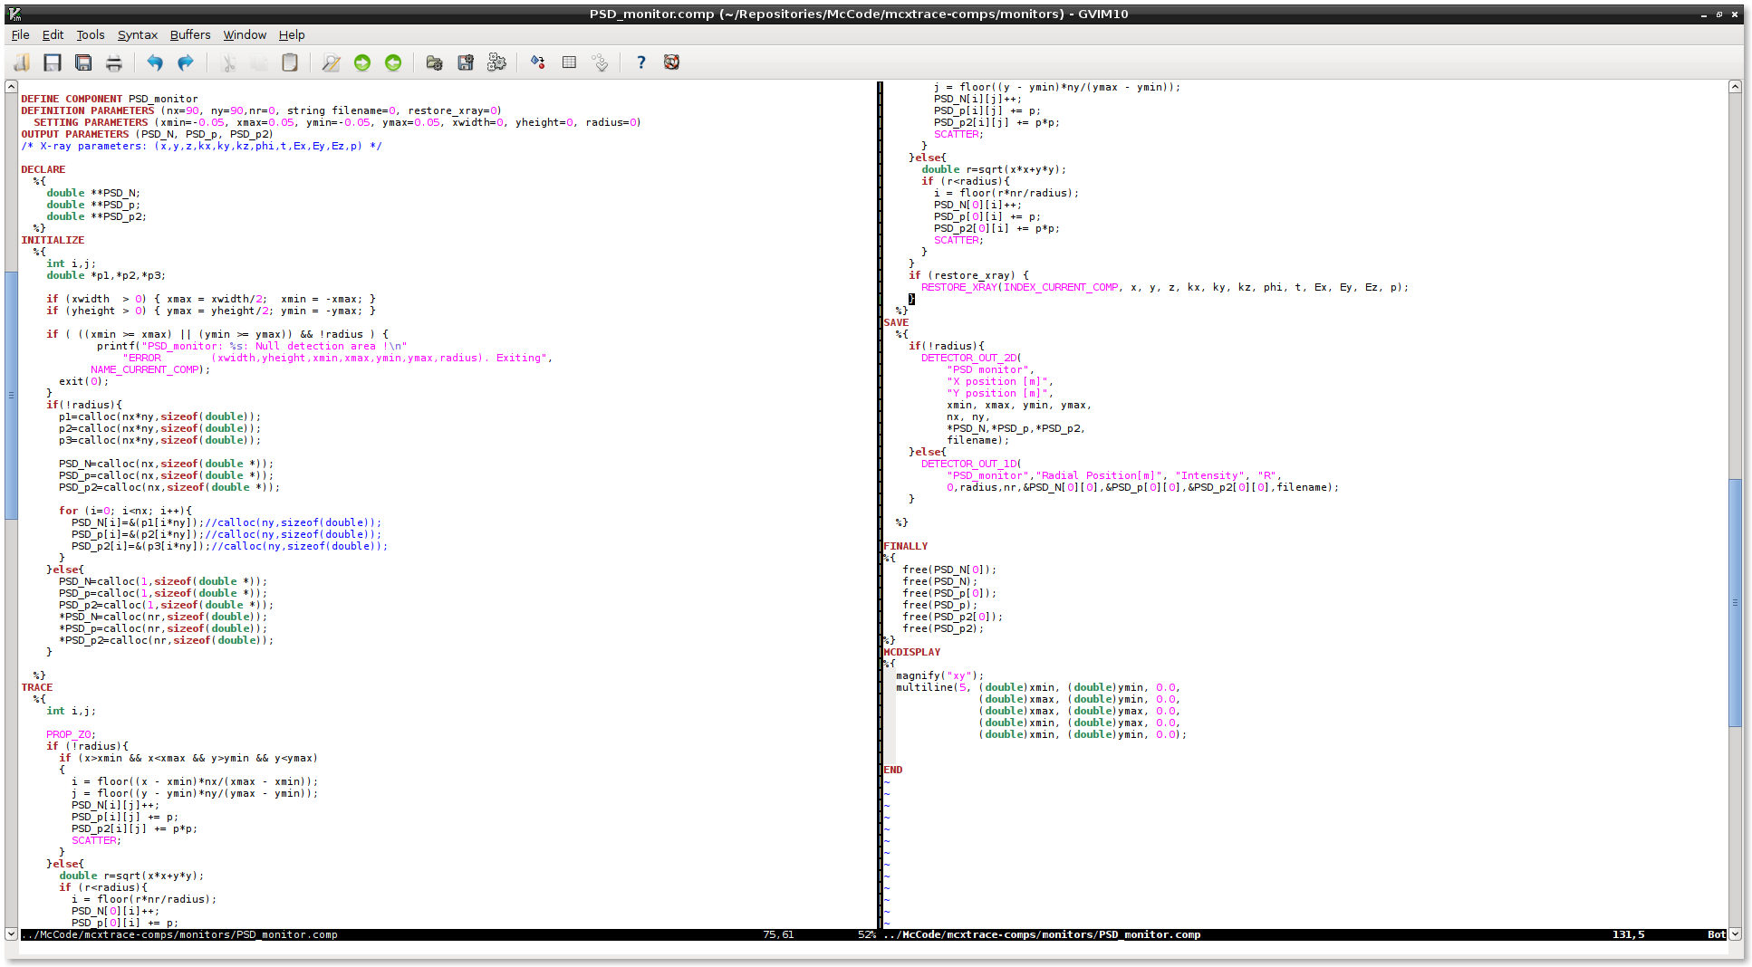
Component file

Slide 15
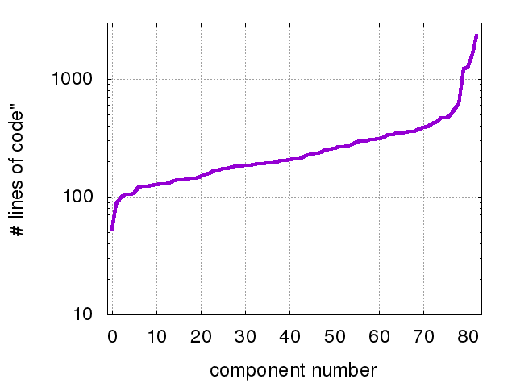
Component size
Single_crystal
SasView_model
PSD_monitor
PowderN
Undulator

Slide 16
Why bother?
Why simulate when you can just do the experiment?
Why McXtrace and not sim. package X?

Slide 17
Why simulate a full beamline?
Users don’t have the luxury you have!
Prospective users may try out experiments.
Teach users how to do experiments.

Slide 18
Why McXtrace
Community driven code
Fairly easy to extend – write a new component and it automatically fits into the framework.
Portable (need a c-compiler).
Several included standard sample models.
Once written, a simulation/beamline is a real program in itself.
...but...
Use whatever you prefer! XRT, SHADOW, SRW, Ray,...<insert package here>...

Slide 19
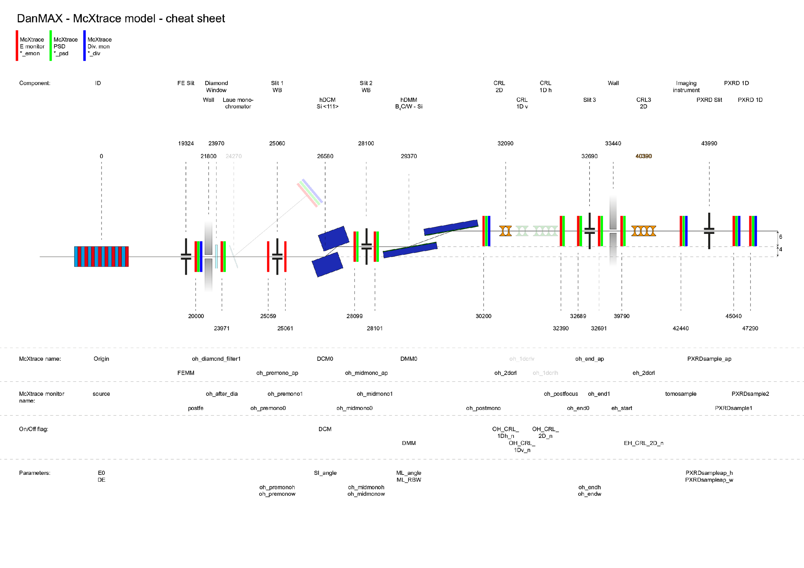
DanMAX simulation effort
McXtrace main simulation vehicle with connections to:
SPECTRA / SRW for source (undulator) calculation benchmarking
COMSOL + SHADOW + MASH – heatload calculations
IMD – multilayer reflectivity calculations

Slide 20
DanMAX simulation workflow
PDF
SPECTRA
Optics/
Experiments
(Powder,
Abs. Phantom)
DCM
DMM
Detectors
SRW
McXtrace
Heat
Deformation
FLUKA
Reflectivity map
SHADOW/
MASH
Crystal/
Heatload
COMSOL
IMD/
Multilayers
Undulator
Heat map
Detector models
G4 / MCNP /
Penelope

Slide 21
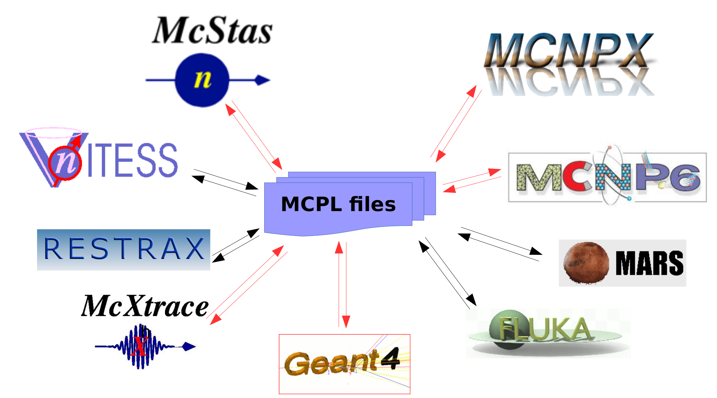
MCPL
Monte Carlo Particle List-format
Courtesy T. Kittelmann, ESS

Slide 22
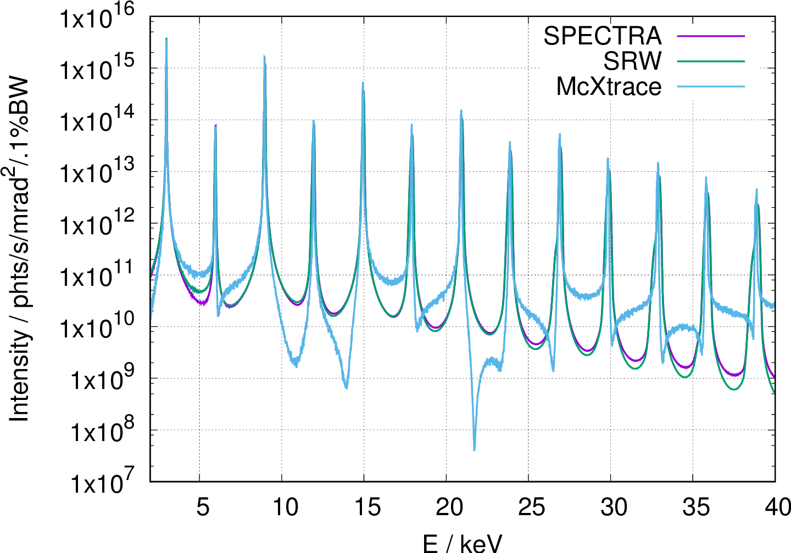

Source: Undulator

Slide 23
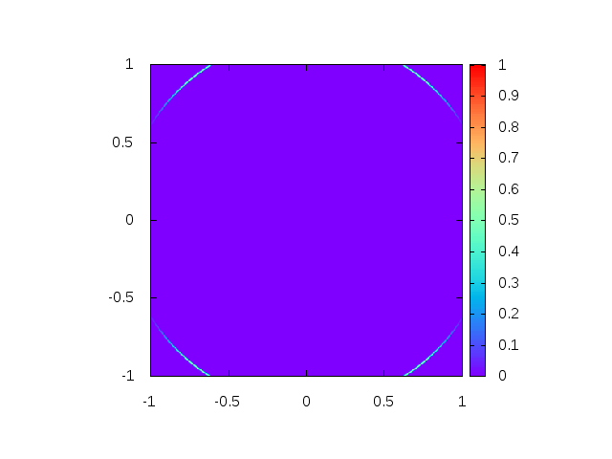

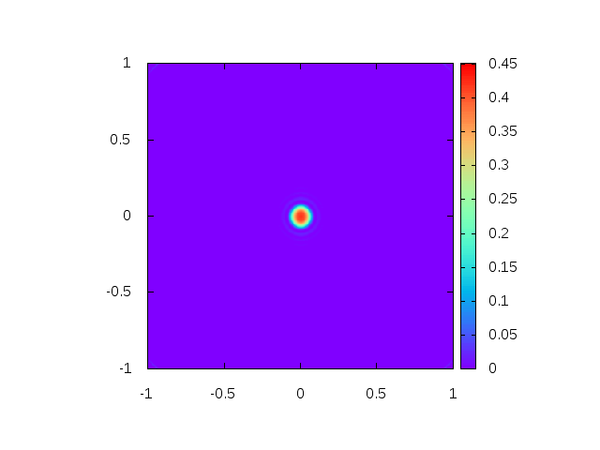


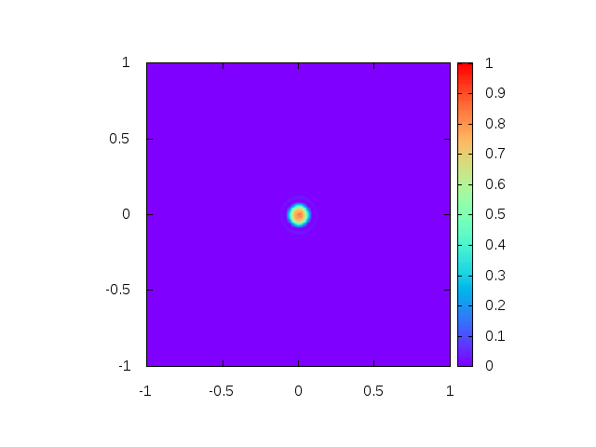
Undulator: Spatial distr.
Tuned to have 11th Harmonic at 33 keV
25.3 keV
26.8 keV
33 keV
SPECTRA
McXtrace

Slide 24
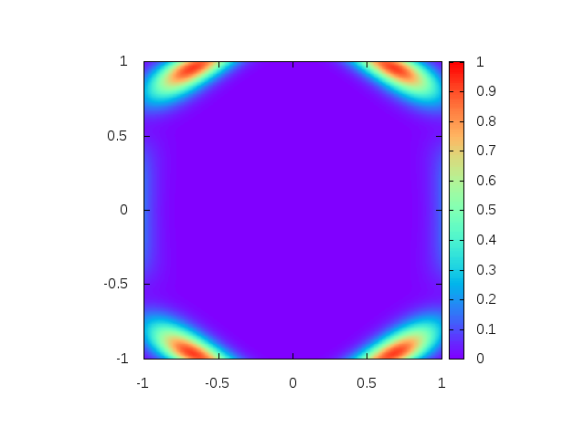
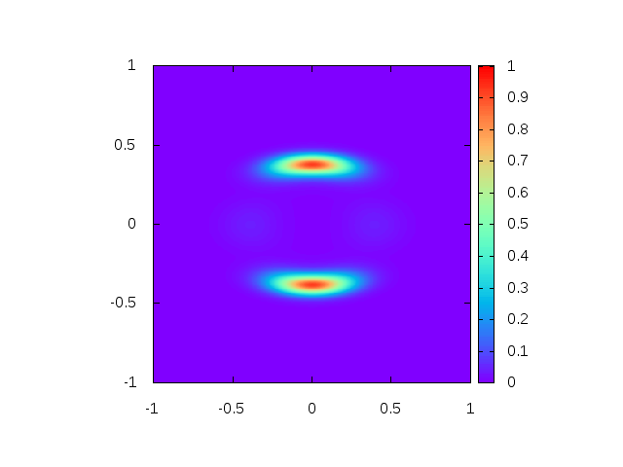
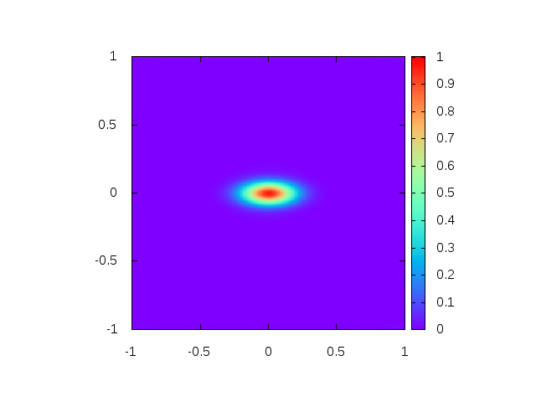
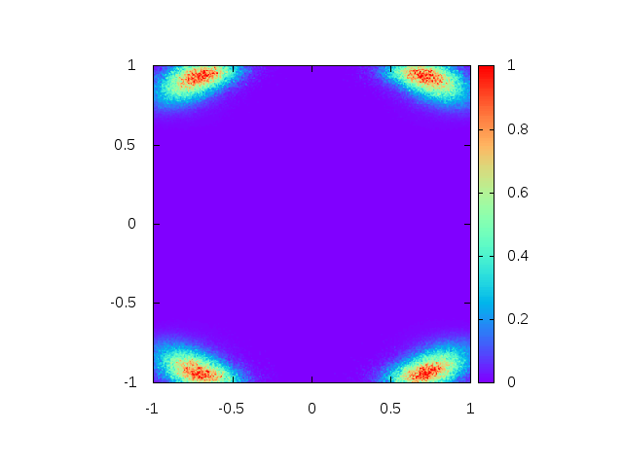
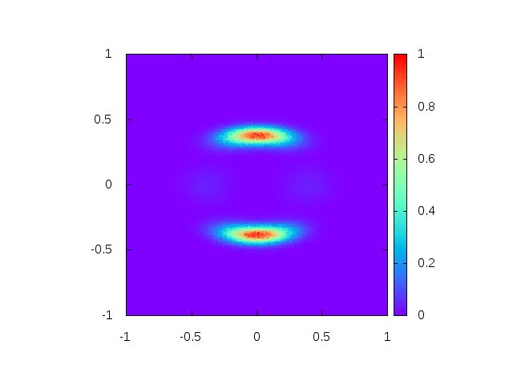

Undulator: Spatial distr.
Tuned to have 11th Harmonic at 33 keV
With emittance
25.3 keV
26.8 keV
33 keV
SPECTRA
McXtrace

Slide 25
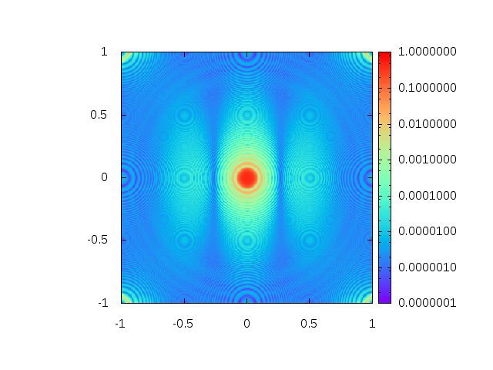
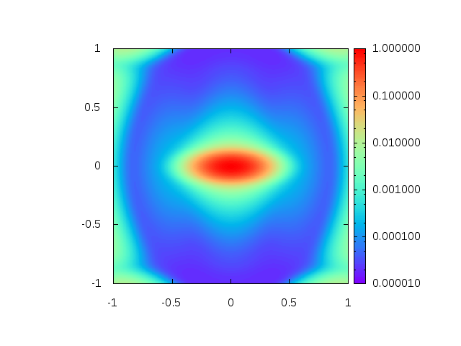
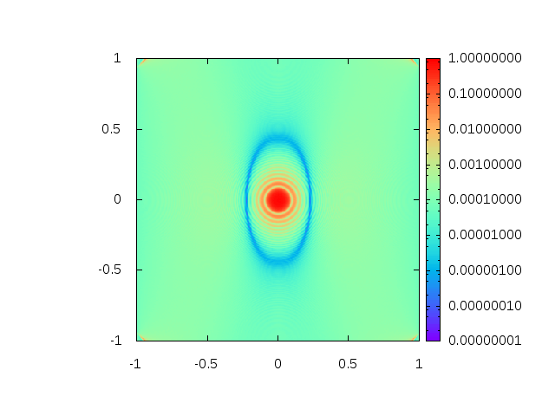
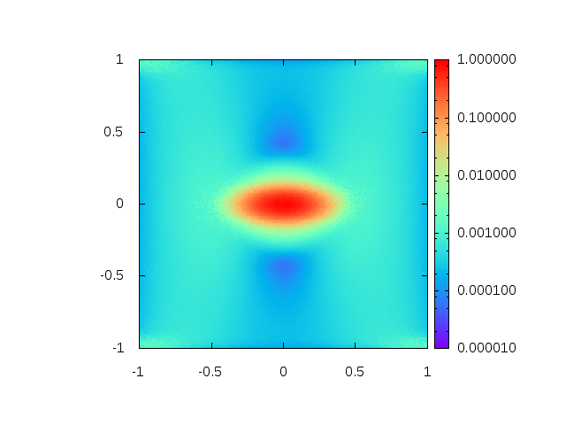
Undulator: Spatial distr.
Log-plots. 33 keV
SPECTRA
No emittance
With emittance
McXtrace

Slide 26
DanMAX simulation effort
McXtrace main simulation vehicle with connections to:
SPECTRA / SRW for source (undulator) calculation benchmarking
COMSOL + SHADOW + MASH – heatload calculations
IMD – multilayer reflectivity calculations

Slide 27
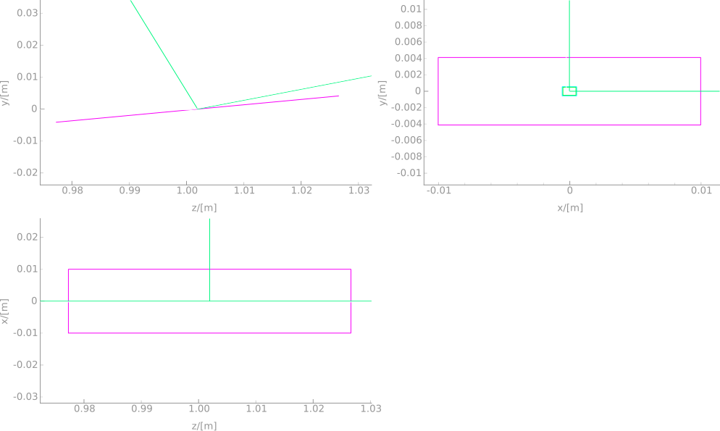
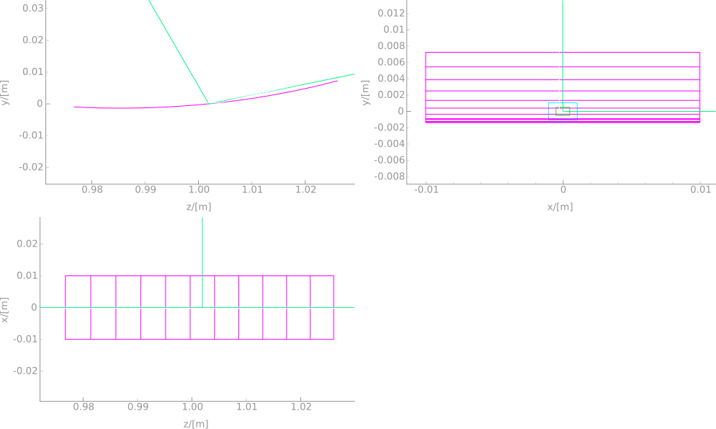
Monochromator Crystals
Flat
Bent (r=200m)

Slide 28
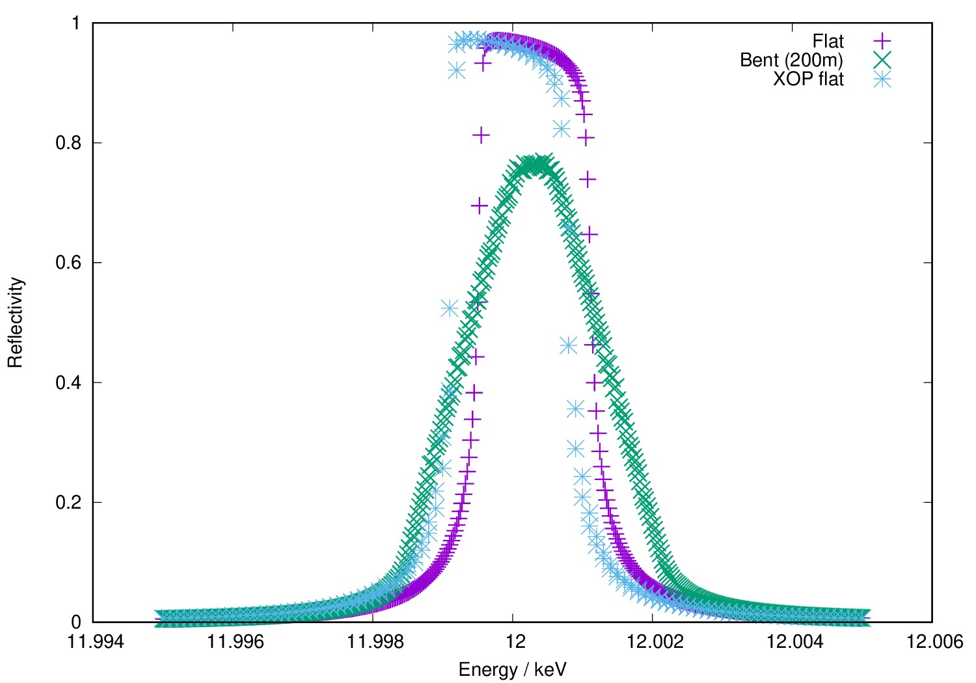

Monochromator Crystals

Slide 29
Monochromator Crystals
Currently limited to
Single atom crystals

Slide 30
DanMAX simulation effort
McXtrace main simulation vehicle with connections to:
SPECTRA / SRW for source (undulator) calculation benchmarking
COMSOL + SHADOW + MASH – heatload calculations
IMD – multilayer reflectivity calculations

Slide 31
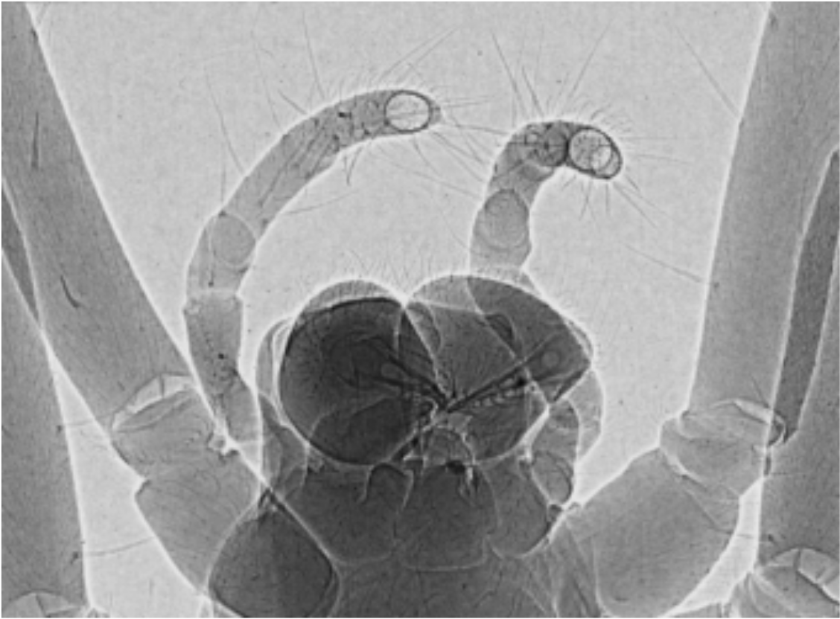
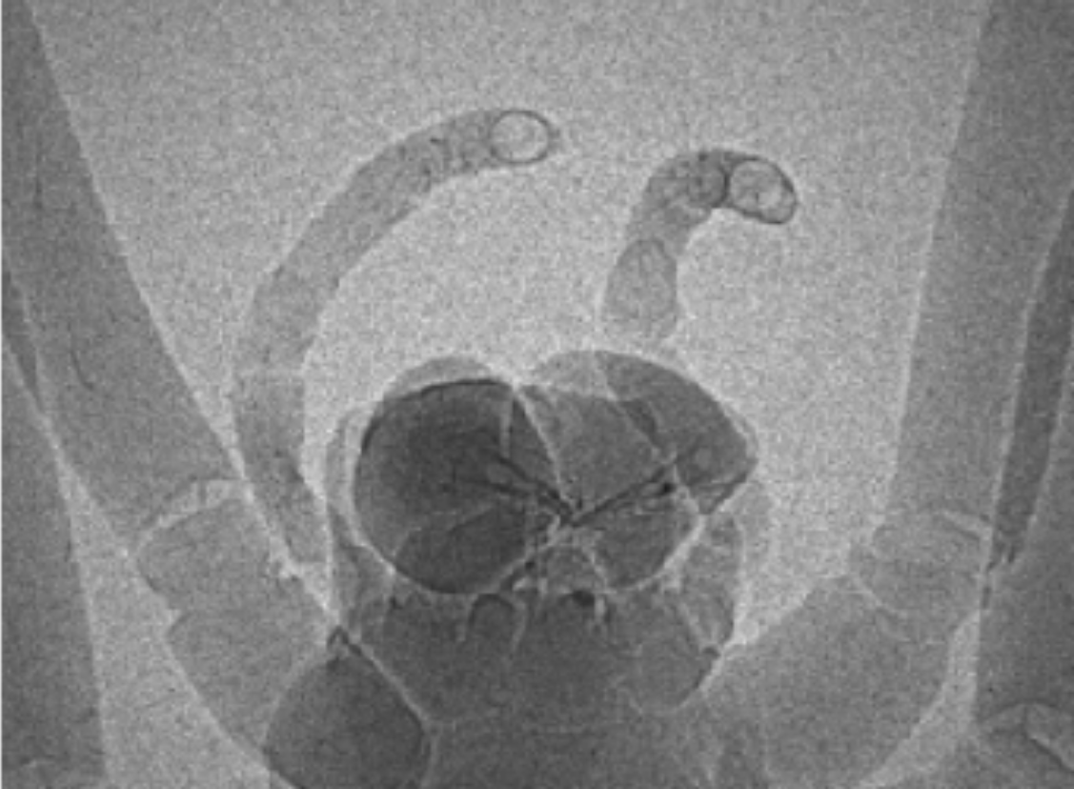
DanMAX virtual data
[I. Kantor]

Slide 32
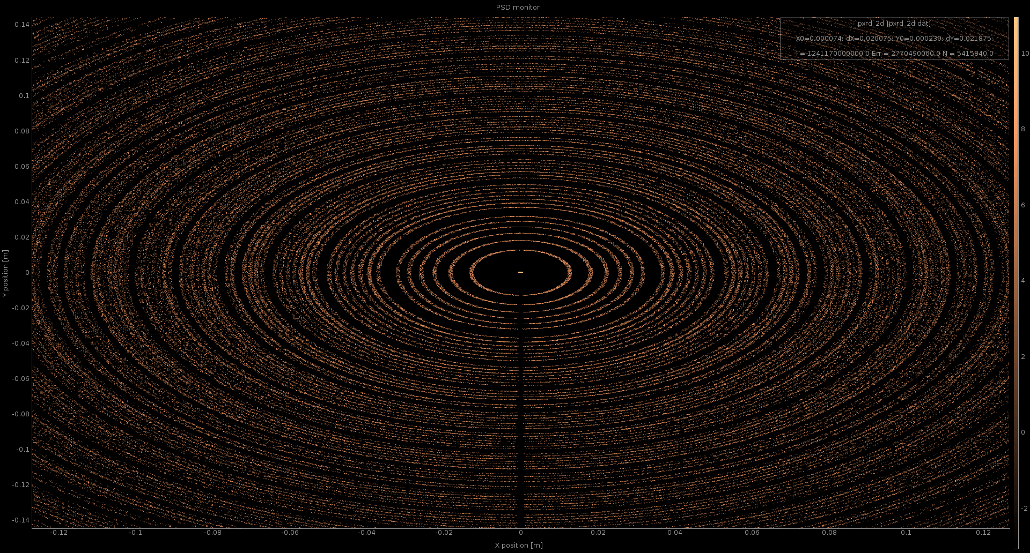
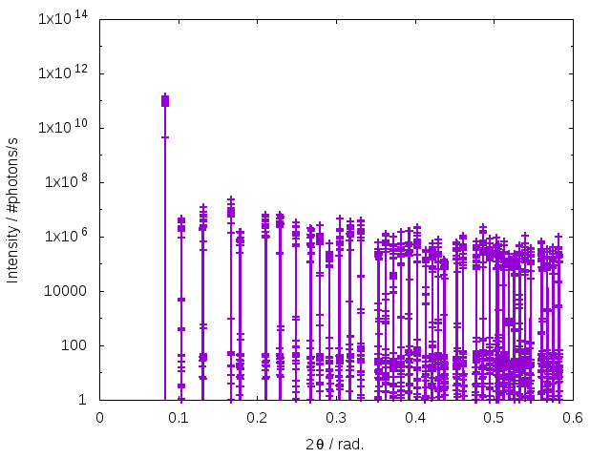
DanMAX virtual data

Slide 33
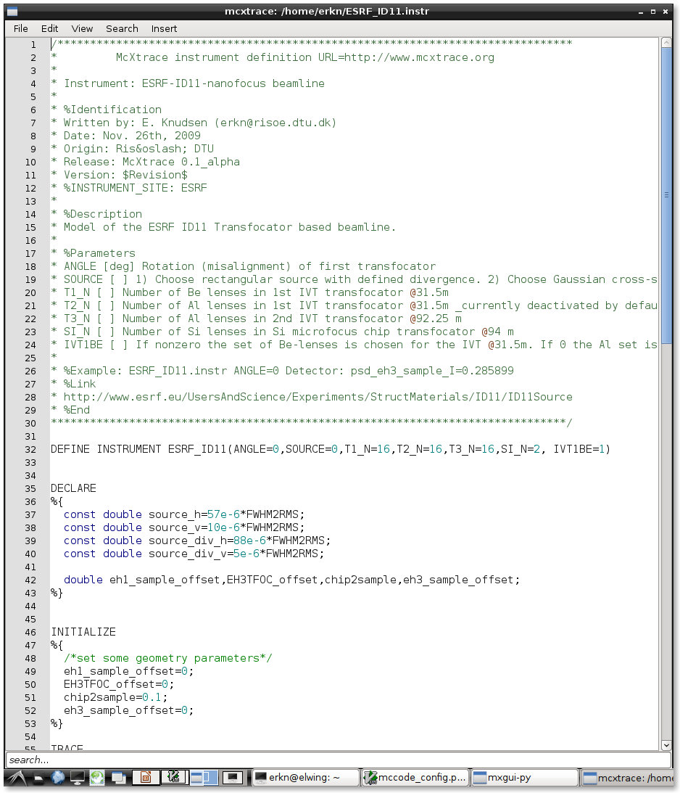
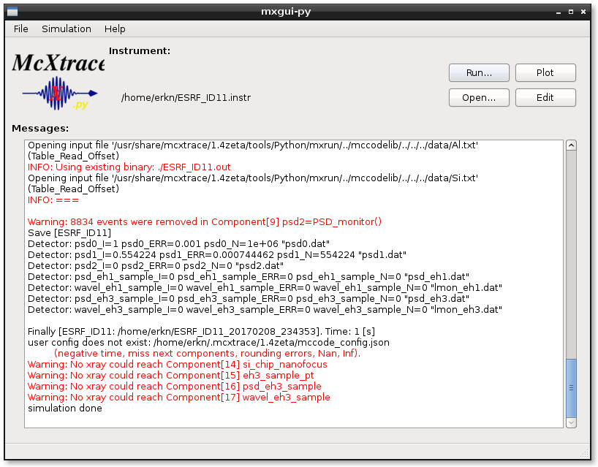
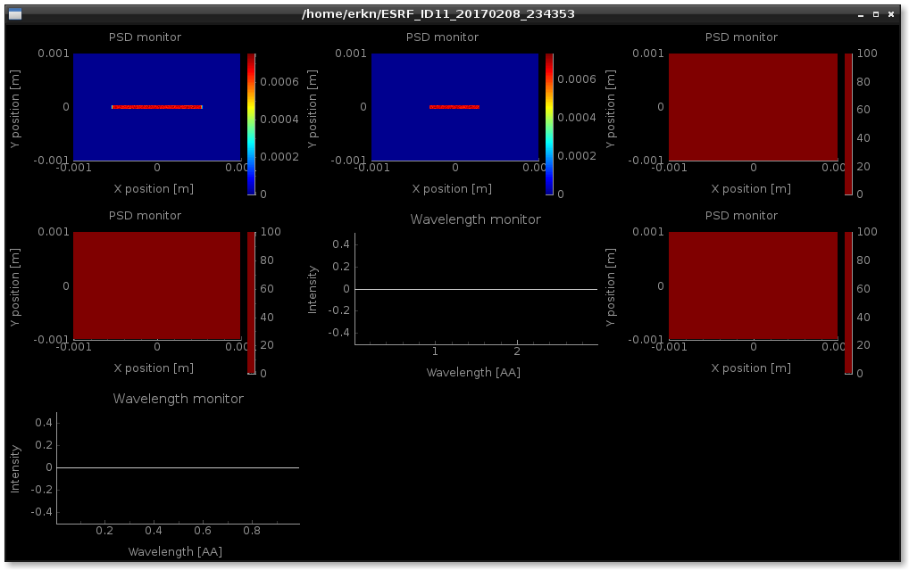
GUI
Python based

Slide 34
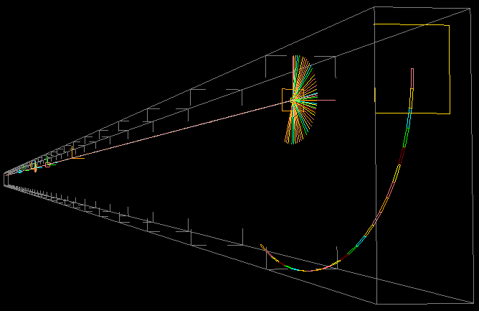
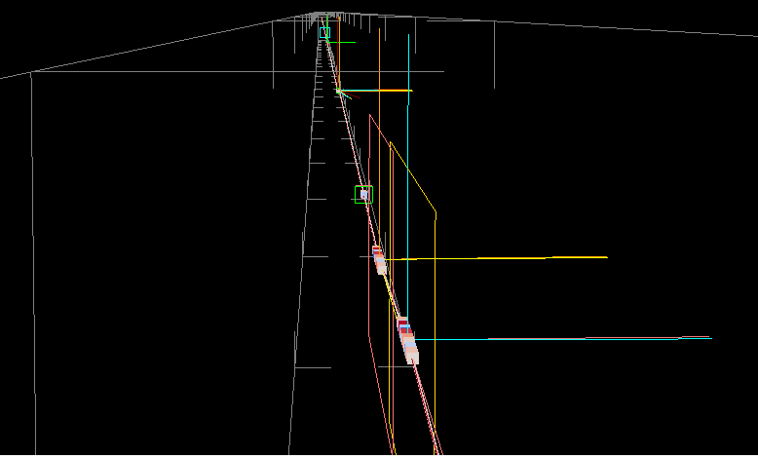
DanMAX visual ray tracing

Slide 35
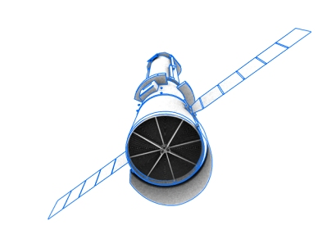
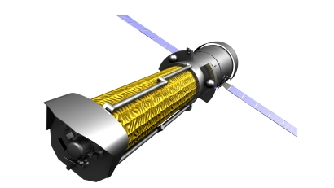
X-Ray satellite telescope
ATHENA X-ray space telescope: http://sci.esa.int/ixo/

Slide 36

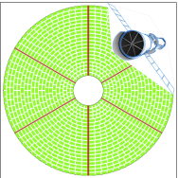
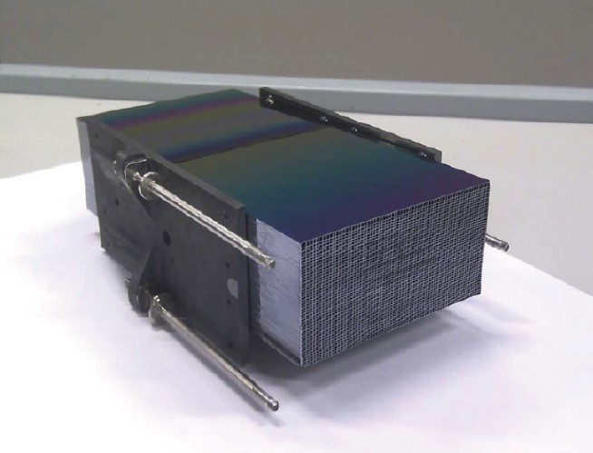

X-Ray satellite telescope

Slide 37


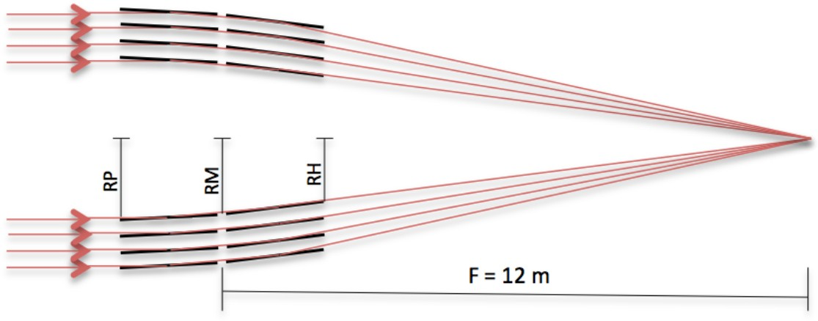
X-Ray satellite telescope

Slide 38



Thank you for your attention!
Peter Willendrup [1]
Andrea Prodi [4]
Jana Baltser [2]
Søren Schmidt [1]
Martin Meedom [1]
Henning Friis Poulsen [1]
Manuel Sanchez del Rio [4]
Claudio Ferrero [4]
Karsten Joensen [5]
Kell Mortensen [3]
Søren Kynde [3]
Martin Cramer Petersen [3]
Robert Feidenhans’l [2]
Kim Lefmann [2]
Matteo Busi [1]
Innokenty Kantor [1,7]
Mads Ry Jørgensen[8,7]
Marcus Mendenhall [9]
Giovannin Fevola [10]
[1] DTU Physics, Kgs. Lyngby, Denmark.
[2] Niels Bohr Institute, University of Copenhagen, Copenhagen, Denmark.
[3] Faculty of Life Science, University of Copenhagen, Copenhagen, Denmark.
[4] European Synchrotron Radiation Facility (ESRF), Grenoble, France.
[5] SAXSLAB, Denmark (Formerly JJ X-RAY Systems).
[6] European Spallation Source, Lund, Sweden. [7] MAX IV Laboratory, Lund, Sweden.
[8] iNANO-center, Århus University, Århus, Denmark.
[9] NIST, Gaithersburg, MD, USA.
[10] DTU Energy, Roskilde, Denmark.

