Slide 1
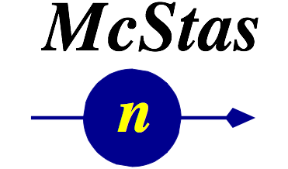




McStas samples for diffraction
Erik Knudsen

Slide 2
Agenda
General concepts (reminder)
Focus on diffraction-oriented samples:
Incoherent scatterer
Powder
Single Crystal
File formats

Slide 3
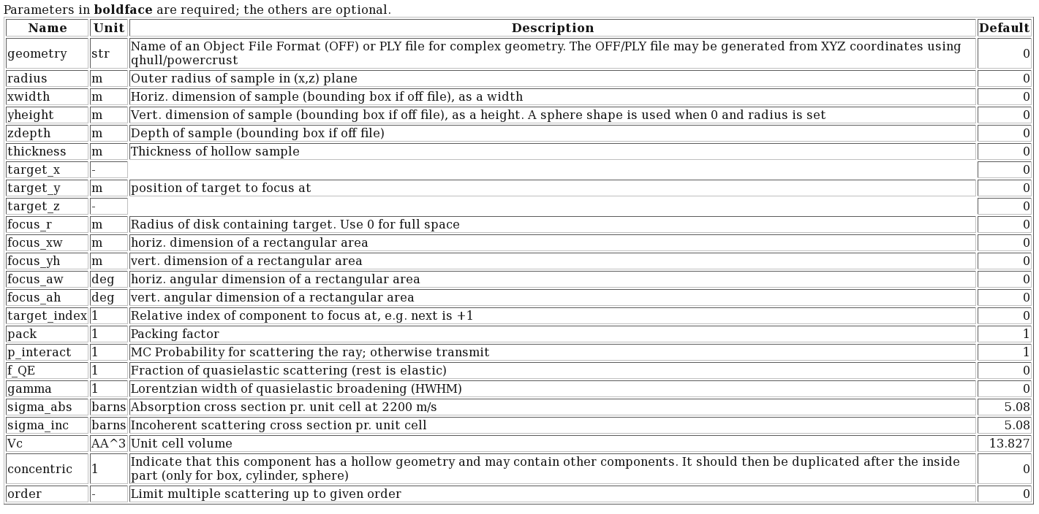
Incoherent Sample
Incoherent.comp
An incoherent scatterer with various sample shape options
Samples - Incoherent

Slide 4
Incoherent Sample
Incoherent.comp
An incoherent scatterer with various sample shape options
p_interact = The probability that a given ray will interact (scatter) with a sample. Does not directly affect the intensity – only the quality of the resulting Monte Carlo estimate.

Slide 5
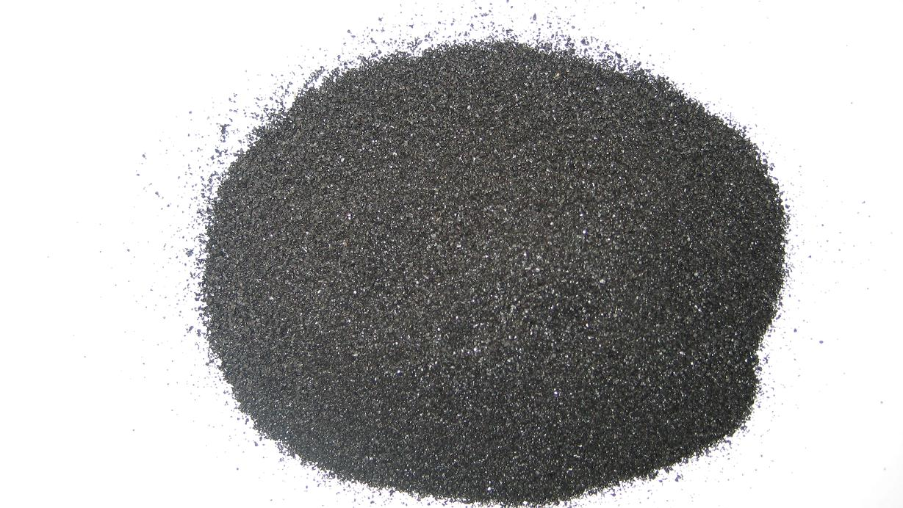
Crystalline Samples

Slide 6
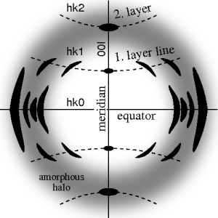
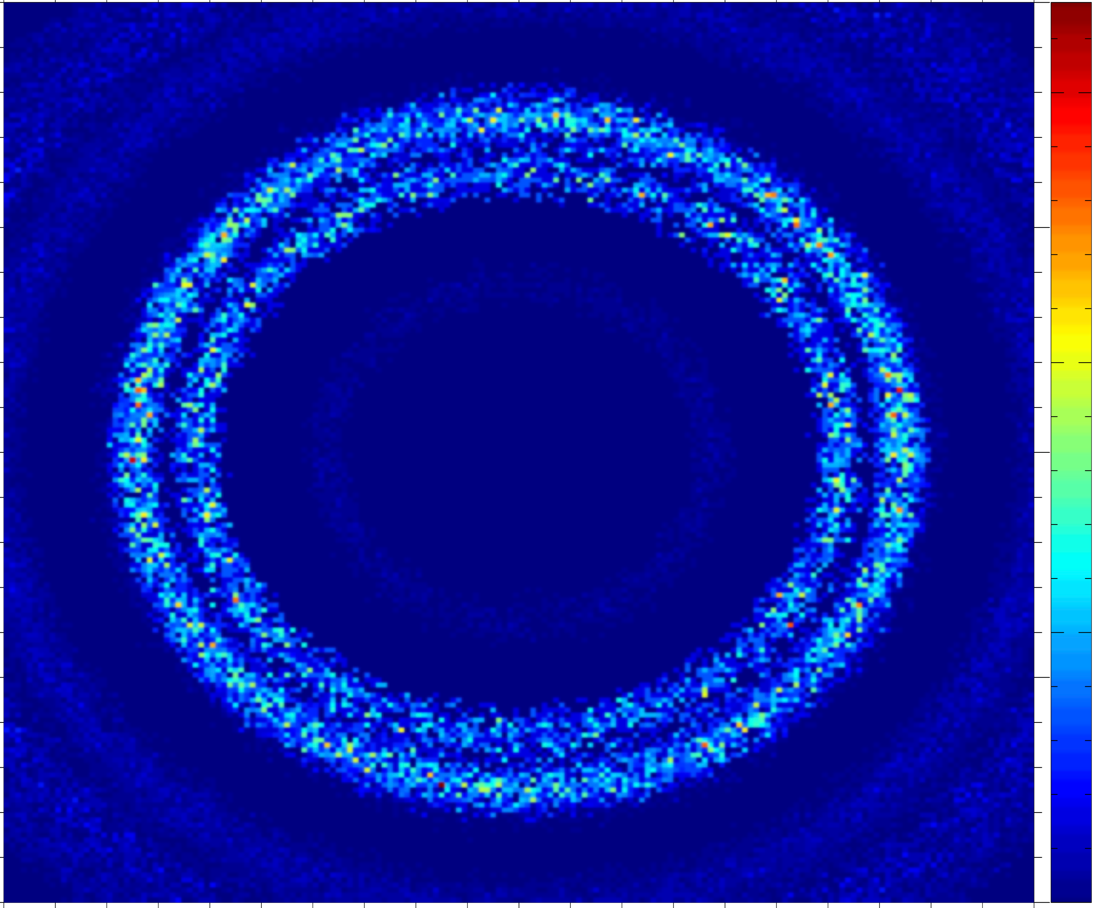

From single crystal / crystallites to powder….
Single crystal
Polycrystal with a little disorder, i.e. a preferred orientation, texture
Powder with complete disorder

Slide 7
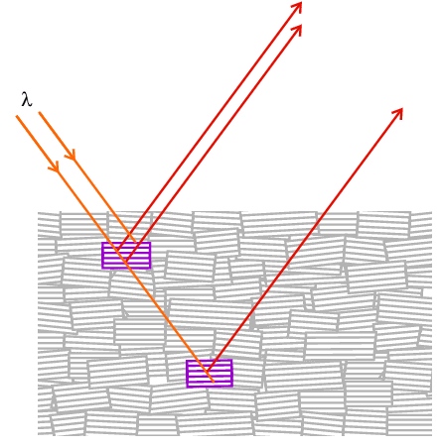
Single Crystal model
Models ideally imperfect crystal:
Peak broadening is dominated by mosaic => not appropriate for highly perfect crystals.
“Space group symmetries” considered out of scope.
Optimized for small unit cells but…
No assumption about unit cell, orientation etc.
Gaussian model for mosaic (see later)
Courtesy University College London

Slide 8
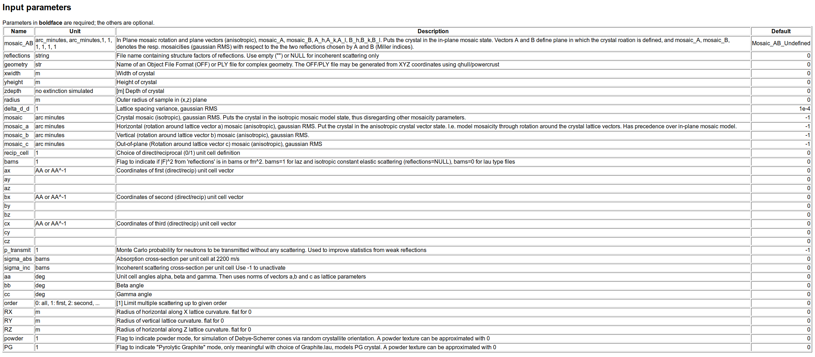
Single Crystal

Slide 9
Single Crystal
Unit cell vectors (ax,ay,az, bx, by,bz, cx,cy, cz). Encodes the crystal orientation relative to the Component’s orientation

Slide 10
Single Crystal
Mosaicity parameters: mosaic, mosaic_a, mosaic_b, mosaic_c, mosaic_AB

Slide 11
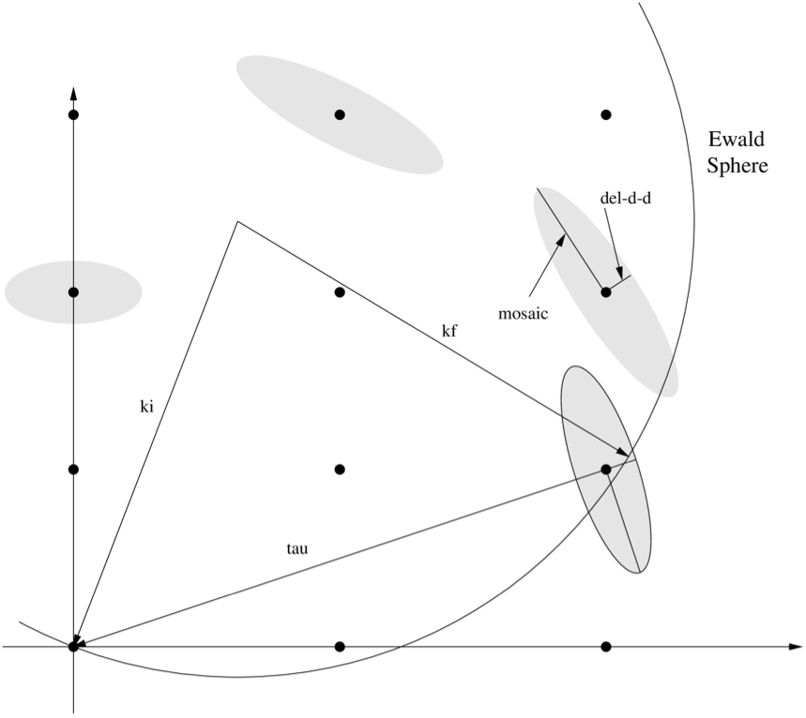
Single Crystal mosaicity

Slide 12
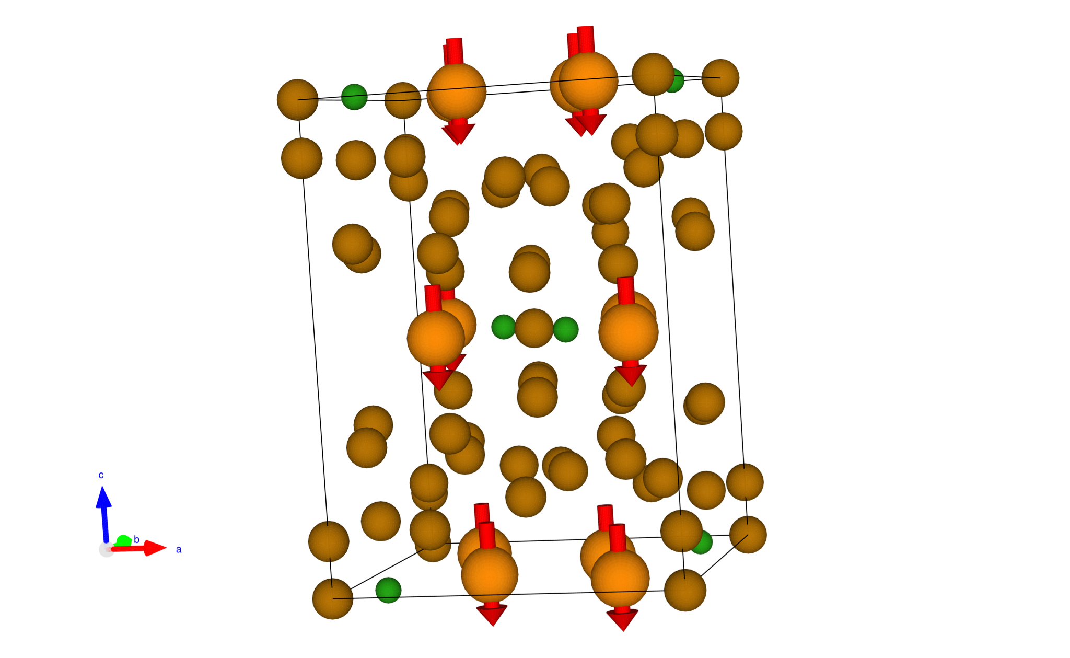
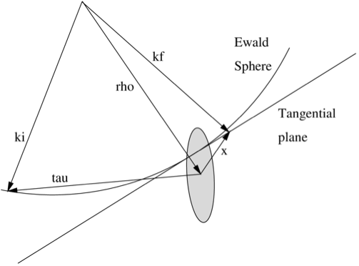
Single Crystal mosaicity
Three models:
Isotropic Mosaicity = Gaussian distribution of rotation angle, with given standard deviation, around a random vector.
Anistropic mosaicity = Gaussian distribution of angles around each of the unit cell axis.

Slide 13
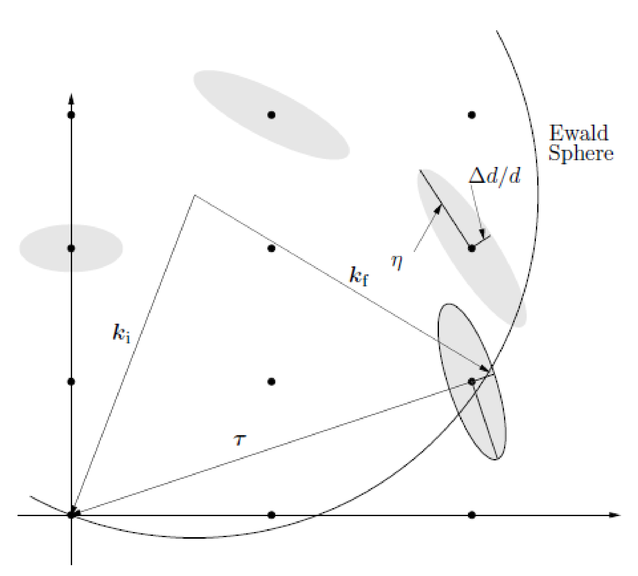
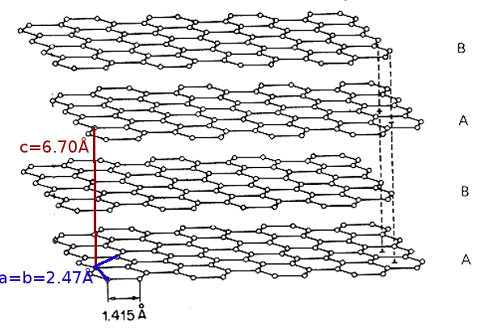
Single crystal mosaicity
Three models:
Isotropic Mosaicity = Gaussian distribution of rotation angle, with given standard deviation, around a random vector.
Anistropic mosaicity = Gaussian distribution of angles around each of the unit cell axis.
“Rocking curve mosaic” = Gaussian distr. around axis determined by width of two given Bragg peaks. Specify &sigma, and hkl for two peaks.

Slide 14
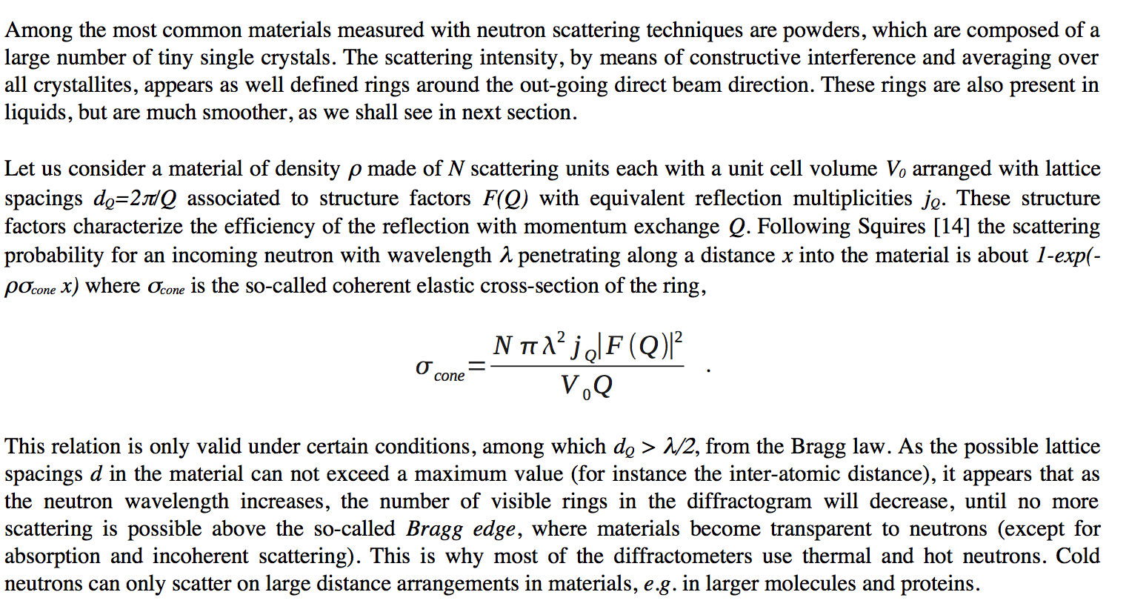
9.2 PowderN

Slide 15
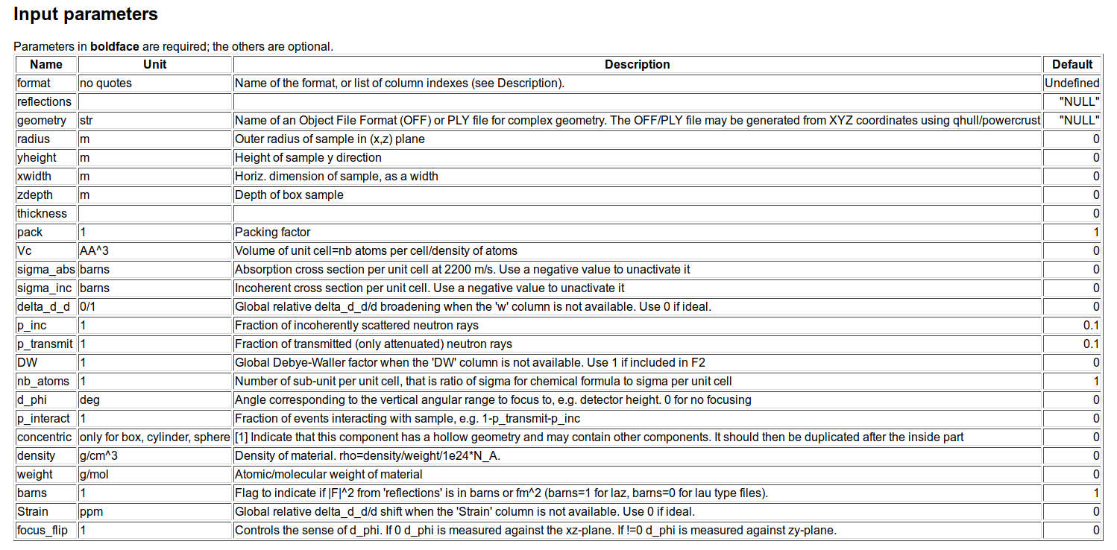
PowderN inputs

Slide 16
PowderN inputs
Sampling parameters
Concentric = Hollow Powder [cylinder]

Slide 17
PowderN inputs
Sampling parameters
Sampling parameters
Concentric = Hollow Powder [cylinder]

Slide 18
PowderN inputs
B
3
2
C
5
4
A
3
Sampling parameters
2
1
0
Concentric = Hollow Powder [cylinder]

Slide 19
B
3
PowderN concentric in code
2
C
5
COMPONENT Al = PowderN(
reflections="Al.laz", radius=0.02, yheight=0.05, thickness=0.005,
p_transmit=0.8, concentric=1)
AT (0, 0, 0) RELATIVE PREVIOUS
COMPONENT al2co3 = PowderN(
reflections=Al2CO3-laz, radius=0.005, yheight=0.05,
p_inc=0.15, p_transmit=0.5)
AT (0, 0, 0) RELATIVE PREVIOUS
COMPONENT Al_2 = COPY(Al)(concentric=0)
AT (0,0,0) RELATIVE PREVIOUS
4
A
3
Sampling parameters
2
1
0

Slide 20
PowderN inputs
Only scatter into a part of 4π

Slide 21
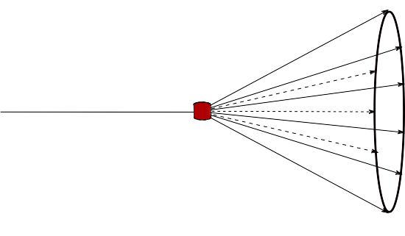
PowderN inputs
Only scatter into a part of 4\pi

Slide 22
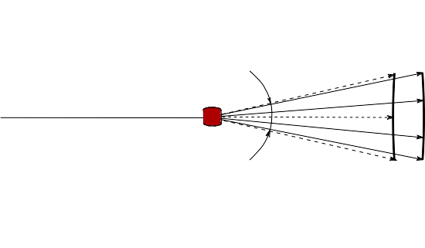
PowderN inputs
d_phi
Only scatter into a part of 4\pi

Slide 23
Reflection files for Single_crystal and PowderN
# TITLE *Aluminum-Al-[FM3-M] Miller, H.P.jr.;DuMond, J.W.M.[1942] at 298 K
# CELL 4.049320 4.049320 4.049320 90.000000 90.000000 90.000000
# SPCGRP F M 3 M CUBIC STRUCTURE
# ATOM AL 1 0.000000 0.000000 0.000000
# SCATTERING FACTOR COEFFICIENTS: AL F= 0.345 CM-12
# Reference: Physical Review (1940) 57, 198-206
#
# Physical parameters:
# sigma_coh 1.495 coherent scattering cross section (single atom) in [barn]
# sigma_inc 0.0082 incoherent scattering cross section (single atom)in [barn]
# sigma_abs 0.231 absorption scattering cross section (single atom) in [barn]
# density 2.70 in [g/cm^3]
# weight 26.98 in [g/mol] (single atom)
# multiplicity 4 in [atoms/unit cell]
# Vc 66.4 volume of unit cell in [A^3]
# v_sound 5100 in [m/s]
# v_sound_l 6420 velocity of longitudinal sound in [m/s]
# v_sound_t 3040 velocity of transversal sound in [m/s]
# T_m 933.5 melting temperature in [K]
# T_b 2792.2 boiling temperature in [K]
# At_number 13 atomic number Z
# lattice_a 4.04932 lattice parameter a in [Angs]
#
# Format parameters: Crystallographica format
# column_j 4 multiplicity 'j'
# column_d 5 d-spacing 'd' in [Angs]
# column_F2 7 norm of scattering factor |F|^2 in [fm^2]
# column_h 1
# column_k 2
# column_l 3
#
# h k l Mult. d-space 2Theta F-squared
-1 -1 -1 8 2.338 24.6973 21.3
-1 -1 1 8 2.338 24.6973 21.3
…
Lau datafiles
header
+
reflection list
Can be used with Single_crystal, PowderN, Isotropic_Sqw

Slide 24
Input for the PowderN
# TITLE *Corundum-Al2O3-[R3-CH] Graafsma, H.;Souhassou, M.;Harkem[1998] [corundum saphire:blue, ruby:red]
# CELL 4.757000 4.757000 12.987700 90.000000 90.000000 120.000000
# SPCGRP R -3 C TRIGONAL STRUCTURE
# ATOM AL 1 0.000000 0.000000 0.352110
# ATOM O 1 0.306260 0.306260 0.250000
# SCATTERING FACTOR COEFFICIENTS: AL F= 0.345 CM-12 ; O F= 0.581 CM-12
# Reference: Acta Crystallographica B (1998) 54, 193-195
#
# Physical parameters:
# sigma_coh 15.683 coherent scattering cross section for Al2O3 in [barn]
# sigma_inc 0.0188 incoherent scattering cross section for Al2O3 in [barn]
# sigma_abs 0.4625 absorption scattering cross section for Al2O3 in [barn]
# density 4.05 in [g/cm^3]
# weight 101.96 in [g/mol] for Al2O3
# multiplicity 6 in [Al2O3/unit cell]
# Vc 254.52 volume of unit cell in [A^3]
# T_m 2273 melting temperature in [K]
# T_b 3773 boiling temperature in [K]
# lattice_a 4.757 lattice parameter a in [Angs]
# lattice_c 12.9877 lattice parameter c in [Angs]
# lattice_cc 120 lattice angle gamma in [deg]
#
# Format parameters: Lazy format <http://icsd.ill.fr>
# column_j 17 multiplicity 'j'
# column_d 6 d-spacing 'd' in [Angs]
# column_F 13 norm of scattering factor |F| in [barn]
# column_h 1
# column_k 2
# column_l 3
#
# H K L THETA 2THETA D VALUE 1/D**2 SIN2*1000 H K L INTENSITY /F(HKL)/ A(HKL) B(HKL) PHA.ANG. MULT LPG
1 0 1 6.35 12.71 4.5175 0.0490 12.25 1 0 1 367.0 4.1 -4.08 0.00 180.00 6 82.14
0 0 3 7.10 14.20 4.0467 0.0611 15.27 0 0 3 110.0 4.3 4.32 0.00 0.00 2 66.01
0 1 2 7.57 15.13 3.7972 0.0694 17.34 0 1 2 10.9 0.8 0.84 0.00 0.00 6 58.18
…
Laz + Lau datafiles
header
+
reflection list
Can be used with PowderN, Isotropic_Sqw

Slide 25
Ag.laz
Al.laz
Al2O3_sapphire.laz
Au.laz
B4C.laz
Ba.laz
Be.laz
BeO.laz
Bi.laz
C_diamond.laz
C_graphite.laz
Cd.laz
Cr.laz
Cs.laz
Cu.laz
Cu2MnAl.laz
Fe.laz
Fe_Gamma.laz
Ga.laz
Gd.laz
Ge.laz
H2O_ice_1h.laz
He4_hcp.laz
Hg.laz
I2.laz
K.laz
Li.laz
LiF.laz
Mo.laz
Na2Ca3Al2F14.laz
Nb.laz
Ni.laz
Pb.laz
Pd.laz
Pt.laz
Rb.laz
Se_alpha.laz
Se_beta.laz
Si.laz
SiO2_quartza.laz
SiO2_quartzb.laz
Sn_alpha.laz
Sn_beta.laz
Ti.laz
Tl.laz
UO2.laz
V.laz
Y2O3.laz
Y3Fe5O12_YIG.laz
Zn.laz
Zr.laz
duplex.laz
What’s already there?
Single Crystals
Powders
Al.lau
Al2O3_sapphire.lau
B4C.lau
BCC_fake.lau
BeO.lau
C60.lau
C_diamond.lau
C_graphite.lau
CaF2.lau
Ge.lau
In.lau
PPase_D_P1.lau
Rubredoxin.lau
SiO2_cristobalite.lau
SiO2_quartza.lau
SiO2_quartzb.lau
TiO2_rutile.lau
YBaCuO.lau
adrenaline.lau
aspirin.lau
leucine.lau

Slide 26
Where to get these files…
$MCSTAS/data
Windows: c:\mcstas-3.1\lib\data
Linux: /usr/(local)/share/mcstas/3.1/data
OS X: /Applications/McStas-3.1/Contents/Resources/mcstas/3.1/data
- Or make your own via
Finding a CIF file for the given structure
e.g. from ICSD http://icsd.fiz-karlsruhe.de or COD <http://crystallography.net>
Process it using
cif2hkl which is available in your McStas installation

Slide 27
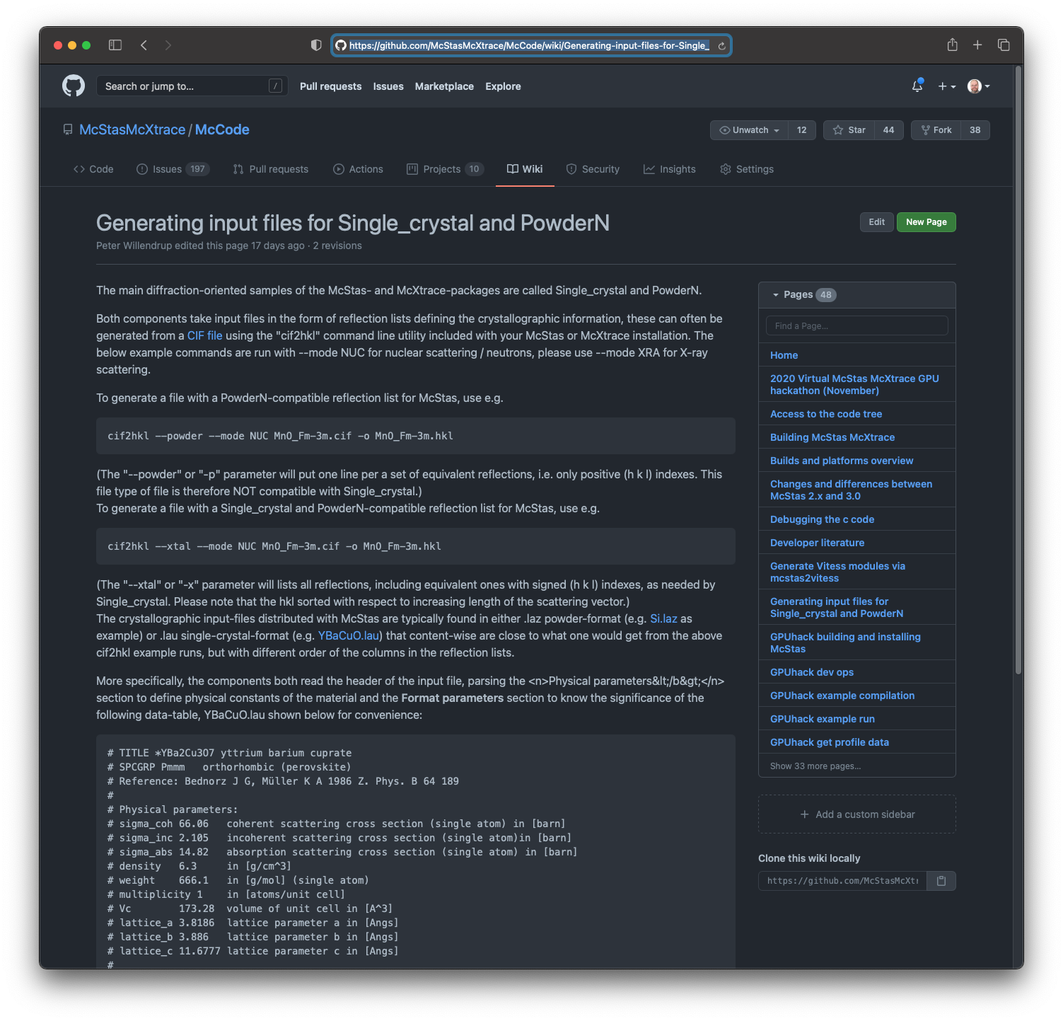
https://github.com/McStasMcXtrace/McCode/wiki/Generating-input-files-for-Single_crystal-and-PowderN

Slide 28
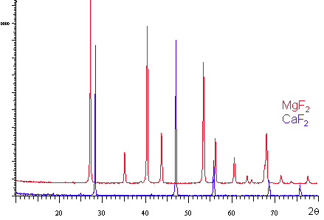
McStas: structure: powder
For powders, the pure elastic diffraction is easy to prepare: LAZ
PowderN
Single_crystal(powder=1, ...)
Isotropic_Sqw
CIF file
FullProf/ShelX
Terminal:
cif2hkl --powder file.cif
McStas Laz file

Slide 29
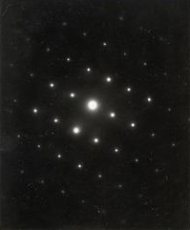
McStas: structure: SX
For single crystals, the pure elastic diffraction is easy to prepare: LAU
PowderN
Single_crystal
Isotropic_Sqw
CIF file
FullProf/ShelX
Terminal:
cif2hkl --xtal file.cif
McStas Lau file

Slide 30
McStas Data formats
McStas uses a number of input data formats, all text based.
Lau (Single_crystal, PowderN, Isotropic_Sqw)
Laz (PowderN, Isotropic_Sqw)
Sqw (Isotropic_Sqw)
qSq (Isotropic_Sqw) – mostly for liquids
PDB (SANSPDB)
ncmat (NCrystal)

Slide 31
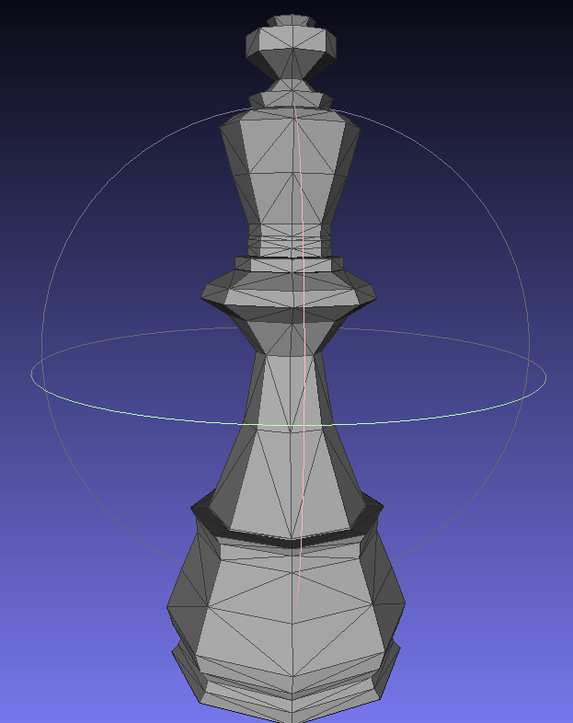
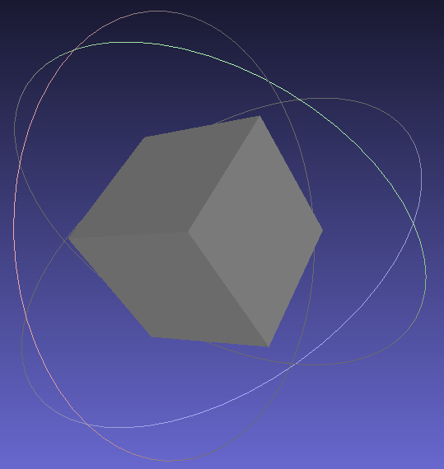
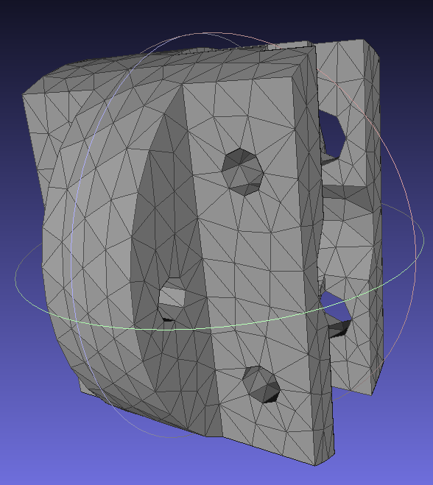
OFF/PLY any geometry
An additional complex geometry enables to use any point set to describe the material volume (geomview OFF file).

