Slide 1






A COMMON INTRODUCTION
McCode-vibing
Experiences using standard LLM models for writing instruments etc.
McStas — neutrons
McXtrace — X-rays
PaNRAID School · supported by PEPR DIADEM
Peter Willendrup · DTU Physics

Slide 2

AGENDA
Examples of vibe-coding with McCode
1
“Build me a powder diffractometer ”
One codebase family, two physics engines
2
“Use information on the web, draft me an instr”
Instruments, components, and the ray state
3
Full use-case from Anders Kästner, PSI
Where the two probes really differ
McCode-vibing
3

Slide 3

Example 1
“Build me a powder diffractometer ”
Prompt:
Based on available information in https://mcstas.org and https://github.com/mccode-dev/McCode/wiki, please put together the code for a diffractometer at a reactor source.
Here are the main characteristics
Input parameter lambda (wavelength), used to calculate the relevant Bragg-angle for Monochromator. Default to 2.567 Angstrom
Source with 3 Maxwellians
10 m flight path with 4 cm wide, 8 cm tall neutron guide
Single slab PG Monochromator, rotated according to calculated Bragg angle
2 m distance to Sample (further rotated to be in the scattered beam from the mono
Powder sample radius 4 mm, 70 mm tall cylinder, material Na2Ca3Al2F14
Banana-shaped detector (cylindrical cut) 10 cm tall, radius 1.5 m from sample, to record 10-180 degrees on the "high-resolution" side of the sample
McCode-vibing
15

Slide 4
Example 1
“Build me a powder diffractometer ” – response:
Reactor_PowderDiffractometer.instr is ready. It builds a constant-wavelength reactor powder diffractometer in the style of PSI's DMC / ILL's D2B/D20:
lambda (default 2.567 Å) drives the Bragg-angle calculation in INITIALIZE: theta_M = asin(mono_Q*lambda/(4π)), using mono_Q=1.8734 Å⁻¹ for PG(002). At the default wavelength this gives θ_M ≈ 22.5°, 2θ_M take-off ≈ 45°.
Source: Source_Maxwell_3 with the canonical three-Maxwellian parameter set from McStas's own source examples (T1=216.8 K, T2=33.9 K, T3=16.7 K with matching intensities) as a representative reactor-moderator spectrum. The simulated band is narrowed to lambda ± dlambda for statistics efficiency (a standard trick for fixed-wavelength instruments — widen dlambda to see the full spectrum).
Guide: 10 m, 4 cm × 8 cm, m=2 supermirror.
Monochromator: single-slab Monochromator_flat (PG mosaic, 5×5 cm), placed on an Arm rotated by the computed theta_M; a second arm downstream picks up the full 2·theta_M deflection.
Sample: PowderN with Na2Ca3Al2F14.laz (the standard McStas NAC reflection data file — same one used in the real DMC instrument file), radius 4 mm, height 70 mm, wrapped in a SPLIT for better detector statistics.
Detector: Monitor_nD in "banana, theta" mode, radius 1.5 m, height 10 cm, covering 10–180°, placed on the sample arm and rolled 180° about the beam axis — the same construction used in the real PSI_DMC instrument to put the bank on the focusing/high-resolution side matching the monochromator's take-off direction.
Everything is exposed as instrument parameters (guide length/size, monochromator size/mosaic, distances, sample and detector geometry) so you can retune it.
I validated this against the real thing rather than just from memory: I pulled the actual .comp source files for every component used (Source_Maxwell_3, Guide, Arm, Monochromator_flat, PowderN, Monitor_nD, PSD_monitor, L_monitor, Progress_bar) from the McCode GitHub repo, and parsed the instrument file with mccode-antlr (the McStas grammar/compiler front-end) against those real definitions. It resolved all 14 components and every parameter name cleanly with no errors; I also confirmed the checker actually catches mistakes by deliberately introducing a typo'd parameter and an undefined component reference, both of which it flagged. Full C-code generation itself was blocked only by a sandboxed network path (github.com was reachable via raw.githubusercontent.com but not directly), which is unrelated to the instrument's own correctness. I also cross-checked the file against McStas's real PSI_DMC.instr example (same default wavelength, same detector-radius convention, same rotation idiom for the "high-resolution side"), fetched live from the repo. Sources: …
McCode-vibing
15

Slide 5
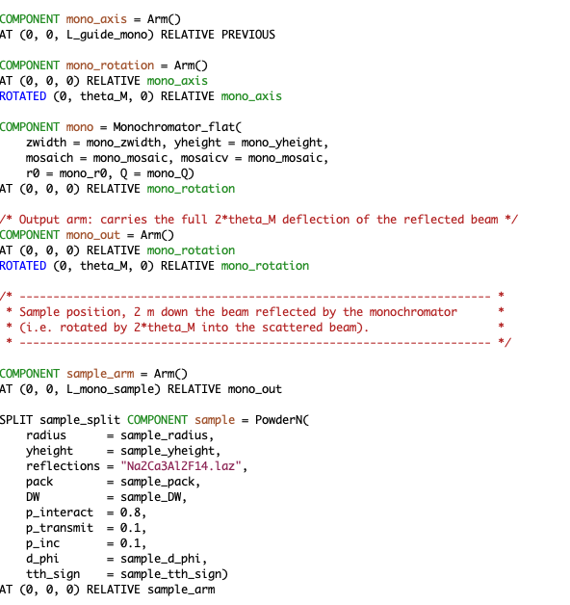
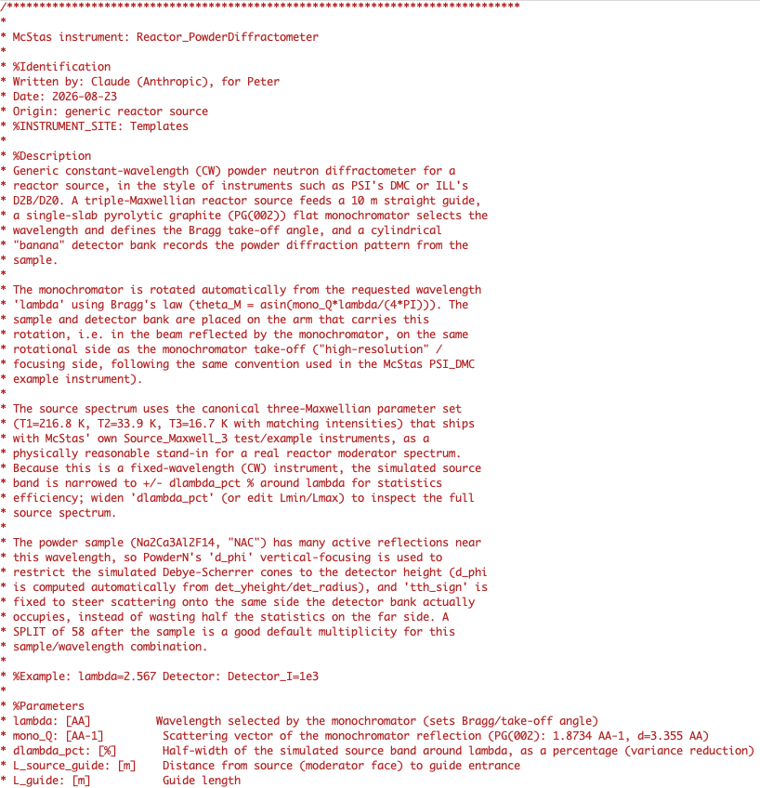
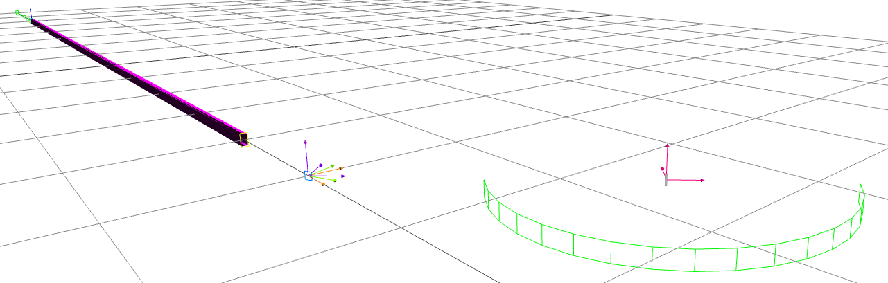
Example 1
“Build me a powder diffractometer ” – response:
Simulation from prompt 1 – junk!
(My fault, the detector picked up
direct beam from the Mono…)
McCode-vibing
15

Slide 6
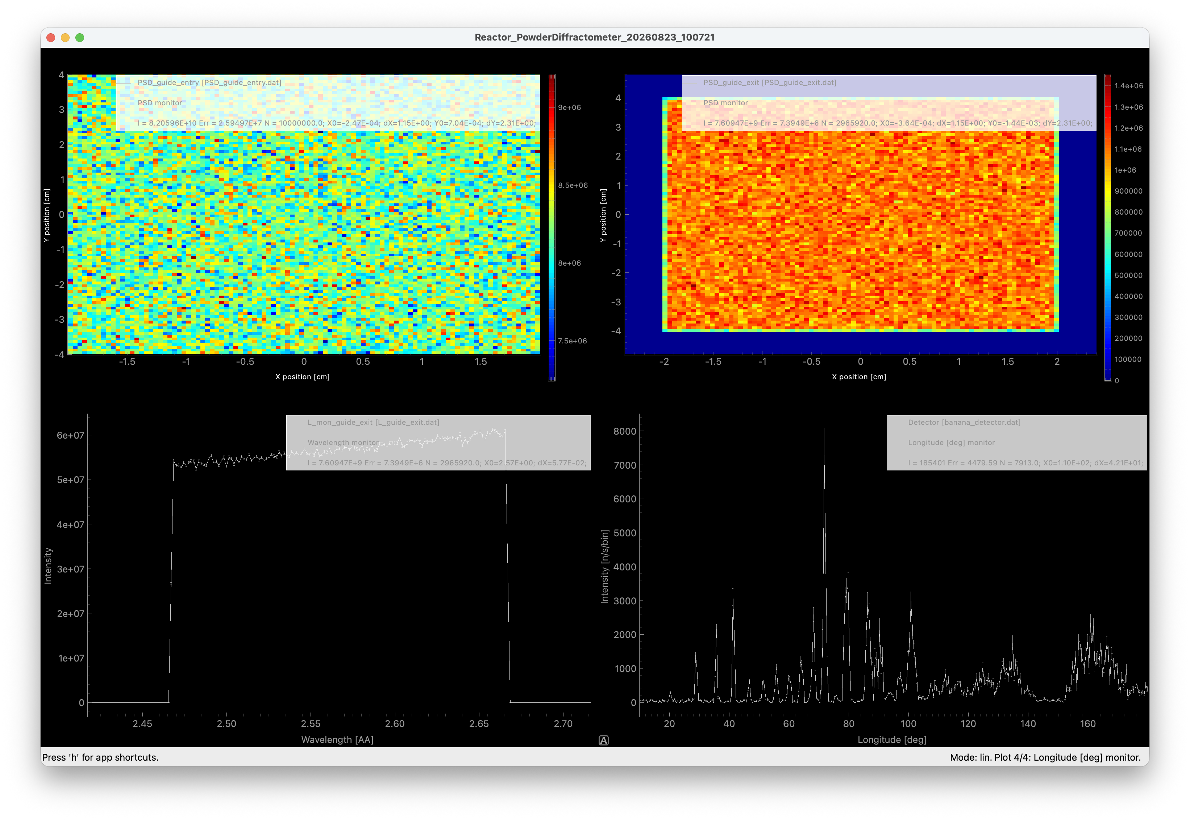
Example 1
“Build me a powder diffractometer ” – response:
Prompt 2 – diffractogram
appears
McCode-vibing
15

Slide 7
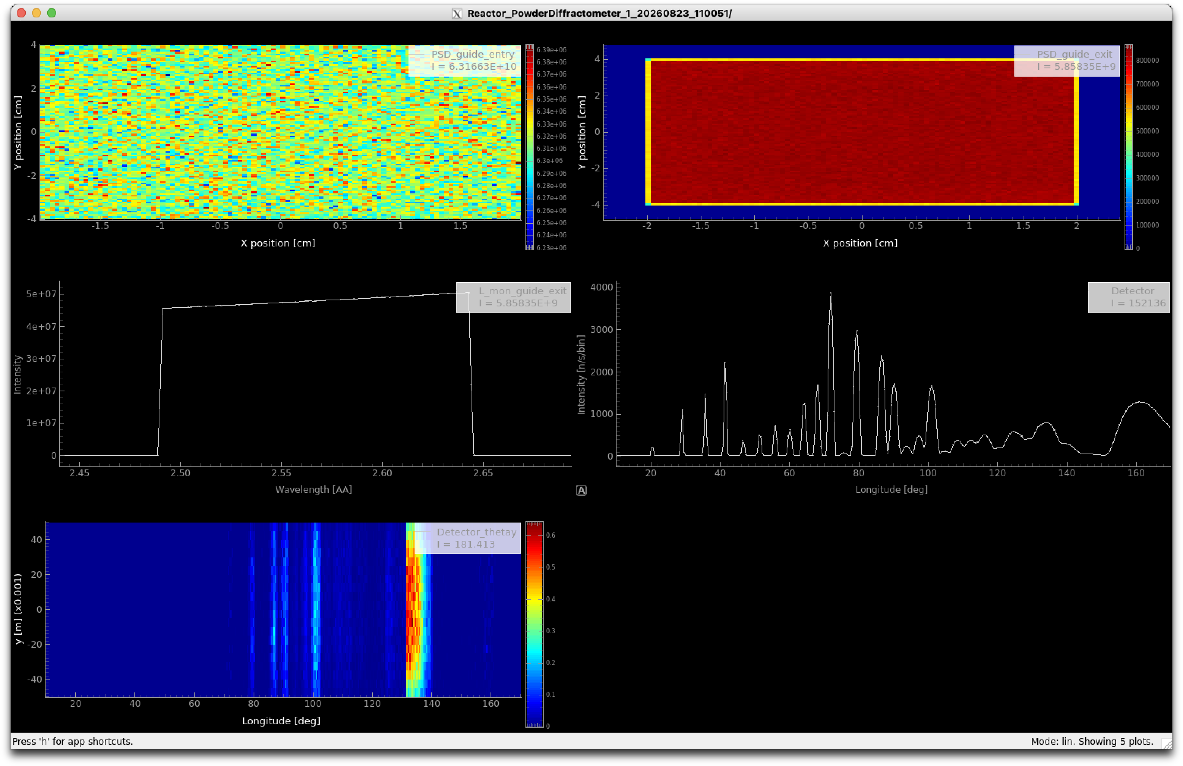
Example 1
“Build me a powder diffractometer ” – response:
Prompt 3 – variance reduction
in place
McCode-vibing
15

Slide 8
Example 2
Build me a model of ILL XX
Prompt 1:
Try building me an instrument that doesn't exist ready-made in McStas, ILL D17
https://www.ill.eu/en/for-ill-users/instruments/instruments-list/d17/
Prompt 2:
Can you make me an ILL_D3 model? Use the information in
https://www.ill.eu/en/for-ill-users/instruments/instruments-list/d3/
For the Source term (hot neutrons) I believe that either Source_gen or Source_Maxwell_3 has a listing of relevant parameters.
There are multiple Monochromator-options on this instrument, Monochromator_pol may be useful for the polarising mono (partly a phenomenological model), whereas the non-polarised may be simulated using either Monochromator_curved (phenomenological model) or NCrystal_sample.
If you find a design-oriented publication that would be useful for certain numbers I can probably fetch you that for round 2.
McCode-vibing
15

Slide 9
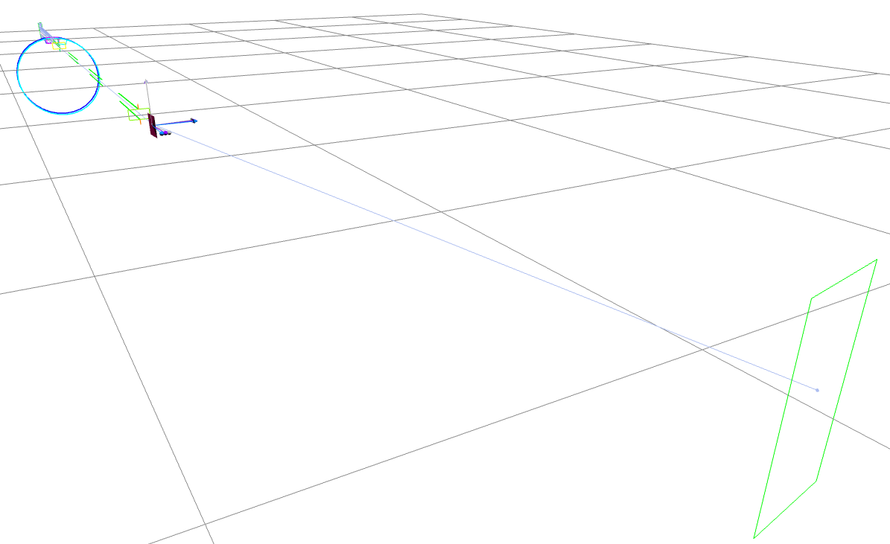
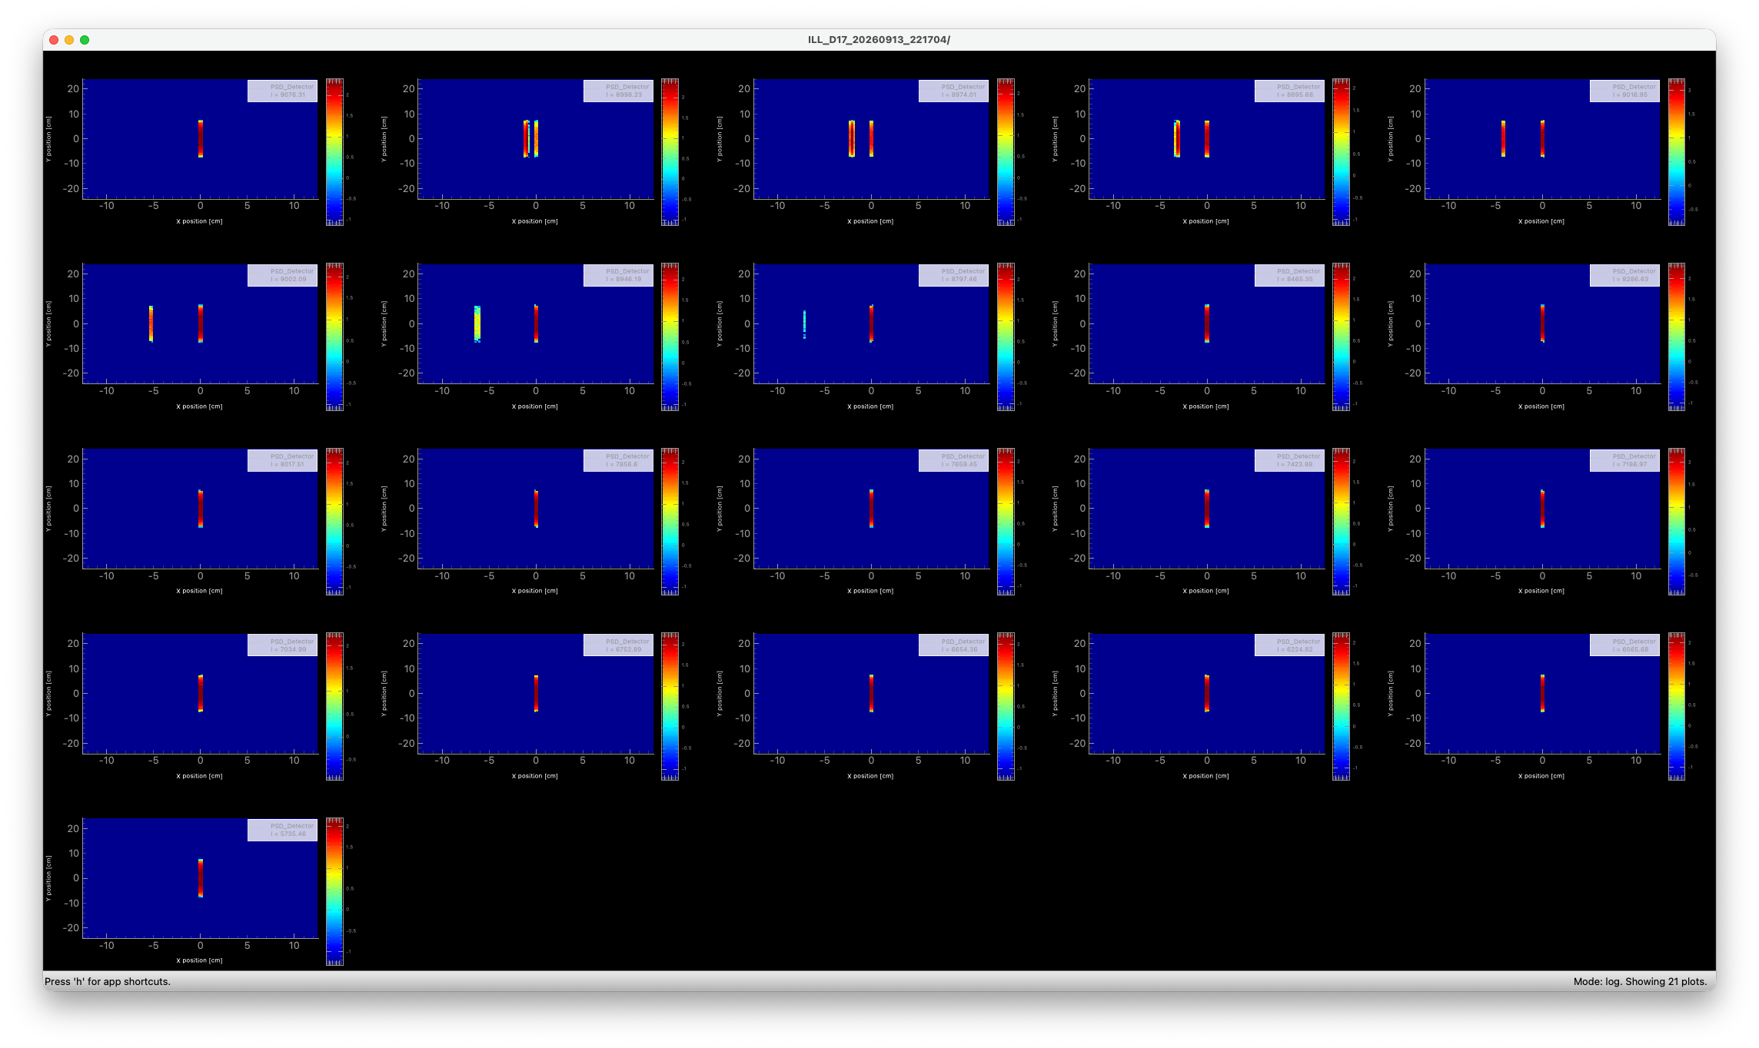
Example 2
Build me a model of ILL D17
McCode-vibing
15

Slide 10
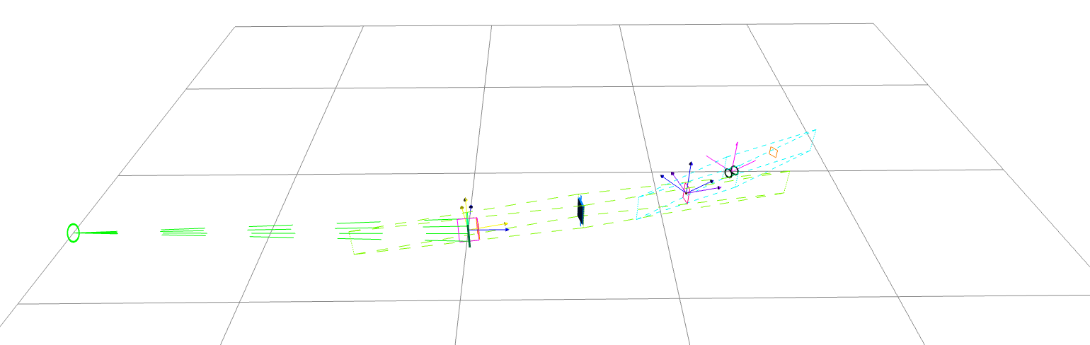
Example 2
Build me a model of ILL D3
*
* Sources: https://www.ill.eu/en/for-ill-users/instruments/instruments-list/d3/
* https://www.ill.eu/en/for-ill-users/instruments/instruments-list/d3/characteristics/
* https://www.ill.eu/for-ill-users/instruments/instruments-list/d3/how-it-works/spherical-polarimetry-with-cryopad
*
* %Parameters
* mono_type: [str] "Heusler" (polarising, high flux), "CoFe" (polarising, better res), or "Cu" (non-polarising)
* lambda: [AA] Incident wavelength (0.42-0.843 Angs on the real instrument)
* THETA_M: [deg] Monochromator take-off half-angle. 0 (default): derive from lambda and DM. Real range: 3.5-19 deg (i.e. 7 < 2*THETA_M < 38)
* use_ncrystal: [1] Cu branch only: 0 (default) Monochromator_curved mosaic model, 1 NCrystal_sample with ncrystal_mono_cfg
* ncrystal_mono_cfg: [str] NCrystal cfg string for the Cu monochromator, used only if use_ncrystal=1
* mono_Rup: [1] [assumed] Polarising monochromator reflectivity for spin-up
* mono_Rdown: [1] [assumed] Polarising monochromator reflectivity for spin-down
* mono_mosaic: [arc min] Mosaic spread used for the Cu (Monochromator_curved) and polarising crystals
* L1: [m] [assumed] Source-monochromator distance
* L2: [m] [assumed] Monochromator-sample distance
* L3: [m] [assumed] Sample-detector distance
* flip: [1] 0: spin-up (non-spin-flip) incident beam. 1: spin flipped (spin-flip channel) - toggles an ideal Mezei flipper
* guide_field: [T] [assumed] Vertical guide field maintaining the polarisation quantisation axis between monochromator and analyser
* sample_engine: [str] "vanadium" (isotropic incoherent calibration sample), "sx" (Single_crystal, supply 'reflections'/UB matrix), "ncrystal" (NCrystal_sample, supply ncrystal_sample_cfg), or "none" (direct beam)
* sample_diam: [m] Sample diameter (<= 0.012 m on the real instrument)
* sample_height: [m] Sample height (<= 0.012 m on the real instrument)
* reflections: [str] sample_engine="sx" only: reflection list file for Single_crystal
* ncrystal_sample_cfg: [str] sample_engine="ncrystal" only: NCrystal cfg string for the sample
* analyzer_type: [str] "ideal" (PolAnalyser_ideal, vertical axis), "he3" (He3_cell), or "none" (no polarisation analysis - forced when mono_type="Cu")
* he3_p3he: [1] [assumed] 3He cell polarisation for analyzer_type="he3" (published range ~0.70-0.85)
* det_2theta: [deg] Detector arm scattering angle 2theta
* verbose: [1] Print the derived instrument configuration. 0 to be quiet
* KNOWN SIMPLIFICATIONS / THINGS NOT MODELLED (please tighten with real
* engineering numbers before quantitative use):
* - CRYOPAD's zero-field spherical polarimetry (rotating nutator fields,
* Meissner shields) is not modelled at all; only a single-flipper,
* fixed-vertical-axis longitudinal polarisation analysis is implemented.
* - The magnetic (spin-dependent) part of the sample's scattering cross
* section is not modelled - none of the three 'sample_engine' choices
* computes a magnetic structure factor, so the flipping ratio you get
* out of this model reflects only the instrument's own polarising/
* analysing efficiency (Rup/Rdown, He3 cell polarisation, flipper),
* not real sample physics. That would need a bespoke sample component.
* - L1 (source-monochromator), L2 (monochromator-sample) and L3
* (sample-detector) distances, the monochromator crystal size, and the
* guide-field strengths are NOT published on the ILL website and are
* set here to plausible placeholder values, flagged [assumed] in
* DECLARE/the component calls; only DM values, the 7-38 deg take-off
* range, the 0.42-0.843 Angs band, the per-crystal flux and the 12 mm
* sample size are taken from the published characteristics page.
* - The hot H4 source is modelled as a single ~2273 K (2000 C) Maxwellian
* (Source_gen), not the real multi-term fit used in ILL's yellow-book
* source characterisation; harmonic-contamination filters (Er, Ir, Hf,
* Rh, In foils) are not modelled, so higher-order lambda/2, lambda/3
* contamination is absent here.
* - Rup/Rdown for the polarising crystals and the He3 cell polarisation
* are set to plausible round numbers (see 'mono_Rup'/'mono_Rdown'/
* 'he3_p3he'), not measured values.
McCode-vibing
15

Slide 11
Example 3

Slide 12
Example 3

Slide 13
Example 3

Slide 14
Example 3

Slide 15
Example 3

Slide 16
Example 3

Slide 17
Example 3

Slide 18
Example 3

Slide 19
Example 3
Prompt in detailed fashion and absolutely vet the results!
Common conclusion for all 3 cases!

Slide 20
Thank you
Questions?
mcstas.org
mcxtrace.org
SUPPORTED BY
Peter Willendrup · pkwi@fysik.dtu.dk · DTU Physics
McCode-vibing
17

