Slide 1






A COMMON INTRODUCTION
McStas & McXtrace
Monte Carlo ray-tracing for neutron and X-ray instrumentation
McStas — neutrons
McXtrace — X-rays
PaNRAID School · supported by PEPR DIADEM
Peter Willendrup · DTU Physics

Slide 2

PANRAID SCHOOL
Who's behind this school
PaNRAID is organised with support from the France 2030 PEPR DIADEM programme, training researchers to combine McStas and McXtrace ray-tracing simulations with AI methods.
PARTNERS & SUPPORTING ORGANISATIONS
McStas & McXtrace · Common Introduction
2

Slide 3
AGENDA
What we'll cover
1
Shared origins & philosophy
2
The Monte Carlo ray-tracing idea
One codebase family, two physics engines
Why rays, weights, and randomness
3
Anatomy of a simulation
4
Under the hood
Instruments, components, and the ray state
DSL, code generation, and coordinate placement
5
Neutrons vs. X-rays
6
Community, use & getting started
Where the two probes really differ
License, ecosystem, and next steps
McStas & McXtrace · Common Introduction
3

Slide 4
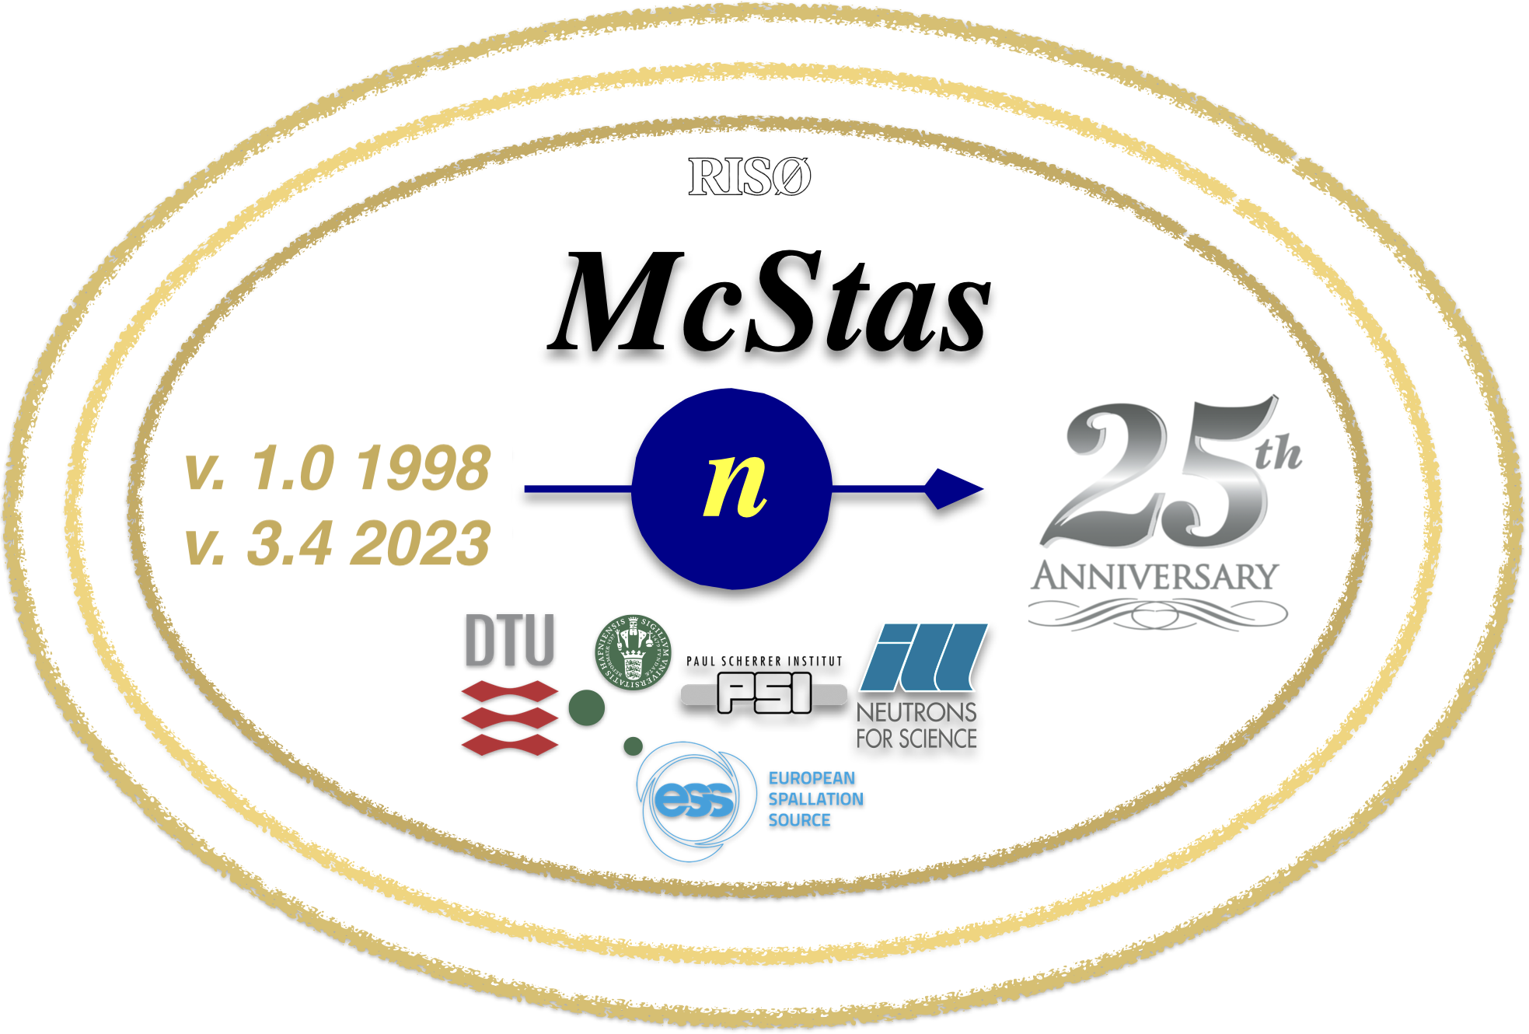
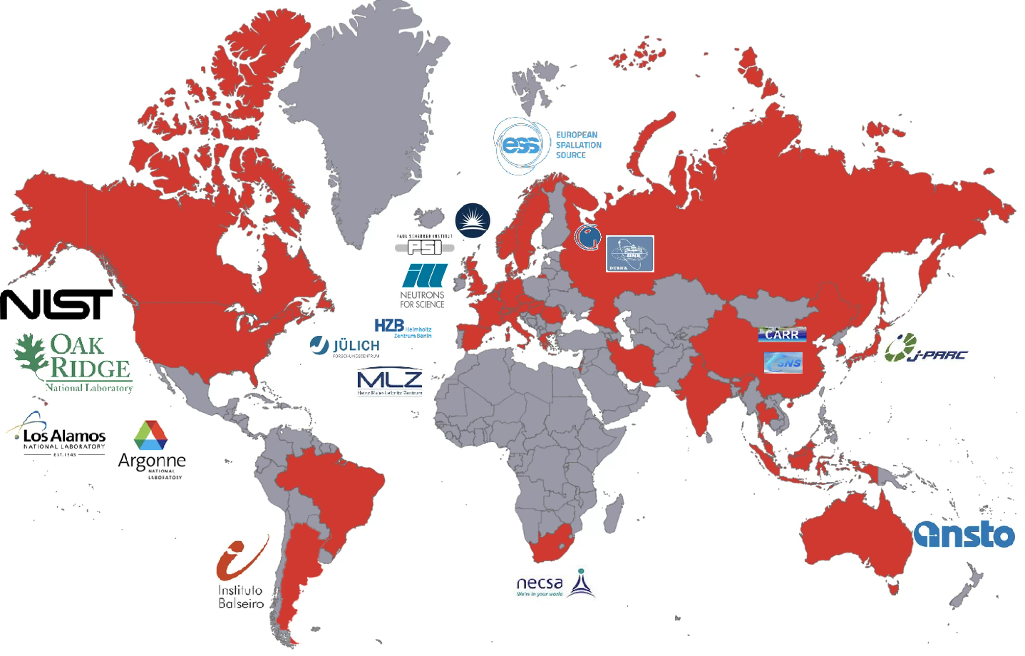
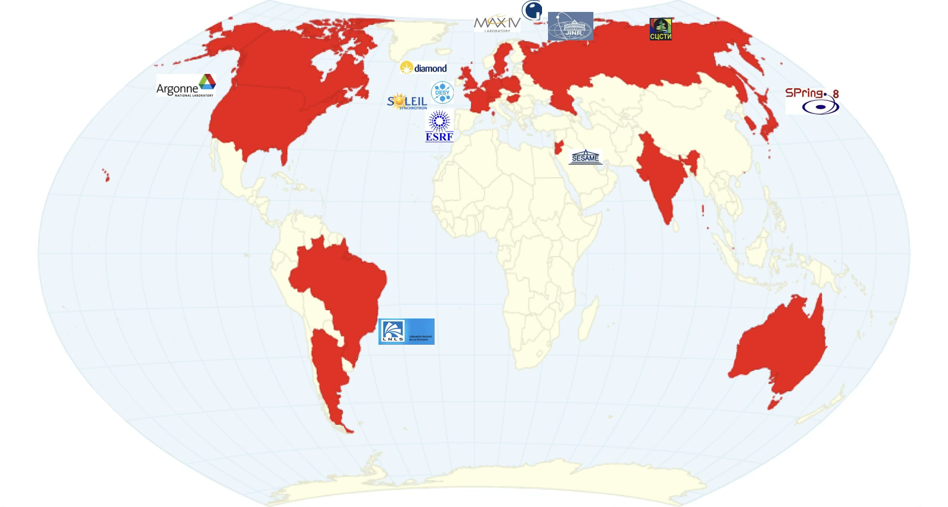
SHARED ORIGINS
One family, two probes
McXtrace was built on proven McStas technology — same architecture, adapted for X-rays.
Commonality: same domain-specific language, same component-based architecture, same open, community-driven development model.
1998
2000s
2009
Today
McStas is born
Grows into a general tool
McXtrace forks off
Parallel development
K. Nielsen & K. Lefmann, Risø.
Originally for triple-axis
spectrometer simulation.
Adopted by DTU Physics, ILL,
PSI, University of Copenhagen,
ESS DMSC. GPL open source.
“Powered by McStas
technology.” Re-targeted at
X-ray optics & beamlines.
Shared kernel philosophy,
separate physics & component
libraries, active communities.
McStas & McXtrace · Common Introduction
4

Slide 5
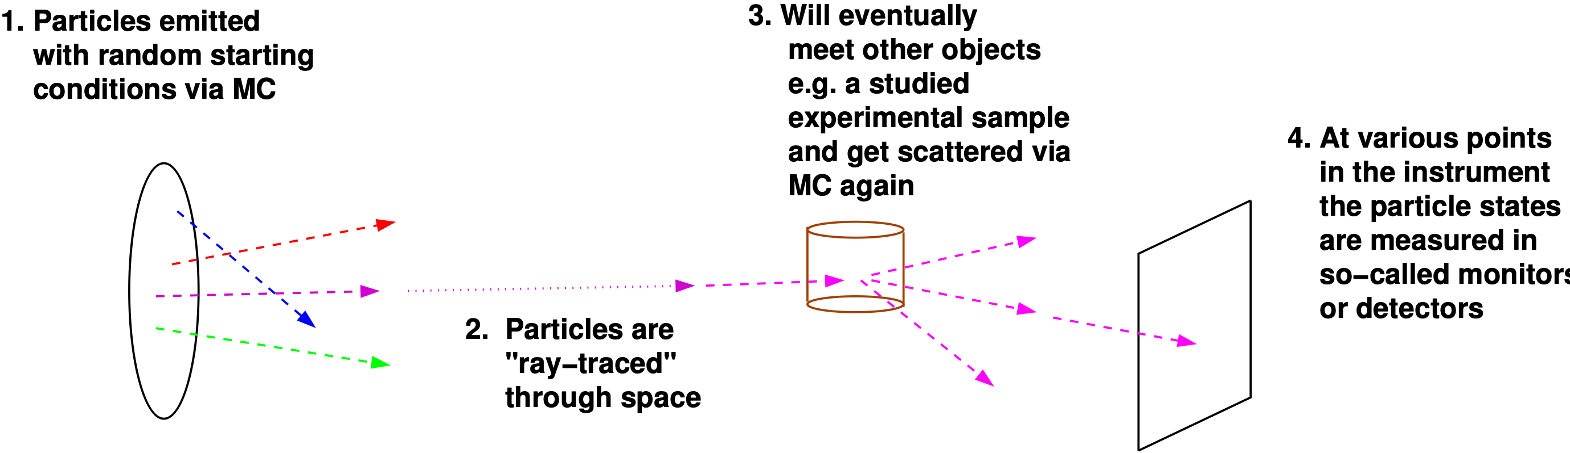
THE CORE IDEA
Monte Carlo ray-tracing, in a nutshell
A statistical method born at Los Alamos in the 1940s (von Neumann, Ulam, Metropolis) for solving particle-transport problems by numerical experiment.
Both codes trace many independent rays (neutrons or photons) one at a time through the instrument.
Propagation in free space is deterministic — straight lines (plus gravity, for slow neutrons).
Where physics is probabilistic — scattering, absorption, reflection — outcomes are Monte Carlo sampled.
Each ray carries a statistical weight rather than representing one real particle, so rare but important events can be sampled efficiently.
A single ray, one weight at a time
Weight p is adjusted multiplicatively at every interaction — the physical result is recovered statistically over many rays.
McStas & McXtrace · Common Introduction
5

Slide 6
SHARED ARCHITECTURE
Anatomy of a simulation
An instrument is an ordered chain of components in a shared lab coordinate system. Rays flow through it, changing state at each stop.
Source
Optics
Sample
Monitor
injects rays
shapes the beam
the physics of interest
records the result
Instrument: defines the lab coordinate system. Components: devices/features available in the instrument, each with its own function. Rays: passed from one component to the next, changing state along the way.
This chain — and the DSL that describes it — is identical in McStas and McXtrace.
McStas & McXtrace · Common Introduction
6

Slide 7
COMMONALITY & DIFFERENCE
What travels through the beamline: the ray
Neutron ray · McStas
Photon ray · McXtrace
r
position (x, y, z)
r
position (x, y, z)
v
velocity vector
k
wave vector
t
time
φ, E
phase & polarisation (E-field)
s
spin / polarisation
t
time
p
statistical weight
p
statistical weight
Same idea, different carrier: both rays are position + time + statistical weight. The neutron adds mass, velocity and spin; the photon adds a wave vector, phase and field polarisation.
McStas & McXtrace · Common Introduction
7

Slide 8
SHARED TAXONOMY, DIFFERENT PHYSICS
Component classes
Every instrument, in either code, is built from the same four component classes.
Class | McStas (neutrons) | McXtrace (X-rays)
Sources | Reactor / spallation moderator | Undulator, wiggler, bending magnet
Optics | Guides, mirrors, choppers, collimators | Mirrors, monochromator crystals, multilayers, slits
Samples | Powders, crystals, liquids, magnetism | Powders, crystals, multilayers, absorbing phantoms
Monitors | PSD / histograms / event lists | PSD / histograms / event lists (same concept)
Common to all components: they set, manipulate, or measure the state of the ray — and each is written as a self-contained, reusable code module.
McStas & McXtrace · Common Introduction
8

Slide 9
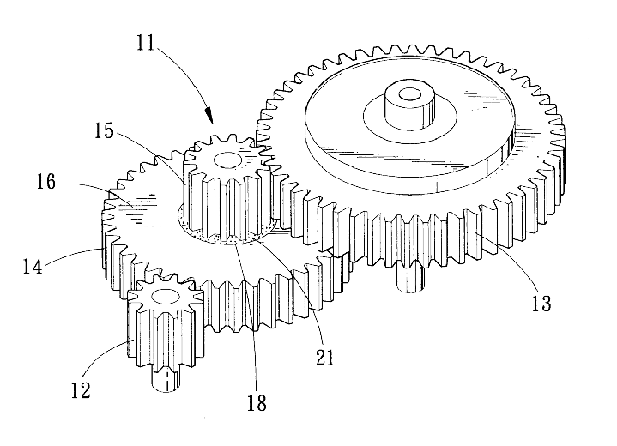
UNDER THE HOOD
From instrument file to running simulation
.instr file
Parser
Generated C
Executable
DSL describing the
instrument (readable text)
Lex & Yacc
compiler technology
Portable ISO-C code,
only what you use
Compiled for your
platform & hardware
Same toolchain in both codes — the DSL grammar and code generator are shared.
Three levels of code, three audiences
Instrument file
Component file
Kernel
MOST USERS
ADVANCED USERS
CORE DEV TEAM
Existing examples, GUI-assisted, or written from scratch in the DSL.
Short, self-contained C code — easy to modify from an existing component.
Propagation, intersections, and the runtime library shared by all components.
McStas & McXtrace · Common Introduction
9

Slide 10
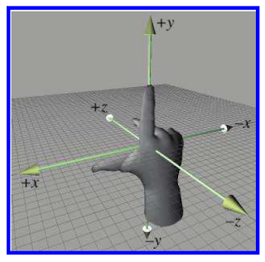
SHARED SYNTAX
Placing components in space
Every component is placed with the same two statements, in both codes:
Vertical
Right-handed lab frame
y
x
AT (x, y, z) RELATIVE <ref>
ROTATED (rx, ry, rz) RELATIVE <ref>
z
Particle beam
<ref> can be ABSOLUTE (the lab frame), another component's name, or PREVIOUS.
z runs along the beam, y is vertical, x completes a right-handed frame.
Component authors choose whatever local origin is physically natural — the kernel handles the coordinate transforms between them.
AT and ROTATED can be fully decoupled, referring to different RELATIVE <ref>
McStas & McXtrace · Common Introduction
10

Slide 11
WHERE THEY DIVERGE
Neutrons vs. X-rays: key differences at a glance
 | Neutrons · McStas | X-rays · McXtrace
Probe | Neutral particle — mass, spin | Massless electromagnetic wave
Typical facility | Reactor or spallation source | Synchrotron or free-electron laser
Energy scale | meV (thermal / cold) | keV (hard X-ray)
Dominant interaction | Nuclear & magnetic scattering; deep penetration | Electronic scattering; surface-sensitive, strongly absorbed
What stays the same: the ray-tracing method, the DSL, the component architecture, and the statistical-weight formalism are identical — only the physics inside the components differs.
McStas & McXtrace · Common Introduction
11

Slide 12
COMMUNITY & PRACTICALITIES
Open, portable, community-built
GPL
3
175+
30–40%
Open-source license
for both packages
Platforms: Linux,
macOS, Windows
Components in the
shared-style libraries
Of new components
come from users
Runs everywhere from a laptop to HPC clusters and GPUs (OpenACC) — the same generated C code, recompiled per target.
New components automatically fit the framework once written in structured, standard C.
Contributions require at least one test instrument and a documented header — then they join the shared contrib/ library.
Permanent staff at DTU Physics maintain the core; a wider network of institutes and students keeps both libraries growing.
McStas & McXtrace · Common Introduction
12

Slide 13
ONE CORE TEAM, TWO NETWORKS
Who builds & maintains them
A shared core team at DTU Physics, plus partner institutes around each package.
McStas partner network
McXtrace partner network
DTU Physics (core development)
European Spallation Source (ESS DMSC)
University of Copenhagen
Institut Laue-Langevin (ILL), Grenoble
Paul Scherrer Institute (PSI)
Synchrotron SOLEIL
DTU Physics (core development)
DTU Space
University of Copenhagen
Further both codes benefit from the greater network of users across a plethora of use-cases and applications.
Several developers work across both projects — shared infrastructure means fixes and features often benefit both codes at once.
McStas & McXtrace · Common Introduction
13

Slide 14
APPLICATIONS
What are they used for?
1
2
3
4
5
Instrument design
Construction support
Virtual experiments
Data analysis
Teaching
Planning and optimising new beamlines before they're built
Verifying components and layouts during commissioning
Letting prospective users try an experiment before travelling to a facility
Comparing measured data against simulated instrument response
Training students and new users in instrumentation & scattering methods
Both communities use their code across the full lifecycle — from first sketch to published data.
McStas & McXtrace · Common Introduction
14

Slide 15
ECOSYSTEM
A shared, interoperable ecosystem
1
MCPL
2
Graphical interface
The Monte Carlo Particle List format lets McStas, McXtrace and other transport codes (MCNP, Geant4, PHITS, …) exchange rays and couple simulations together.
A common Python-based GUI supports building, running and browsing results for instruments in either code.
3
Plotting tools
4
Packaging
A shared plotting toolchain (HTML/D3, pyqtgraph, matplotlib backends) visualises monitor output from both packages.
Conda-forge distributions and cross-platform installers keep both codes easy to install on Linux, macOS and Windows.
McStas & McXtrace · Common Introduction
15

Slide 16
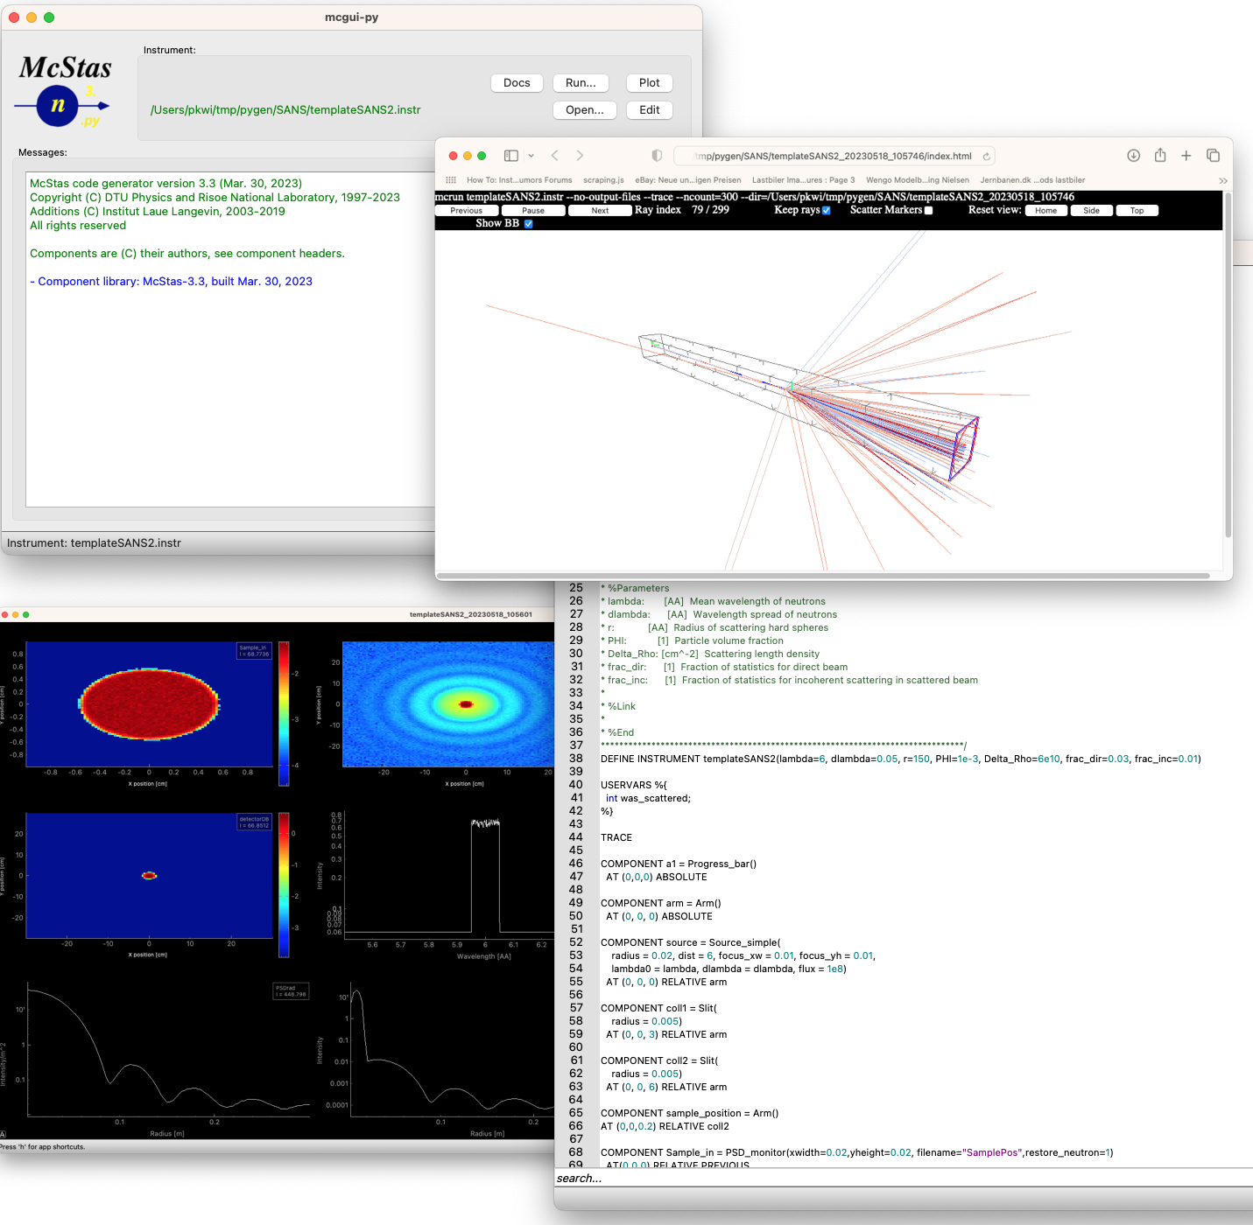
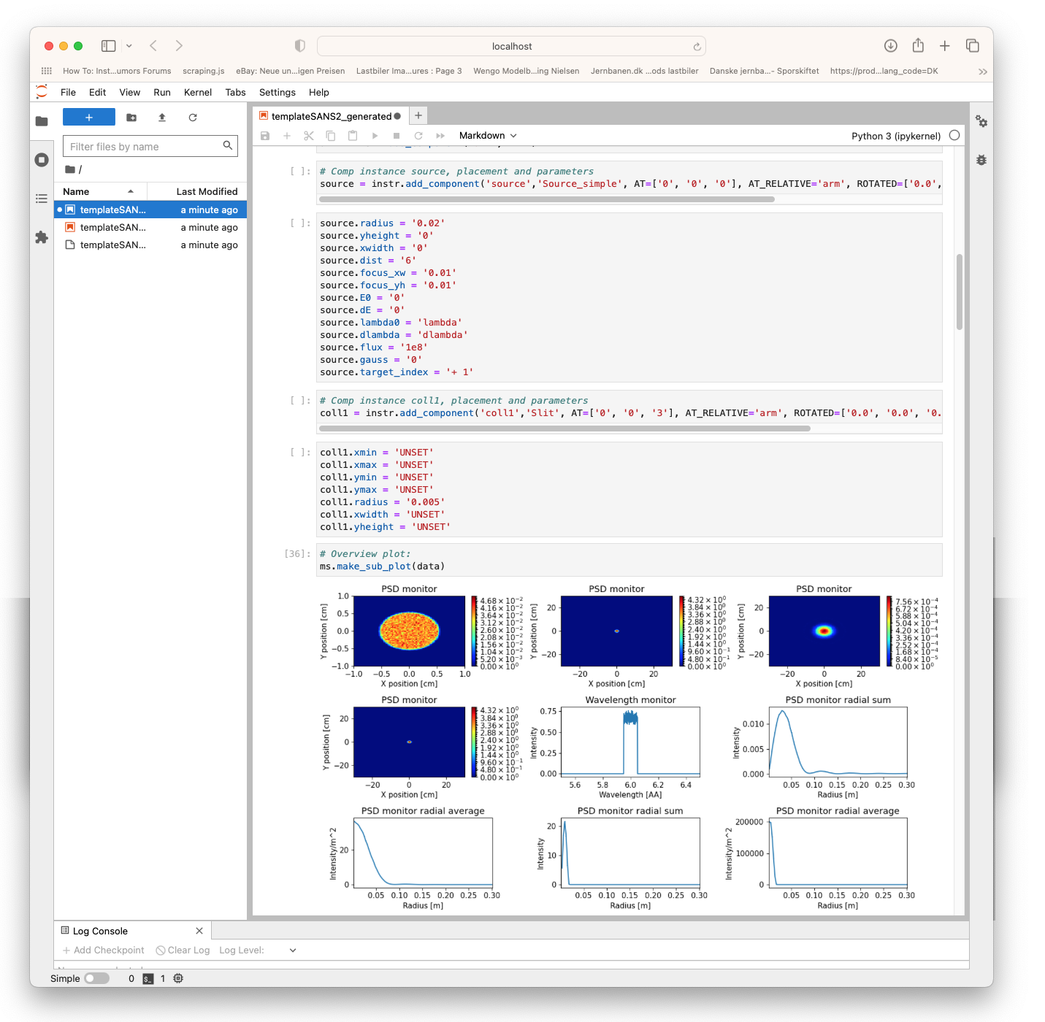
Tools
Shared interfaces, tools and utilities
McStas & McXtrace · Common Introduction
15

Slide 17
GETTING STARTED
Where to go next
McStas
McXtrace
WEBSITE
WEBSITE
mcstas.org
mcxtrace.org
MAILING LIST
MAILING LIST
mcstas-users@mcstas.org
mcxtrace-users@mcxtrace.org
INSTALL
INSTALL
conda-forge · cross-platform installers
conda-forge · cross-platform installers
SOURCE
SOURCE
GitHub — McStasMcXtrace/McCode
GitHub — McStasMcXtrace/McCode
micromamba env create – n panraid mcstas mcxtrace -y
(apt install mcstas-suite-python-ng mcxtrace-suite-python-ng)
McStas & McXtrace · Common Introduction
16

Slide 18
Thank you
Questions?
mcstas.org
mcxtrace.org
SUPPORTED BY
Peter Willendrup · pkwi@fysik.dtu.dk · DTU Physics
McStas & McXtrace · Common Introduction
17

