Slide 1


SOURCES & MONITORS
How rays are born,
and how they're recorded
A closer look at source and monitor components in McStas & McXtrace
McStas — neutrons
McXtrace — X-rays
Peter Willendrup · DTU Physics
PaNRAID School · supported by PEPR DIADEM

Slide 2




AGENDA
What we'll cover
Building on the Common Introduction — now with a closer look at two component families every instrument needs.
1
What a source does
2
Finding the docs
Setting the ray state at the start of the beamline
mcdoc & mxdoc, and how to read a component's parameters
3
Anatomy of a simple source
4
Two source landscapes
Position, direction, and spectrum
Mathematical, reactor/pulsed, and accelerator-based sources
5
Shared source physics
6
MCPL
Solid angle, ncount, and statistical weight
Coupling simulations together via particle lists
7
Monitors vs. detectors
8
A shared monitor library
Probing the beam without disturbing it
1D, 2D and nD monitors — and how they compute statistics
McStas & McXtrace · Sources & Monitors
2

Slide 3
SHARED CONCEPT
What a source component does
A source generates rays — in McStas terms, it sets the ray state to something representative of the source being modelled.
In practice: draw values for the ray's state vector from chosen distributions — not from a single fixed value.
Example: rays of uniformly distributed wavelength, emerging from a circular aperture, aimed at a region of interest.
Every other component downstream only ever sees a ray in this state — it doesn't know or care how the source produced it.
Recap — the ray state vector
McStas · neutron ray
{ x, y, z, vx, vy, vz, t, sx, sy, sz, p }
position · velocity · time · spin · weight
McXtrace · photon ray
{ x, y, z, kx, ky, kz, Ex, Ey, Ez, φ, t, p }
position · wave vector · polarisation · phase · time · weight
McStas & McXtrace · Sources & Monitors
3

Slide 4
SHARED WORKFLOW
Finding the docs
Every component's parameters, defaults and physics are documented — and the two codes use the same pattern to reach them.
You want… | McStas | McXtrace
Overview documentation page | mcdoc (or “Docs” in mcgui) | mxdoc (or “Docs” in mxgui)
The full PDF component manual | mcdoc -c | mxdoc -c
Docs for one specific component | mcdoc <component_name> | mxdoc <component_name>
Watch out: online copies of the manuals exist (mcstas.org / mcxtrace.org) but may not match your installed version exactly — the local mcdoc / mxdoc is always authoritative.
McStas & McXtrace · Sources & Monitors
4

Slide 5
SHARED CONCEPT
Anatomy of a simple source
Three questions every source answers — identically in shape, whichever code you're in.
1
Where?
2
Which way?
3
What spectrum?
Pick a start point on the source surface — e.g. uniform on a disc of radius R.
Aim toward a region of interest: a target of size focus_xw × focus_yh at distance dist.
Assign a wavelength / energy from a chosen distribution — uniform, Gaussian, Maxwellian…
dist
Every emitted ray points from the source at some (x,y,z) toward a randomly chosen point inside this target — concentrating statistics where they matter.
source
(radius R)
target
focus_xw × focus_yh
McStas & McXtrace · Sources & Monitors
5

Slide 6
SAME SHAPE, DIFFERENT NAME
A minimal source, in both codes
COMPONENT src = Source_simple(
radius=0.05, lambda0=2.5, dlambda=1.5,
focus_xw=0.1, focus_yh=0.1, dist=5)
AT (0,0,0) RELATIVE origin
COMPONENT src = Source_flat(
radius=0.05, lambda0=2.5, dlambda=1.5,
focus_xw=0.1, focus_yh=0.1, dist=5)
AT (0,0,0) RELATIVE origin
McStas · Source_simple
McXtrace · Source_flat
Same parameter names, same units: radius, lambda0/dlambda, focus_xw, focus_yh and dist mean the same thing in both instrument files — only the wavelength range and physical scale differ between neutrons and X-rays.
McStas & McXtrace · Sources & Monitors
6

Slide 7
WHERE THEY DIVERGE
Two source landscapes
This is where the two libraries look most different — shaped by very different facilities.
McStas · neutron sources
McXtrace · X-ray sources
MATHEMATICAL
MATHEMATICAL
Source_simple, Source_div
Source_flat, Source_div, Source_pt
REACTOR / CONTINUOUS
ACCELERATOR INSERTION DEVICES
Source_Maxwell_3, Source_gen
Bending_magnet, Wiggler, Undulator
PULSED (SPALLATION)
ESS_butterfly, Moderator, SNS_source, ISIS_moderator
PARTICLE-LIST I/O
PARTICLE-LIST I/O
MCPL_input / MCPL_output
MCPL_input / MCPL_output
Neutron sources mirror facility diversity (reactor vs. spallation); X-ray sources mirror accelerator physics (magnet type). Both share simple analytic sources and the same MCPL format.
McStas & McXtrace · Sources & Monitors
7

Slide 8



SHARED PHYSICS
Solid angle, ncount, and ray weight
Most neutron- and some X-ray sources emit into the full 4π steradian — but a simulation only needs the solid angle Ω subtended by the beamline's first aperture.
The emission integrated over Ω, wavelength and time gives a physical intensity (rays / second).
That intensity is partitioned over a finite number of simulated rays: ncount (default 1e6, set with -n / --ncount).
Each ray carries a statistical weight p, chosen so the sum of weights over all rays reproduces the physical intensity.
E.g. the beamport?
source
Many low-weight rays, or fewer high-weight rays — the physical result comes out the same, but statistics (and runtime) differ.
McStas & McXtrace · Sources & Monitors
8

Slide 9
SHARED ECOSYSTEM
MCPL: coupling simulations together
MCPL_output writes the full ray state to a portable, code-agnostic file at any point in an instrument.
MCPL_input reads those rays back in as a source — in the same code, or a different one entirely (McStas ↔ McXtrace ↔ MCNP ↔ Geant4…).
COMPONENT vout = MCPL_output(filename="v.mcpl", doubleprec=1, polarisationuse=1)
AT (Xout,Yout,Zout) RELATIVE PREVIOUS
COMPONENT vin = MCPL_input(filename="v.mcpl", polarisationuse=1)
AT (Xin,Yin,Zin) RELATIVE PREVIOUS
Coordinates travel with the rays: MCPL stores an implicit translation/rotation, so a ray written out at one orientation is placed correctly when read into an instrument with a different local frame.
McStas & McXtrace · Sources & Monitors
9

Slide 10
MCSTAS — NEUTRONS
Pulsed neutron sources
Reactors run continuously; spallation sources are pulsed. McStas offers a spectrum of ways to model that.
The simplest trick
Dedicated pulsed-source components
Use a continuous source and force an infinitely short pulse: t = 0 or define a short pulse via a rand01() for every ray within an EXTEND block — or use a chopper to carve pulses out of a continuous beam.
Moderator flat pulsed source, uniform energy spectrum, energy-dependent pulse shape
ESS_butterfly ESS's characteristic “butterfly” moderator brightness model
COMPONENT src = Source_simple(...)
AT (0,0,0) RELATIVE origin
EXTEND %{
t = 10e-3*rand01(); // 1 ms square pulse
%}
SNS_source / SNS_source_analytic samples MCNP target+moderator tallies (or fast Padé fits); also used for J-PARC, CSNS
ViewModISIS / ISIS_moderator samples tallies supplied per beamport at ISIS
McStas & McXtrace · Sources & Monitors
10

Slide 11
SHARED CONCEPT
Monitors vs. detectors, in general
Both codes draw exactly the same line — and let you program either behaviour when you need to.
Monitors
Detectors
An intensity probe of the beam
Should be transparent to rays — efficiency ≪ 1% (neutrons) / low efficiency (X-rays)
Doesn't meaningfully perturb what happens downstream
Should detect (almost) every ray — efficiency as high as possible
McStas models a real He3 tube via PSD_Detector
Otherwise: both codes let a monitor be given any efficiency/transparency you specify
Same philosophy in both codes: “we refer to both indistinguishably as monitors” — the component is the same, only the parameters you give it change its role.
Simulation of ’real’ detection-physics is an exception: “we leave that to expert-codes such as Geant4” — measurement is by default ”magic / for free”
McStas & McXtrace · Sources & Monitors
11

Slide 12
SAME SYNTAX, BOTH CODES
Adding monitors to a beamline
Swap the source component and the rest reads identically in McStas or McXtrace.
COMPONENT origin = Progress_bar() AT (0,0,0) ABSOLUTE
COMPONENT src = Source_simple(radius=0.05, lambda0=2.5, dlambda=1.5,
focus_xw=0.1, focus_yh=0.1, dist=5)
AT (0,0,0) RELATIVE origin
COMPONENT psd = PSD_monitor(xwidth=0.2, yheight=0.2, filename="psd.dat")
AT (0,0,5) RELATIVE src
COMPONENT lm = L_monitor(xwidth=0.2, yheight=0.2, filename="lm.dat", Lmin=0, Lmax=8)
AT (0,0,5.01) RELATIVE src
In McXtrace: replace Source_simple with Source_flat — PSD_monitor and L_monitor are called exactly the same way.
McStas & McXtrace · Sources & Monitors
12

Slide 13
SHARED LIBRARY
A shared monitor library
Most monitors exist under the same name and parameter conventions in both codes.
1D
2D
nD
L_monitor
PSD_monitor
Monitor_nD
TOF_monitor
PSD_monitor_4PI
— records almost
Hdiv_monitor
Divergence_monitor
any requested
E_monitor
DivPos_monitor
quantity, any
MeanPolLambda *
PolLambda_monitor *
shape
* a small number of monitors are probe-specific — polarisation monitors exist for neutrons, not X-rays. Look up the full, current list with mcdoc monitor / mxdoc monitor.
McStas & McXtrace · Sources & Monitors
13

Slide 14

SHARED STATISTICS ENGINE
How a monitor computes its statistics
Every bin (pixel) accumulates a running sum of ray weight as the simulation proceeds — not a per-ray record.
At the end of the run, each bin reports three numbers: intensity I, its estimated RMS error E, and an effective event count N.
I is the weighted sum of rays landing in that bin; E follows from the sum of squared weights — the Monte Carlo estimate of statistical uncertainty.
The same estimator runs underneath every monitor, in both codes — from a single L_monitor to the full Monitor_nD.
I(λ): intensity per bin
I = Σ pⱼ (summed weight)
E ≈ √(Σ pⱼ²) (RMS error)
N = ray count in bin i
…
…
In bin i, N events each carrying a fractional intensity pj so that
bin i
1
2
3
i
k
McStas & McXtrace · Sources & Monitors
14

Slide 15
SHARED COMPONENT
Monitor_nD: the swiss-army-knife
A general 0D / 1D / 2D recorder — almost any shape, recording almost any requested quantity — same options grammar in both codes.
COMPONENT MyMon = Monitor_nD(xwidth=0.1, yheight=0.1, zdepth=0,
options="intensity per cm2 angle, limits=[-5 5], bins=10, with borders, file=mon1")
options = "banana, theta limits=[10,130], bins=120, y"
options = "user1, auto" → with user1="age", username1="Age of the Captain [years]" — monitor just about anything.
McStas & McXtrace · Sources & Monitors
15

Slide 16
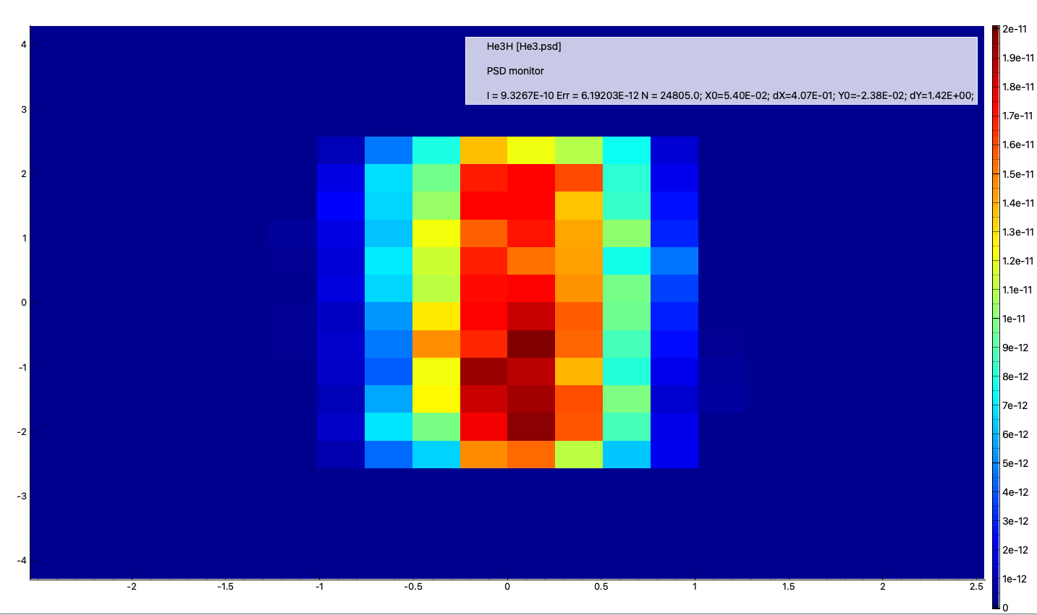
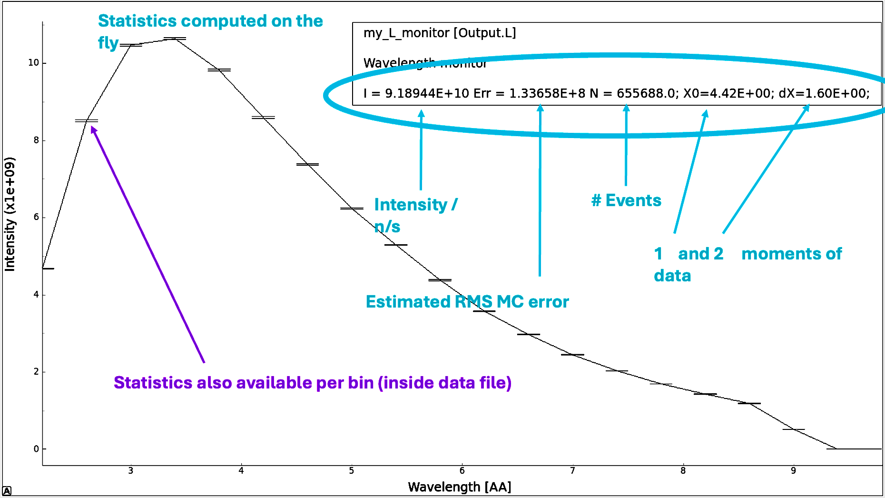
MONITOR OUTPUTS
1D and 2D example output (by default in Ascii)
In 2D
1st and 2nd moments
Plotting tools are mcplot(-pyqtgraph/-matplotlib/-html) for McStas and
mxplot-(-pyqtgraph/-matplotlib/-html) for McXtrace
There are further mccoplot/mxcoplot and mcplotdiff/mxplotdiff tools
When output is written in HDF5 / NeXus format we
recommend the ‘nexpy’ software
(always included when installing from conda-forge)
McStas & McXtrace · Sources & Monitors
When a particle event-list is the suitable format, this can be created using Monitor_nD
15

Slide 17
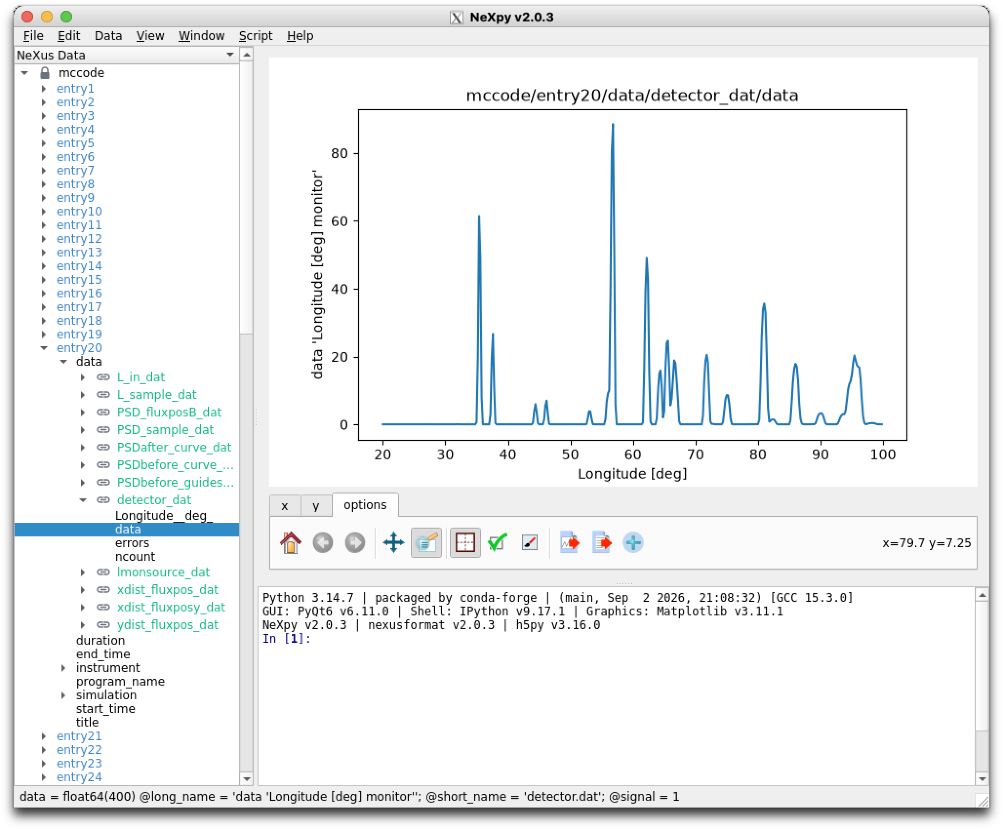
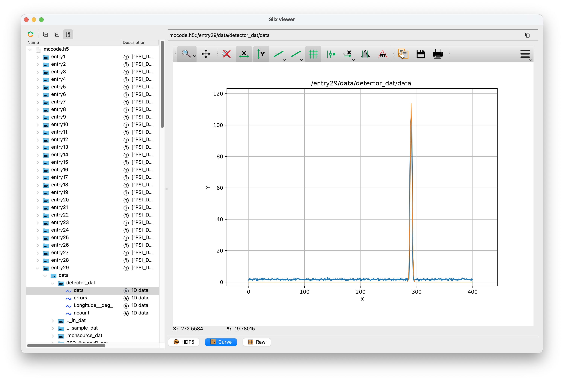

Lightweight HDF5/NeXus plotting, fits etc.
NeXpy

Slide 18
RECAP
Sources differ; monitors mostly don't
What's shared
What differs
A source's role: set the ray state from chosen distributions
The solid-angle / ncount / weight formalism
Simple analytic sources: Source_simple ↔ Source_flat
The monitor library, naming, and statistics engine
Monitor_nD and its options syntax
MCPL for coupling simulations together
mcdoc / mxdoc as the doc-access pattern
Source families: pulsed/reactor moderators vs. accelerator insertion devices
Ray fields: velocity & spin vs. wave vector, phase & E-field
Energy scale of the emitted spectrum: meV vs. keV
A handful of probe-specific monitors (e.g. polarisation, neutron-only)
Facility-specific source components (ISIS, SNS, ESS … have no X-ray analogue)
McStas & McXtrace · Sources & Monitors
16

Slide 19
Where to go deeper
McStas
McXtrace
mcdoc / mcdoc -c
mxdoc / mxdoc -c
mcstas.org/download/components
mcxtrace.org/download/components
mcstas-users@mcstas.org
mcxtrace-users@mcxtrace.org
Hands-on exercises on sources and monitors will be provided during the school session.
Peter Willendrup · pkwi@fysik.dtu.dk · DTU Physics
McStas & McXtrace · Sources & Monitors
17

