Slide 1
Sources and Monitors
DTU Physics

Slide 2
Sources: In general
A source component generates Monte Carlo neutrons.
In McStas terms this means:
  Set the neutron state to something representative of the source we are trying to model.
  i.e.: insert values in the neutron state vector:
  {x,y,z, vx,vy,vz, t, sx,sy,sz, p}
  drawn from appropriate distributions.
  EXAMPLE:
  Neutrons from a uniform wavelength distribution emerging from a circular aperture.

Slide 3
Access the docs
IMPORTANT:
All (and more) of this information can be found in the online pdf component documentation, e.g.
https://github.com/McStasMcXtrace/McCode/raw/master/docpkg/manuals/mcstas/Component_manual.pdf
or
http://mcstas.org/download/components/doc/manuals/mcstas-components.pdf
- also distributed with your McStas installation - mcdoc -c
The component documentation along with the command:
“mcdoc <component_you_are_searching_for>”
are your best friends when using McStas

Slide 4
Sources: Example 1
Neutron spatial coordinates are picked from a uniform distribution on a circle with radius R.

Slide 5
Sources: Example 1
Length of the velocity vector encodes the wavelength

Slide 6
Sources: Example 1
focus_xw
Neutron velocity vector is picked to point at a ROI.
In McStas: this is defined by the parameters: focus_xw, focus_yh, and
dist
focus_yh
dist

Slide 7
Sources: Example 1
TRACE
COMPONENT origin = Progress_bar()
AT(0,0,0) ABSOLUTE
COMPONENT src = Source_simple(
radius=0.05, lambda0=2.5, dlambda=1.5,
focus_xw=0.1, focus_yh=0.1, dist=5)
AT(0,0,0) RELATIVE origin

Slide 8
Monitors: in general
REALITY:
Monitors:
Intensity probe of the beam
Transparent to neutrons → Efficiency <1%
Detectors:
Should detect all neutrons → Efficiency as high as possible
SIMULATIONS (McStas):
In McStas:
We can program monitors and detectors to behave any way we like. We refer to both of those indistinguishably as ‘monitors’.
E.g. monitor with Efficiency =100% and Transparency=100%
(With exception of PSD_Detector that models a “physical” He³ detector)

Slide 9
Monitors: Example PSD_monitor

Slide 10
Monitors: Example PSD_monitor
When the simulation has been completed, the detected intensity in pixel (i,j) is:
… during simulation, the pixels are maintained as running sums.

Slide 11
Monitors: Example PSD_monitor and L_monitor
...
TRACE
COMPONENT origin = Progress_bar()
AT(0,0,0) ABSOLUTE
COMPONENT src = Source_simple(
radius=0.05, lambda0=2.5, dlambda=1.5,
focus_xw=0.1, focus_yh=0.1, dist=5)
AT(0,0,0) RELATIVE origin
COMPONENT psd = PSD_monitor(
xwidth=0.2, yheight=0.2, filename=”psd.dat”)
AT (0,0,5) RELATIVE src
COMPONENT lm = L_monitor(
xwidth=0.2, yheight=0.2, filename=”lm.dat”,
Lmin=0, Lmax=8)
AT (0,0,5+0.01) RELATIVE src

Slide 12
Sources: Mathematical sources
Source_simple:
Square or circular surface emitting neutrons from either uniform or Gaussian wavelength (or energy) distribution.
Neutrons are directed towards a square target.
Source_div:
Square surface emitting neutrons from either uniform or Gaussian wavelength (or energy) distribution.
Neutrons have a divergence defined by either uniform or Gaussian distribution.

Slide 13
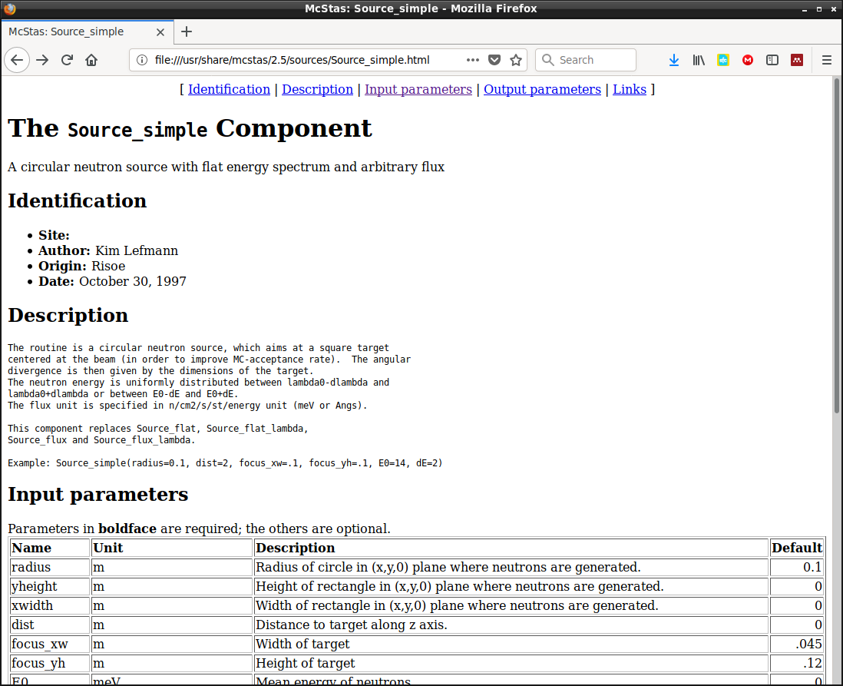
Source_simple docs
Try “mcdoc Source_simple”
or
( in GUI ) Help → mcdoc Component Reference → (In Webpage ) Source_simple

Slide 14
Source_simple docs
Try “mcdoc Source_simple”
or
( in GUI ) Help → mcdoc Component Reference → (In Webpage ) Source_simple
Click “Input parameters”

Slide 15
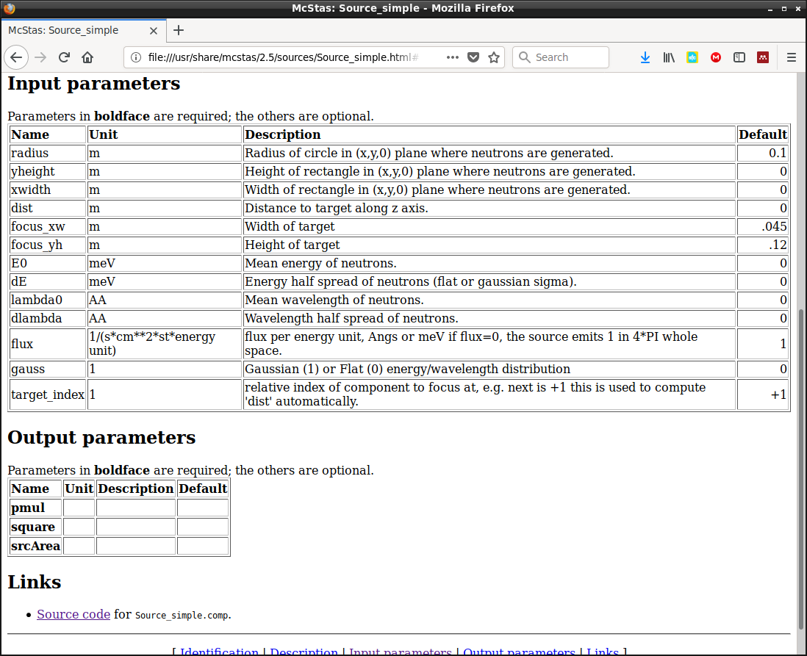
Source_simple docs
Try “mcdoc Source_simple”
or
( in GUI ) Help → mcdoc Component Reference → (In Webpage ) Source_simple

Slide 16
Monitors: Example PSD_monitor and L_monitor
Let’s do a very simple exercise on this:
Head on over to:
Exercise 1 - Sources and Monitors on github
https://github.com/mccode-dev/Schools/tree/master/2025/ISIS_November_2025/1_Tuesday_November_4th/2_Component_basics/Exercise

