Slide 1
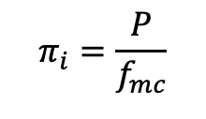
Write your own McStas component
Aim:
Write a component that models a semi-permeable mirror. i.e. a mirror with scalar reflectivity<1, which also uses focused sampling.
Hints:
Step by step instructions in README on github / Thursday – item 2 https://github.com/mccode-dev/Schools/blob/master/2025/ISIS_November_2025/3_Thursday_November_6th/2_Writing_a_component/README.md
Start with the Arm – copied in place for convenience.
(it has most of the McStas structure present already.)
Focused sampling is governed by:
$$π_{i}$$
: weight multiplier
: physical probability
: Monte Carlo probability
$$π_{i}=\frac{P}{f_{mc}}$$
$$P$$
$$f_{mc}$$
1

