Slide 1
McStasScript Python interface
ISIS 2025 McStas School
PRESENTED BY Mads Bertelsen

Slide 2

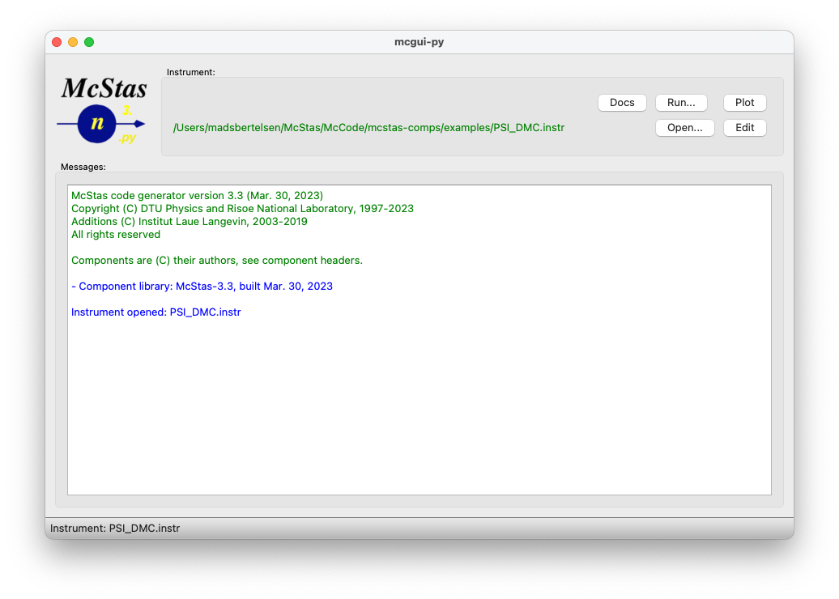

McStas
McStas instrument file
User interface
DEFINE INSTRUMENT example(theta)
DECLARE
// C-code – declare variables
double two_theta;
INITIALIZE
// C-code - perform initial calculations
two_theta = 2.0*theta;
TRACE
// McStas component sequence
Monochromator = Monochromator_flat(
yheight=0.1, zdepth=0.05, Q=1.78)
AT (0,0,2.0) RELATIVE source
ROTATED (0, theta, 0) RELATIVE source
FINALLY
// C-code – perform calculations after simulation
C meta-language instrument file
Help and plotting from mcgui

Slide 3
McStas
y
User interface
Instrument file
Simulated instrument
x
COMPONENT A(par=2)
AT (0, 0, 0.5)
ROTATED (-10, 0, 0)
z
COMPONENT B(width=0.3)
AT (0, 0, 4.0)
ROTATED (10, 0, 0)
COMPONENT C(length=2.5)
AT (0, 0, 11.5)
ROTATED (-12, 0, 0)

Slide 4
McStas
Execution of simulation
Simulated instrument
Assemble from component library
Place components in a sequence
Place them in simulated space
Execute through terminal or mcgui
Instrument file
c file
Executable
COMPONENT A(par=2)
AT (0, 0, 0.5)
ROTATED (10, 0, 0)
COMPONENT B(width=0.3)
AT (0, 0, 4.0)
ROTATED (-10, 0, 0)
COMPONENT C(length=2.5)
AT (0, 0, 11.5)
ROTATED (12, 0, 0)
McStas
compiler
Users
c - compiler

Slide 5
McStas
McStasScript overview
Python McStas API
Build instrument object
Execute simulation
Receive data as Python objects
Open source
https://github.com/PaNOSC-ViNYL/McStasScript
Comprehensive test suite
Local components
McStasScript
Produced data
Generate instrument file
Instrument file
c file
Executable
McStas
compiler
Users
c - compiler

Slide 6


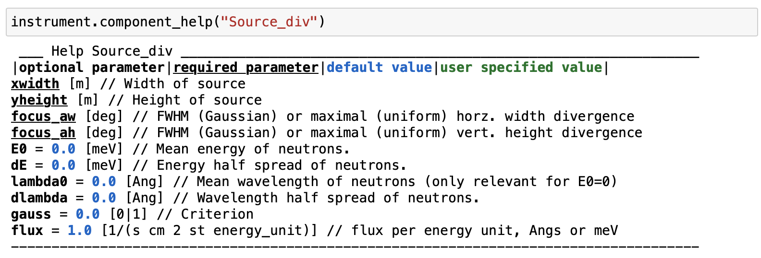
McStasScript
McStas
Demo
Instrument object
Knows components

Slide 7
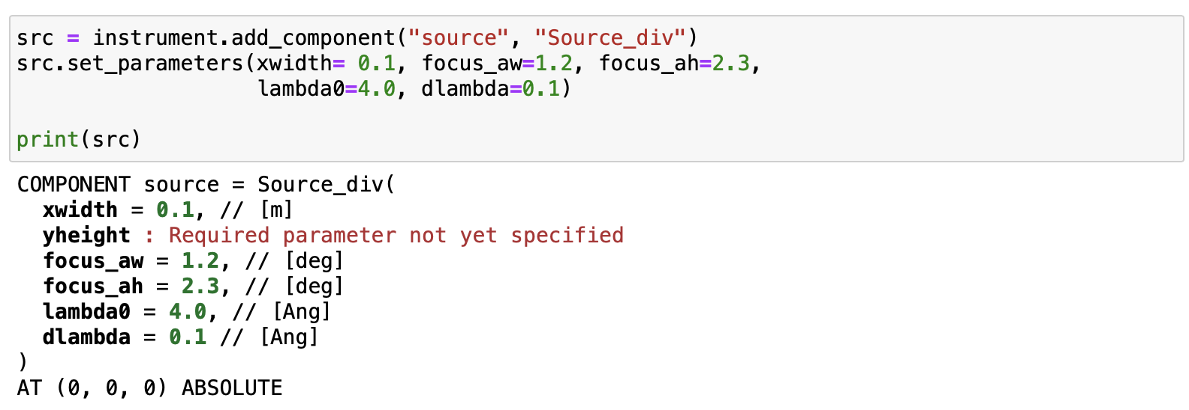
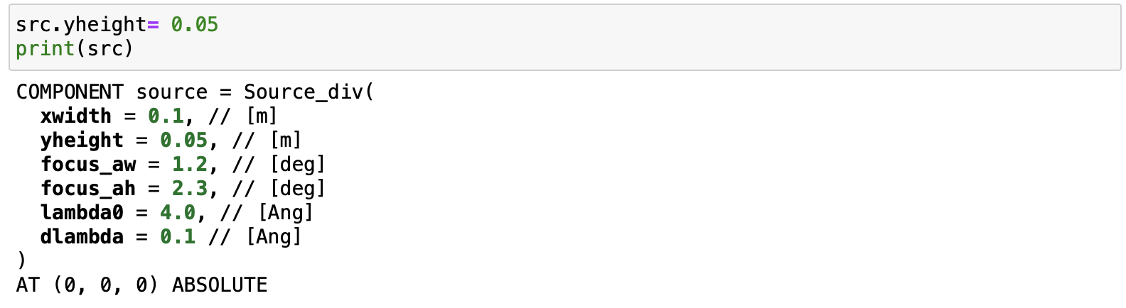
McStasScript
McStas
Demo
Component object
Spots errors
Autocompletion

Slide 8
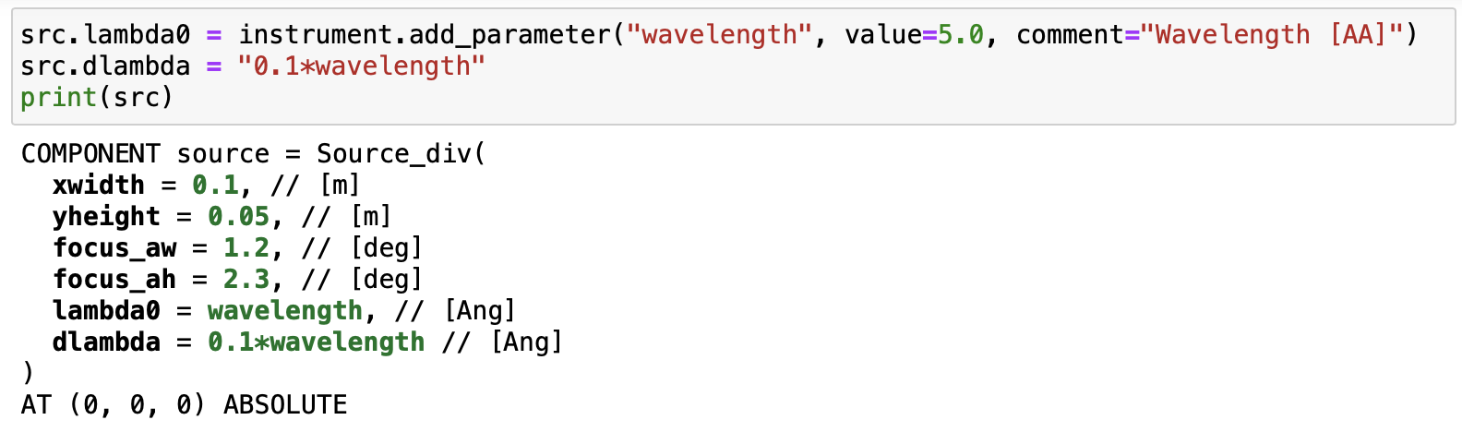
McStasScript
McStas
Demo
Parameter objects
Calculations
Parameter overview

Slide 9
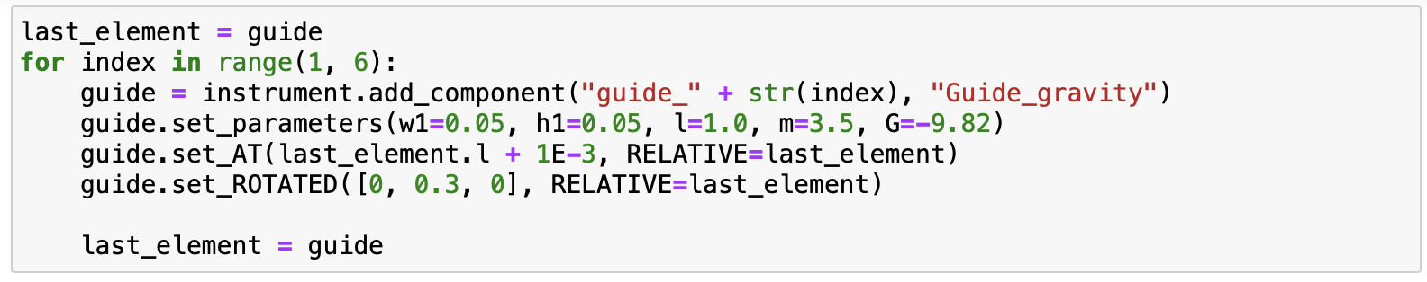
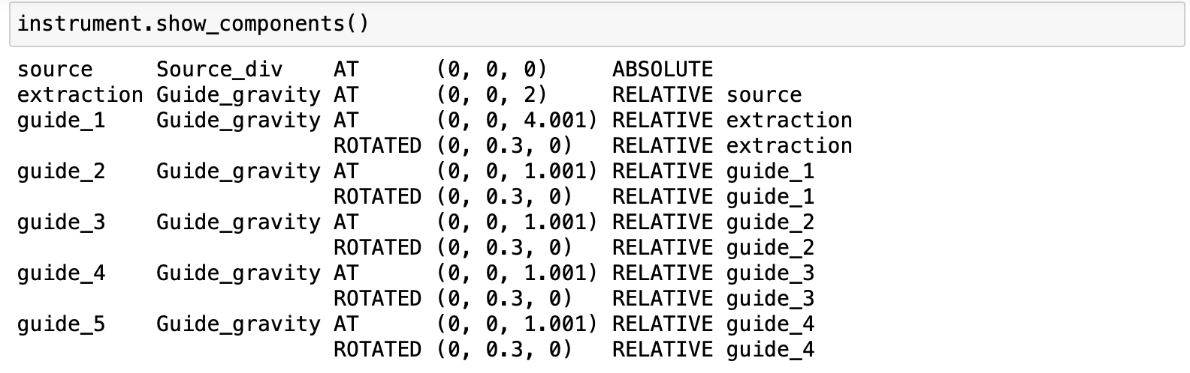
McStasScript
McStas
Demo
Set position
For-loop
Component list

Slide 10
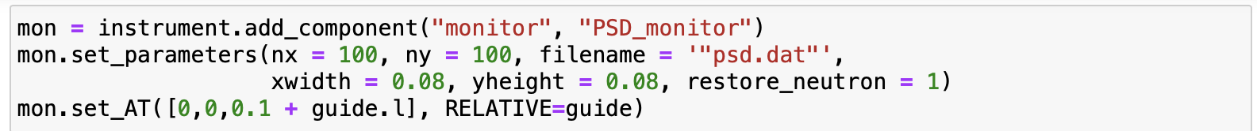
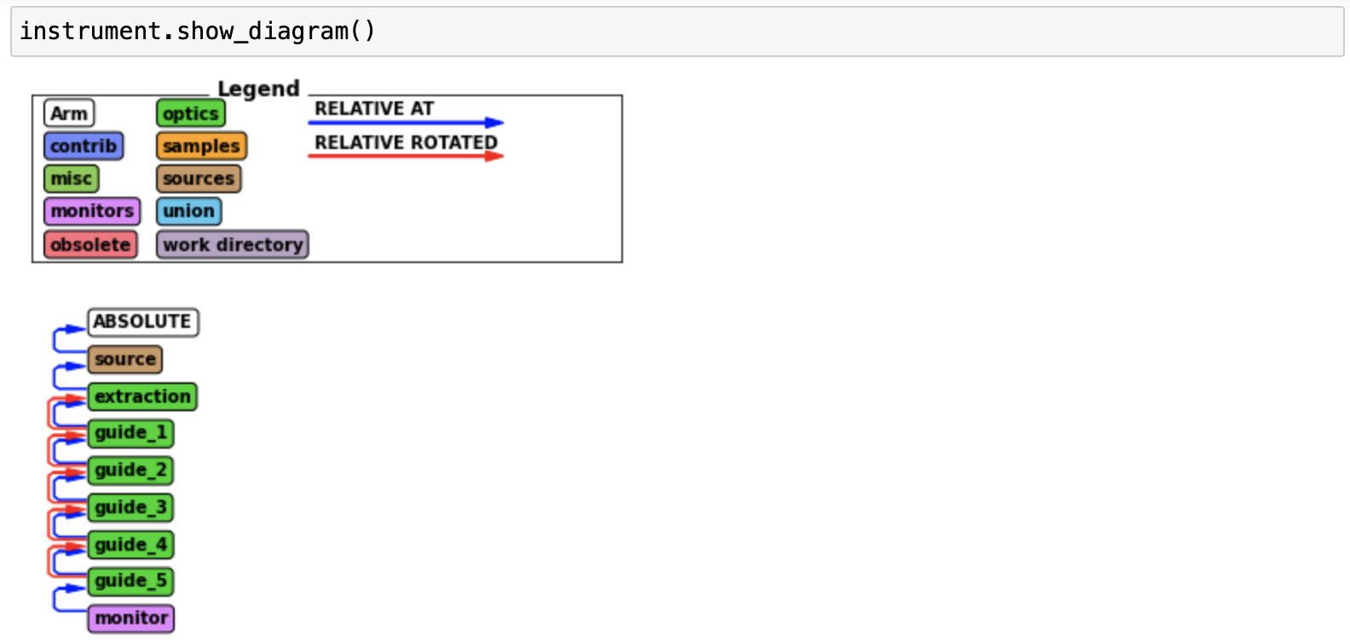
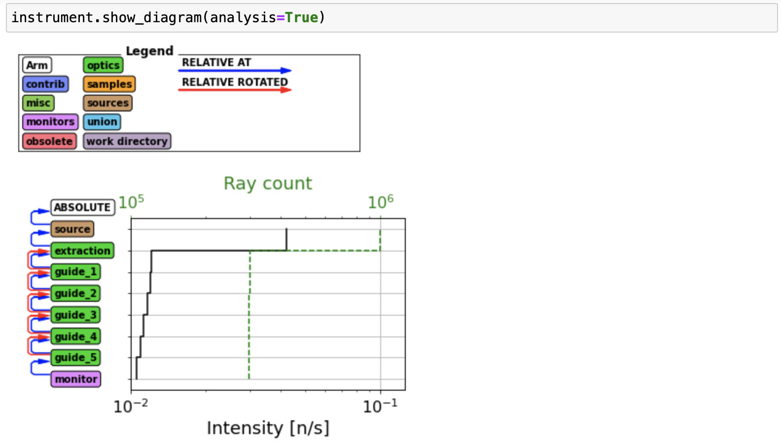
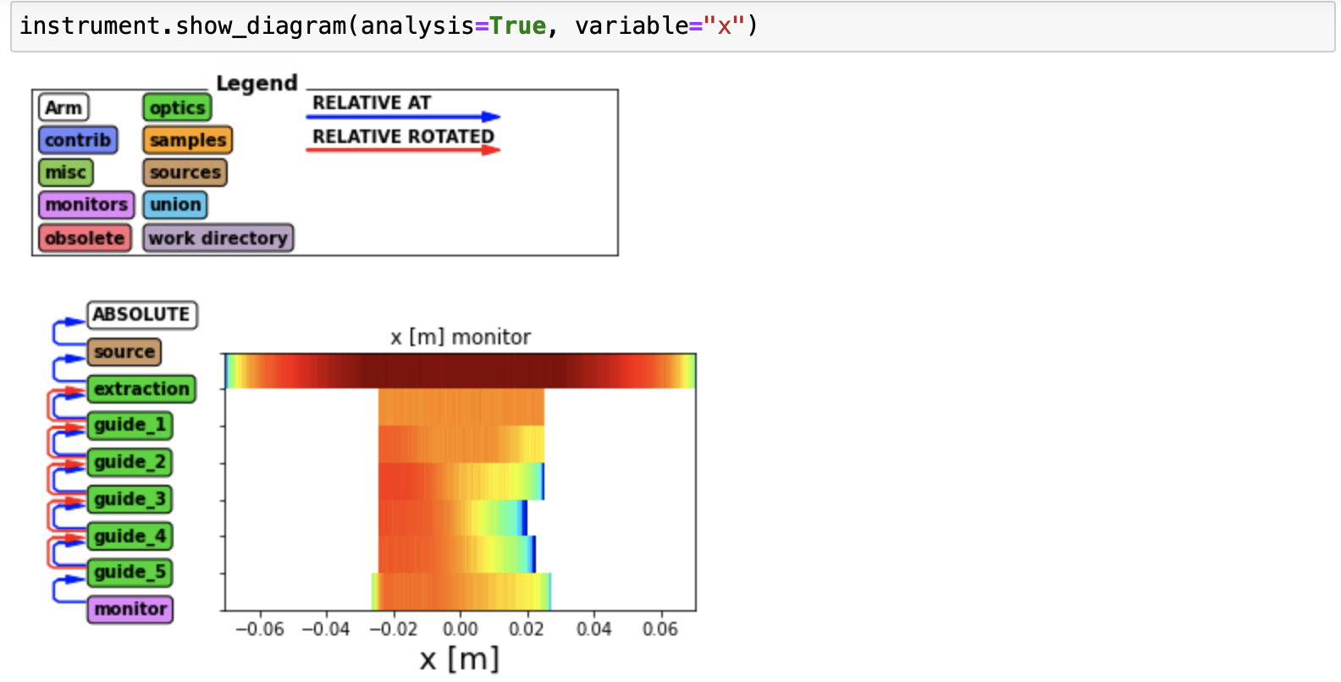
McStasScript
McStas
Demo
Filename pitfall
Diagrams

Slide 11
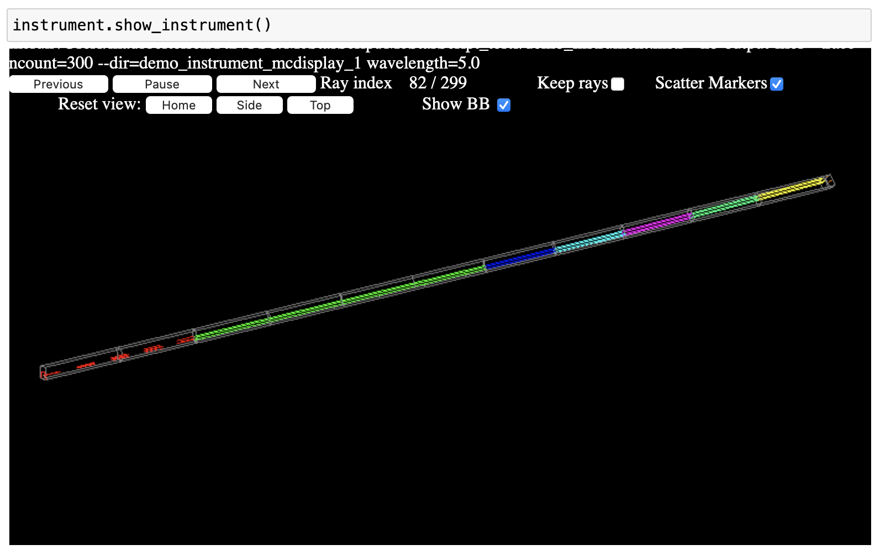
McStasScript
McStas
Demo
Visualization

Slide 12
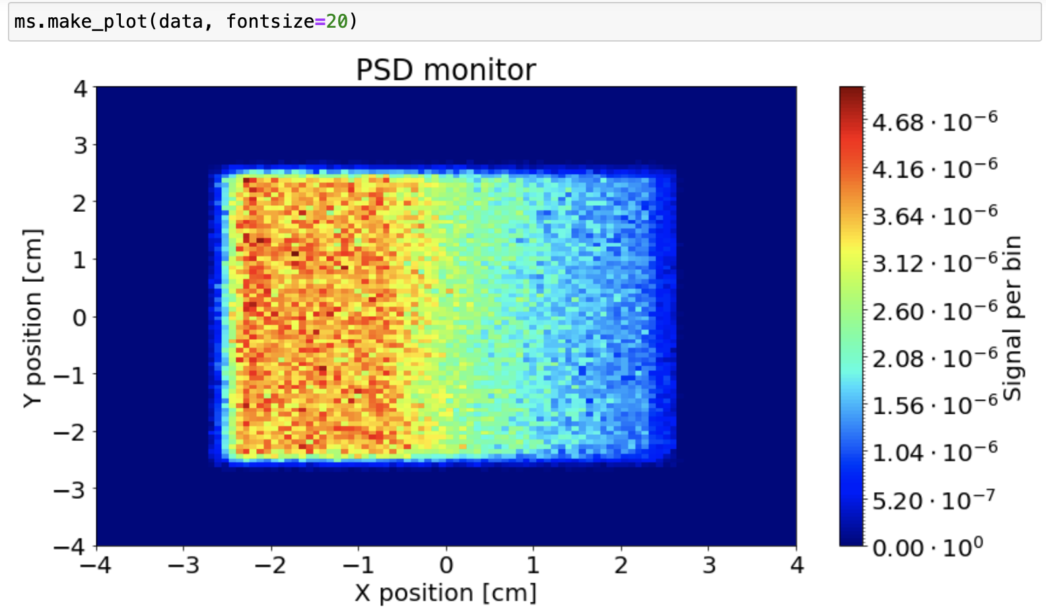
McStasScript
McStas
Demo
Settings
Parameters
Run simulation
Plot data

Slide 13
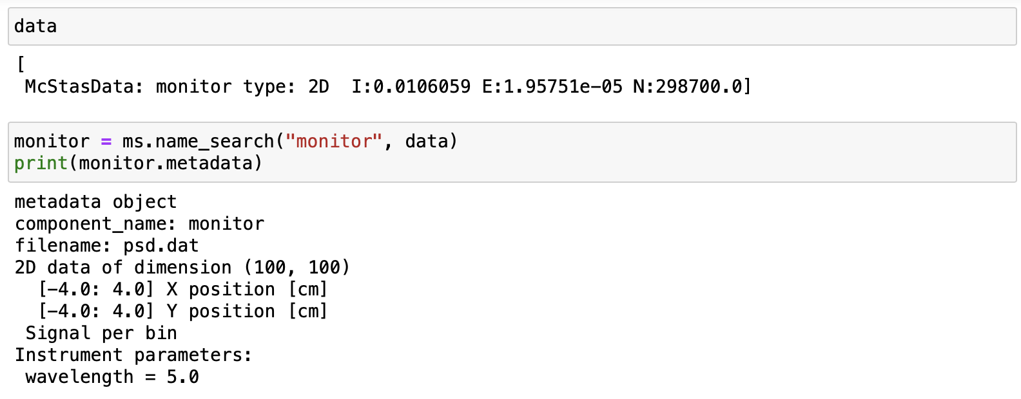
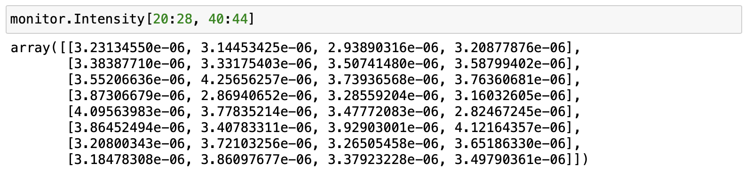
McStasScript
McStas
Demo
Python objects
Metadata
Numpy arrays

Slide 14
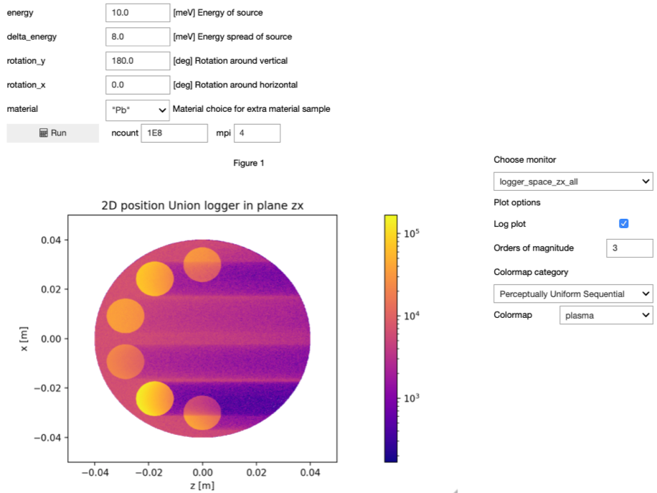
McStasScript
Demo
Simulation widget

Slide 15
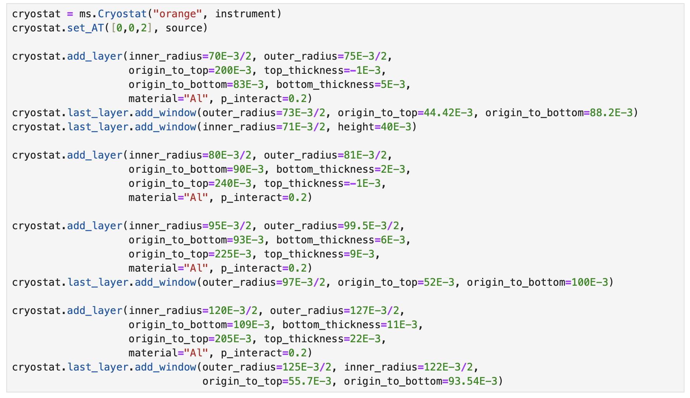
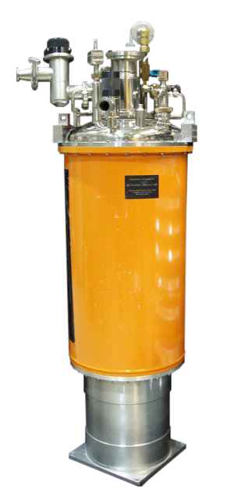
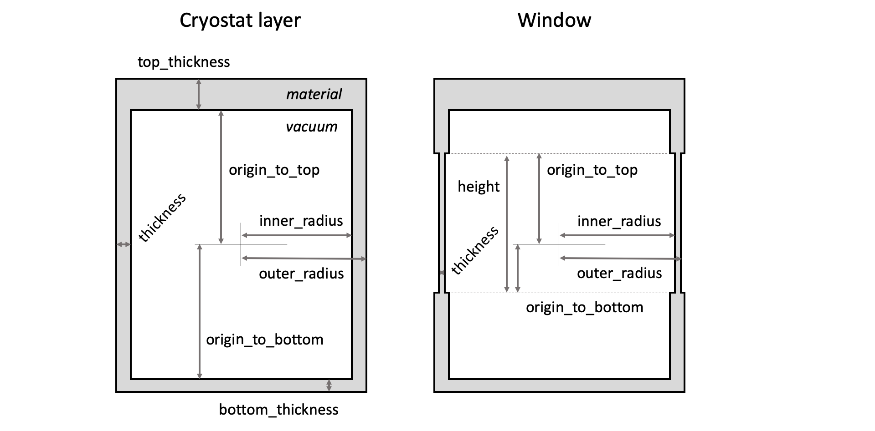
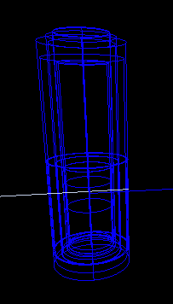
McStasScript
Tools
Cryostat tool
NCrystal tool

Slide 16
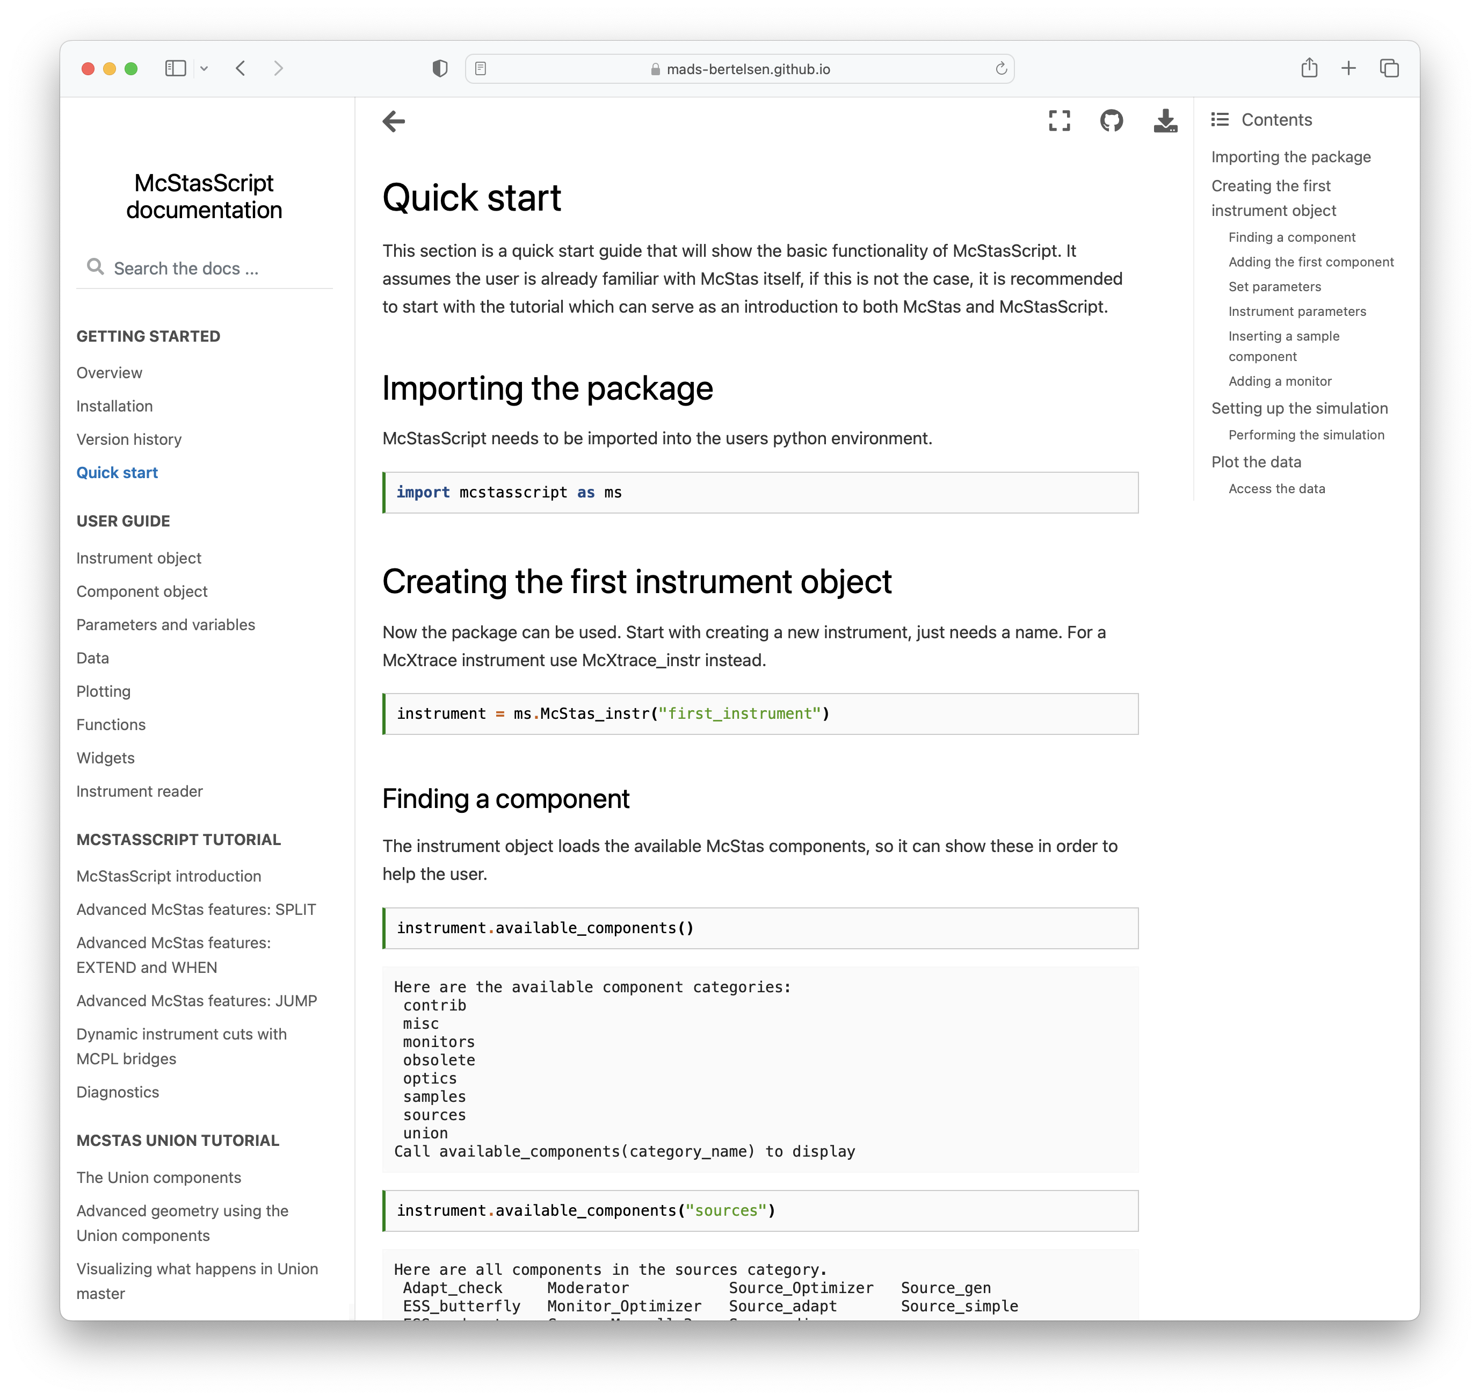
McStasScript
Documentation
Comprehensive documentation
Descriptions of the classes
Tutorials for
McStasScript
McStas features
McStas Union components
https://mads-bertelsen.github.io
Should be moved to better place
Workshop / School available

Slide 17
McStasScript
McStas instrument file
McStasScript
Code structure
DEFINE INSTRUMENT example(
)
DECLARE
INITIALIZE
TRACE
instr = McStas_instr(“demo”)
# Guide
# Choppers
# Sample environment
# Detectors
Powerful Python features
for-loops
functions
classes
Chopper example
Parameters for wavelength band
Variables for frequency phase
Calculations
Component
mcstas-pygen translator

Slide 18
McStasScript
Installation
Install from pip / conda
pip install McStasScript
conda install –c conda-forge mcstasscript
Included as dependency if you install McStas, e.g. conda install –c conda-forge mcstas
Already available in your VISA instance in ESS conda environment

Slide 19
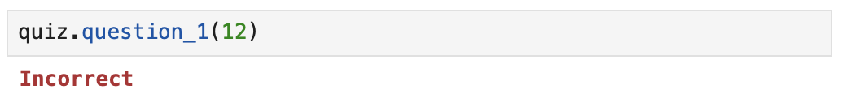
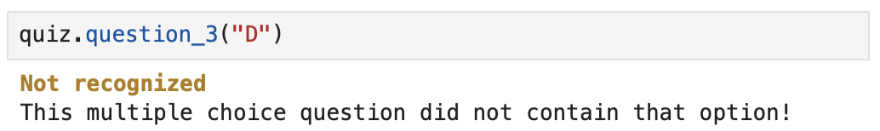
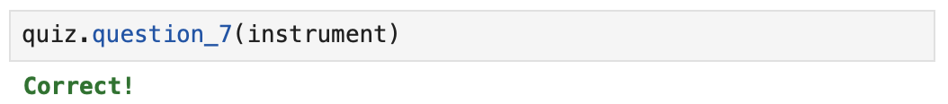
McStasScript
Exercise
Also cryostat_demo notebook if you are curious! Uses NCrystal
McStasScript quiz
Questions that need to be answered by a number
Multiple choice questions need a string, options typically A, B, C, D, …
Instrument questions check you have set up an instrument correctly

