Slide 1
Establishing the learning goals, a look at the programme
Peter Willendrup

Slide 2
Learning goals:
Learn McStas basics
Build and operate simple instrument models, source + optics + sample + detector
Learn basics of instrument-optimisation for your type of instrument
Add Mantid / NeXus capabilities
Get a better idea of what you want to do with McStas, how to do it, how to get help
Get up-to-speed with latest developments and advanced features
Enable your independent work with McStas

Slide 3
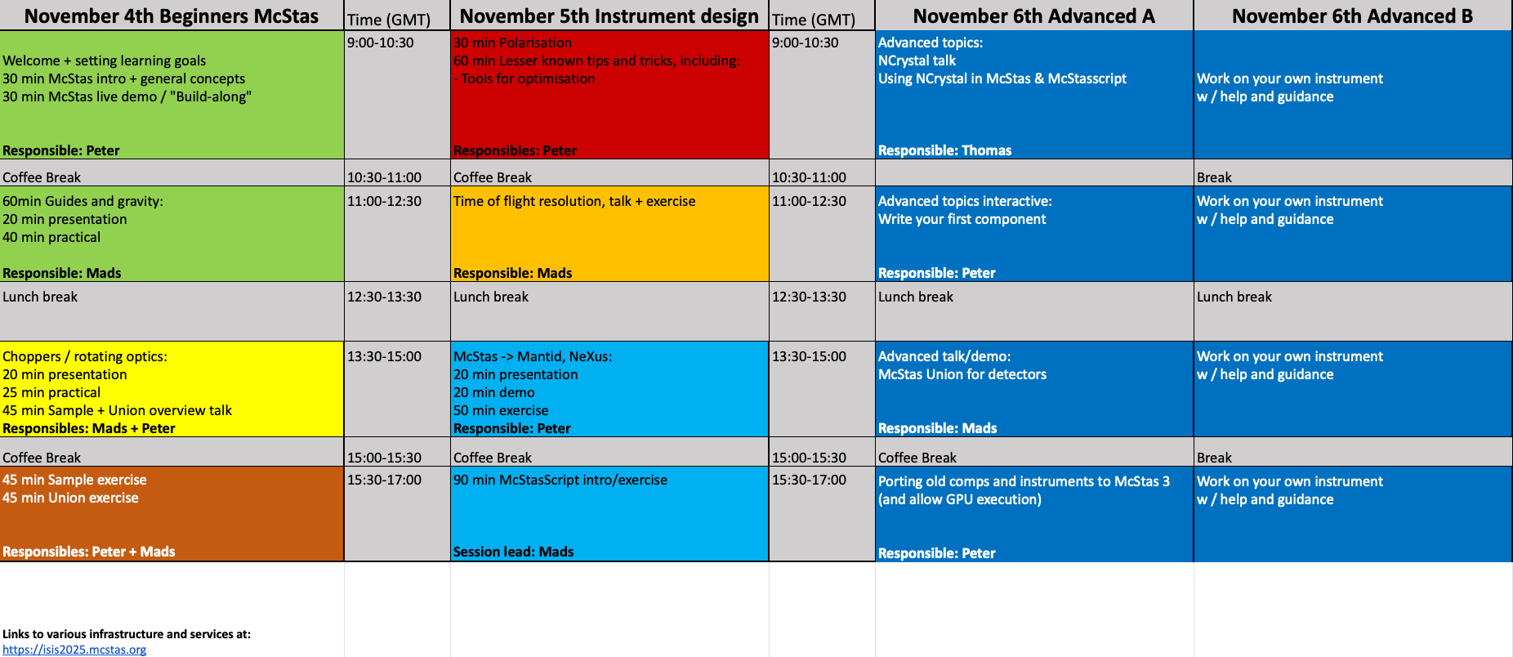
School programme

Slide 4
School programme - day 1
Intro lecture, general principles, sources + monitors,
In “cookbook” sections, think ahead toward your own project: * Which neutron source * What optics * What sample - K.I.S.S. for now
Lectures + “recipe” exercises
Sample-lecture, including “advanced McStas grammar”, sample exercises

Slide 5
School programme - day 2
Lectures on polarisation and instrument optimisation technicals
ToF resolution, talk + exercise
Mantid-howto, lecture and demo
McStasScript intro/exercise

Slide 6
School programme - day 3, advanced stuff + work on own project

Slide 7
For the exercise-based work-sessions
You will benefit from working in pairs, 2 > 1
Take turns being the “coder” and the “parallel processor” ( use sharing-feature of the IDAaaS system )

Slide 8
Let’s get to it!

