Slide 1
Moving Optics
Disk Chopper
Fermi Chopper
Velocity selector

Slide 2
Moving optics
Not optics that move
...optics with moving parts

Slide 3
Moving optics
Moving optics
I.e. we can’t do:
COMPONENT something = Sometype(
par1=value1, par2=value2, ….)
AT( f_x(t), f_y(t), f_z(t) )RELATIVE someother
So what can we do?

Slide 4
Moving optics
Moving optics
I.e. we can’t do:
COMPONENT something = Sometype(
par1=value1, par2=value2, ….)
AT( f_x(t), f_y(t), f_z(t) )RELATIVE someother
So what can we do?
Instead, we operate internally in the component on the neutron state, e.g. “rotate” the neutron etc.
n
n

Slide 5
DISK CHOPPER
Define time structure of the beam
Time Of Flight (TOF) measurements

Slide 6
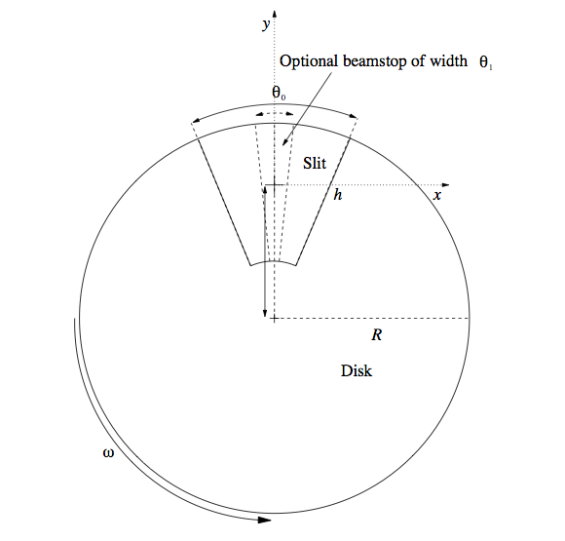
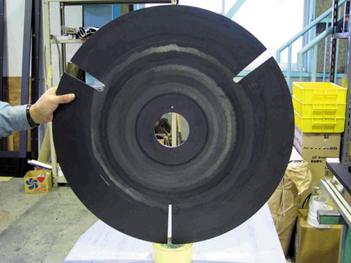
Disk chopper

Slide 7
Disk chopper
INPUT PARAMETER
nu [Hz] frequency
yheight [m] slit height (if 0, yheight = radius)
radius [m] disk radius
theta_0 [deg] angular width of slits
xwidth [m] horizontal slit width opening, beam center
jitter [s] jitter in time phase
delay [s] time delay
phase [deg] angular delay, overrides time
Isfirst [0/1] several choppers, defines first chopper
npulse [1] number of pulses if isfirst=true
verbose [1] display disk chopper config

Slide 8
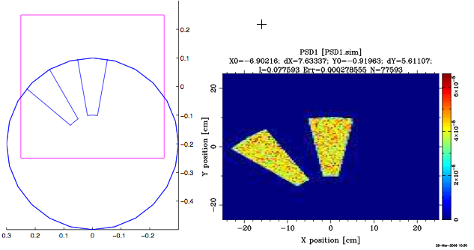
Disk Chopper

Slide 9
Disk Chopper exercise
Let’s do an exercise on this – head on over to github and find it there:
https://github.com/McStasMcXtrace/Schools/blob/master/ISIS_April_2021/Tuesday_April_13th/4_Choppers_and_other_rotating_optics/README.md

Slide 10
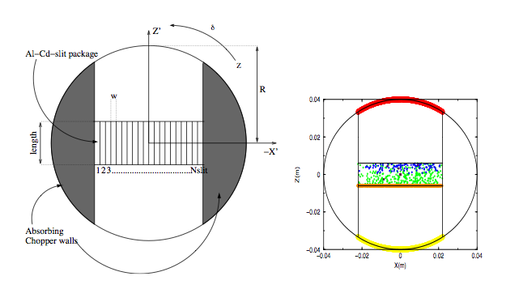
Fermi Chopper

Slide 11
Velocity Selectors
-
Select the neutron energy you want

Slide 12
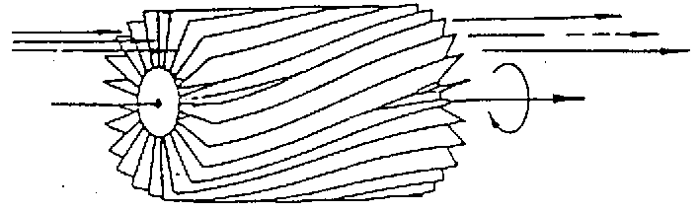
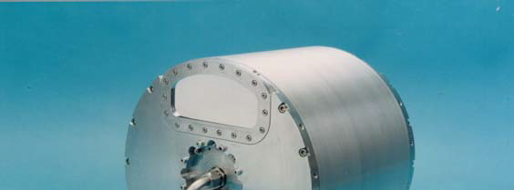
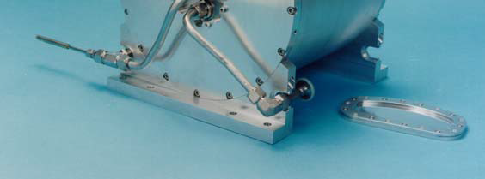
Velocity Selectors
Drum with curved absorbing blades
ILL.FR
Astrium

Slide 13
Velocity Selectors
Schematic of a velocity selector
absorbing blades

Slide 14
Velocity selectors
‘broad’ monochromatization δλ/λ ≈ 10 %
ILL.FR
Astrium

Slide 15
Velocity selectors
INPUT PARAMETER
xwidth [m] width entry aperture
yheight [m] height entry aperture
zdepth [m] housing! length
length [m] blade length
d [m] blade thickness
alpha [deg] twisting angle
radius [m] distance rotation axis – aperture centre
nu [Hz] rotation speed, counterclockwise
nslit [] number of blades
housing

Slide 16
Velocity selectors
Let’s do an exercise on this also:
Go to the same place on github you were before and do the second Task:
https://github.com/McStasMcXtrace/Schools/blob/master/ISIS_April_2021/Tuesday_April_13th/4_Choppers_and_other_rotating_optics/README.md

