Slide 1
Investigating instrument resolution with McStas
ISIS 2025 McStas School
PRESENTED BY Mads Bertelsen

Slide 2
Resolution
What do we mean by instrument resolution?
Two important concepts:
Point spread function: Distribution on detector from specific q, E
Used to build expected detector response from known q, E distribution
Detector response: Distribution of q, E measured by part of detector (pixel, time)
Used to build up map of q, E measured from detector response
Depends on almost all aspects of instrument:
Source size/time structure, optics, sample size/shape, detector, …

Slide 3
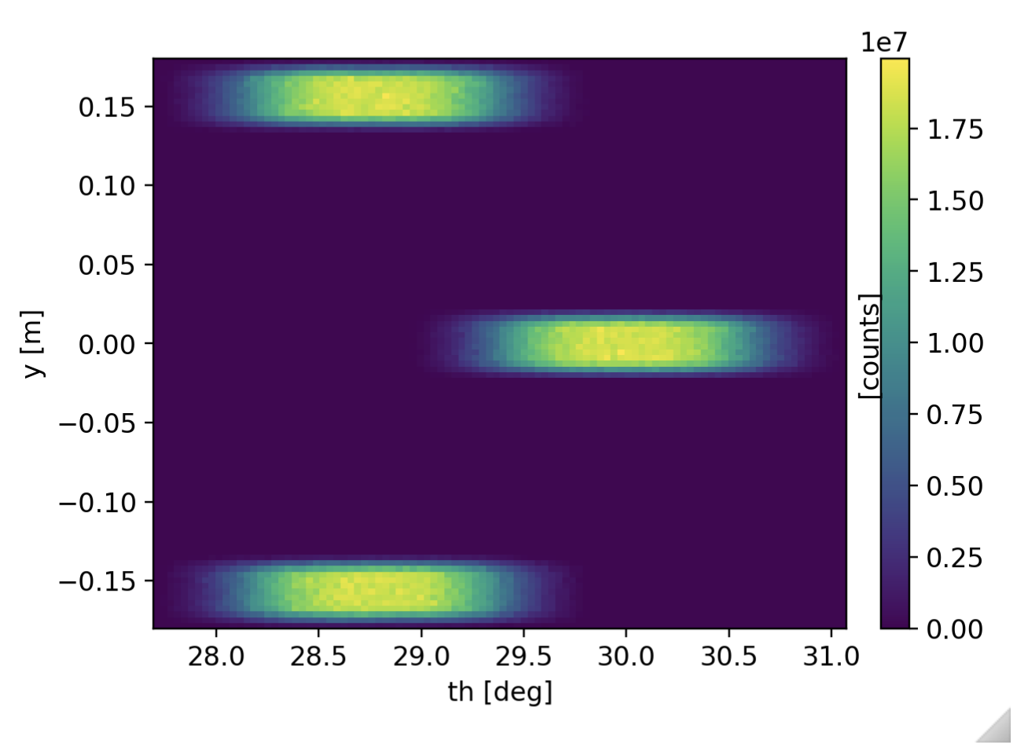
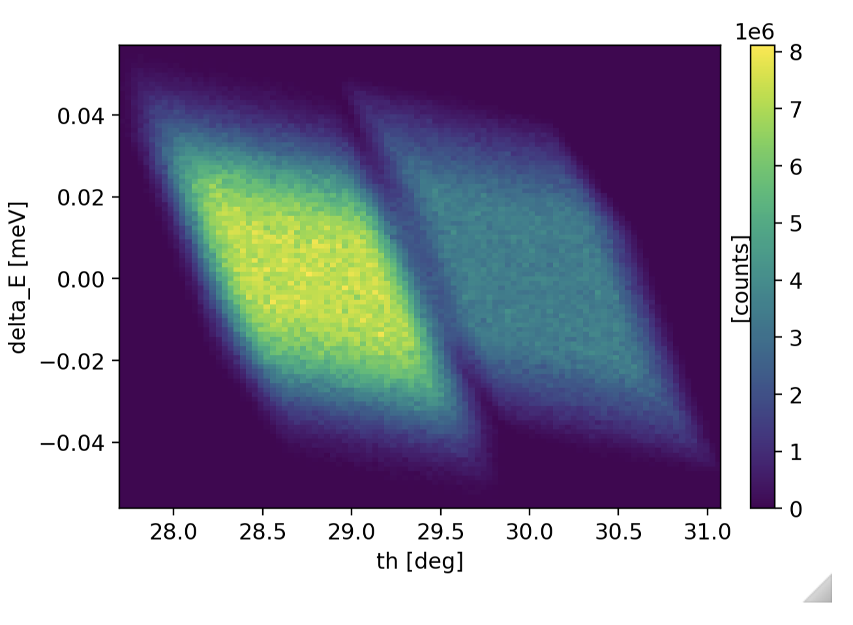
Resolution
Tools for point spread function
Spot_sample (in Contrib, by Garrett Granroth)
Number of spots in q, E
Probes the point spread function for all these spots in one simulation

Slide 4
Resolution
Tools for detector response
Continuous measurements Res_sample.comp / Res_monitor.comp
Start of instrument
Res_monitor
Res_sample
Sample sends rays towards monitor.
Selects random final energy in given interval.
Sample records q, E for each event
Monitor histograms those that reach it

Slide 5
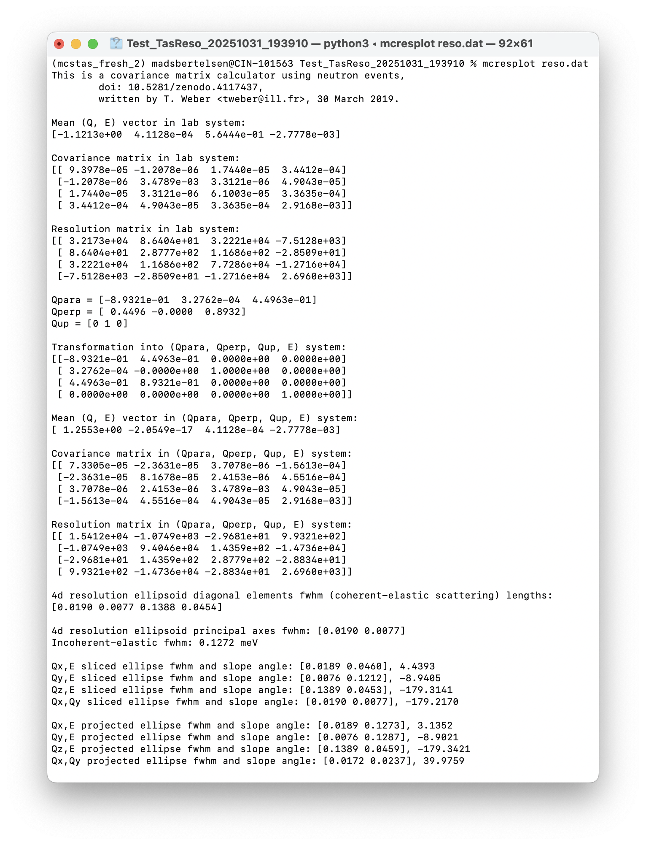
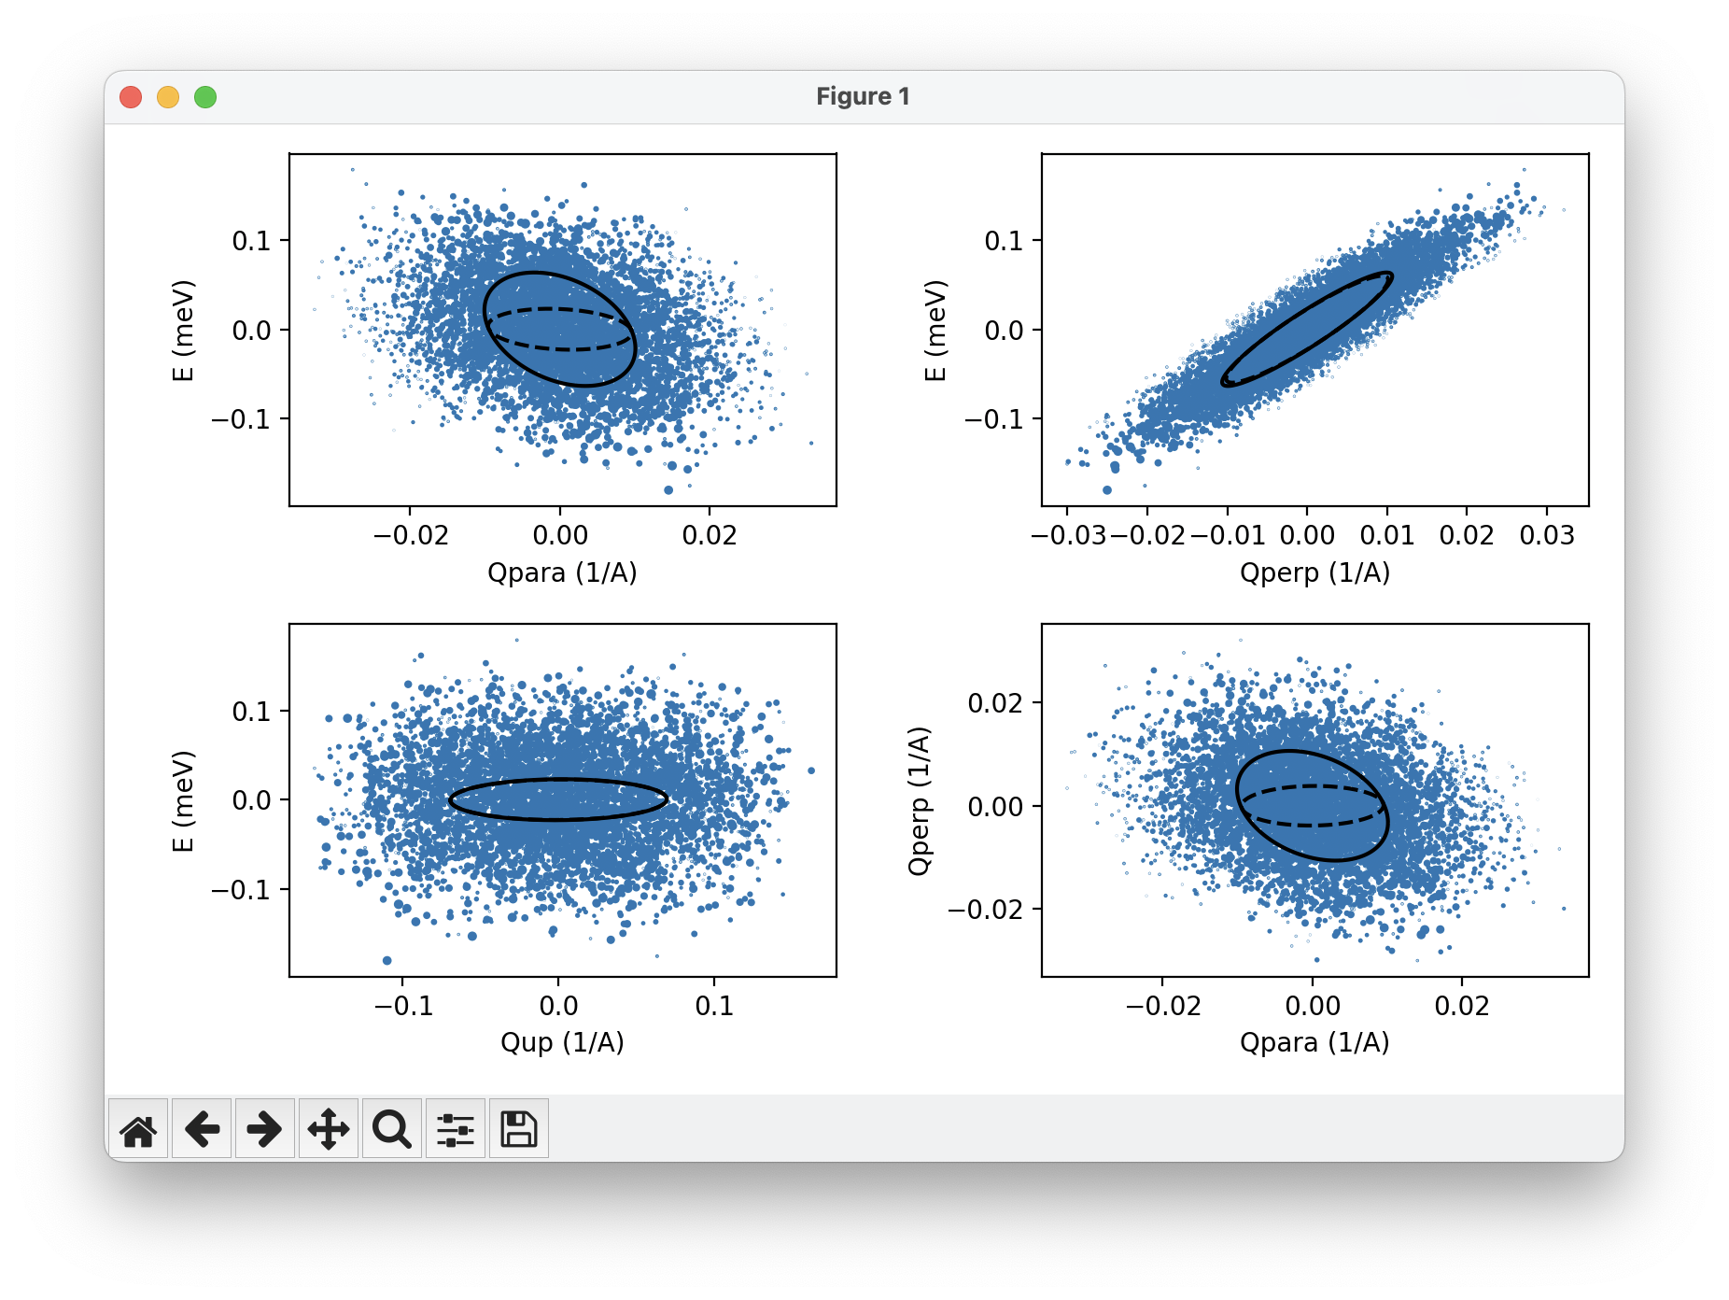
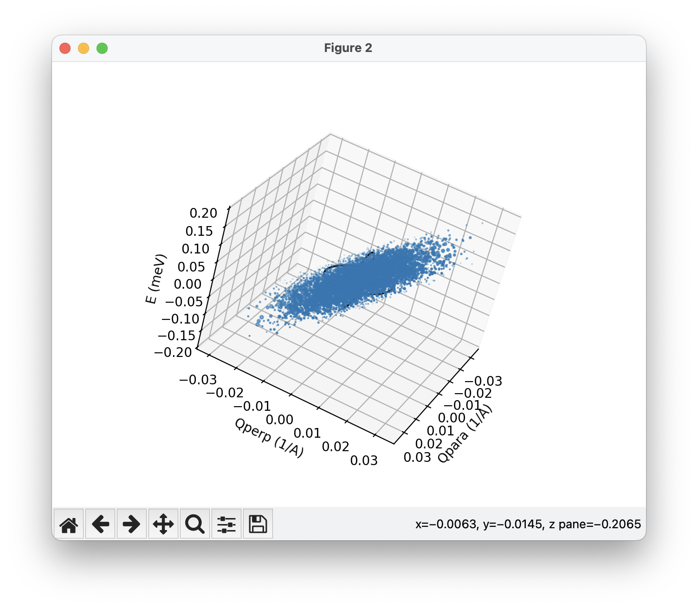
Resolution
Tools for detector response
Terminal tool: mcresplot

Slide 6
Resolution
Tools for detector response TOF case
Time of flight measurements TOFRes_sample.comp / TOFRes_monitor.comp
Start of instrument
TOFRes_monitor
TOFRes_sample
Sample sends rays towards monitor.
Selects random final time in given interval.
Sample records q, E for each event
Monitor histograms those that reach it

Slide 7
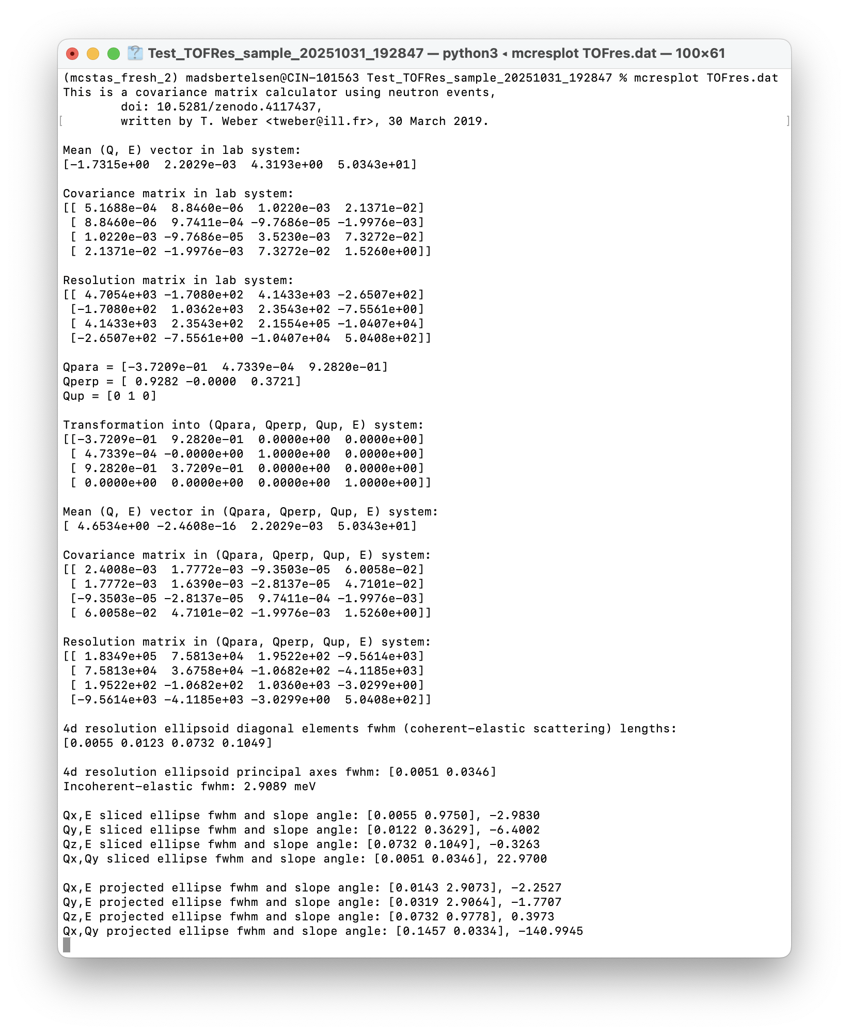
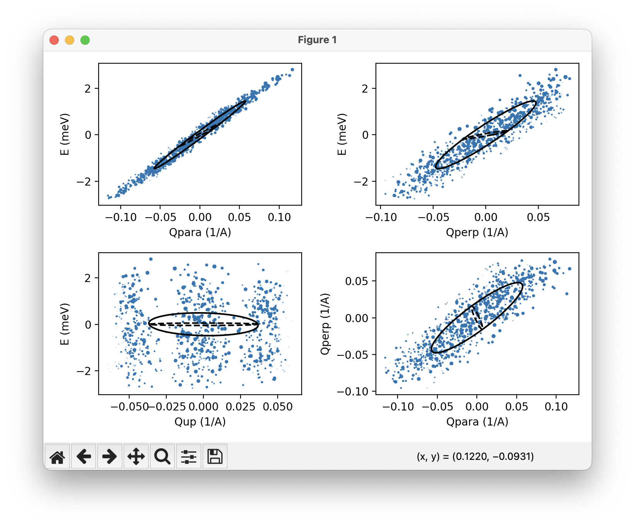
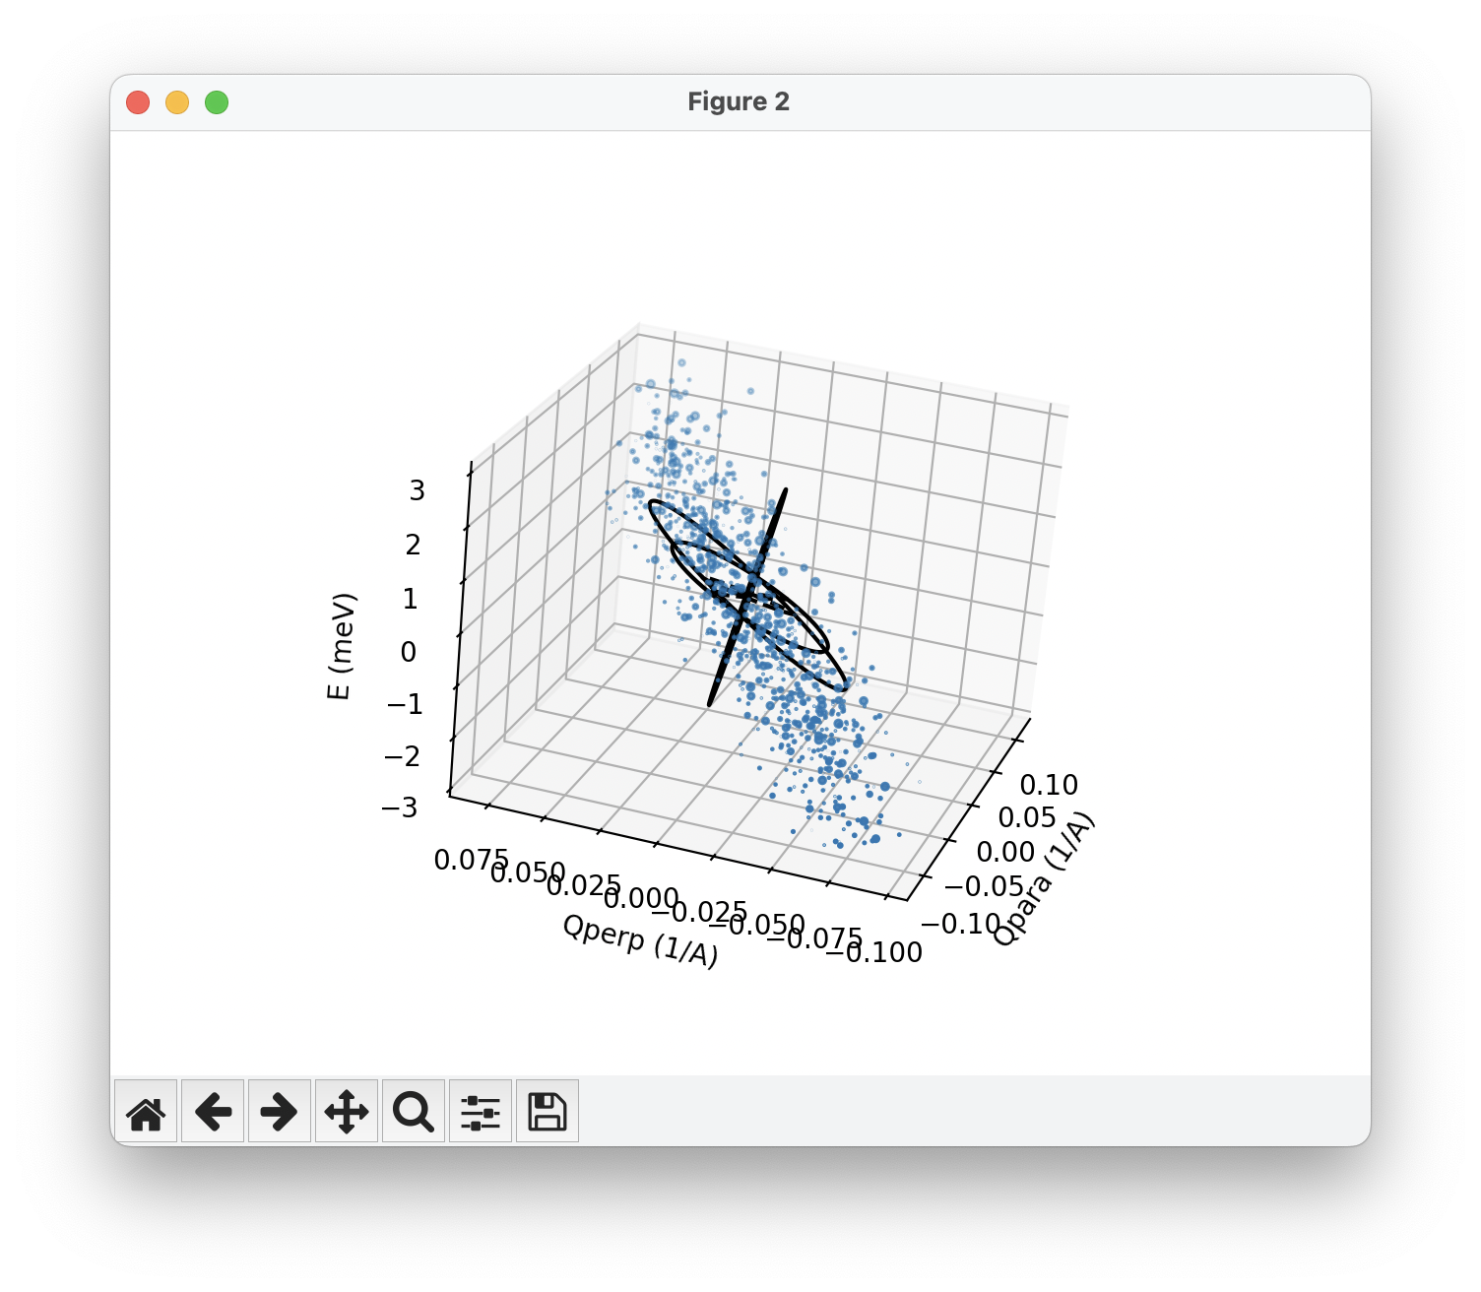
Resolution
Tools for detector response TOF case
Terminal tool: mcresplot

Slide 8
Resolution
Current situation
Separate for detector response and point spread function
Point spread function can be determined for n spots at once with Spot_sample
For detector response
Existing solutions look at a single pixel (and time bin for TOF)
Getting resolution function for whole detector requires
Scan over instrument settings (incoming / final energy)
Either scan over all pixel positions or large number of components
For TOF instruments, scan over investigated time bin at given pixel
These components are admittedly designed for TAS / simple TOF instruments

Slide 9
Resolution
Method for full detector resolution
Want to get both detector response and point spread function
Want to get entire detector and all times in one simulation
Monitor_nD
Start of instrument
Monitor_nD
Res_sample
Monitor_nD
Before sample:
After sample:
Detector:
k, neutron id
k, neutron id
pixel position, time and neutron id
Sample sends rays towards monitor.
Selects random final energy in given interval.

Slide 10
Resolution
Method for full detector resolution
For each event recorded in the detector we know
From the detector itself: pixel position, time and neutron id
From this id, we can look up: initial and final wavevector -> q, E
With this information we can look at
Small subset of pixel / time positions -> Detector response for that area in q, E
Small subset of q, E -> Point spread function on detector
This requires large dataset and code to handle data
Still requires multiple simulations scanning over instrument settings

