Slide 1
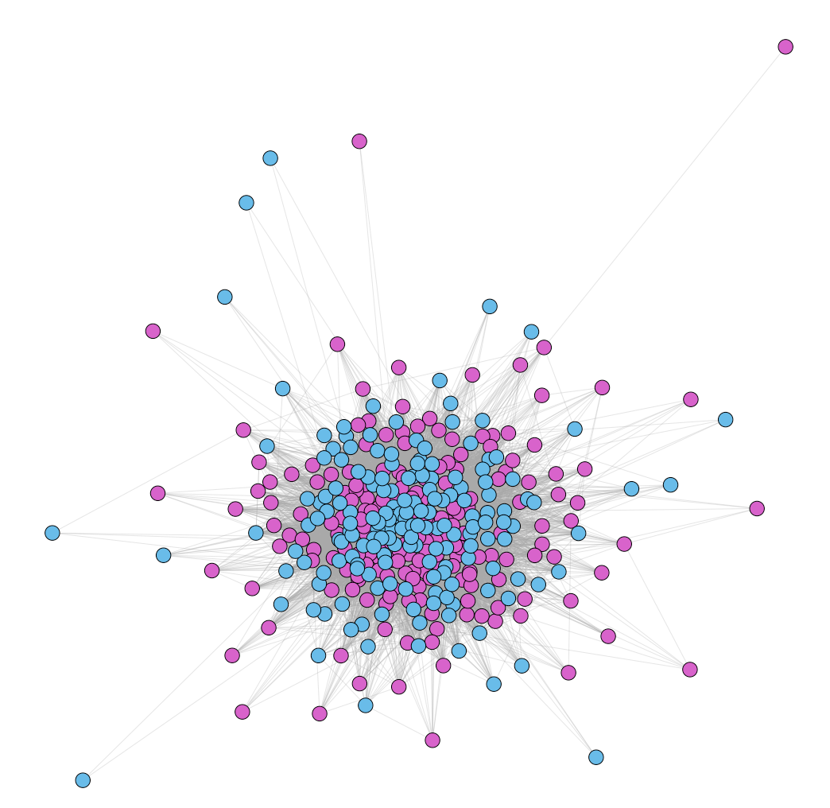

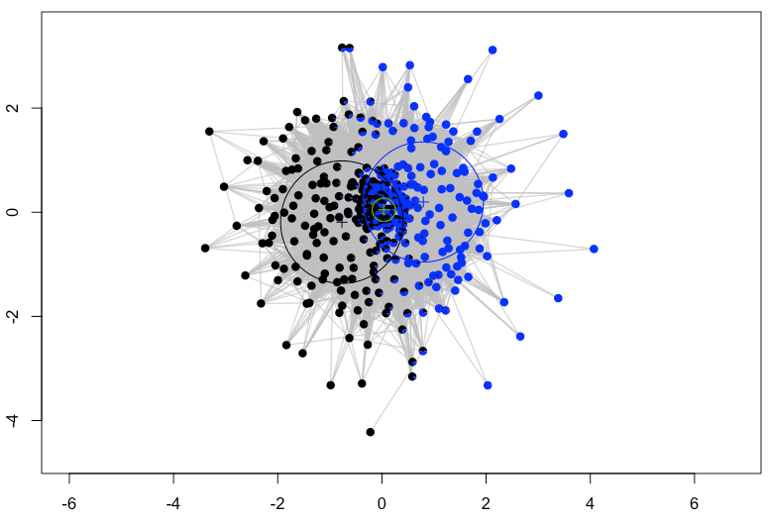
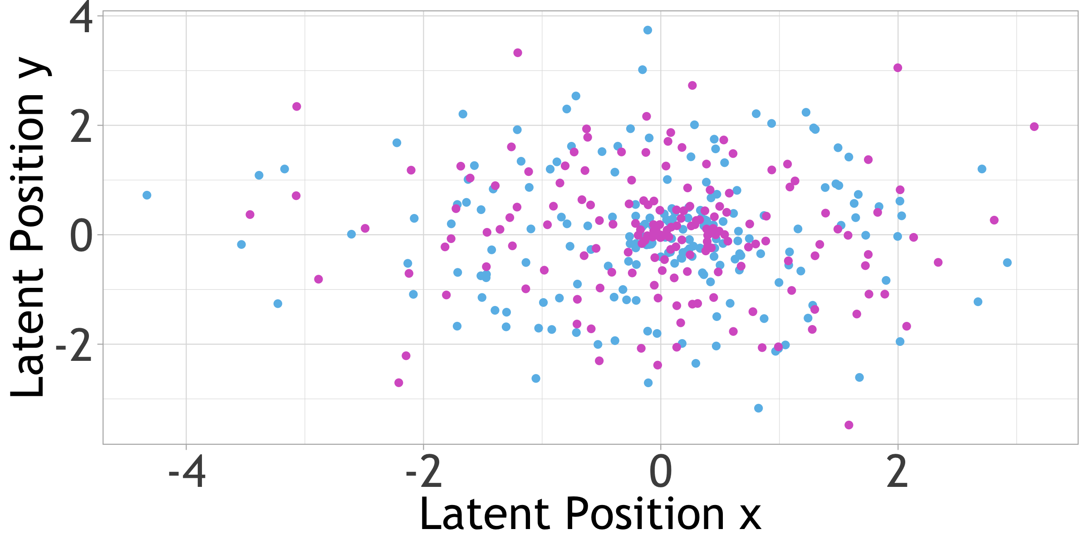



Anna Neufeld
Emily Flanagan
Did song lyric sentiment change after the 2016 election?
Introduction
Naïve Approach
Conclusions
2016 marked a big year for the United States with the election of a new president. When numerous artists refused to perform at the 45th inauguration, it was clear that pop and politics did in fact intersect. Various media sources and experts claim that music became more political, protest oriented, and sad post election, while others suggest that happier, positive music is more prevalent during hard times. Did pop song lyrics change at all before and after the 2016 election?
Assign scores to words from -5 (most negative) to 5 (most positive)
For each song, add up word scores and divide by number of words
Assign “negative” if in lowest 25%, ”positive” if in highest 25%
Table 1: Song sentiment pre and post election
Naïve approach shows slightly increased negativity and neutrality in post-election songs when compared to pre-election songs
Network clustering approach yields inconclusive results, clustering not centered around pre or post election
5 Nearest Neighbors generally outputs reasonable results for closest 5 songs
5 Nearest Neighbors of pre-election songs are usually pre-election songs, and vice versa
(%) | Negative | Neutral | Positive
Pre-Election | 23.71 | 48.96 | 27.31
Post-Election | 26.74 | 50.58 | 22.67
Network Approach
Average degree of 101.24, 2 isolated nodes
Transitivity of 0.54, total of 44 cliques
Run Variational Bayes Latent Cluster Model with 2 clusters in 2 dimensions
Limitations
Data
There is more to song sentiment than just lyrics
Pop songs are not representative of all songs
Sentiment scoring may be inconsistent for song lyrics, especially rap
VBLPCM package does not accept edge weights
Scrape lyrics for the top 40 songs of Billboard Hot 100 Pop
“pre-election”: September 1, 2015 – September 1, 2016, “post-election”: January 1, 2017 – January 1, 2018
Remove non-English songs, and words that appear in most or all songs
Word stemming to match the same word but with different endings (eg call, called, calling)
Two songs are adjacent if they share more than 100 words
366 songs total, 2164 unique words
Figure 1: Network of song adjacencies, colored by pre and post election
Figure 3: VBLPCM clusters in 2 dimensions, colored by assigned cluster
Use latent positions to calculate 5 nearest neighbors
Table 2: Latent space 5 Nearest Neighbors classification confusion matrix
Class | Pre-Election | Post-Election
Pre-Election | 131 | 57
Post-Election | 61 | 115
Figure 2: VBLPCM song latent space positions colored by pre and post election

