Slide 1
Glade
Game Pitch by Space Cowboys
CS6457 – Summer 22

Slide 2
Agenda
Group Intro
Game Concept
Elements & Mechanics
Work Plan
Who are the Space Cowboys?
What we are making
Gameplay description
How we intend on making this work

Slide 3
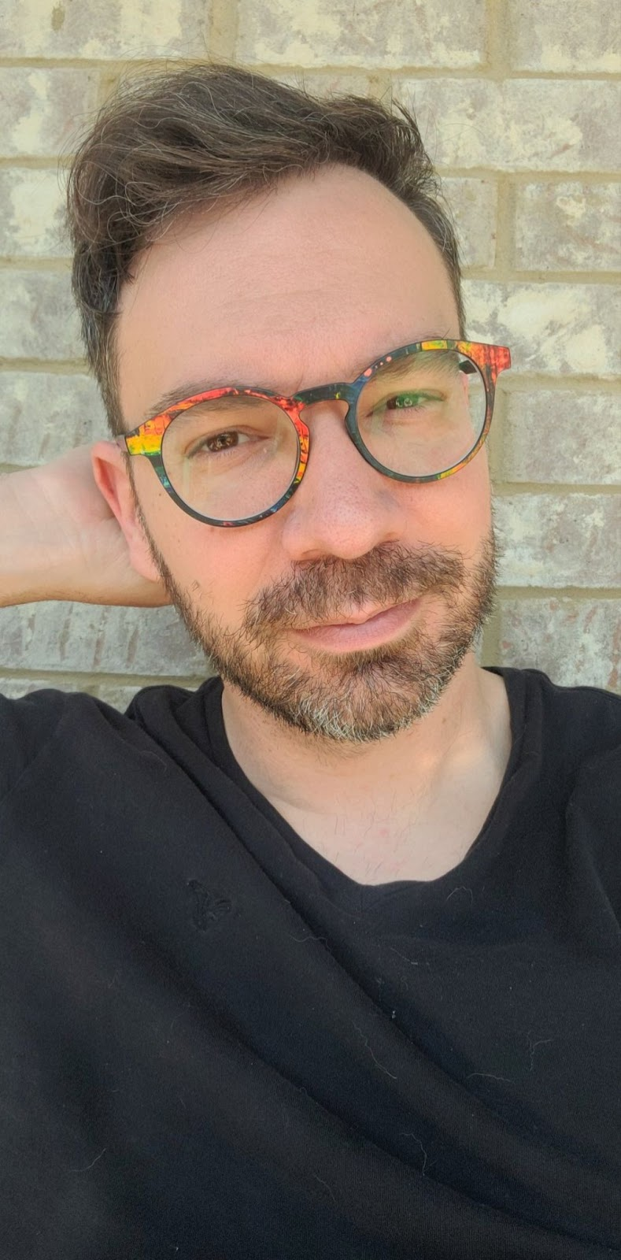
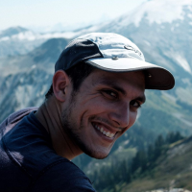
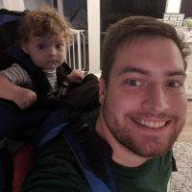
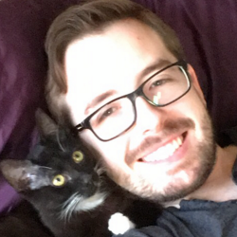
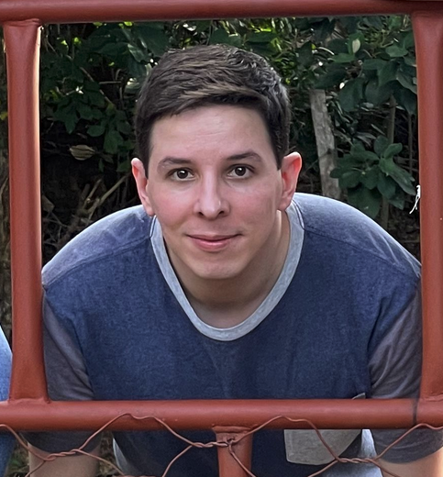
Space Cowboys
Chris Dail
Eric Gilligan
Thomas Lagrange
McCormick Wooden
Daniel Zuniga

Slide 4
Game Concept
Action game where you play as a Warden, chosen protector of the glades in a distant forest world
Vigorously fend off an impending alien invasion with the help of your weapon(s) and blessings of the forest (aka power-ups)
Destroy enemy beacons to get the chance to face the alien champions (aka bosses) in combat

Slide 5
Gameplay Loop
The Warden must find and destroy enemy beacons scattered throughout the map
Successfully destroying beacons will grant power-ups to the Warden.
The game progresses across different “runs”.
Each one involving a new glade being invaded.
Hostile alien forces will attack the Warden and/or defend the beacons.
When all beacons are destroyed, a boss fight will occur.

Slide 6
Mechanics
Recon
Combat
Power-ups
Enemy scaling and boss fights
Search for the beacons
Fight and defeat the alien invaders.
Destroy beacons to acquire abilities that will help you in your quest.
Face more aggressive and organized foes as you make your way to the end.

Slide 7
Work Plan
Synchronous meetings to agree on goals and scope
Asynchronous work (Kanban-like strategy)
Scout for free resources
Identify technical challenges and research about potential solutions

Slide 8
THANKS!
Does anyone have any questions?

