Slide 1
TESTING AS A FIRST-CLASS CITIZEN.
<p> Ensuring quality by taking tests seriously </p>

Slide 2
HELLO! I’m…
CHRIS MCCOWN
Senior Developer at Altec

Slide 3
TABLE OF CONTENTS.
01
02
03
04
Testing Overview
The Application We’ll be Testing
Unit Testing
05
06
Integration Testing
Other Testing Types
End to End Testing

Slide 4
DISCLAIMER
THIS PRESENTATION CONTAINS
OPINIONS

Slide 5
TESTING OVERVIEW
01
To tell somebody that he is wrong is called criticism. To do so officially is called testing. – Gaurav Khurana

Slide 6
DEFINITION
Software Testing involves:
Validating and Verifying an application performs as expected, free of bugs
Ensuring an application meets the specified requirements

Slide 7
BENEFITS
Quality – Ensures the delivery of a high-quality product by catching errors early in the development cycle
Code Quality – Testable code is also well designed code. Developers who get good at writing tests also get good at writing code
User Satisfaction – Increased user confidence in your system
Cost Effective – By catching errors early, you don’t pay the cost of having to fix them in production
Regression – Helps you be confident that the new functionality you add does not break the existing functionality

Slide 8
What Happens when there’s no tests?
Nest Thermostat Firmware updates causes batteries to drain, causing user to be unable to heat homes
December 2015, glitch in prison software results in over 3,200 prisoners being released early.
A defect in Hawaii results in false incoming missile alert.
A defect in Chase Bank allows full check amount to be withdrawn before funds are verified, resulting in a lot of stupid people going to jail.
Crowdstrike

Slide 9
YOU EITHER PAY THE COST OF TESTING UP FRONT IN TIME AND MONEY, OR YOU PAY IT LATER WITH LOST REVENUE AND ANGRY USERS
“The bitterness of poor quality remains long after the sweetness of meeting the schedule has been forgotten.” (Karl Wiegers)

Slide 10
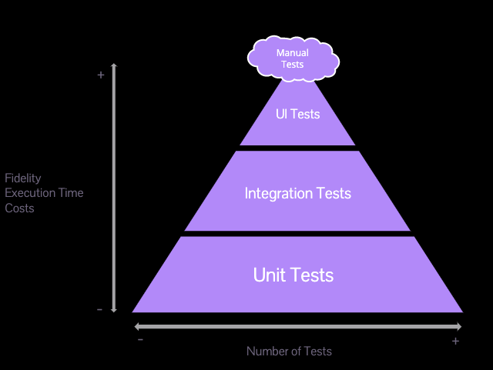
TESTING PYRAMID
Unit Tests – easy to write, fast to run, easy to maintain. Tests every possible thing that can happen.
Integration Tests – more complicated to write, slower to run.
UI Tests (End to End) – Hardest to write, slowest to run, hardest to maintain. Mainly tests happy path

Slide 11
WRITING SOFTWARE WITHOUT TESTING IS LIKE WALKING A HIGH WIRE WITHOUT A NET. YOU MIGHT NOT FALL, BUT WHEN YOU DO, YOU’RE GOING TO HIT THE GROUND HARD.

Slide 12
THE DEMO APP
02
“If debugging is the process of removing bugs, then programming must be the process of putting them in.”

Slide 13
UNIT TESTING
03
“Always code as if the guy who ends up maintaining your code will be a violent psychopath who knows where you live.”

Slide 14
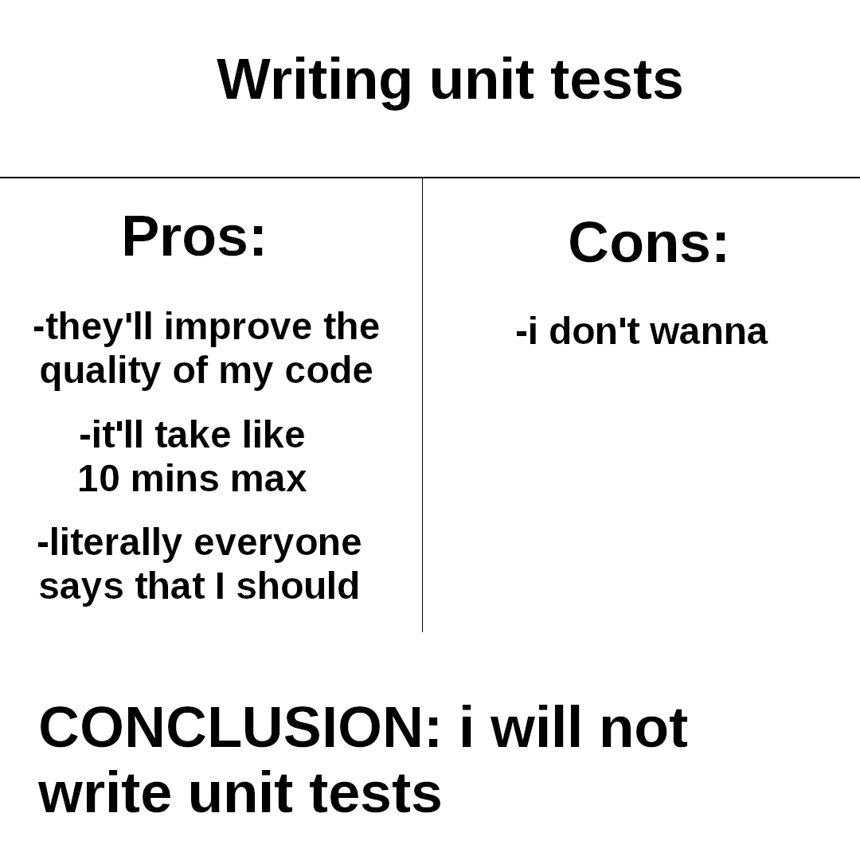

Slide 15
WHAT IS UNIT TESTING?
Unit testing is the process of testing individual components or modules of a software application in isolation.
Each “Unit” is tested independently to ensure it performs as expected
Unit Tests are automated so they can provide immediate feedback
Unit Tests can be run the most often during the CI/CD process, helping prevent bad code from being merged
Code that tests your code

Slide 16
MISCONCEPTIONS
Unit Testing ensures bug free code
Unit Testing is only for finding bugs
All code must be testing (100% code coverage)
Unit testing is time consuming to write and difficult to maintain.
Once the unit tests pass, SHIP IT

Slide 17
CORE CONCEPTS

Slide 18
THREE PARTS OF A TEST
ARRANGE – Sets up the test
ACT – Performs the test
ASSERT –Verifies that the results of the test are as expected
These parts of your test should be explicitly defined, regardless of test type.

Slide 19
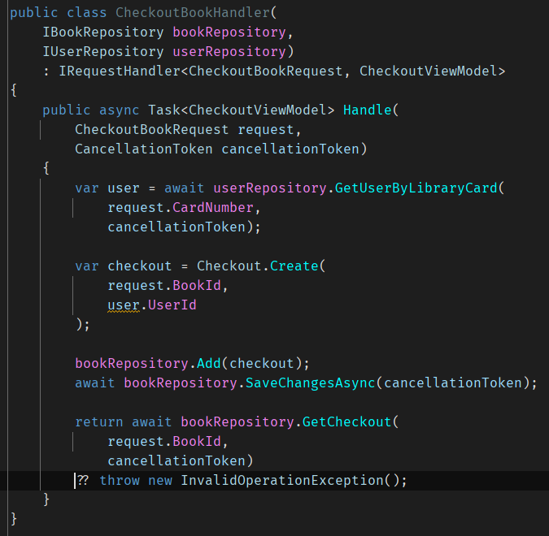
ISOLATION
A Unit Test should focus on a single piece of functionality, without dependencies on external systems or other code
System Under Test (SUT) is the term used to describe the unit that is being tested.

Slide 20
MOCKING/ STUBBING
Mocking allows for a simulated version of an external dependency
Responses to method calls can be set
Calls to methods can be verified

Slide 21
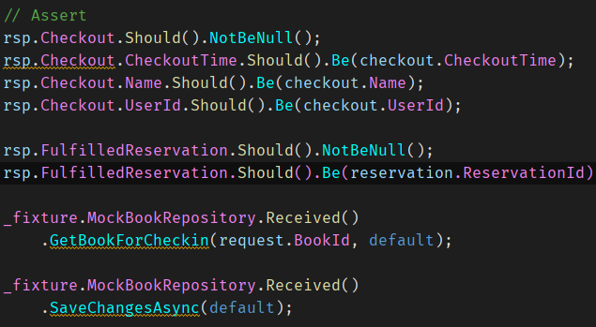
ASSERTIONS/ VERIFICATIONS
Assertions ensure the actual output of the SUT is the expected output
Verifications ensure the SUT called it’s dependencies with the correct values

Slide 22
DO’S AND DON’TS OF UNIT TESTING
DO – Write your code in a testable way, even if you’re not planning on writing tests immediately
DO – Apply the same coding standards to tests as you would production code
DON’T – Test the plumbing
DON’T – Strive for 100% code coverage (80/20 rule)
DON’T – Only use 1 assert per test
DON’T – Make private methods public just to test them
DON’T – Go down rabbit holes

Slide 23
MUTATION TESTING
Helps evaluate the quality of your unit tests
Mutates your code and expects your tests to fail. If the tests still pass, you might have poor quality tests
Helps compliment code coverage

Slide 24
ARCHITECTURE TESTING
Ensures that the code meets coding and architecture standards
Tests non-functional requirements, such as naming conventions, dependency direction, and other code standard conventions
Does not ensure the code behavior is correct

Slide 25
INTEGRATION TESTS
04
“There is no I in TEAM. But you can’t spell BUGS without U.”

Slide 26
WHAT IS INTEGRATION TESTING?
Integration testing is testing the different components of your application together to ensure they work together correctly
As few external dependencies are mocked as possible
Can be done against a standing environment or a temporary environment that resembles production as closely as possible

Slide 27
STANDING ENVIRONMENT
EPHEMERAL ENVIRONMENT
PRO – Consistency
PRO – Reduced setup time
CON – Resource Intensive
CON – Environment Drift
CON – Maintenance
PRO – Clean State
PRO – Isolation
PRO – Flexibility
CON – Setup Time
CON – Complexity

Slide 28
OTHER TEST TYPES
05
“Failure is not an option. It comes bundled with the software.”

Slide 29
MEDIATOR PATTERN
ENDPOINT 1
HANDLER 1
REQUEST1
REQUEST1
ENDPOINT 2
MEDIATOR
(DISPATCHER)
HANDLER 2
REQUEST2
REQUEST2
ENDPOINT 3
REQUEST2
REQUEST2
HANDLER 3

Slide 30
ACCESSING YOUR DOMAIN
YOUR DOMAIN
COMMANDS
WEB API
DATA
QUERIES
mediator.Send(…)

Slide 31
ASPECT ORIENTED PROGRAMMING
INVOKE METHOD()
METHOD()
PIPELINE
LOGGING
VALIDATION
VERIFICATION

Slide 32


Slide 33
DOMAIN DRIVEN DESIGN
IDENTIFY THE BOUNDARIES OF YOUR DOMAIN
ENFORCE BUSINESS LOGIC THROUGH CODE
NOTIFY WHEN YOUR DOMAIN HAS CHANGED
Use your domain objects to enforce what is allowed to happen to them
Only store and manipulate data that your domain owns
Raise events to allow your application to react when your domain has changed.
Allows for operations to be open for extensibility, but closed for change

Slide 34
REBUS
04
An abstraction library for Message Buses

Slide 35
WHY REBUS?
ABSTRACTION
ERROR HANDLING
POLYMORPHIC
PIPELINES
MUCH MORE
Rebus is an abstraction layer between your app and your bus implementation
Can map handlers based on interfaces or base classes
Provides Sending and Receiving pipelines for middleware
Sagas
Outbox Pattern
Idempotence
Handles dead lettering messages
Second Level Retries

Slide 36
WITHOUT A BUS
YOUR DOMAIN
COMMANDS
WEB API
DATA
QUERIES
mediator.Send(…)

Slide 37
WITH A BUS
WEB API
YOUR DOMAIN
COMMANDS
httpClient.Send(…)
DATA
QUERIES
bus.Send(…)
MESSAGE PROCESSOR
mediator.Send(…)

