Slide 1
INTRO TO ASPIRE
Simplifying .NET Development

Slide 2
HELLO! I’m…
CHRIS MCCOWN
Senior Developer at Altec

Slide 3
WHAT IS ASPIRE?
NET Aspire is an opinionated, cloud-ready stack for building observable, production-ready, distributed applications.

Slide 4
WHAT IT IS
WHAT IT ISN’T
A Stack to help with local development
A way streamline and speed up the development process
Opinionated
A Framework
A replacement for Kubernetes
A production orchestrator
A deployment tool

Slide 5
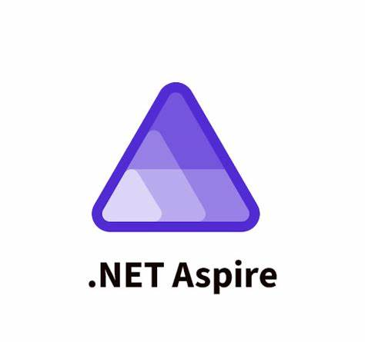
ASPIRE TOPICS
Service and Dependency Orchestration
Aspire Dashboard
Observability (Open Telemetry)
Service Discovery
Hosting Integrations
Integration Testing
Deployments

Slide 6
LIBRARY CHECKOUT
UI
API
Message Processor
Service Bus
Google Books API
SQL
Elasticsearch

Slide 7
WHAT IS OPEN TELEMETRY?
An Open Source standard for collecting:
Traces
Metrics
Logs
It is vendor neutral and can work with multiple monitoring services.

Slide 8
WHAT ARE HEALTH CHECKS?
Determines if a resource is ready
Can include dependency checks
Automatically wired up for many Aspire resources

Slide 9
WHAT IS STANDARD RESILIENCE?
Strategy | Description | Defaults
Rate Limiter | Limits the maximum number of concurrent requests being sent to the dependency. | 1,000
Total Timeout | Applies an overall timeout to the execution, ensuring that the request, including retry attempts, doesn't exceed the configured limit. | 30 Seconds
Retry | Retries the request in case the dependency is slow or returns a transient error. | Max Retries: 3 Backoff: Exponentials Use Jitter: true Delay: 2s
Circuit Breaker | Blocks the execution if too many direct failures or timeouts are detected. | Failure Ratio: 10% Min Throughput: 100 Sampling Duration: 30s Break Duration: 5s
Attempt Timeout | Limits each request attempt duration and throws if it's exceeded. | Timeout: 10s
limits each request attempt duration and throws if it's exceeded.

Slide 10
SERVICE DISCOVERY
{
"Services": {
"books-api": {
"https": [
"https://www.googleapis.com"
]
}
}
}
Service discovery is how services locate and communicate with each other dynamically, without hardcoding IPs or URLs.
builder.Services
.AddHttpClient<GoogleHttpClient>()
.ConfigureHttpClient(c =>
c.BaseAddress =
new Uri("http+https://books-api"));

Slide 11
FUTURE
Aspire CLI
Better Developer Tooling
More Hosting Integrations
More Publishing Support, such as AWS, Azure Apps, and more
Better Azure Function Support

Slide 12
TABLE OF CONTENTS.
01
02
03
04
Testing Overview
The Application We’ll be Testing
Unit Testing
05
06
Integration Testing
Other Testing Types
End-to-End Testing

Slide 13
DISCLAIMER
THIS PRESENTATION CONTAINS
OPINIONS

Slide 14
TESTING OVERVIEW
01
“To tell somebody that he is wrong is called criticism. To do so officially is called testing.”

Slide 15
BENEFITS
Quality – Ensures the delivery of a high-quality product by catching errors early in the development cycle
Code Quality – Testable code is also well-designed code. Developers who get good at writing tests also get good at writing code
User Satisfaction – Increased user confidence in your system
Cost Effective – By catching errors early, you don’t pay the cost of having to fix them in production
Regression – Helps you be confident that the new functionality you add does not break the existing functionality

Slide 16
What Happens when there’s no tests?
Nest Thermostat Firmware updates causes batteries to drain, causing user to be unable to heat homes
December 2015, glitch in prison software results in over 3,200 prisoners being released early
A defect in Hawaii results in false incoming missile alert, causing mass panic
A defect in Chase Bank allows full check amount to be withdrawn before funds are verified, resulting in a lot of stupid people going to jail
Crowdstrike

Slide 17
YOU EITHER PAY THE COST OF TESTING UP FRONT IN TIME AND MONEY, OR YOU PAY IT LATER WITH LOST REVENUE AND ANGRY USERS
“The bitterness of poor quality remains long after the sweetness of meeting the schedule has been forgotten.” (Karl Wiegers)

Slide 18
Which layer is the most valuable?
All layers have value and should all ideally be present.
If you’re just starting off with testing, then unit tests provide the most value.
Unit tests help teach the “testing mindset” and are the easiest tests to write, run, and maintain.
If you are experienced with testing but are under a time constraint, then integration or end-to-end testing provide the most immediate value while leaving the most room for refactoring.

Slide 19
WRITING SOFTWARE WITHOUT TESTING IS LIKE WALKING A HIGH WIRE WITHOUT A NET. YOU MIGHT NOT FALL, BUT WHEN YOU DO, YOU’RE GOING TO HIT THE GROUND HARD.

Slide 20
THE DEMO APP
02
“If debugging is the process of removing bugs, then programming must be the process of putting them in.”

Slide 21
UNIT TESTING
03
“Always code as if the guy who ends up maintaining your code will be a violent psychopath who knows where you live.”

Slide 22
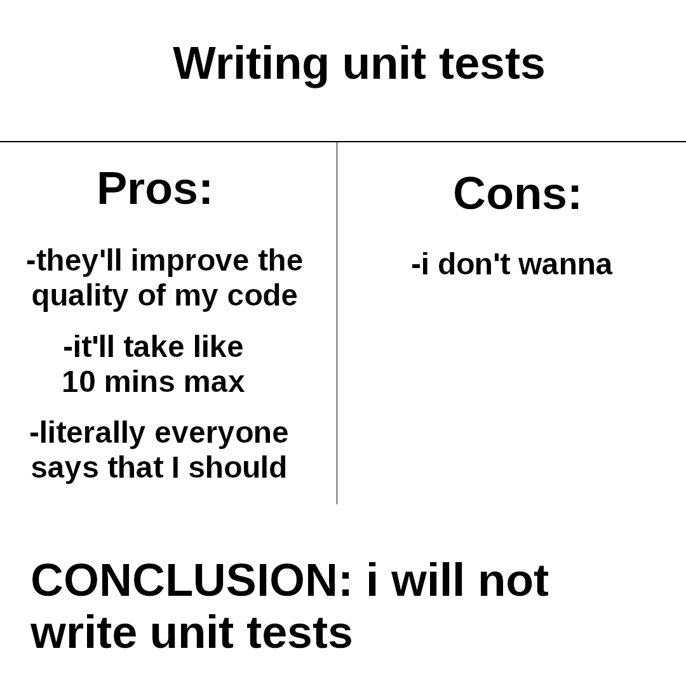

Slide 23
WHAT IS UNIT TESTING?
Unit testing is the process of testing individual components or modules of a software application in isolation.
Each “Unit” is tested independently to ensure it performs as expected
Unit Tests are automated so they can provide immediate feedback
Unit Tests are run during the CI/CD process, helping prevent bad code from being merged
Code that tests your code

Slide 24
MISCONCEPTIONS
Unit Testing ensures bug free code
Unit Testing is only for finding bugs
All code must be tested (100% code coverage)
Unit testing is time consuming to write and difficult to maintain.
Once the unit tests pass, SHIP IT

Slide 25
CORE CONCEPTS

Slide 26
THREE PARTS OF A TEST
ARRANGE – Sets up the test
ACT – Performs the test
ASSERT –Verifies that the results of the test are as expected
These parts of your test should be explicitly defined, regardless of test type.

Slide 27
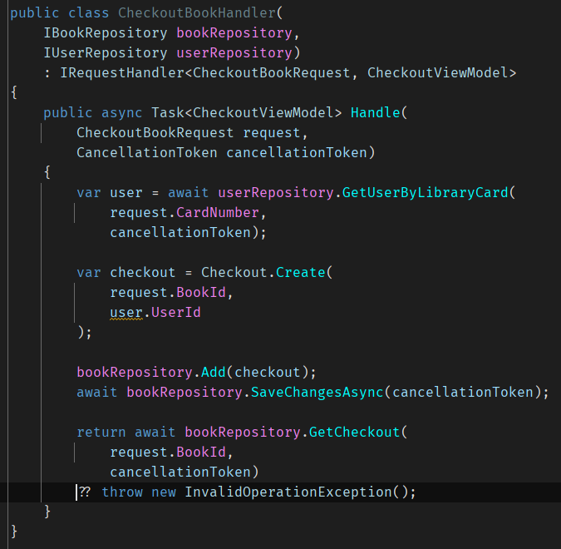
ISOLATION
A Unit Test should focus on a single piece of functionality, without dependencies on external systems or other code
System Under Test (SUT) is the term used to describe the unit that is being tested.

Slide 28
MOCKING/ STUBBING
Mocking allows for a simulated version of an external dependency
Responses to method calls can be set
Calls to methods can be verified

Slide 29
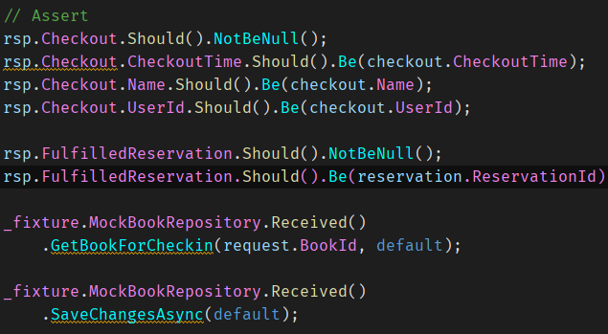
ASSERTIONS/ VERIFICATIONS
Assertions ensure the actual output of the SUT is the expected output
Verifications ensure the SUT called its dependencies with the correct values

Slide 30
GENERATING FAKE DATA
Generate random data over hard coding data for tests
Introduces randomness and realism into tests

Slide 31
DO’S AND DON’TS OF UNIT TESTING
DO – Write your code in a testable way, even if you’re not planning on writing tests immediately
DO – Apply the same coding standards to tests as you would production code
DON’T – Test the plumbing
DON’T – Strive for 100% code coverage (80/20 rule)
DON’T – Only use 1 assert per test
DON’T – Make private methods public just to test them
DON’T – Go down rabbit holes

Slide 32
TEST DRIVEN DEVELOPMENT (TDD)
The method of writing tests where tests are written before the actual code
Teaches and encourages writing software that is easily testable
Red-Green-Refactor – write a test that fails, write the code to make it pass, refactor the code and keep it passing
Easiest when using tools like NCrunch that automatically run tests for modified code
😬 … Once you know how to write testable code, TDD becomes less valuable

Slide 33
MUTATION TESTING
Helps evaluate the quality of your unit tests
Mutates your code and expects your tests to fail. If the tests still pass, you have poor quality tests
Compliments code coverage

Slide 34
ARCHITECTURE TESTING
Ensures that the application meets coding and architecture standards
Tests non-functional requirements, such as naming conventions, dependency direction, and other code standard conventions
Does not ensure the code behavior is correct

Slide 35
INTEGRATION TESTS
04
“There is no I in TEAM. But you can’t spell BUGS without U.”

Slide 36
WHAT IS INTEGRATION TESTING?
Integration testing is testing the different components of your application together to ensure they work together correctly
As few external dependencies are mocked as possible
Can be done against a standing environment or a temporary environment that resembles production as closely as possible

Slide 37
STANDING ENVIRONMENT
EPHEMERAL ENVIRONMENT
PRO – Consistency
PRO – Reduced setup time
CON – Resource Intensive
CON – Environment Drift
CON – Maintenance
PRO – Clean State
PRO – Isolation
PRO – Flexibility
CON – Setup Time
CON – Complexity

Slide 38
LIBRARIES

Slide 39
TESTCONTAINERS
Allows you to spin up Docker containers at the start of a Test Class and tear them down when the test is finished.

Slide 40
MOCKSERVER
While Integration Tests need to avoid mocks, this can be impossible when dealing with third party APIs.
MockServer allows you to define endpoints that return expected results
You can also verify that endpoints were called and that they were called with the correct payload

Slide 41
OTHER TEST TYPES
05
“Failure is not an option. It comes bundled with the software.”

Slide 42
ACCEPTANCE TESTING
Testing that focuses on compliance with a given business requirement rather than a unit of work
Often uses the Given-When-Then format to define a scenario, an action, and the result
SpecFlow is a dotnet solution for Acceptance testing

Slide 43
PERFORMANCE TESTING
Evaluates the speed, responsiveness, and stability of a system under a particular workload
Useful for comparing before and after of refactors
Benchmarkdotnet is a dotnet solution for Performance Testing

Slide 44
LOAD TESTING
Load testing is a type of performance testing that evaluates how a system performances under expected load conditions
Helps to identify bottlenecks, memory issues, or latency issues
Best if used with realistic scenarios based on user behavior and patterns
Challenging due to the necessity of accurate real-world conditions and effective planning
NBomber is a paid dotnet solution for load testing. K6 is a free solution

Slide 45
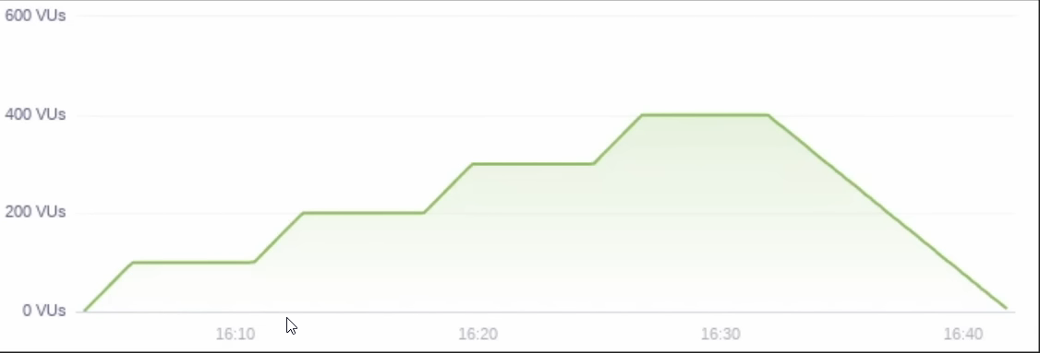
STRESS TEST
Places stress on the system by ramping up concurrent users past the expected breaking point
Determines the maximum capacity of your system
Determines if your system will recover automatically once load decreases

Slide 46
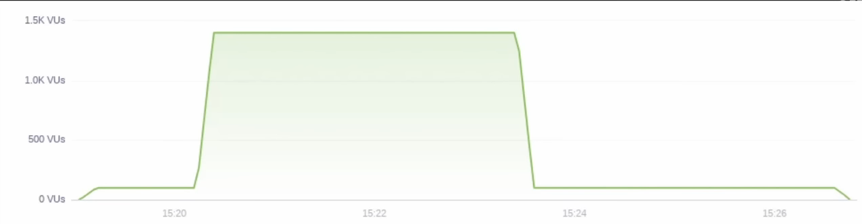
SPIKE TEST
Tests what would happen if a sudden spike of users hit your system
Determines if your system will automatically recover once the spike ends

Slide 47
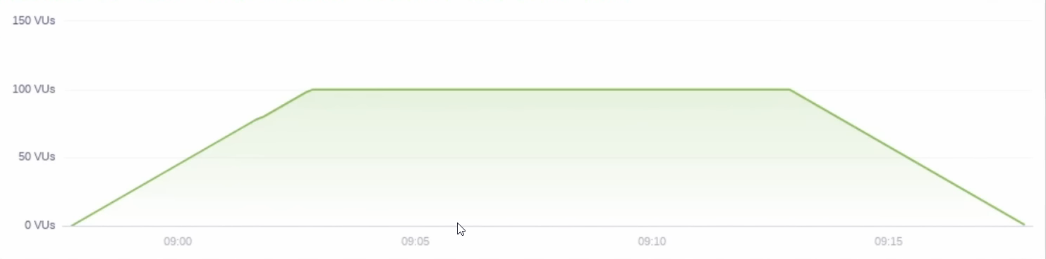
LOAD TEST
Tests the current performance of your site with the expected peak number of users
Ensures you are continuing to meet performance standards as you make changes

Slide 48
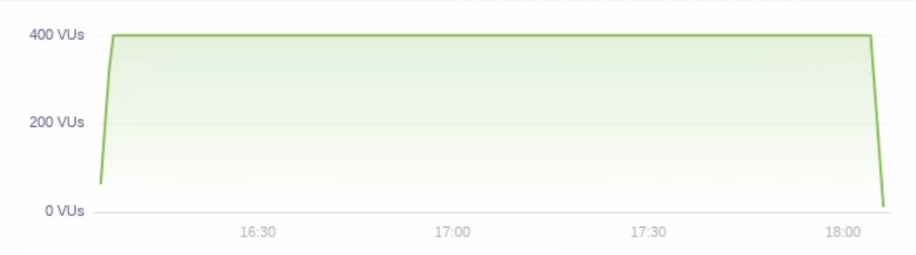
SOAK TEST
Tests the reliability of your system over a long period of time
Verifies your system running over a long period doesn’t result in memory leaks, space issues, or race conditions

Slide 49
SMOKE TESTING
Quick automated tests to determine if a new release is stable
Typically uses the same approach as end-to-end testing, except it keeps interactions to a minimum
Load pages to verify they load correctly
Purpose is to find any “smoke” that might indicate a fire

Slide 50
CONTRACT TESTING
Contract testing is used to verify the APIs can communicate with each other as expected
Useful in microservice architectures
Typically, the provider will generate a contract that a consumer can verify against. If the provider changes the contract, the consumer’s test will fail
Pact.NET is a dotnet library for Contract Testing

Slide 51
End-to-End TESTS
06
“A good programmer looks both ways before crossing a one-way street”

Slide 52
WHAT IS END-TO-END TESTING?
End-to-End testing validates the complete and integrated functionality of a system from start to finish
Covers the entire workflow of an application, from UI to Database and all interconnected applications
These are the most difficult and brittle tests due to their needs for a real environment that resembles production as closely as possible

Slide 53
CONCLUSION
SOMEONE IS GOING TO TEST YOUR CODE. BETTER IT BE YOU THAN YOUR USERS

