Slide 1
Credit One Kickoff Report
Nick McCoy

Slide 2
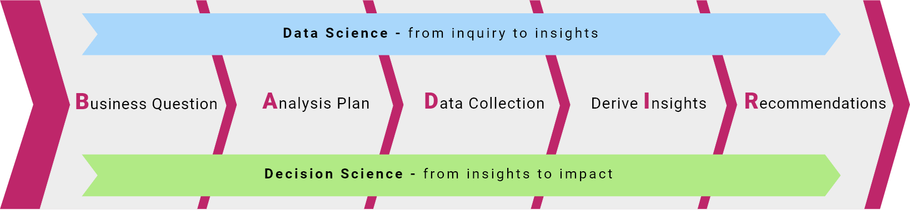
The Data Science Process

Slide 3
Goals
Main Goal
Reduce the rate of loan charge-offs by 10%
Requirements
Creative, empirically sound solution
Data
Historical consumer data: Demographics & payment history
Solution
A tool that that helps loan officers more accurately score loan applicant
Publish
Publish a model that shows relationships between consumer data and default probability on GitHub

Slide 4
Data Science Process – BADIR Framework
This is process ensures the stakeholders and data science team agree on the goals of the project and maintains cooperative engagement.
Business Question
What leads to consumer default and how can Credit One approve limits accordingly?
Can we reduce default rates to protect our business?
Analysis Plan
The goal is to create a mathematical model that can be used to predict safe credit limits based upon demographics.
Hypothesis
Educated, married customers with lower credit limits tend to default less whereas uneducated and unmarried customer with higher credit limits default more.
Required Data
Payment history and customer demographics
Methodology
Regression model
Data Collection
A csv file with 30,000 customers including the required data has been provided

Slide 5
Data Science Process – BADIR Framework
This is process ensures the stakeholders and data science team agree on the goals of the project and maintains cooperative engagement.
Analysis Plan
The goal is to create a mathematical model that can be used to predict safe credit limits based upon demographics.
Hypothesis
Educated, married customers with lower credit limits tend to default less whereas uneducated and unmarried customer with higher credit limits default more.
Required Data
Payment history and customer demographics
Methodology
Regression model
Data Collection
A csv file with 30,000 customers including the required data has been provided

Slide 6
Data Science Process – BADIR Framework
Data Collection
A csv file with 30,000 customers including the required data has been provided
That data will be cleaned and verified using to ensure model accuracy

Slide 7
Data Breakdown
Individual + family
demographics
payment status
statement amounts
previous month payment
default/not default
Credit Limit | Gender | Educ. | Marital Status | Age | Sep | Aug | Jul | Jun | May | Apr | Sep Bill | Aug Bill | Jul Bill | Jun Bill | May Bill | Apr Bill | Paid in Sep | Paid in Aug | Paid in Jul | Paid in Jun | Paid in May | Paid in Apr | Default in October
20000 | female | Uni | 1 | 24 | 2 | 2 | -1 | -1 | -2 | -2 | 3913 | 3102 | 689 | 0 | 0 | 0 | 0 | 689 | 0 | 0 | 0 | 0 | default

Slide 8
Data Science Process – BADIR Framework
Insights
Statistical:
Statistics on the following for all data:
Credit limit range max, minimum and mean
Default rates for all customers
Default rates based on demographics
Correlation between default rates
Produce the same statistics for groups:
Demographics
Age groups
Male/Female
Education
Credit limit range
Analytical:
The final model include analytics on variables the lead to better credit limits, those that do not result in default

Slide 9
Insights
Explore the Data
Produce statistics on the following for all data:
Credit limit range max, minimum and mean
Default rates for all customers
Default rates based on demographics
Correlation between default rates
Produce the same statistics for groups:
Demographics
Age groups
Male/Female
Education
Credit limit ranges

Slide 10
Collect and Manage Data
Data: 30,000 loans with the following information
Limit Balance
Sex
Education
Marital status
Age
April-September payment status; i.e. paid in full or payment delayed for x months
April-September statement amounts
April-September amount of previous month payment
Default history

Slide 11
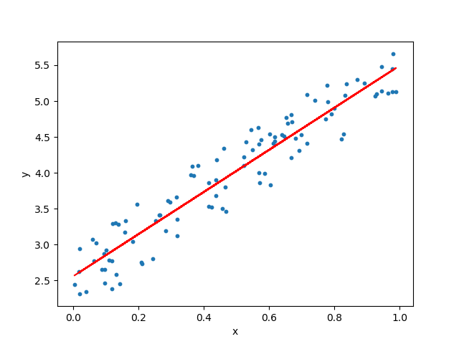
Recommendaton
A regression model will be built to:
Show relationships between balance limits and default rates while taking into consideration:
Age, sex, marital status and payment history
Thresholds will be defined to assist loan officers when making credit limit decisions.

