Slide 1
YAHOS (Yet Another HOst Sentinel)
Process monitoring tool for network-based signatures and host-based signatures. Mainly targeting Windows systems, x86 architecture, with limited Linux support.

Slide 2
Group Members & Project Advisor
Group Members:
Guillermo Rached - Computer Science - rachedge@mail.uc.edu
Thomas McCoy - Computer Science - mccoyt5@mail.uc.edu
Project Advisor:
Giovani Abuaitah

Slide 3
Project Abstract
YAHOS monitors running processes and their open ports for network monitoring. Apart from this, YAHOS has the ability to flag directories via a provided path for focused monitoring and analysis of the directory's content. The tool includes a well-designed interface that allows the user to see important information quickly and easily. YAHOS is tested using simulated threats in a virtual lab. This allows for the verification of functionality and ensures the tool works correctly in a safe environment. YAHOS is intended to be useful for assisting in the reverse engineering of malware and overall system monitoring.

Slide 4
User Stories
As a systems administrator, I want to monitor file access in specific paths of a system, so that I can accurately monitor system and users.
As a Security Analyst, I want to actively monitor what a process does within a system, so that I can better understand the process' nature.
As a Malware Analyst, I want to inspect and monitor suspicious processes within a system, so that I know the properties and functionalities of the software.

Slide 5
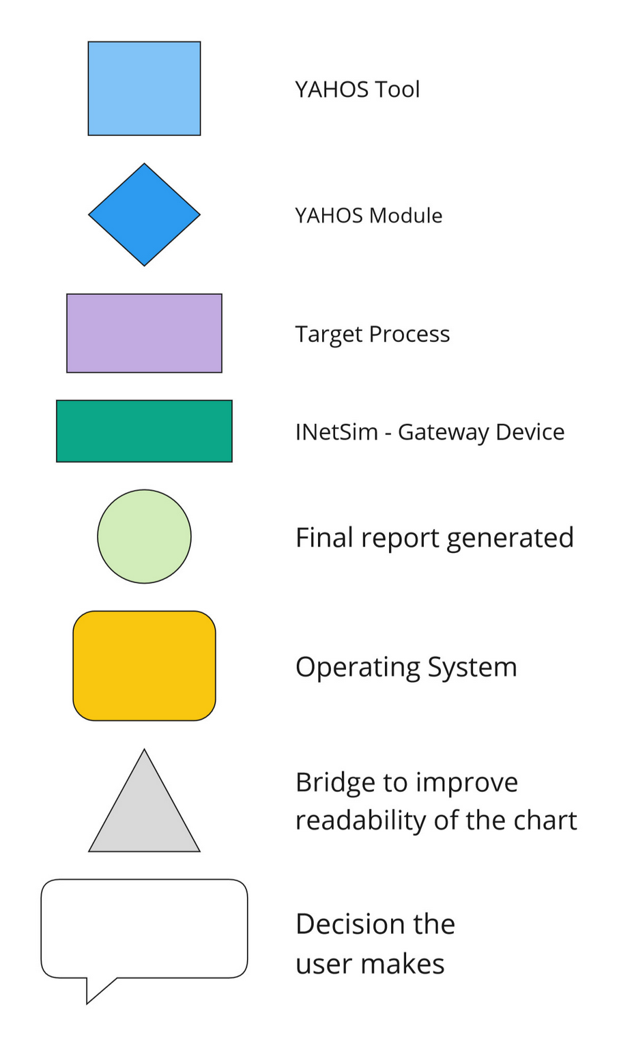
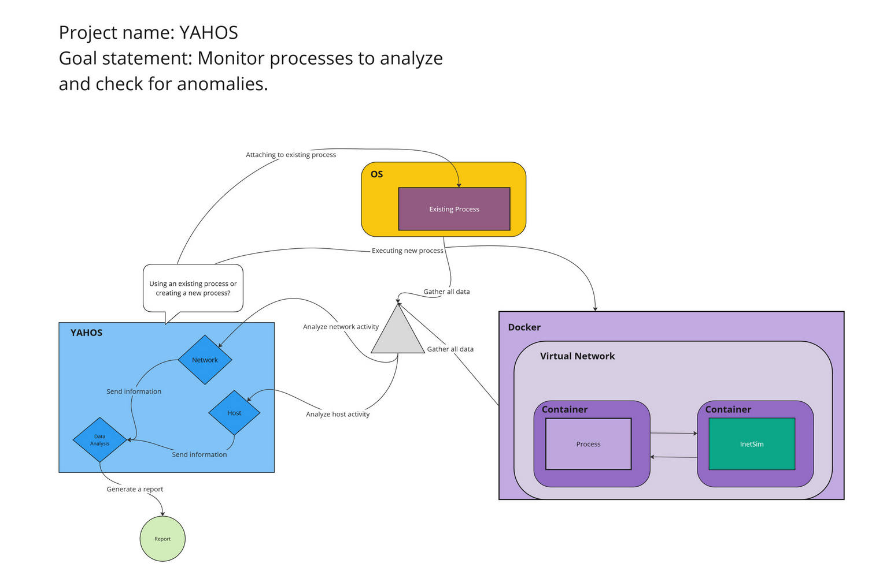
Design Diagrams

Slide 6
Major Project Constraints
Economics
Use of Qt
Security
Testing our application with malware
Professional
Required knowledge of operating system internals
Programming expertise
Cybersecurity knowledge/skills

Slide 7

Review of Project Progress
API Research
Event Tracing for Windows (ETW)
Toolhelp32 API
Notes:
ETW (Event Tracing for Windows):
ETW provides a built-in mechanism to capture file system events in real-time:
Register for specific ETW providers related to file system activity Process the incoming ETW events, extracting information such as the process accessing the file, the file path, and the type of operation (read, write, etc.).
Toolhelp32 API:
Use functions like CreateToolhelp32Snapshot, Process32First, and Process32Next to enumerate running processes and get their details (process ID, name, etc.).

Slide 8

Expected Accomplishments (this term)
Understanding of:
Win32 API
Kernel driver development
Docker environment
Security and development best-practices

Slide 9

Division of Work
Research
Guillermo – 50%
Thomas – 50%
Development
Guillermo – 52.17%
Thomas – 47.83
Testing

Slide 10

Expected Demo at Expo
YAHOS:
Process enumeration
Process attachment
Process execution
Generated report

