Slide 1
YAHOS (Yet Another HOst Sentinel)
Process monitoring tool for network-based signatures and host-based signatures. Mainly targeting Windows systems and x86 architecture.

Slide 2


Group Members & Project Advisor
Group Members:
Guillermo Rached - Computer Science - rachedge@mail.uc.edu
Thomas McCoy - Computer Science - mccoyt5@mail.uc.edu
Project Advisor:
Giovani Abuaitah

Slide 3
Goals
YAHOS monitors running processes and their open ports for network monitoring.
YAHOS should have the ability to flag directories via a provided path for focused monitoring and analysis of the directory's content.
YAHOS should include a well-designed interface that allows the user to see important information quickly and easily.
YAHOS should be tested using simulated threats in a virtual lab. This allows for the verification of functionality and ensures the tool works correctly in a safe environment.

Slide 4
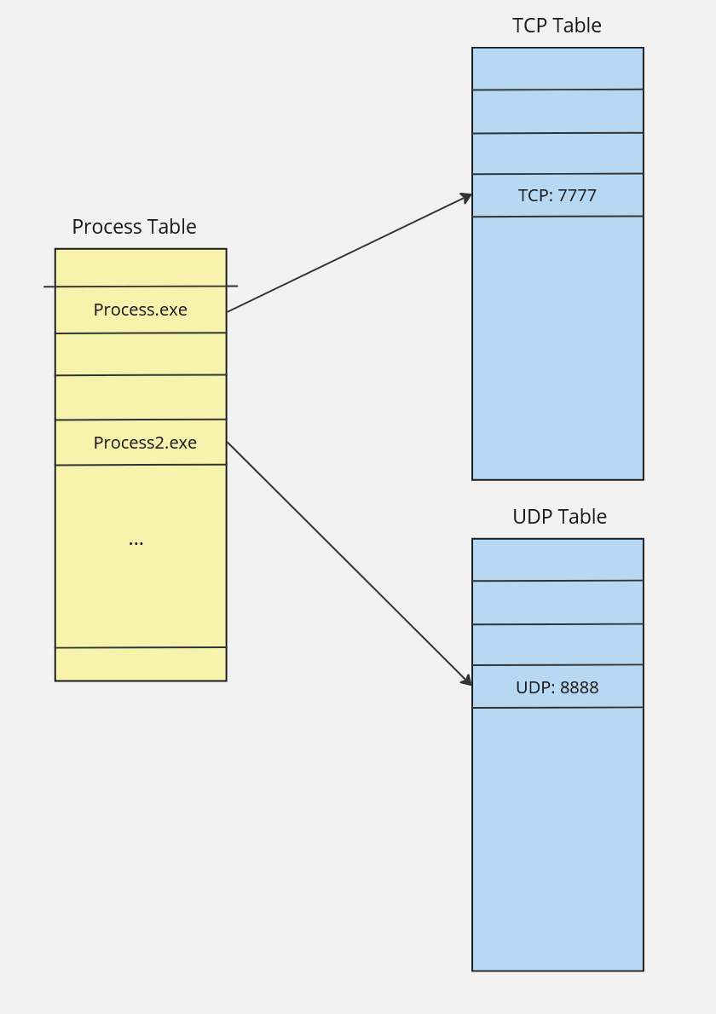
Intellectual Merits
Application-focused on process mapping to open-ports
Running process enumeration

Slide 5
Broader Impacts
YAHOS is intended to be useful for assisting in the reverse engineering of malware and overall system monitoring.
This will help improve the overall safety of the digital landscape

Slide 6
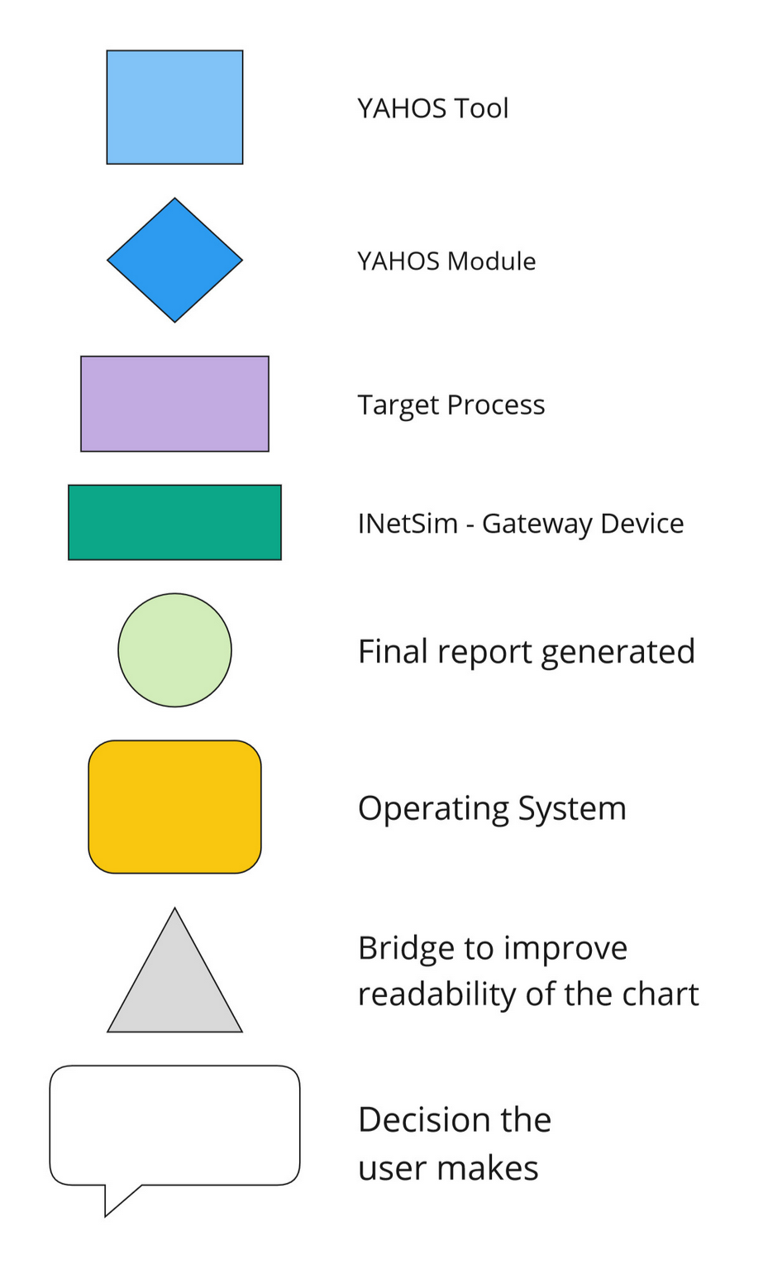
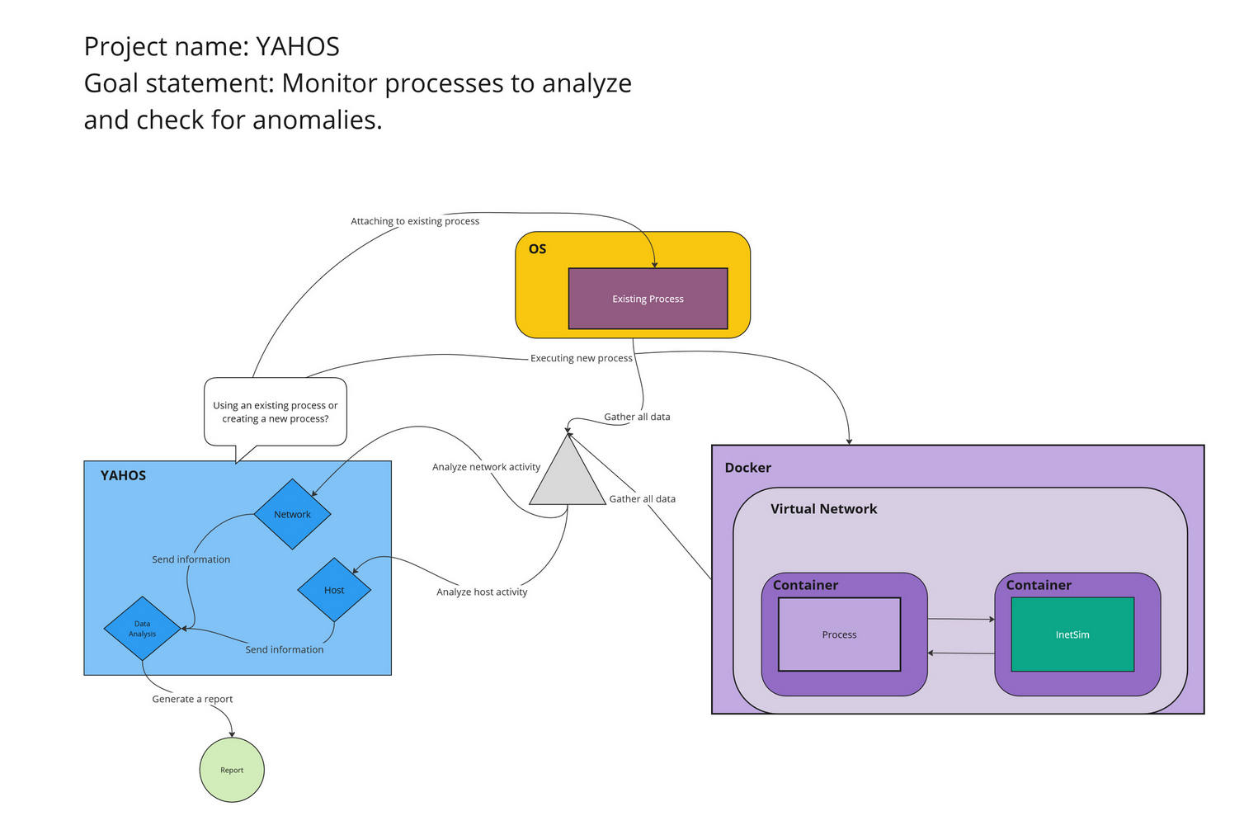
Design Specifications
The application will present a choice to the user of attaching to an existing process or starting a process.
If a user wants to attach to a process, the application will query the OS and a list of processes will be display for selection.
If the user wants to start a process, then a path must be provided to a binary file. If a valid path is provided, the application will provide an option to start an isolated environment. If selected, the application will then create a docker environment with a virtual network, a container for the running process, and a container for INetSim to act as a network gateway. In this environment, YAHOS will monitor the process activities and report as normal.

Slide 7
Technologies
All of our programming is done in C++
To create the user interface for our project, we decided to use the Qt framework (official documentation: https://doc.qt.io/qt-6/qtcore-module.html)
The Win32 API was used to capture information about running processes, like name and process ID (official documentation: https://learn.microsoft.com/en-us/windows/win32/api/)

Slide 8
Milestones
Application Research: [12/02/2024]
Discover Win32 API functions
Determine driver necessity
Proof of Concept: [02/28/2025]
Host process enumeration
Extract process information
Process creation
Map process to open port
UI Development [03/24/2025]

Slide 9
Results
So far, we have a user interface that displays all running processes on the system
The user can select one of these processes and analyze it
The user can also select a file from their computer to analyze
To complete our demo:
Add additional information to process analyzation, like imports
Add network capture for a selected process with an open port
General debugging and UI design improvements

Slide 10
Challenges
Working with Win32 API
We addressed this challenge by researching functions through available documentation
Implementing Qt Framework for UI
We addressed this challenge by researching Windows graphics and Qt Framework documentation
Mapping running processes to open ports
We addressed this challenge by incorporating knowledge of Win32 API and networking concepts explained in Windows documentation

