Slide 1
Wrightcalc.com
The future of education:
Smart calculators for every purpose

Slide 2
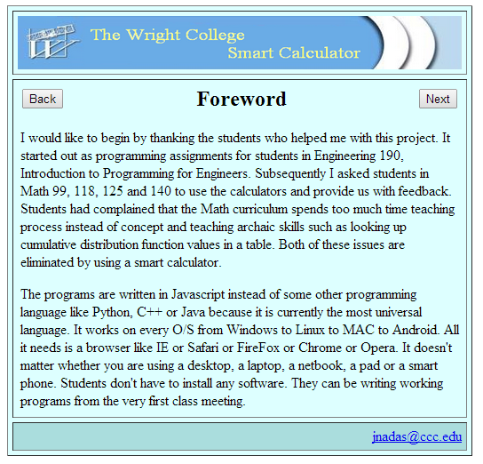

Slide 3
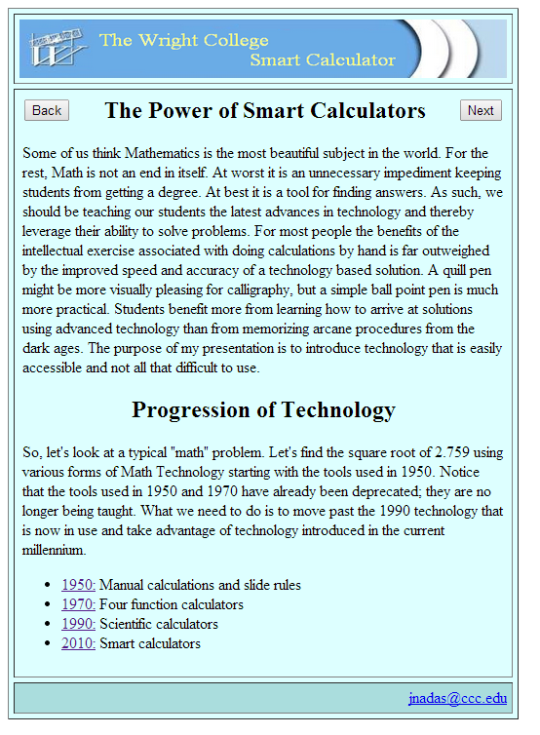

Slide 4
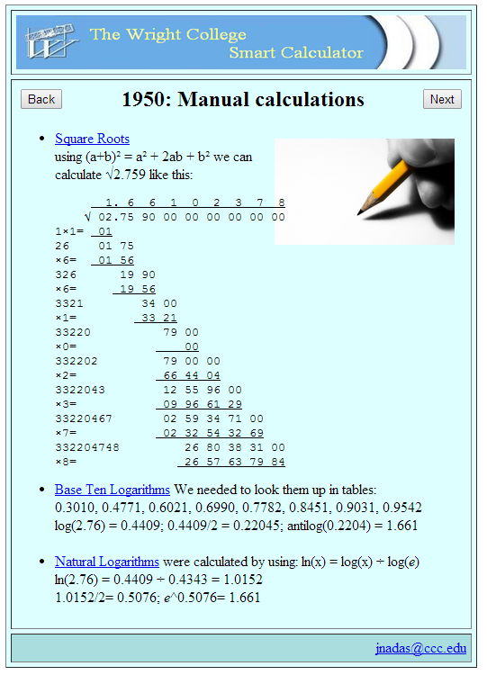

Slide 5
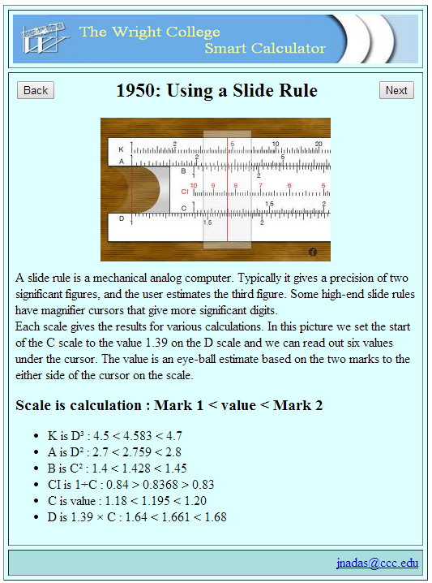

Slide 6
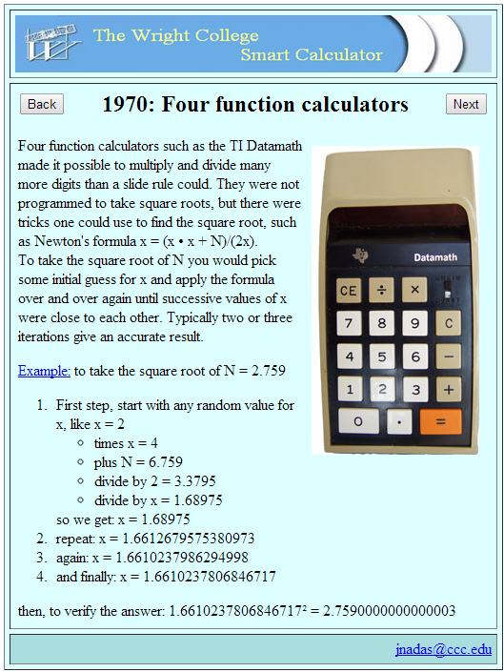

Slide 7
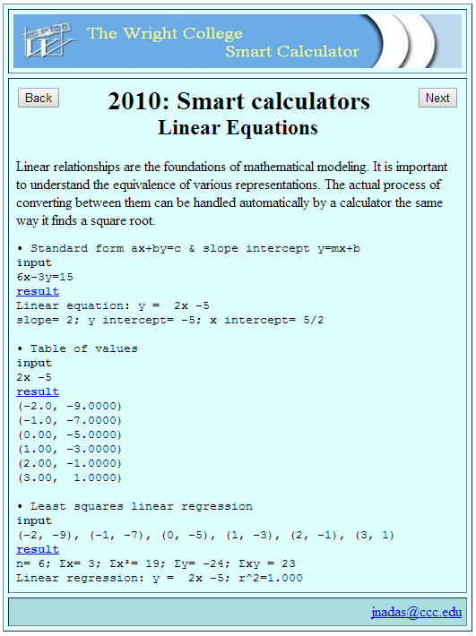
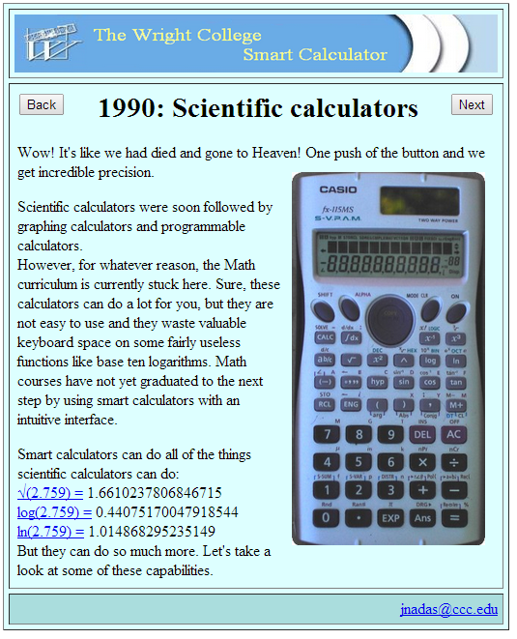
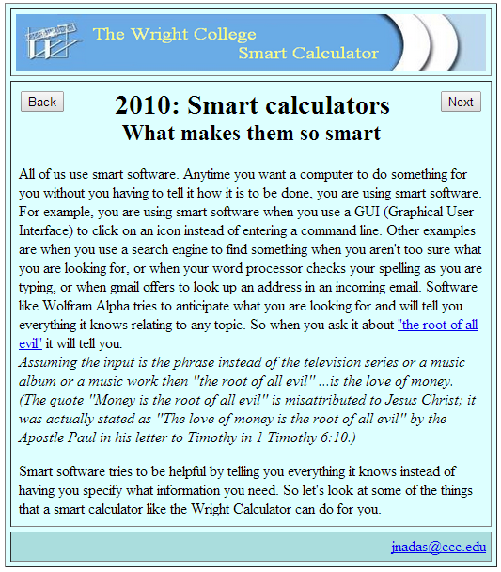

Slide 8
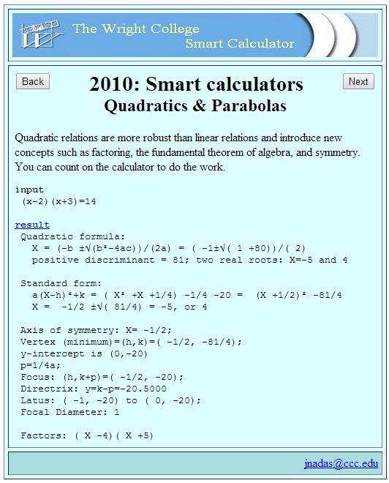

Slide 9
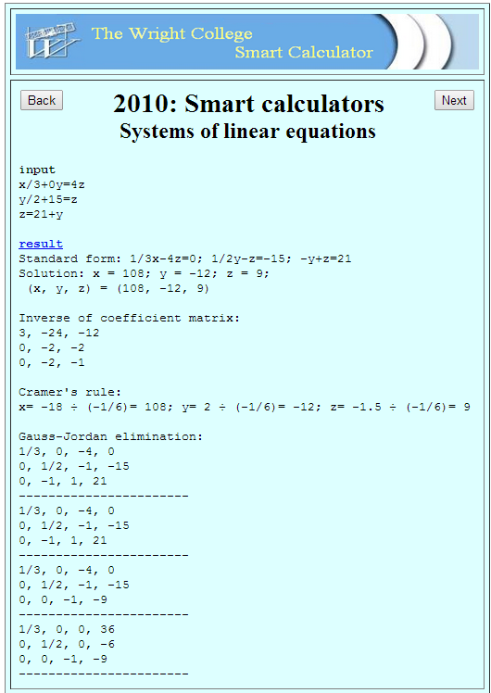
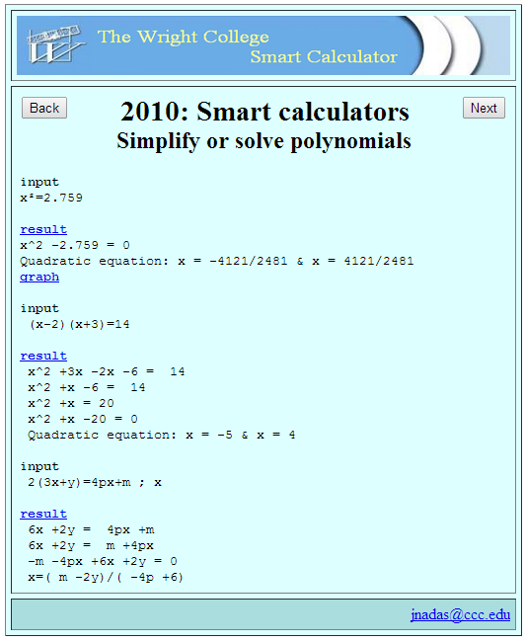

Slide 10
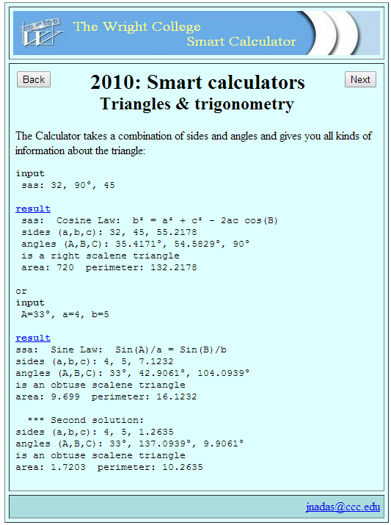
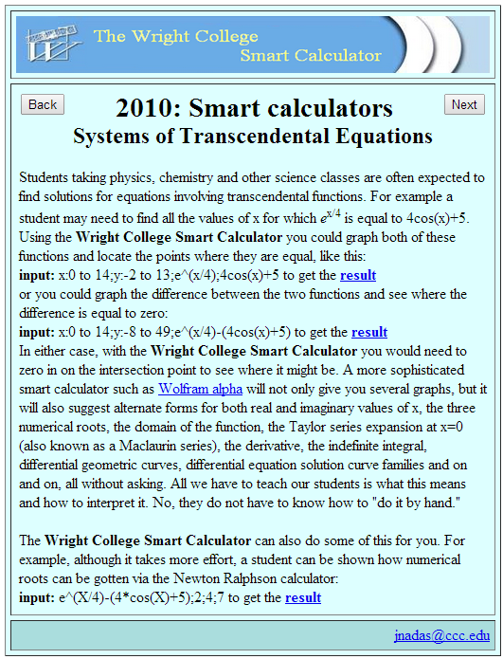

Slide 11
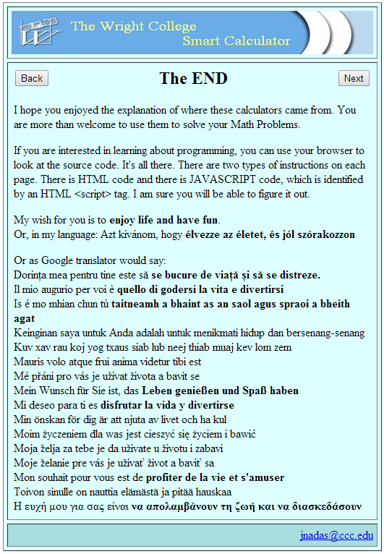

Slide 12
Some other apps/calculators
Payment schedule for mortgage or other loan
Office hour calculator
Generate groups of students: every student is grouped with every other student from your roster.
Calculate a student’s projected GPA

Slide 13
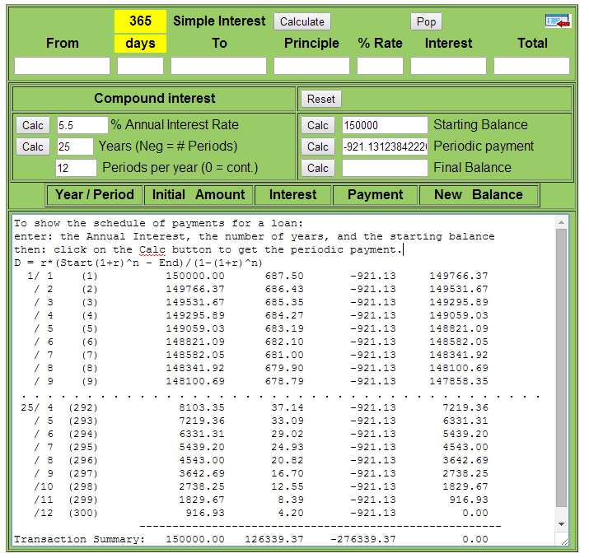

Slide 14
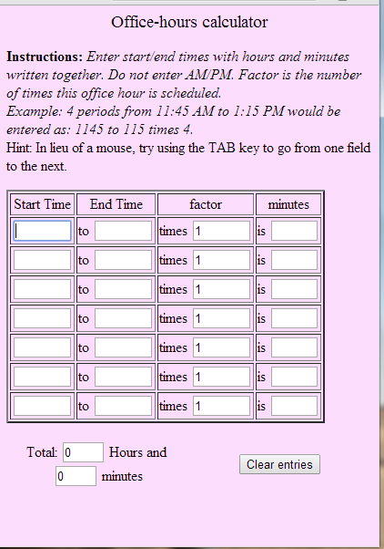

Slide 15
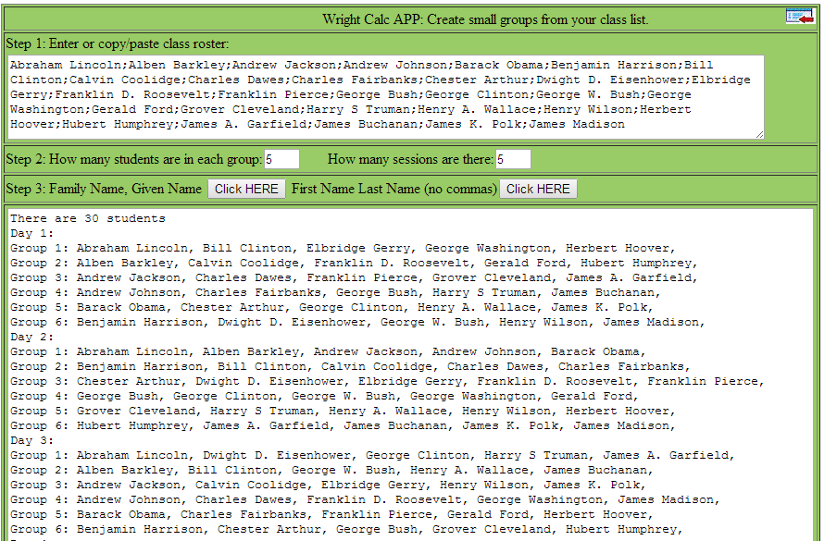

Slide 16
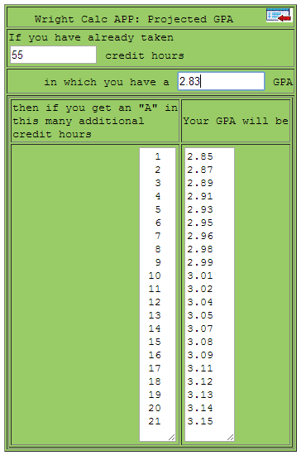

Slide 17
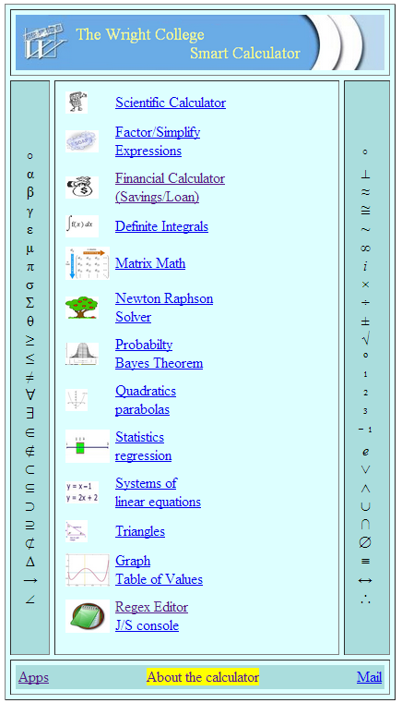
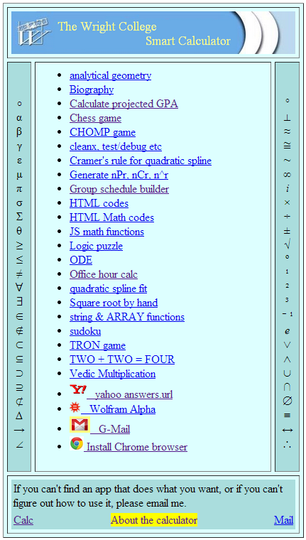
Other Calculators and Apps

Slide 18
What’s next
All of these applications can be accessed by any device that can display web pages. You can use them on a PC, a laptop computer, a pad or even a smart phone. Similar applications are not all that hard to program. Many of your students are already doing it in various CIS classes. Eventually programming apps should be part of every STEM course and program.
I hope to see you soon at: WrightCalc.com

